Slide 1
Recombinant Adenovirus In Molecular Biology & Medicine
Will Herrick
Peyton Group Meeting
March 20, 2013

Slide 2
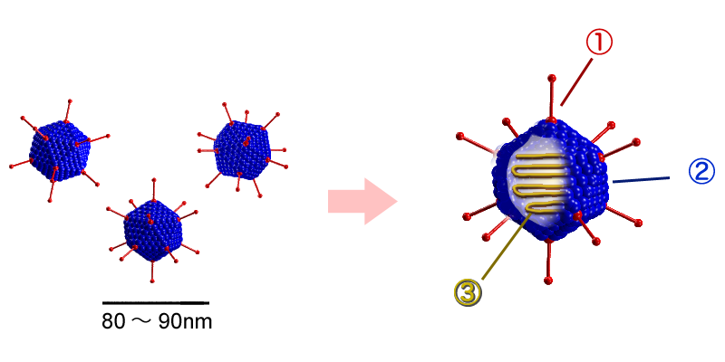
What Are Adenoviruses?
Linear dsDNA virus
80-100 nm
Nonenveloped
Icosahedral structure:
1: penton capsomeres
2: hexon capsomeres
3: viral genomic DNA
Capsomeres are the protein subunits that self-assemble into a capsid to enclose/protect viral DNA

Slide 3
Adenoviruses in Disease
57 human adenovirus serotypes
Three major possible effects of infection:
Respiratory disease
Conjunctivitis
Gastroenteritis
Enter cells via receptor-mediated endocytosis
i.e. cell membrane engulfs particle into vesicles called endosomes
Infections:
Spreads primarily through respiratory droplets
Can cause severe respiratory problems including pneumonia and symptoms similar to whooping cough, strep throat
Very rarely fatal
No vaccines, no therapies, NO TREATMENTS AVAILABLE AT ALL!

Slide 4
Adenovirus Infection & Replication
Cell surface attachment
Involving integrins (alphaVs) and another receptor
Endocytosis and shedding of capsid
dsDNA entry into nucleus
Host RNA polymerase makes viral proteins
Transcription factors
Viral DNA polymerase
Modify host gene expression i.e. block apoptosis
Later, viral DNA polymerase and transcription factors make rest of viral proteins
In nucleus, capsids assemble around viral DNA.
Cell lyses and releases particles.

Slide 5
Adenovirus Uses in Medicine
Popular vector for gene therapy
1999: healthy 18-year old dies during clinical trial of adenovirus gene therapy
Freak occurrence, basically
But it has greatly slowed work on gene therapy in the USA ever since
FDA put ‘brakes’ on research, became less popular to study
This gave China, with less regulations, an opportunity..
Without the stigma, China basically copied US ideas.
2003: first adenovirus-based gene therapy approved in China
pAd-p53: injected directly into tumors to express p53, which suppresses tumor growth and increases chemoradiation sensitivity (head & neck cancers)
$10,000/month! Not approved in USA. Can’t kill metastasized cells.
Under investigation to treat:
Malignant mesothelioma & many other cancers
Cardiovascular disease
VEGF to promote reendothelialization with stent implantation
SERCA to modulate contraction

Slide 6
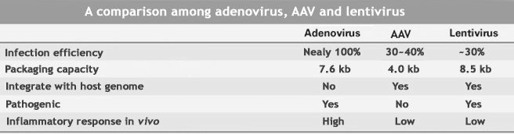
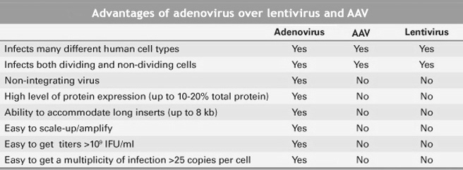
Adenovirus Uses In Molecular Biology
Used primarily to induce expression of a gene or genes of interest.
But why pick adenovirus over lentivirus?
Higher efficiency
Higher gene expression
Higher titers

Slide 7
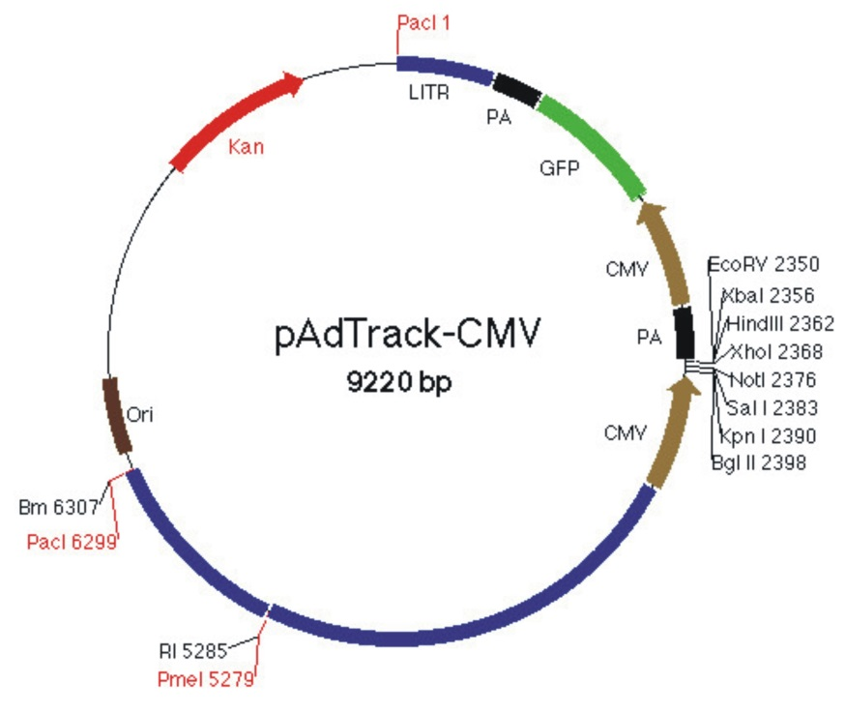
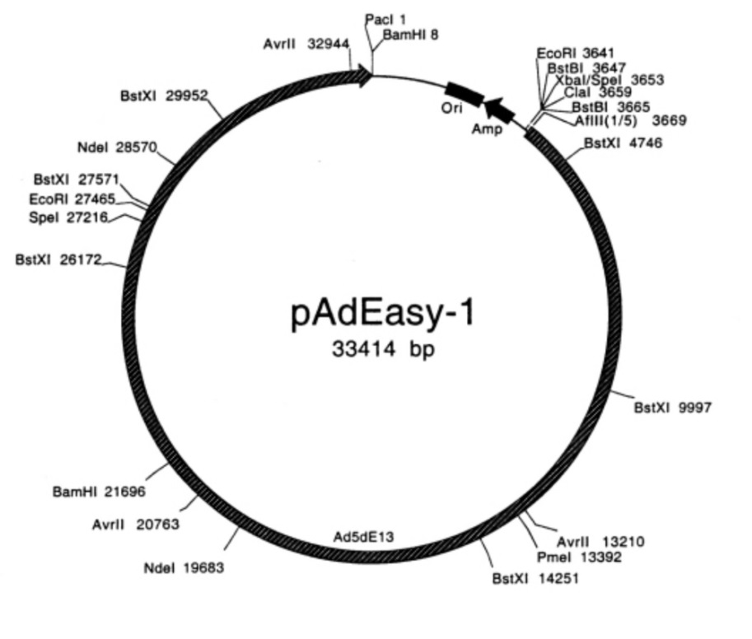
How To Make Recombinant Adenovirus with the AdEasy System (Bert Vogelstein Lab)
Insert gene of interest into ‘shuttle’ vector with DNA subcloning
Adenovirus plasmid with adenovirus type 5 genome and sequences necessary for replication in E. coli

Slide 8
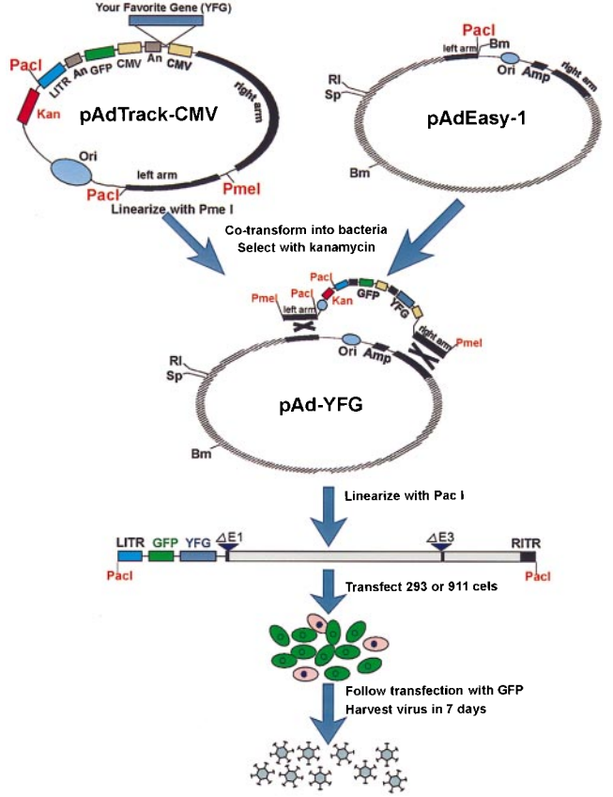
Insert Gene of Interest into Adenoviral Plasmid
Linearize shuttle vector (left) with PmeI digestion
Co-transform BJ5183 E. coli with both plasmids
BJ5183 E. coli encode for genes which enable robust homologous recombination

Slide 9
Digestion with PmeI allows the left and right arms of the shuttle vector to overlap with regions of the adenovirus vector, and the gene gets inserted by bacterial machinery
Selection with kanamycin only permits survival of colonies containing the intact plasmid with the gene of interest

Slide 10
Recombinant Adenovirus Production
Adenovirus plasmid with gene of interest is linearized by PacI digestion, then transfected into mammalian cells expressinh E1a and E1b adenovirus genes
Necessary for replication, absent from adenovirus plasmid
Typically, human embryonic kidney (HEK) 293’s are used

Slide 11
Purifying Viral Titers
HEKs are made to express the adenovirus vector by chemical transfection
Then adenovirus is collected and used to infect more flasks of HEKs
Then more adenovirus collected, more HEKs infected.
Repeat until titer is high, than purify.
Purification:
Vogelstein method uses cesium chloride ultracentrifugation
Hard to do unless you own an ultracentrifuge…
Instead, I used a kit that can be done in the hood and only takes 10 minutes to use.

Slide 12
Conclusions
Adenovirus are relatively straightforward to make and use
Very high infection efficiency and gene expression makes them valuable to labs such as ours
They are potentially dangerous and do not create stable cell lines
So we cannot use them effectively in experiments with much cell proliferation, as new cells won’t have the gene
Questions?

