Slide 1
ANOVA and STEM Results
Lauren Kelly
April 19th, 2017
BIOL398-05

Slide 2
Over 50% of the Genes are Significant
ANOVA | dHAP4
p < 0.05 | 5584 genes, 90.22%
p < 0.01 | 5154 genes, 83.28%
p < 0.001 | 4287 genes, 69.27%
p < 0.0001 | 3352 genes, 54.16%
B & H p < 0.05 | 5557 genes, 90.11%
Bonferroni p < 0.05 | 3325 genes, 53.72%

Slide 3
 | Cold Shock |  |  | Recovery
t test | t₁₅ | t₃₀ | t₆₀ | t₉₀ | t₁₂₀
Average Log Fold Change > 0.25 and p < 0.05 | 2039 genes (32.95%) | 2126 genes (34.35%) | 2174 genes (35.13%) | 1859 genes (30.04%) | 1932 genes (31.22%)
Average Log Fold Change < -0.25 and p < 0.05 | 2176 genes (35.2%) | 2272 genes (36.7%) | 2177 genes (35.18%) | 1862 genes (30.09%) | 2199 genes (35.5%)
Total p < 0.05 | 5584 genes (90.22%) | 5584 genes (90.22%) | 5584 genes (90.22%) | 5584 genes (90.22%) | 5584 genes (90.22%)
Total B & H p < 0.05 | 5557 genes (89.8%) | 5557 genes (89.8%) | 5557 genes (89.8%) | 5557 genes (89.8%) | 5557 genes (89.8%)
Total Bonferroni p < 0.05 | 3325 genes (53.72%) | 3325 genes (53.72%) | 3325 genes (53.72%) | 3325 genes (53.72%) | 3325 genes (53.72%)

Slide 4
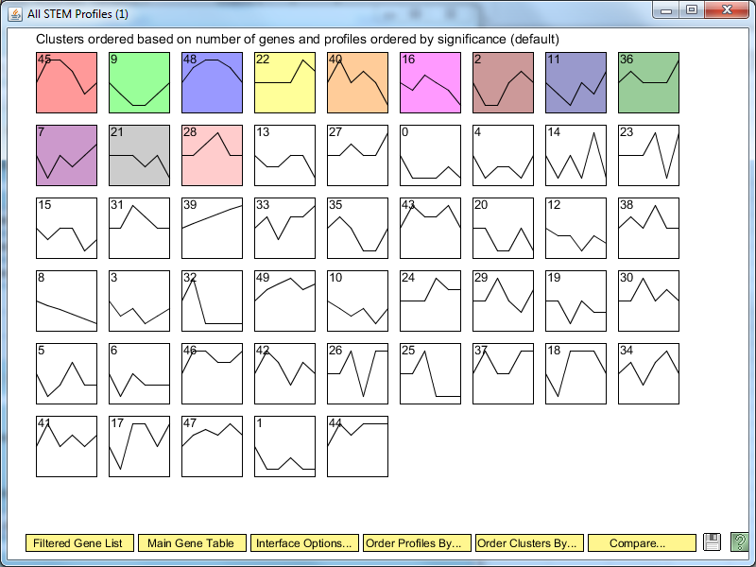
12 Profiles are Statistically Significant

Slide 5
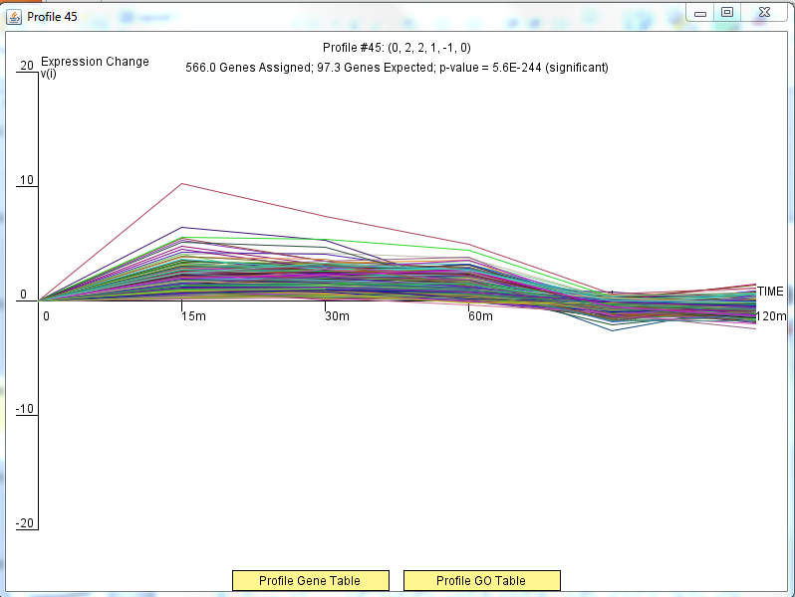
566 Genes in Profile 45

Slide 6
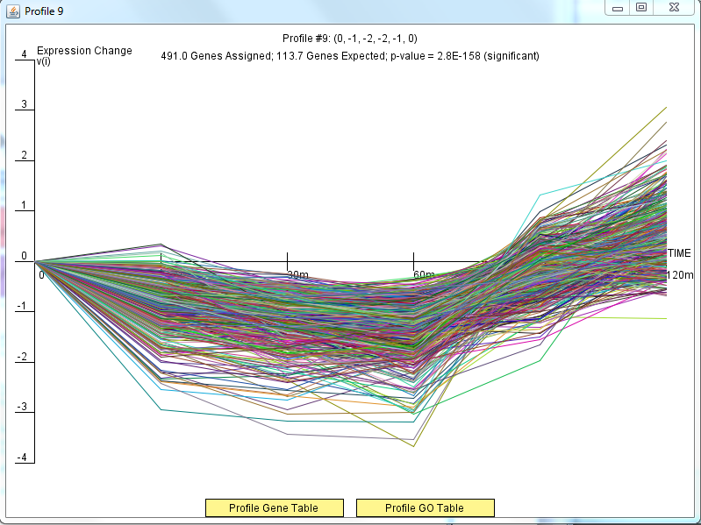
491 Genes in Profile 9

Slide 7
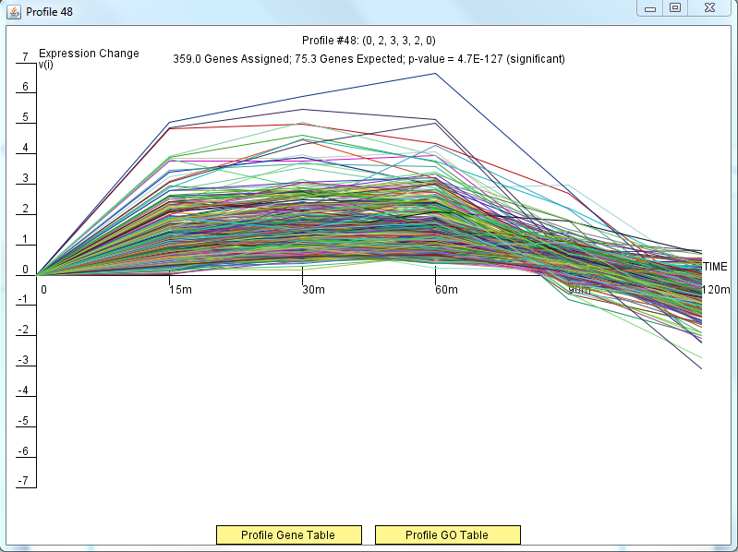
359 Genes in Profile 48

Slide 8
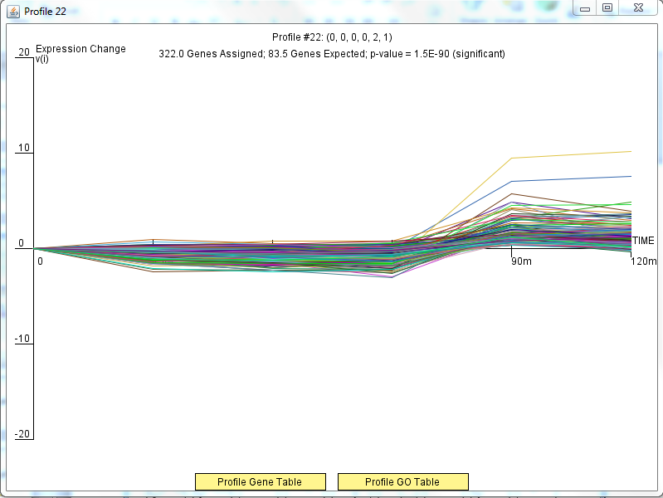
322 Genes in Profile 22

Slide 9
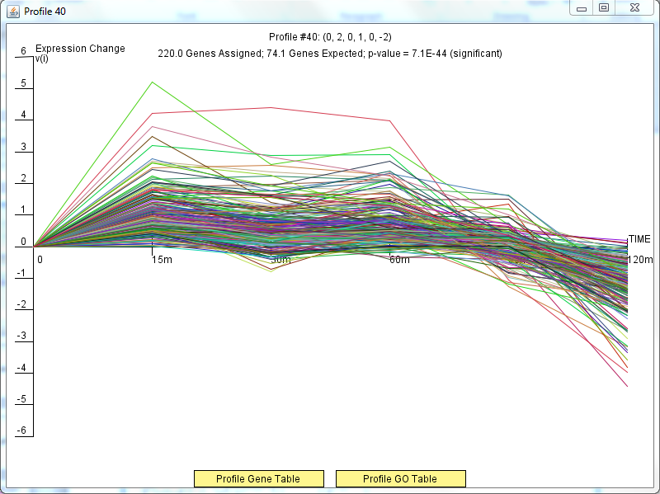
220 Genes in Profile 40

Slide 10
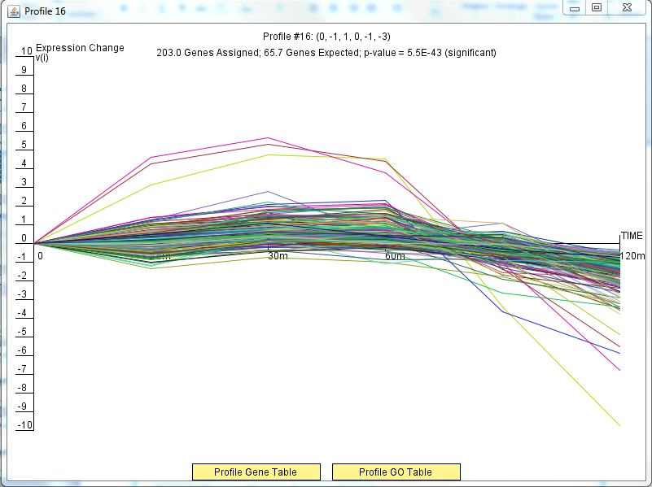
203 Genes in Profile 16

Slide 11
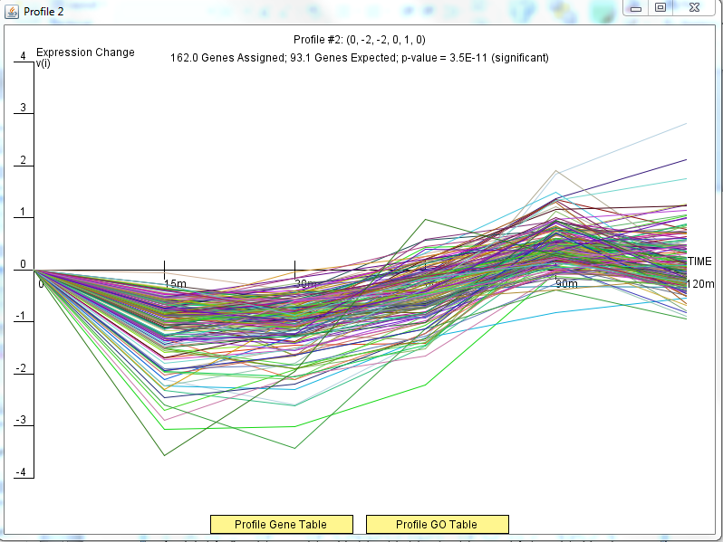
162 Genes in Profile 2

Slide 12
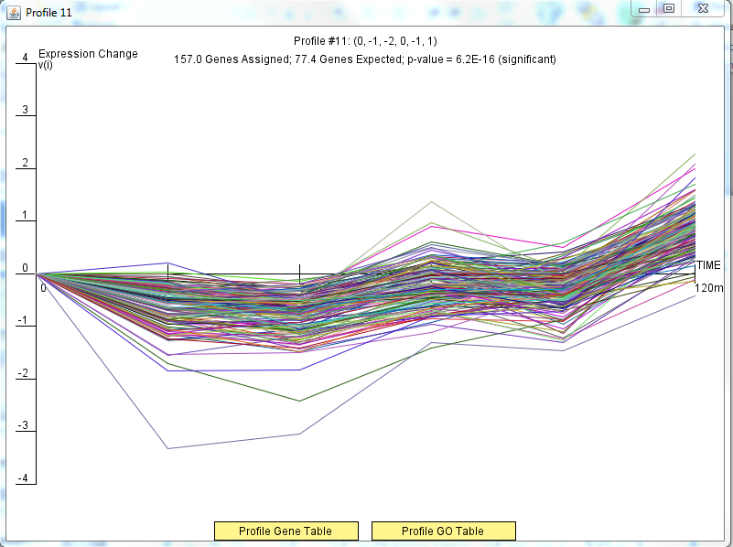
157 Genes in Profile 11

Slide 13
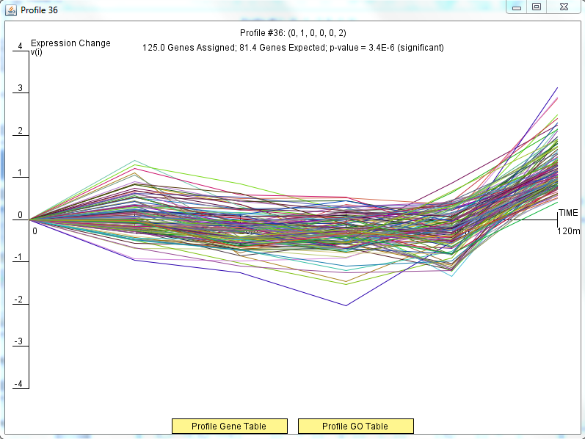
125 Genes in Profile 36

Slide 14
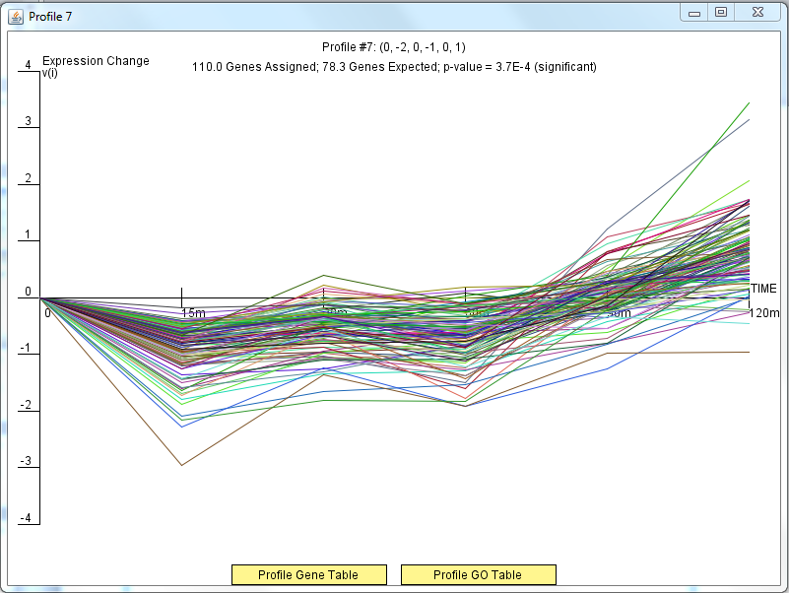
110 Genes in Profile 7

Slide 15
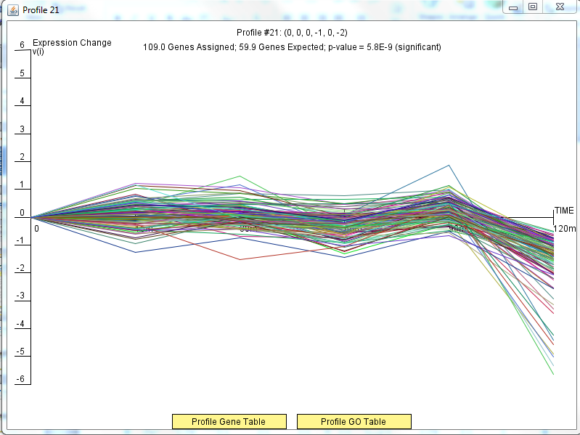
109 Genes in Profile 21

Slide 16
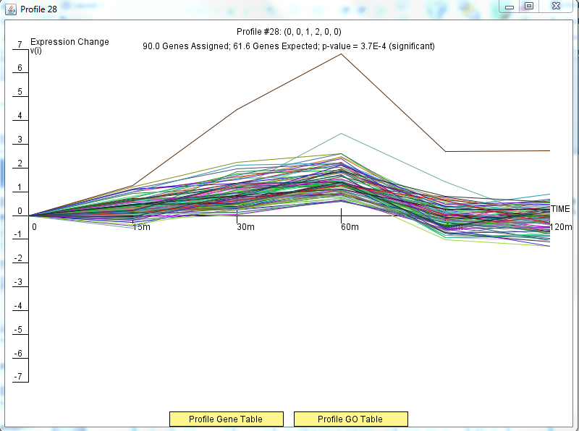
90 Genes in Profile 28

Slide 17
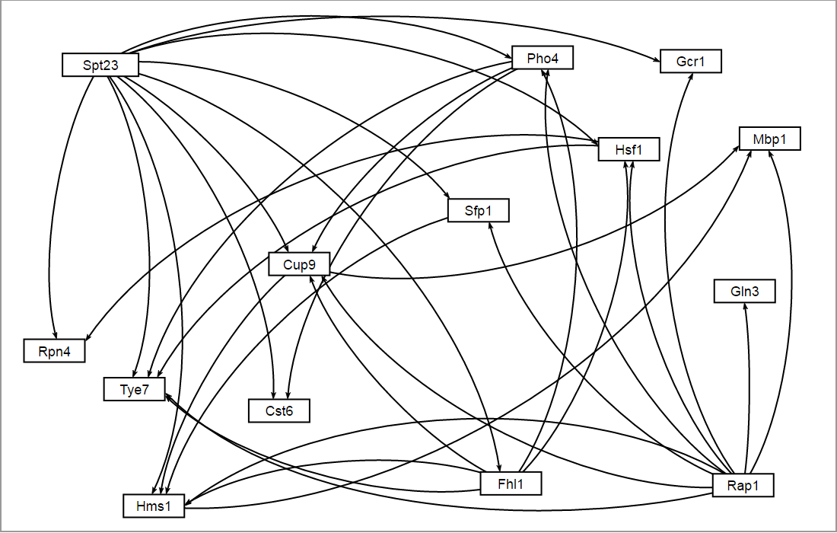
14 Nodes and 33 Edges

