Slide 1
Low-mutation-rate, reduced-genome Escherichia coli: an improved host for faithful maintenance of engineered genetic constructs
Csörgő B, Fehér T, Tímár, Blattner FR, Pósfai G. Microbial Cell Factories (2012), 11:11.
Presented by Queenie Chan
April 18, 2012

Slide 2
Background
Genetic variation
In nature: leads to evolution & survival of the fittest
In lab conditions: not favorable, can lead to unwanted genotypic and phenotypic alterations
Notes:
paper based on idea of genetic variation
Genetic variation in lab – refined and precise, don’t want variants
Genetic variation comes from mutations. How do mutations arise?

Slide 3
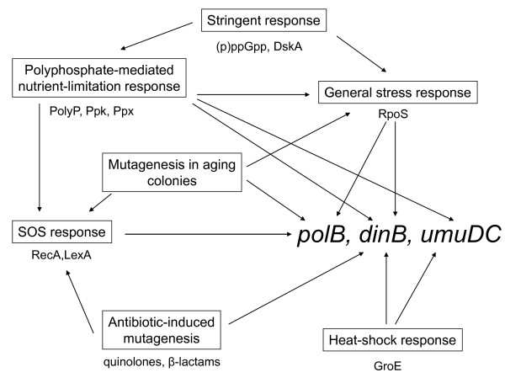
How do mutations arise?
Stress → SOS response
DNA polymerases: can bypass damaged sites and stalled replication forks; create mutations
Pol II
Pol IV
Pol V
Notes:
Under stressful conditions, the SOS response activated
Includes 3 DNA polymerases:
Pol II, IV, V - known to create mutations
- Also known to not be necessary for cell survival beyond generating genetic diversity under stressful conditions – cell has alternative pathways for DNA repair
-- cell has ways of creating genetic diversity in nature to adapt to environments, but we don't necessarily want cells to be able to do so in controlled lab experiments

Slide 4
Goal
Create chassis that allows stable production of growth-inhibiting biomolecules for applications in synthetic and molecular bio
Why growth-inhibiting biomolecules, specifically?
Mutants usually positively selected for
Notes:
Stable- minimal mutants over time
Growth-inhibiting biomolec –
mutants of cells producing growth-inhibiting biomolec usually positively selected for bc can survive and outgrow those that correctly create growth-inhibiting molecules

Slide 5
Project
MG1655: wild-type E. coli strain
MDS42: reduced genome E. coli strain
Genes irrelevant for lab applications (such as insertion sequences) deleted
Modifying MDS42 by creating variants that are more genetically stable
Evaluated variants under stressful conditions
Evaluated variants transformed with toxic-product-producing gene
Notes:
project based on two E coli strains that were already established
removing genes for polymerases that contribute to genetic variation

Slide 6
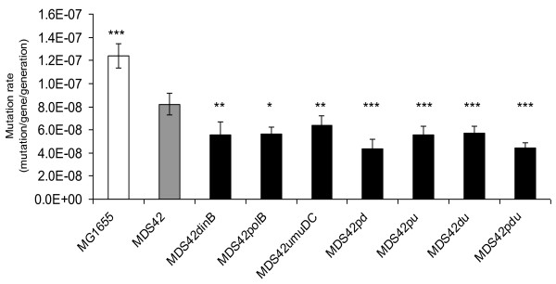
Creating Variants
Polymerase : gene
Pol II : polB
Pol IV : dinB
Pol V : umuDC
Measuring mutation rates of variants
Triple
gene
deletion
Single gene deletion
Double gene deletion
* p < 0.05 ** p < 0.01 *** p < 0.001
Notes:
MG1655 = WT
MDS42 = WT minus IS
Removal of genes encoding pol II, pol IV, and pol V
--> single, double, triple mutant
Measured mutation rate using D-cycloserine resistance assay
single: 20% decrease in mut rate
More gene deletions --> lower mutation rates
So selected trip gene deletion for further study
**MDS42pd actually slightly lower mut rate than MDS42pdu – didn’t explain why so similar rates

Slide 7
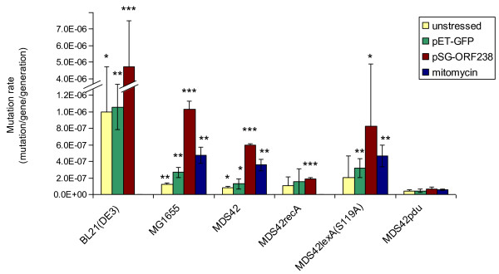
Evaluating under Stressful Conditions
Overproduction of GFP
Overproduction of toxic protein
Activation of SOS response
Regulator mutants
WT
Triple
gene
deletion
Notes:
*Overproduction of protein stresses cells
BL21(DE3) = protein production strain
MG1655 = WT
MDS42 = WT minus IS
Triple gene deletion
Regulator mutants: inactivate whole SOS response, rather than just the 3 DNA polymerases
See if same effect on mutation rate as elimination of polymerases
didn't explain why MDS42lexA(S119A) reacted differently to MDS42recA
--> In general, stresses increased mutation rate (except MDS42recA and MDS42pdu)
increase mutation rate - compare to yellow bar
-->Toxic ORF had largest effect
MDS42pdu (trip gene deletion) characterized as genetically most stable -- even more obvious here with stress

Slide 8
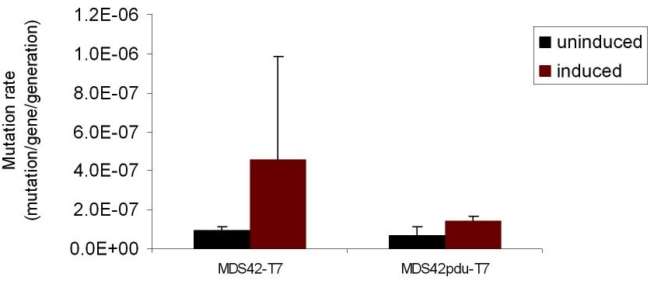
Evaluating with Toxic Protein Gene
BL21(DE3)mcrBC
MDS42-T7
MDS42pdu-T7
pSin32 +
Notes:
pSin32 = gene encoding SinI, which leads to DNA cleavage ( = toxic effect)
Transformed with BL21…(protein production strain), MDS42 (reduced genome WT), and MDS42pdu (trip gene deletion)
System designed so that addition of IPTG would lead to transcription of SinI --> toxic
Checked that strains were inducible by IPTG --> were (supp slides)
Measure mutation rates of induced and uninduced cells
Induced= IPTG = transcription of SinI = toxic
Lower mutation rate in trip gene deletion, as supported by previous results

Slide 9
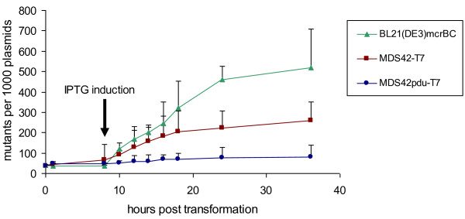
Test with Toxic Protein Gene
Measuring number of mutants in different strains over time
Notes:
--> Triple gene deletion much slower in generating mutants --> more stable!

Slide 10
Conclusion
Eliminating 3 polymerases involved in SOS response significantly decreases mutation rates
MDS42pdu most genetically stable variation of MDS42
Lowest rate of mutation in response to:
Stressful conditions
Production of toxic products

Slide 11
Significance
Developed chassis that is able to stably produce growth-inhibiting biomolecules
Applications:
Synthetic & molecular biology
Biotechnology
Cloning
DNA therapeutics
Notes:
Gene product imposing a metabolic burden or being toxic to host – can now be reliably produced over long periods of time without cells mutating
Same desired DNA seq carried on over generations

Slide 12
Concerns
Explanation for MDS42pd’s (double gene deletion) slightly lower mutation rate than MDS42pdu (triple gene deletion)
Explanation for difference in MDS42lexA(S119A) and MDS42recA (regulator mutants)’s reaction to stress
Inclusion of BL21(DE3)
Notes:
SLIDE 12
Slide 6
Slide 7
Slide 7,8,9

Slide 13
Questions?

Slide 14
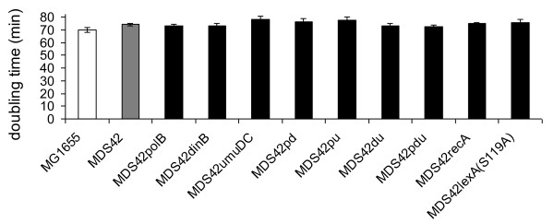
Supplementary Slides: Creating Variants
Verifying that variations do not affect normal cell growth
Triple
gene
deletion
Single gene deletion
Double gene deletion
Regulator
mutants
Notes:
Plated on minimal media
None of deletions or mutants had effect on fitness

Slide 15
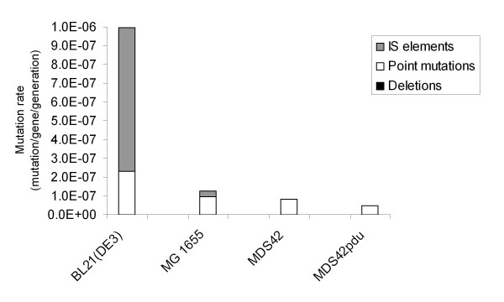
Supplementary Slides: Characterizing Types of Mutations

Slide 16
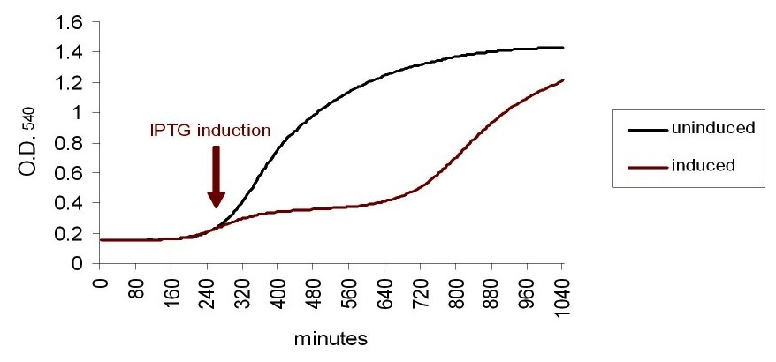
Supplementary Slides: Checking IPTG Inducibility of strains
BL21(DE3)mcrBC
MDS42-T7
MDS42pdu-T7
pSin32 +

