Slide 1
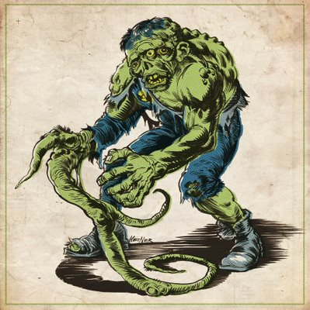
Making a mutant

Slide 2
Goal: to create 3 strains of mutants in Yersinia pseudotuberculosis from previously generated strains of Yersinia pestis.
Strains: Y. pestis ΔpmrA, Y. pestis ΔphoP, Y. pestis ΔpmrA ΔphoP

Slide 3
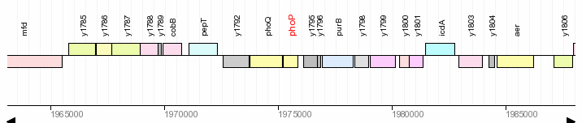
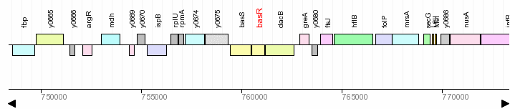
NWRCE

Slide 4
>y0677|basR|Yersinia pestis KIM|500 nt upstream|500 nt downstream|:c760025-761687 GTCTTCAGAACCATTGGTCATCAGCGTTTTGGGGTTCCGGGTACTTGGCGCTCGGGTGCCGATGCCGTTC GCCAAATTTTACGCCAAAAAGCAGGCGTTGATCTTGGTAACAGCATTGTGGTGGATGGATCTGGCCTATC GCGCCATAATCTTATTTCACCAGCAACAATGATGCAGGTTTTGCAATATATTGCTCAAAATGATCAAGAG CTTAATTTTATATCAATGCTGCCTCTAGCAGGATATGACGGTACTCTACGTTATCGTGGTGGCCTGCATG AAGCGGGGGTCAACGGTAAAGTTTCAGCGAAGACGGGTGCACTGCAAGGGGTTTACAATCTTGCCGGTTT CATTACTACCGCTAGTGGGCAACGTATGGCATTTGTACAATTTTTATCCGGCTATGCCGTTCCACCTGAA GACCAAAAAAATCGCCGAGCCCCCTTGGTTCGATTTGAGAGCCGCCTCTATAAAGATATTTATCAGAATA ACTGAGAGCTATGAAATTACTGATTGTTGAAGATGATGAACTGCTACAACGCGGTATAGCCATGGCGCTG ACCAGTGAAGGCTATGTCTGCGACTGCGCAGCTACCGCCGCCGAGGCTCACAGTTTGCTGCAAACCAGTC AGTACAGCATGATTATTCTTGATCTCGGCCTGCCGGATCAGGATGGTACTCTGTTATTACGTCAATGGCG TCGCCAACATGTCACCCTGCCAGTACTCATCCTCACCGCACGTGATGCGCTTGAAGACAGGGTTGACGGG CTGGATGCCGGTGCTGACGATTATCTTGTCAAACCTTTTGCCTTGGCTGAATTACTGGCCCGGGTACGTG CTCTCATCCGCCGTTATCAGGGGCAGAGTGACAACCTGGTACAGCAAGATGACCTGAGCCTTAACTTGTC GACACAACAAGTCTGTTTACAAGGGCAGCCATTAGAGATAACCCCTAAAGAGTTTGCGATCCTCTCACGT CTAATCATGCGAGCTGGGCAAACAGTTAACCGCGAGTTGTTACAACAGGATCTATATACCTGGAATGACG ACCTTAGCTCTAATACGCTGGAAGTTCATATTCATAATTTGCGACGCAAACTGGGTAAAGATCGTATCCG AACCGTTCGAGGTATTGGTTATCGATTGGAAGCCTTATCATGATCAGCATGCGCCGTCGTTTGCTGTTAA TGCTGGCGCTGATTTTACTGGTGACCCAGTTGATCAGCGCATTCTGGCTATGGCATGAAAGTCAGGAACA AATAAGTTTTCTGGTCGATGAAACTCTTAGCGCAAAAGCCCGTAATGAGCAGGTTGATAAAGAAATAGCT GAGGCGATTGCCTCCCTGCTTGCACCGTCGCTAATCATGATGACAATCACTCTGCTGCTGTCTTTCTGGG CAATCAGTTGGATTATTCGTCCACTTGATCAATTACAACAAAAGTTGGCAGAACGCTCCGCAGATAACCT TTCCCCCTTGGTTGTTAACAGTGAAATGCAAGAAATTGTCTCTGTTACCTCAACACTCAATCAATTGTTA TTGCGACTTTCTAATACCATTCAGCAAGAACGGTTGTTTACCGCCGATGCCGCCCATGAACTGCGTACAC CACTCGCAGGAATACGCCTCCACCTAGAATTAATGGAAAAGCAGGGAATTGCC
Sequence Massager

Slide 5
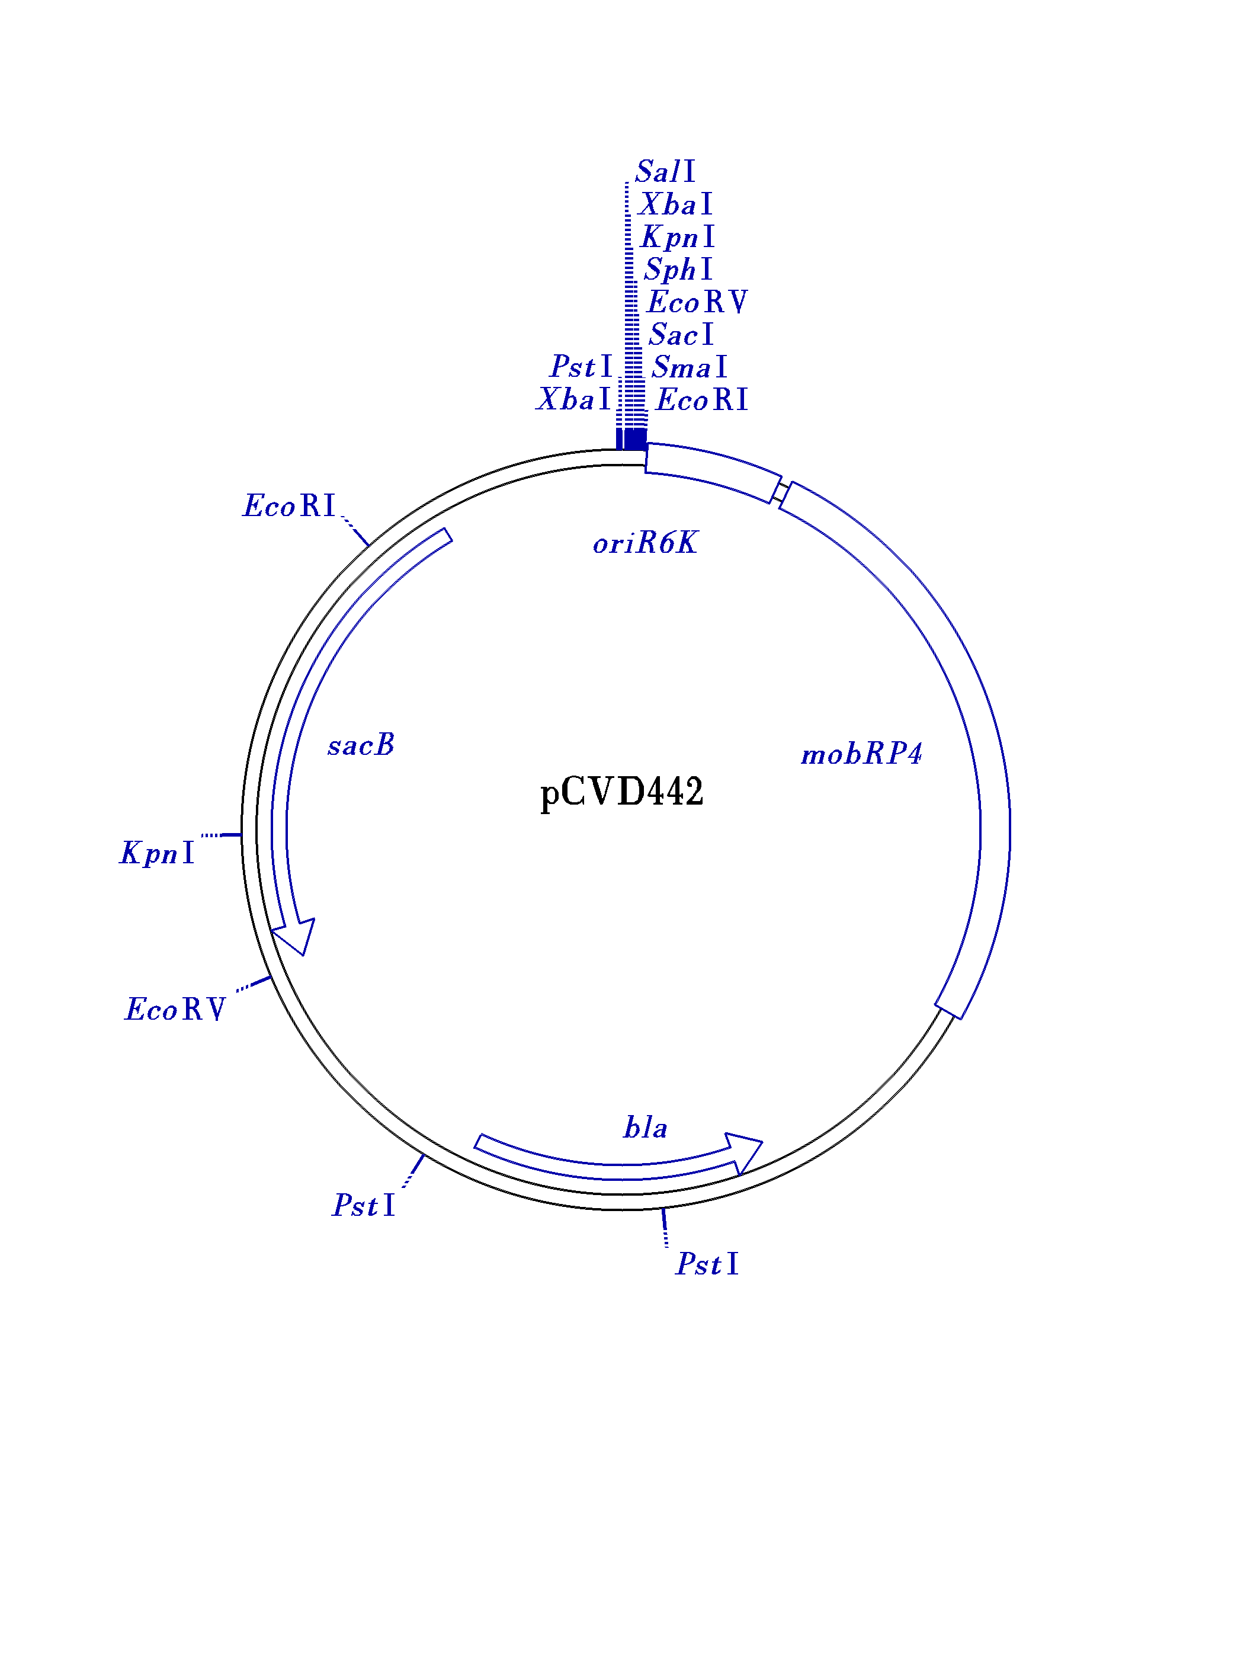
pCVD442 is R6K oriV (pir dependent).
Must integrate into the genome to be replicated in a pir⁻ strain
Take PCR fragment, digest with enzymes (Xba1) and add CIP (optional)
Ligate at 16°C overnight
Transform by electroporation or heat shock

Slide 6
pCVD442 is in B083 (pir⁺ host strain)
Plasmid is not self-transferrable
Need helper strain that has tra genes (B001)
Alternatively, place vector and gene into a pir⁺ host with tra genes.
Perform tri (bi) parental mating.

Slide 7
Selection series: 1st round – BHI+Irg+cb, why?
2nd round – LB + 10% sucrose, why?
3rd round – Screen on LB and LB + cb, why?

