Slide 1
GRNmap Testing
Grace Johnson and Natalie Williams
June 17, 2015

Slide 2
Outline
Testing code updates
b estimation for genes with no inputs should be zero
Checking min LSE in new optimization_diagnostics sheet
Results of using new alpha (0.001)
Classification of genes in network by connectivity
Patterns in goodness of fit were seen when looking at inputs of genes
Many regulators have no significant dynamics. This makes it difficult to estimate w’s and b of their target.

Slide 3
Threshold b’s for genes with no inputs were correctly estimated as 0 in beta v1.0.10
Tested twice, new alpha 0.001
Wt alone, initial weights 1 (421900 iterations)
Wt alone, initial weights 0 (383000 iterations)

Slide 4
Min LSE calculated correctly by v1.0.10 code
For the same network, using only wt data:
LSE output: 0.507517
min LSE output: 0.487463
ss manual calculation: 0.487463

Slide 5
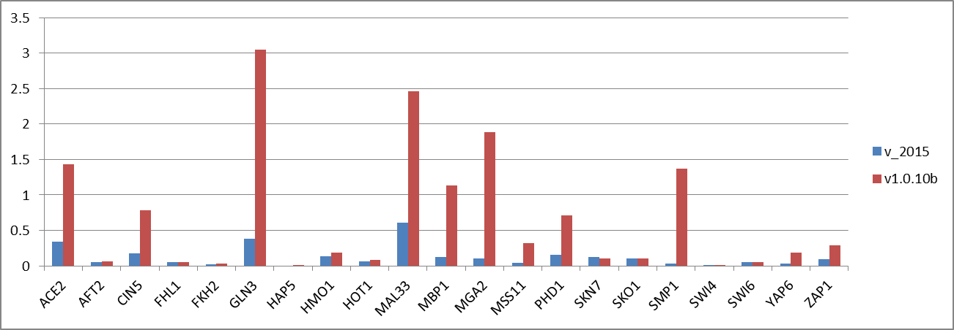
With a new alpha (0.001) the model takes 15x longer to run
Version from spring 2015
Alpha: 0.01
Less freedom estimating parameters
Estimated parameters are closer to zero
Iterations: ~25,000
Time to run: 10 minutes
Version beta 1.0.10
Alpha: 0.001
More freedom estimating parameters
More extreme estimated parameters
Iterations: ~400,000
Time to run: 2.5 hours
Estimated production rates

Slide 6
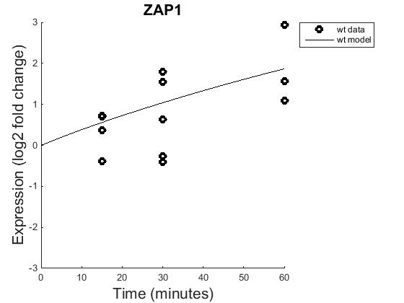
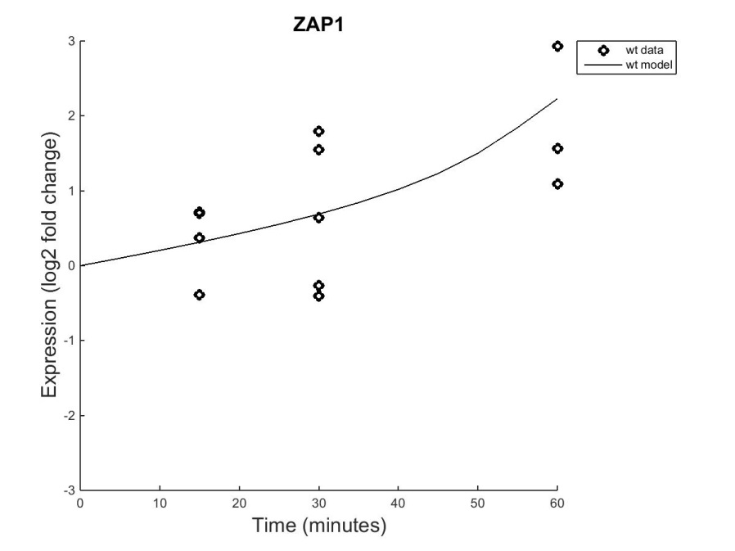
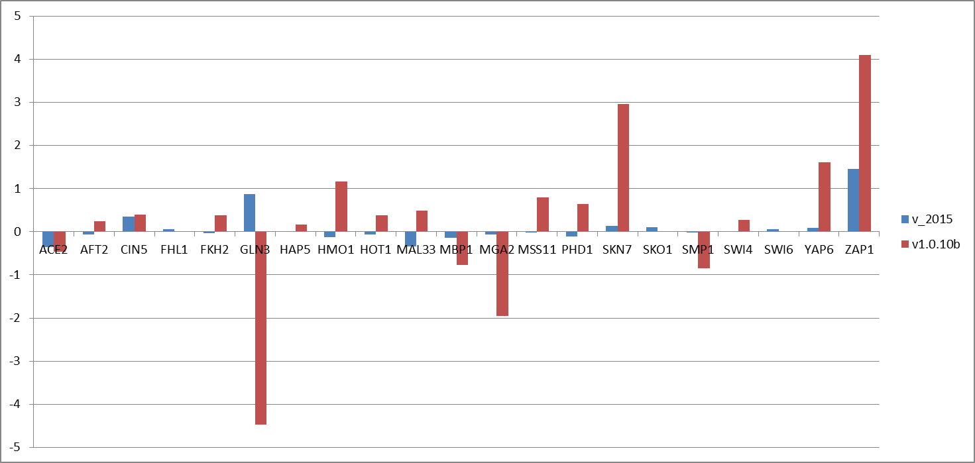
With alpha 0.001, new code produces better fit, but longer running time and more extreme estimated parameters
Version spring 2014 (alpha 0.01) Version 1.0.10 (alpha 0.001)
In new version, model is trying to hit the average of the data points (LSE is close to min LSE)
Estimated b’s

Slide 7
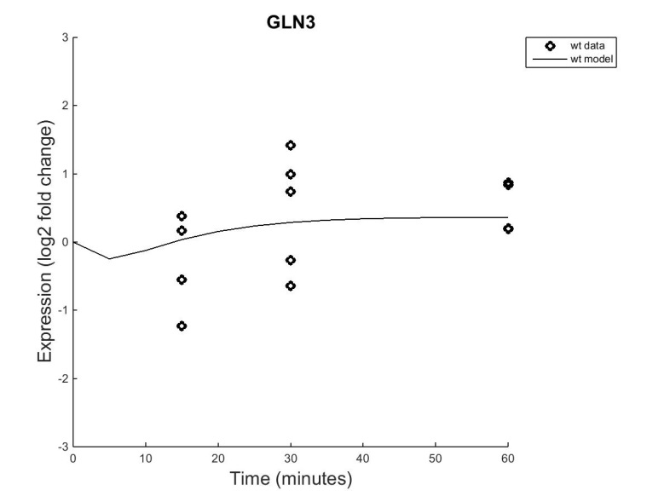
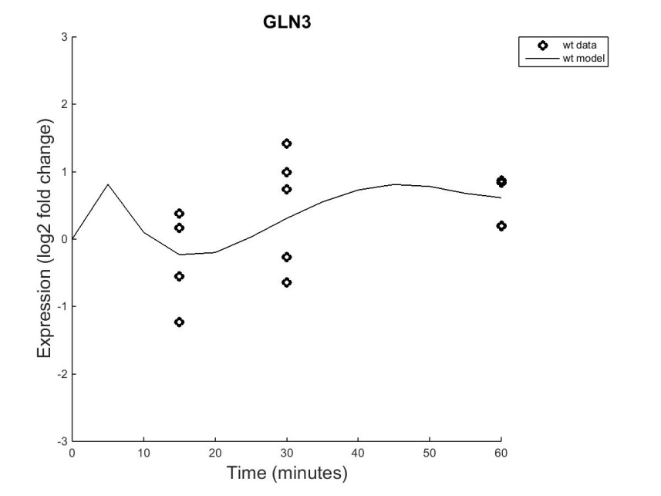
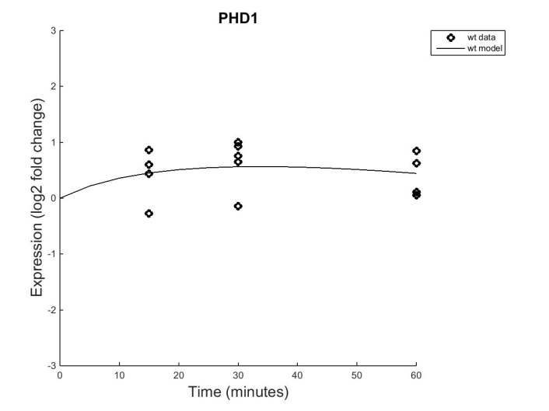
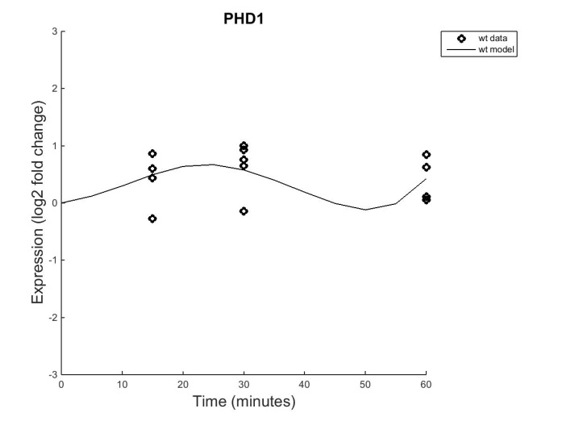
Is alpha 0.001 making penalty term too small?
Version spring 2014 (alpha 0.01) Version 1.0.10 (alpha 0.001)

Slide 8
Classification of genes shows a correlation to fit of the model.
Chacteristic | Gene | In Degree | Out Degree
No_Inputs | FHL1 | 0 | 5
No_Inputs | SKO1 | 0 | 4
No_Inputs | SWI6 | 0 | 2
One_Input | HAP5 | 1 | 0
One_Input | HMO1 | 1 | 0
Self_Reg_No_Others | MBP1 | 1 | 3
Self_Reg_No_Others | SKN7 | 1 | 6
Self_Reg_No_Others | ZAP1 | 1 | 2
Self_Reg_Others | FKH2 | 2 | 3
Self_Reg_Others | AFT2 | 2 | 1
Self_Reg_Others | CIN5 | 4 | 6
Self_Reg_Others | GLN3 | 2 | 2
Self_Reg_Others | SMP1 | 4 | 3
Self_Reg_Others | YAP6 | 7 | 3
Self_Reg_Others | PHD1 | 7 | 5
Self_Reg_Others | SWI4 | 6 | 3
Three_Input | MSS11 | 3 | 0
Two_Input | ACE2 | 2 | 0
Two_Input | HOT1 | 2 | 0
Two_Input | MGA2 | 2 | 0
Two_Input | MAL33 | 2 | 2
Table 1 shows how the genes were classified with the degrees of the genes showing their connectivity in the GRN.

Slide 9
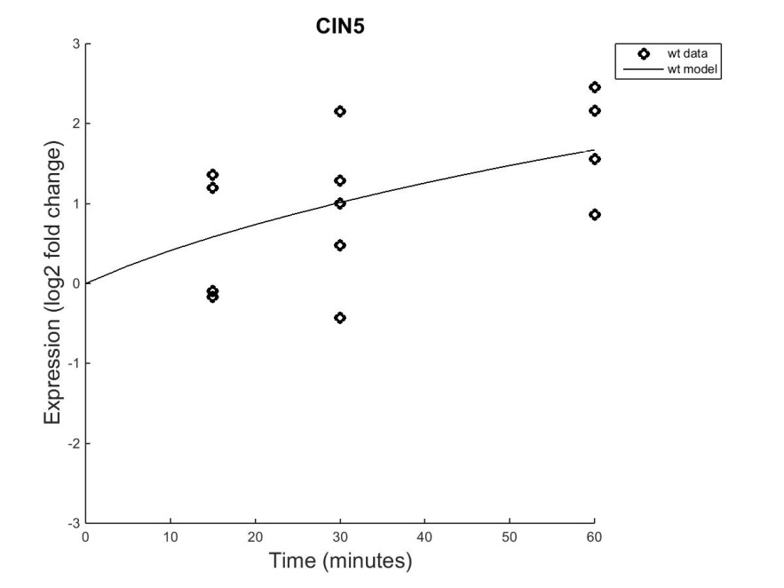
The model tends to better fit the data of self-regulating genes
Self-Regulating with No Other Inputs (3):
Fit simulated data pretty well.
Self-Regulating with Other Inputs (9):
Does a decent job in modeling the data

Slide 10
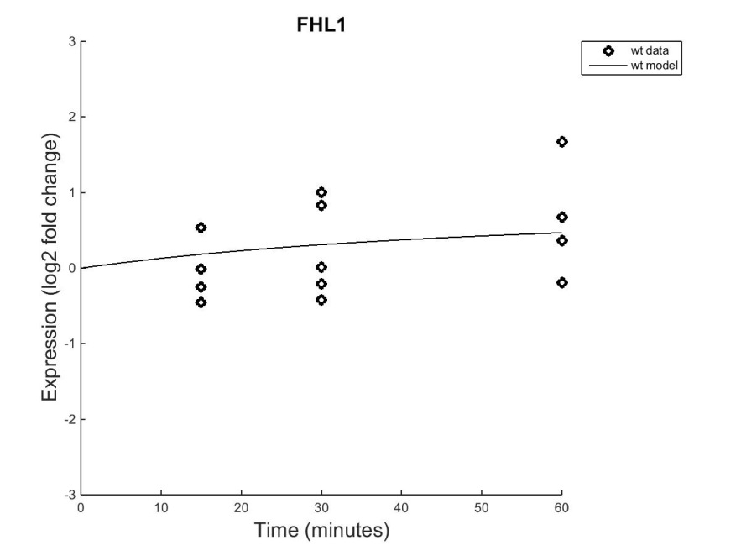
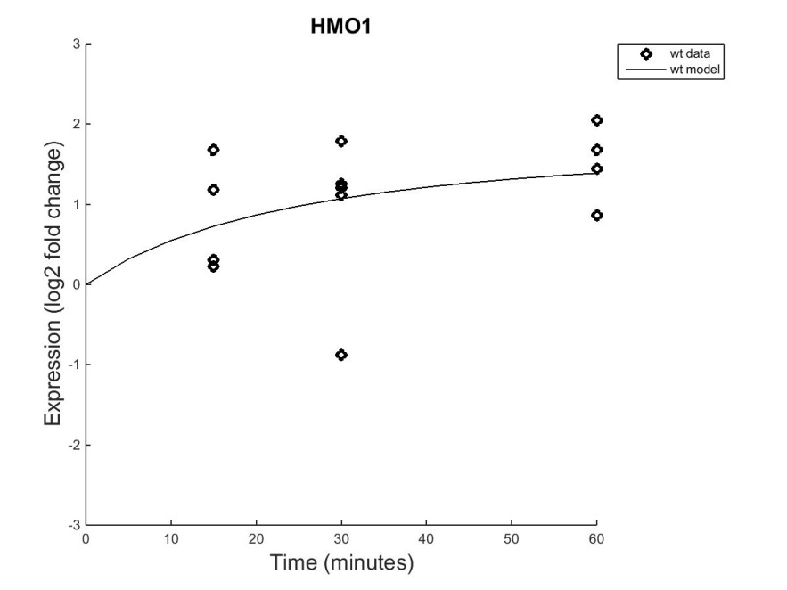
One_Input genes show dynamics that act in accordance with its regulator’s signal.
No Inputs (3):
Fits decently, but not as tight to the data points
One Input (2):
Fits were decent to the data points

Slide 11

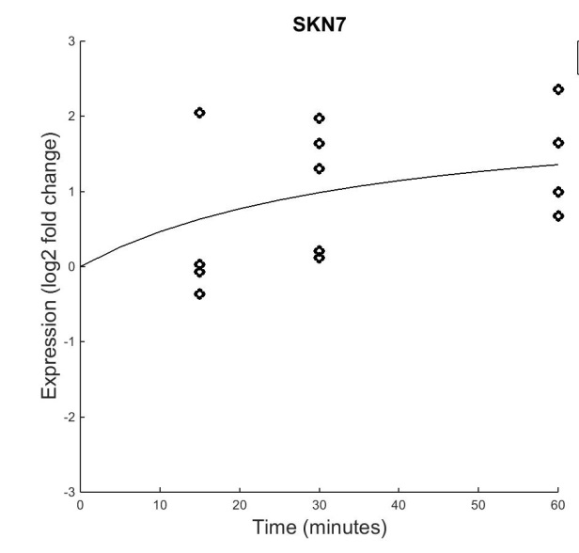
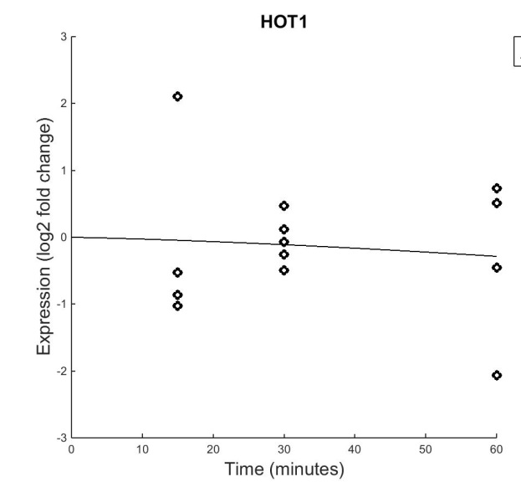
When two regulators send the same cues, the model of the target gene has good fit.
FHL1 & SKN7 both repress HOT1. With both of their dynamics increasing, they send greater signals for down-regulation of HOT1.

Slide 12
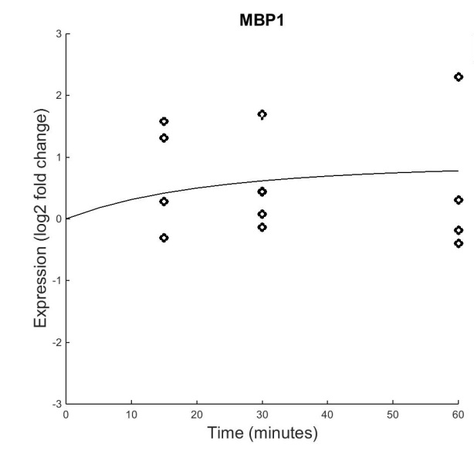
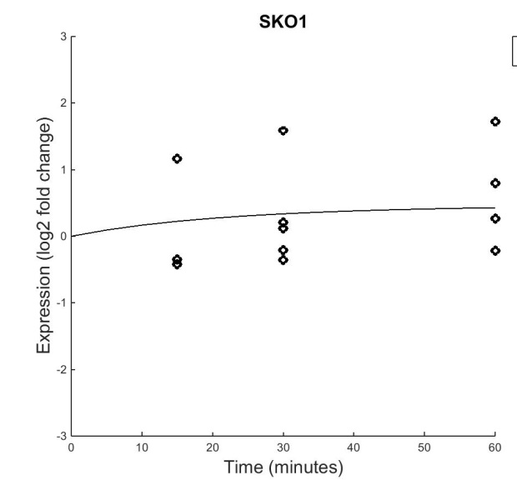
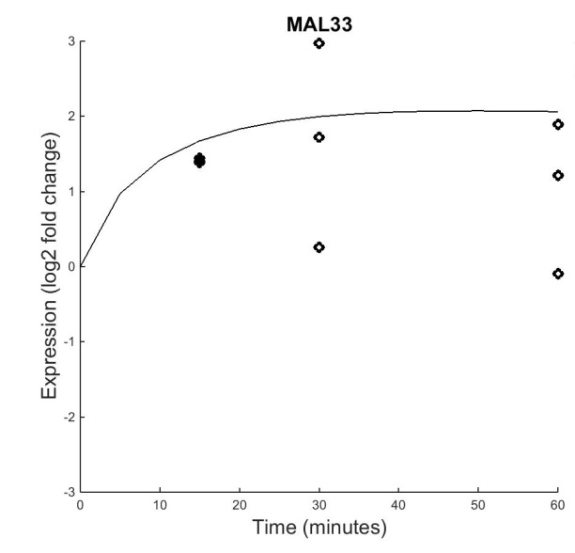
With opposing signals from regulators, the target gene’s model poorly fits the data.
MBP1 represses MAL33 while SKO1 activates it. When both regulators are up-regulated they send conflicting signals. The up-regulation seen may potentially be due to a factor outside of the network.

Slide 13
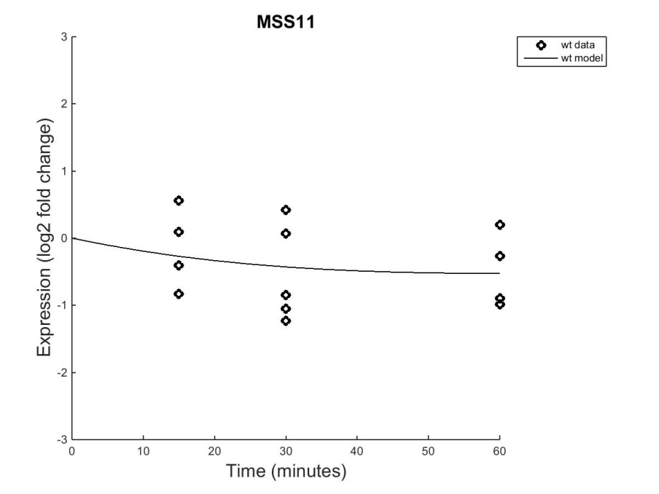
Target genes with the same input command from their regulators have better fitting models.
MSS11 receives activation cues from CIN5, SKN7, and SKO1.
However, the down-regulation could be due to a greater degradation rate than production rate or a missing input.

Slide 14
Problem estimating weights and threshold values
14 genes (2/3) have at least one regulator without dynamics (insignificant B&H p-value)
9 have half or more regulators with no dynamics
4 have regulators with no dynamics (FKH2, HMO1, MAL33, MBP1)

Slide 15
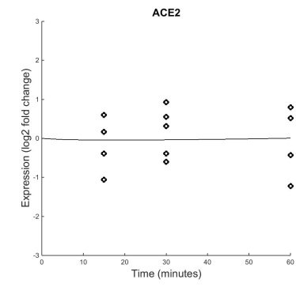
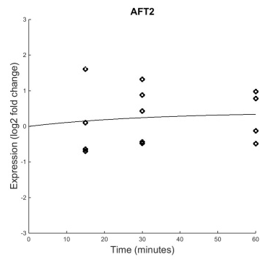


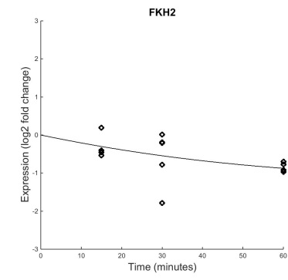

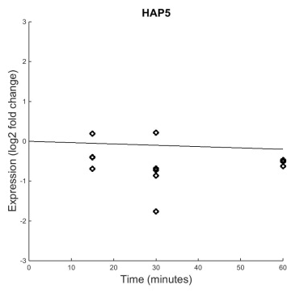




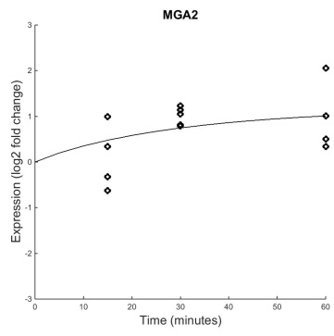




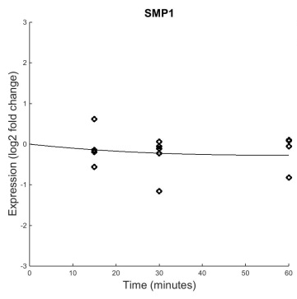
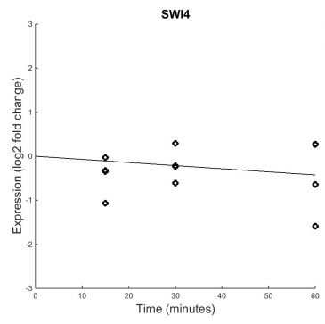
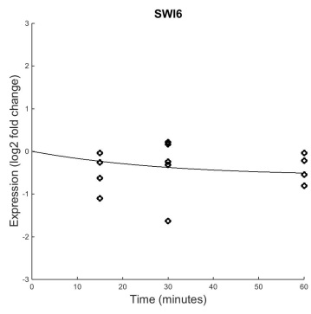
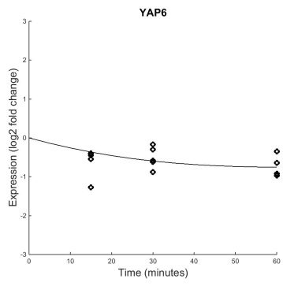
B&H p=0.8702
B&H p=0.7161
B&H p=0.0642
B&H p=0.4454
B&H p=0.1274
B&H p=0.4125
B&H p=0.1539
B&H p=0.0409
B&H p=0.6387
B&H p=0.0101
B&H p=0.5240
B&H p=0.1028
B&H p=0.4275
B&H p=0.0017
B&H p=0.0228
B&H p=0.1330
B&H p=0.6046
B&H p=0.6367
B&H p=0.1178
B&H p=0.0003
B&H p=0.0086
Wt strain outputs with wt ANOVA B&H p-values
Notes:
dCIN5

Slide 16
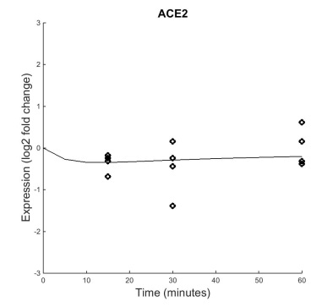
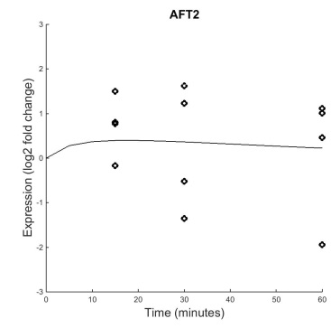
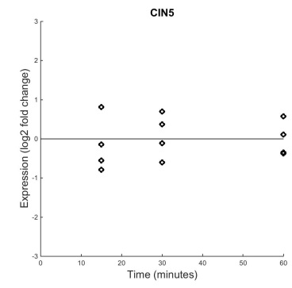
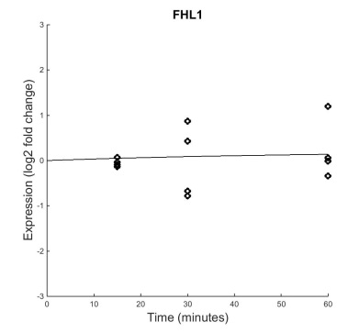
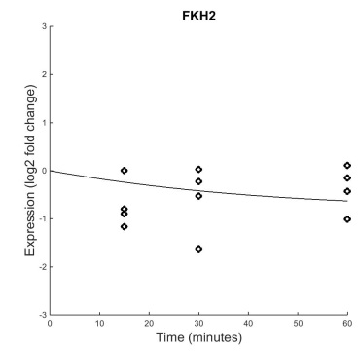
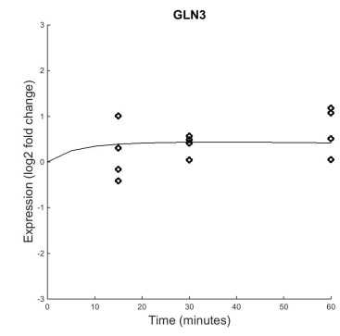
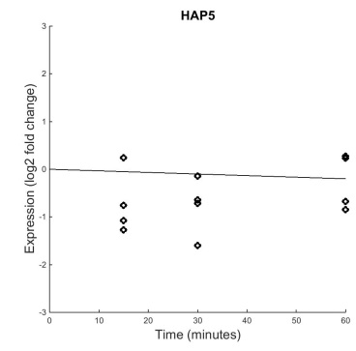
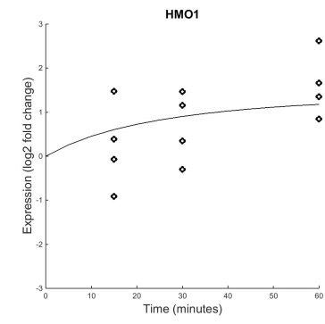
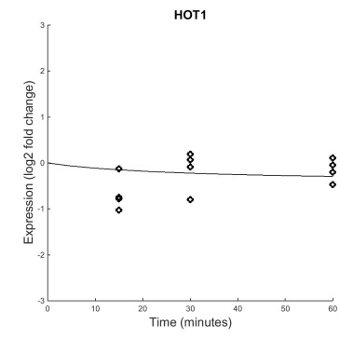
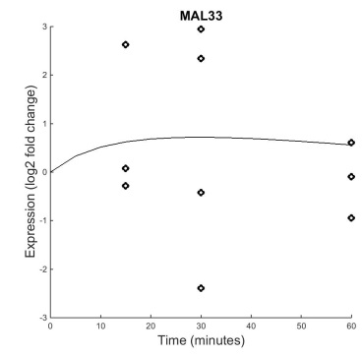
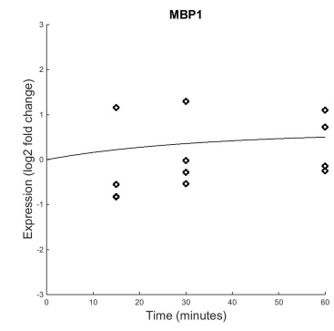
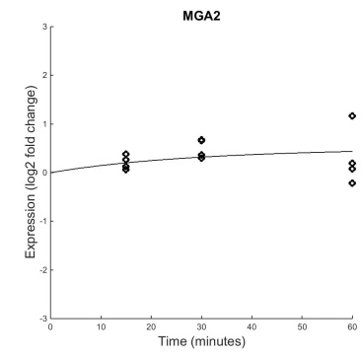
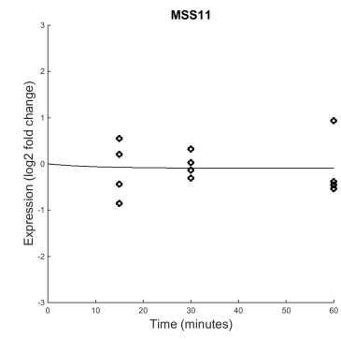
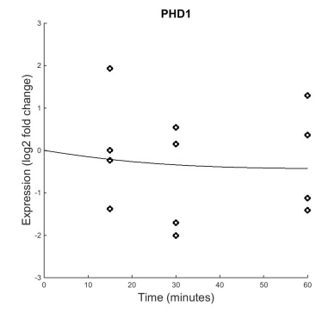
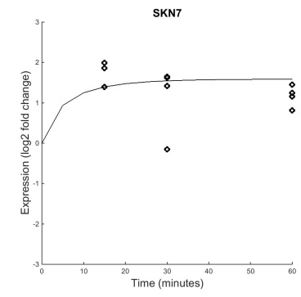
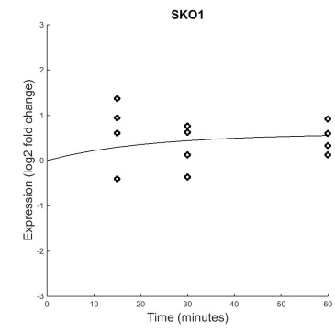
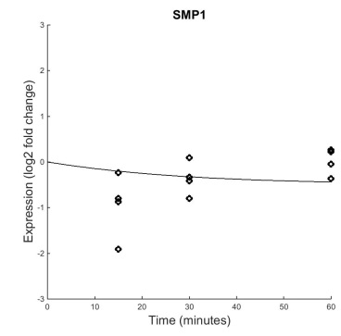
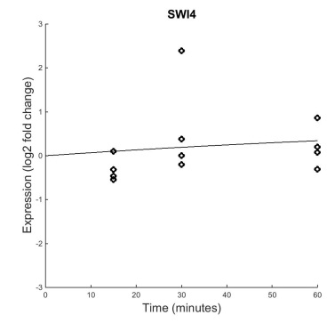
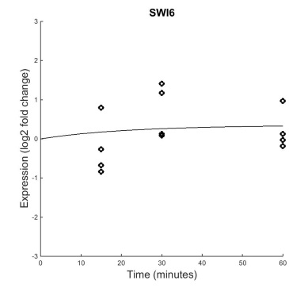
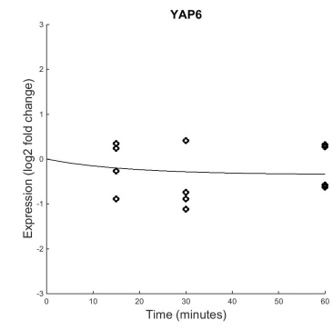
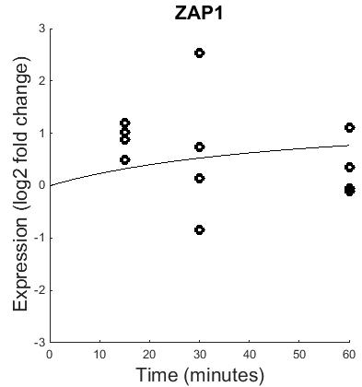
B&H p=0.4087
B&H p=0.6684
B&H p=0.9208
B&H p=0.9626
B&H p=0.0570
B&H p=0.5458
B&H p=0.1841
B&H p=0.0019
B&H p=0.1031
B&H p=0.7691
B&H p=0.9383
B&H p=0.3546
B&H p=0.6064
B&H p=0.4645
B&H p=0.0185
B&H p=0.2005
B&H p=0.0523
B&H p=0.4371
B&H p=0.6350
B&H p=0.0724
B&H p=0.2811
dCIN5 strain outputs with dCIN5 ANOVA B&H p-values
Notes:
dCIN5

