Slide 1
Final Presentation [work in progress… work completed for Week 11 Journal Assignment]
Kara Dismuke

Slide 2
Table 1: As we tightened the restriction on the p-value, the percentages of significant results decreased with the Bonferroni-adjusted p-value proving to be most selective for obtaining significant results (for both the wild type strain and dZAP1 strain)
ANOVA | WT | dZAP1
p < 0.05 | 2378/6189 (31.42%) | 2264/6189 (36.58%)
p < 0.01 | 1527/6189 (24.67%) | 1445/6189 (23.35%)
p < 0.001 | 860/6189 (13.90%) | 792/6189 (12.80%)
p < 0.0001 | 460/6189 (7.43%) | 414/6189 (6.69%)
B-H p < 0.05 | 1656/6189 (26.76%) | 1538/6189 (24.85%)
Bonferroni p < 0.05 | 228/6189 (3.68%) | 192/6189 (3.10%)
Notes:
From Excel data/calculations

Slide 3
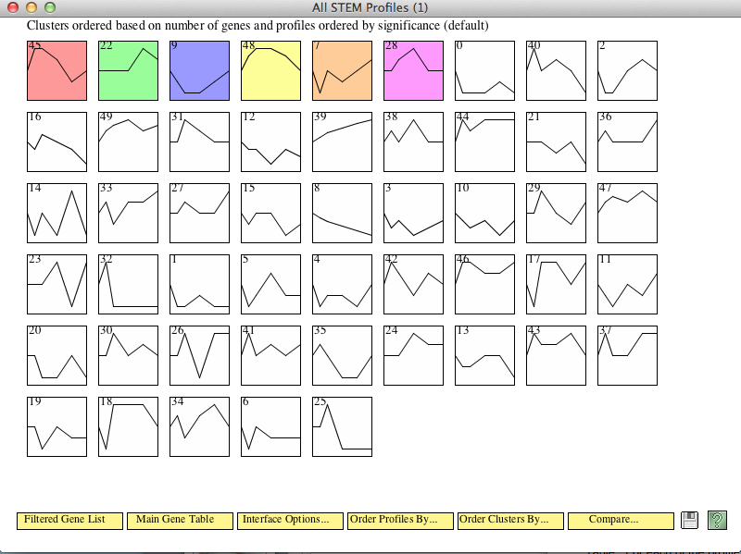
STEM Profile Results for dZAP1
Note: colored profiles have a statistically significant number of genes assigned
Notes:
Each box corresponds to a model expression profile.
Colored profiles have a statistically significant number of genes assigned; they are arranged in order from most to least significant p value.
Profiles with the same color belong to the same cluster of profiles.
The number in each box is simply an ID number for the profile.

Slide 4
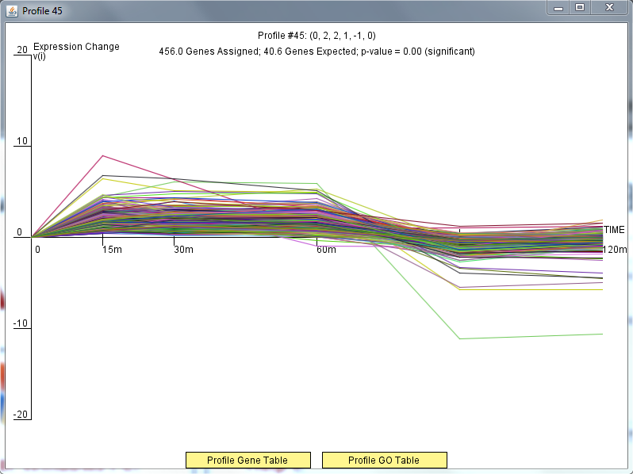
Results: Profile 45

Slide 5
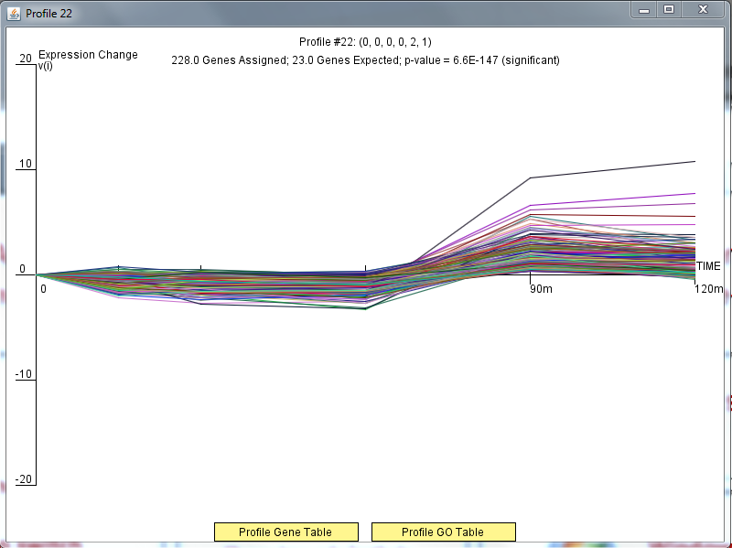
Results: Profile 22

Slide 6
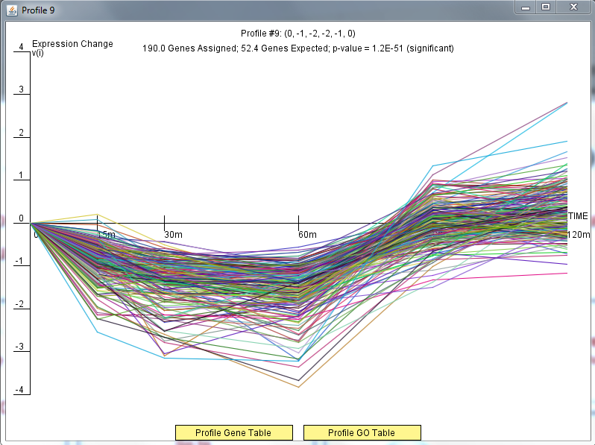
Results: Profile 9

Slide 7
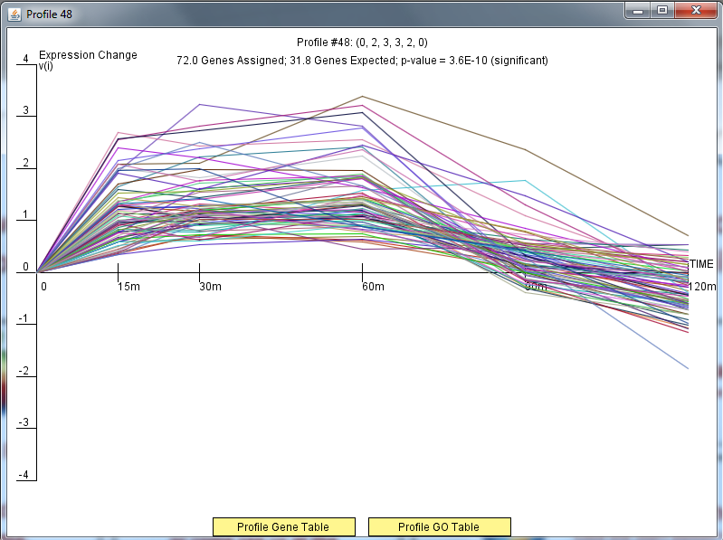
Results: Profile 48

Slide 8
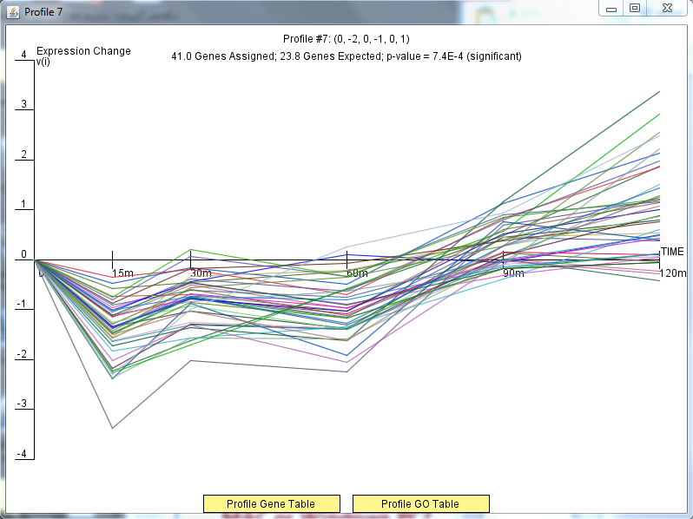
Results: Profile 7

Slide 9
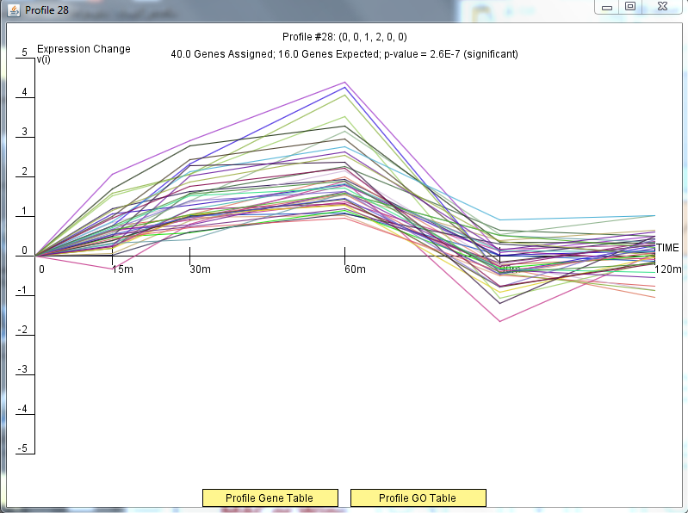
Results: Profile 28

Slide 10
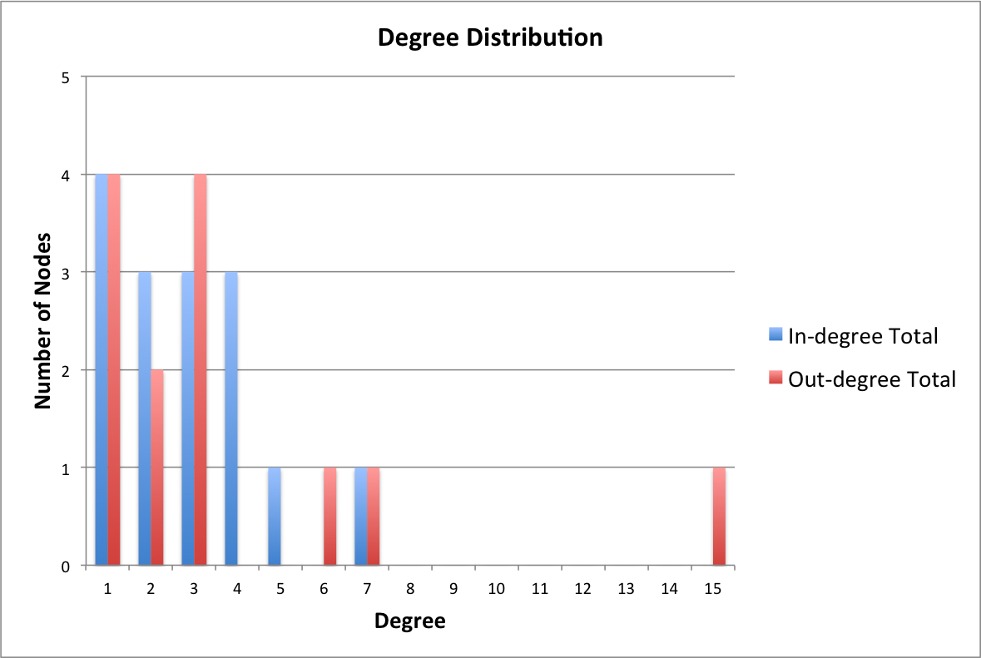
Figure 1
Notes:
Note: Title- will change (be more specific)
Note- 48 edges

Slide 11
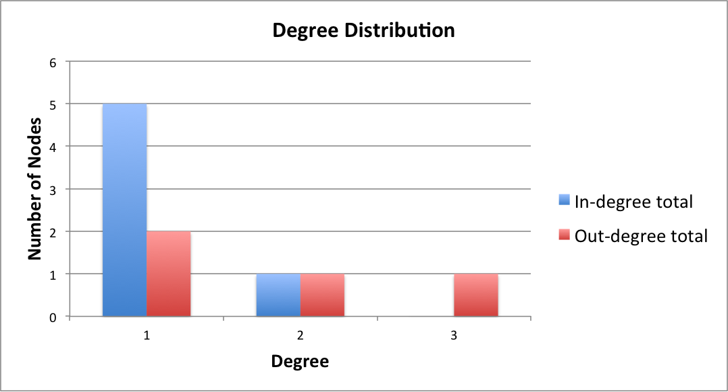
Figure 2
Notes:
Note: Title- will change (be more specific)
Note: only 7 edges

Slide 12
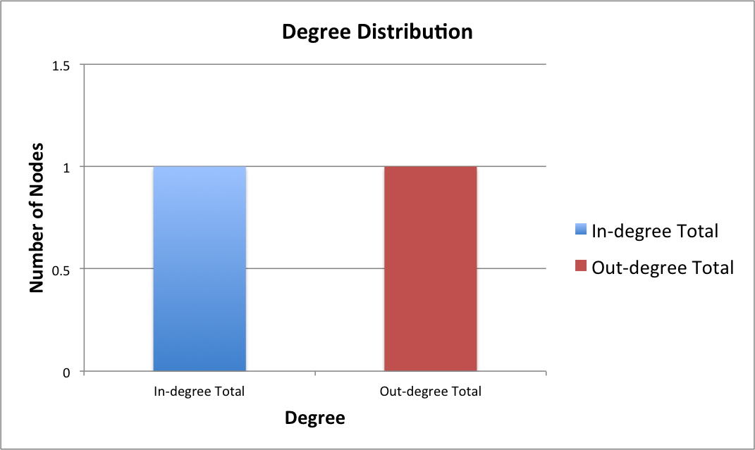
Figure 3
Notes:
Note: Title- will change (be more specific)
Note: only 1 edge

Slide 13
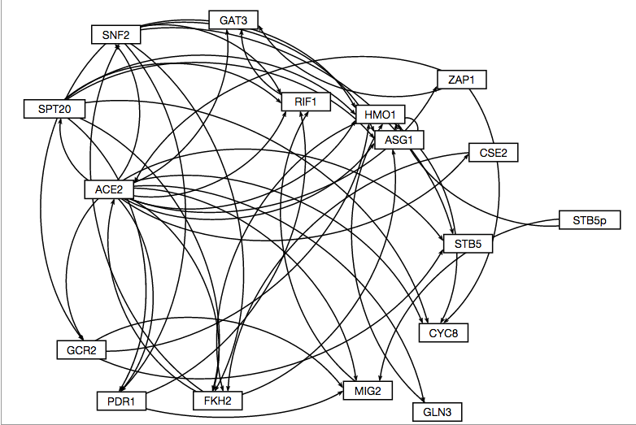
GRNsight Graph (1)

Slide 14
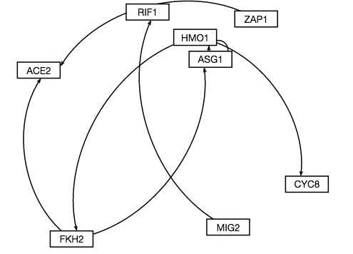
GRNsight Graph (2)

Slide 15
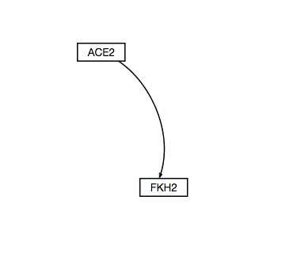
GRNsight Graph (3)

