Slide 1

Control of skin cancer by the circadian rhythm
Current Topics in Cancer
Tim Butler
2/23/12
Notes:
Circadian rhythm much more important than simply controlling when I do/don’t feel tired, metabolism, and as this paper shows dna repiar

Slide 2
What We’ll Cover
Circadian rhythm and skin cancer
  DNA repair and replication regulated by circadian rhythm
  Timing of UV damage contributes to cancer risk
The human circadian rhythm
  How do these findings affect us?
Circadian Rhythm and Cancer
  Chronotherapy
Discussion

Slide 3
Findings
Building off previous work on XPA, cyclical repair of UV damage is demonstrated
Groups of hairless mice are exposed to UVR when repair ability is high and low
Number and severity of skin tumors correlates with ability to repair UV damage

Slide 4
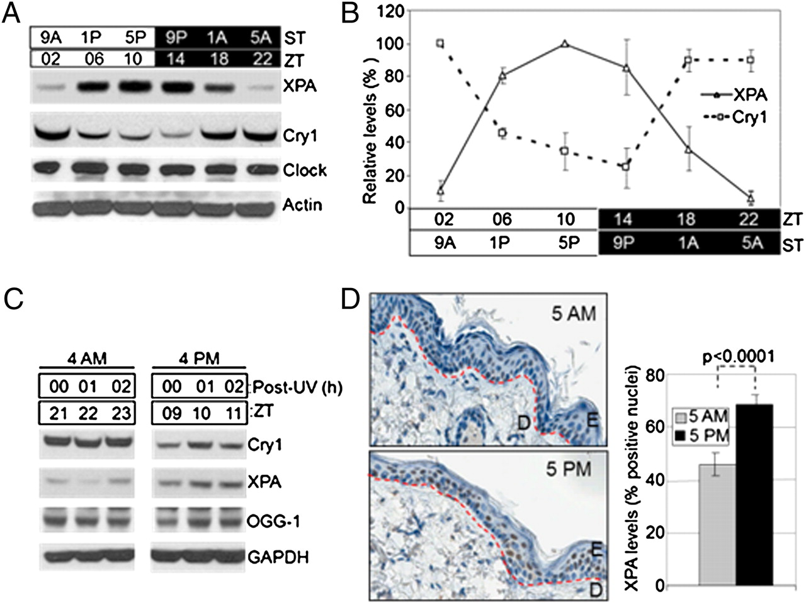
XPA
Investigators confirm previous findings
XPA is a circadian controlled protein
Not all epidermal cells XPA positive
Note that for this and subsequent figures N=2
Notes:
ZT=0 is when lights come on
OGG 1 glycoslase part of BER responsible for repairing UV oxidative damage
c) UV damage does not alter Cry1 or XPA expression
d) IHC of XPA from mouse skin, more nuclei express XPA in PM group

Slide 5
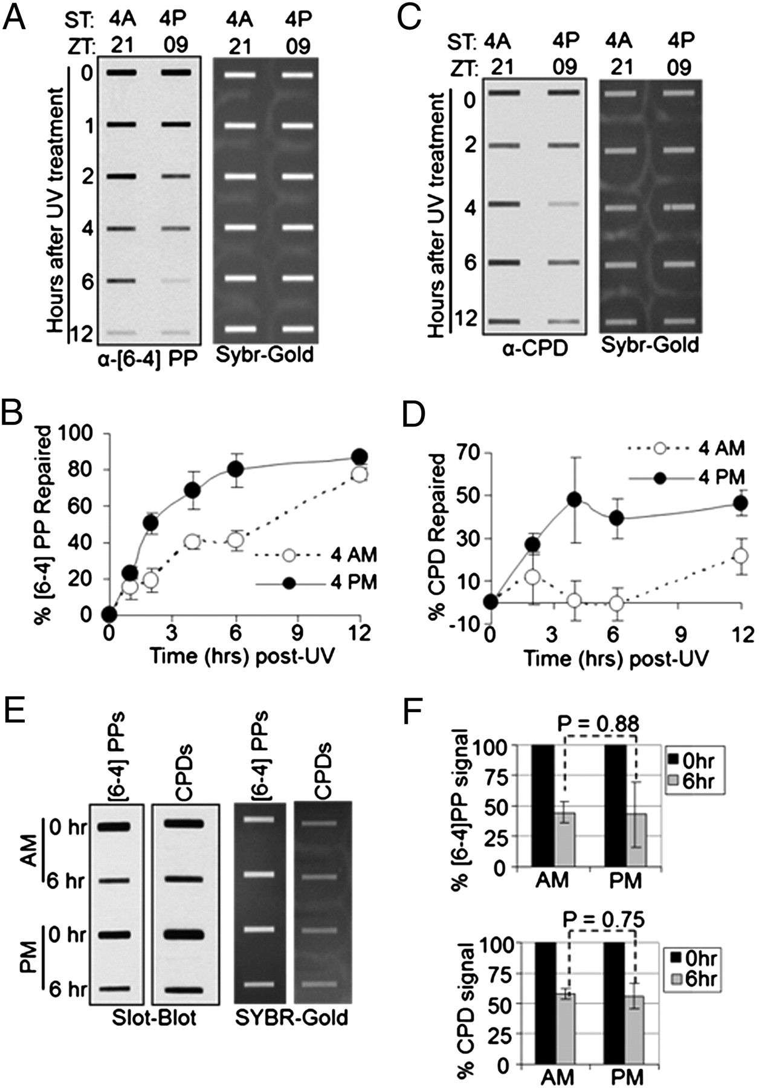
UV Damage Repair Cyclical
AM Mice less/slower repair than PM Mice
PP easier to repair, less dependent on XPA concentration
PP and CPD repair display different kinetics
XPA appears to be rate limiting for NER
Cry1/2 -/-
No circadian rhythm
Notes:
Slot blots
Cry ½ -/- no circadian rhythm, in Black 6 background, supplemental shows black 6 has same phenotype as SHK-1 hairless
CPD remaining 50% unrepaired even in PM mice consistent with what Nathalie previously showed

Slide 6
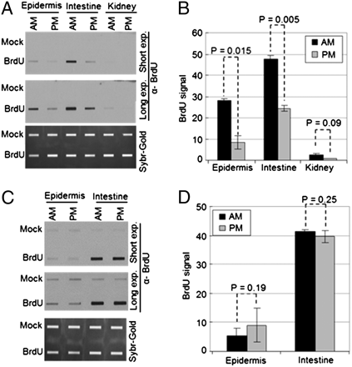
Replication also Cyclic
Replication also important in UV mutations
Replication rhythmic, showing opposite timing as DNA repair
In the PM low replication and high repair both acting to reduce mutations
Cry1/2 -/-
No circadian rhythm

Slide 7
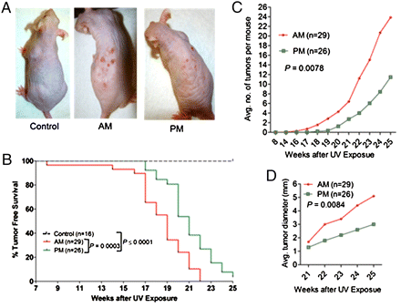
Time of Day and Carcinogenesis
SKH-1 Hairless mice
Exposed to UVB for 3x weekly for 25 weeks
PM mice had fewer and smaller tumors, which occurred more slowly
Notes:
N=26
More tumors, sooner tumors, larger tumors
Kaplan meyer curve, roughly same pattern 4 weeks delayed

Slide 8
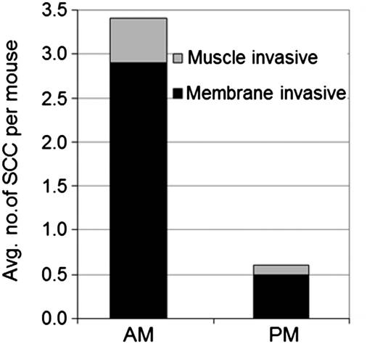
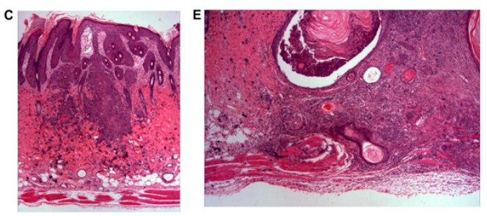
Tumor Number and Profile
AM treated mice had 5x more invasive tumors than PM treated mice
Notes:
Kertoacanthomas, papillomas, sccs

Slide 9
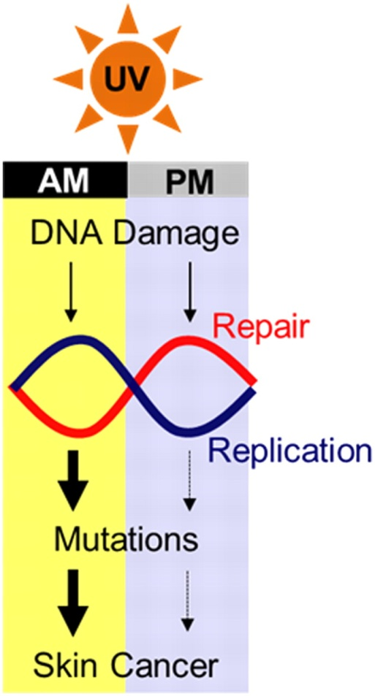
The Model
Same UV dose more tumorgenic in AM than PM
Both repair and replication contribute to reduced/increased UV repair

Slide 10
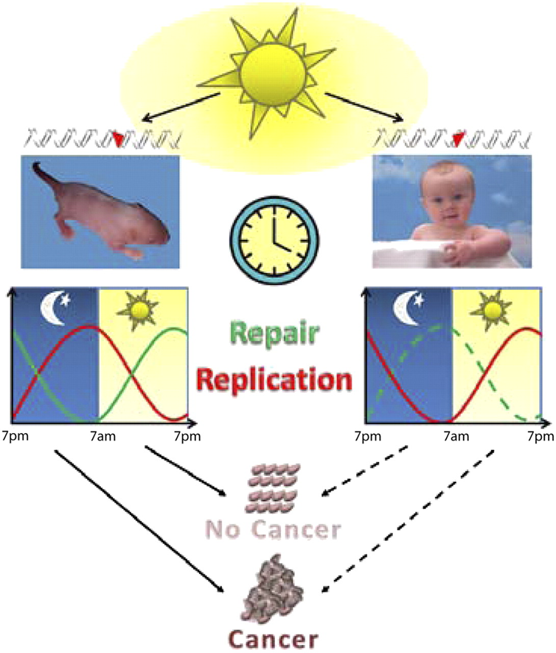
Human Circadian Rhythm
Mice are nocturnal, humans diurnal
Humans have the opposite phase to their circadian clock
  Predict that for humans XPA high in AM, low in PM
  Replication Low in AM, High in PM
Mitra S PNAS 2011;108:18857-18858

Slide 11

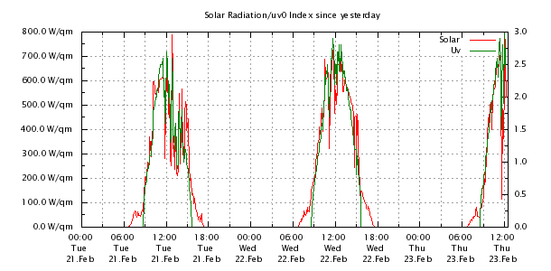
Human Health Implications
UV intensity has predictable pattern over the course of a day, UVI peaks at noon, but remains high until 3pm
Our repair capacity (according to model) is 50% of what it is when we wakeup
Often people stop reapplying sunscreen in the afternoon
"WEATHER FROM THE HEIGHTS." Weather Hasbrouck Heights, NJ. Web. 23 Feb. 2012.

Slide 12
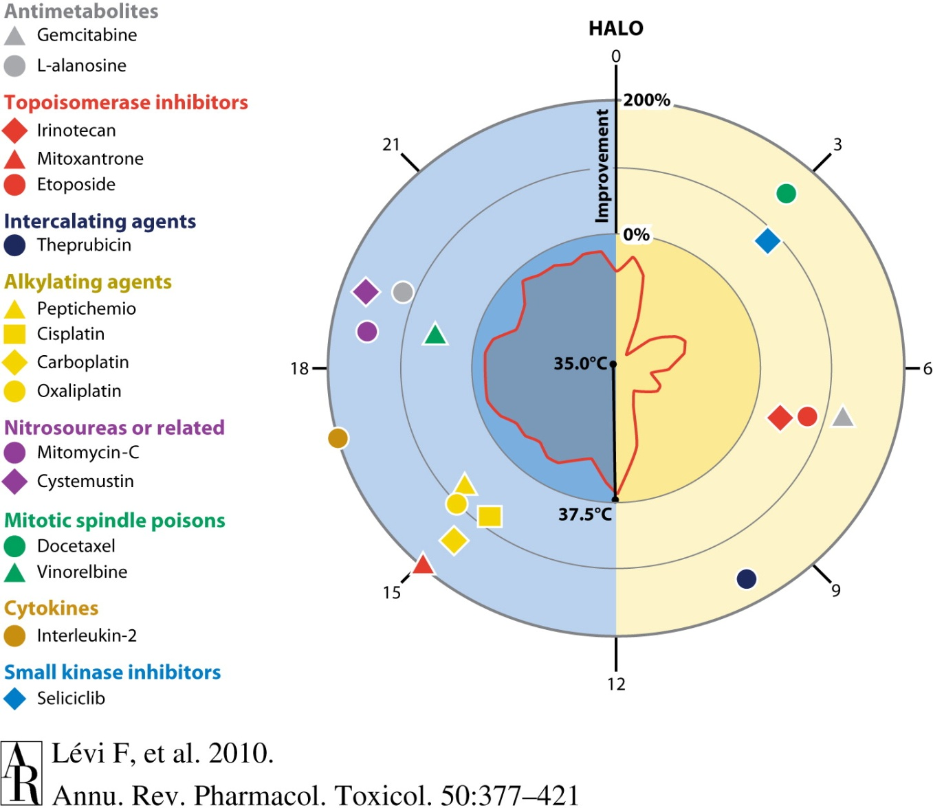
Circadian Rhythm and Cancer
Survival benefit of toxic dose of anti-cancer drug
ZT of optimal survival benefit shown, 2-10 fold benefit
Can’t predict benefit based on class of drug
Argues for better understanding of how mouse and human circadian rhythms differ

Slide 13
Consequences of Disrupting the Circadian Rhythm
Evidence for link between shift-workers and breast cancer
  Odds ratios reported 1.8-2.9 in study looking at nurses working varied shifts
  Is this due to a disruption in the rhythm or exposure at a sensitive time?
Studies have shown downregulation of circadian rhythm genes in cancer
  Loss of circadian rhythm a potential vulnerability?
Hansen, J. et al. Case-control study of shift-work and breast cancer risk in danish nurses: Impact of shift systems. European Journal of Cancer.
Yang, M et al. (2011). Altered expression of circadian clock genes in human chronic myeloid leukemia. Journal of Biological Rhythms, 26(2), 136-148

Slide 14
Questions and Discussion

