Slide 1
Creating a Gene Regulatory Network Comparing a Wild Type Strain with a Mutant ΔGLN3 Deletion in S. cerevisiae Showed that ΔGLN3 Exhibits No Meaningful Control of Cold Shock Response
Alyssa N. Gomes & Tessa A. Morris
Loyola Marymount University
Biomathematical Modeling
Dr. Dahlquist & Fitzpatrick
May 7, 2015

Slide 2
Understand the Effect of Deleting gene, ΔGLN3, on the Cell’s Cold Shock Response
What transcription factors in S. cerevisiae control the cold shock response responsible for maintaining homeostasis?
Discuss the importance of cold shock, microarray analysis, ΔGLN3
Statistical analysis leading to profile selection
Choosing profile 45 to create a gene regulatory network
Statistical Analysis: p-values, Bonferroni, B-H tests
Clustering and Gene Oncology Analysis with STEM: STEM analysis, GO terms, significant profiles
Use YEASTRACT and GRNsight to determine which transcription factors regulate a cluster of genes and that “ONLY DNA binding” should be pursued further
Run model one where the threshold parameters b are not estimated and one where they are estimated
ΔGLN3 exhibits no meaningful control of cold shock response, other more connected genes should be studied.

Slide 3
Understand the Effect of Deleting gene, ΔGLN3, on the Cell’s Cold Shock Response
What transcription factors in S. cerevisiae control the cold shock response responsible for maintaining homeostasis?
Discuss the importance of cold shock, microarray analysis, ΔGLN3
Statistical analysis leading to profile selection
Choosing profile 45 to create a gene regulatory network
Statistical Analysis: p-values, Bonferroni, B-H tests
Clustering and Gene Oncology Analysis with STEM: STEM analysis, GO terms, significant profiles
Use YEASTRACT and GRNsight to determine which transcription factors regulate a cluster of genes and that “ONLY DNA binding” should be pursued further
Run model one where the threshold parameters b are not estimated and one where they are estimated
ΔGLN3 exhibits no meaningful control of cold shock response, other more connected genes should be studied.

Slide 4
What Transcription Factors in S. cerevisiae Control the Cold Shock Response Responsible for Maintaining Homeostasis?
ΔGLN3 was noted as a transcriptional activator of genes regulated by nitrogen catabolite repression and a lack of nitrogen sources
Cold Shock, the response to a sudden decline in temperature, is not well studied.
DNA microarray analysis was performed to analyze the gene expression thousands of genes at once
Red spot if amount of RNA expressed is increased
Green spot if decreased
Log fold change was calculated for time points (15, 30, 60, 90, 120)
Conducted with cold shock at 13°C until 60m, then recovery 30°C

Slide 5
Understand the Effect of Deleting gene, ΔGLN3, on the Cell’s Cold Shock Response
What transcription factors in S. cerevisiae control the cold shock response responsible for maintaining homeostasis?
Discuss the importance of cold shock, microarray analysis, ΔGLN3
Statistical analysis leading to profile selection
Choosing profile 45 to create a gene regulatory network
Statistical Analysis: p-values, Bonferroni, B-H tests
Clustering and Gene Oncology Analysis with STEM: STEM analysis, GO terms, significant profiles
Use YEASTRACT and GRNsight to determine which transcription factors regulate a cluster of genes and that “ONLY DNA binding” should be pursued further
Run model one where the threshold parameters b are not estimated and one where they are estimated
ΔGLN3 exhibits no meaningful control of cold shock response, other more connected genes should be studied.

Slide 6
Choosing Profile 45 to Create a Gene Regulatory Network From
Statistical Analysis:
Determine the number of genes that have a log fold change that is different than zero at one or more time points
p-values, Bonferroni, B-H tests
Clustering and Gene Oncology Analysis with STEM
STEM analysis provides significance ranking of cluster gene profiles
GO terms provide insight into function of gene clusters
Compare significant profiles for wild type and ΔGLN3

Slide 7
Proportion of Genes that Were Significant Followed Similar Patterns for the Wild Type and ΔGLN3 Mutant
ANOVA | WT | ΔGLN3
p < 0.05 | 2378/6189 (38.42%) | 1864/6189 (30.11%)
p < 0.01 | 1527/6189 (24.67%) | 1008/6189 (16.29%)
p < 0.001 | 860/6189 (13.90%) | 404/6189 (6.53%)
p < 0.0001 | 460/6189 (7.43%) | 126/6189 (2.04%)
B-H p < 0.05 | 1656/6189 (26.76%) | 913/6189 (14.75%)
Bonferroni p < 0.05 | 228/6189 (3.68%) | 26/6189 (0.42%)
Notes:
We performed a statistical analysis on the wild type and the
Purpose of this part was to determine which genes have a log fold change that is different than zero at one or more time points?
Before moving onto clustering we want to perform a sanity check to make sure that we performed the data analysis correctly. This slide shows the number of genes that are significantly changed at arioous p value cutoffs.
This data table showed that the data analysis was performed corrected. The wild type and the dgln3 followed the same pattern where the

Slide 8
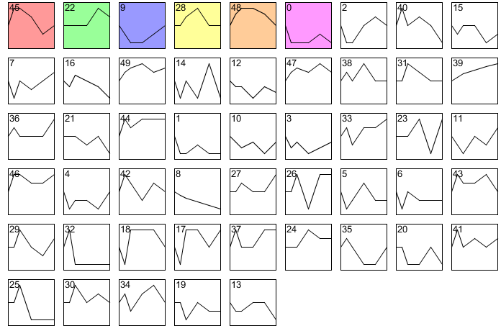
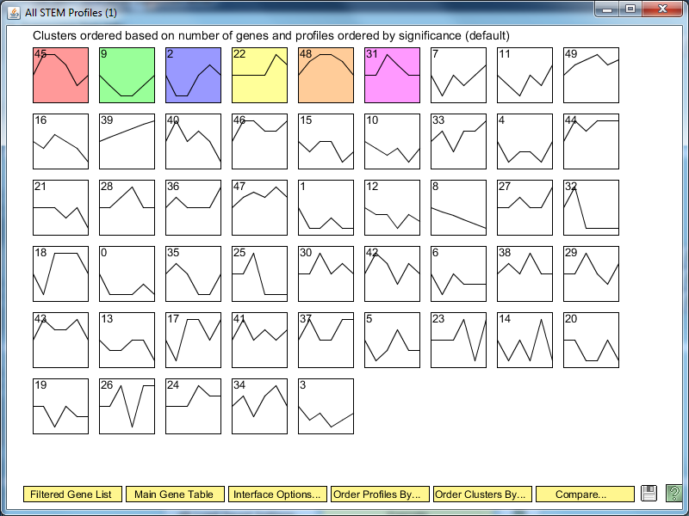
The Wild Type and Mutant Had Four Significant Profiles in Common
Wild Type
ΔGLN3
45 22 9 28 48 0
45 9 2 22 48 31

Slide 9
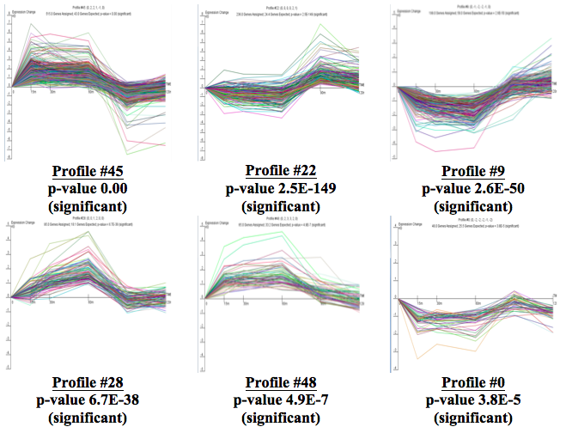
Profile #45 Had the Most Significant p-value for the Wild Type

Slide 10
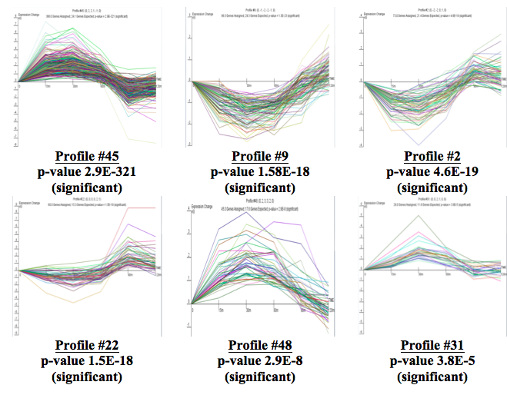
Profile #45 had the Most Significant p-value for the ΔGLN3 Mutant

Slide 11
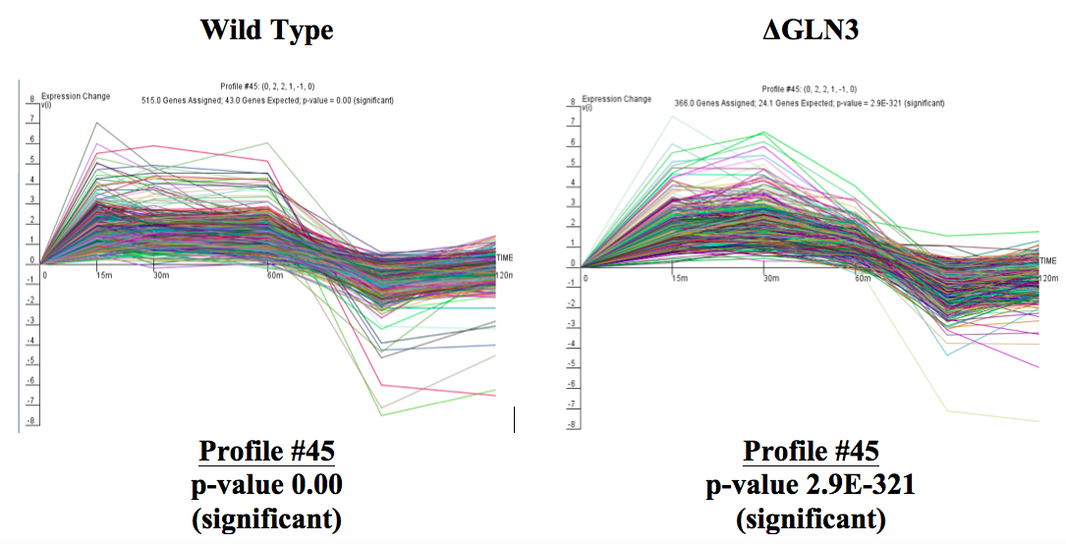
Profile 45 for Wild Type and ΔGLN3 Had a Pattern of Up-Regulated genes During the Significant Time points

Slide 12
Majority of GO list terms Dealt with Ribosome Biogenesis
All of the terms in both of our lists dealt with ribosome biogenesis, the process of making new ribosomes
Cold temperatures stabilize RNA secondary structures, which causes ribosomes to be immobilized, slowing the normal functions of the cell (transcription, translation)
To compensate, the cell makes more ribosomes
WILD TYPE | ΔGLN3
GO:0005730 GO:0022613 GO:0042254 GO:0016072 GO:0006364 GO:0034660 GO:0034470 GO:0031981 GO:0030684 GO:0043233 | GO:0022613 GO:0042254 GO:0005730 GO:0034470 GO:0006364 GO:0016072 GO:0030684 GO:0034660 GO:0031981 GO:0016070

Slide 13
Understand the Effect of Deleting gene, ΔGLN3, on the Cell’s Cold Shock Response
What transcription factors in S. cerevisiae control the cold shock response responsible for maintaining homeostasis?
Discuss the importance of cold shock, microarray analysis, ΔGLN3
Statistical analysis leading to profile selection
Choosing profile 45 to create a gene regulatory network
Statistical Analysis: p-values, Bonferroni, B-H tests
Clustering and Gene Oncology Analysis with STEM: STEM analysis, GO terms, significant profiles
Use YEASTRACT and GRNsight to determine which transcription factors regulate a cluster of genes and that “ONLY DNA binding” should be pursued further
Run model one where the threshold parameters b are not estimated and one where they are estimated
ΔGLN3 exhibits no meaningful control of cold shock response, other more connected genes should be studied.

Slide 14
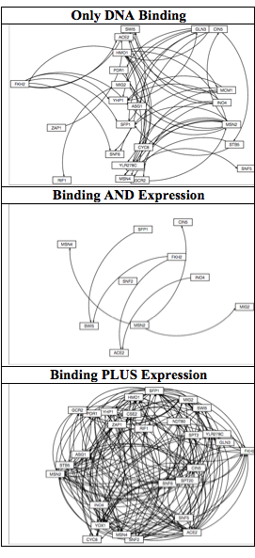
GRNSight Only DNA Binding Degree Had a Managable Gene Regulatory Network
“DNA binding AND expression evidence” required there to be both DNA binding and expression evidence present, there was the least amount of connections shown by the GRNsight maps.
There were not 15-30 transcription factors present
“DNA binding PLUS expression evidence” only required there to be DNA binding or expression evidence present, there was the most amount of connections shown by the GRNsight maps.

Slide 15
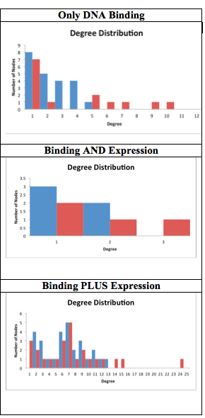
GRNSight DNA only binding had the optimal number of edges
“DNA binding PLUS expression evidence” 185 edges
“DNA binding AND expression evidence” 7 edges
“Only DNA binding evidence” 51 edges
The frequency distribution for “DNA binding AND expression evidence” had very little data, so it is difficult to come to conclusions.
The distribution for “DNA binding PLUS expression evidence” was roughly bell-shaped, with the most frequent number being 7.
“DNA binding AND expression evidence” had a skewed right plot with it being most common to have a low number of connections.

Slide 16
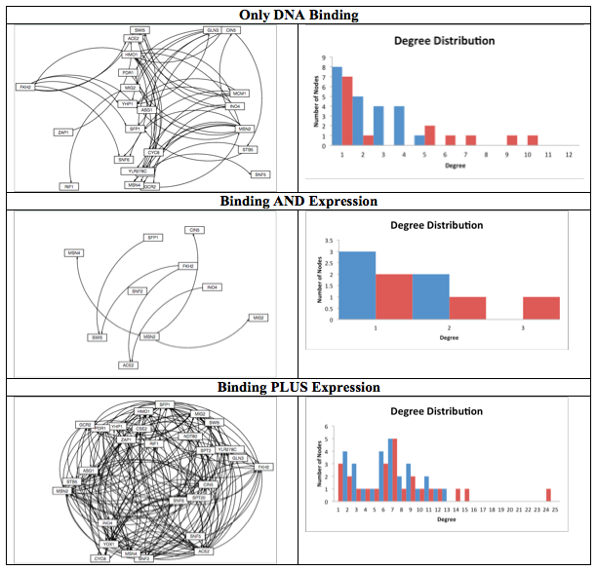
GRNSight “Only DNA Binding” Had Optimal Edges a gene regulatory network
The desired amount of edges was 40-60, so the “Only DNA binding evidence” was the most optimal for further study

Slide 17
Understand the Effect of Deleting gene, ΔGLN3, on the Cell’s Cold Shock Response
What transcription factors in S. cerevisiae control the cold shock response responsible for maintaining homeostasis?
Discuss the importance of cold shock, microarray analysis, ΔGLN3
Statistical analysis leading to profile selection
Choosing profile 45 to create a gene regulatory network
Statistical Analysis: p-values, Bonferroni, B-H tests
Clustering and Gene Oncology Analysis with STEM: STEM analysis, GO terms, significant profiles
Use YEASTRACT and GRNsight to determine which transcription factors regulate a cluster of genes and that “ONLY DNA binding” should be pursued further
Run model one where the threshold parameters b are not estimated and one where they are estimated
ΔGLN3 exhibits no meaningful control of cold shock response, other more connected genes should be studied.

Slide 18
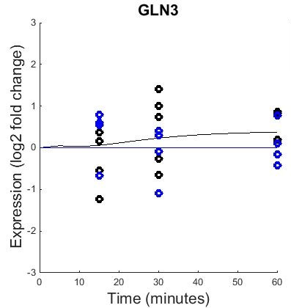
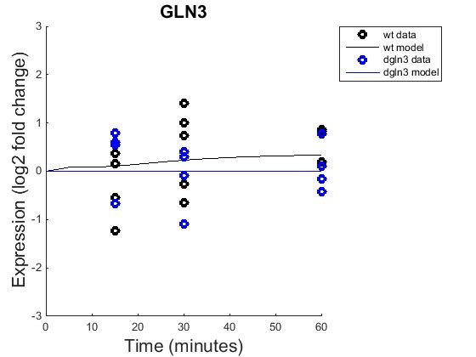
GLN3 (b=0 on the left, b=1 right)

Slide 19
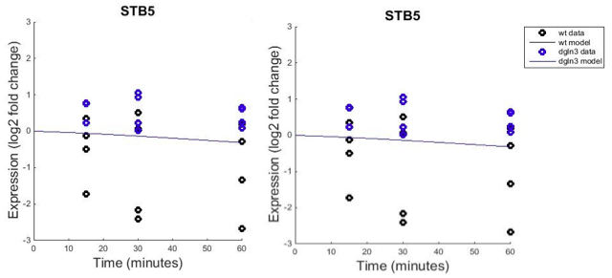
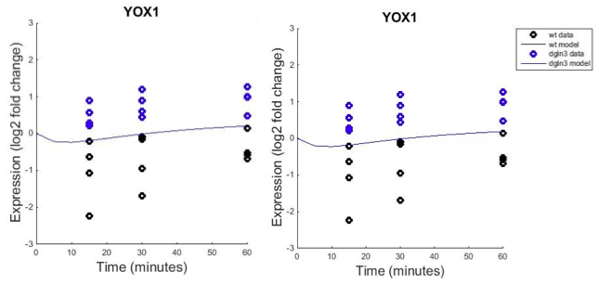
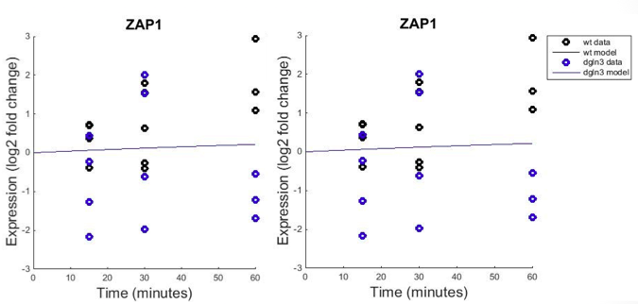
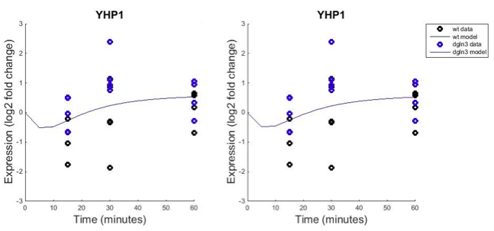
The Wild Type and ΔGLN3 Strain Diverge Dramatically, But the Model Does Not and Therefore Does Not Fit the Individual Strain Data Well

Slide 20
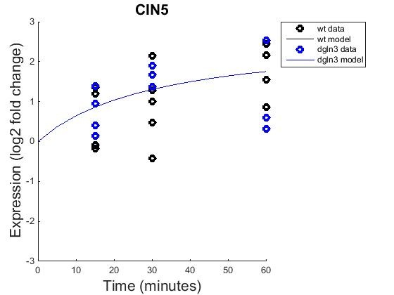

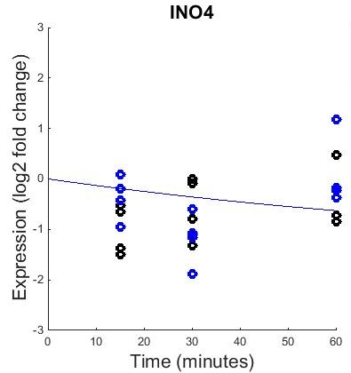

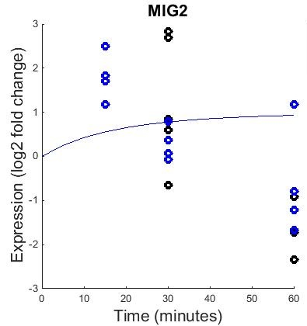

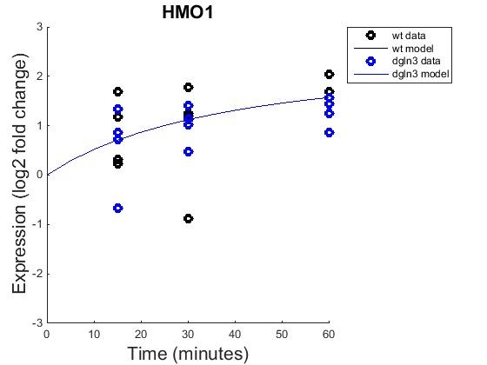

Many Genes Showed Non-Zero Dynamics within the Model
CIN5, HMO1, INO4, MIG2, MSN4, PDR1, SFP1, SNF5, and YLR278C
showed non-zero dynamics within the model

Slide 21
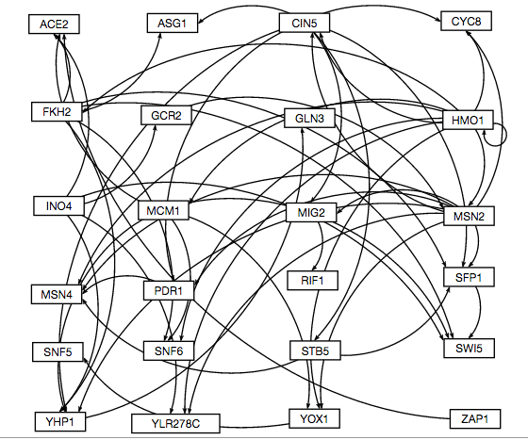
GRNsight Map for both Inputs Showed GLN3 Was Not Well Connected

Slide 22
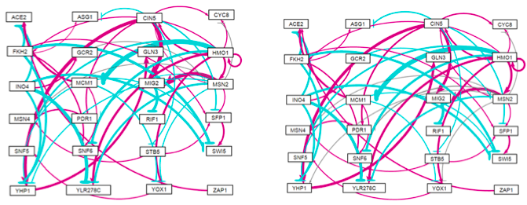
Comparison of GRNsight outputs
b=1 on the left, b=0 on the right

Slide 23
Bar Graph comparing fixed and estimated weights
ControllerGeneA->TargetGeneB

Slide 24
Production Rates of Fixed vs. Estimated b

Slide 25
Understand the Effect of Deleting gene, ΔGLN3, on the Cell’s Cold Shock Response
What transcription factors in S. cerevisiae control the cold shock response responsible for maintaining homeostasis?
Discuss the importance of cold shock, microarray analysis, ΔGLN3
Statistical analysis leading to profile selection
Choosing profile 45 to create a gene regulatory network
Statistical Analysis: p-values, Bonferroni, B-H tests
Clustering and Gene Oncology Analysis with STEM: STEM analysis, GO terms, significant profiles
Use YEASTRACT and GRNsight to determine which transcription factors regulate a cluster of genes and that “ONLY DNA binding” should be pursued further
Run model one where the threshold parameters b are not estimated and one where they are estimated
ΔGLN3 exhibits no meaningful control of cold shock response, other more connected genes should be studied.

Slide 26
ΔGLN3 exhibits no meaningful control of cold shock response, other genes should be studied
GLN3 was only controlled by one gene and controlled no genes
The fact that GLN3 did not activate or repress any other genes means that there was no real effect when it was deleted
There does seem to be a relationship between goodness of fit and noise in the data.
Any future direction should not involve GLN3, but rather a more connected gene, such as CIN5, MSN4, or SPF1

Slide 27
Acknowledgments
We would like to thank Professor Dahlquist and Fitzpatrick for their insight and assistance in creating our model
We would also like to thank our wonderful classmates, for constructive partnerships and help, although we were examining different strains

Slide 28
Works Cited
Alberts, B. (2002). Studying Gene Expression and Function. In Molecular biology of the cell (4th ed.). New York: Garland Science.
Aguilera J, Randez-Gil F, Prieto JA. Cold response in Saccharomyces cerevisiae: new functions for old mechanisms. FEMS Microbiol Rev 2007;31:327-41
Al-Fageeh, M. B., & Smales, C. M. (2006). Control and regulation of the cellular responses to cold shock: the responses in yeast and mammalian systems. Biochemical Journal, 397(Pt 2), 247–259. doi:10.1042/BJ20060166
Cherry JM, Hong EL, Amundsen C, Balakrishnan R, Binkley G, Chan ET, Christie KR, Costanzo MC, Dwight SS, Engel SR, Fisk DG, Hirschman JE, Hitz BC, Karra K, Krieger CJ, Miyasato SR, Nash RS, Park J, Skrzypek MS, Simison M, Weng S, Wong ED (2012) Saccharomyces Genome Database: the genomics resource of budding yeast. Nucleic Acids Res. Jan;40(Database issue):D700-5.
Tai, S. L., Daran-Lapujade, P., Walsh, M. C., Pronk, J. T., & Daran, J.-M. (2007). Acclimation of Saccharomyces cerevisiae to Low Temperature: A Chemostat-based Transcriptome Analysis. Molecular Biology of the Cell, 18(12), 5100–5112. doi:10.1091/mbc.E07-02-0131
Thieringer, H. A., Jones, P. G. and Inouye, M. (1998), Cold shock and adaptation. Bioessays, 20: 49–57. doi: 10.1002/(SICI)1521-1878(199801)20:1<49::AID-BIES8>3.0.CO;2-N

