Slide 1
Model-Driven Engineering of RNA Devices to Quantitatively Program Gene Expression
James M Carothers, Jonathan A Goler, Darmawi Juminaga, Jay D Keasling
Presented by Lauren Berry
April 25, 2012

Slide 2
Goal
RNA-regulated devices with predictable activity
Allow programmable pathways/circuits
Ribozyme-regulated expression devices (rREDs)
Aptamer-regulated expression devices (aREDs)
Notes:
Design-driven approach to create
rREDs are static
aREDs are dynamic, ligand-controlled
NOPE: Both rREDs and aREDS increase transcript half-life and therefore expression

Slide 3
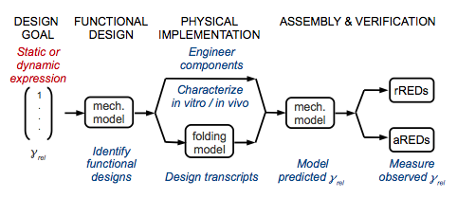
Design-Driven Engineering
Notes:
Identify the ones that meet specification, characterize the components individually (including RNA folding simulations), predict gamma rel and compare to observed output

Slide 4
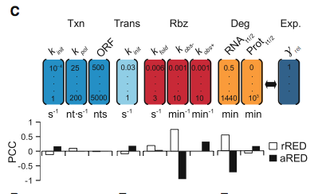
Impact of Design Variables
Identify Functional Designs
Notes:
Monte Carlo Simulations to find PCC (partial Correlation coefficients) with gene expression
K fold = ribozyme folding
K obs- = (-) ligand ribozyme catalysis
RNA t½ = RNA half life

Slide 5
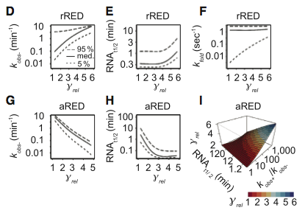
Impact of Design Variables
Identify Functional Designs
Notes:
rRED magnitude of response depended on timescale of rbz folding and cleavage relative to transcript degradation
Aptz ligand-activation ratio (kobs+/kobs-) and RNA t½ explained 85% variation in expression
Transcript design:
Structures formed with RBS couldn’t prevent initiation
Rbz and aptz folding was fast compared to RNA t½

Slide 6
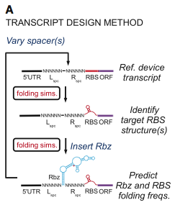
Design Method
Physical Implementation
Notes:
Looked for spacers that allowed correct folding
Lspc, Rspc = left, right spacers
Also wanted to ensure interaction

Slide 7
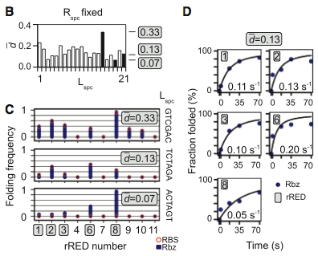
Folding Characterization
Physical Implementation
Notes:
Transcripts evaluated by distance score d (larger d = improved RBS and rbz/aptz folding probabilities)
Illustrated by d plotted for 21 Lspc variants
High, median, and low matched with rREDs and folding freq measured
Median d rREDs were only ones predicted to fold into target structures

Slide 8
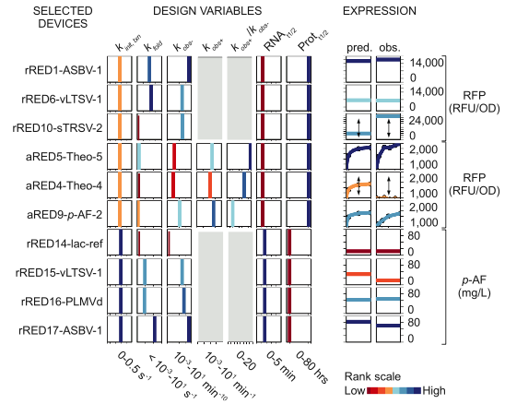
Expression Profiles
Assembly & Verification
Notes:
Just selected devices (others in supplementary)
Everything matches well, considering the variation of genes being expressed
rRED1 designed to be highest
Things with arrows means that they had divergence from model
kfold < 0, which makes it much harder to predict the expression profile (fall outside domain of model)

Slide 9
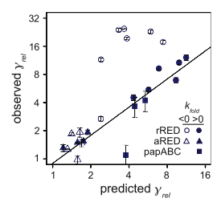
Predicted vs. Observed Expression
Assembly & Verification
Notes:
Gamma rel = expression
Filled in = kfold > 0 (predictable)
Not filled in = kfold < 0 (not predictable)
r = 0.94

Slide 10
Conclusions
Expression mediated by rREDs and aREDs correlated with the predicted levels
Folding was important to programmable function
Functional aREDs and rREDs can be made from component parts

Slide 11
Significance
Program expression of large number of genes
Can be used to:
Study natural mRNA activity
Control engineered pathways or circuits
Implement new genetic programs

Slide 12
Concerns
Not much description on rRED/aRED mechanism
Only characterized either rREDs or aREDs, not both
Essential information only in supplemental material

Slide 13
Questions?

Slide 14
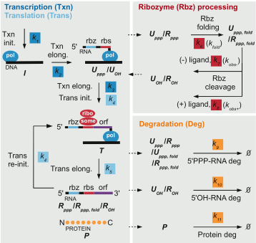
The System
Identify Functional Designs
Notes:
Both rREDs and aREDS increase transcript half-life and therefore expression

