Slide 1
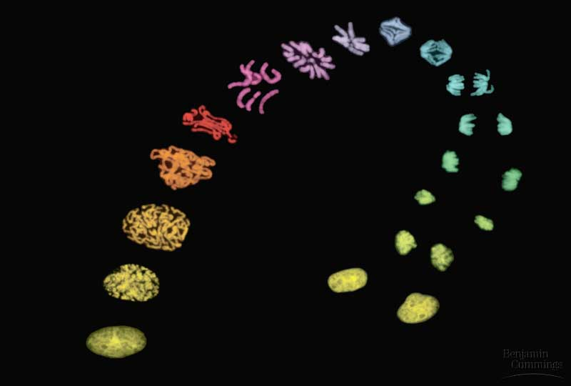
Figure 12.0 Mitosis

Slide 2
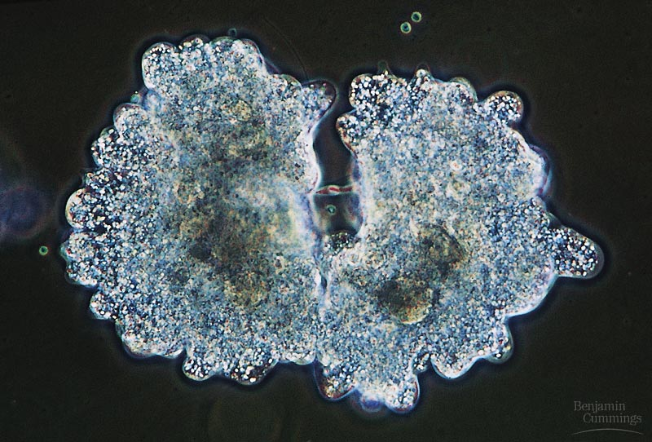
Figure 12.1a The functions of cell division: Reproduction

Slide 3
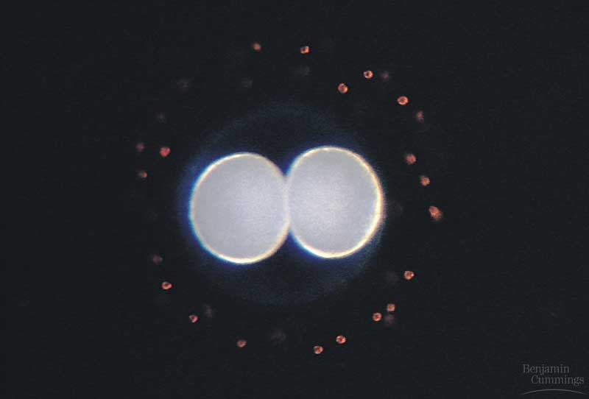
Figure 12.1b The functions of cell division: Growth and development

Slide 4
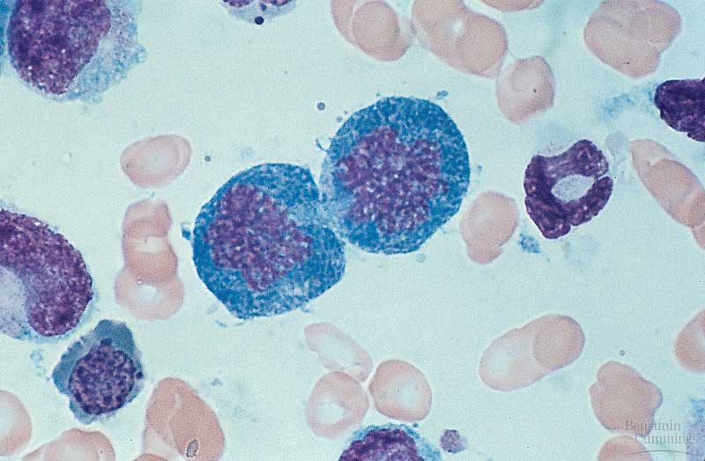
Figure 12.1c The functions of cell division: Tissue renewal

Slide 5
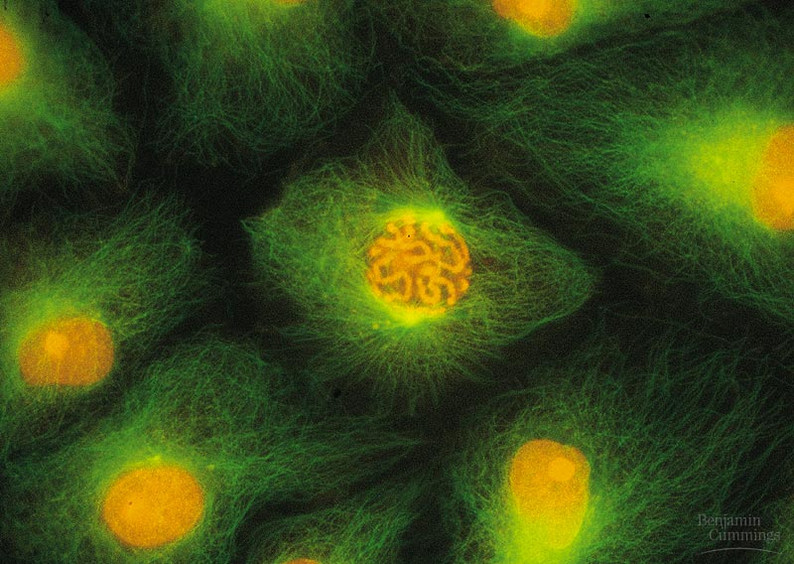
Figure 12.2 Eukaryotic chomosomes

Slide 6
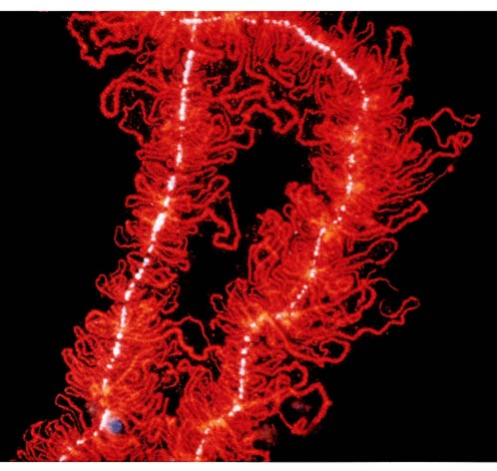
Figure 19.0 Chromatin in a developing salamander ovum

Slide 7
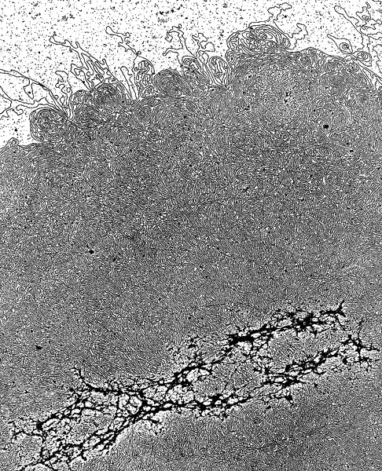
Figure 19.x1a Chromatin

Slide 8
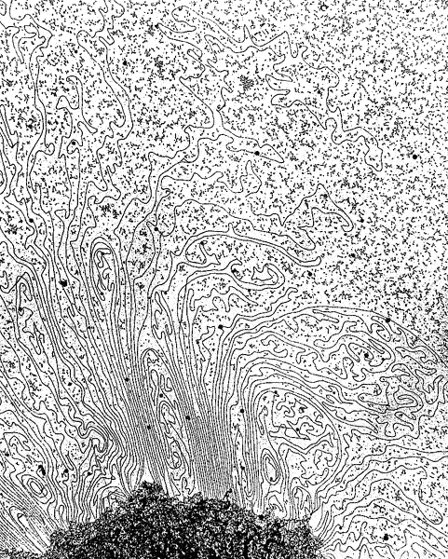
Figure 19.x1b Chromatin, detail

Slide 9
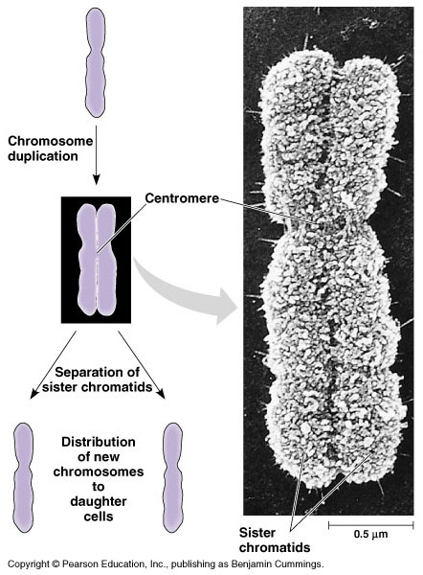
Figure 12.3 Chromosome duplication and distribution during mitosis

Slide 10
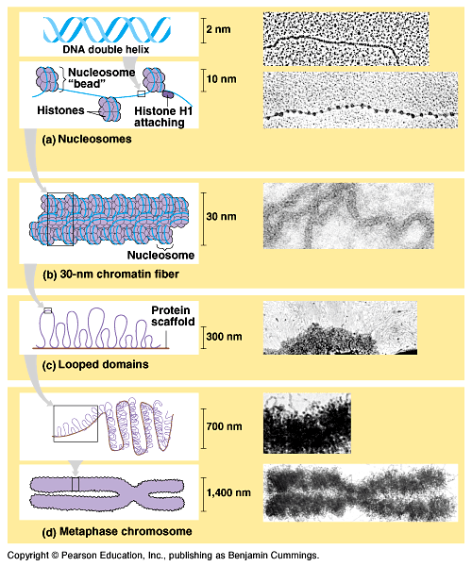
Figure 19.1 Levels of chromatin packing

Slide 11
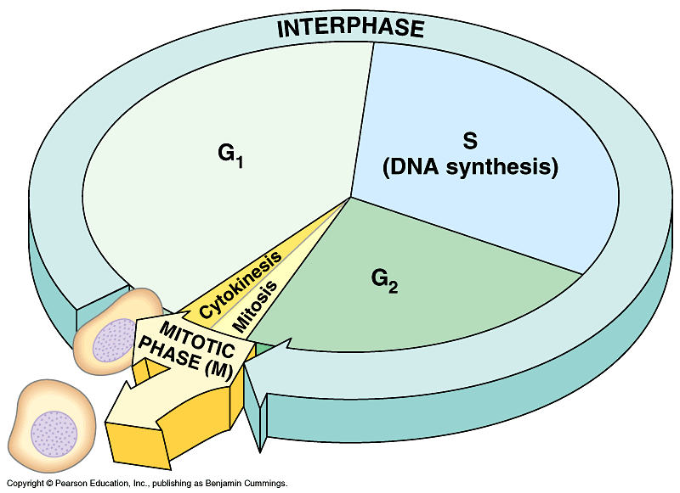
Figure 12.4 The cell cycle

Slide 12
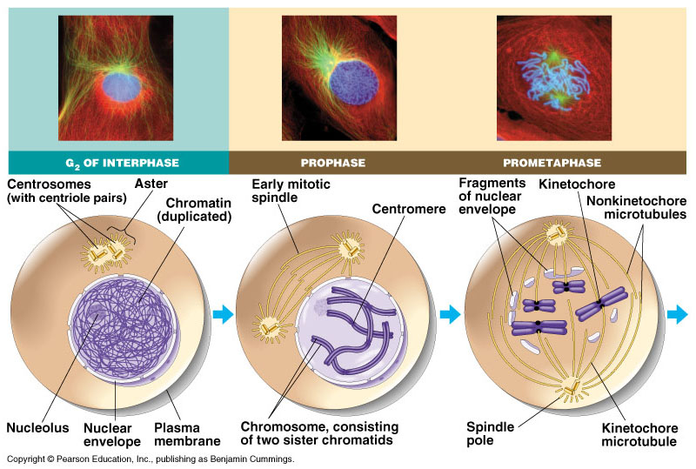
Figure 12.5 The stages of mitotic cell division in an animal cell: G₂ phase; prophase; prometaphase

Slide 13
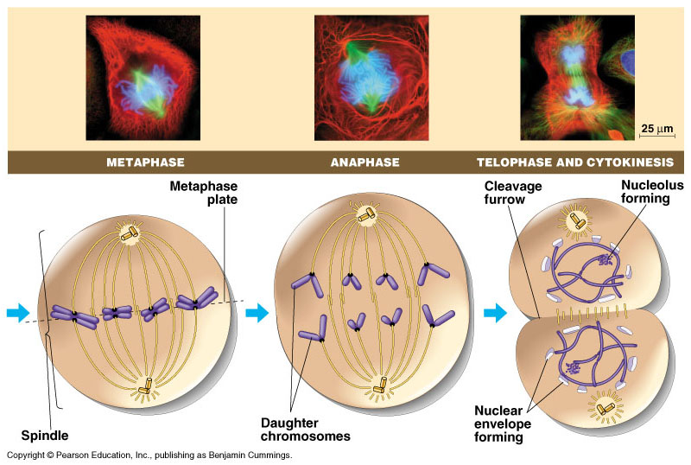
Figure 12.5 The stages of mitotic cell division in an animal cell: metaphase; anaphase; telophase and cytokinesis.

Slide 14
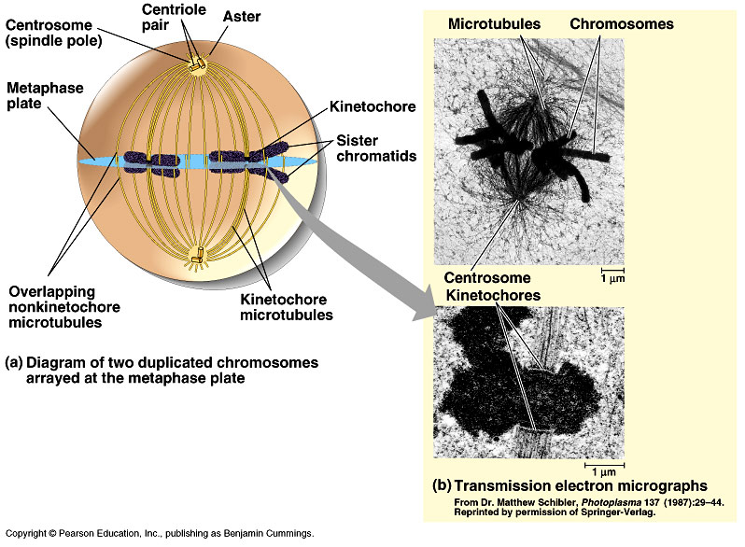
Figure 12.6 The mitotic spindle at metaphase

Slide 15
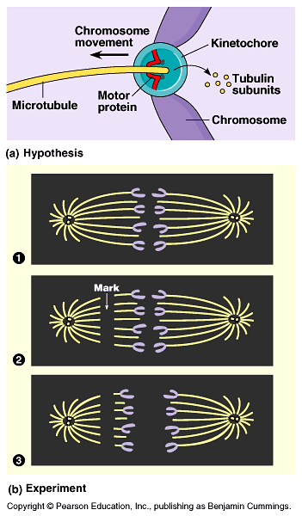
Figure 12.7 Testing a hypothesis for chromosome migration during anaphase

Slide 16
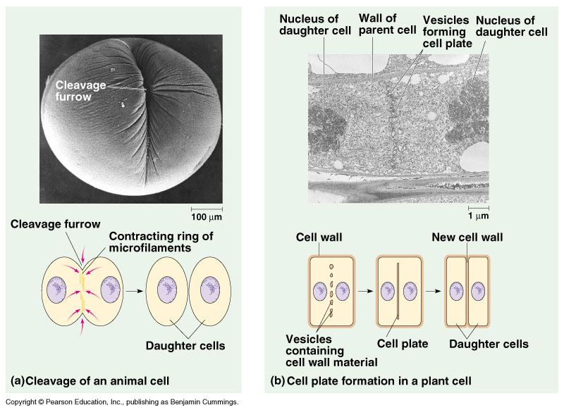
Figure 12.8 Cytokinesis in animal and plant cells

Slide 17
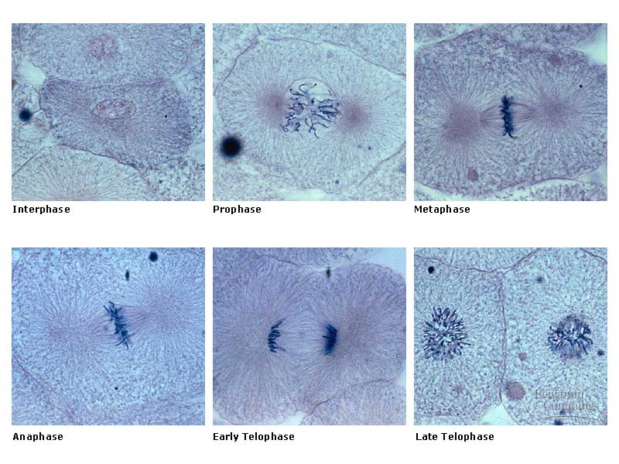
Figure 12.5x Mitosis

Slide 18
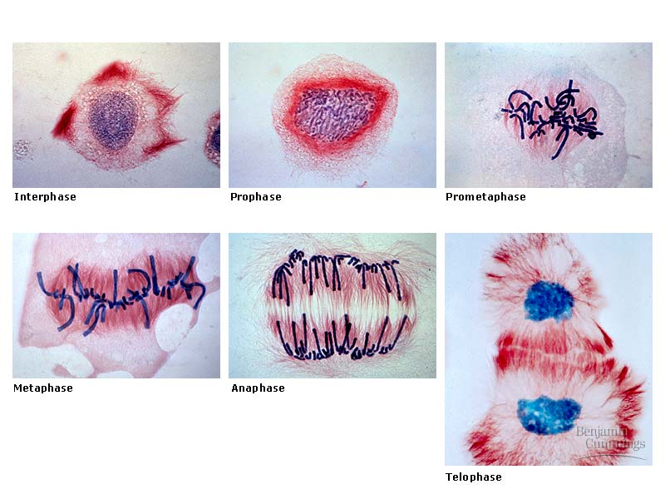
Figure 12.9 Mitosis in a plant cell

Slide 19
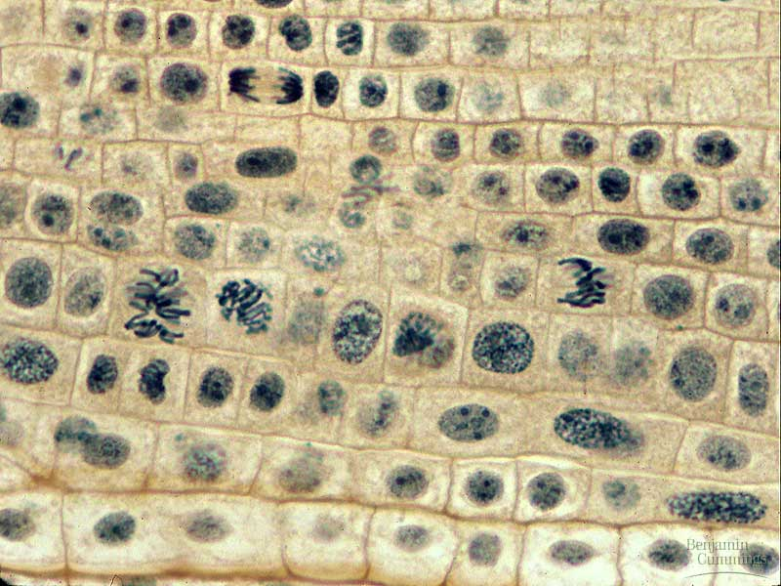
Figure 12-09x Mitosis in an onion root

Slide 20
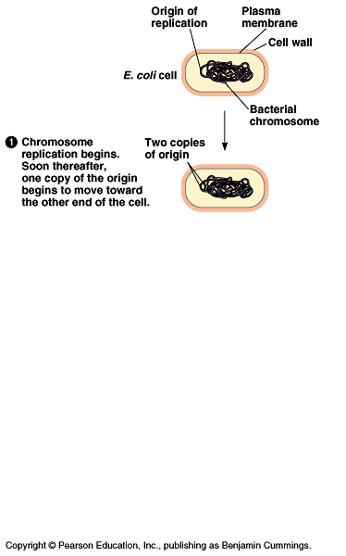
Figure 12.10 Bacterial cell division (binary fission) (Layer 1)

Slide 21
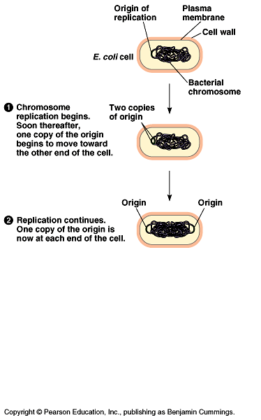
Figure 12.10 Bacterial cell division (binary fission) (Layer 2)

Slide 22
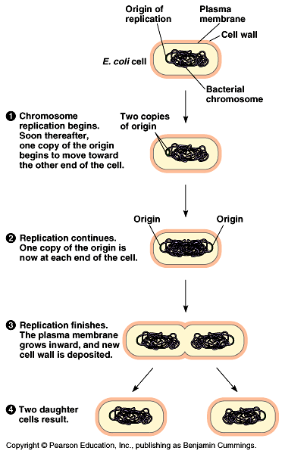
Figure 12.10 Bacterial cell division (binary fission) (Layer 3)

Slide 23
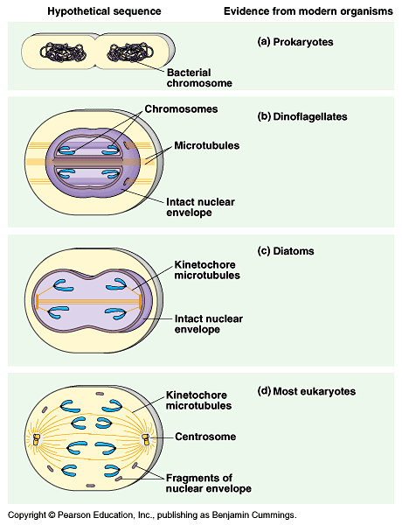
Figure 12.11 A hypothesis for the evolution of mitosis

Slide 24
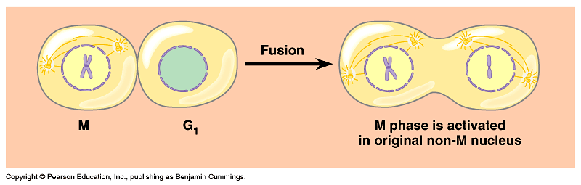
Figure 12.12 Evidence for cytoplasmic chemical signals in cell cycle regulation

Slide 25
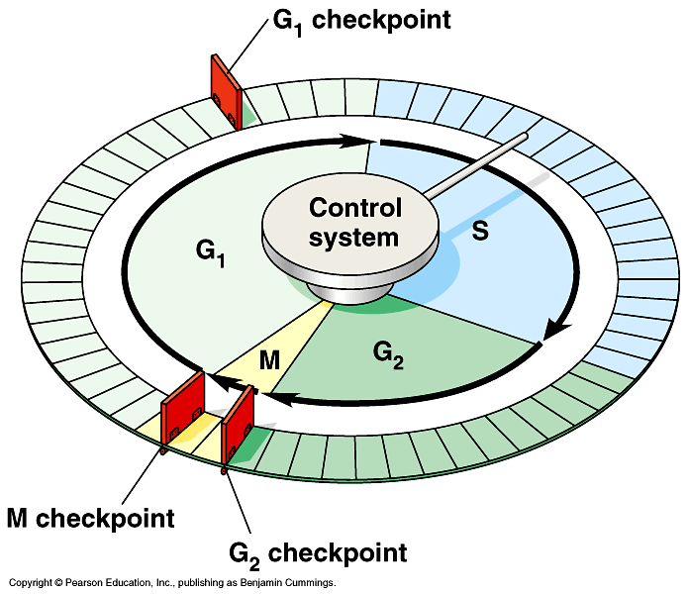
Figure 12.13 Mechanical analogy for the cell cycle control system

Slide 26
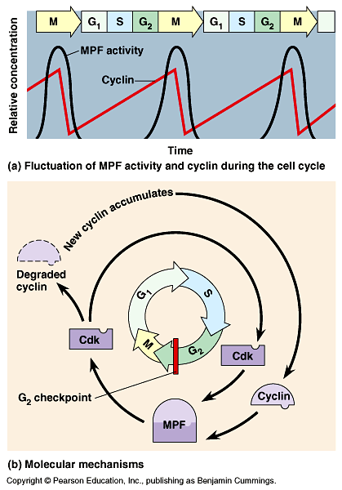
Figure 12.14 Molecular control of the cell cycle at the G₂ checkpoint

Slide 27
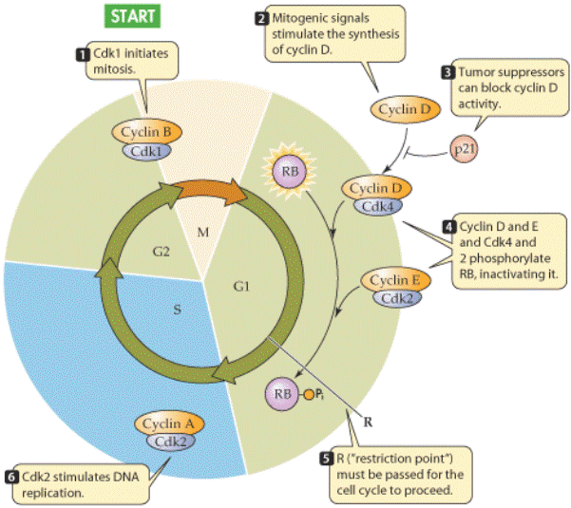

Slide 28
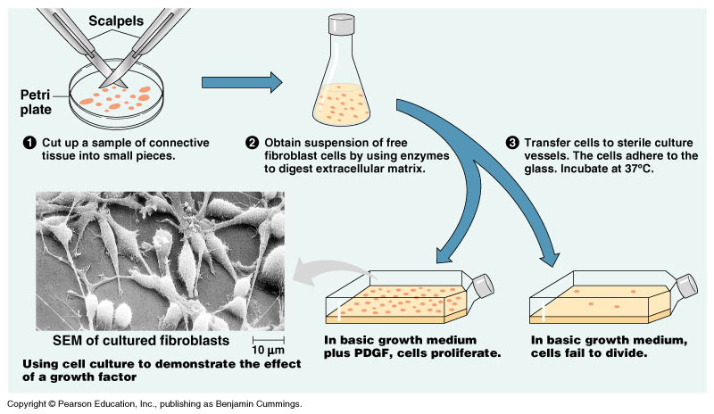
Figure 12.15 The effect of a growth factor on cell division

Slide 29
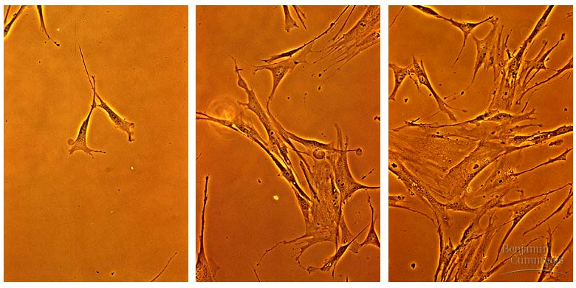
Figure 12.15x Fibroblast growth

Slide 30
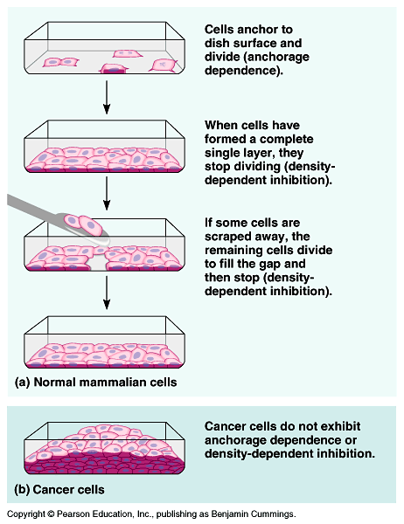
Figure 12.16 Density-dependent inhibition of cell division

Slide 31
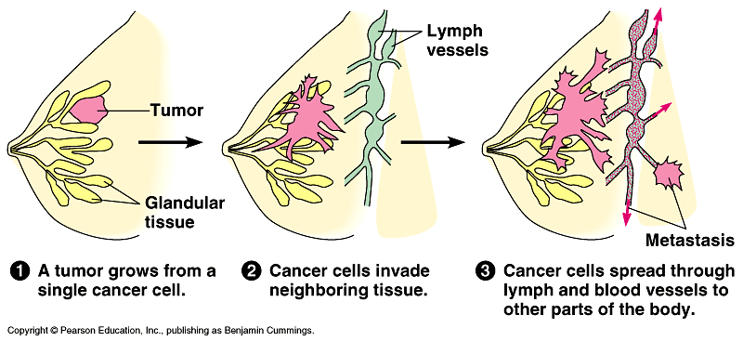
Figure 12.17 The growth and metastasis of a malignant breast tumor

Slide 32
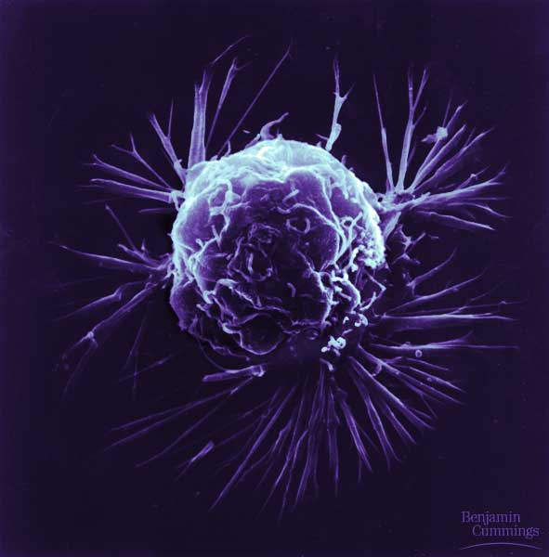
Figure 12-17x1 Breast cancer cell

Slide 33
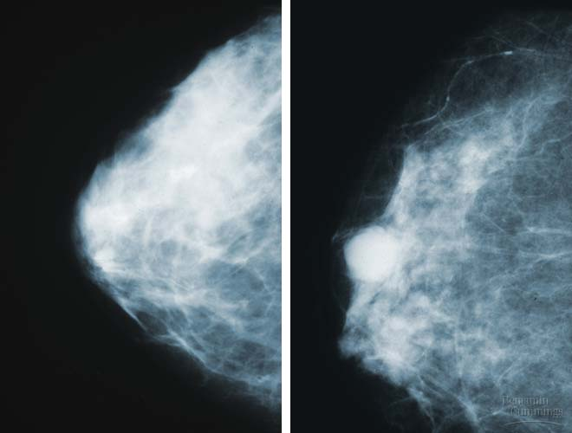
Figure 12-17x2 Mammogram: normal (left) and cancerous (right)

Slide 34
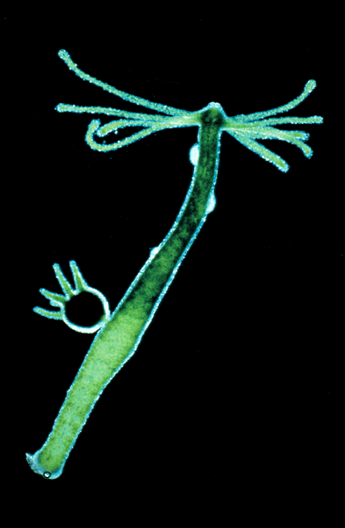
Figure 13.1 The asexual reproduction of a hydra

Slide 35
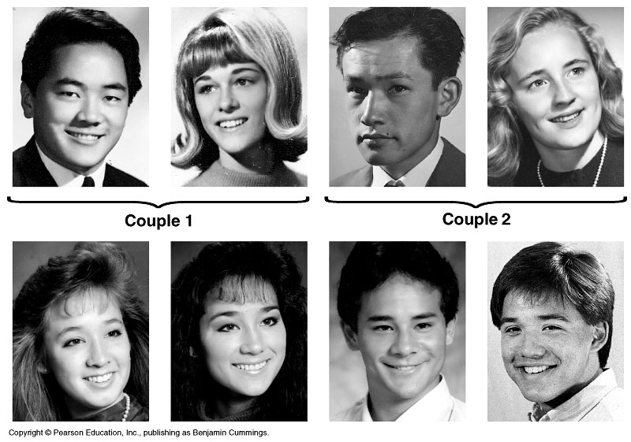
Figure 13.2 Two families

Slide 36
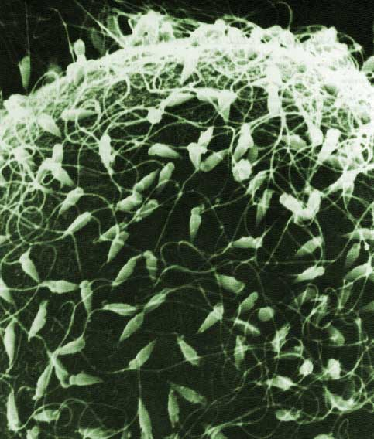
Figure 13.x1 SEM of sea urchin sperm fertilizing egg

Slide 37
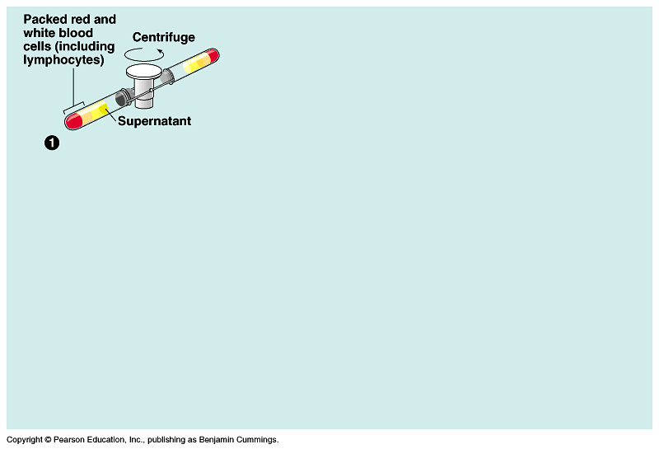
Figure 13.3 Preparation of a human karyotype (Layer 1)

Slide 38
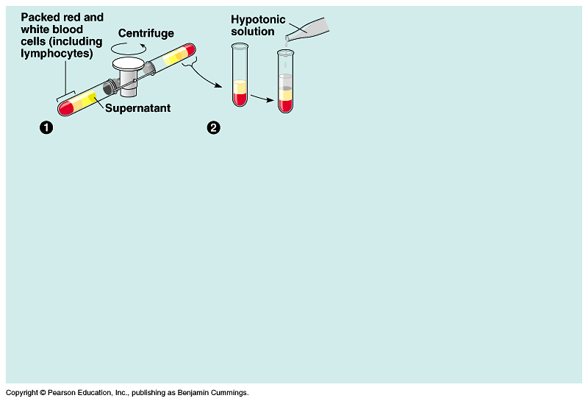
Figure 13.3 Preparation of a human karyotype (Layer 2)

Slide 39
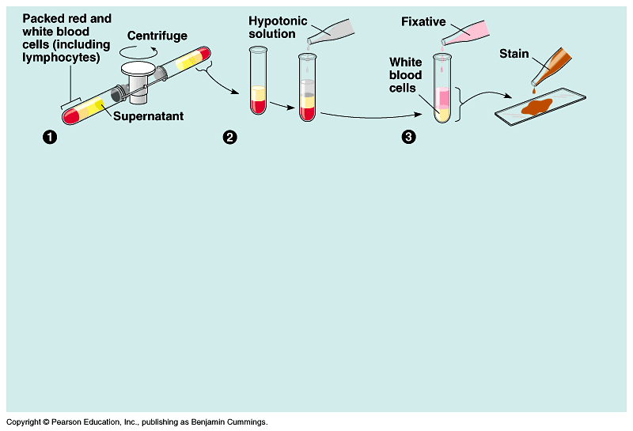
Figure 13.3 Preparation of a human karyotype (Layer 3)

Slide 40
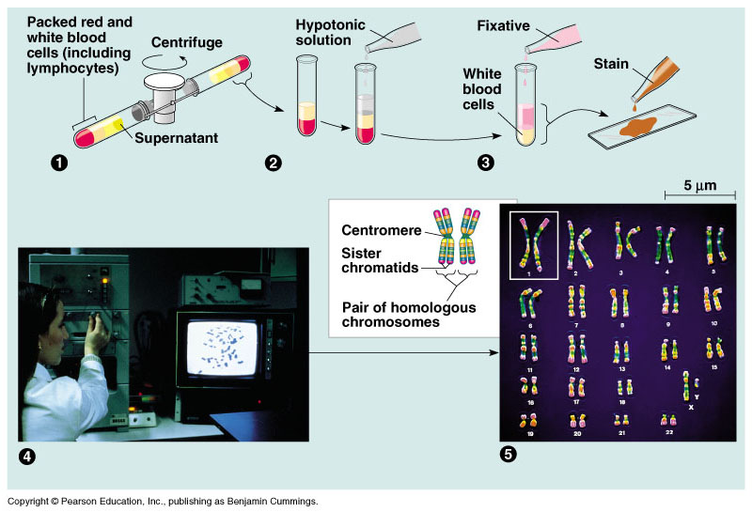
Figure 13.3 Preparation of a human karyotype (Layer 4)

Slide 41
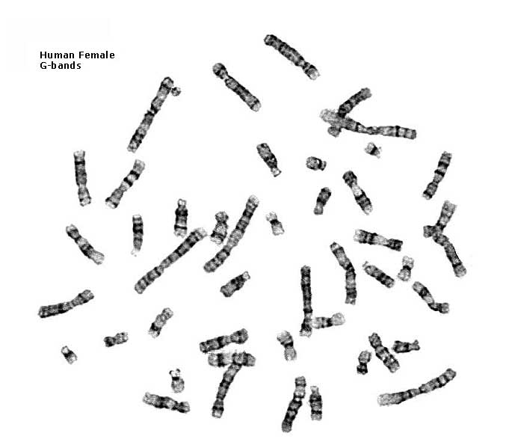
Figure 13.x2 Human female chromosomes shown by bright field G-banding

Slide 42
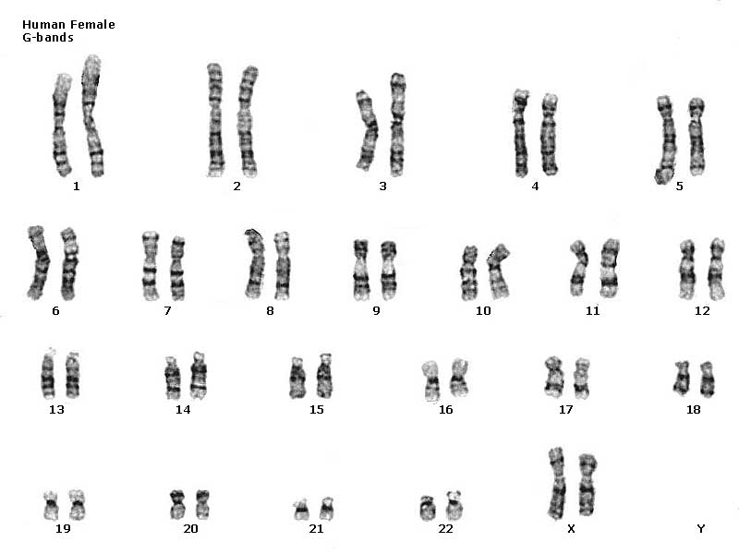
Figure 13.x3 Human female karyotype shown by bright field G-banding of chromosomes

Slide 43
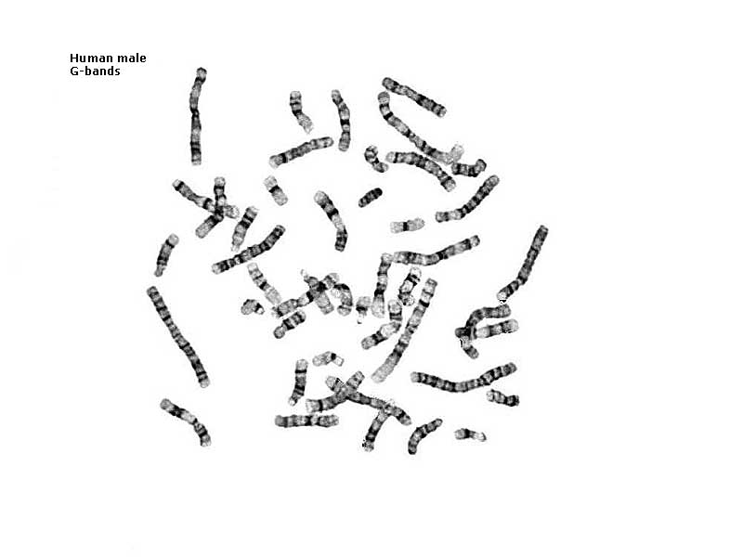
Figure 13.x4 Human male chromosomes shown by bright field G-banding

Slide 44
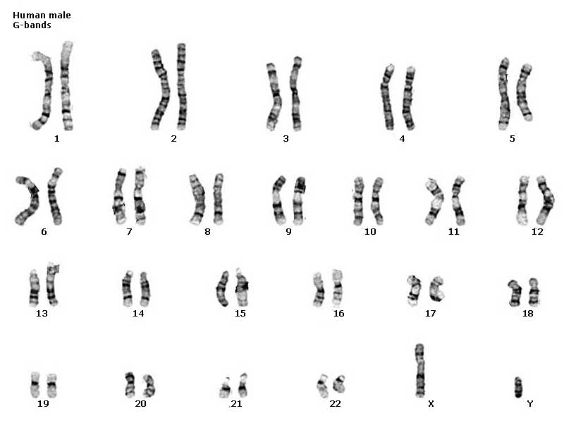
Figure 13.x5 Human male karyotype shown by bright field G-banding of chromosomes

Slide 45
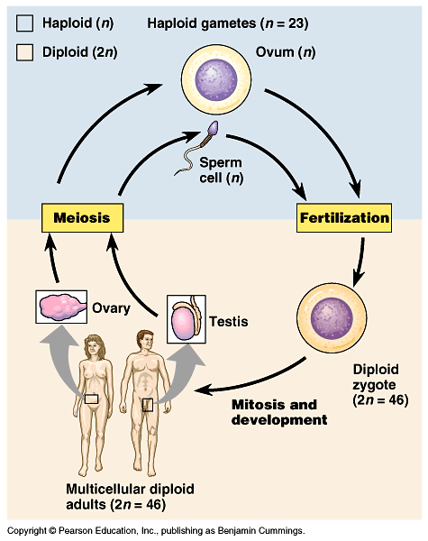
Figure 13.4 The human life cycle

Slide 46
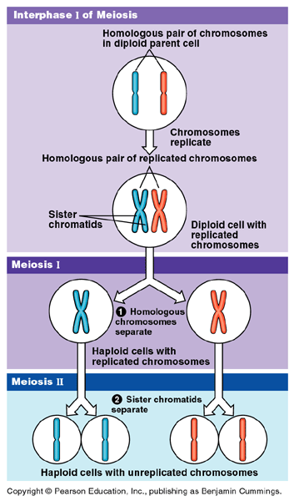
Figure 13.6 Overview of meiosis: how meiosis reduces chromosome number

Slide 47
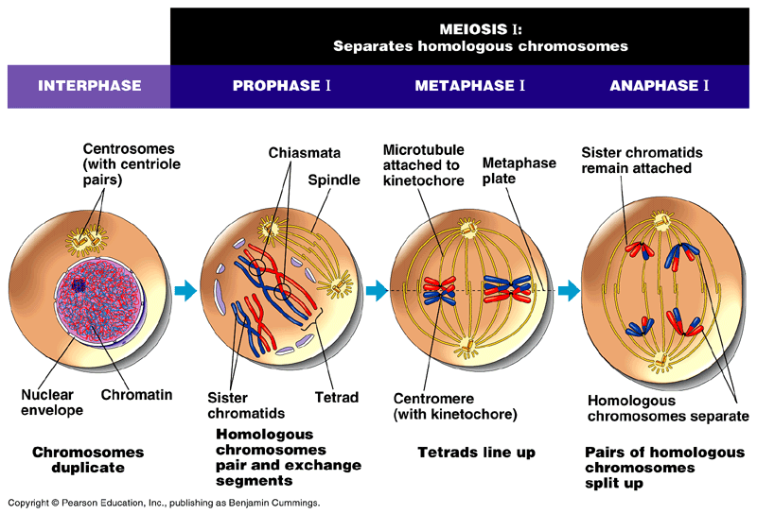
Figure 13.7 The stages of meiotic cell division: Meiosis I

Slide 48
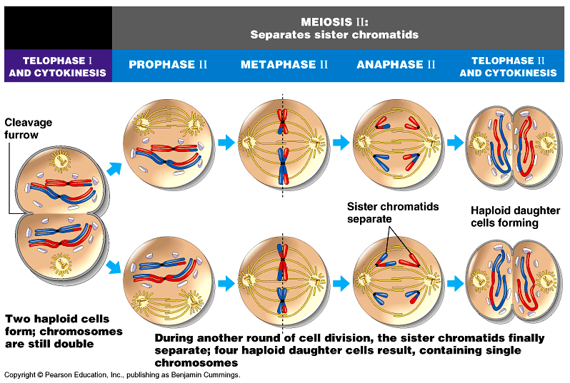
Figure 13.7 The stages of meiotic cell division: Meiosis II

Slide 49
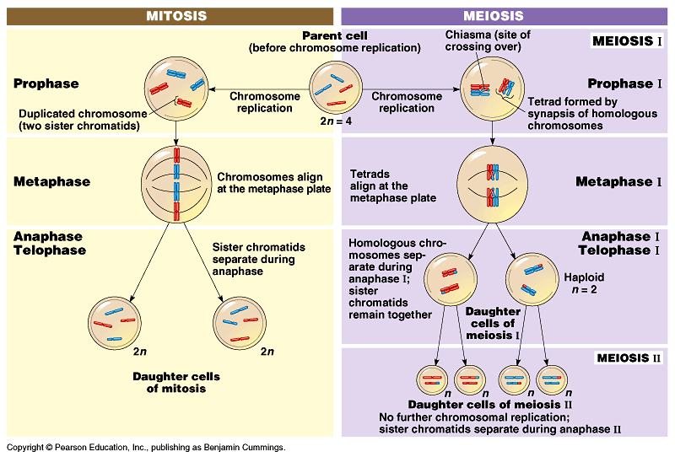
Figure 13.8 A comparison of mitosis and meiosis

Slide 50
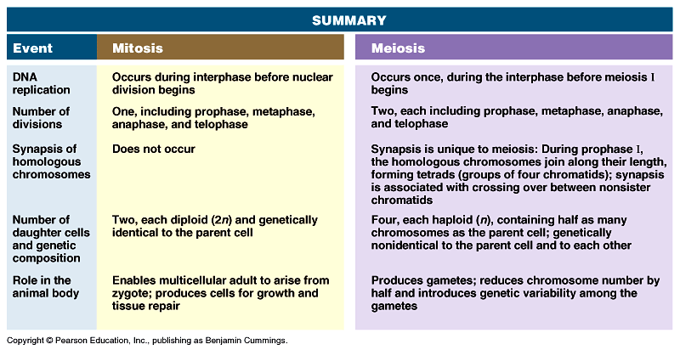
Figure 13.8 A comparison of mitosis and meiosis: summary

Slide 51

Figure 13.9 The results of alternative arrangements of two homologous chromosome pairs on the metaphase plate in meiosis I

Slide 52

Figure 13.10 The results of crossing over during meiosis

Slide 53

Figure 46.11 Spermatogenesis

Slide 54

Figure 46.12 Structure of a human sperm cell

Slide 55

Figure 46.13a Oogenesis

Slide 56

Figure 46.13b Oogenesis

