Slide 1
DNA nanomechanics allows direct digital detection of complementary DNA and microRNA targets
Sudhir Husale, Henrik H. J. Persson & Ozgur Sahin
Nature, 13 December 2009
Sachin Shinde & Yuan Zhao

Slide 2
Motivation
Modern genomics requires the detection and quantification of RNA and DNA binding to profile gene expression
Throughput can be increased through conventional microarrays
Many techniques developed for hybridization quantification:
  Measure intensity from labeled cDNA/cRNA, but costly...
  Cheaper label-free methods exist, but can only detect concentration at the femtomolar level…
  Need cheap method that detects at low concentration!
Solution: Use specific nanoscale phenomena of DNA/RNA to measure attomolar concentrations

Slide 3
Nanoscale Phenomena
Many possible choices exist
Past research examples include:
  Surface stress
  Added mass of molecules
  Electrical Forces
  Hydration-Induced Surface Tension
Measure the elastic modulus of DNA to check for hybridization
  Elastic Modulus = Stress/Strain

Slide 4
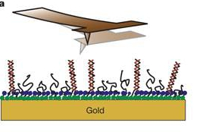
Instrumentation Design
Use a recently-developed variant of tapping AFM
  Real-Time Forces: sub-microsecond resolution with torsional cantilever
  High Spatial Resolution: nanometer-scale
  Large Dynamic Range: 1 MPa to 10 GPa
  Tapping Force: 30nN-50nN
  Set-Point Amplitude: 60nm
Place DNA probes on gold substrate
  Attached via mercapto-hexanol
Force increases at a rate proportional to
stiffness

Slide 5
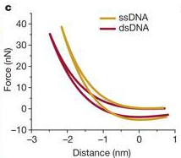
Distinguishing Stiffness Signature
Higher stiffness seen in ssDNA compared to dsDNA
Due to mechanical properties and conformations
  Conformation affects stiffness
  Most ssDNA lies flat on surface
  If not, tapping flattens it
  Really measuring stiffness of gold substrate
Verified with height measurements
Notes:
Verified identification of DNA molecules via series of experiments with non-complementary / complementary targets @ varying concentrations.
Also, verified with height measurements (hybridized molecules seem taller); greater height makes spot sizes larger than physical size of molecules due to tip convolution – this requires nM to mM however due to sensitivity to roughness of surface (needs atomically flat substrates)

Slide 6
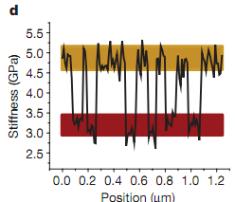
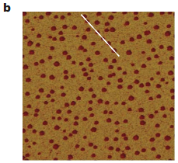
Distinguishing Stiffness Signature
Measured interaction forces of ssDNA and dsDNA on gold-coated silicon substrate
Distinct stiffness signatures
  Well separated
  Sufficiently uniform

Slide 7
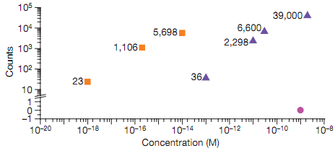
Characterizing Detection Limits
Varying target concentration and immobilization area
Lower target concentrations and larger immobilization areas produce fewer hybridized molecules
Detection limits from 1nM to 1aM target concentration
Three to eight orders of magnitude enhancement
Notes:
Varied target concentration from nM to aM, and tested 5mm (triangles) and 50µm (squares) areas.
… per given scan area (of 10 µm wide)
No hybridized molecules are found with the non-matching sequence.

Slide 8
Measuring tumor-derived miRNAs
Analyzing total RNA extracts from tumor tissues requires:
  Large amounts of starting material
  Additional steps for reverse transcription and amplification
Small molecules (ie miRNAs) not easily amplified with conventional techniques
Nanomechanical AFM bypasses these obstacles!
miRNA expression patterns can be used to predict tissue origins in metastatic tissues
  miR-205
  miR-194-1 / miR-194-2
Notes:
Done with performance characterization, now to test against a real sample with complex biological background….
This approach can simplify the process and allows a way to analyze miRNA since it can detect hybridization activity much, much lower concentrations.
Citing Rosenfield paper, miRNAs expression patterns can be used to identify tissue originsof metatstic tumors

Slide 9
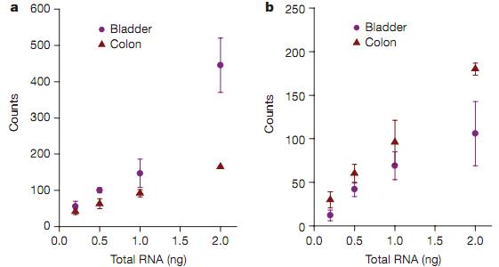
Measuring tumor-derived miRNAs
Results match those of Rosenfeld, et al. 2008
  miR-205 expression levels are higher in bladder tumor
  miR-194 is higher in colon tumor
Notes:
Verified results with conventional microarray analysis of tumor samples using a kit from Invitrogen
Numbers obtained are broadly in agreement with numbers derived from q-PCR (real-time)
Note that RNA-DNA mechanical profile ~ signature to DNA-DNA

Slide 10
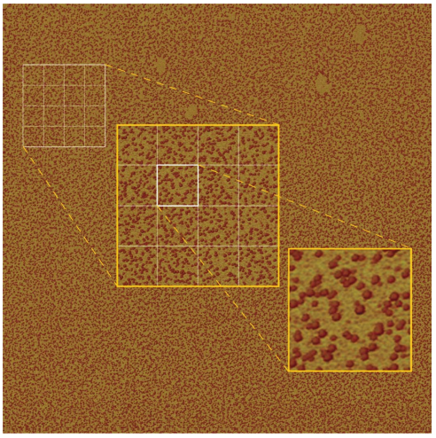
High-throughput Multiplexing
5mm² stiffness map generated in 2hrs without scan speed optimization
Multiplexing sufficient for whole-genome expression profiling
Capable of utilizing probes:
  With secondary structures
  Mismatches
  Unusual base pairing
  Free termini

