Slide 1
Programming cells by mutliplex genome engineering and accelerated evolution
Harris H. Wang, Farren J. Isaacs, Peter A. Carr, Zachary Z. Sun, George Xu, Craig R. Forest, George M. Church
Raven Reddy
March 30, 2011

Slide 2
MAGE Technology
Wanted to modify genomes on large, parallel scale
Automated method to modify many locations
Incorporate ssDNA oligos onto lagging strand of replication fork
Create genetic modifications in 30% of cells every 2-2.5 hrs

Slide 3
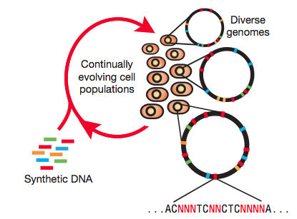
MAGE Technology

Slide 4
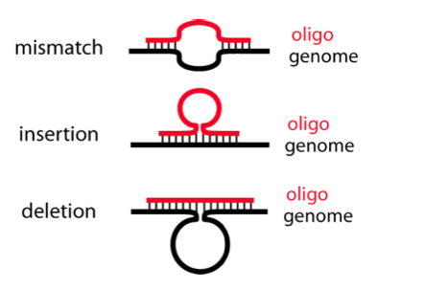
MAGE Technology

Slide 5
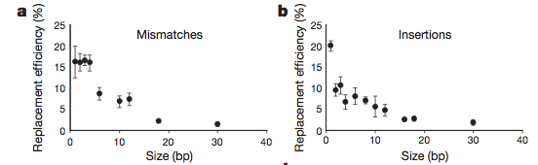
Quantifying Efficiency
Mismatch or Insertion efficiency proportional to amount of homologous sequence

Slide 6
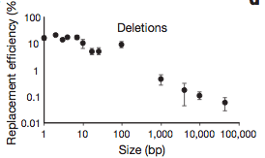
Quantifying Efficiency
Deletion efficiency proportional to size of deletion

Slide 7
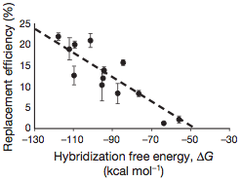
Quantifying Efficiency
Hybridization free energy between oligo and chromosome predicts replacement efficiency

Slide 8
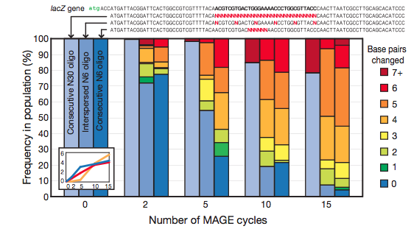
Generating Sequence Diversity
30 consecutive mutations
6 consecutive mutations
6 interspersed mutations

Slide 9
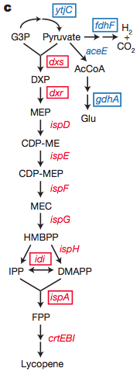
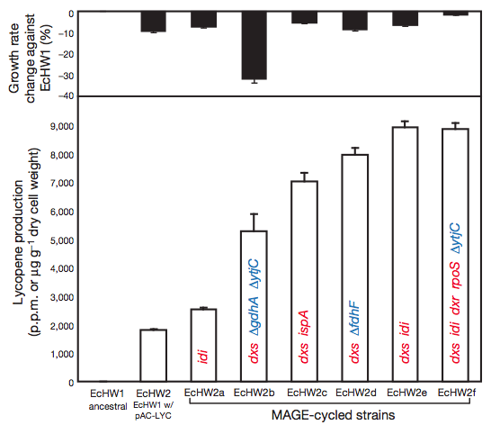
Lycopene Optimization

Slide 10
Conclusions
Created adjustable diversity with MAGE
Rationally designed oligos can have specific effects
Oligos with degenerate sequences create diversity
Accelerates the rate of accumulation of useful mutations

Slide 11
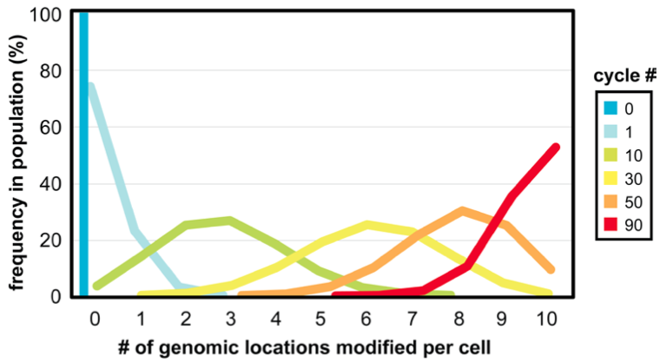
Generating Sequence Diversity
  Complexity of the oligo pool
  Number of loci targeted
  Number of MAGE cycles performed

Slide 12
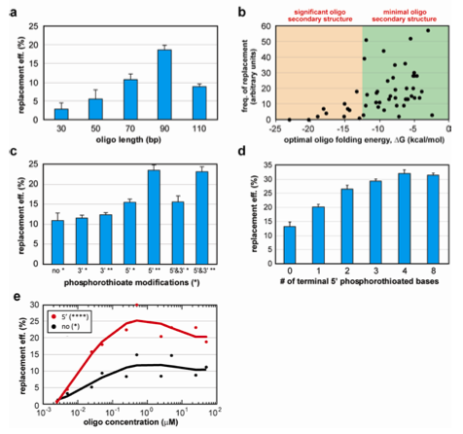
Characterization of allelic replacement frequency

