Slide 1
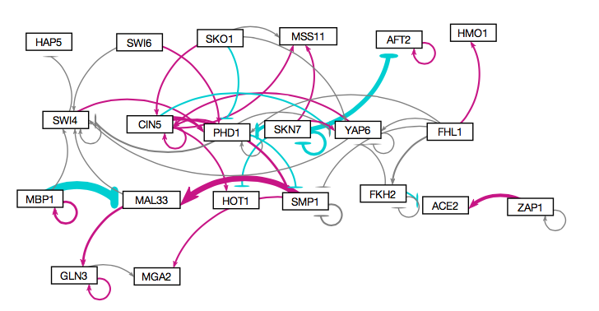
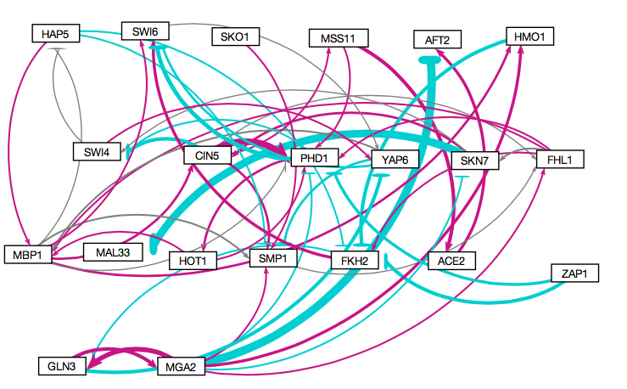
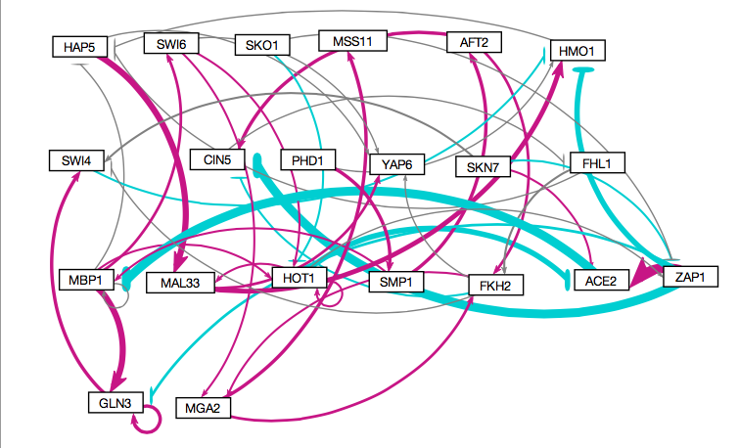
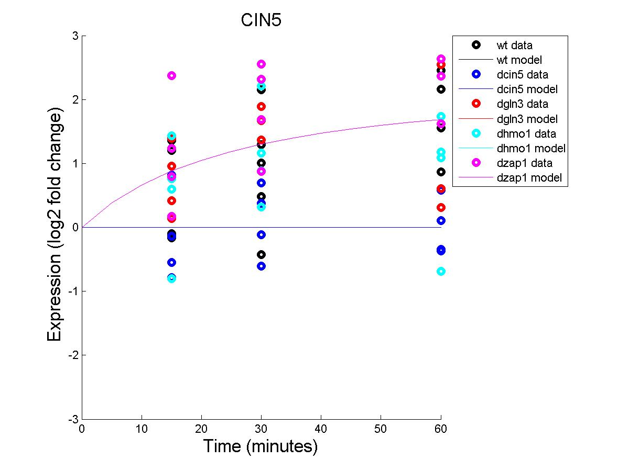
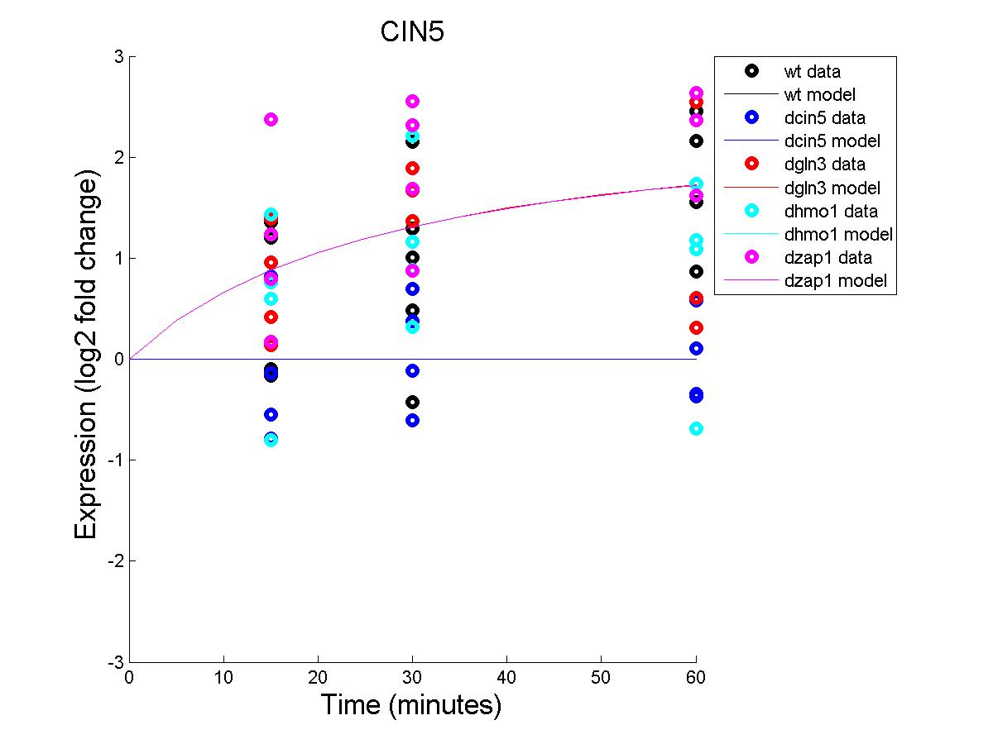
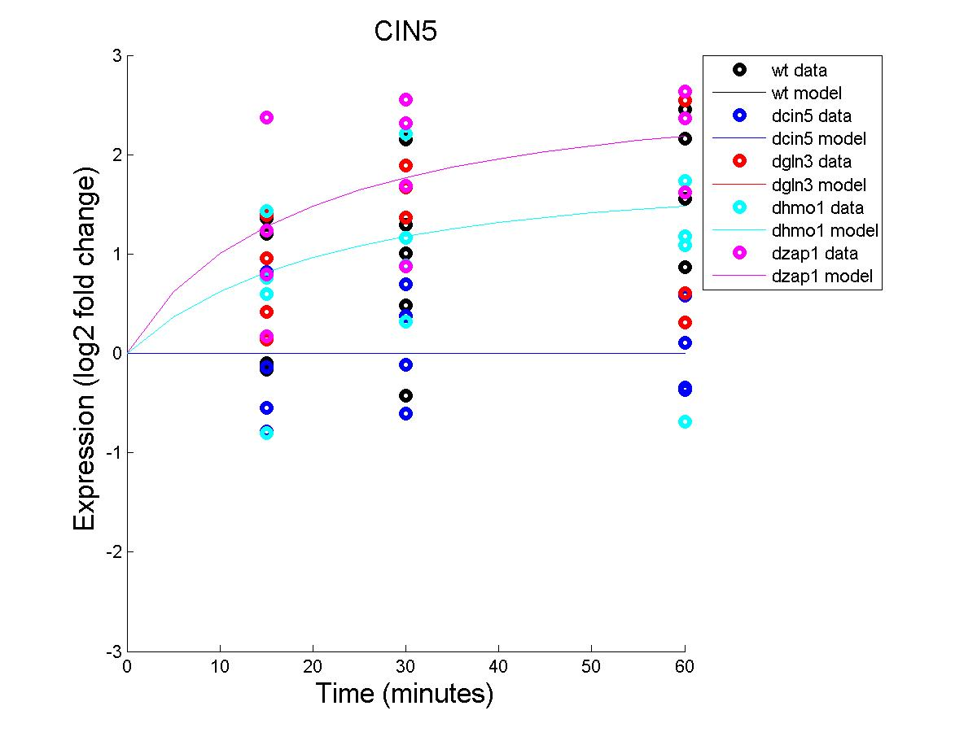
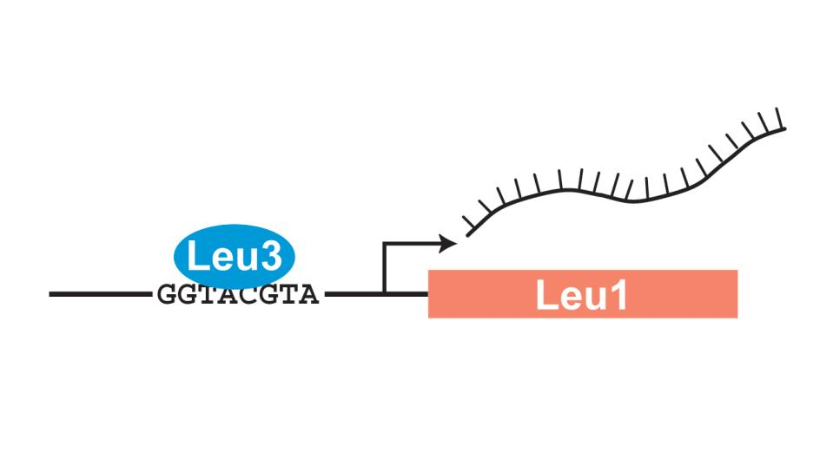
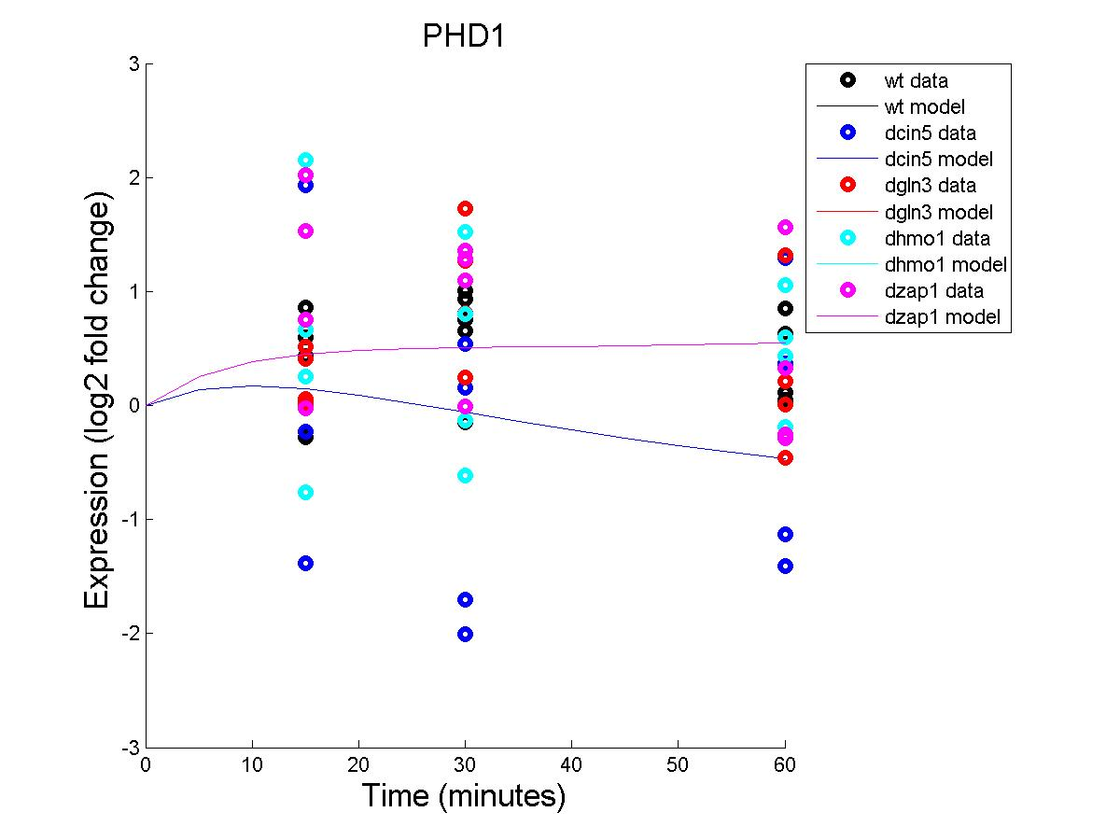
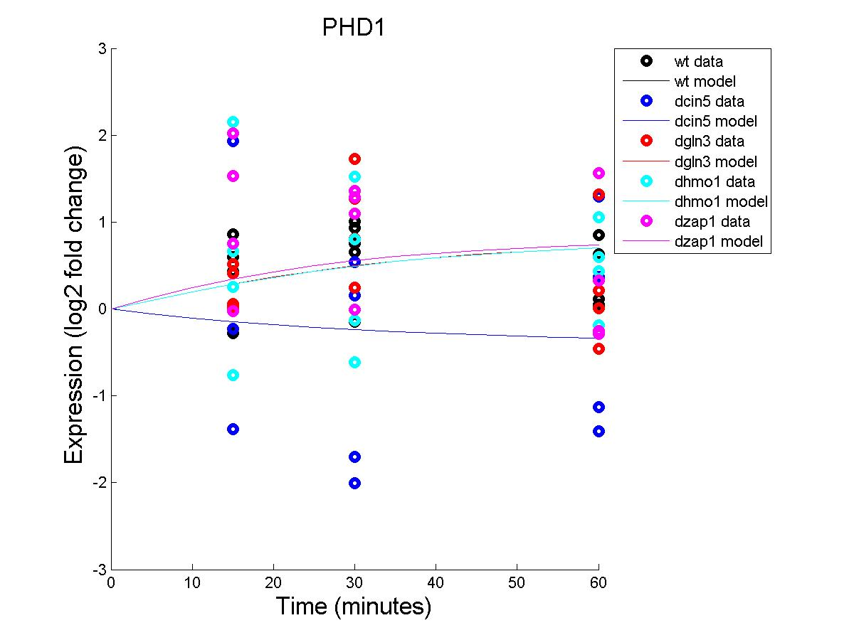
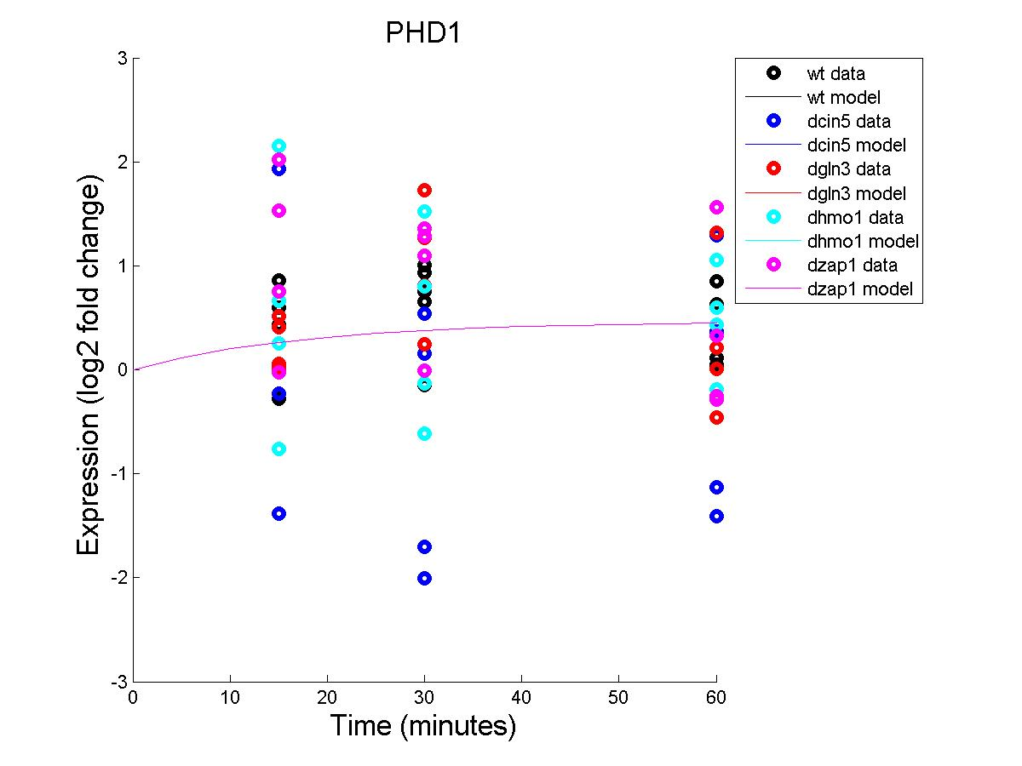
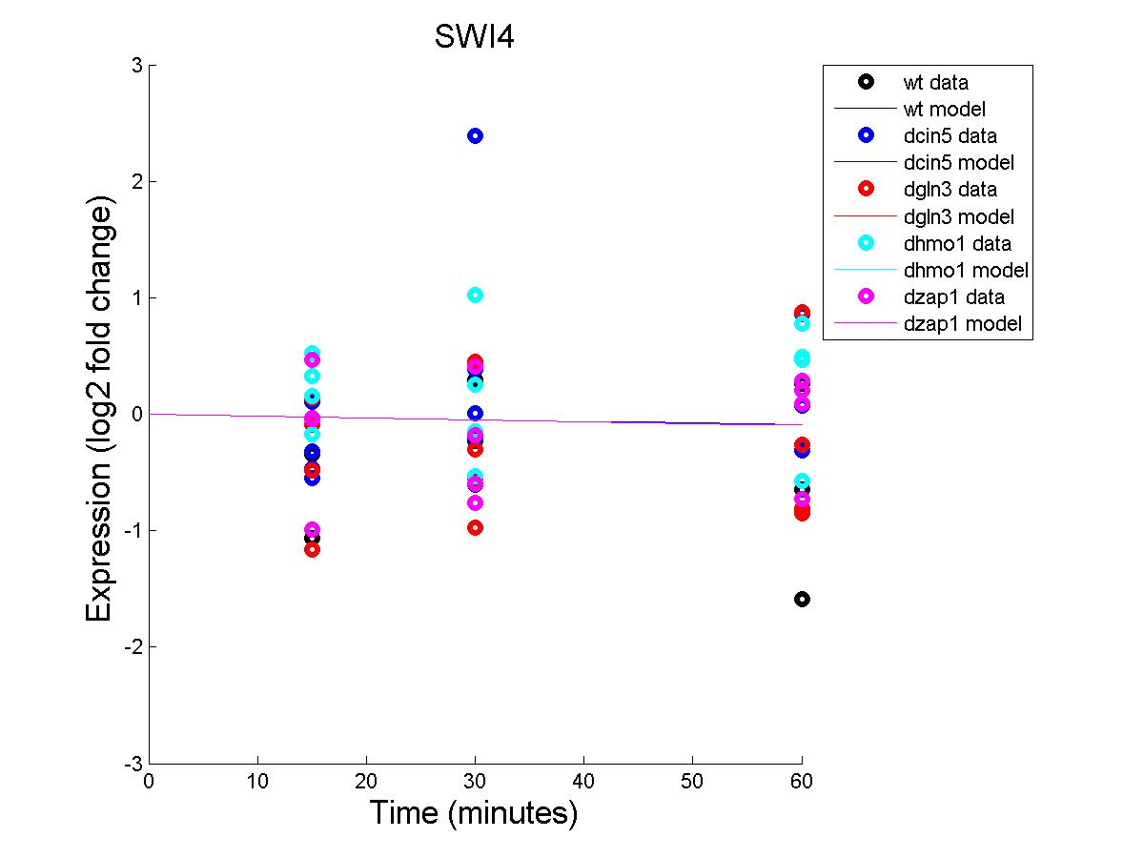
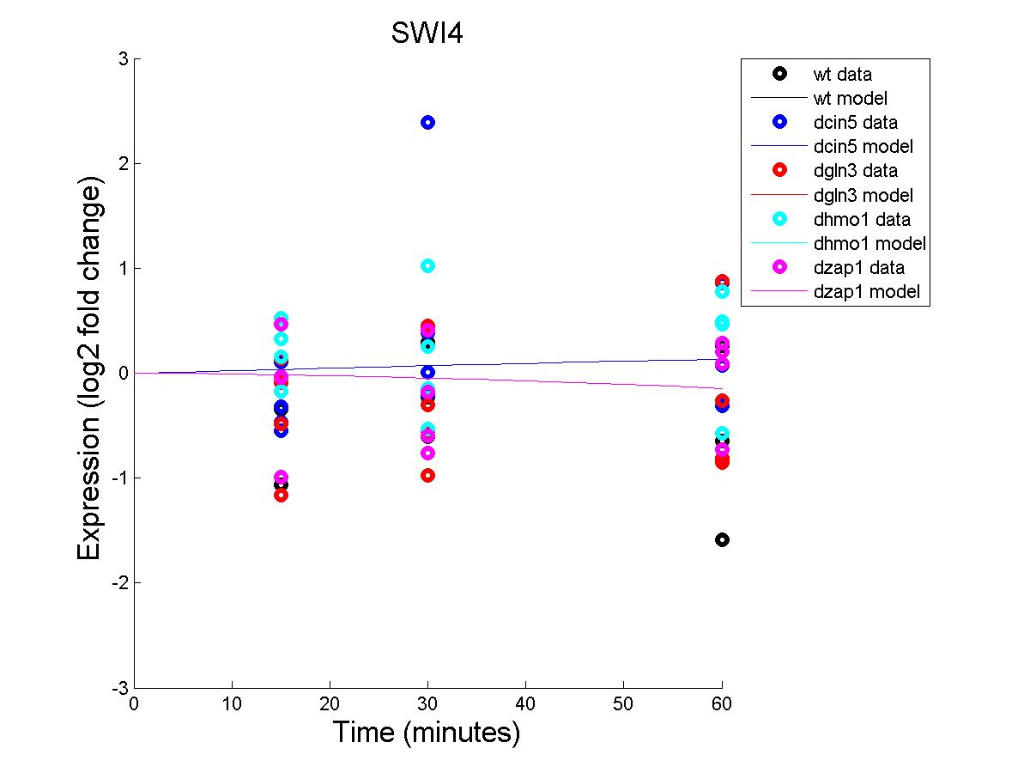
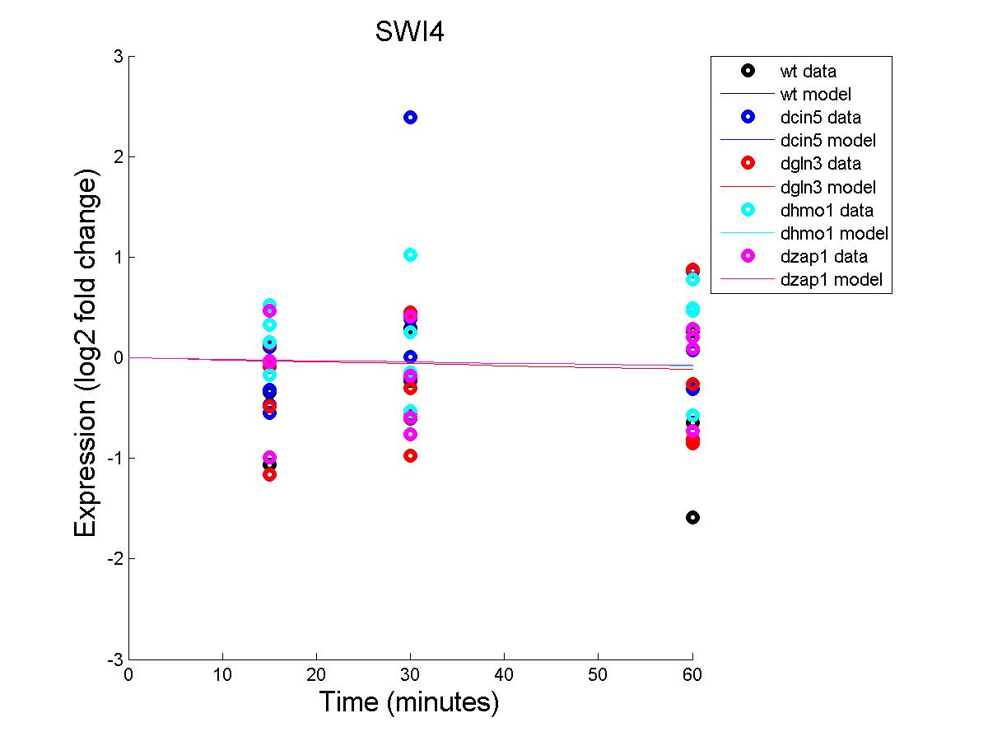
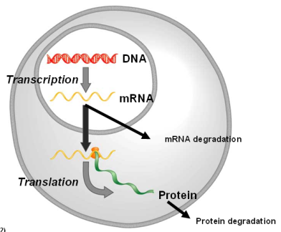
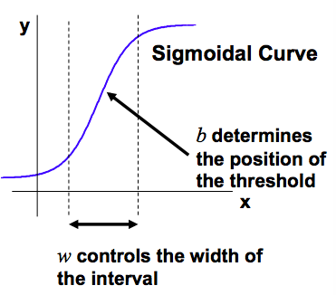
Comparing the Dynamics of the Cold Shock Gene Regulatory Network in Yeast with a Random Network
K. Grace Johnson¹, Natalie E. Williams², Kam D. Dahlquist², and Ben G. Fitzpatrick³
¹Department of Chemistry and Biochemistry, ²Department of Biology, ³Department of Mathematics
Loyola Marymount University, 1 LMU Drive, Los Angeles, CA 90045 USA
Slides from SysBio to include: 4,7,9, 16, 17
Introduction
Higher Auto-regulation was found in the Literature-Derived Network
Estimated Gene Expression Output Graphs
Transcription factors control gene expression by binding to regulatory DNA sequences
Activators increase gene expression
Repressors decrease gene expression
Transcription factors are themselves proteins that are encoded by other genes
Yeast respond to cold shock by changing gene expression
Little is known about which transcription factors regulate this response
General Environmental Stress Response genes are induced in late response
Which transcription factors control early response?
Which part of the early response is due to indirect effects of other transcription factors?
Literature Derived Network
Random 1 Network
Random 4 Network
A gene regulatory network (GRN) consists of a set of transcription factors that regulate the level of expression of genes encoding other transcription factors.
The dynamics of a GRN is how gene expression changes over time.
Literature-Derived Network
Random 1 Network
Random 4 Network
Background
GRNsight: automatically generates weighted network graphs from the spreadsheets produced by GRNmap
We propose a “medium scale” GRN that regulates the cold shock response
Absolute value of weight outputs from GRNmap are divided by the largest value
This distributes the weights between -1 and 1
Positive weights are colored magenta to denote up regulation
Negative weights are colored cyan to denote down regulation
Weights within ± 0.05 of zero are colored gray to denote zero regulation
GRNsight is available at http://dondi.github.io/GRNsight/
GRNmap: Gene Regulatory Network Modeling and Parameter Estimation
Variations in gene expression were seen with different connectivity among the genes.
For each gene in the network, a nonlinear differential equation determines the rate at which the gene is transcribed/translated
Conclusion
In and Out Degree Frequencies of Random 1 Network Closely Resemble those of the Literature Derived Network
More statistical testing of the model needs to occur to distinguish what makes the literature-derived network a better model than a random one.
The degree frequencies of the networks indicates that frequencies that resemble the literature derived network has a lower least squares error
Describe sigmoidal, parameters, discuss matlab….
P_{i} is mRNA production rate for gene i
D_{i} is the mRNA degradation rate for gene i
w is weight term, determining the level of activation or repression of j on i
b is …
Optimization of 92 Parameters Required the Use of a Penalty Term
The Random Networks have genes with heavier weights on other genes compared to the Literature Derived Network
A statistical analysis of DNA microarray data from the Dahlquist Lab for the wild type yeast strain and four transcription factor deletion strains were performed. These data was used to define a GRN of 21 transcription factors that are thought to regulate transcriptional response to cold shock in yeast. For validation, we compared this network to ten different random networks that contained the same nodes and same number of edges, but varied in connectivity.
Acknowledgements
For their work on the GRNmap code, we would like to thank Juan S. Carrillo, Nicholas A. Rohacz, and Katrina Sherbina. We thank Nicole A. Anguiano and Anindita Varshneya for their work on GRNsight visualization. Microarray data was collected by Cybele Arsan, Wesley Citti, Kevin Entzminger, Andrew Herman, Heather King, Lauren Kubeck, Stephanie Kuelbs, Elizabeth Liu, Matthew Mejia, Kenny Rodriguez, Olivia Sakhon, and Alondra Vega. Partial funding for this project was provided by NSF-RUI 0921038.
Least Squares Error Was Higher in Random Networks than in the Literature Derived Network
The magnitude of weights in the Random Networks was smaller than those of the Literature Derived Network
References
Alberts, Bruce, Dennis Bray, Karen Hopkin, Keiko Nakamura, and Ken'ichi
Matsubara. (2010). Essential Cell Biology. 3rd ed.
Dahlquist, Kam., Fitzpatrick, Ben., Camacho, Erika., Entzminger, Stephanie., Wanner, Nathan. (2014). Parameter estimation for gene regulatory networks from microarray data: cold shock response in Saccharomyces cerevisiae. Unpublished manuscript.
Sherbina, Katrina. Dynamical Systems Modeling of the Cold Shock Response in Saccharomyces cerevisiae. Thesis. Loyola Marymount University, 2014. Online Document.
Zhu, Cong., Byers, Kelsey J.R.P., McCord, Rachel P., Berger, Michael F., Newburger, Daniel E.,Saulrieta, Katrina., Smith, Zachary., Shah, Mita V., Radhakrishman, Mathangi., Philippakis, Anthony A., Hu, Yanhui., de Masi, Federico., Pacek, Marcin., Rolfs, Andreas., Murthy, Tal.., LaBaer, Joshua., and Bulyk, Martha L. (2009). High-resolution DNA-binding specificity analysis of yeast transcription factors. Genome Resarch 19, p 556 – 566. doi:10.1101/gr.090233.108
Least squares error measures the approximation of a solution of a system. For this approximation, the solution minimizes the sums of squares of error for every equation in the system.
A good least squares error value falls between 20 and 40

