Slide 1
ANOVA | WT
p < 0.05 | 2600 (42%)
p < 0.01 | 1727 (28%)
p < 0.001 | 1015 (16.4%)
p < 0.0001 | 574 (9.3%)
B & H p < 0.05 | 302 (4.88%)
Bonferroni p < 0.05 | 1936 (31.3%)

Slide 2
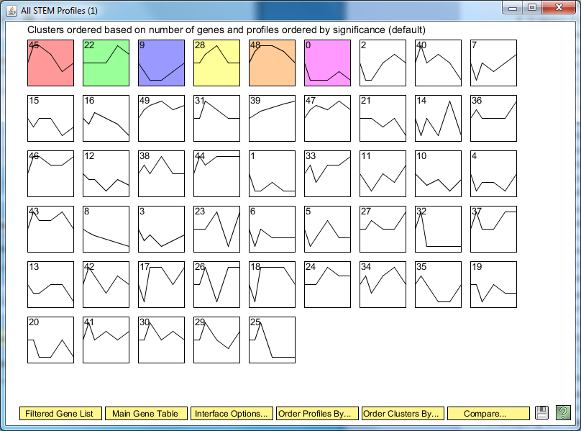

Slide 3
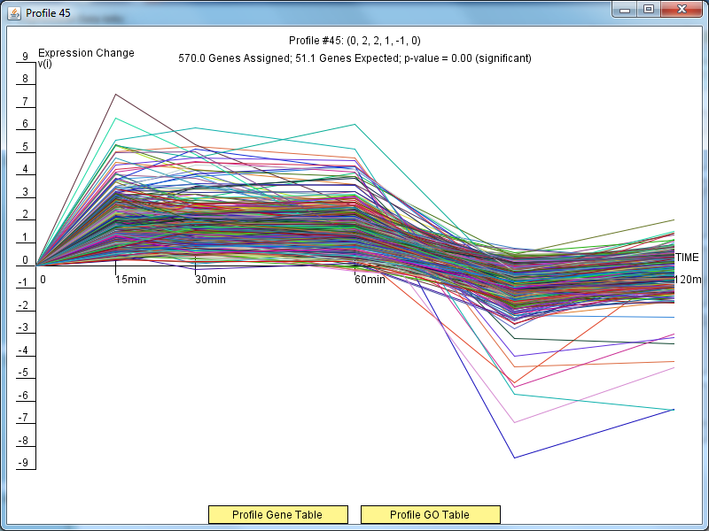

Slide 4
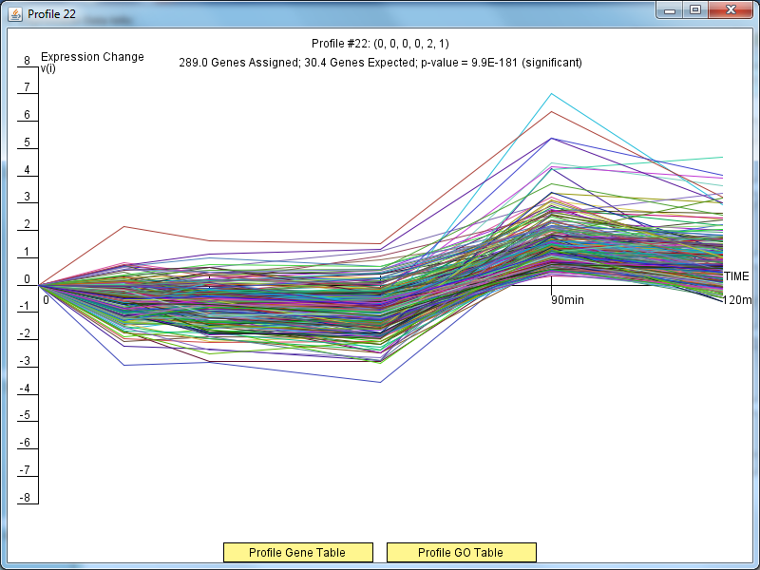

Slide 5
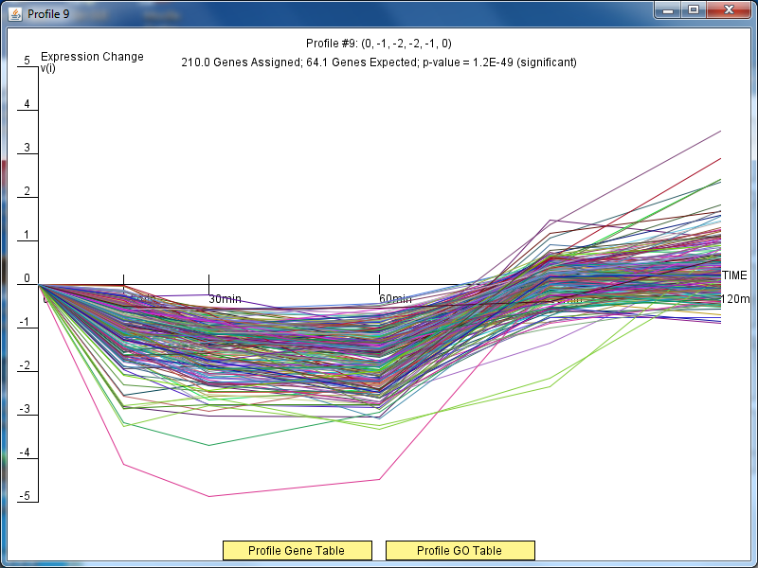

Slide 6
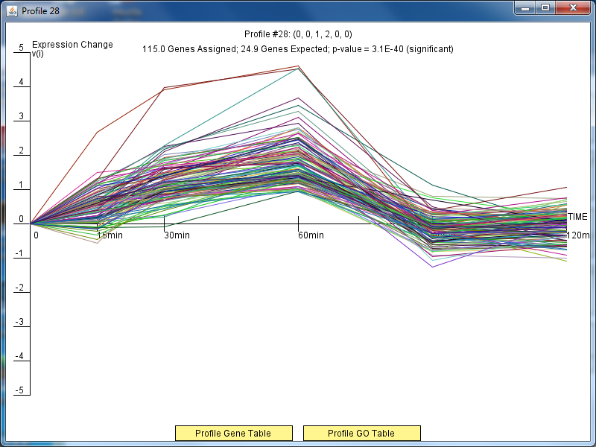

Slide 7
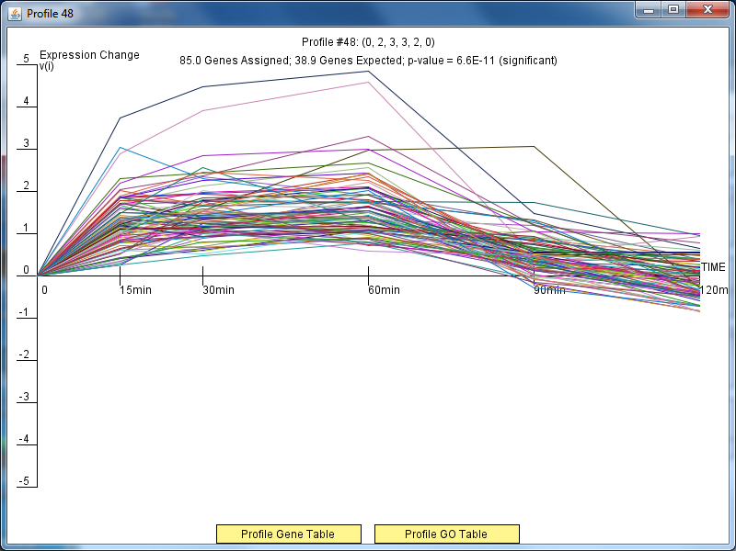

Slide 8
