Slide 1
Measuring the Activity of BioBrick promoters using an in vivo reference standard
JR Kelly, AJ Rubin, JH Davis, CM Ajo-Franklin, J Cumbers, MJ Czar, K de Mora, AL Glieberman, DD Monie and D Endy
Journal of Biological Engineering. 2009
Presented by: Nicholas Swenson

Slide 2
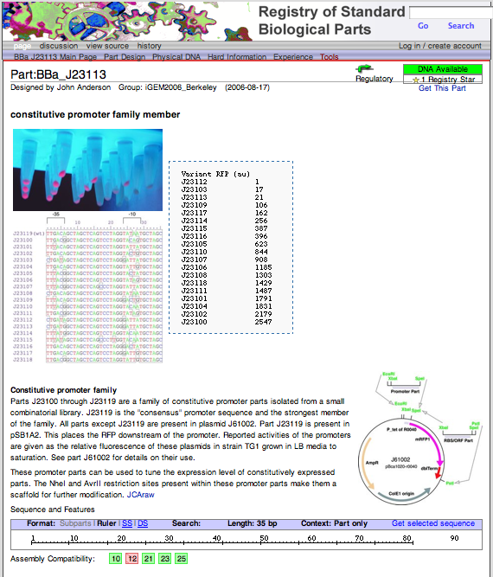
Introduction to BioBrick Biological Parts
A BioBrick component is a standard, by physical composition, biological parts
The authors focus on the promoters
Registry of Standard Biological Parts, started at MIT, maintains and distributes numerous BioBrick parts
Picture of Biobrick Registry
Notes:
BioBricks is a foundation that is dedicated to the advancement of science by helping the standardization of synthetic biological parts in an open source manner
Here they focus on the activity of biological promoters
The MIT Registry of Standard Biological parts maintains and distributes the biobrick parts that can be accessed by a synthetic biologist when trying to build a synthetic system
This means that a biologist can look up a promoter type and order it from this registry

Slide 3
Standardization of Activity of BioBrick Promoters
BioBrick promoters are currently characterized and sorted by physical composition
Current Methods: activities reported in “Miller units” even though in several cases there were differences in the substrates used to quantify
The authors saw a need to characterize the activity of each of these BioBrick promoters with a standardized unit
Authors Goal: Create a standard unit (relative promoter unit [RPU]) based on a ratio of promoter activity to the activity of a reference standard
Notes:
Currently the BioBricks are standardized in terms of how individual parts are assembled into multi-component systems, i.e. physical composition, and not by by the behavior of these parts.
For example, each promoter has different activity based on environmental conditions, inherent binding affinity etc. The same promoter under different conditions may have different absolute activities
They decided to standardized these units.
To standardize they created a ratio of the promoter activity to the activity of the reference standard
This allowed for the measurement of relative promoter activity robust to the variances in experimental condition

Slide 4

Promoter Activity
Defined “promoter activity” as the number of RNA polymerase that pass by the final base pair of the promoter
Promoter activity measured by GFP production
Based on a steady state ordinary differential equation (ODE) formed:
Where PoPS^{SS}: is the activity measured in polymerases per second, γ_{M}: mRNA degradation rate, a: GFP maturation rate, γ_{I}: degradation of immature GFP, ρ: transcription rate of immature GFP, n: copies of promoter, S^{SS}_{Cell}: GFP synthesis rate
Notes:
To measure the relative promoter activity, they first needed to define promoter activity
Here they define promoter activity as the number of RNA polymerase to clear the last base of the promoter, they equated this to the rate of GFP production within the cell
This is a crude estimate because of course after the mRNA was transcribed it must still be translated into GFP
The important thing to notice here is that the GFP synthesis rate is proportional to absolute activity of the promoter

Slide 5
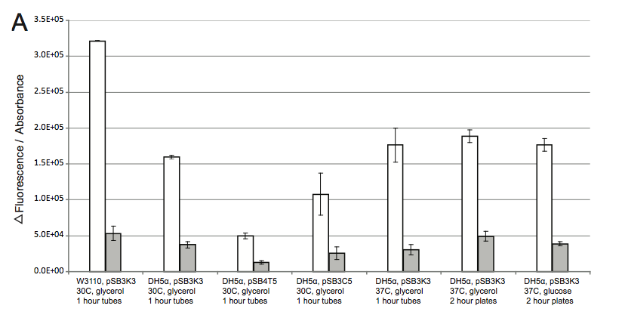
Promoter Response to Environmental Variations was correlated
They tested 7 different conditions where cell type (TOP310 vs W3110), carbon source (glucose vs glycerol) and temperature (30˚C vs 37˚C) was varied for two promoters
Notes:
The next step after formulating an equation for promoter activity was to assess the variation of promoter activity under varying environmental conditions
They tested them under 7 different conditions
DESCRIBE PLOTS
Saw that promoter response to environmental variations was correlated
This result has a very implication that we can create relative unit that reduces all variation

Slide 6


Derivation of Relative Promoter Unit (RPU)
The relative activity of the promoter can be based on the ratio of the GFP synthesis rates of the test promoter vs the reference standard
Main assumption: the experimental conditions are the same for both test promoter and reference standard
PoPS^{SS}: absolute promoter activity
S^{ss}_{cell}: GFP synthesis rate
Assumptions and promoter activity equation
Notes:
After measuring absolute fluorescence activity across two promoters, they created their relative unit based on assumptions and the promoter activity equation

Slide 7
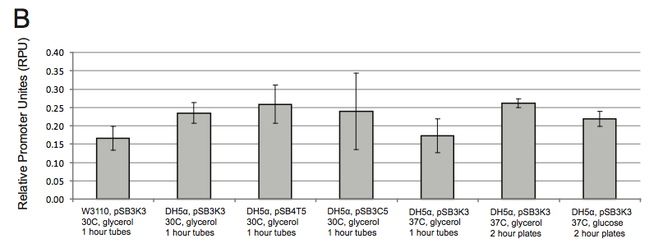
RPU decreases variance
Coefficient of variation of promoter activity was reduced in half when converted to RPUs
From 39.1% in GFP synthesis units to 17.5% in RPUs
Notes:
They were able to show a decrease in variation of the promoter activity when converted to units of RPU

Slide 8
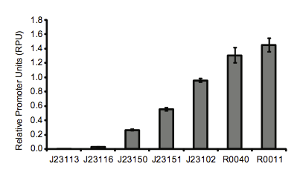
Characterization of 7 BioBrick Promoters
They measured the relative promoter units of 7 other promoters to start the characterization of the promoter registry
Nine independent clones were characterized across three separate experimental runs

Slide 9
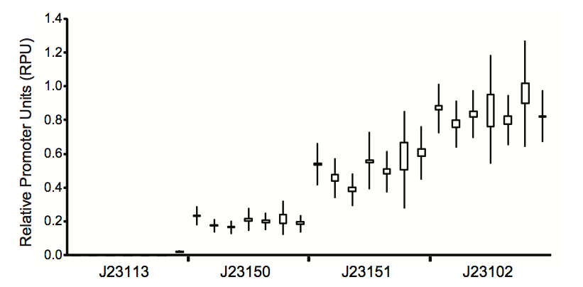
Lab-Lab Variation
Four promoters were sent to seven labs and activity was measured in RPUs following a standard 5-step procedure
Notes:
Absolute differences arise in promoter activity due to differences in growth conditions and slight differences in calibration of fluorescence measurement.
The RPU helps eliminate these differences in a common unit that can compared across labs
The mean promoter activty was relatively consitent with les than a 2-fold range of activities across all promoters
The activity of the weakest promoter was equivalent to the negative control within error for all but one of the labs
Results suggest that RPU is an effective metric for making comparable measurements

Slide 10
Construction of a Kit
To allow for the widespread measurement of BioBrick promoters in RPUs, they created kits that follow the protocol to the right
Ultimate hope of authors is to have other investigators characterize BioBrick promoters

Slide 11
Conclusions
Defined a new promoter activity unit that the authors hoped would be able to characterize the BioBrick promoters in a standard manner
Showed that they could decrease variability by standardizing the promoter activity
To further the standardization process they created a kit and protocol that allows for easing testing of promoters

Slide 12
Discussion Questions
From a methods based approach, did they succeed in standardizing promoter activity?
What could they have done/assumptions made to more accurately predict polymerase activity?
Was the assumption that promoter response to environmental variations was correlated valid? The graph is not perfectly clear.

