Slide 1
How can we tell synthetic from native sequences?
Watermarks

Slide 2
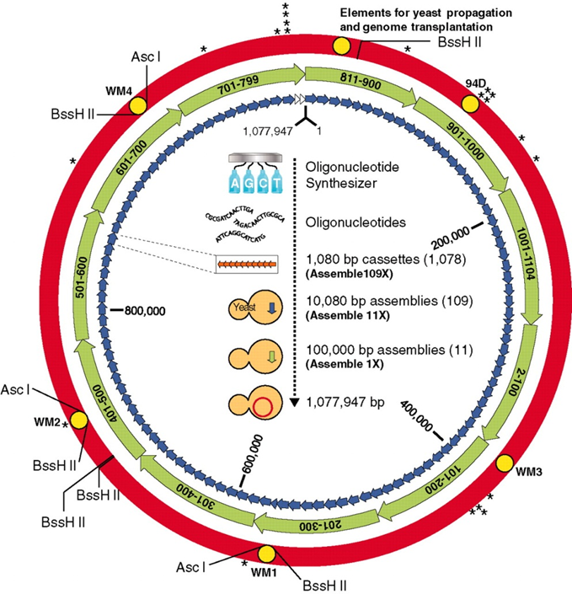
Synthetic bacteria project (JCVI)
(Gibson, Science, 2010, 329:52)
Four sequences, 1000 bp each
Inserted into noncoding regions of genome
Translated into English using secret triplet nucleotide to character code
  Names of scientists
  “To live, to err, to fall, to triumph, to recreate life out of life." "See things not as they are, but as they might be." "What I cannot build, I cannot understand."
  Email address to send decoded sequences

Slide 3
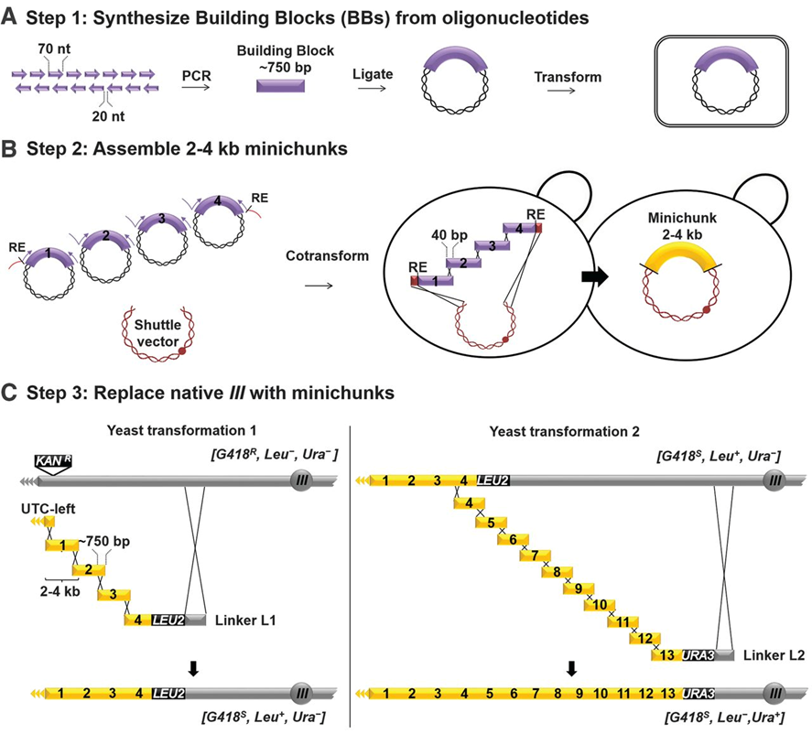
Synthetic Yeast Project (NYU)
(Annalaru, Science, 2014, 344:58)
Each gene >500 bp was given a PCR Tag
  Use GeneDesign program to recode a portion of gene to maximize difference (Avoid first 100 bases of each gene)
  At least 33% of nucleotides recoded (target tags to regions where amino acids can vary at >1 nucleotide)
  First and last nucleotides correspond to variable position
  Melting temperature between 58-60C
  Amplifies 200-500 bp fragment
  Primers will not amplify other genome sequence <1000 nucleotides
5-10% error rate

Slide 4
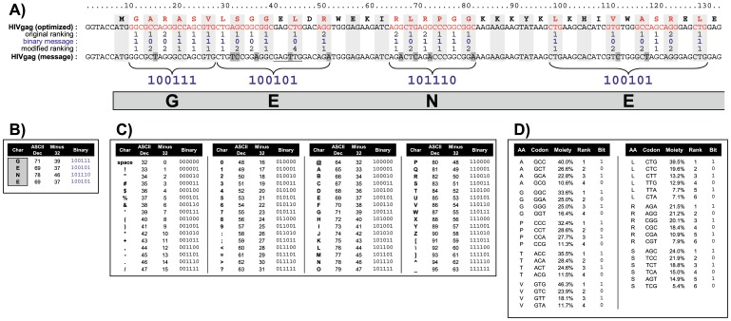
Embedding watermarks into coding genes (Liss, PLoS ONE, 2012, 7:e42465)
Create codon usage table and convert to binary
Convert watermark from English to binary
Change the codons of your gene so that binary watermark is encoded in DNA (this will change the rankings of your codons)
This method takes into account the frequency of the different codons, which will vary for each species

Slide 5
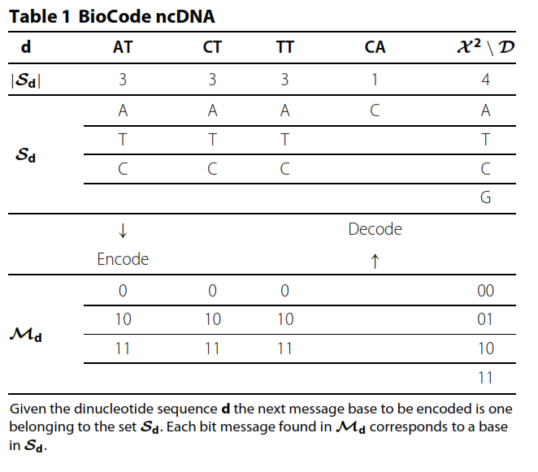
BioCode algorithm for information storage
(Haughton, BMC Bioinformatics, 2013, 14:121)
NONCODING REGIONS
PROTEIN-CODING REGIONS
Assign 2 bit sequence to each base
Does not want to introduce cryptic start codons (ATG, CTG, TTG) or their complements (CAT, CAG, CAA)
Examines the dinucleotides AT, CT, TT, CA and restricts the subsequent dinucleotide
Like previous paper, changes the codons, but retains the amino acid sequence
Not only does it take into account the frequency of codons, it preserves the codon count for each (if a codon is used X number of times in the gene, once the recoded gene uses it X times, that codon can no longer be used)

Slide 6
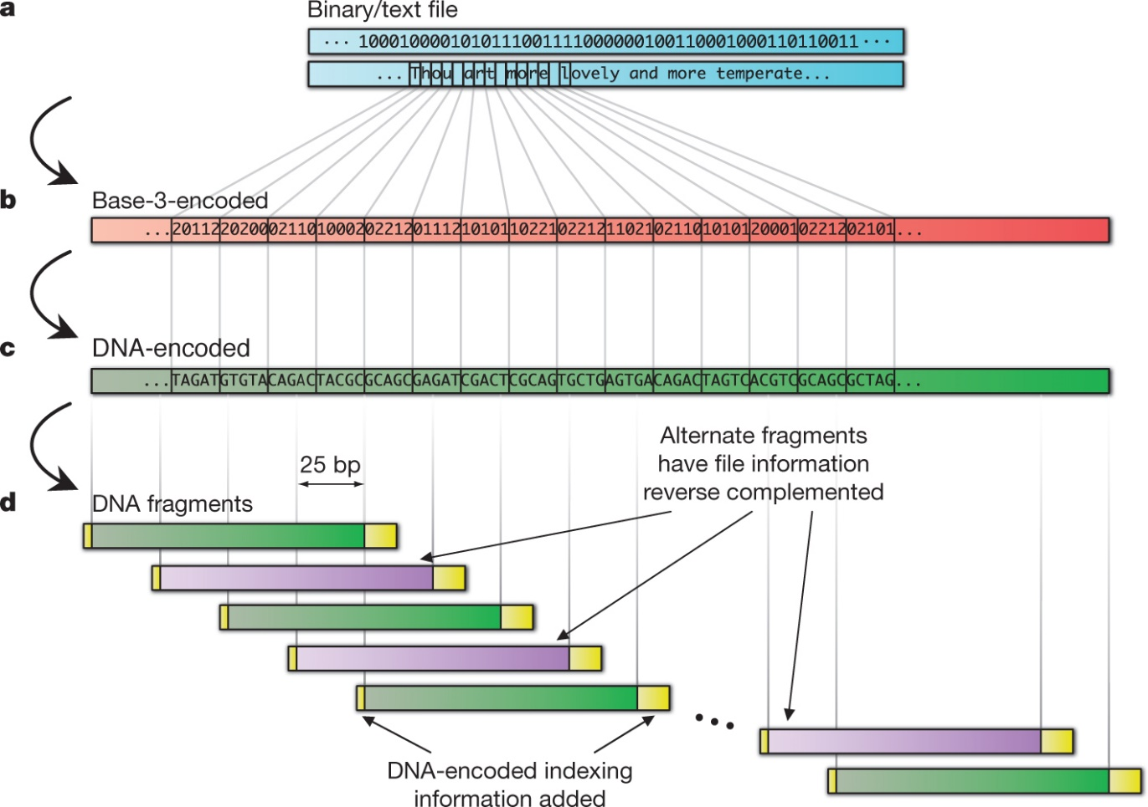
Large scale information encoding in DNA
The five files comprised all 154 of Shakespeare’s sonnets (ASCII text), a classic scientific paper¹⁸ (PDF format), a medium-resolution colour photograph of the European Bioinformatics Institute (JPEG 2000 format), a 26-s excerpt from Martin Luther King’s 1963 ‘I have a dream’ speech (MP3 format) and a Huffman code¹⁰ used in this study to convert bytes to base-3 digits (ASCII text), giving a total of 757,051 bytes or a Shannon information¹⁰ of 5.2 × 10⁶ bits
N Goldman et al. Nature 000, 1-4 (2013) doi:10.1038/nature11875

