Slide 1
Intro to Stem Cells
ChemEng 575: Tissue Engineering
Lecture 2
January 28th, 2016

Slide 2
Reading
Chapter 2 of the Wiki Textbook.

Slide 3
Reminder: Tissue Replacement Strategy
These can be stem cells!

Slide 4
Stem Cells vs. Primary Cells in TE
Primary Cells
Stem Cells
What is a primary cell?
PRO: Harvest and grow cell type of interest
CON: Not all cell types expand well in culture
e.g. Smooth muscle, Neurons, Cardiomyocytes
CON: Difficult to find a good source for all cells
Limited number, what if those cells aren’t healthy? Donor?
What is a stem cell?
PRO: Theoretically possible to make any cell of interest
CON?: Can be differentiated down correct pathway?
Depends on the cell derived and the stem cell source
CON?: Expansion properties known, but often loss of “stemness”
Start to differentiate (lose stemness) immediately in culture
CON: Sources of some stem cells are controversial within public eye

Slide 5
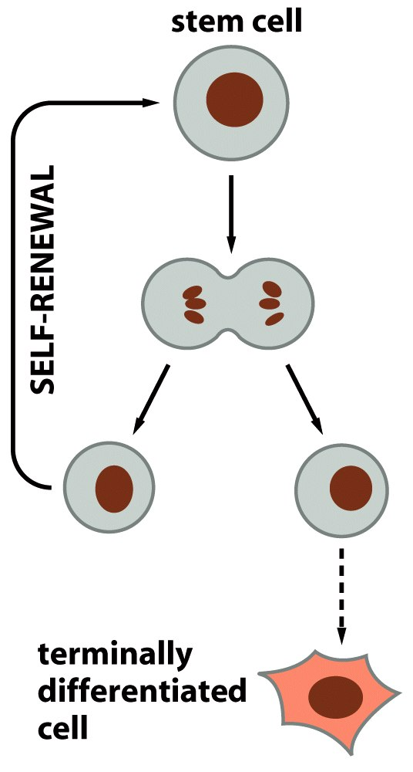
Stem cells asymmetrically divide
Many steps here!
Figure 23-5 Molecular Biology of the Cell (© Garland Science 2008)

Slide 6
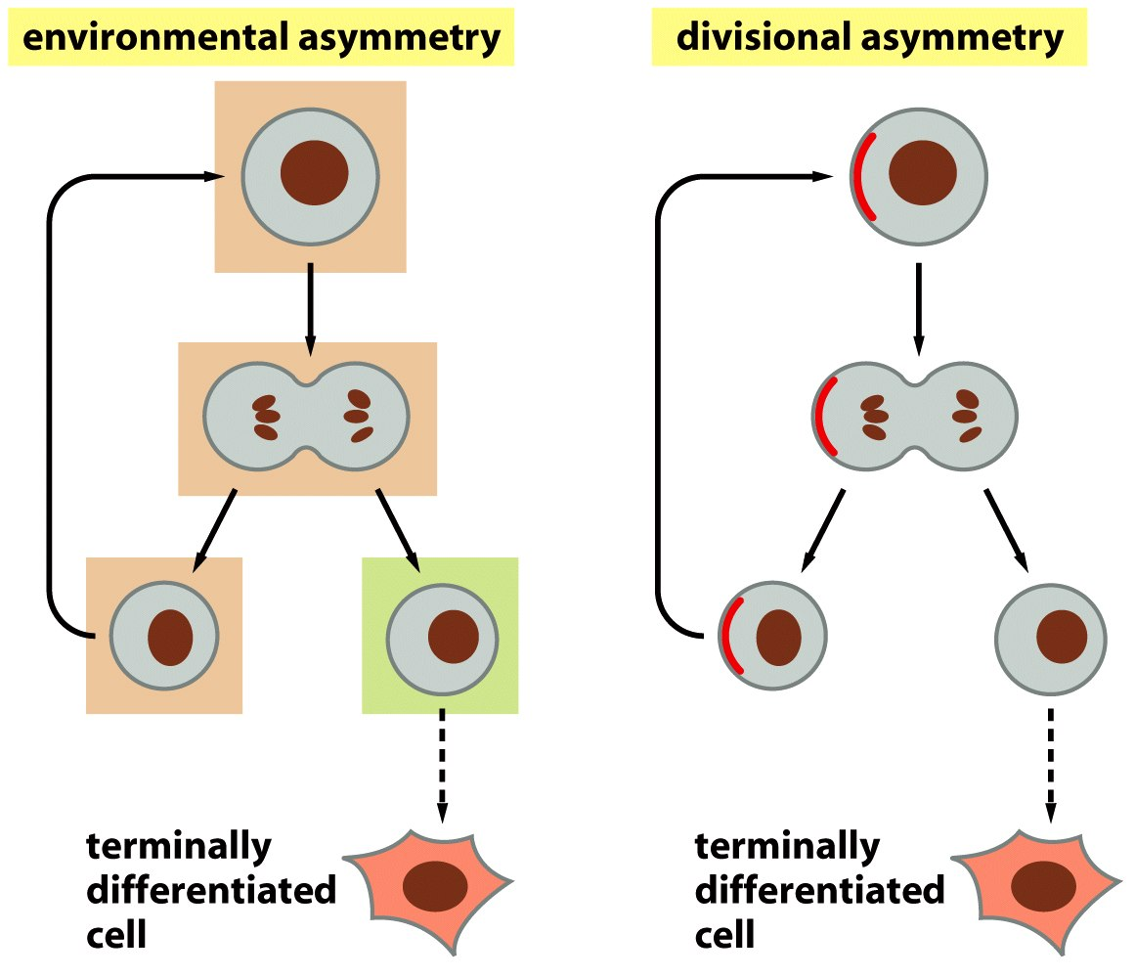
What dictates this asymmetric division?
Intracellular proteins go to only one cell
The daughter cells are in contact with different factors after division
What types of proteins might these be?
What types of factors might these be?
Figure 23-6 Molecular Biology of the Cell (© Garland Science 2008)

Slide 7
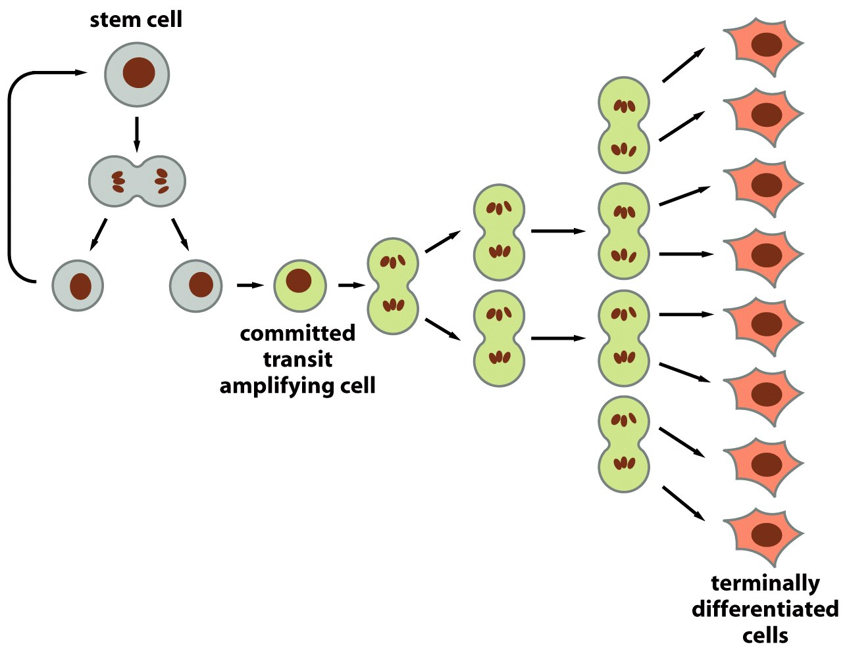
Many steps between stem cell and differentiated cell
Factor 4
Factors 2&3
Factor 1
Advantage: this is great for differentiated cells that don’t grow! e.g. neurons, cardiomyocytes.
Engineering design challenge: how do you get cells to go through all these different steps??
Are all these steps in culture? Does a biomaterial you want to use cause these steps? Or, do you “let the body” do the work? (in vivo bioreactor)
Figure 23-8 Molecular Biology of the Cell (© Garland Science 2008)

Slide 8
Mesenchymal and Tissue-Specific Stem Cells

Slide 9
Stem Cell Type 1: Mesenchymal Stem Cells
Loose definition: Mesenchyme is a cell surrounded by matrix – derived from the mesoderm germ layer.
Found everywhere in your body at low levels.
Found at very high levels in:
Bone marrow
Cord blood
Adipose
Characterized, classically by Surface Markers
CD105, CD73, CD90
CD44. CD71, CD106, CD166, CD129 (also accepted)
Not CD34, CD14, CD45, CD11a, CD31 (vascular and hematopoietic progenitors)
Also characterized by: ability to adhere to plastic dish
Finally characterized by: ability to differentiate into different cell types

Slide 10
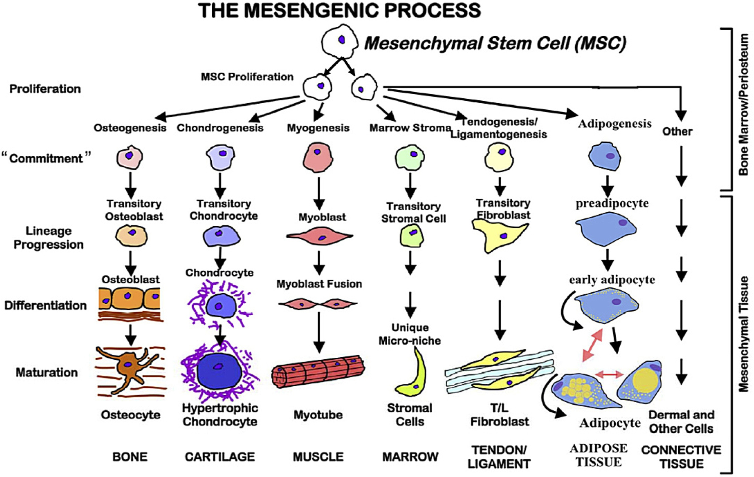
Differentiation Potential of Mesenchymal Stem Cells
Discovery medicine 2015

Slide 11
What do Mesenchymal Stem Cells do? (while still stem cells, not differentiated)
Migrate to injured sites
Secretion of growth factors (VEGF, PDGF), these growth factors make blood vessels.
Modulate immune responses (Sometimes good, sometimes bad)
PGE2, TGFβ – inhibit Natural Killer cell proliferation
IL-10, IL-1, M-CSF suppresses dendritic cell differentiation
CCL5, IL-17B - Promote cell motility

Slide 12
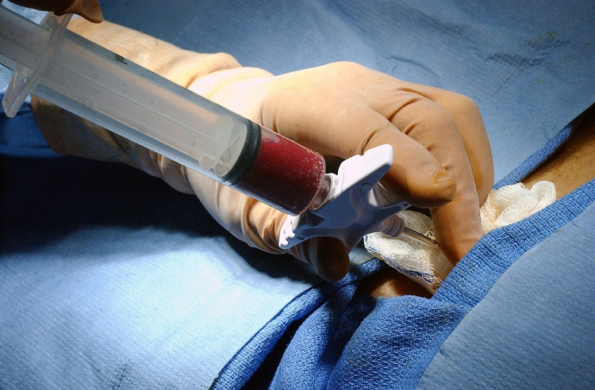
How we get and differentiate MSCs from
fresh marrow
Marrow Aspirate
Mesenchymal stem cells
Hematopoietic stem cells
Immune Cells
Red Blood Cells
Not Efficient!!!!
chondrocytes
unwanted
About 1:20,000 cells in marrow aspirate
Just one, possible desired differentiation pathway
Mesenchymal stem cell
osteoprogenitor
pre-osteoblast
osteoblast
osteocyte
Expensive and time consuming!
unwanted
adipocytes
http://openwetware.org/wiki/Bone_Marrow_Transplants%2C_by_Erinn_Dandley%2C_Max_Nowak_and_Jean_Smith

Slide 13
Where cost and time comes from: Finding Right Growth Factor Cocktail to get right cell type
“Colony forming cell”
i.e. cells that stick to the dish and grow (therefore is an MSC)
CFC
CFC
CFC
EGF
HB-EGF
FGF-2
Ascorbic acid
Dexamethasone
Serum
B-glycerophosphate
Time +
EGF
PDGF
?????
CFC
Time +
TGF-β
Time +
EGF
PDGF
Osteoprogenitors
Osteoblasts
Osteocytes
Adipocytes
Chondrocytes
Notes:
EGF effect depends strongly upon other culture conditions: serum, adhesion conditions, concentration, type of MSC cell line

Slide 14
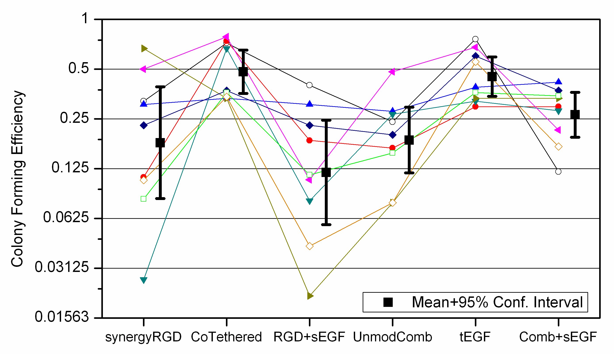
Even With Extensive Cues, Just getting the first set of MSCs from marrow is Patient-Specific and Heterogeneous
n=9 patients
Griffith, MIT
Different plate conditions

Slide 15
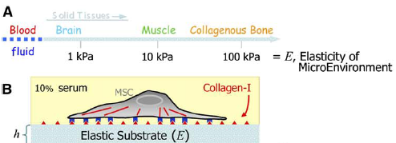
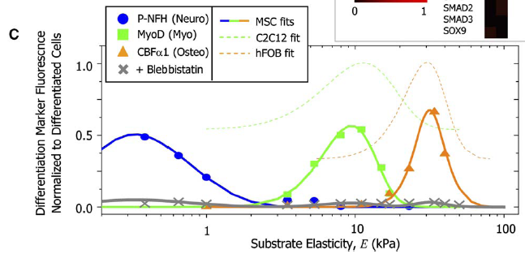
Insoluble Cues: Stiffness of Microenvironment Effects MSC Differentiation
Engler et al., Cell 2006

Slide 16
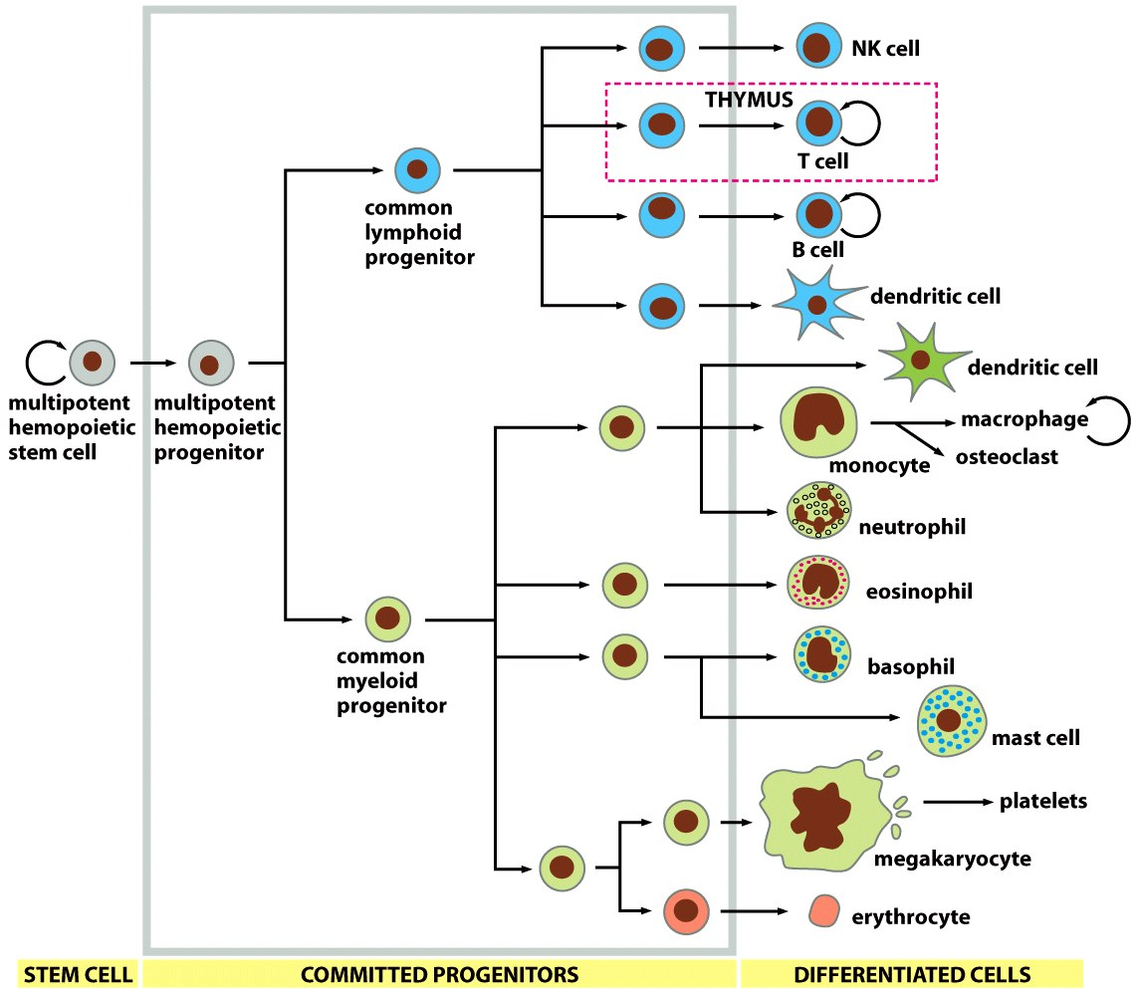
Stem Cell Type 2: Hematopoietic Stem Cells (Immune System, blood)
Also from marrow and cord blood
Don’t stick to plastic
Characterized by different surface markers
Clinically used for more than 60 years
Figure 23-42 Molecular Biology of the Cell (© Garland Science 2008)

Slide 17
Stem Cell Type 3: Tissue-Specific Stem Cells
EVERY tissue has a specific set of “stem cells” in it.
What are these?
Some “committed” but not “completely differentiated” cell
Somewhere downstream of a mesenchymal or hematopoietic stem cell
Already reside in the matched tissue, but not yet totally differentiated.
Respond to inflammation and participate in local wound healing.
What activates this mobilization?
Examples:
Neuronal progenitor cells (neurons don’t grow!)
Lung stem cells (produce 1-3 different lung cells)
Skin stem cells (skin replenished every 2-3 months)
Skeletal muscle stem cells (they activate when we exercise)

Slide 18
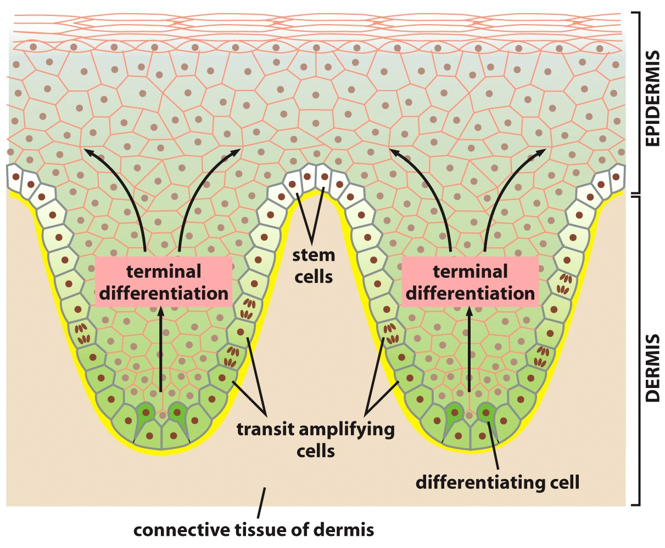
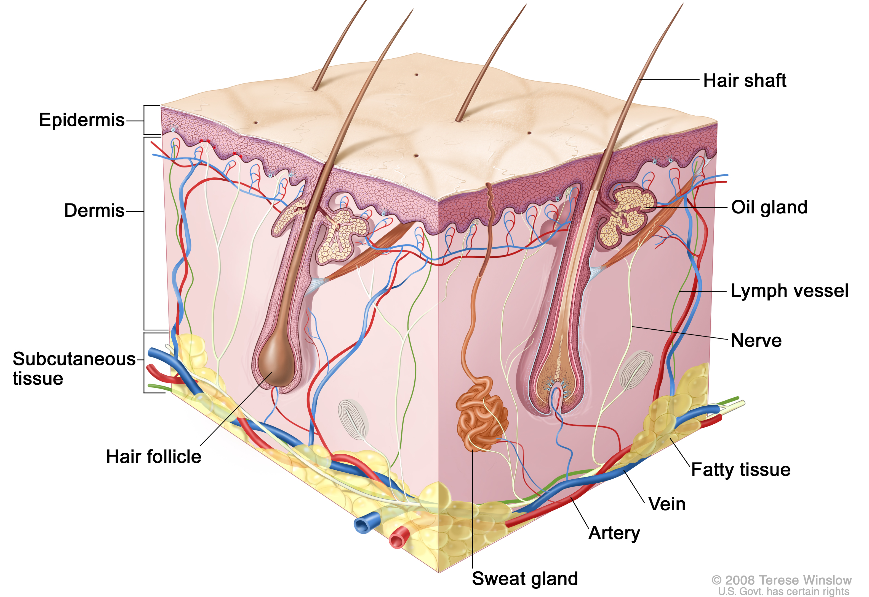
Lots of stem cells in EVERY epithelial layer
Example 1: Skin
Skin stem cells!
“crypt”
Figure 23-7 Molecular Biology of the Cell (© Garland Science 2008)

Slide 19
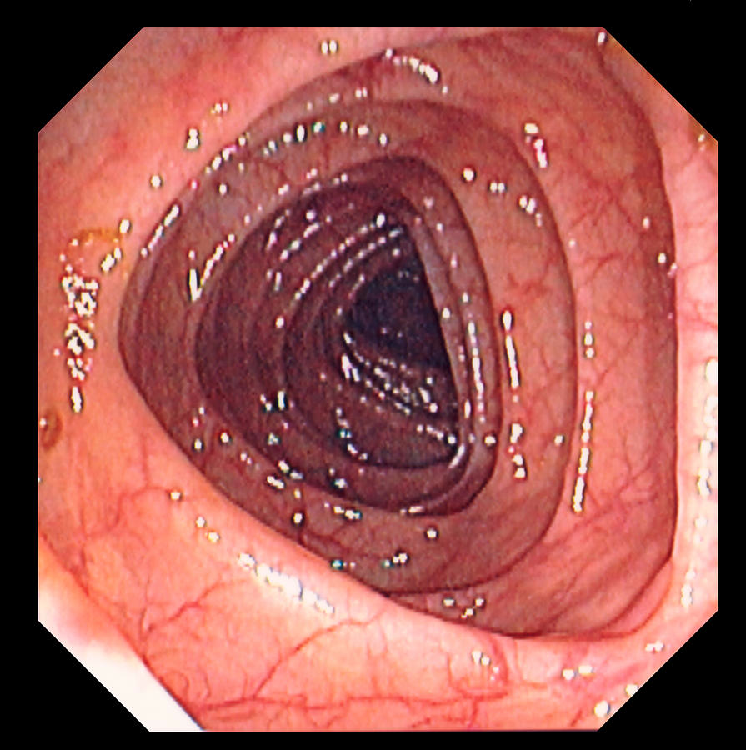
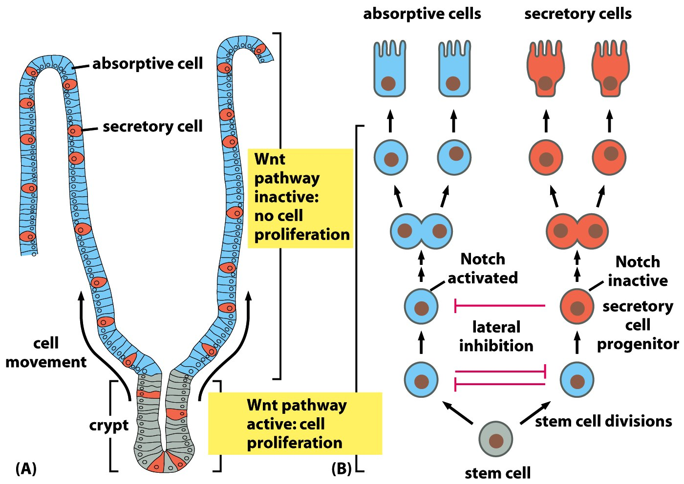
Your gut is also an area of intense renewal
Gut stem cells!
Extracellular factor controlling differentiation after division
Figure 23-24 Molecular Biology of the Cell (© Garland Science 2008)

Slide 20
Embryonic and Reprogrammed Stem Cells

Slide 21
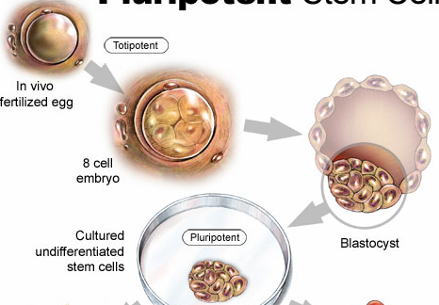
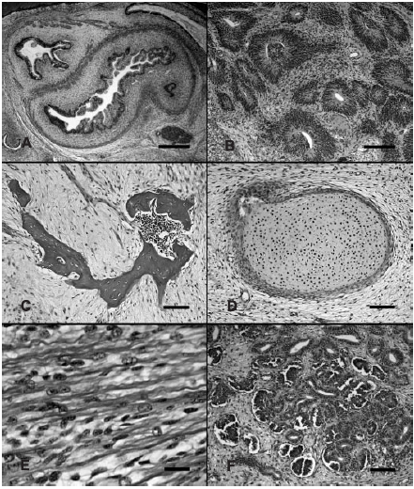

Embryonic Stem Cells
Form teratomas in nude mice
Gut-like structures
Neural epithelium
bone
cartilage
muscle
Fetal glomeruli

Slide 22
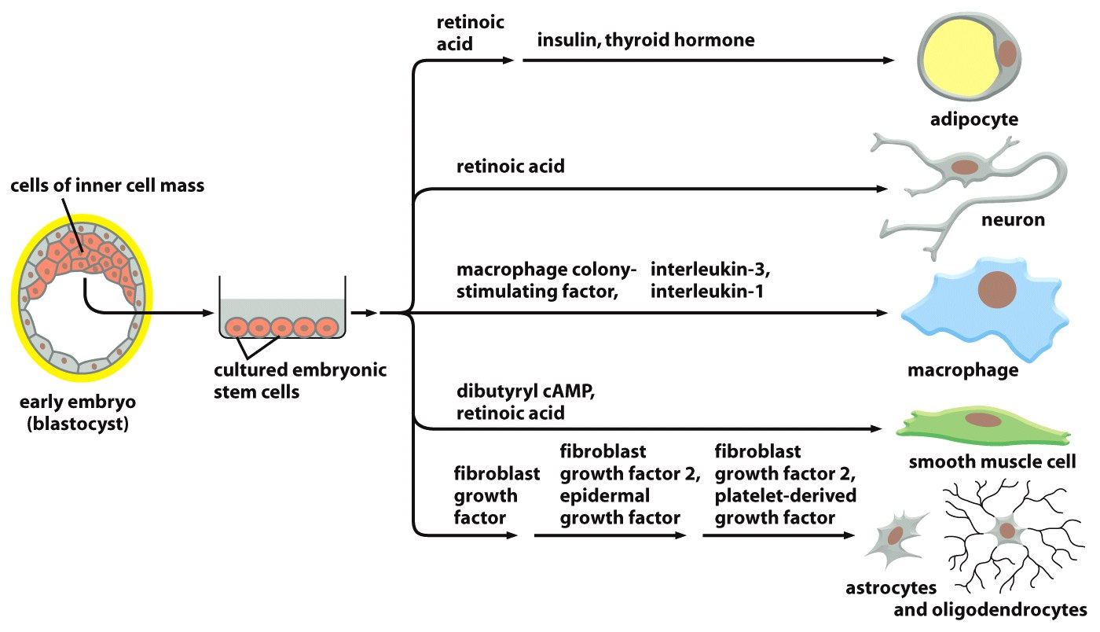
Some Chemical Factors for ESC differentiation known
Figure 23-68 Molecular Biology of the Cell (© Garland Science 2008)

Slide 23
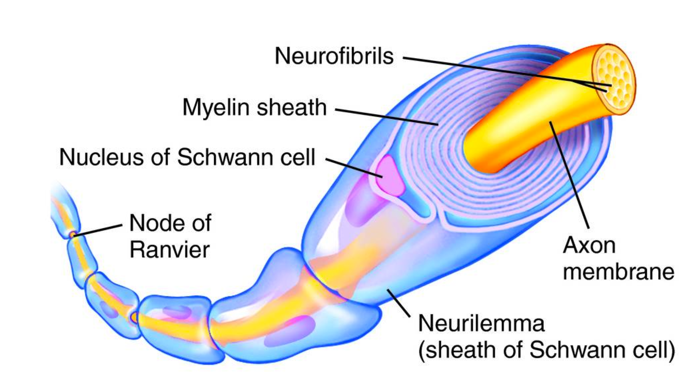

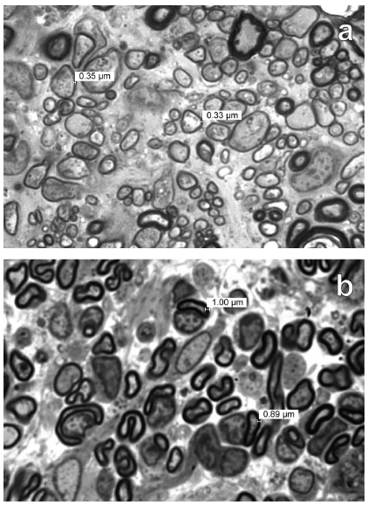
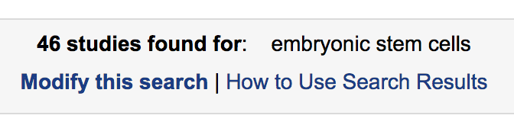
Clinical Impact of ESCs
Geron Corporation: Using ESCs to heal acute and chronic spinal cord injuries
ESCs differentiated into oligodendrocytes, and re-myelinated nerve bundles in injured rats.
Impact: acute spinal cord injury and multiple sclerosis
Rats regained motor function after acute spinal cord injury.
Clinical trials for human patients began, but ended prematurely.
Ischemic heart disease
Infertility
Macular degeneration
Muscular dystrophy
Ischemia

Slide 24
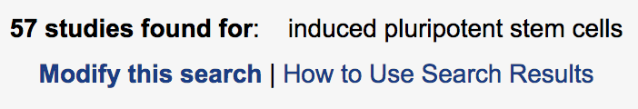
Induced Pluripotent Stem Cells (iPSCs)
2012 Nobel Prize
Autism, Drug addiction, Neurodegeneration,
Liver disease, Retinoblastoma,
Ischemic heart disease, Multiple Sclerosis, Cancer
Notes:
Totipotency: a mature metaphase II oocyte as in somatic cell nuclear transfer (Wilmut et al., 1997).
Direct reprogramming methods support reversion to pluripotency; though, vehicles and biotypes vary considerably in efficiencies (Takahashi and Yamanaka, 2006).
Viral-mediated transduction robustly supports dedifferentiation to pluripotency through retroviral or DNA-viral routes but carries the onus of insertional inactivation.
While protein-mediated transduction supports reprogramming adult cells to pluripotency, the method is cumbersome and requires recombinant protein expression and purification expertise, and reprograms albeit at very low frequencies (Kim et al., 2009).
No cocktail has been identified to completely reprogram adult cells to totipotency or pluripotency, but many examples exist that improve the overall efficiency of the process and can supplant one or more genes by direct reprogramming routes (Feng et al., 2009; Zhu et al., 2010).

Slide 25
Stem Cells are all over the literature…. With conflicting evidence and advice
How do you parse through the literature?
Pay particular attention to:
Cell isolation techniques
Cell populations and heterogeneity
Different animal sources/model systems
Dose of stem cells
Timing of stem cell delivery
Patient environment (genetic, disease states, exposures)
Probably others as well

Slide 26
Factors for you to consider if using stem cells in your grant project
Do you need the cells to proliferate a lot to build up the tissue?
How many cell types do you need?
Is the differentiation to that cell type known?
How expensive and/or time consuming will the differentiation process be?

Slide 27
In class problem set 1
Clinical Trials for mesenchymal stem cells
Go to clinicaltrials.gov and search for mesenchymal stem cells.
How many OPEN studies are there?
Pick one that is currently RECRUITING.
Where is this trial taking place and how many patients are they recruiting?
What is the application and what does that disease involve?
What is the current gold standard treatment that disease has?
What could, in your opinion, stem cells do to help treatment of this disease?
Turn in your 1-page report before you leave class.

