Slide 1
575 Lecture 5
Paper Review
Physical plasticity of the nucleus in stem
cell differentiation
2/9/16

Slide 2
Introduction to Paper/Motivation
DNA is in the nucleus.
Gene transcription (DNA to RNA) happens in the nucleus.
Chromosomes need to structurally rearrange, at least a bit, for RNA transcription to functionally occur.
PIs’ hypothesis is that an undifferentiated cell (a stem cell) would need a more pliable nucleus than a differentiated cell to make lots of different genes be available for transcription.
They will focus on a particular method (micropipette aspiration) and a particular nuclear crosslinking protein (Lamin) to test this hypothesis.

Slide 3
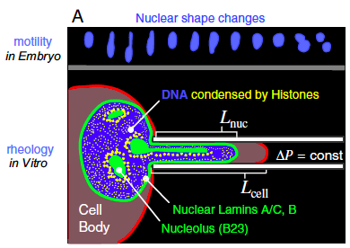
Figure 1a: Jake Kellett

Slide 4
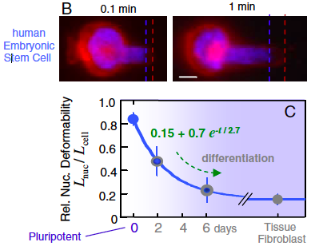
Figure 1b: Daniel Kosteva

Slide 5
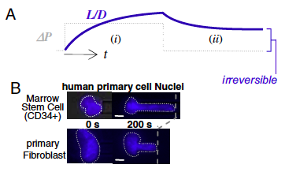
Figure 2a-b: Vinnie La

Slide 6
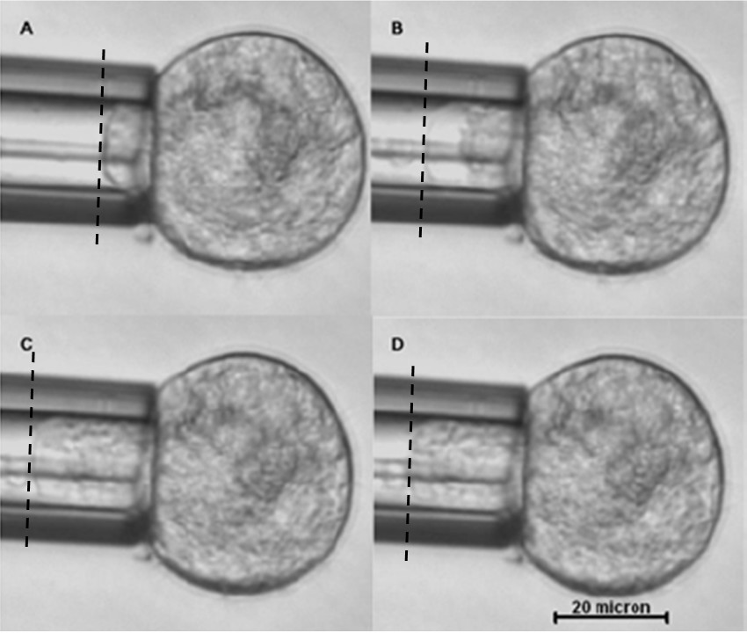
Micropipette Aspiration
Small diameter glass pipette brought into contact with cell
Known suction pressure applied
Mesenchymal stem cells should deform to a similar degree as HSCs
Tan, S. C.; Pan, W. X.; Ma, G.; Cai, N.; Leong, K. W.; Liao, K.
Viscoelastic Behaviour of Human Mesenchymal Stem Cells.
BMC Cell Biol BMC Cell Biology. 2008, 9, 40.

Slide 7
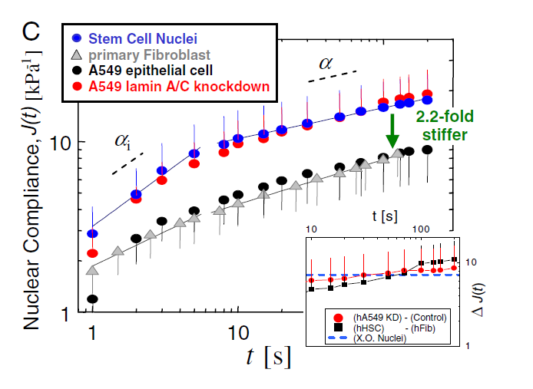
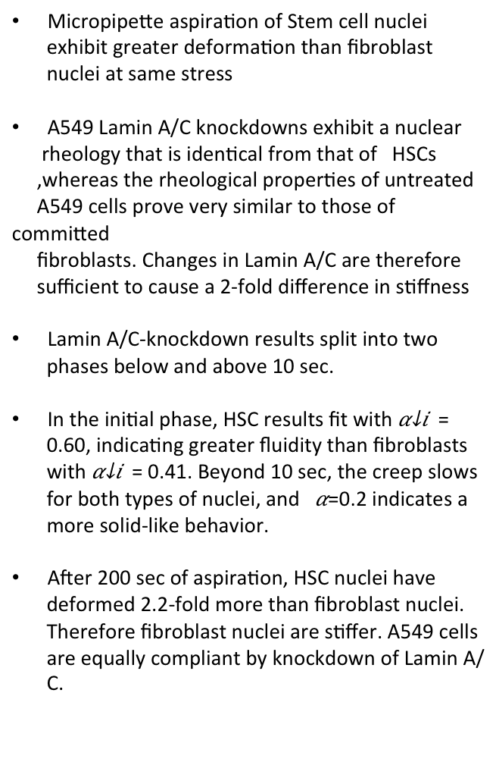
Figure 2c: Md Shafium Hossain
Micropipette aspiration of Stem cell nuclei exhibit greater deformation than fibroblast nuclei at same stress
A549 Lamin A/C knockdowns exhibit a nuclear
rheology that is identical from that of HSCs
,whereas the rheological properties of untreated
A549 cells prove very similar to those of committed
fibroblasts. Changes in Lamin A/C are therefore
sufficient to cause a 2-fold difference in stiffness
Lamin A/C-knockdown results split into two phases below and above 10 sec.
In the initial phase, HSC results fit with = 0.60, indicating greater fluidity than fibroblasts with = 0.41. Beyond 10 sec, the creep slows for both types of nuclei, and =0.2 indicates a more solid-like behavior.
After 200 sec of aspiration, HSC nuclei have deformed 2.2-fold more than fibroblast nuclei. Therefore fibroblast nuclei are stiffer. A549 cells are equally compliant by knockdown of Lamin A/C.

Slide 8
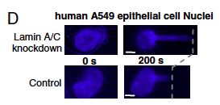
Figure 2d: Andrew Mason

Slide 9

Equations 1-2: Chelsea Orefice

Slide 10
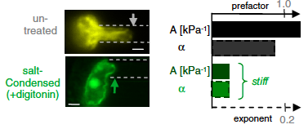
Figure 3: Shayna Nolan

Slide 11
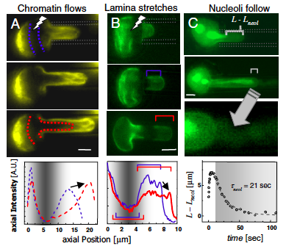
Figure 4: Emma Klinkhamer

Slide 12
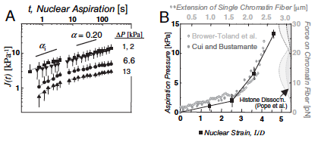
Figure 5: Megan Greiner

Slide 13
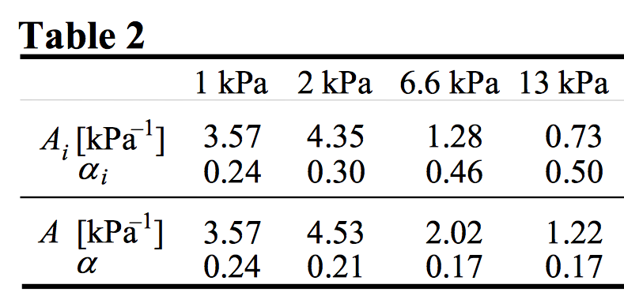
Figure 5
Figure 5A: Applied four different aspiration stresses to nuclei at short and long timescales
α=1 simple fluid, α=0 simple elastic solid
Pajerowski, J. David, et al. "Physical plasticity of the nucleus in stem cell differentiation." Proceedings of the National Academy of Sciences 104.40 (2007): 15619-15624.

Slide 14
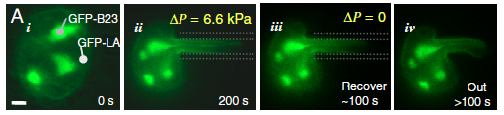
Figure 6a: Jeremy Keys

Slide 15
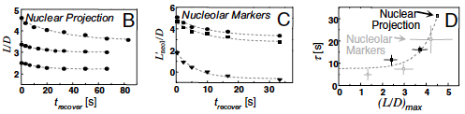
Figure 6b-d: Steven Ayotte

Slide 16
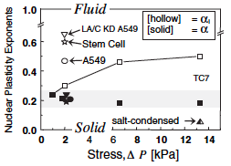
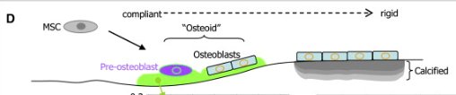
Figure 7: Julie Boshar

Slide 17
Conclusions, from paper and from class discussion
Nuclei of undifferentiated stem cells and Lamin A/C knockdown shows a more fluid-like behavior than solid.
Stress impacts the nuclei display showing a more solid-like behavior.
Cell differentiations seems to have a direct impact in the physical plasticity of the nucleus.
Cells that undergo deformation retain memory of the nucleus shape change.
Proposed future experiments:
  Time-lapse experiments through cells undergoing differentiation to monitor change in nucleus under stress.
  Use a more complicated platform than micropipette to simulate the migration of cells through narrow channels.
  Effect of substrate on the cell deformation behavior.

