Slide 1
NIH Grant Project
ChemEng 575
3/12/15

Slide 2
Outline of Project
Come up with a creative tissue engineering topic to study, advance, and present via an NIH-style grant and class presentation.
4 groups of 4-5: after everything is graded: 50% of your individual, final grade.
Project involves 4 major parts:
  A grant review panel, March 31st, in class (10%)
  A specific aims page, which introduces me to your proposed topic, due April 9th (10%)
  A 6-page grant, that must adhere to the guidelines for an NIH R21 mechanism, due Friday, May 1st (20%)
  A presentation (sales pitch!) on your tissue engineering idea in front of the class. 2 days of presentations: April 23rd and 28th, in class. (10%)

Slide 3
Groups (Made by CATME)
Group 1: April 23rd
Singyuk Hou, Michael Mulroy, Kyle Pariseau, Brittany Shepler, Eric Stowe
Group 2: April 23rd
Dan Ezra Aurian-Blajeni, Alpha Bamba, Michael Grunwald, Akarawin Hongdusit
Group 3: April 28th
Christine Davis, Bobbi Gaspardi, Jemima Lamothe, Thanh Nguyen, Cody Siroka
Group 4: April 28th
Jonathan Hummel, Sarah Johnson, Matt Tiller, Marco Yeung, Ronen Zeidel
ALL PAPERS DUE ON May 1st, 11:59pm

Slide 4
How does one create a new idea?
Lectures and Readings: ideas we discuss in class
  Stem cells for building new replacement tissue
  Driving or studying cell movement, growth, differentiation
  Driving or studying cell-cell and cell-matrix interactions
  Disease specific!
  I HIGHLY RECOMMEND: you come talk to me about the feasibility of your idea (set up an appt.)
New literature research: Library Resources

Slide 5
Grant Writing Guidelines
The “call” for R21s is on:
http://grants.nih.gov/grants/guide/pa-files/pa-10-069.html
The writing guidelines for the grant are here:
http://grants.nih.gov/grants/funding/424/SF424_RR_Guide_General_Adobe_VerB.pdf
Pay attention to section 5.5 (page 112) about the “Research Strategy”. That’s what you need.

Slide 6
Your NIH Grant MUST Include:
Go here for formatting (margins, font size, etc.): http://grants.nih.gov/grants/funding/424/index.htm
Research Plan.
  1 Page (Single Spaced): Specific Aims.
    This can be updated between with the Aims page is due and the full grant is due.
  6 Pages (Single Spaced):
    Significance
      background, relevance to human health
    Innovation
      why it’s so novel, creative, what it will lead to
    Approach
      research methods planned, and including Preliminary Data that you find from other papers
      Benchmarks for success
      Potential pitfalls and solutions
      Future directions
      Timeline
  References
    not part of page limit

Slide 7
Grant Review Day: 10%
In class, we will spend 1 lecture acting like a grant panel (March 31st).
I have 3 grants from previous classes. Everyone in class can see each of the 3 grants. (posted online)
Each group has been formally assigned to review just one of these grants.
Before class (March 31st), each member of the group should independently prepare ~1 page of notes (that you won’t turn in), that include the pros and cons of the grant idea.
Each person should bring a copy of the grant as well to facilitate discussion.
In class, we will go through each grant. For the grant you are officially assigned, you will talk, in class, from your seat, for about 5min, giving a short summary of what was good and bad about the grant.
During this discussion, anyone in class can comment, but you’re only required to talk about the grant you were assigned.
Within your group, before class, assign someone to be the “lead”. This is the person who will start off the discussion. The “lead” reviewer should give a brief overview of the grant, i.e. what they were proposing, what the aims were, etc., and then go into the specific pros and cons. Then, after the lead reviewer, each of the other group members will just go through the pros and cons.
Within your group, assign one person to be the “scribe” for the group. During the discussion, the scribe will take notes on their laptop about what was discussed about the grant. This will be read aloud, at the end of the lecture, to the whole group. Please email me this summary page for your grade by 11:59pm, March 31st (same day). I’m looking for how detailed your reviews were. The summary should be no more than 1 page!
NOTE: the “scribe” also needs to state their own pros and cons that they noticed while reviewing the grant beforehand.
Use this review to help you write your own grants!

Slide 8
The science library is your resource.
Paulina Borrego: Your science librarian. Made a guide for this class.
http://guides.library.umass.edu/ChemEng590B
Go talk to her if you need some help finding papers!
Most importantly, on this page are links to Databases, which you can use to find papers.
  Web of Science, PubMed, SciFinder Web, Google Scholar.
My favorite: PubMed. http://www.ncbi.nlm.nih.gov/pubmed

Slide 9
Referencing
The easiest way to reference papers is to use an automated software. I use EndNote, but most people at UMass use RefWorks (it’s free!)
http://guides.library.umass.edu/content.php?pid=24130&sid=173734
Very easy to use: find the paper in RefWorks, add it to your bibliography, and then insert into document.
Microsoft Word also has a built in referencing tool, but I don’t know how to use it.
If you don’t use a software, then you have to manually enter, and it’s VERY EASY to make a mistake.
Easiest method: numbered references.
Do not include ANY WEBSITE ADDRESSES in your references.
No reference should include the ‘date accessed’
No reference should include ‘print’ or ‘web’

Slide 10
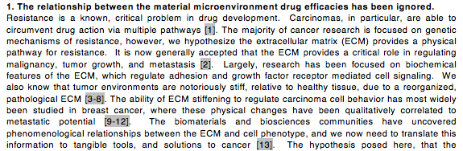
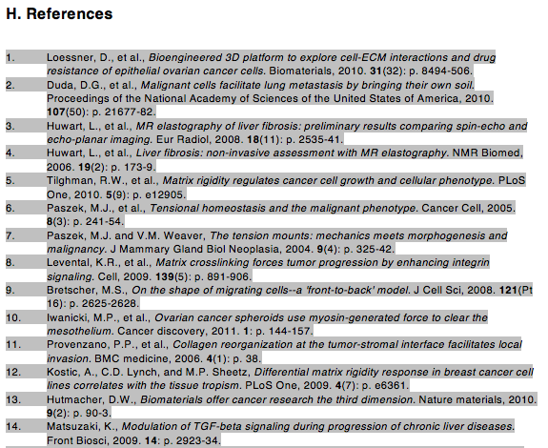
Sample Text with References

Slide 11
Some General Writing Tips: From Experience from Previous Classes
Don't cite review papers. Use review papers to get the actual experimental papers, and cite those.
When I suggest a length - do your best to hit it. That is the length I think you need to be convincing, and your grade will reflect that.
Use commas. In general, from the research papers I’ve graded for both sophomores and seniors, you use about 50% of the commas you need to use. When in doubt, add one.
Proofread! write well! Spend time on the writing. Just because you are an engineer doesn't mean you don't have to know how to write. Communication of your ideas is the 2nd most important part of being a scientist.
Break up your paragraphs. 4-5 sentences per paragraph is a good rule of thumb, but anytime you start a new thought, that's a new paragraph.
Be clear!!! If I can't tell what you're saying, too late. Have a friend read it, or just read it over yourself. My strategy with my own writing is to print it out and read it, because I catch things that way, which I would otherwise miss.
Make it impersonal. Things I catch that aren't appropriate are: "comes to mind" "in my opinion" "I believe/hope" "my research", etc. Unless, of course, I specifically ask for your opinion. Then, ideally, say, “I hypothesize”…
No 2nd person either. "You would want to use", etc. For NIH, first person is best, and stay consistent.
Keep your tenses consistent.
No passive voice. This is tough, and something I still struggle with! But that type of writing is the easiest and most fun to read.

Slide 12
What is Passive Voice?
This is when the object of the sentence appears as the subject of the sentence.
  PV: The experiment was performed by the engineer.
  Fixed: The engineer performed the experiment.
http://www.dailywritingtips.com/7-examples-of-passive-voice/
Another helpful book: Strunk and White, The Elements of Style.

Slide 13
Specific Aims Page: 10%
Due April 9th, in class
  1 page introduction of project. No more than 1 page!
  It’s a good idea to come talk to me about your idea before you write this up and turn it in.
  I have an example of a funded specific aims page (online)
  You can modify this after the graded feedback, because you will turn it in again with your final grant.
  There are no references in the specific aims page. If you would like to include some references for me to see, attach another page, but don’t reference them in the text.

Slide 14
Note about Presentation Dates
Dates: April 23rd and 28th
Remember, this is a sales pitch for your idea.
You need to get across:
  The human health problem is real and needs novel solutions, approaches
  The literature backs up the fact that your idea will work
  That your idea is awesome and novel
  That your idea will work if you are funded! (find preliminary data from the literature)
Everyone must be at all the presentations. Groups will be partly graded by classmates, and turning your evaluation of the other groups is mandatory.
  You can find this form on the Documents Wiki Page

Slide 15
The most important thing you can do is…..
Proofread. Not just you, but get it done early and send to a peer. They can catch mistakes that you will miss.
Come talk to me!! Send a group member (or even better, all of you) to talk to me once a week. I will give you critical feedback. Better to get some constructive comments back from me in person than on your grade!
  I can also show you examples of my grants to help you with organization.

