Slide 1
Baccelerator
Overview
Assembly strategy
Testing strategy
Issues
Modelling

Slide 2
Current Mechanism
Activation
signal
C
Viral Protease
Pre-made FRET pair
Coloured products

Slide 3
K 74
1
2
Ex
Int_{A1}
CMD
stop
LacI
stop
Suffix
Ex
Int_{A2}
sp
3
p SB1C

Slide 4
1
2
Ex
Int_{A}
CMD
stop
Int_{A2}
sp
3
p SB1C

Slide 5
Int_{A1}
SPEC
stop
Int_{A2}
1
Int_{A1}
SPEC
stop
Int_{A2}
2
Int_{A1}
SPEC
stop
Int_{A2}

Slide 6
3
Int_{P1}
SPEC
stop
Int_{P2}
p SB1C3

Slide 7
Pyrd
RC
Coil (Reporter)
Com E
Com D
Surface Protein
AmyE
RC
LacI
stop
Lac I
binding
Coil (Reporter)
TEV

Slide 8
Surface Display

Slide 9
Cell Wall Proteins
CwlC
  765bp
  2 cell wall binding repeats
LytC
  1488bp
  3 cell wall binding repeats

Slide 10
Previous Research
Everything except the CWBs removed
Both successfully attached to a lipase
Retained function on the cell surface
When both combined, 36% of cell wall protein
B. sub native so can perform PCR
Linker/peptide can be attached to primer

Slide 11
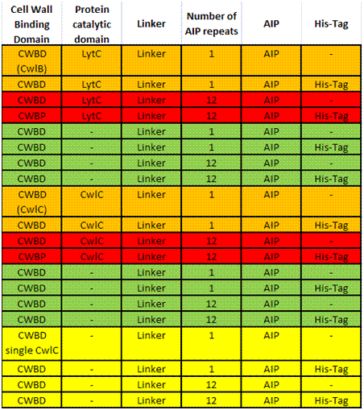
Options

Slide 12
Testing
Increased salt concentration disrupts CWB
  Can test for production and rough localisation
Attach His-tag and linker
  Can test for precise localisation and cleavage

Slide 13
Modelling
10 ng/ml is the required conc. of the peptide to activate ComD
2.24 kDa is the mass of the peptide
If there is total cleavage in a small area, resultant conc. is 1000x required
750nm
200nm

Slide 14
Additional
Two BioBricks
  Schistosoma protease specific linker/signal, which could be formed into a series of parts responding to different parasites
  Cell wall binding segment, which when attached would allow you to display anything on the surface of B. sub

Slide 15
Modelling

Slide 16


GFP

Slide 17



GFP
GFP
TEV

Slide 18


GFP
TEVs
TEV

Slide 19
GFP
TEVs
HIV1

Slide 20
GFP

Slide 21
GFP
TEV

Slide 22
GFP
TEVs
TEV

Slide 23
GFP
TEVs
HIV1

Slide 24
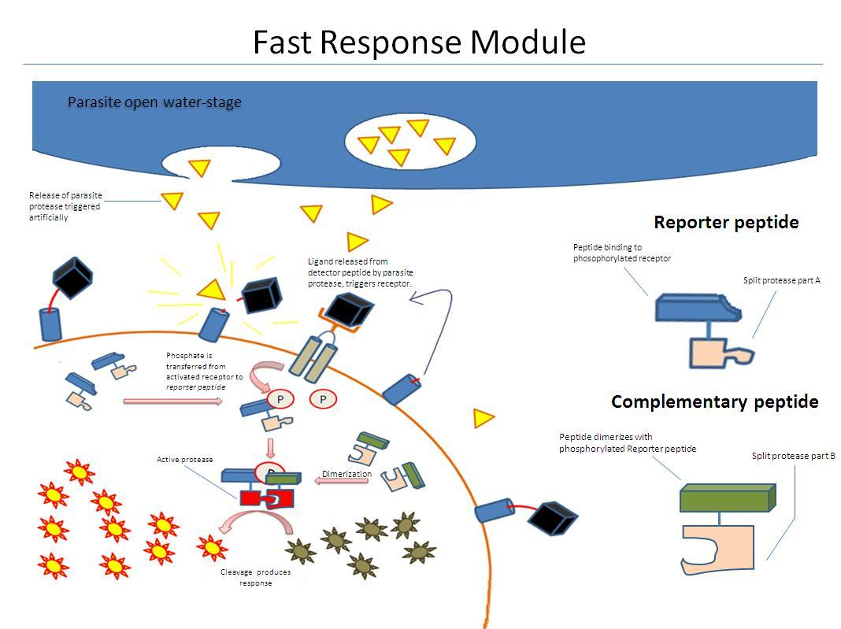

Slide 25
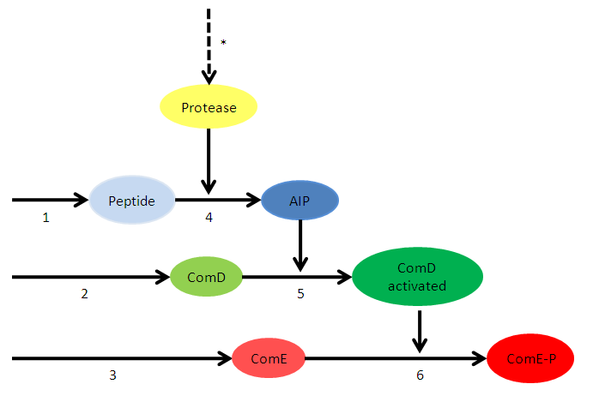
The System
1. Transcription and translation of Protease detector Peptide
2. Transcription and translation of ComD
3. Transcription and translation of ComE
4. Cleavage of AIP, activated by Protease
5. Activation of ComD receptor, reaction activated by AIP
6. Phosphorylation of ComE, activated by ComD receptor
* Release of Protease (artificially triggered)

Slide 26



Equations
1. Transcription and translation of Protease detector Peptide
2. Transcription and translation of ComD
3. Transcription and translation of ComE

Slide 27



Equations
4. Cleavage of AIP, activated by Protease
5. Activation of ComD receptor, reaction activated by AIP
6. Phosphorylation of ComE, activated by ComD receptor

