Slide 1
Comparison of the wild type of S. cerevisiae and S. paradoxus
Karina Alvarez and Natalie Williams

Slide 2
The WT of S. cerevisiae shows a higher percentage of significance with all p-values in the NSR1 gene than in S. paradoxus’.
 | S. cerevisiae | S. paradoxus
p < 0.05 | 38.42 % | 36.55%
p < 0.01 | 24.67% | 22.62%
p < 0.001 | 13.90% | 11.05%
p < 0.0001 | 7.43% | 5.073%
B-H p < 0.05 | 26.76% | 24.25%
Bonferroni p < 0.05 | 3.86% | 2.343%

Slide 3
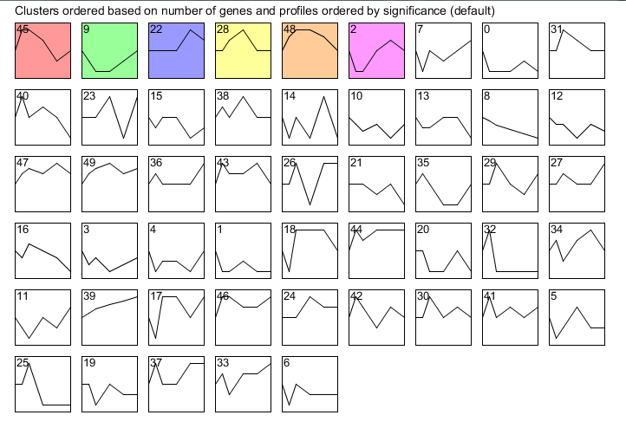
Results of stem show 6 different profiles, signifying that S. par has a collection of genes that reacts to cold shock.

Slide 4
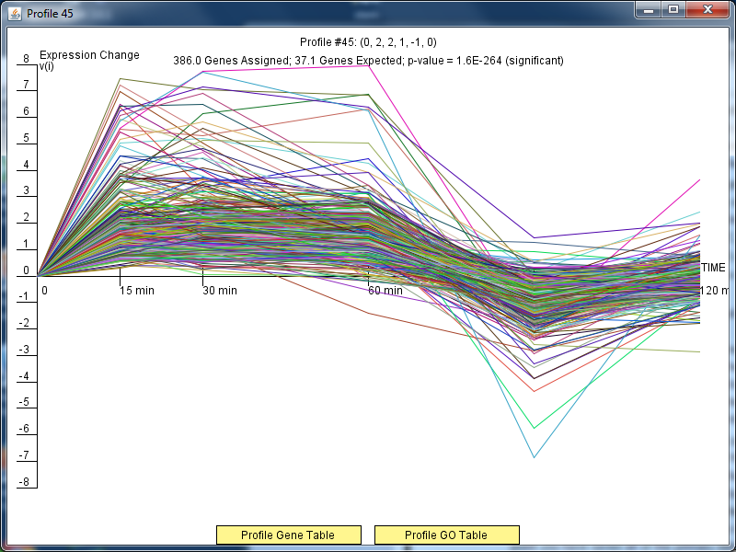
Profile #45 contains genes that are activated during cold shock and then are repressed during the recovery phase. S. paradoxus

Slide 5
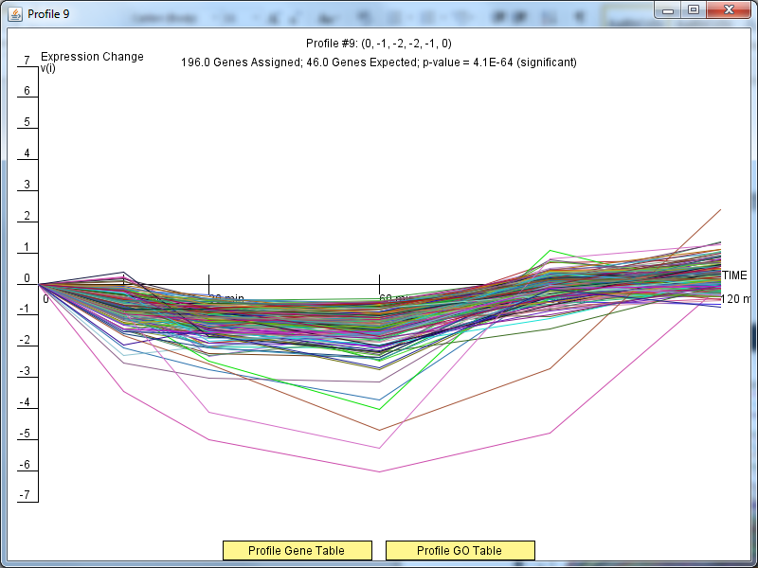
Profile #9 shows genes that are generally repressed throughout the cold shock and gradually reach activation later in the recovery phase. S. paradoxus

Slide 6
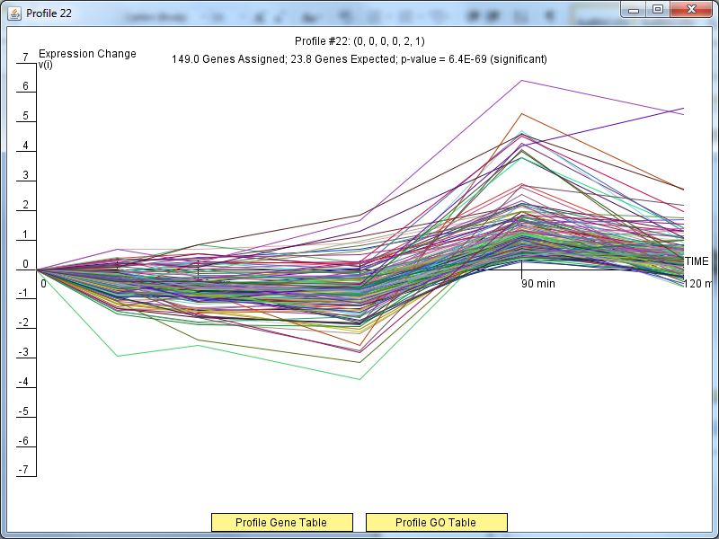
Profile #22 shows genes that do not have a significant level of expression during cold shock, but in the recovery phase, they are highly activated. S. paradoxus

Slide 7
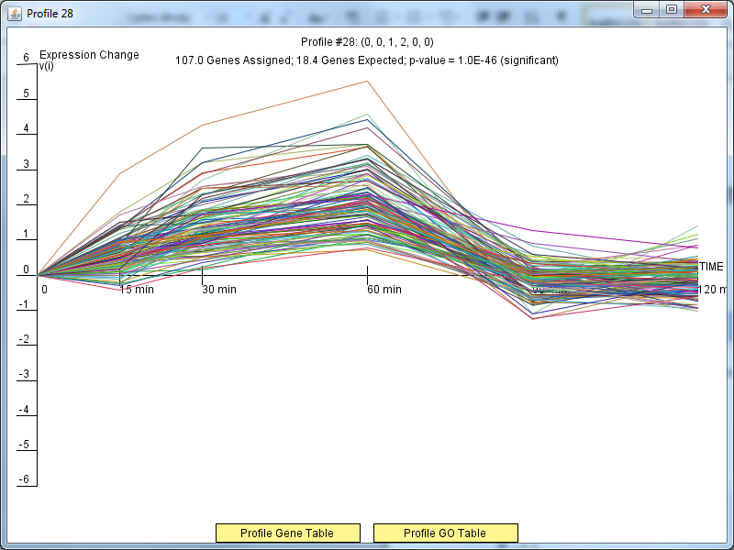
Profile #28 shows genes that are activated and then reach a level of steady expression close to 0 or no expression. S. paradoxus

Slide 8
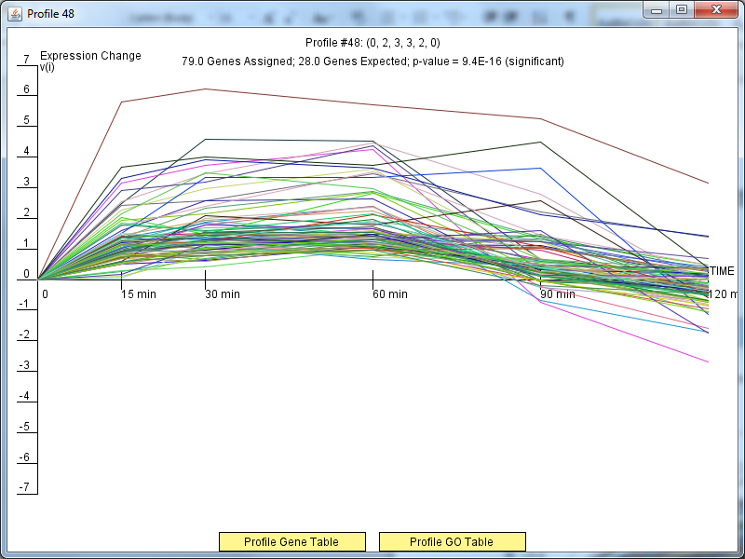
Profile #48 shows fewer genes than previous profiles and that those genes are activated before reaching decreased expression levels. S. paradoxus

Slide 9
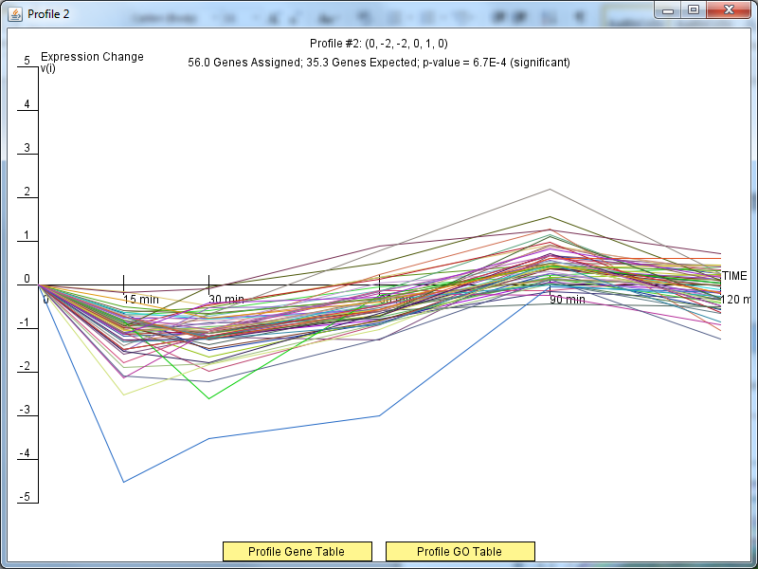
Profile #2 shows genes that are decreased initially in cold shock and during recovery phase are activated. S. paradoxus

