Slide 1
The Digestive System and Body Metabolism
Digestion
  Breakdown of ingested food
  Absorption of nutrients into the blood
Metabolism
  Production of cellular energy (ATP)
  Constructive and degradative cellular activities

Slide 2
Five Tasks of the Digestive System
Mechanical processing
  Chewing
  Peristalsis (squeezing of digestive tube)
Secretion of enzymes
Chemical digestion of food
Absorption of nutrients
Elimination of feces (unwanted stuff)

Slide 3
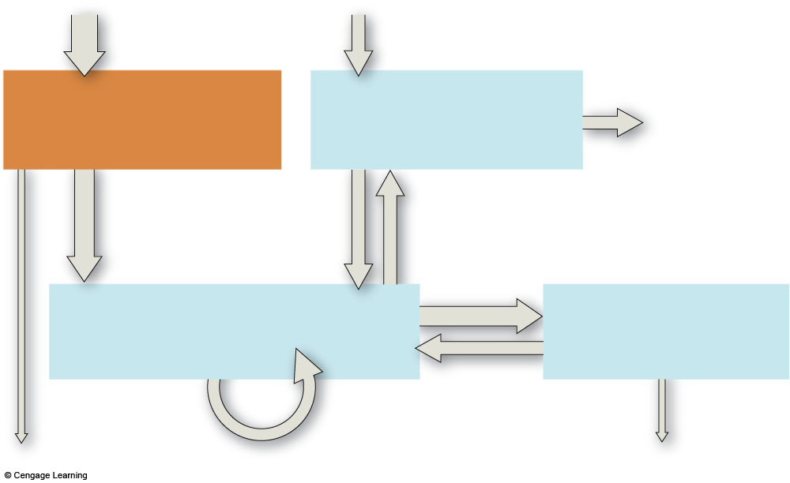
food, water intake
oxygen intake
Digestive
System
Respiratory
System
elimination
of carbon
dioxide
nutrients,
water,
salts
oxygen
carbon
dioxide
Circulatory
System
Urinary
System
water,
solutes
elimination
of food
residues
rapid transport
to and from all
living cells
elimination of
excess water,
salts, wastes
Fig. 37.3, p.618

Slide 4
Organs of the Digestive System
Two main groups
  Alimentary canal – continuous coiled hollow tube
  Accessory digestive organs

Slide 5
Organs of the Alimentary Canal
Mouth
Pharynx
Esophagus
Stomach
Small intestine
Large intestine
Anus

Slide 6
Accessory Digestive Organs
Salivary glands
Teeth
Pancreas
Liver
Gall bladder

Slide 7
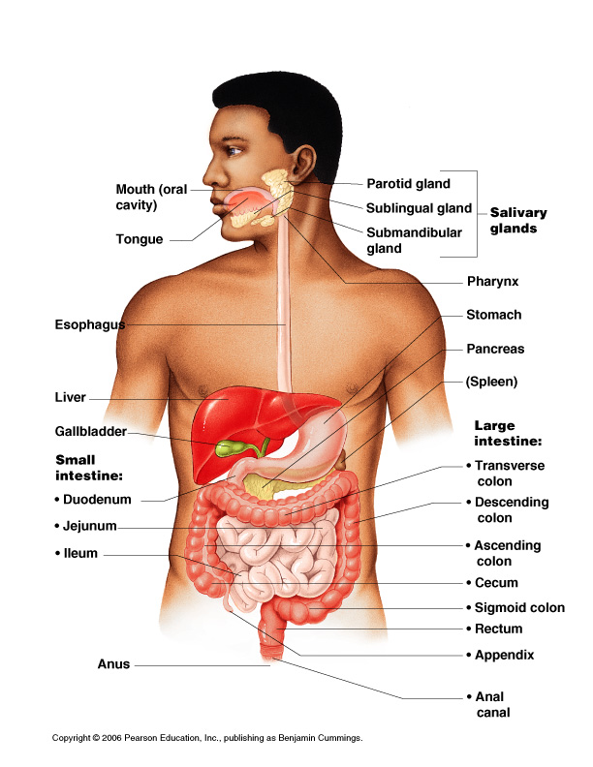
Organs of the Digestive System
Figure 14.1

Slide 8
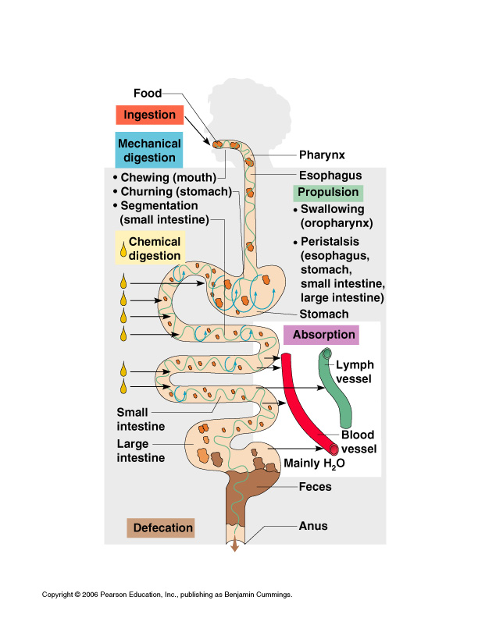
Figure 14.11

Slide 9
Processes of the Digestive System
Ingestion – getting food into the mouth
Propulsion – moving foods from one region of the digestive system to another

Slide 10
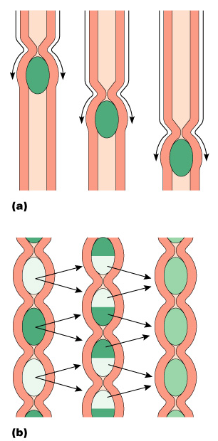
Processes of the Digestive System
Peristalsis – alternating waves of contraction
Segmentation – moving materials back and forth to aid in mixing
Figure 14.12

Slide 11
Processes of the Digestive System
Mechanical digestion
  Mixing of food in the mouth by the tongue
  Churning of food in the stomach
  Segmentation in the small intestine

Slide 12
Processes of the Digestive System
Chemical Digestion
  Enzymes break down food molecules into their building blocks
  Each major food group uses different enzymes
    Carbohydrates are broken to simple sugars
    Proteins are broken to amino acids
    Fats are broken to fatty acids and alcohols

Slide 13
Processes of the Digestive System
Absorption
  End products of digestion are absorbed in the blood or lymph
  Food must enter mucosal cells and then into blood or lymph capillaries
Defecation
  Elimination of indigestible substances as feces

Slide 14
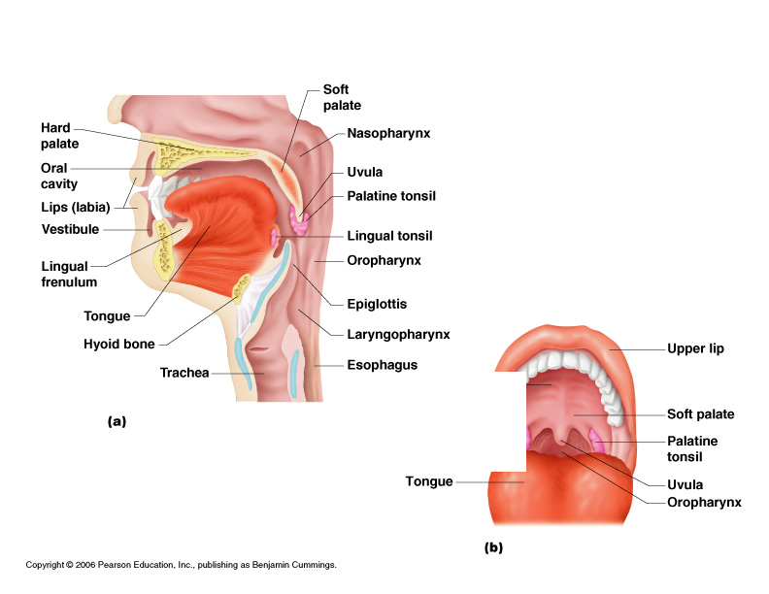
Mouth (Oral Cavity) Anatomy
Lips (labia) – protect
the anterior opening
Cheeks – form the
lateral walls
Hard palate – forms
the anterior roof
Soft palate – forms
the posterior roof
Uvula – fleshy
projection of the
soft palate
Figure 14.2a

Slide 15
Mouth (Oral Cavity) Anatomy
Vestibule – space between lips externally and teeth and gums internally
Oral cavity – area contained by the teeth
Tongue – attached at hyoid and styloid processes of the skull, and by the lingual frenulum
Figure 14.2a

Slide 16
Mouth (Oral Cavity) Anatomy
Tonsils
  Palatine tonsils
  Lingual tonsil
Figure 14.2a

Slide 17
Teeth
The role is to masticate (chew) food
Humans have two sets of teeth
  Deciduous (baby or milk) teeth
  20 teeth are fully formed by age two

Slide 18
Teeth
Permanent teeth
  Replace deciduous teeth beginning between the ages of 6 to 12
  A full set is 32 teeth, but some people do not have wisdom teeth

Slide 19
Classification of Teeth
Incisors
Canines
Premolars
Molars

Slide 20
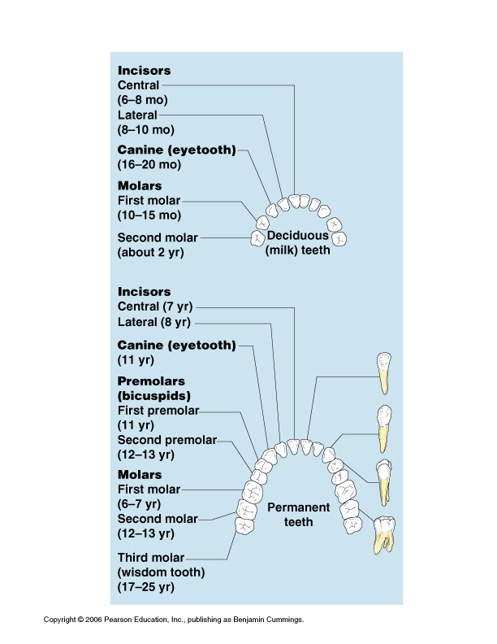
Classification of Teeth
Figure 14.9

Slide 21
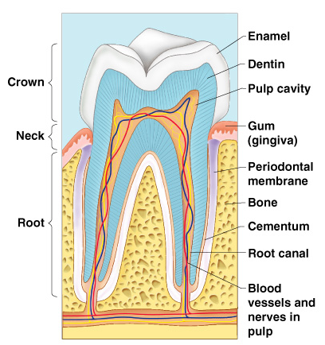
Regions of a Tooth
Crown – exposed part
  Outer enamel
  Dentin
  Pulp cavity
Neck
  Region in contact with the gum
  Connects crown to root
Figure 14.10

Slide 22
Regions of a Tooth
Root
  Periodontal membrane attached to the bone
  Root canal carrying blood vessels and nerves
Figure 14.10

Slide 23
Salivary Glands
Saliva-producing glands
  Parotid glands – located anterior to ears
  Submandibular glands
  Sublingual glands

Slide 24
Saliva
Mixture of mucus and serous fluids
Helps to form a food bolus
Contains salivary amylase to begin starch digestion
Dissolves chemicals so they can be tasted

Slide 25
Processes of the Mouth
Mastication (chewing) of food
Mixing masticated food with saliva
Initiation of swallowing by the tongue
Allowing for the sense of taste

Slide 26
Digestive Activities of the Mouth
Mechanical breakdown
  Food is physically broken down by chewing
Chemical digestion
  Food is mixed with saliva
  Breaking of starch into maltose by salivary amylase

Slide 27
Pharynx Anatomy
Nasopharynx –
not part of the digestive system
Oropharynx – posterior to oral cavity
Laryngopharynx – below the oropharynx and connected to
the esophagus
Figure 14.2a

Slide 28
Pharynx Function
Serves as a passageway for air and food
Food is propelled to the esophagus by two muscle layers
  Longitudinal inner layer
  Circular outer layer
Food movement is by alternating contractions of the muscle layers (peristalsis)

Slide 29
Deglutition (Swallowing)
Buccal phase
  Voluntary
  Occurs in the mouth
  Food is formed into a bolus
  The bolus is forced into the pharynx by the tongue

Slide 30
Deglutition (Swallowing)
Pharyngeal-esophageal phase
  Involuntary transport of the bolus
  All passageways except to the stomach are blocked
    Tongue blocks off the mouth
    Soft palate (uvula) blocks the nasopharynx
    Epiglottis blocks the larynx

Slide 31
Deglutition (Swallowing)
Pharyngeal-esophogeal phase (continued)
  Peristalsis moves the bolus toward the stomach
  The cardioesophageal sphincter is opened when food presses against it

Slide 32
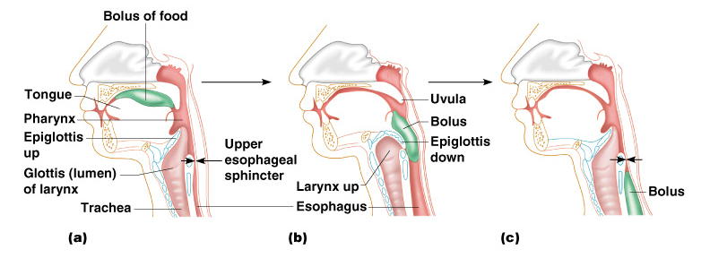
Deglutition (Swallowing)
Figure 14.14

Slide 33
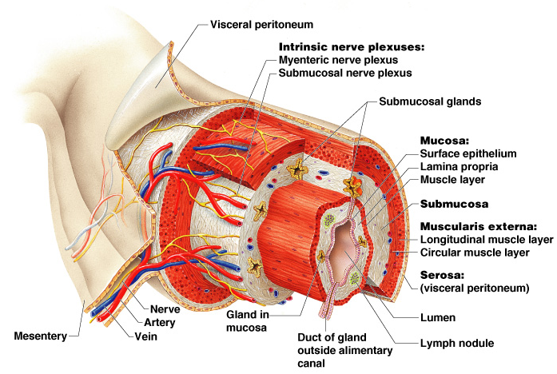
Layers of Alimentary Canal Organs
Figure 14.3

Slide 34
Layers of Alimentary Canal Organs
Mucosa
  Innermost layer
  Moist membrane
    Surface epithelium
    Small amount of connective tissue
    (lamina propria)
    Small smooth muscle layer

Slide 35
Layers of Alimentary Canal Organs
Submucosa
  Just beneath the mucosa
  Soft connective tissue with blood vessels, nerve endings, and lymphatics

Slide 36
Layers of Alimentary Canal Organs
Muscularis externa – smooth muscle
  Inner circular layer
  Outer longitudinal layer
Serosa
  Outermost layer – visceral peritoneum
  Layer of serous fluid-producing cells

Slide 37
Esophagus
Runs from pharynx to stomach through the diaphragm
Conducts food by peristalsis
(slow rhythmic squeezing)
Passageway for food only (respiratory system branches off after the pharynx)

Slide 38
Activities of the Pharynx and Esophagus
These organs have no digestive function
Serve as passageways to the stomach

Slide 39
Stomach Anatomy
Located on the left side of the abdominal cavity
Food enters at the cardioesophageal sphincter

Slide 40
Stomach Anatomy
Regions of the stomach
  Cardiac region – near the heart
  Fundus
  Body
  Phylorus – funnel-shaped terminal end
Food empties into the small intestine at the pyloric sphincter

Slide 41
Stomach Anatomy
Rugae – internal folds of the mucosa
External regions
  Lesser curvature
  Greater curvature

Slide 42
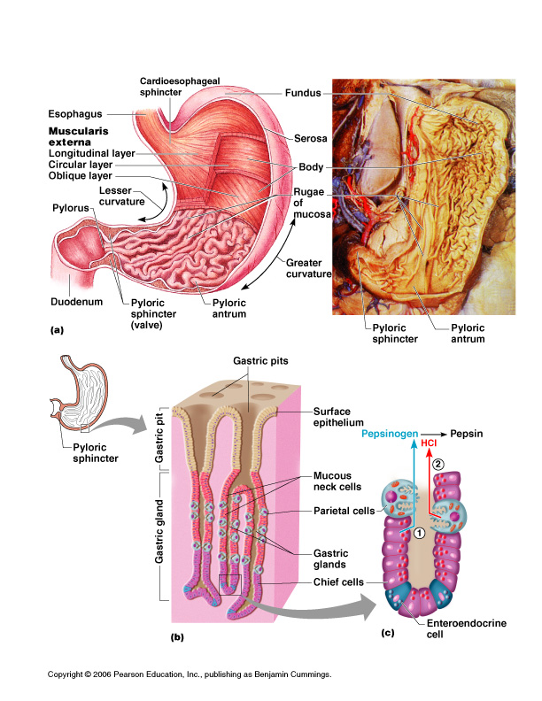
Stomach Anatomy
Figure 14.4a

Slide 43
Stomach Functions
Acts as a storage tank for food
Site of food breakdown
Chemical breakdown of protein begins
Delivers chyme (processed food) to the small intestine

Slide 44
Structure of the Stomach Mucosa
Figure 14.4b–c

Slide 45
Specialized Mucosa of the Stomach
Simple columnar epithelium
  Mucous neck cells – produce a sticky alkaline mucus
  Gastric glands – secrete gastric juice
  Chief cells – produce protein-digesting enzymes (pepsinogens)
  Parietal cells – produce hydrochloric acid
  Endocrine cells – produce gastrin

Slide 46
Structure of the Stomach Mucosa
Gastric pits formed by folded mucosa
Glands and specialized cells are in the gastric gland region

Slide 47
Food Breakdown in the Stomach
Gastric juice is regulated by neural and hormonal factors
Presence of food or falling pH causes the release of gastrin
Gastrin causes stomach glands to produce protein-digesting enzymes
Hydrocholoric acid makes the stomach contents very acidic

Slide 48
Necessity of an Extremely Acid Environment in the Stomach
Activates pepsinogen to pepsin for protein digestion
Provides a hostile environment for microorganisms

Slide 49
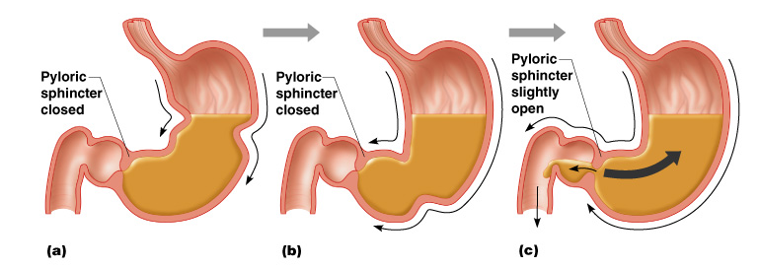
Propulsion in the Stomach
Food must first be well mixed
Rippling peristalsis occurs in the lower stomach
Figure 14.15

Slide 50
Propulsion in the Stomach
The pylorus meters out chyme into the small intestine (30 ml at a time)
The stomach empties in four to six hours
Figure 14.15

Slide 51
Digestion and Absorption in the Stomach
Protein digestion enzymes
  Pepsin – an active protein digesting enzyme
  Rennin – works on digesting milk protein
The only absorption that occurs in the stomach is of alcohol and aspirin

Slide 52
Small Intestine
The body’s major digestive organ
Site of nutrient absorption into the blood
Muscular tube extending form the pyloric sphincter to the ileocecal valve
Suspended from the posterior abdominal wall by the mesentery

Slide 53
Subdivisions of the Small Intestine
Duodenum
  Attached to the stomach
  Curves around the head of the pancreas
Jejunum
  Attaches anteriorly to the duodenum
Ileum
  Extends from jejunum to large intestine

Slide 54
Chemical Digestion in the Small Intestine
Source of enzymes that are mixed with chyme
  Intestinal cells
  Pancreas
Bile enters from the gall bladder

Slide 55
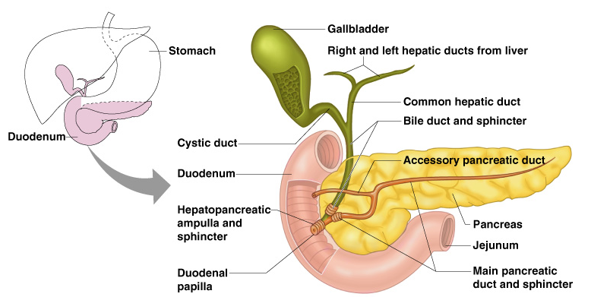
Chemical Digestion in the Small Intestine
Figure 14.6

Slide 56
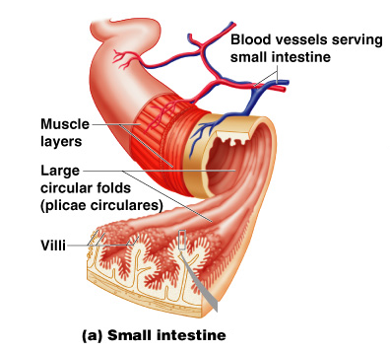
Villi of the Small Intestine
Fingerlike structures formed by the mucosa
Give the small intestine more surface area
Figure 14.7a

Slide 57
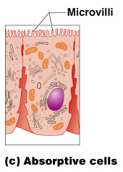
Microvilli of the Small Intestine
Small projections of the plasma membrane
Found on absorptive cells
Figure 14.7c

Slide 58
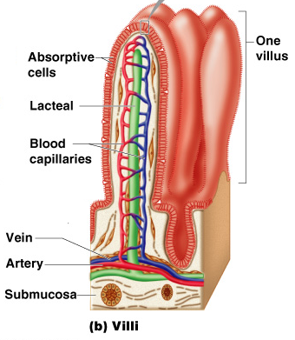
Structures Involved in Absorption of Nutrients
Absorptive cells
Blood capillaries
Lacteals (specialized lymphatic capillaries)
Figure 14.7b

Slide 59
Folds of the Small Intestine
Called circular folds or plicae circulares
Deep folds of the mucosa and submucosa
Do not disappear when filled with food
The submucosa has Peyer’s patches (collections of lymphatic tissue)

Slide 60
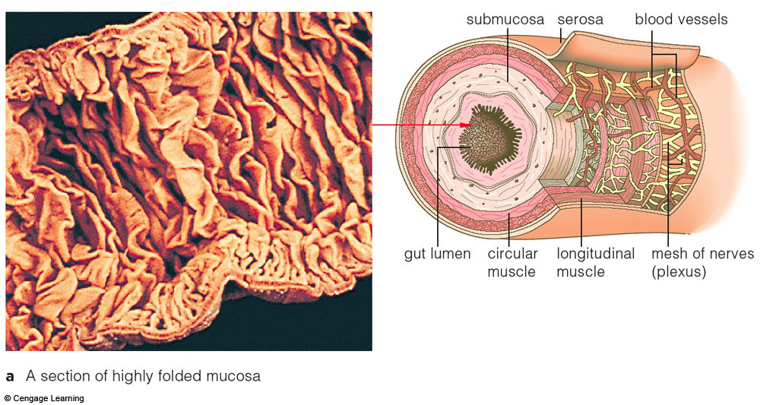
Fig. 37.9a, p.623

Slide 61
Digestion in the Small Intestine
Enzymes from the brush border
  Break double sugars into simple sugars
  Complete some protein digestion
Pancreatic enzymes play the major digestive function
  Help complete digestion of starch (pancreatic amylase)
  Carry out about half of all protein digestion (trypsin, etc.)

Slide 62
Digestion in the Small Intestine
Pancreatic enzymes play the major digestive function (continued)
  Responsible for fat digestion (lipase)
  Digest nucleic acids (nucleases)
  Alkaline content neutralizes acidic chyme

Slide 63
Absorption in the Small Intestine
Water is absorbed along the length of the small intestine
End products of digestion
  Most substances are absorbed by active transport through cell membranes
  Lipids are absorbed by diffusion
Substances are transported to the liver by the hepatic portal vein or lymph

Slide 64
Propulsion in the Small Intestine
Peristalsis is the major means of moving food
Segmental movements
  Mix chyme with digestive juices
  Aid in propelling food

Slide 65
Pancreas
Produces a wide spectrum of digestive enzymes that break down all categories of food
Enzymes are secreted into the duodenum
Alkaline fluid introduced with enzymes neutralizes acidic chyme
Endocrine products of pancreas
  Insulin
  Glucagons

Slide 66
Liver
Largest gland in the body
Located on the right side of the body under the diaphragm
Consists of four lobes suspended from the diaphragm and abdominal wall by the falciform ligament
Connected to the gall bladder via the common hepatic duct

Slide 67
Bile
Produced by cells in the liver
Composition
  Bile salts
  Bile pigment (mostly bilirubin from the breakdown of hemoglobin)
  Cholesterol
  Phospholipids
  Electrolytes

Slide 68
Gall Bladder
Sac found in hollow fossa of liver
Stores bile from the liver by way of the cystic duct
Bile is introduced into the duodenum in the presence of fatty food
Gallstones can cause blockages

Slide 69
Large Intestine
Larger in diameter, but shorter than the small intestine
Frames the internal abdomen

Slide 70
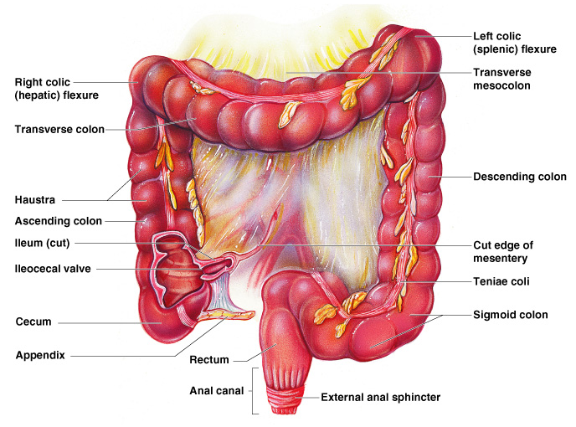
Large Intestine
Figure 14.8

Slide 71
Functions of the Large Intestine
Absorption of water
Eliminates indigestible food from the body as feces
Does not participate in digestion of food
Goblet cells produce mucus to act as a lubricant

Slide 72
Structures of the Large Intestine
Cecum – saclike first part of the large intestine
Appendix
  Accumulation of lymphatic tissue that sometimes becomes inflamed (appendicitis)
  Hangs from the cecum

Slide 73
Structures of the Large Intestine
Colon
  Ascending
  Transverse
  Descending
  S-shaped sigmoidal
Rectum
Anus – external body opening

Slide 74
Food Breakdown and Absorption in the Large Intestine
No digestive enzymes are produced
Resident bacteria digest remaining nutrients
  Produce some vitamin K and B
  Release gases
Water and vitamins K and B are absorbed
Remaining materials are eliminated via feces

Slide 75
Propulsion in the Large Intestine
Sluggish peristalsis
Mass movements
  Slow, powerful movements
  Occur three to four times per day
Presence of feces in the rectum causes a defecation reflex
  Internal anal sphincter is relaxed
  Defecation occurs with relaxation of the voluntary (external) anal sphincter

Slide 76
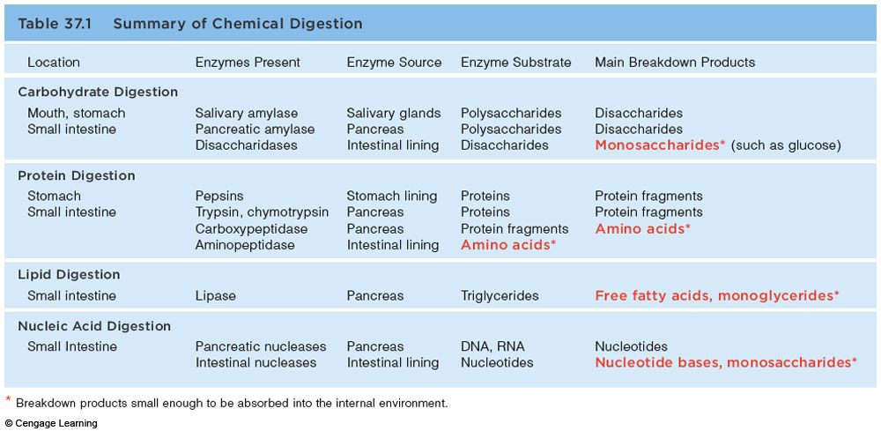
Chemical Digestion

Slide 77
Figure 14.11

Slide 78
Control of Digestive Activity
Mostly controlled by reflexes via the parasympathetic division
Chemical and mechanical receptors are located in organ walls that trigger reflexes

Slide 79
Control of Digestive Activity
Stimuli include:
  Stretch of the organ
  pH of the contents
  Presence of breakdown products
Reflexes include:
  Activation or inhibition of glandular secretions
  Smooth muscle activity

Slide 80
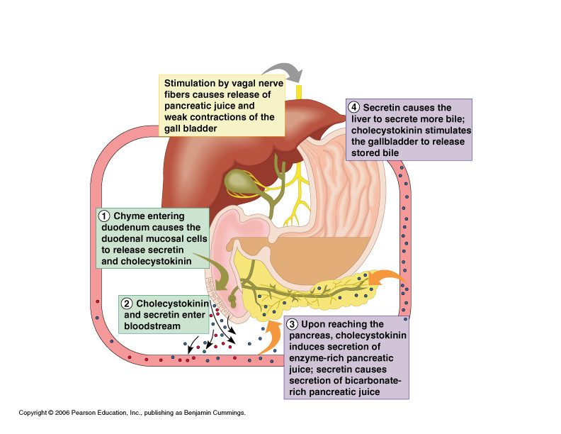
Stimulation of the Release of Pancreatic Juice
Vagus nerve
Local hormones
  Secretin
  Cholecystokinin
Figure 14.16

Slide 81
Nutrition
Nutrient – substance used by the body for growth, maintenance, and repair
Categories of nutrients
  Carbohydrates
  Lipids
  Proteins
  Vitamins
  Mineral
  Water

Slide 82
Dietary Sources of Major Nutrients
Carbohydrates
  Most are derived from plants
  Exceptions: lactose from milk and small amounts of glycogens from meats
Lipids
  Saturated fats from animal products
  Unsaturated fats from nuts, seeds, and vegetable oils
  Cholesterol from egg yolk, meats, and milk products

Slide 83
Dietary Sources of Major Nutrients
Proteins
  Complete proteins – contain all essential amino acids
    Most are from animal products
  Legumes and beans also have proteins, but are incomplete
Vitamins
  Most vitamins are used as cofactors and act with enzymes
  Found in all major food groups

Slide 84
Dietary Sources of Major Nutrients
Minerals
  Play many roles in the body
  Most mineral-rich foods are vegetables, legumes, milk, and some meats

Slide 85
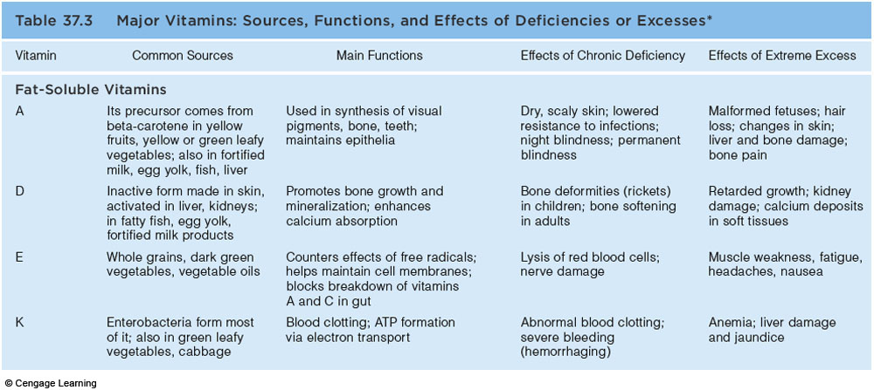
Major Vitamins

Slide 86
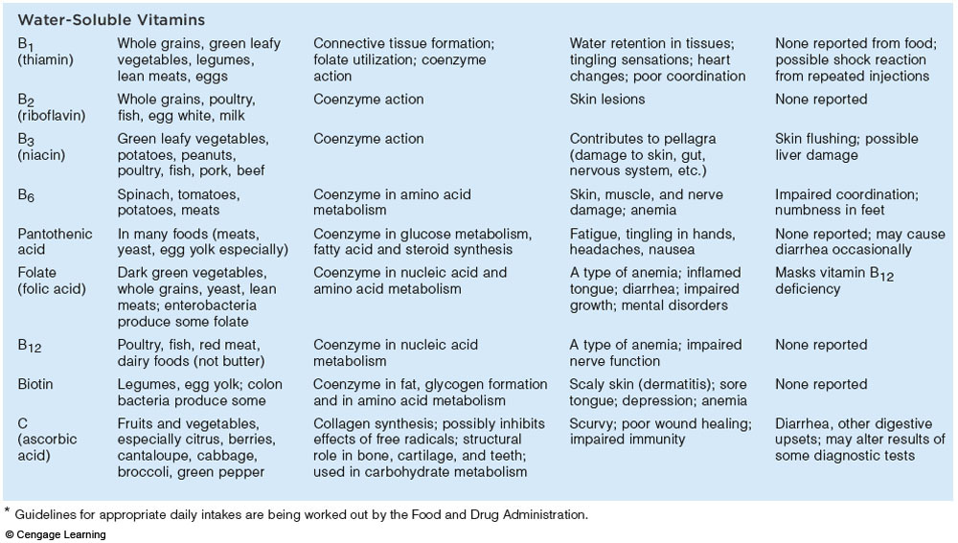
Major Vitamins

Slide 87
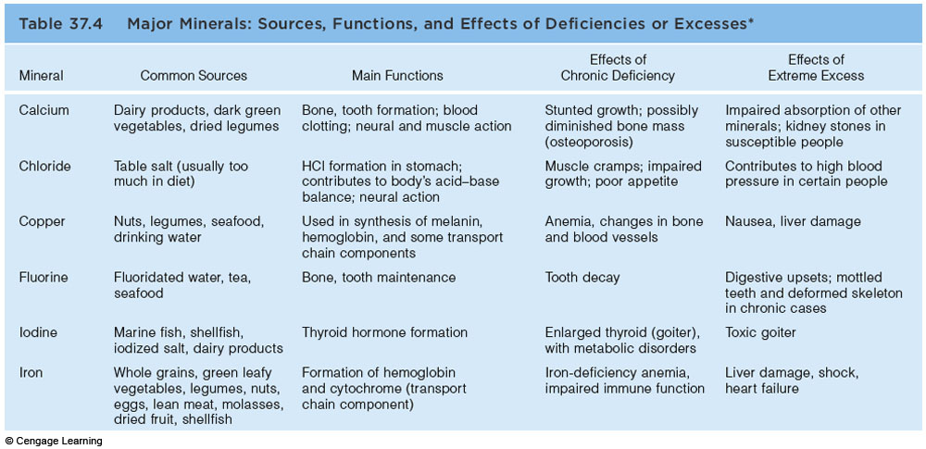
Major Minerals

Slide 88
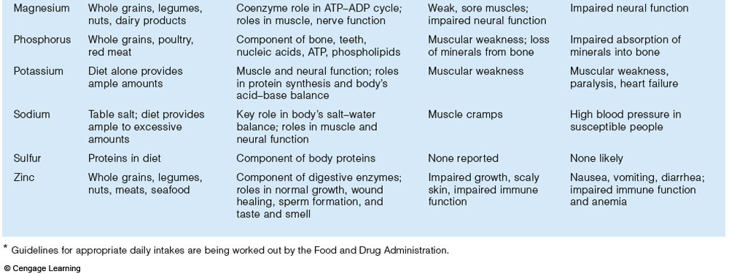
Major Minerals

Slide 89
Metabolism
Chemical reactions necessary to maintain life
  Catabolism – substances are broken down to simpler substances
  Anabolism – larger molecules are built from smaller ones
  Energy is released during catabolism

Slide 90
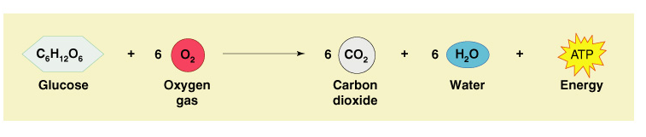
Carbohydrate Metabolism
The body’s preferred source to produce cellular energy (ATP)
Glucose (blood sugar) is the major breakdown product and fuel to make ATP
Figure 14.17

Slide 91
Cellular Respiration
Oxygen-using events take place within the cell to create ATP from ADP
Carbon leaves cells as carbon dioxide (CO₂)
Hydrogen atoms are combined with oxygen to form water
Energy produced by these reactions adds a phosphorus to ADP to produce ATP
ATP can be broken down to release energy for cellular use

Slide 92
Metabolic Pathways Involved in Cellular Respiration
Glycolysis – energizes a glucose molecule so that it can be split into two pyruvic acid molecules and yield ATP

Slide 93
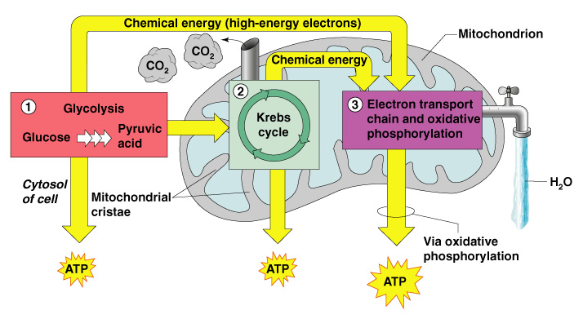
Metabolic Pathways Involved in Cellular Respiration
Figure 14.18

Slide 94
Metabolic Pathways Involved in Cellular Respiration
Krebs cycle
  Produces virtually all the carbon dioxide and water resulting from cell respiration
  Yields a small amount of ATP

Slide 95
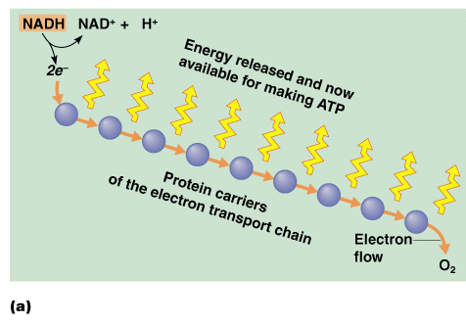
Metabolic Pathways Involved in Cellular Respiration
Electron transport chain
  Hydrogen atoms
  removed during
  glycolysis and
  the Krebs cycle
  are delivered to
  protein carriers
Figure 14.19a

Slide 96
Metabolic Pathways Involved in Cellular Respiration
Electron transport chain (continued)
  Hydrogen is
  split into
  hydrogen ions
  and electrons
  in the
  mitochondria
Figure 14.19a

Slide 97
Fat Metabolism
Handled mostly by the liver
  Use some fats to make ATP
  Synthesize lipoproteins, thromboplastin, and cholesterol
  Release breakdown products to the blood
Body cells remove fat and cholesterol to build membranes and steroid hormones

Slide 98
Use of Fats for ATP Synthesis
Fats must first be broken down to acetic acid
Within mitochondria, acetic acid is completely oxidized to produce water, carbon dioxide, and ATP

Slide 99
Protein Metabolism
Proteins are conserved by body cells because they are used for most cellular structures
Ingested proteins are broken down to amino acids

Slide 100
Role of the Liver in Metabolism
Several roles in digestion
Detoxifies drugs and alcohol
Degrades hormones
Produce cholesterol, blood proteins (albumin and clotting proteins)
Plays a central role in metabolism

Slide 101
Metabolic Functions of the Liver
Glycogenesis
  Glucose molecules are converted to glycogen
  Glycogen molecules are stored in the liver
Glycogenolysis
  Glucose is released from the liver after conversion from glycogen
Gluconeogenesis
  Glucose is produced from fats and proteins

Slide 102
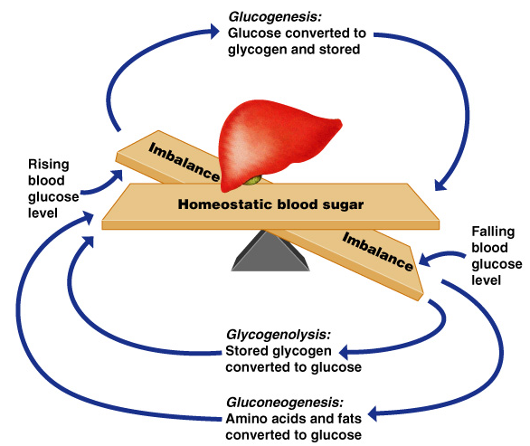
Metabolic Functions of the Liver
Figure 14.21

Slide 103
Metabolic Functions of the Liver
Fats and fatty acids are picked up by the liver
  Some are oxidized to provide energy for liver cells
  The rest are broken down into simpler compounds and released into the blood

Slide 104
Cholesterol Metabolism
Functions of cholesterol
  Serves as a structural basis of steroid hormones and vitamin D
  Is a major building block of plasma membranes
Most cholesterol is produced in the liver and is not from diet

Slide 105
Cholesterol Transport
Cholesterol and fatty acids cannot freely circulate in the bloodstream
They are transported by lipoproteins (lipid-protein complexes)
  Low-density lipoproteins (LDLs) transport to body cells
  High-density lilpoproteins (HDLs) transport from body cells to the liver

Slide 106
Body Energy Balance
Energy intake = total energy output (heat + work + energy storage)
  Energy intake is liberated during food oxidation
  Energy output
    Heat is usually about 60%
    Storage energy is in the form of fat or glycogen

Slide 107
Regulation of Food Intake
Body weight is usually relatively stable
  Energy intake and output remain about equal
Mechanisms that may regulate food intake
  Levels of nutrients in the blood
  Hormones
  Body temperature
  Psychological factors

Slide 108
Metabolic Rate and Body Heat Production
Basic metabolic rate (BMR) – amount of heat produced by the body per unit of time at rest
Factors that influence BMR
  Surface area – small body usually has higher BMR
  Gender – males tend to have higher BMR

Slide 109
Metabolic Rate and Body Heat Production
Factors that influence BMR (continued)
  Age – children and adolescents have a higher BMR
  The amount of thyroxine produced is the most important control factor
    More thyroxine means higher metabolic rate

Slide 110
Total Metabolic Rate (TMR)
Total amount of kilocalories the body must consume to fuel ongoing activities
TMR increases with an increase in body activity
TMR must equal calories consumed to maintain homeostasis and maintain a constant weight

Slide 111
Body Temperature Regulation
Most energy is released as foods are oxidized
Most energy escapes as heat

Slide 112
Body Temperature Regulation
The body has a narrow range of homeostatic temperature
  Must remain between 35.6° to 37.8°C
  (96° to 100° F)
  The body’s thermostat is in the hypothalamus
    Initiates heat-loss or heat-promoting mechanisms

Slide 113
Heat Promoting Mechanisms
Vasoconstriction of blood vessels
  Blood is rerouted to deeper, more vital body organs
Shivering – contraction of muscles produces heat

Slide 114
Heat Loss Mechanisms
Heat loss from the skin via radiation and evaporation
  Skin blood vessels and capillaries are flushed with warm blood
  Evaporation of perspiration cools the skin

Slide 115
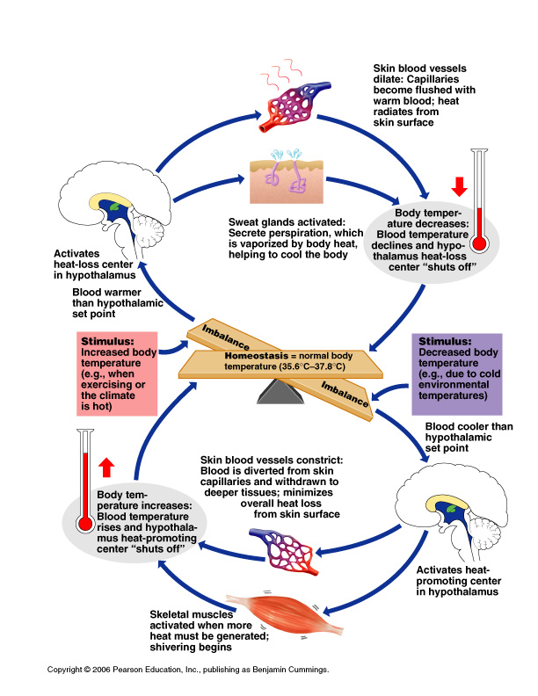
Body Temperature Regulation
Figure 14.22

Slide 116
Protein Metabolism
Cells remove amino acids to build proteins
  Synthesized proteins are actively transported across cell membranes
Amino acids are used to make ATP only when proteins are overabundant or there is a shortage of other sources

Slide 117
Production of ATP from Protein
Amine groups are removed from proteins as ammonia
The rest of the protein molecule enters the Krebs cycle in mitochondria
The liver converts harmful ammonia to urea which can be eliminated in urine

Slide 118
Developmental Aspects of the Digestive System
The alimentary canal is a continuous tube by the fifth week of development
Digestive glands bud from the mucosa of the alimentary tube
The developing fetus receives all nutrients through the placenta
In newborns, feeding must be frequent, peristalsis is inefficient, and vomiting is common

Slide 119
Developmental Aspects of the Digestive System
Teething begins around age six months
Metabolism decreases with old age
Middle age digestive problems
  Ulcers
  Gall bladder problems

Slide 120
Developmental Aspects of the Digestive System
Activity of digestive tract in old age
  Fewer digestive juices
  Peristalsis slows
  Diverticulosis and cancer are more common

Slide 121
Alimentary Canal Nerve Plexuses
All are part of the autonomic nervous system
Three separate networks of nerve fibers
  Submucosal nerve plexus
  Myenteric nerve plexus
  Subserous plexus

Slide 122
Stomach Anatomy
Layers of peritoneum attached to the stomach
  Lesser omentum – attaches the liver to the lesser curvature
  Greater omentum – attaches the greater curvature to the posterior body wall
  Contains fat to insulate, cushion, and protect abdominal organs

Slide 123
Modifications to the Muscularis Externa in the Large Intestine
Smooth muscle is reduced to three bands (teniae coli)
Muscle bands have some degree of tone
Walls are formed into pocketlike sacs called haustra

