Slide 1
Mechanotransduction, Tensegrity and Durotaxis
ChemEng 575: Lecture 16
March 30th, 2017

Slide 2
In Previous Lectures
We discussed ways to test and quantify the mechanical properties of materials
Left you with food for thought: is that important for tissue engineering design? (and your grant)?
Question for today: do cells care?
  i.e. can cells sense and respond to mechanical forces?
We already know that cell migration is responsive to….

Slide 3
1: Step Changes in Stiffness
3T3 Fibroblasts on PAA
Migrate from soft-to-stiff substrates
Biophys J. Lo et al. (2000) 79;144-152

Slide 4
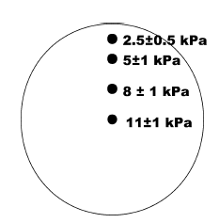
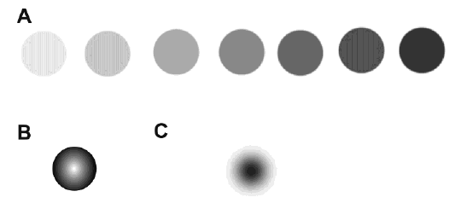
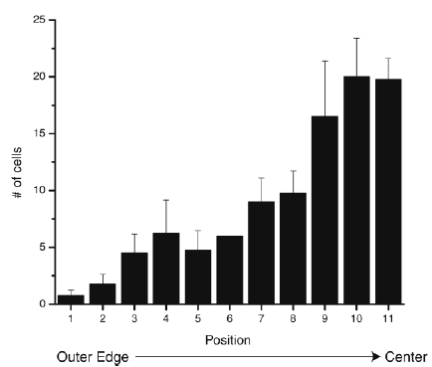
Durotaxis: gradients via photomask polymerization
Wong, J. Langmuir, 2003

Slide 5
Durokinesis: Biphasic Migration Dependence on Substrate Stiffness
Speed (um/hr)
Durokinesis: SMCs migrate fastest on an ‘optimally stiff’ substrate
Lecture 9: actin polymerization controlled by adhesive protein density as well (Haptokinesis).
Cells need stiffer substrate when less fibronectin is attached to surface to migrate at maximum capacity
Substrate stiffness
Peyton and Putnam, J. Cell. Phys. 2005

Slide 6
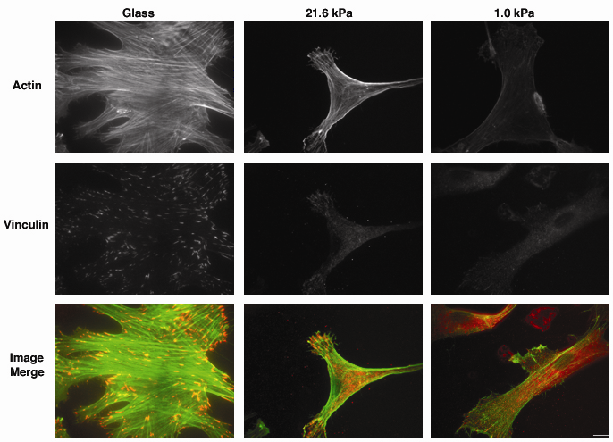
Cytoskeletal Assembly Regulated by Substrate Stiffness
Peyton and Putnam, J. Cell. Phys. 2005
Notes:
In concert with this change in motility, we also saw a clear difference in cytoskeletal assembly as a function of stiffness, indicating the role of the cytoskeleton and potentially RhoA in motivating these changes in cell motility.
As you can see here, the presence of very large, robust focal adhesions is present in cells cultured on the most rigid surface (polystyrene or glass). In contrast, relatively few punctate adhesive structures were observed in SMCs cultured on the softest 1.0 kPa substrate, as most of the vinculin staining in these cells was cytoplasmic. Likewise, the ability of SMCs to form a bundled actin stress fiber network was found to depend on ECM rigidity. As you can see here, there is a relative absence of stress fibers in SMCs on the softest 1.0 kPa substrate, in contrast to the well-defined discrete filaments observed in cells cultured on the stiffer substrates.

Slide 7
Biomaterials to Study Durotaxis/Durokinesis
Natural Biopolymers
  Collagen, Fibrin, Matrigel
  Contain cell-adhesive domains, 3D transferable
  Natural chemistries
  Soft 1Pa-10kPa
  Lumped parameters
Synthetic Polymers
  Polyacrylamide (PAA), Poly(ethylene glycol) (PEG), Polydimethylsiloxane (PDMS)
  Independent tunability
  Wide range of mechanical properties (100Pa – MPa)
  Difficult chemistries
  Not always 3D transferable
In Vivo Tissue Elastic Moduli Range
  Brain: 100s of Pa
  Liver: 10-100 kPa
  Artery: ~40kPa
  Skin: ~100 kPa
  Bone: 100s of MPa to GPa

Slide 8
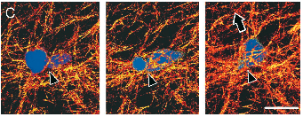
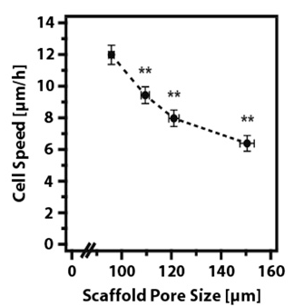
3D Collagen: Results Influenced by Polymerization Conditions
Native bovine dermal type I collagen
Motility requires MT1-MMP
(Nutragen)
JCB Wolf et. al. (2003)
Native bovine dermal type I collagen
Motility can be protease-independent
(Vitrogen, pepsin-extracted, non-covalent crosslinks)
MBC Kim et. al. (2008)
Freeze-dried Collagen-GAG
1D migration along fibers
Biophys J Harley et. al. (2008)

Slide 9
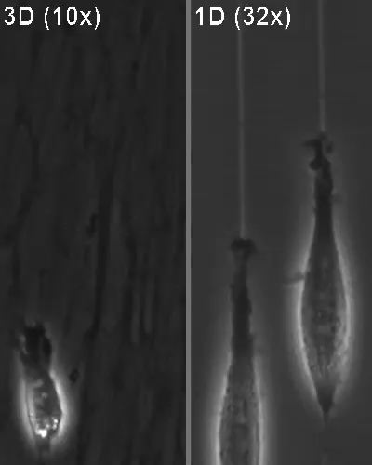
Cell-Secreted ECMs: 3D = 1D?
JCB Doyle et. al. (2009)

Slide 10
Mechanotransduction
The ability of a cell to turn a mechanical cue from the ECM into an intracellular signal
  RhoA, pSrc, pAkt
Or a phenotypic response
  Migration, differentiation, shape, growth

Slide 11
Where might mechanotransduction be important in your body?
Class poll: where are cells exposed to mechanical forces?

Slide 12
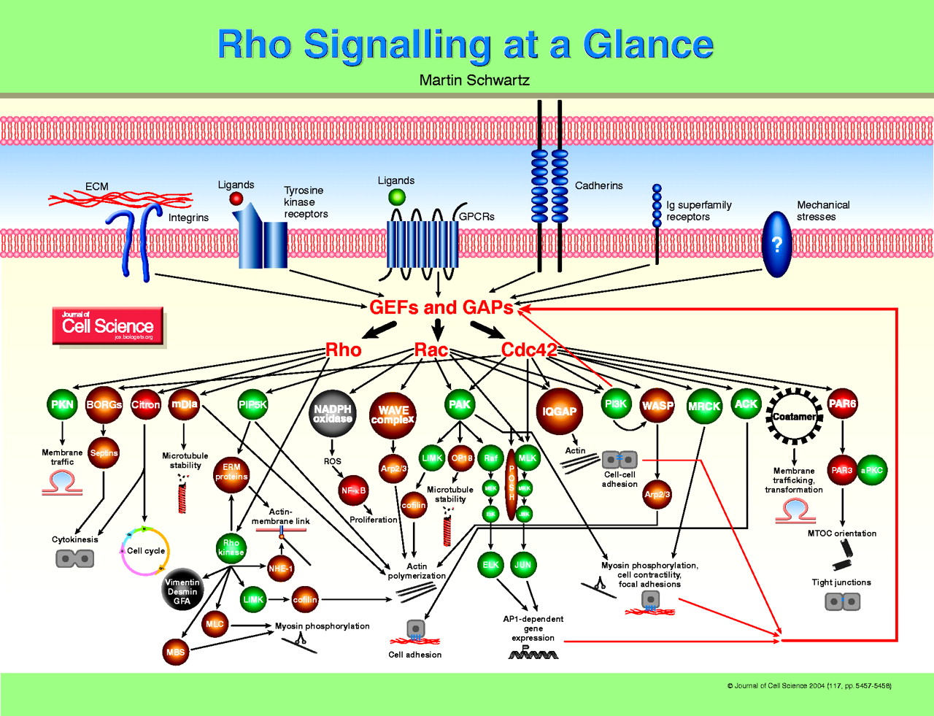
Mechanotransduction: Cell can translate Mechanical Information from the ECM to an intracellular biochemical signal
“Mechanotransduction”

Slide 13
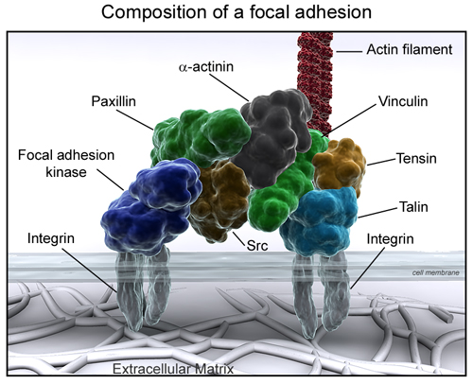
How does this happen?
Focal adhesions.
  Remember, those connections between integrins and the actin cytoskeleton in a cell.
When, how do focal adhesions re-arrange in response to mechanical forces?
S
P
S
S=structural
P=signaler
P
S
S
S
P
S

Slide 14
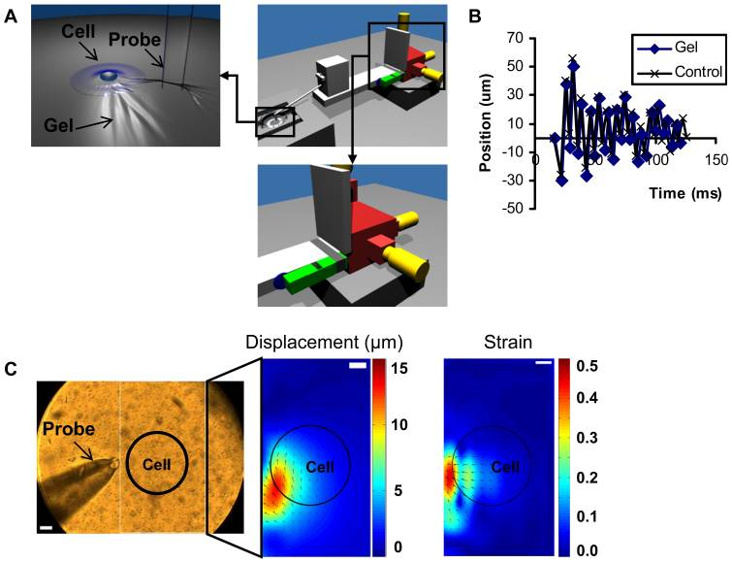
Vibrating Cells:
Cells will pull at the site of vibration
http://www.plosone.org/article/info%3Adoi%2F10.1371%2Fjournal.pone.0026181#s5

Slide 15
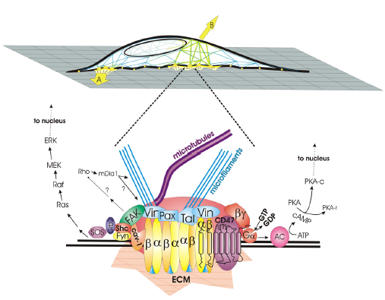
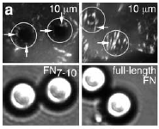


Pulling on cell attachment points:
Focal adhesions are recruited to the site of stretch

Slide 16
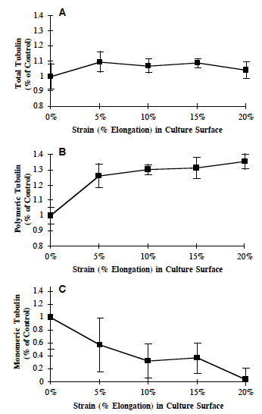
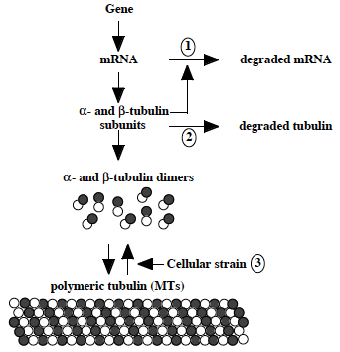
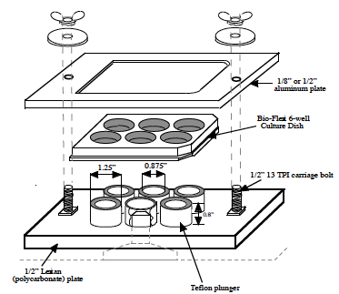
Stretching the underneath substrate:
Microtubules assemble (polymerize) when cell is stretched
Putnam et al., JCS, 1998

Slide 17
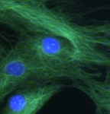
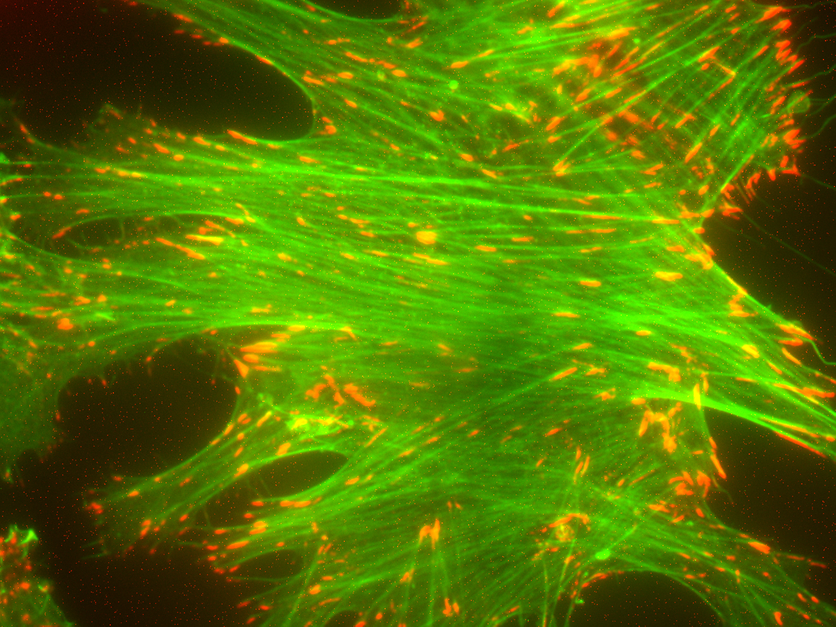
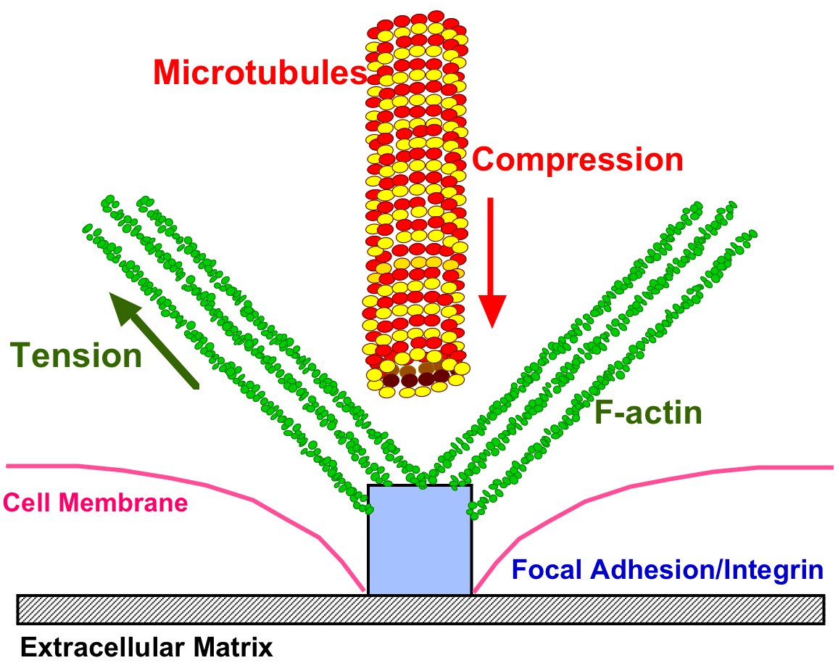
Proposed: Cell-ECM force balance through F-actin and microtubules
Courtesy of A. Putnam
In response to extracellular stretch or an intrinsic ECM stiffness, F-actin microfilaments adjust in tensional resistance, and the microtubule network adjusts in compressive resistance.
Notes:
Apart from the direct biochemical signaling that mechanical changes may impart, a second theory exists that cells exist in a biophysical, homeostatic force balance between themselves and the ECM.
One theory on how a mechanical signal from the ECM could be translated into a cellular process or initiate signaling is through a presumptive Cell-ECM force balance. In this theory, the cell is able to adjust to a mechanical force from the ECM by adjusting to load-bearing cytoskeletal elements, setting up a force balance between itself and either a static or dynamic ECM. The F-actin network consists of cables in constant tension, while the microtubules can buckle and resist compressive loading.

Slide 18
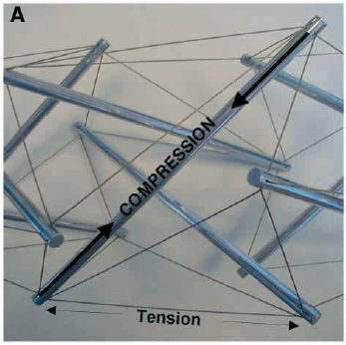
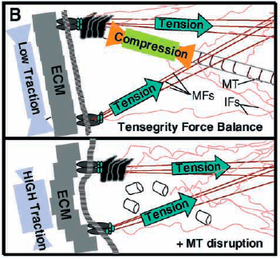
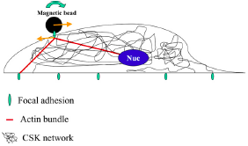
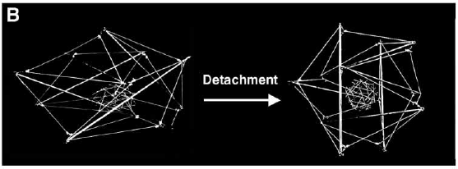

Tensegrity: a Physical Mechanism of Mechanotransduction
Cytoskeleton connects from focal adhesions to nucleus.
Forces at focal adhesions can propogate to changes in shape of nucleus → affects transcription regulators → gene expression/phenotype

Slide 19
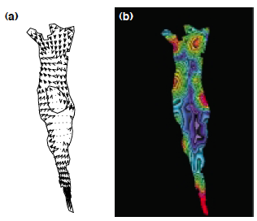

Traction Force Microscopy: Tool to Measure Cellular Forces Exerted on Substrate

Slide 20
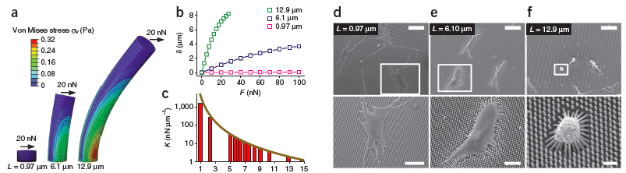
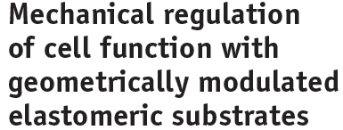

Elastomeric Posts

