Slide 1
Animal Models in Tissue Engineering
March 29, 2016

Slide 2
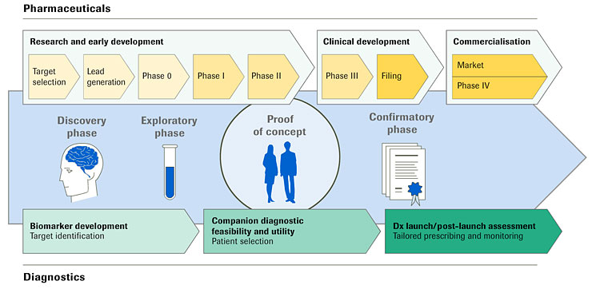
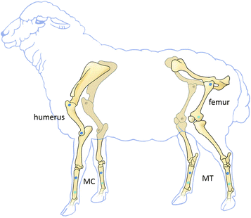
Why the need of animal models in tissue engineering?
Preclinical
Investigation
Considerations with preclinical investigation requirements:
Medical
Legal
Ethical
Notes:
Pharmacological developments have very defined and regulated preclinical investigations in order to meet medical, legal and ethical considerations.
However there is a need for intense preclinical investigations of new biomedical products before introduction into clinical applications in the case of tissue engineering

Slide 3
What comes after animal cell lines in vitro?
Living animals are used to test viability of engineered tissues in living organisms

Slide 4
Factors that cannot be addressed on a smaller scale
Complex immune reactions
Engineering
Angiogenesis
Causes of rejection or inflammation
Rheology of vascular grafts
Kinetic properties of engineered intestinal tissue
Surgical intervention effect
Role of angiogenesis in newly created tissues
Notes:
Each of these factors can significantly influence the experimental results, but all of the available models have limitations in one or more aspects

Slide 5
How to determine model that best suits the specific task?
Consider anatomical, physiological, and pathophysiological properties of different species and compare advantages and disadvantages of each model.

Slide 6
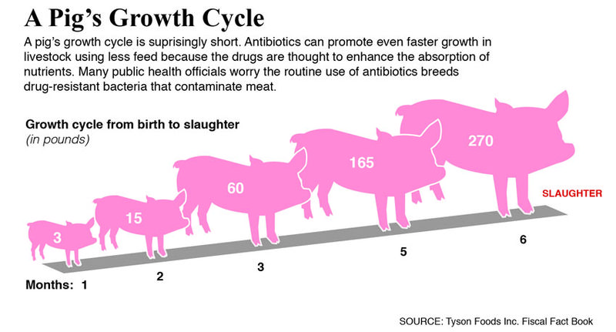
Pigs
Advantages
Disadvantages
Experimental
Difficulties
Higher complication
rates compared to humans
Notes:
Advantages:
Pig anatomy
Physiology
Immunological makeup resemble human
Cost for housing is relatively modest
Disadvantages:
Pigs grow too quickly and reach considerable final sizes
Increased cost of care and feeding for adult pigs
Experimental difficulties (matching engineered grafts and tissues to quickly changing animal size)
Surgical and anesthesiological skills required to operate on pigs is more challenging
Higher complication rates that exceed those in humans

Slide 7
Pigs
Danish Landrace pig
Gottingen Minipig
Options to reduce final body size and rate of growth
(expensive and hard to acquire)
Notes:
Advantages:
Pig anatomy
Physiology
Immunological makeup resemble human
Cost for housing is relatively modest
Disadvantages:
Pigs grow too quickly and reach considerable final sizes
Increased cost of care and feeding for adult pigs
Experimental difficulties (matching engineered grafts and tissues to quickly changing animal size)
Surgical and anesthesiological skills required to operate on pigs is more challenging
Higher complication rates that exceed those in humans

Slide 8
Dogs
Advantages
Disadvantages
Convenient size (10-30 kg)
Ease of care
Modest growth rate
Ethical considerations (Western countries in particular)
Notes:
Advantages:
Dogs are of convenient size (10-30 kg)
Ease of care
Modest growth rates
Disadvantages
Reduced number of experiments in tissue engineering given ethical considerations in western countries
Dogs used
Mongrel (their varying sizes, growth rates and individual differences leads to experimental difficulties)
Dogs bred specifically for experimental research are:
Beagles
Foxhounds
Labradors
Since they are more uniform and are also oftern more cooperative and therefore easier to handle

Slide 9
Rodents
Advantages
Disadvantages
Widely used
Ubiquity and ease of care makes them ideal
Close resemblance to human not required
Used for preliminary proof-of-concept
Cheaper than larger animals
Highly standardized
Small size leads to surgical difficulties
Difficult procedure
Results not easily transferable to human
Encouraging results usually lead to further study in larger animals
Notes:
Advantages
Rats and mice are widely used in all fields of tissue engineering research
Their ubiquity and ease of care makes them ideal animal models
Close resemblance to the human organism is not required
Study of biological features of cells and engineering tissues
Preliminary proof-of-concept experiments and serial trials
Cheaper than experiments on larger animals
Commercial rodents strains are highly standardized
Smaller biological variability
Frequently adaptation to specific purposes by inbreeding and genetic modification
Disadvantages
Small size leads to difficult surgical procedures
Procedures limited in scope
Results can not easily be transferred to humans
Encouraging results must usally lead to further study involving larger animals

Slide 10
Rabbits
Advantages
Disadvantages
Readily available
Relatively Cheap
Reasonably easy to maintain
Size enables reasonable success rates without specific surgical training
Surgical procedures more difficult compared to larger animals
Transfer of research to humans may not be easily accomplished
Notes:
Advantages
Rabbits are readily available
Relatively cheap
Reasonably easy to maintain
Size enables reasonable success rates without specific surgical training
Disadvantages
Surgical procedures are more difficult as compared to larger animals
Transfer of research to humans may not be easily accomplished

Slide 11
Primates
Advantages
Disadvantages
Animal model most closely resembles human anatomy and physiology
Slow and predictable rate of growth
Used for long-term studies of tissue engineered grafts
Ethical and legal restrictions
Excessive cost involved in cases over long time period
Can be aggressive
Hard to control
Notes:
Advantages
Animal model most closely resembling human anatomy and physiology
Slow and predictable rate of growth
Used for long-term studies of tissue engineered grafts
Disadvantages
Ethical and legal restrictions
Excessive cost involved in care and feeding of animals over long period of time

Slide 12
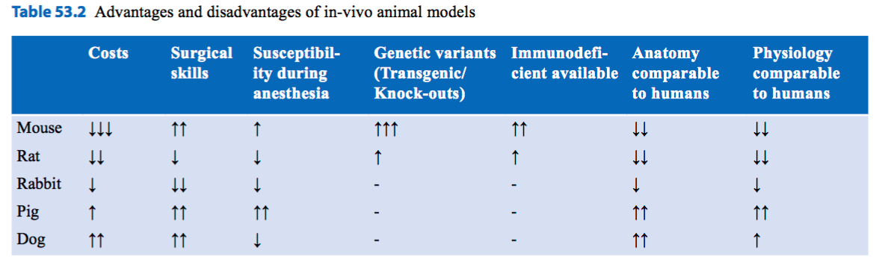
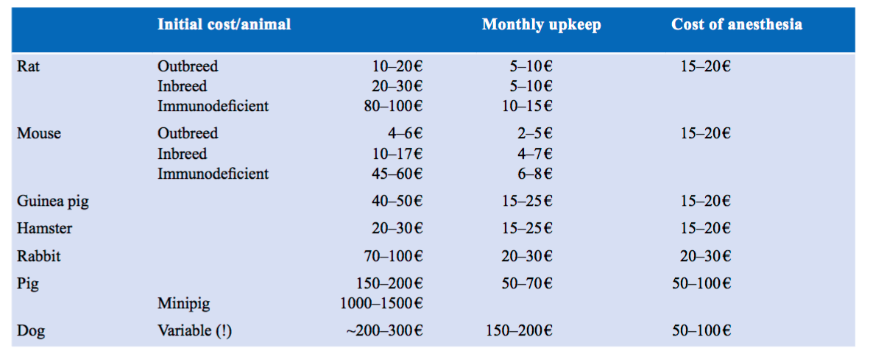

Slide 13
Animal models in selected areas of tissue engineering
Application of specific animal models depending the problem addressed in tissue engineering

Slide 14
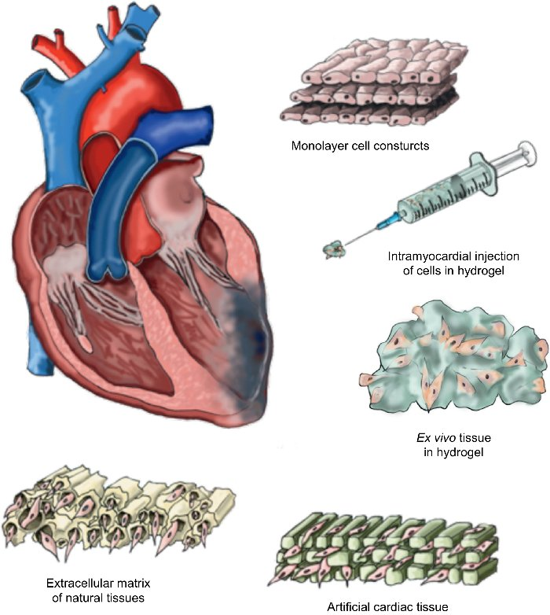
Cardiovascular tissue engineering
Creation and testing of vascular grafts
Notes:
While tissue growth, histological, and immunological properties of engineered materials in many cases can be successfully studied using small animal models such as rodents, rabbits, or guinea pigs, surgical implantation of full size grafts and long term surveillance of adverse effects may require the use of bigger animals more closely resembling human anatomy and pathophysiology

Slide 15
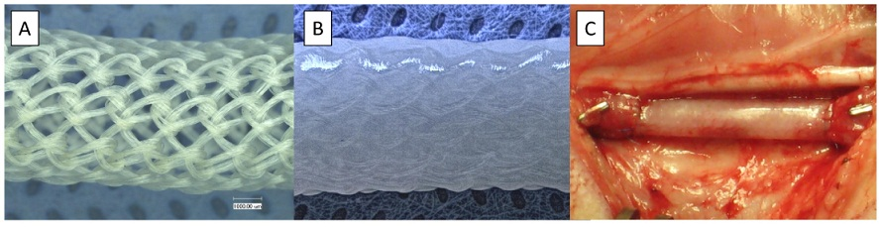
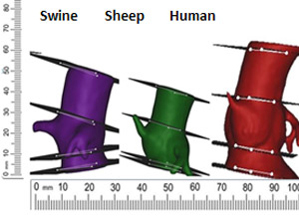
Cardiovascular Tissue Engineering
Fibrin based graft after implantation in the arterial circulation (ovine carotid model)
Details of aortic valve anatomy and motion across cardiac cycle using CT
Tissue engineered heart valve before animal implantation
Notes:
Advantages:
Allows detailed monitoring
Surveillance of adverse effects
Rejection of prostheses
Compromised blood supply
Thrombosis formation due to changes in blood flow
Cardiovascular tissue engineering often involves:
Creation and testing of vascular grafts
Either taken directly from organs (small intestine) or made from synthetic materials enhanced with cell layers to prevent adverse effects due to thrombus formation or immunological reactions
Pigs:
To protect synthetic endografts from rejection and to provide a more physiological inner lining small intestinal mucosa from pigs has been sued to grow venous grafts in vivo
For example, when interposed into the superior vena cava, jejunal segments inte- grated into the surrounding vessel and developed an endothelial lining indistinguishable from the native venous endothelium (An experimental model of small intestinal submucosa as a growing vascular graft )
Arti cial mesh stents coated with porcine smooth muscle cells have been success- fully implanted back into the animal, showing very little in ammatory reaction during a surveillance pe- riod of 1 month (A tissue-engineered stent for cell-based vascular gene transfer )
In another study, viability could be increased even more by pre-stressing coated grafts in bioreactors for 14 days prior to implantation (Extraction of cells for single-stage seeding of vascular-bypass grafts)
Dogs:
In vivo dog models have been used to determine the viability of a wide variety of vascular grafts, such as:
Artificial vascular prostheses coated with autologous cells derived from adipose tissue
Epithelium
Smooth muscle
Small intestinal submucosa
Example: a combination of canine smooth muscle and epithelial cells, supported by a synthetic scaffold to provide necessary stability, showed extraordinary patency 26 weeks after implantation in the carotid artery position of dogs (A hybrid vascular model biomim- icking the hierarchic structure of arterial wall: Neointi- mal stability and neoarterial regeneration process under arterial circulation)
Dogs have also been transplanted with grafts constructed from decellularized vessels of bovine and porcine origin, showing patency and freedom from complications over considerable periods of time if used as a scaffold for autologous cells (Development and evaluation of a novel decellularized vascular xenograft & Transformation of nonvascular acellular tissue ma- trices into durable vascular conduits)
Previous work by Zilla et al. [10], seeding polytetra uoroethylene (PTFE) grafts with epithelial cells and RDG and leading to persistent con uency on the inner graft surface, has led to large clinical trials on human patients needing bypass surgery for peripheral artery disease and thrombosis. (In vitro- lined endothelium: Initial integrity and ultrastructural events)

Slide 16
Biological Patches and Grafts
Explantation of porcine small bowel segment with preserved and cannulated mesenteric vascular pedicle after flushing with sodium chloride
Macroscopy of the epicardial aspect during patch surgery
Representative CT-angiographic images of animals at 20 (A), 50 (B), 80 (C), and 100 weeks (D) postimplantation
tissue-engineered pre-implantation conduit
Notes:
Efforts to generate new intestinal mucosa by patching defects of the intestine with serosa from other parts of the organism, as well as from different species, were among the first attempts at intestinal tissue engineering.
This patching with small intestine submucosa (SIS) taken from the same or different species has been studied in a variety of animal models and graft-host combinations, including pig, dog, and rabbit.
For example, Chen and Badylak [18] used dogs as a model to evalu- ate the repair of defects in the animal’s small bowel with porcine small intestinal submucosa, either as patches to repair smaller defects, or as tubular interponates. (Small bowel tissue engineering using small intestinal submucosa as a scaffold) Regeneration of a mucosal epithelial layer, however, took place in a rather unorganized fashion, and was not feasible for larger patched areas. Animals grafted with tubular SIS usually died during the observation period.
Patching of a defect in the terminal ileum with vascularized rectus abdominis muscle by Lillemoe et al. [17] led to a complete neomucosal cover of the patched area after 4 weeks, and the neomucosa exhibited electrophysiological parameters, glucose, and bile salt absorptions closely resembling the adja- cent resident mucosa. (Use of vascular- ized abdominal wall pedicle aps to grow small bowel neomucosa )

Slide 17
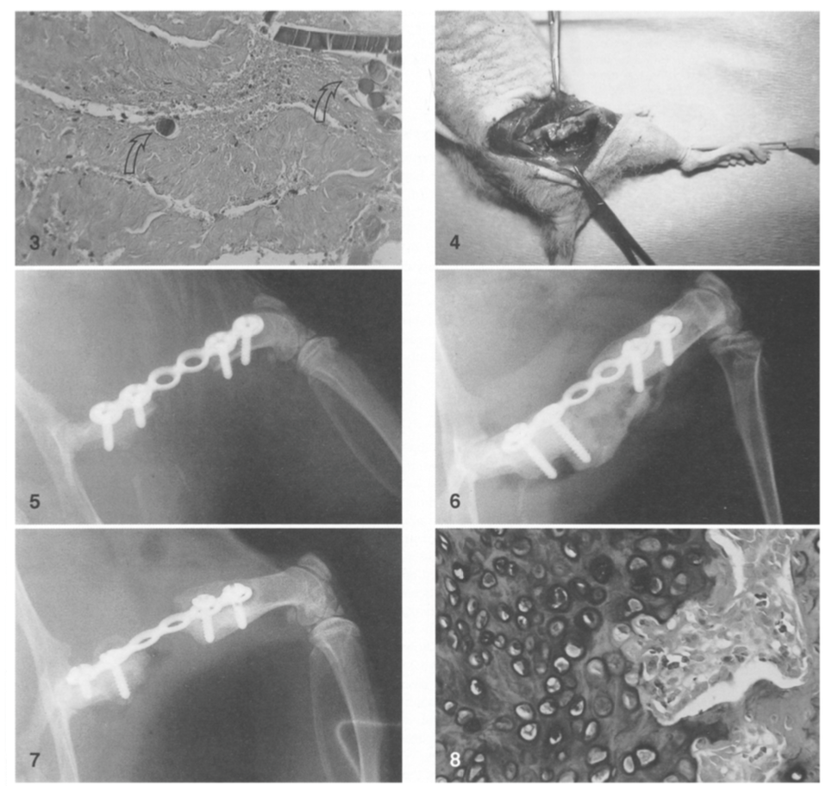
Prosthetics and Biomaterials
Mouse model (2000)
Application human
Ovine tibial defect model (2016)

Slide 18
Prosthetics and Biomaterials
Clinical case of a 52 year old man with a malignant bone tumour above his left hip
The vascularised fibula transfer is one of the most commonly used techniques for reconstruction of large tibial defects in orthopaedic oncology

