Slide 1
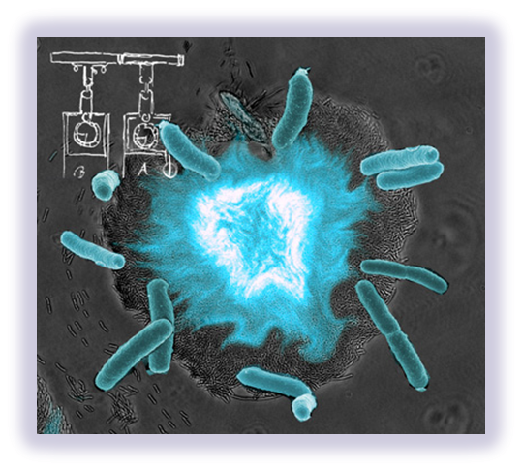
Oscillating Fluorescence in E. coli
Morgan Haskell
Coby Turner
Dan Karkos

Slide 2
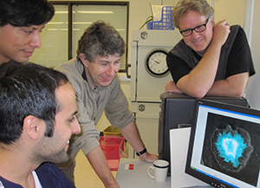
Jeff Hasty and team
University of California in San Diego
  Biological synchronized clocks
    Flash to keep time
    Oscillator controlled by chemicals and temperature
  Quorum sensing = synchronized flashing
Quorum Sensing
  Have made synthetic switches
    Individual bacteria only
      Do not flash together
    http://blogs.discovermagazine.com/80beats/2010/01/21/video-fluorescent-bacteria-keep-time-like-a-clock/

Slide 3
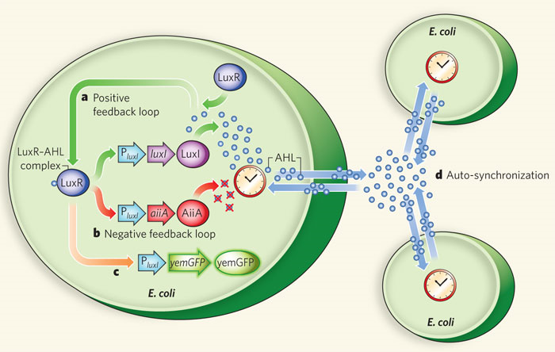
How It Works
luxI fromV. fischeri, AiiA from B. thurigensis, and yemGFP
  Under control of three identical luxI promoters
  luxI synthase enzymatically produces AHL (Acyl-homoserine lactone)
    Diffuses and mediates intercellular coupling
    Binds to LuxR
  luxR-AHL complex = transcriptional activator for luxI promoter
    AiiA negatively regulates promoter
  Degradation of AHL
AHL degraded by AiiA after accumulation
  Swept away by fluid flow in chamber
    Not enough inducer to activate expression from luxI promoter
  After time, promoters return to inactivated state
    AiiA production decreases = AHL accumulation
  Burst from promoters
Density
    At high density = burst of light
      Burst of transcription of luxI promoters
      Increased levels of luxI, AiiA, and green fluorescent protein (GFP)
    Low density = nothing
http://www.nature.com/nature/journal/v463/n7279/extref/nature08753-s1.pdf
Notes:
We placed the luxI (from V. fischeri), aiiA (from B. Thurigensis) and yemGFP genes under the control of three identical copies of the luxI promoter. The LuxI synthase enzymatically produces an acyl-homoserine lactone (AHL), which is a small molecule that can diffuse across the cell membrane and mediates intercellular coupling. It binds intracellularly to the constitutively produced LuxR, and the LuxR–AHL complex is a transcriptional activator for the luxI promoter³⁶. AiiA negatively regulates the promoter by catalysing the degradation of AHL³⁷. This network architecture, whereby an activator activates its own protease or repressor, is similar to the motif used in other synthetic oscillator designs^{30, 31, 32} and forms the core regulatory module for many circadian clock networks^{13, 38, 39}. Furthermore, theoretical work has shown how the introduction of an autoinducer in similar designs can potentially lead to synchronized oscillations over a population of cells^{40, 41}
Supplementary Movies 1–2). The dynamics of the oscillations can be understood as follows. Because AHL is swept away by the fluid flow and is degraded by AiiA internally, a small colony of individual cells cannot produce enough inducer to activate expression from the luxI promoter. However, once the population reaches a critical density, there is a ‘burst’ of transcription of the luxI promoters, resulting in increased levels of LuxI, AiiA and green fluorescent protein (GFP). As AiiA accumulates, it begins to degrade AHL, and after a sufficient time, the promoters return to their inactivated state. The production of AiiA is then attenuated, which permits another round of AHL accumulation and another burst of the promoters
http://www.nature.com/nature/journal/v463/n7279/full/nature08753.html

Slide 4
What We Are Going To Do
Make them flash
  We can make bacteria glow, but how to make them flash?
    AHL degradation is key
    High density
Check each biobrick part
    Positive feedback loop, negative feedback loop, & fluorescent protein gene
      GFP = Green
      On selective antibiotic plates
    Combine positive loop with fluorescent protein together
      Two plasmids
      Transform into E. coli
      Check for fluorescence
  Make new biobrick part
    Our color
      Orange biobrick
        Add luxI promoter
      On selective antibiotic plates
  On mixture antibiotic plates = flash
Create our own biobrick??
  Obtain an organism with fluorescent protein
  Transform in E. coli
  Grow and check intensity

Slide 5
Option 1 – two plasmids
Obtain plasmid BBa_J37015 (AHL & GFP)
  Cut out GFP
  Ligate with BBa_K156009 (AiiA) = two plasmids not three
  Transform bacteria with the two new plasmids
  Grow overnight containing the antibiotics needed
  Monitor intensity of fluorescence
Obtain Bba_J37015 (AHL & GFP)
  Remove GFP
  Transform three separate plasmids into E. coli
  Grow overnight containing antibiotics needed
  Check intensity

Slide 6
Option 2 – three plasmids
Obtain BBa_ J37015 (AHL & GFP)
  Transform into E. coli.
  Grow with Ampicillin overnight
  Black light
Obtain BBa_K156009 (AiiA)
  Add luxI promoter
  Transform into E. coli
  Grow on different antibiotic overnight
    Kanamycin or Chloramphenicol
    LVA tagged = degrade faster
  No black light
Obtain BBa_C0060 (orange fluorescent protein)
  Attach antibiotic resistance gene
    Kanamycin or Chloramphenicol
  Transform into E. coli
  Grow overnight
    Check for plasmid
    Black light

Slide 7
Option 3 – in case of color failure
Create our own fluorescent color
  Build biobrick from an organism
  Check to see if it functions in E. coli
  Cut out piece & ligate with BBa_J37015 (AHL)
    GFP cut out
  Transform into E. coli
  Grow overnight
  Check intensity

Slide 8
Option 4 – just for fun
Grow one culture with orange fluorescent protein
Grow the second with a different color fluorescent protein
Combine the two cultures on one plate, and see if there are the two colors showing up

Slide 9
Problem
Certain density and flow of nutrients
  University of California in San Diego
    Used for a microbial “clock” = biological sensors
    Used a feeding mechanism
    Flow of nutrients, waste exit, large in size
    Monitored continuously
  Can we grow on petri dish or liquid suspension?
    May have to design a larger apparatus
      Sends signals out to surrounding colonies at certain densities and then will glow
    May not glow for more than a few minutes/hours
      Need to be able to maintain flow of nutrients and waste removal
    LVA tagged biobrick
      Degrade aiiA protein faster

Slide 10
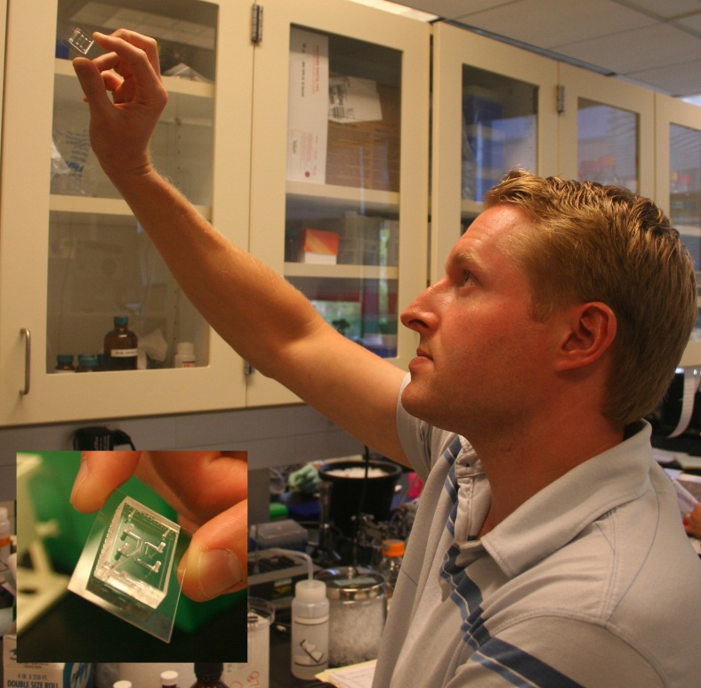
Microfluidic Device
100 um chamber
  37C
0.95 um high
  Monolayer parallel pattern
Around 100 minutes
  Fluorescent burst propagates in the left and right
    AiiA negatively regulates the promoters to catalyze the degradation of AHL
  Will repeat next 100 minutes at original location
  http://www.nature.com/nature/journal/v463/n7279/extref/nature08753-s1.pdf

Slide 11
Amounts of Bacteria
1:1,000 dilution overnight culture grown in 50 ml LB (10 g l⁻¹ NaCl)
  antibiotics 100 μg ml⁻¹ ampicillin (Amp) and 50 μg ml⁻¹ kanamycin (Kan)
  Grown approximately 2 h. Cells reached an A_{600 nm} of 0.05–0.1, and were spun down and concentrated in 5 ml of fresh media with surfactant concentration of 0.075% Tween20 (Sigma-Aldrich) before loading in a device.
  http://www.nature.com/nature/journal/v463/n7279/full/nature08753.html
Notes:
V. fischeri, AiiA from B. thurigensis, and yemGFP

Slide 12
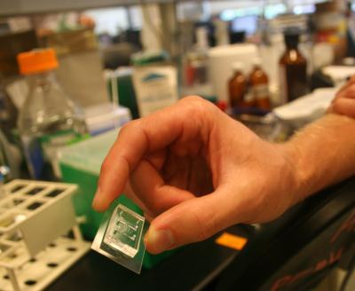
Accession Numbers
BBa_J37015 (Prey Molecule Generator [AHL] plus GFP Reporter)
BBa_C0060 (Autoinducer inactivation enzyme-AiiA from Bacillus, hydrolyzes acetyl homoserine lactone)
BBa_K156009 (Orange Fluorescent Protein)

Slide 13
Primers
BBa_J37015 (AHL & GFP)
  (gaattcgcggccgcttctag) 5’- tccctatcagtgattagaga -3’ beginning primer
  (ctgcagcggccgctactagta) 5’-tttctcctct -3’end primer
BBa_C0060 (AiiA)
  (gaattcgcggccgcttctag) 5’- atgacagtaaagaagcttta -3’ beginning primer
  (ctgcagcggccgctactagta) 5’- ttattaagctactaaagcgt -3’ end primer from very end
  (ctgcagcggccgctactagta) 5’- gcagctatatattcagggaa -3’ end primer from end of AiiA gene
BBa_K156009 (Orange Fluorescent Protein)
  (gaattcgcggccgcttctag) 5’- atgaacctgtccaaaacgt -3’ beginning primer
  (ctgcagcggccgctactagta) 5’- ctttttctttttctttttgg -3’ end primer

