Slide 1
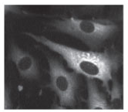
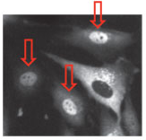
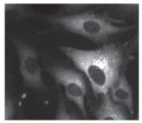
Single-cell NF-κB dynamics reveal digital activation and analogue information processing
Savas Tay, Jacob J. Hughey, Timothy K. Lee, Tomasz Lipniacki, Stephen R. Quake,
Markus W. Covert
Max Wu, Jon Gootenberg
20.309
December 8th 2011

Slide 2
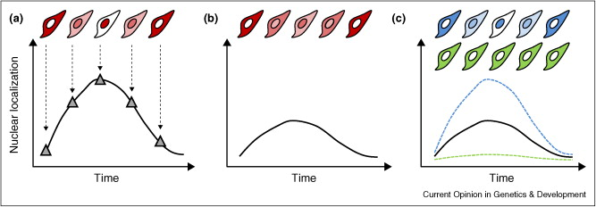
Diversity in single cell responses can be masked by population dynamics
T Lee, M Covert. Current Opinion in Genetics and Development 20, 677-683 (December 2010) doi:10.1016/j.gde.2010.08.005

Slide 3
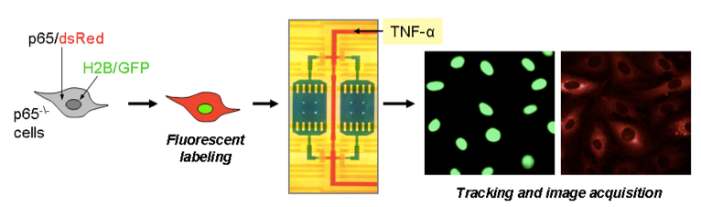
Microfluidic culturing allows for single cell analysis

Slide 4
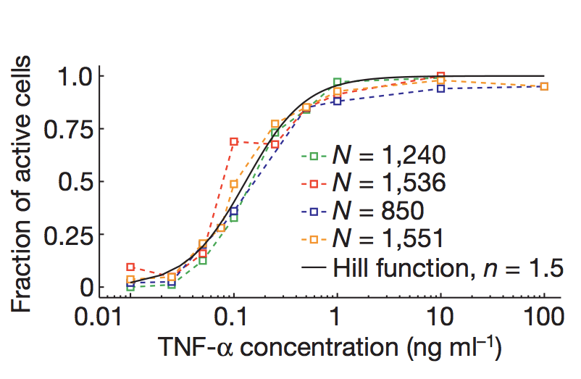
NF-κB activation is digital

Slide 5
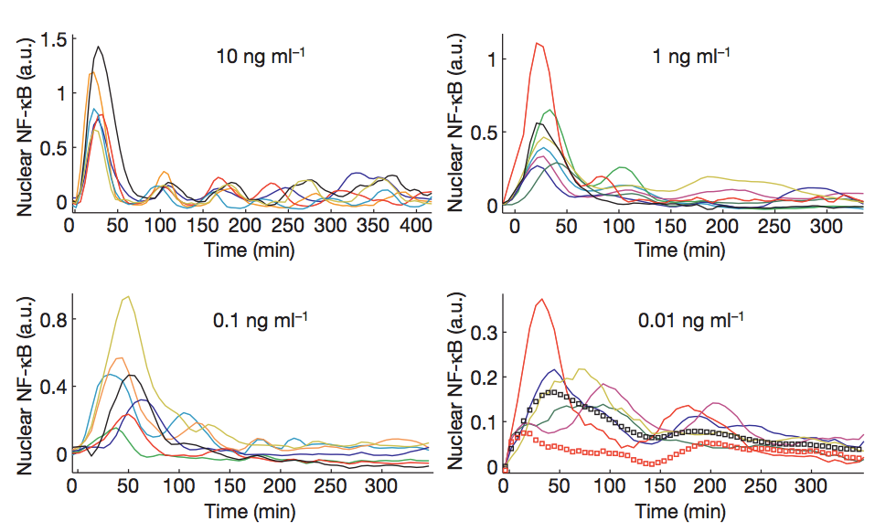
Nuclear NF-κB oscillates based on TNF-α dose

Slide 6
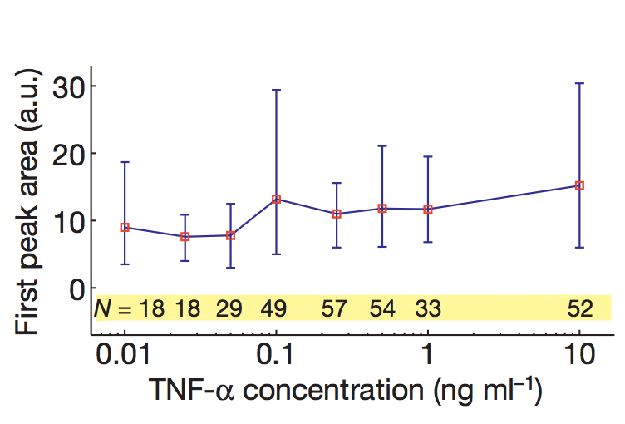
First peak of NF-κB is independent of TNF-α

Slide 7
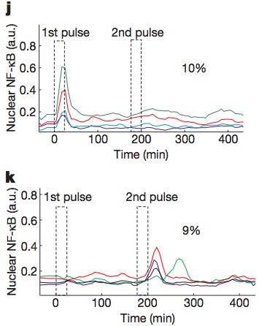
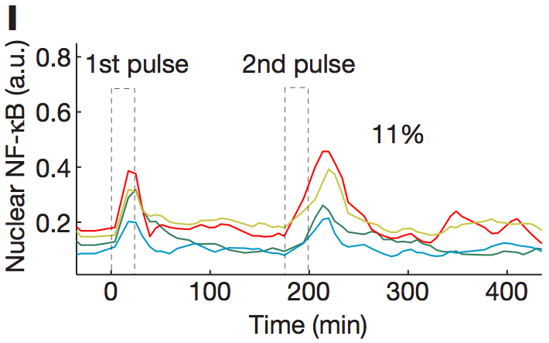
Activation is not entirely stochastic, but dependent on existing cellular state

Slide 8
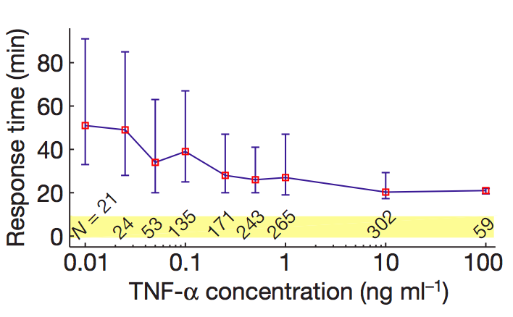
Lower doses of TNF-α lead to longer delay of activation

Slide 9
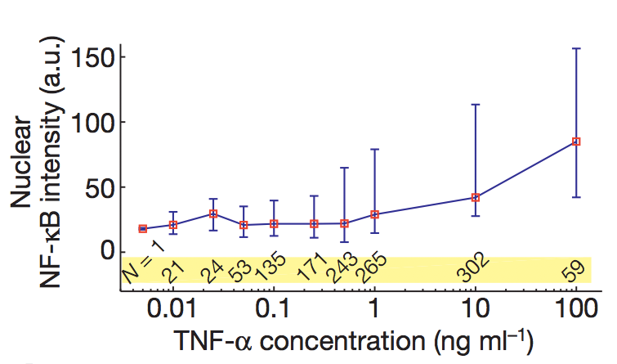
Lower doses of TNF-α lead to lower mean nuclear NF-κB intensity

Slide 10
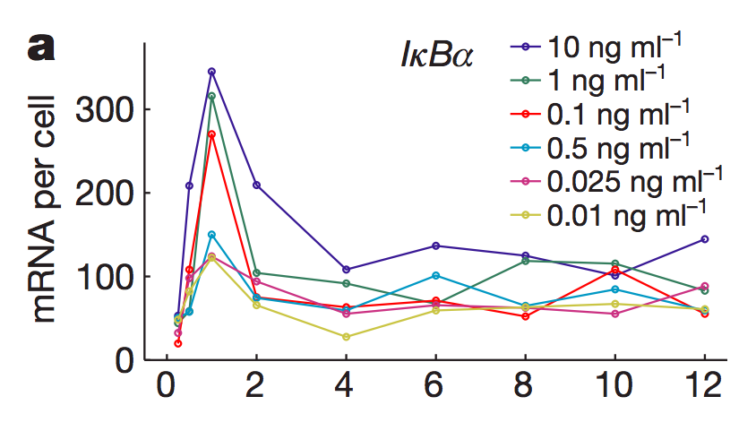
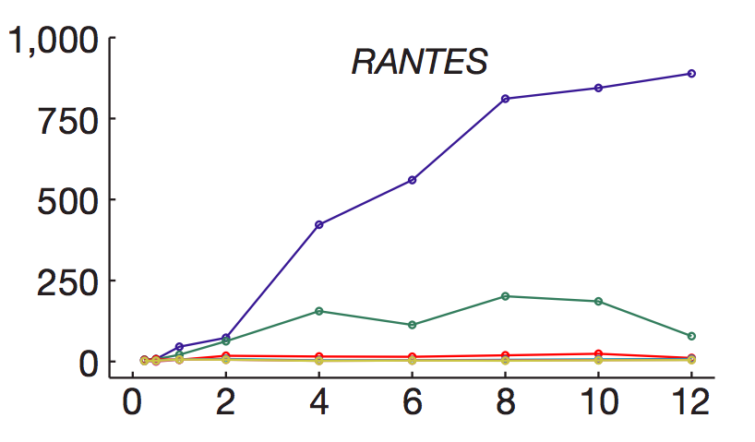
NF-κB drives waves of gene expression
Early genes follow first NF-κB peak closely
Late genes require sustained oscillations of NF-κB

Slide 11
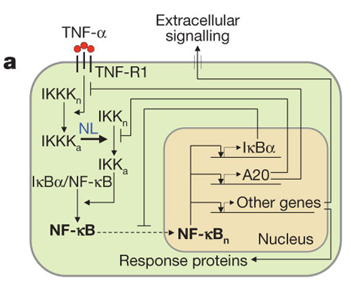
Stochastic-deterministic hybrid model
Reaction channels split into slow (stochastic; receptor binding and gene activation/inactivation) and fast (deterministic; mRNA and protein interactions) processes

Slide 12
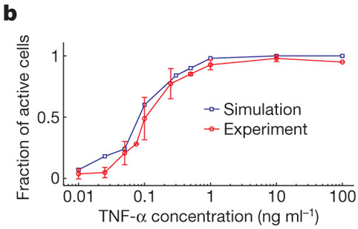
The stochastic model successfully reproduces experimental data

Slide 13
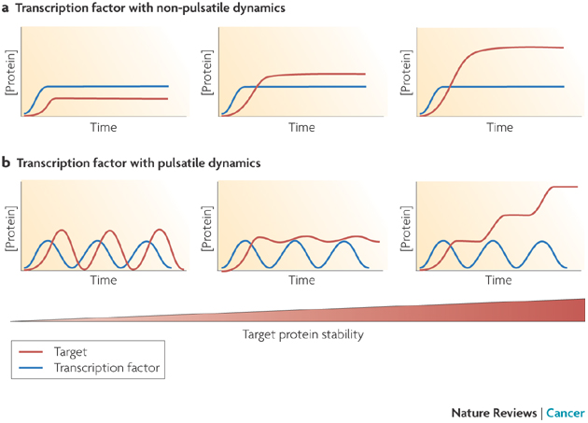
Digital, pulsed responses can lead to a broad range of target behaviors
E Batchelor et al. Nature Reviews Cancer 9, 371-377 (May 2009) | doi:10.1038/nrc2604

Slide 14
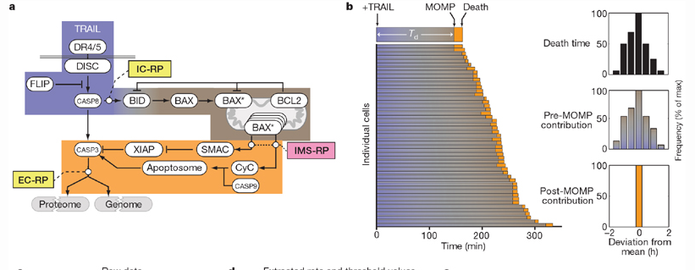
Single cell heterogeneity is important for explaining phenotypic response
SL Spencer et al. Nature 459, 428-432 (21 May 2009) doi:10.1038/nature08012

Slide 15
The stochastic model successfully reproduces experimental data
In resting cells, un-phosphorylated IκBα sequesters NF-κB in cytoplasm
Active IKK phosphorylates IκBα, freeing NF-κB to localize to nucleus and drive transcription
  Nonlinear IKK activation profile yields digital activation in single cells (IKK must be phosphorylated at S177 and S181 to achieve full activity)
  Successfully reproduces important aspects of experimental data

