Slide 1
Comparison of the P-value significance between Wild Type and ΔGLN3
ANOVA | WT | ΔGLN3
p < 0.05 | 38.42% | 30.11%
p < 0.01 | 24.67% | 16.29%
p < 0.001 | 13.90% | 6.53%
p < 0.0001 | 7.43% | 2.04%
B-H p < 0.05 | 26.76% | 2.04%
Bonferroni p < 0.05 | 3.68% | 0.42%

Slide 2
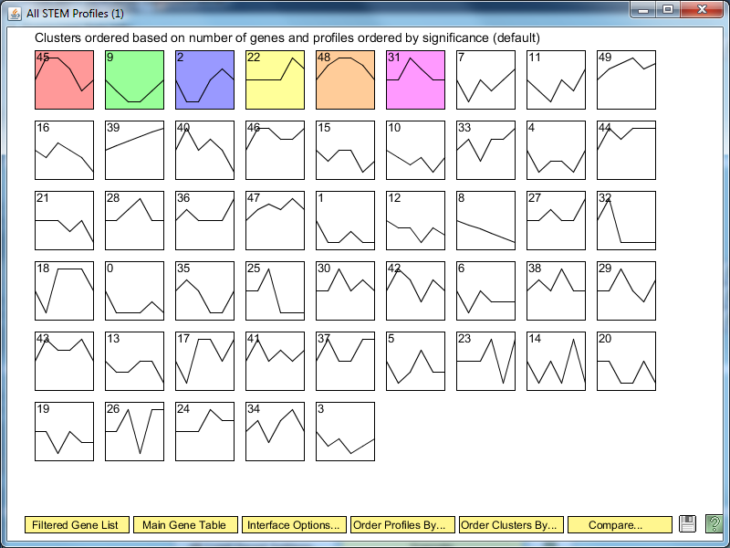
ΔGLN3 STEM Significance Profiles

Slide 3
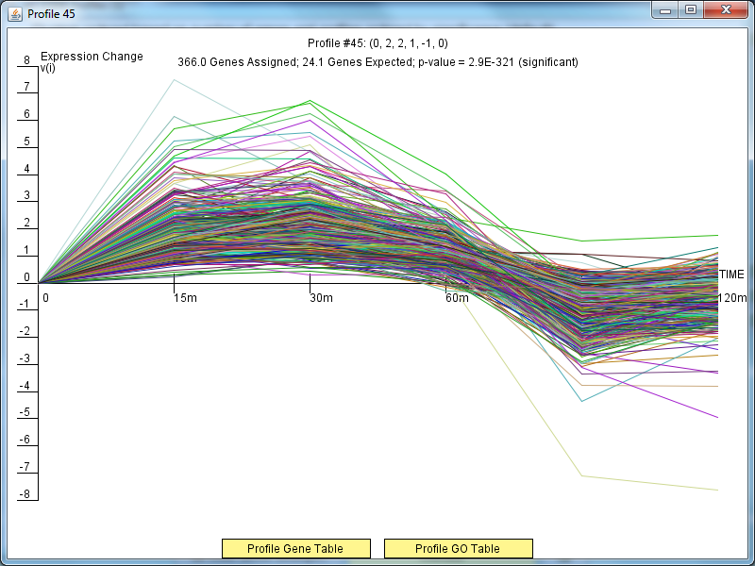
ΔGLN3 Profile 45

Slide 4
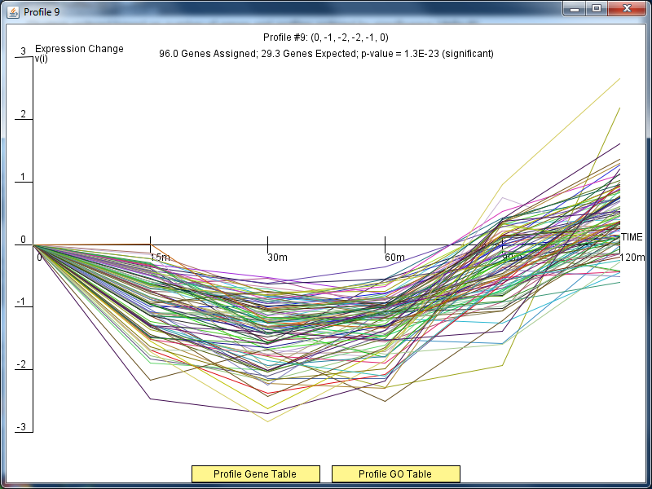
ΔGLN3 Profile 9

Slide 5
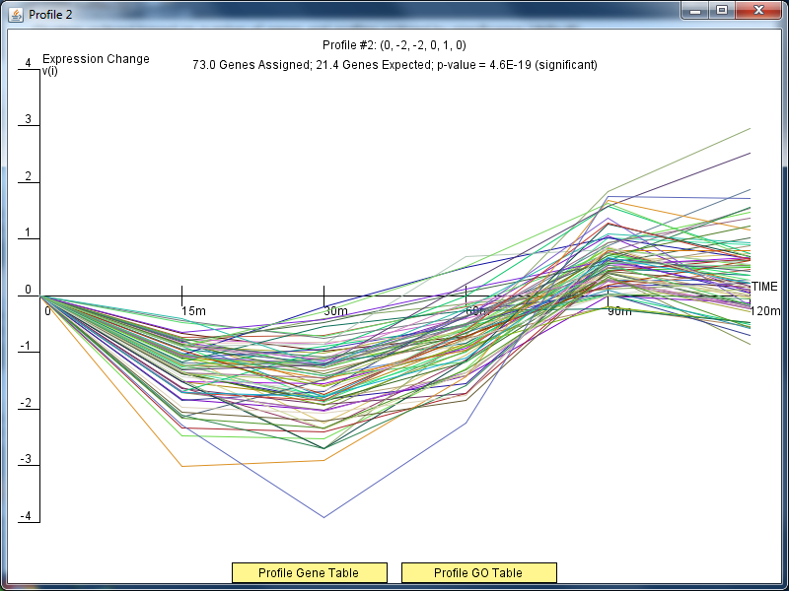
ΔGLN3Profile 2

Slide 6
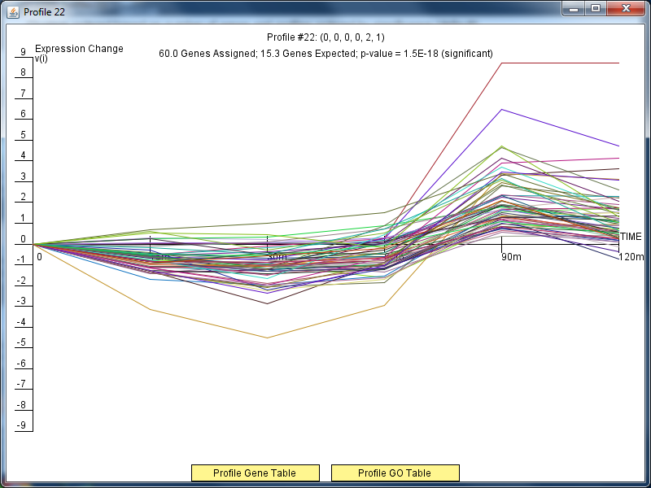
ΔGLN3Profile 22

Slide 7
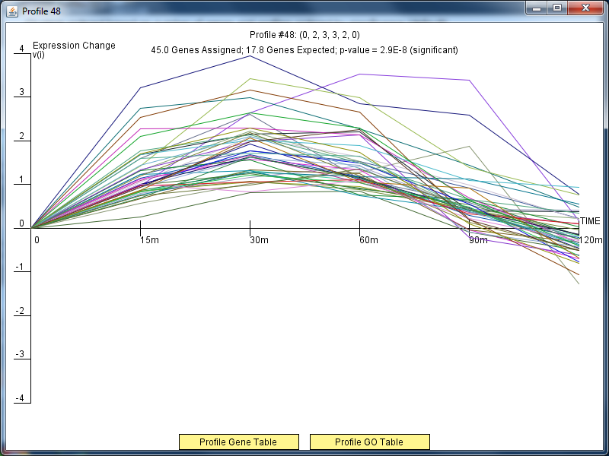
ΔGLN3Profile 48

Slide 8
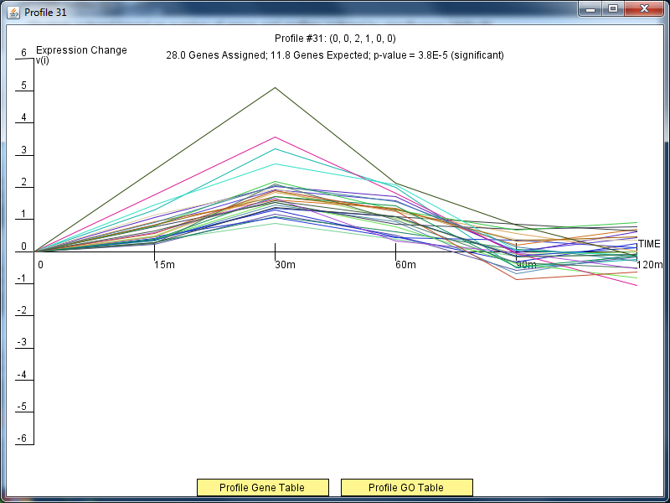
ΔGLN3Profile 31

Slide 9
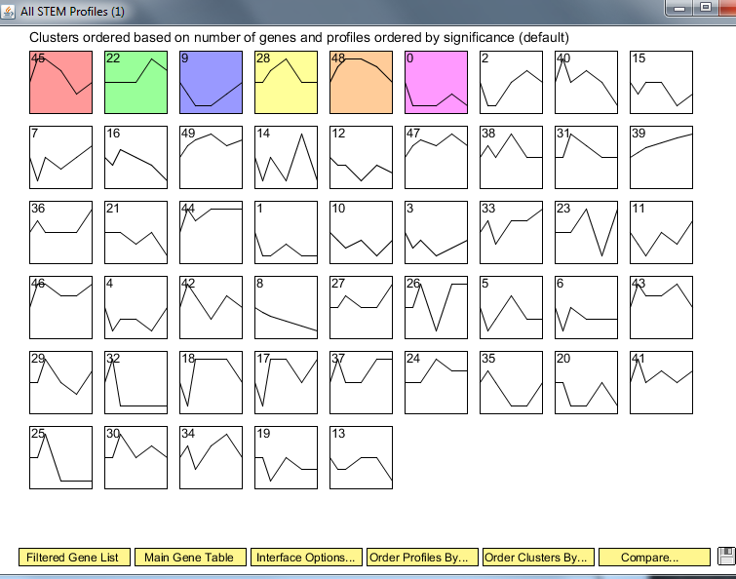
Wild Type Clusters

Slide 10
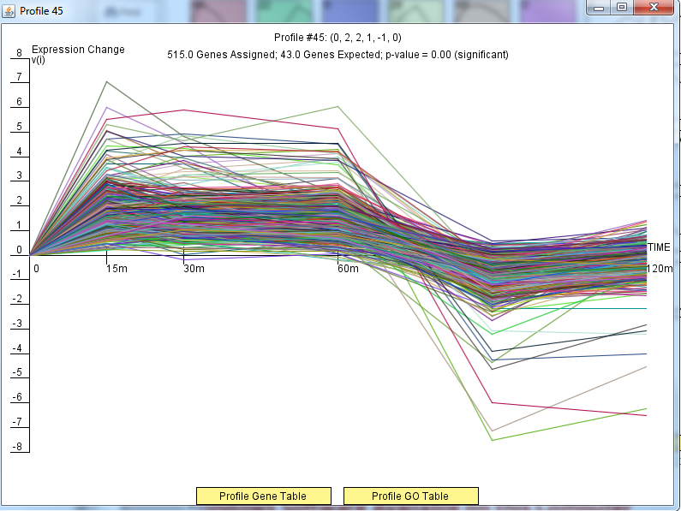
Wild Type Profile 45

Slide 11
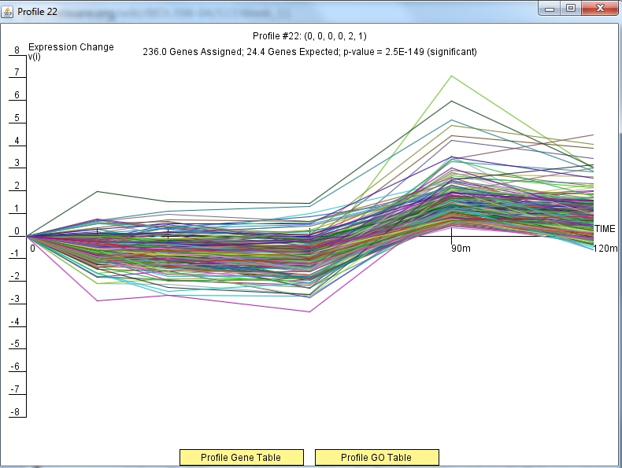
Wild Type Profile 22

Slide 12
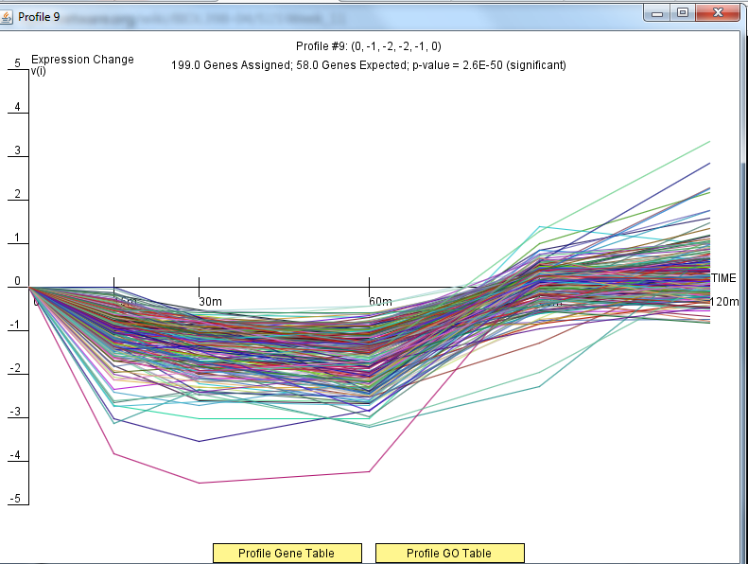
Wild Type Profile 9

Slide 13
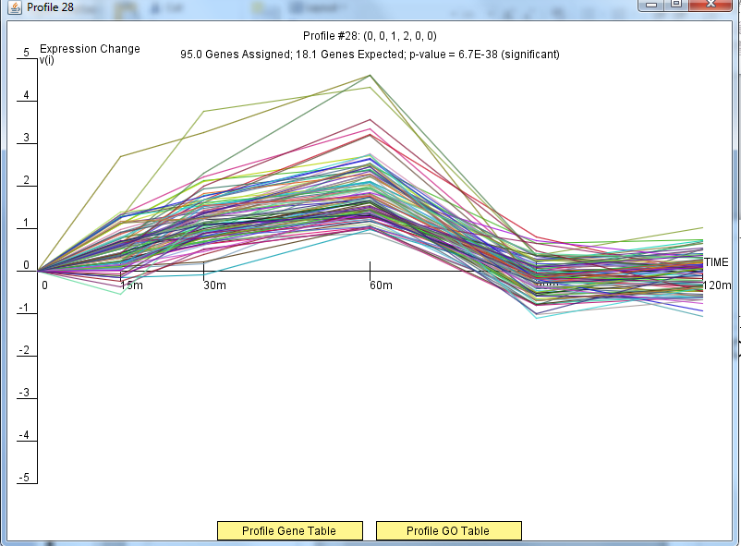
Wild Type Profile 28

Slide 14
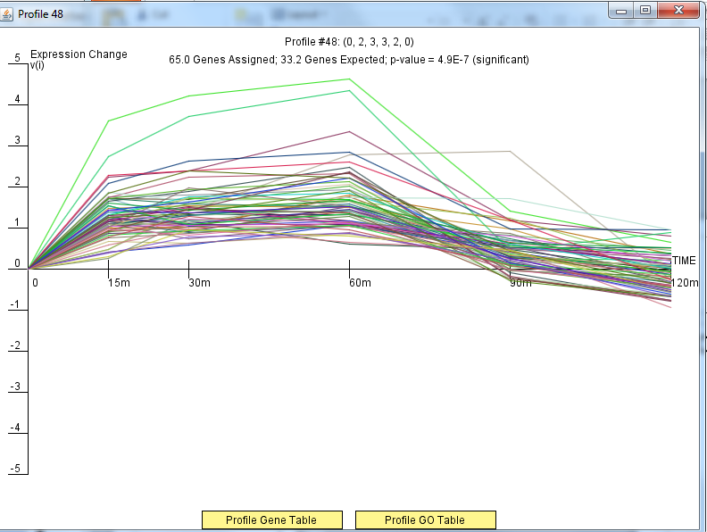
Wild Type Profile 48

Slide 15
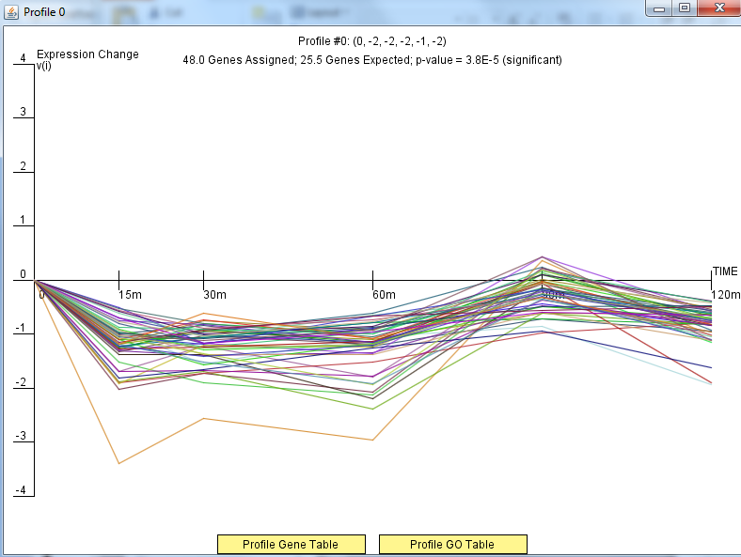
Wild Type Profile 0

Slide 16
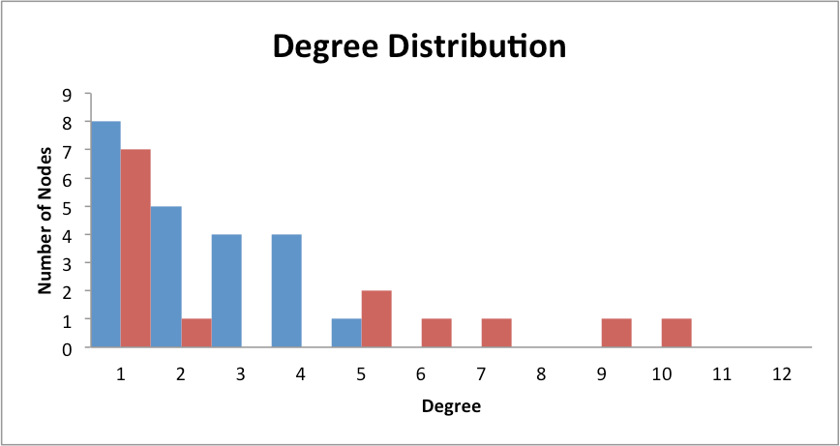
Only DNA Binding Degree Distribution

Slide 17
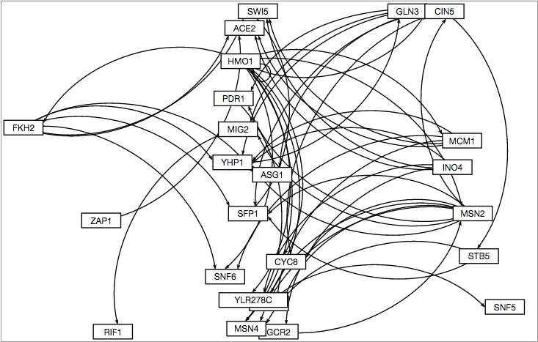
GRNSight Only DNA Binding Degree Distribution

Slide 18
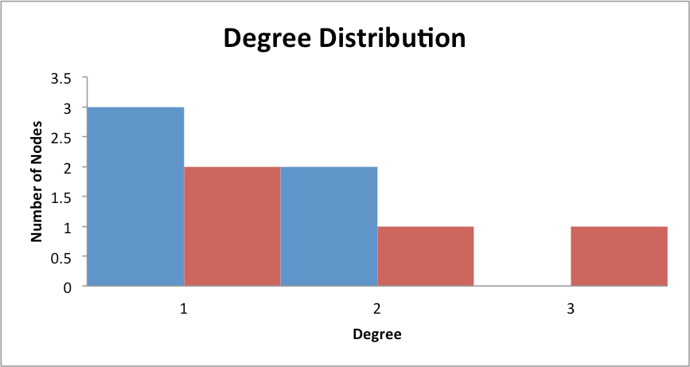
Binding AND Expression Distribution

Slide 19
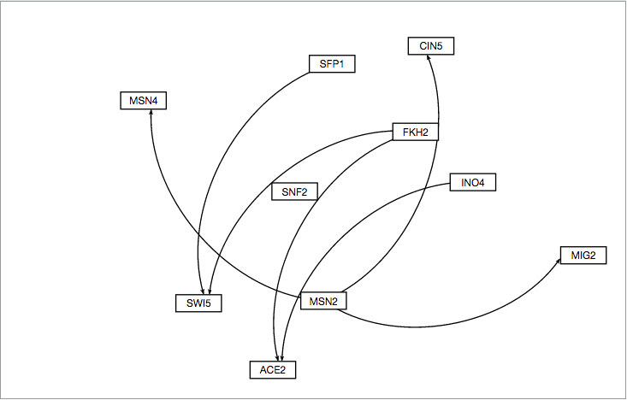
GRNSight Binding AND Expression

Slide 20
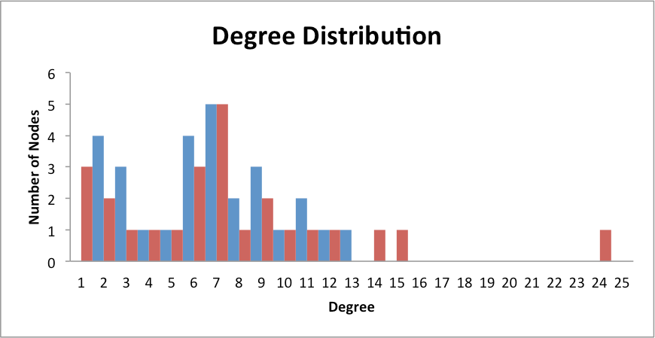
Binding PLUS Expression Distribution

Slide 21
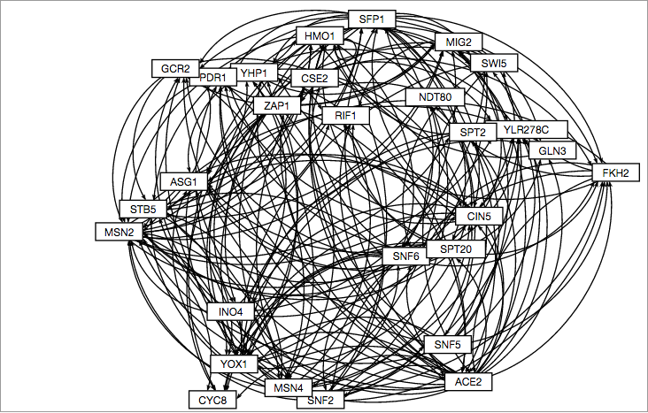
GRNSight Binding PLUS Expression

Slide 22
Compared Parameter Mappings for b=0 and b=1

Slide 23
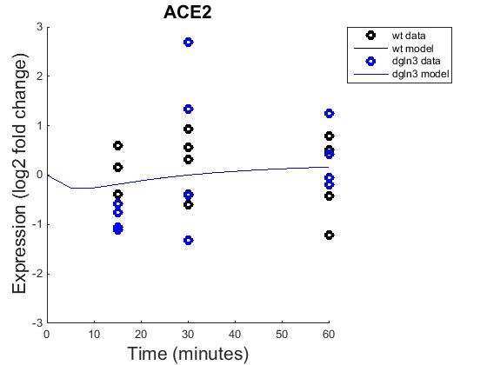

ACE2 (b=0 on the left, b=1 right)

Slide 24
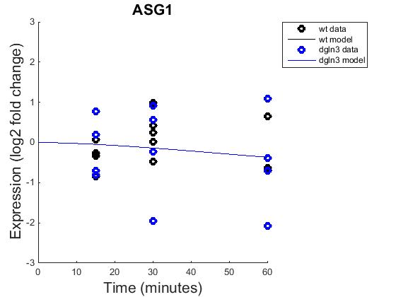
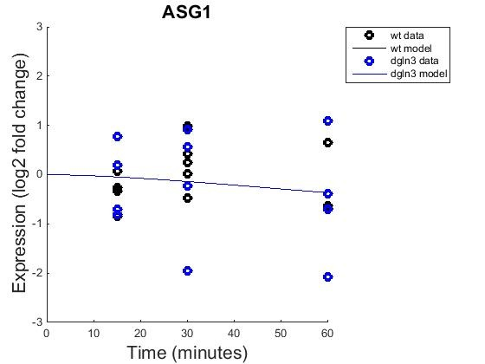
ASG1 (b=0 on the left, b=1 right)

Slide 25
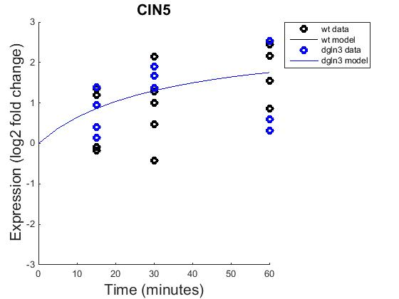

CIN5 (b=0 on the left, b=1 right)

Slide 26
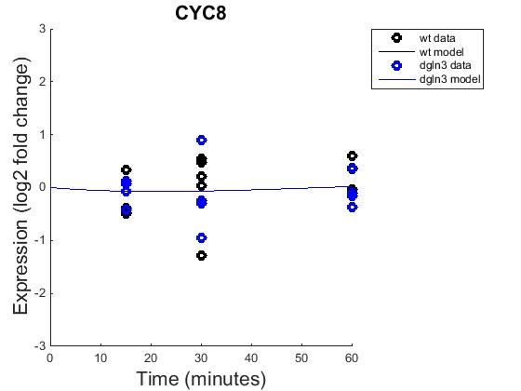
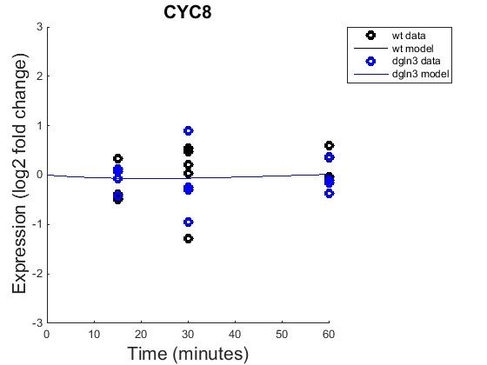
CYC8 (b=0 on the left, r=1 right)

Slide 27
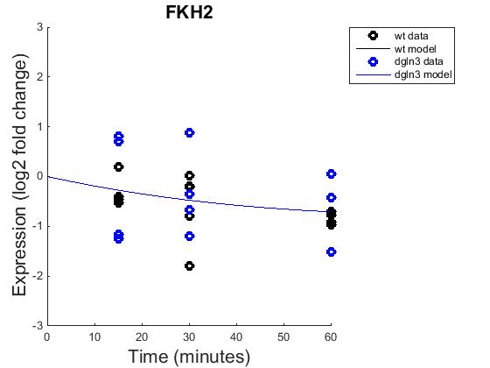
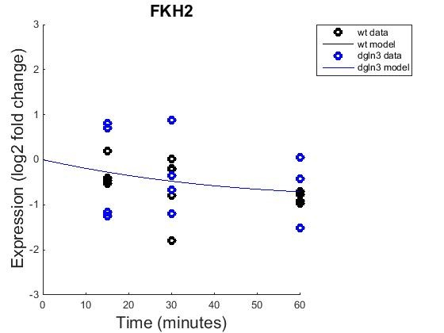
FKH2 (b=0 on the left, r=1 right)

Slide 28
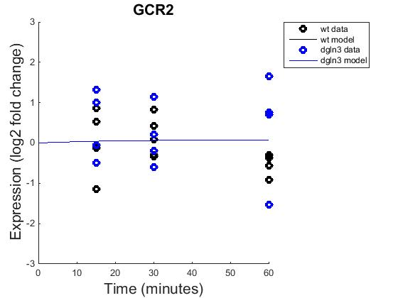

GCR2(b=0 on the left, r=1 right)

Slide 29
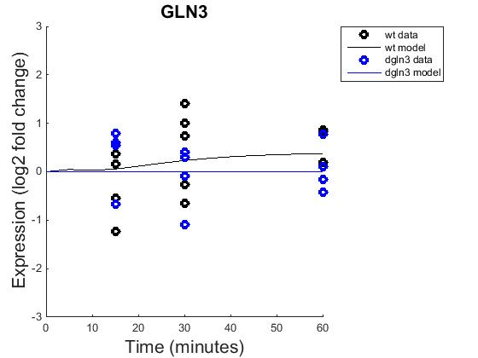
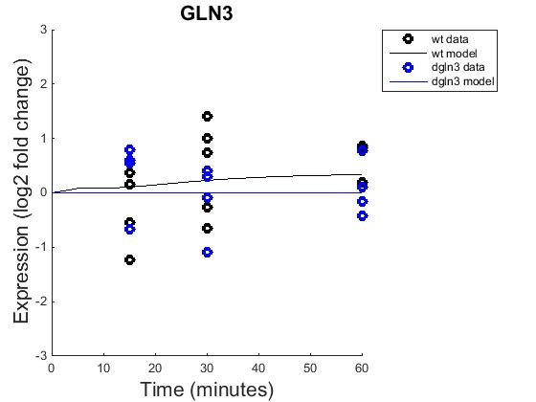
GLN3 (b=0 on the left, r=1 right)

Slide 30
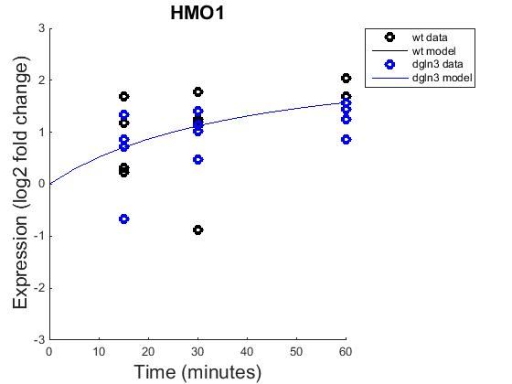

HMO1(b=0 on the left, r=1 right)

Slide 31
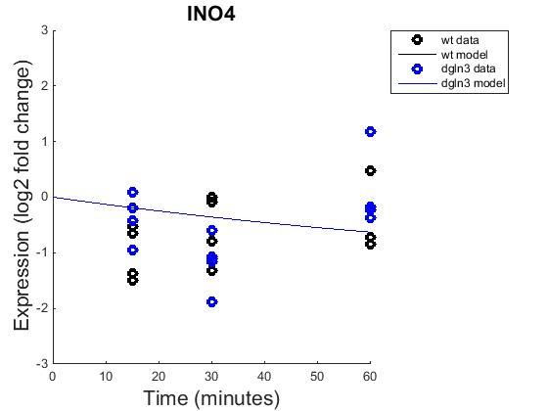

INO4 (b=0 on the left, r=1 right)

Slide 32
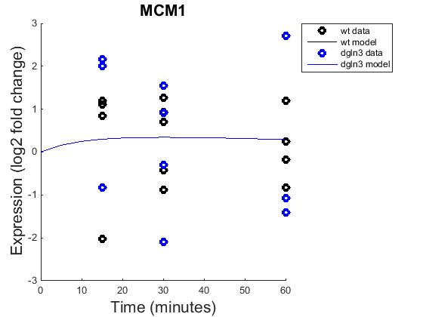
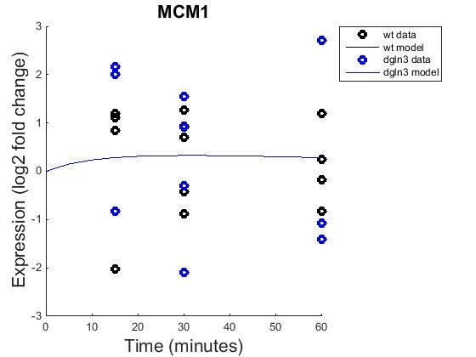
MCM1 (b=0 on the left, r=1 right)

Slide 33
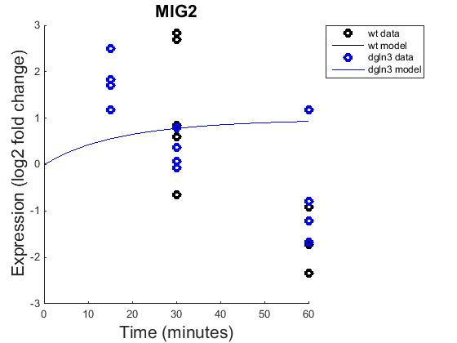
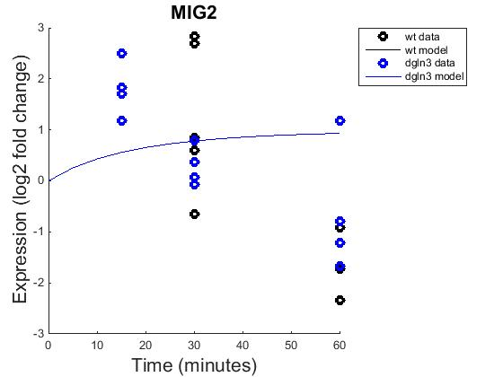
MIG2 (b=0 on the left, r=1 right)

Slide 34
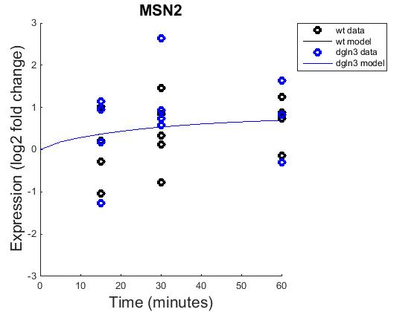

MSN2(b=0 on the left, r=1 right)

Slide 35
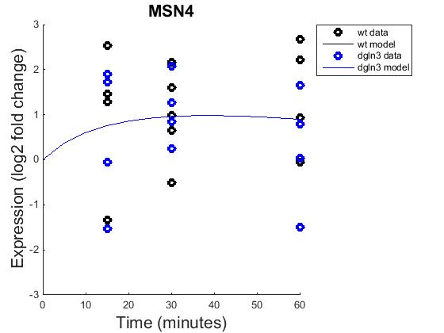

MSN4(b=0 on the left, r=1 right)

Slide 36
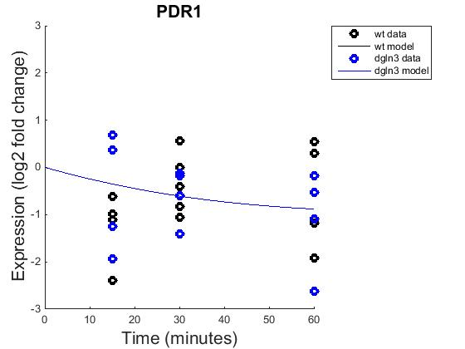
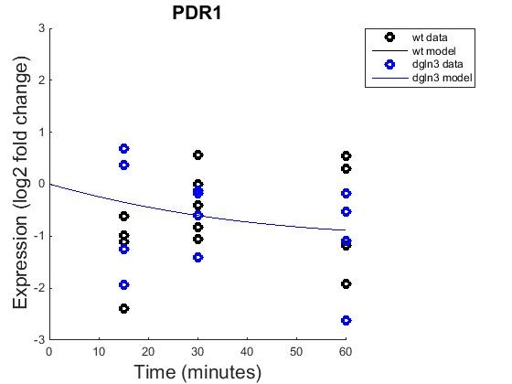
PDR1(b=0 on the left, r=1 right)

Slide 37
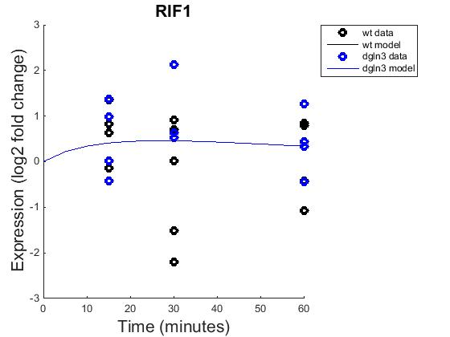

RIF1(b=0 on the left, r=1 right)

Slide 38
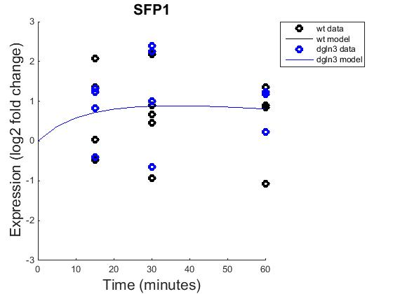

SFP1(b=0 on the left, r=1 right)

Slide 39
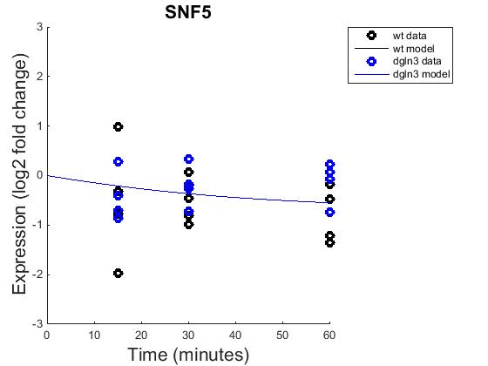

SNF5(b=0 on the left, r=1 right)

Slide 40
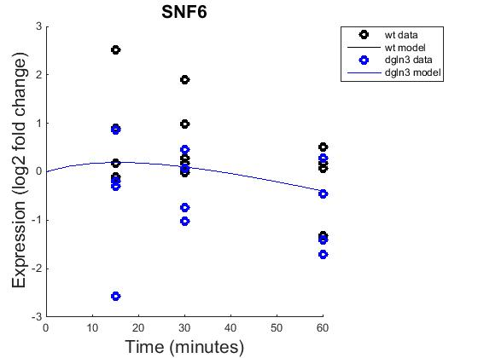
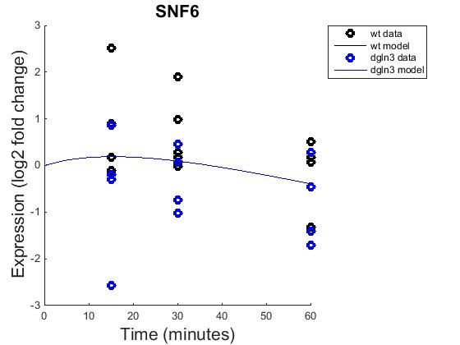
SNF6(b=0 on the left, r=1 right)

Slide 41
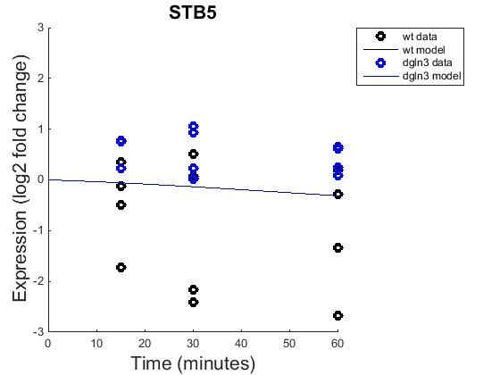
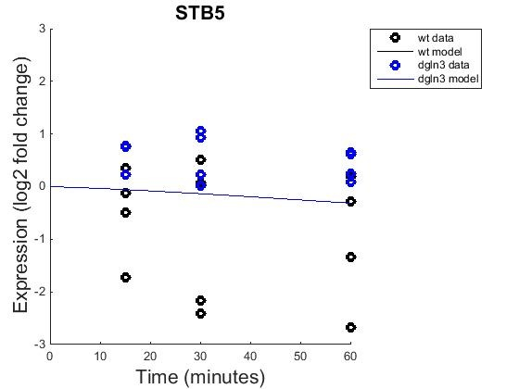
STB5(b=0 on the left, r=1 right)

Slide 42
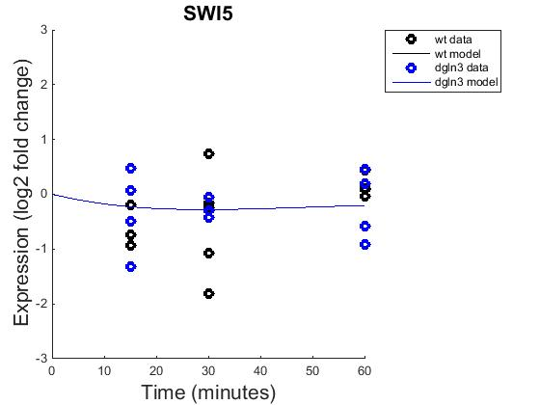

SWI5(b=0 on the left, r=1 right)

Slide 43
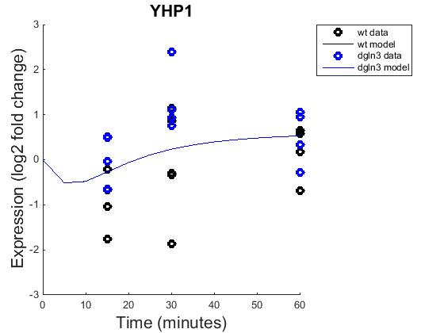

YHP1(b=0 on the left, r=1 right)

Slide 44


YLR278C(b=0 on the left, r=1 right)

Slide 45


YOX1(b=0 on the left, r=1 right)

Slide 46


ZAP1(b=0 on the left, r=1 right)

Slide 47

GRNsight Map for both Inputs

Slide 48

GRNsight Map for output b=0

Slide 49

GRNsight Map for b=1

Slide 50
Comparison of GRNsight outputs
b=1 on the left, b=0 on the right

Slide 51
Bar Graph comparing fixed and estimated weights
ControllerGeneA->TargetGeneB

Slide 52
Production Rates of Fixed vs. Estimated b
By standard name

