Slide 1
Comparison of the P-value significance between Wild Type and ΔGLN3
ANOVA | WT | ΔGLN3
p < 0.05 | 38.42% | 30.11%
p < 0.01 | 24.67% | 16.29%
p < 0.001 | 13.90% | 6.53%
p < 0.0001 | 7.43% | 2.04%
B-H p < 0.05 | 26.76% | 2.04%
Bonferroni p < 0.05 | 3.68% | 0.42%

Slide 2
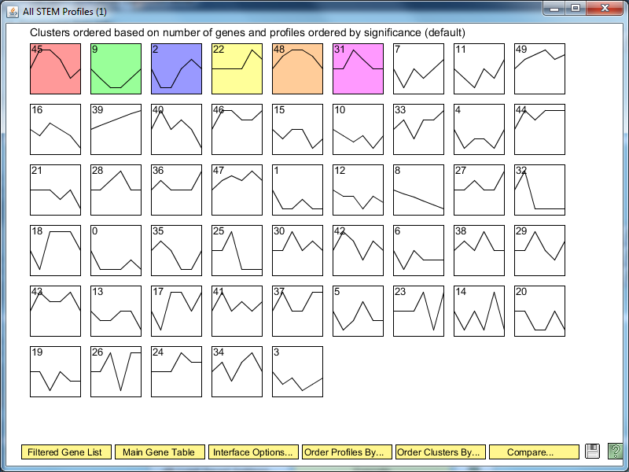
ΔGLN3 STEM Significance Profiles

Slide 3
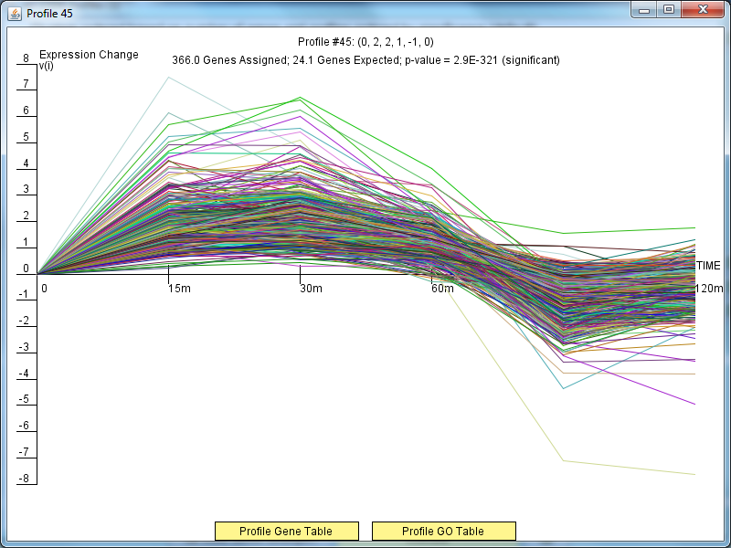
ΔGLN3 Profile 45

Slide 4
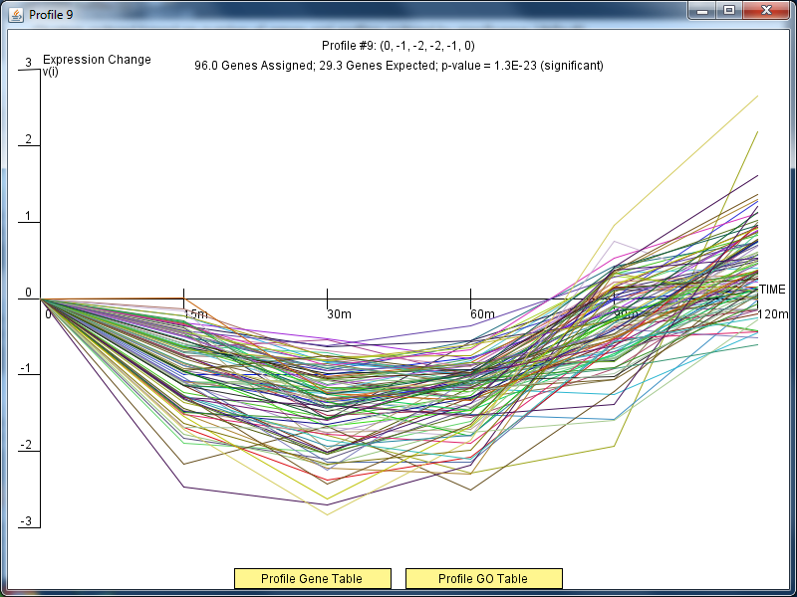
ΔGLN3 Profile 9

Slide 5
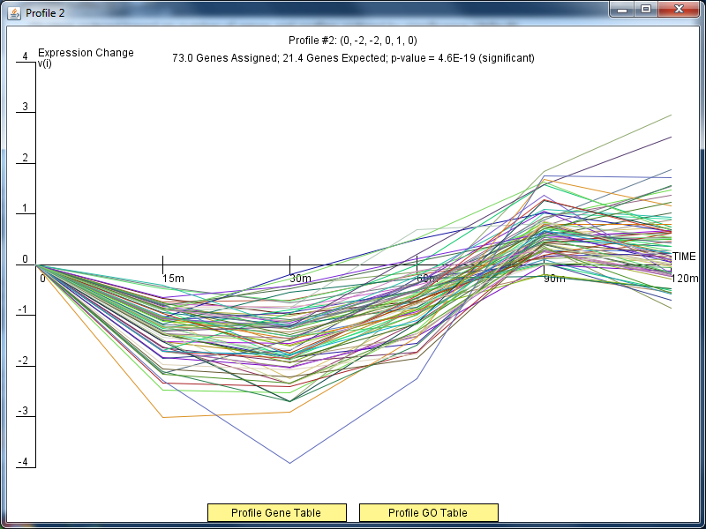
ΔGLN3Profile 2

Slide 6
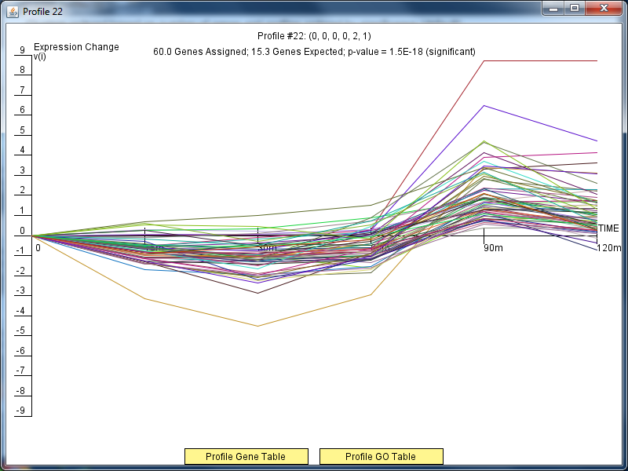
ΔGLN3Profile 22

Slide 7
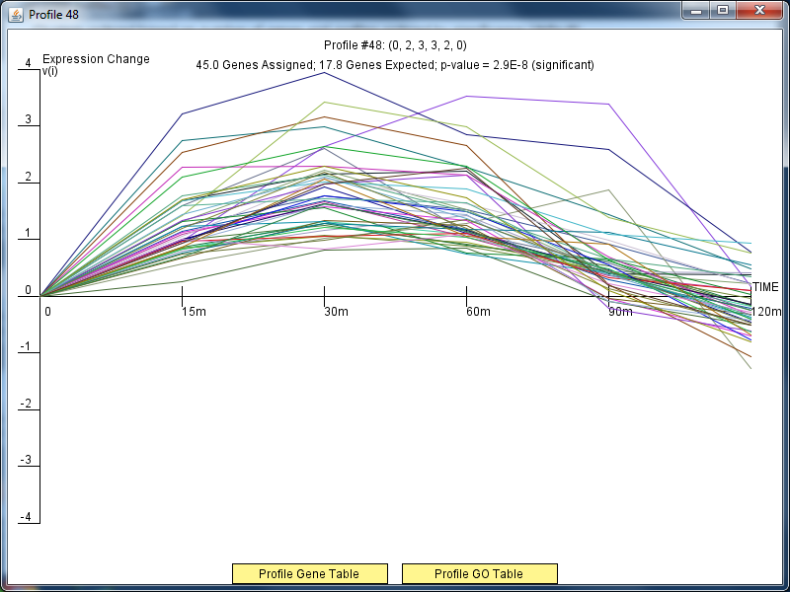
ΔGLN3Profile 48

Slide 8
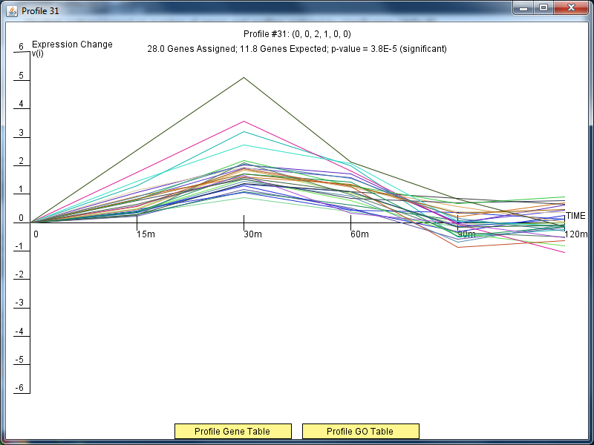
ΔGLN3Profile 31

Slide 9
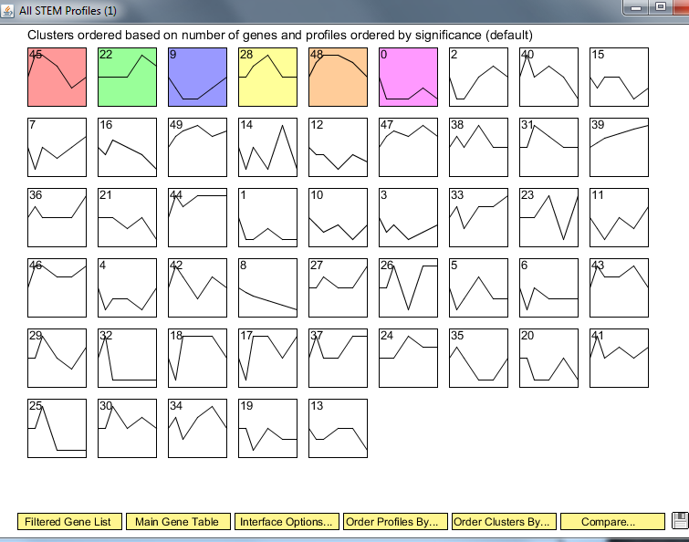
Wild Type Clusters

Slide 10
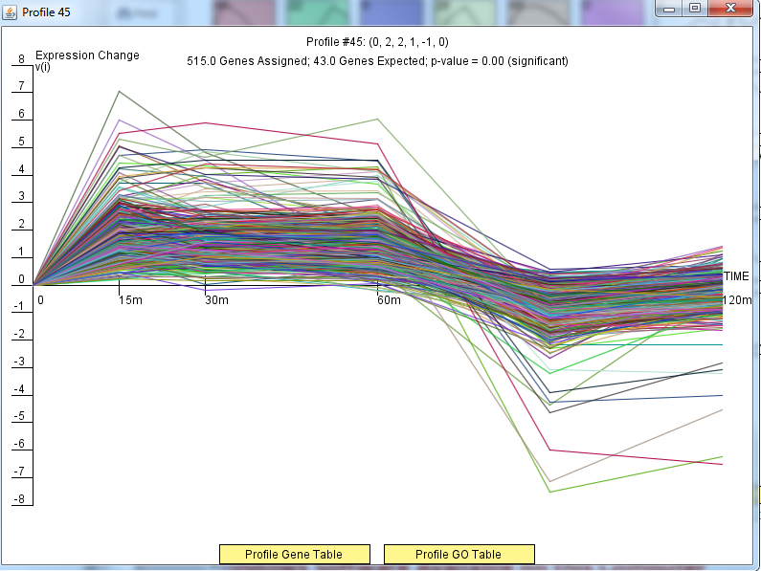
Wild Type Profile 45

Slide 11
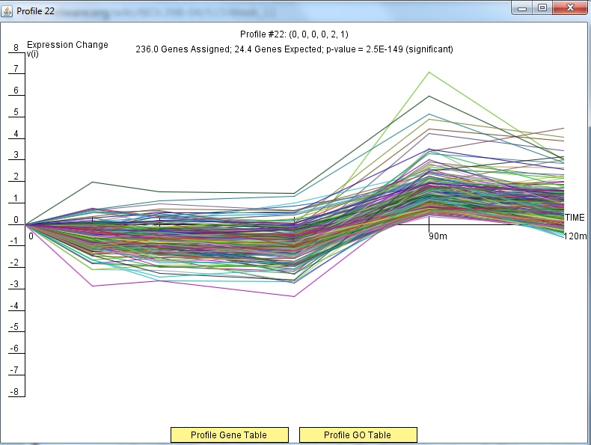
Wild Type Profile 22

Slide 12
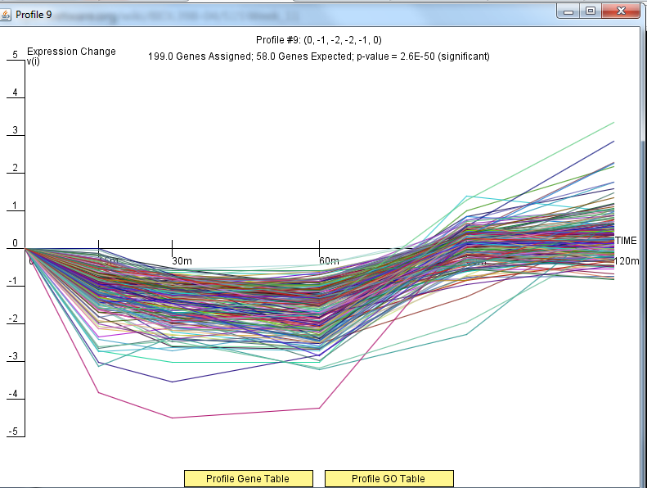
Wild Type Profile 9

Slide 13
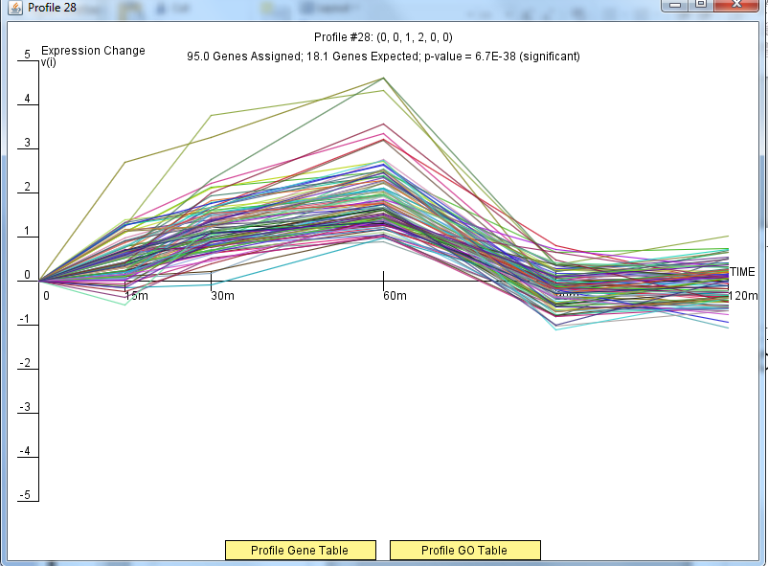
Wild Type Profile 28

Slide 14
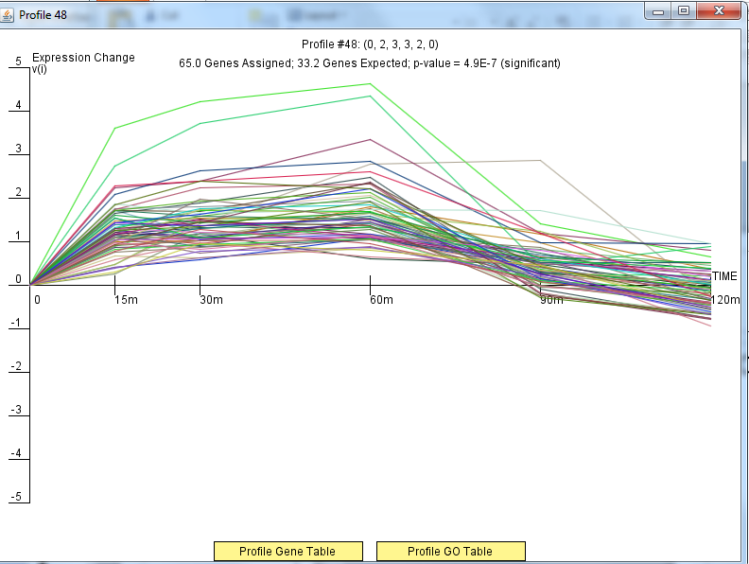
Wild Type Profile 48

Slide 15
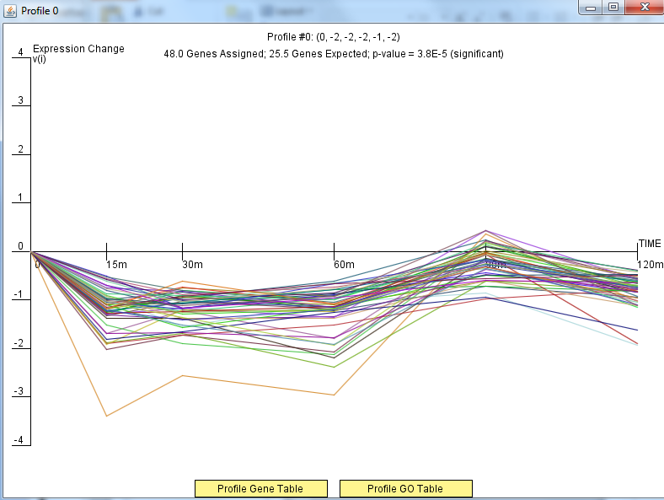
Wild Type Profile 0

Slide 16
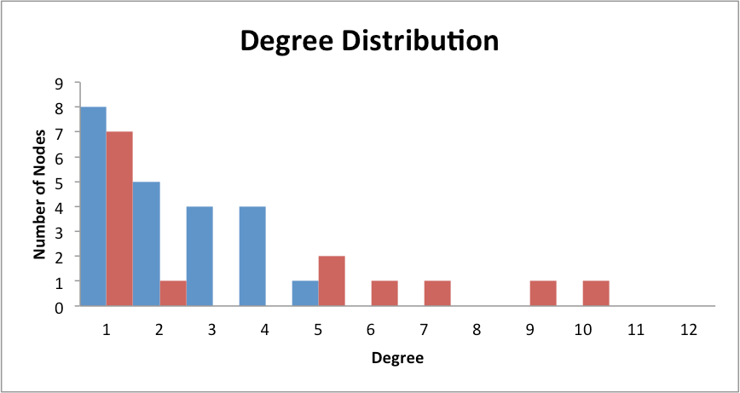
Only DNA Binding Degree Distribution

Slide 17
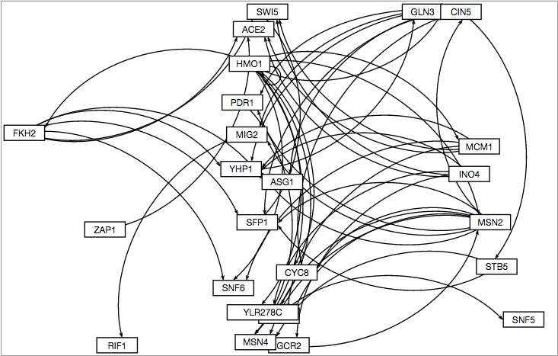
GRNSight Only DNA Binding Degree Distribution

Slide 18
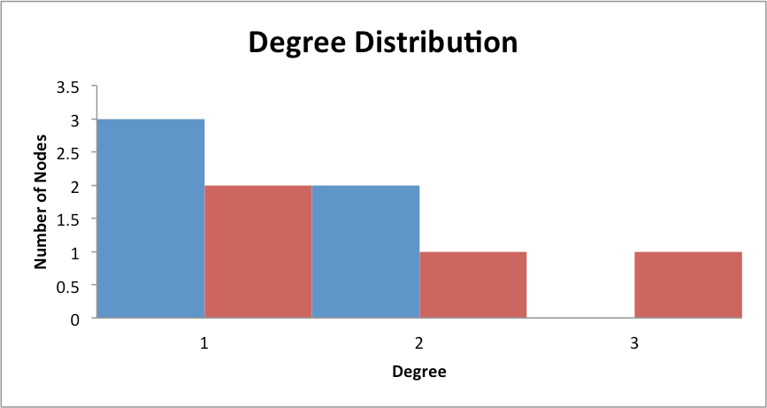
Binding AND Expression Distribution

Slide 19
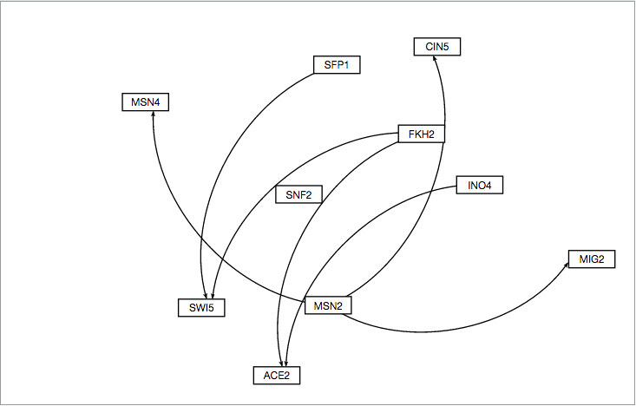
GRNSight Binding AND Expression

Slide 20
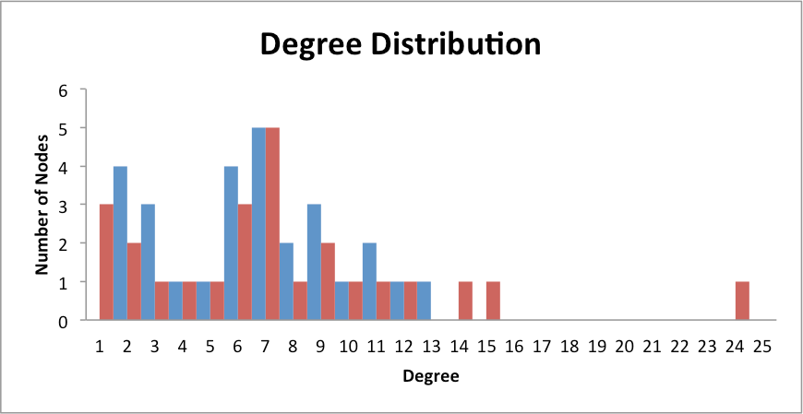
Binding PLUS Expression Distribution

Slide 21
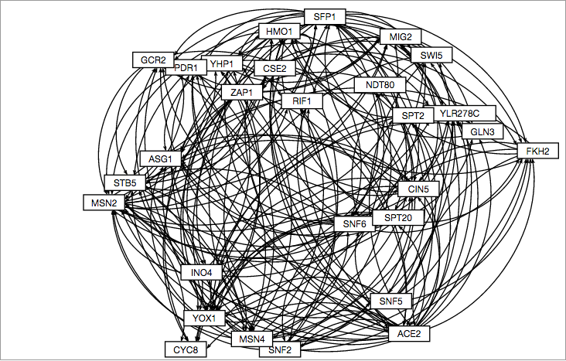
GRNSight Binding PLUS Expression

Slide 22
Figures for Mappings for b=0

Slide 23
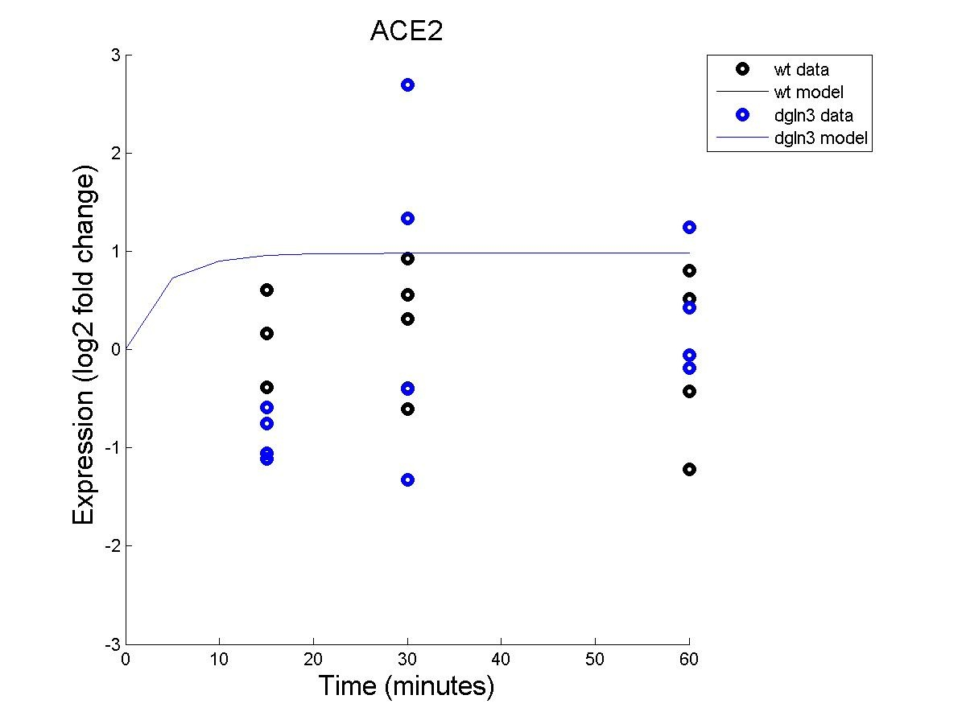
ACE2

Slide 24
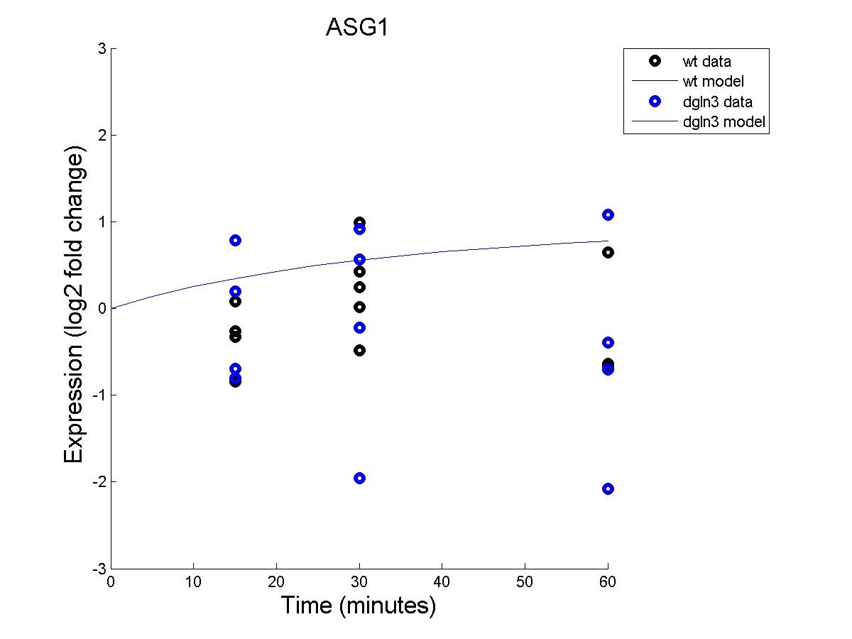
ASG1

Slide 25
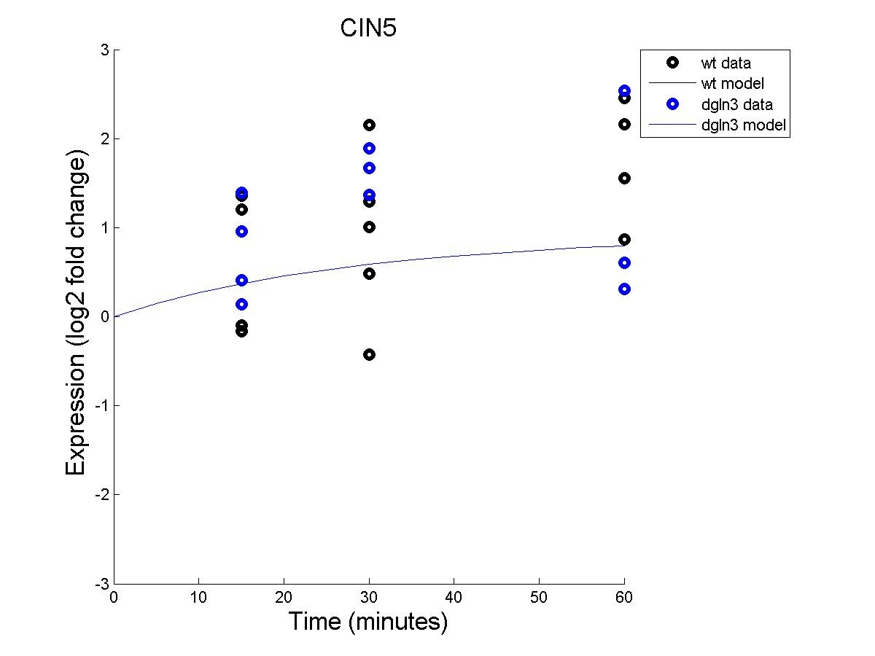
CIN5

Slide 26
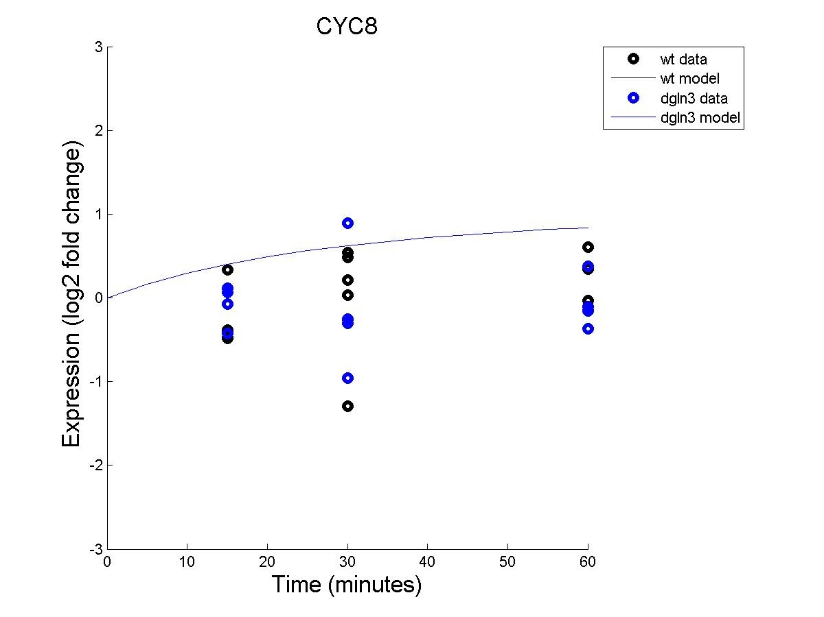
CYC8

Slide 27
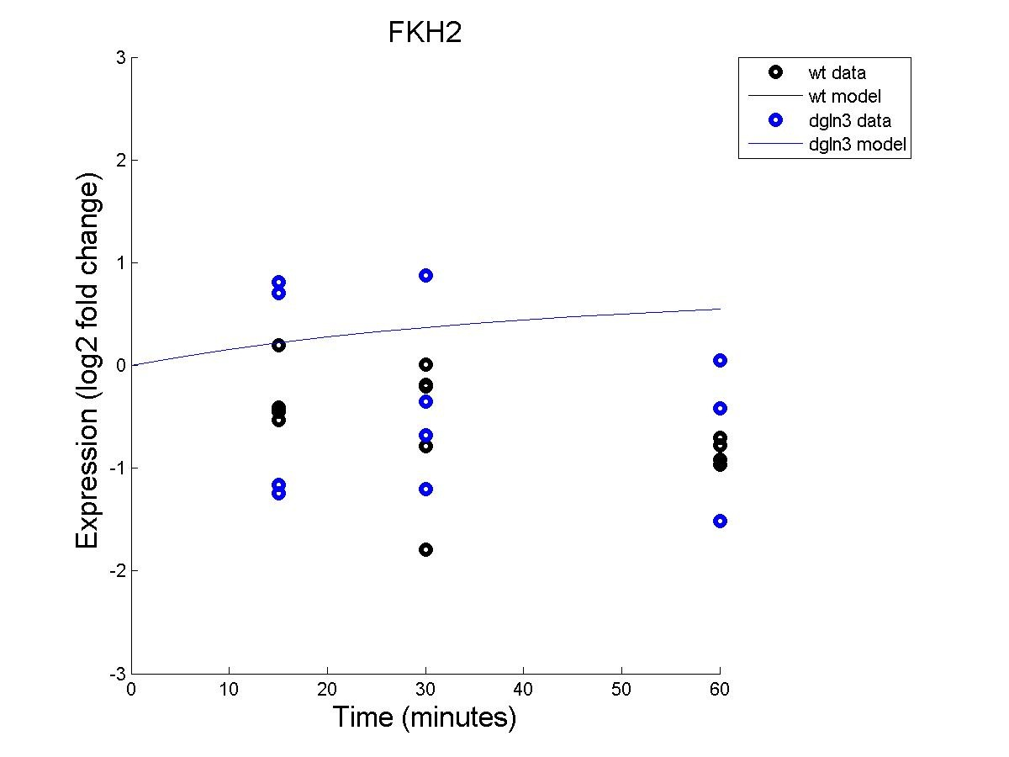
FKH2

Slide 28
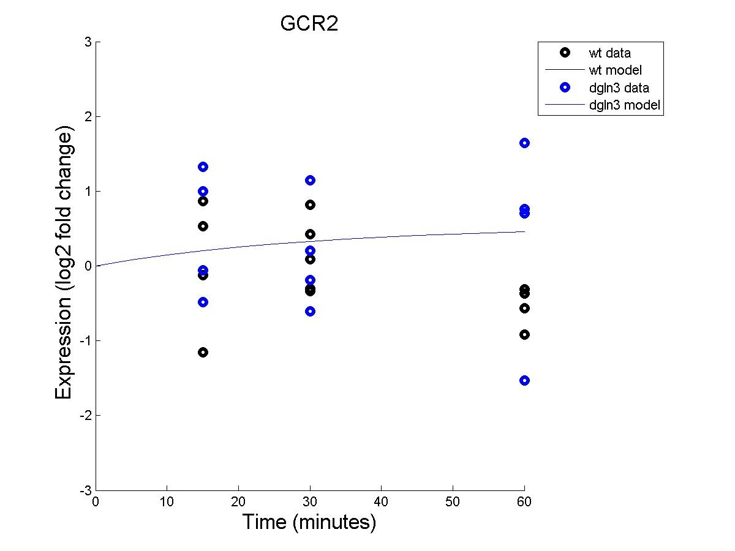
GCR2

Slide 29
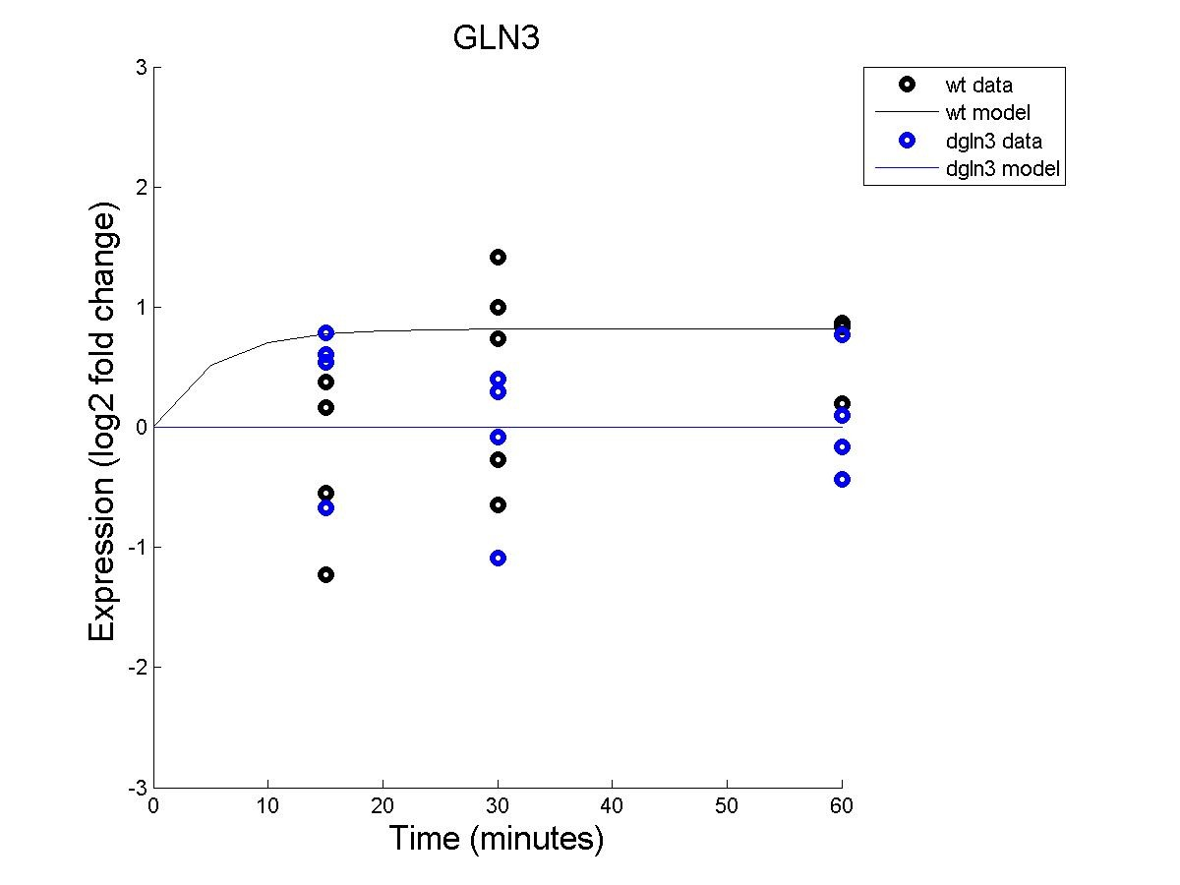
GLN3

Slide 30
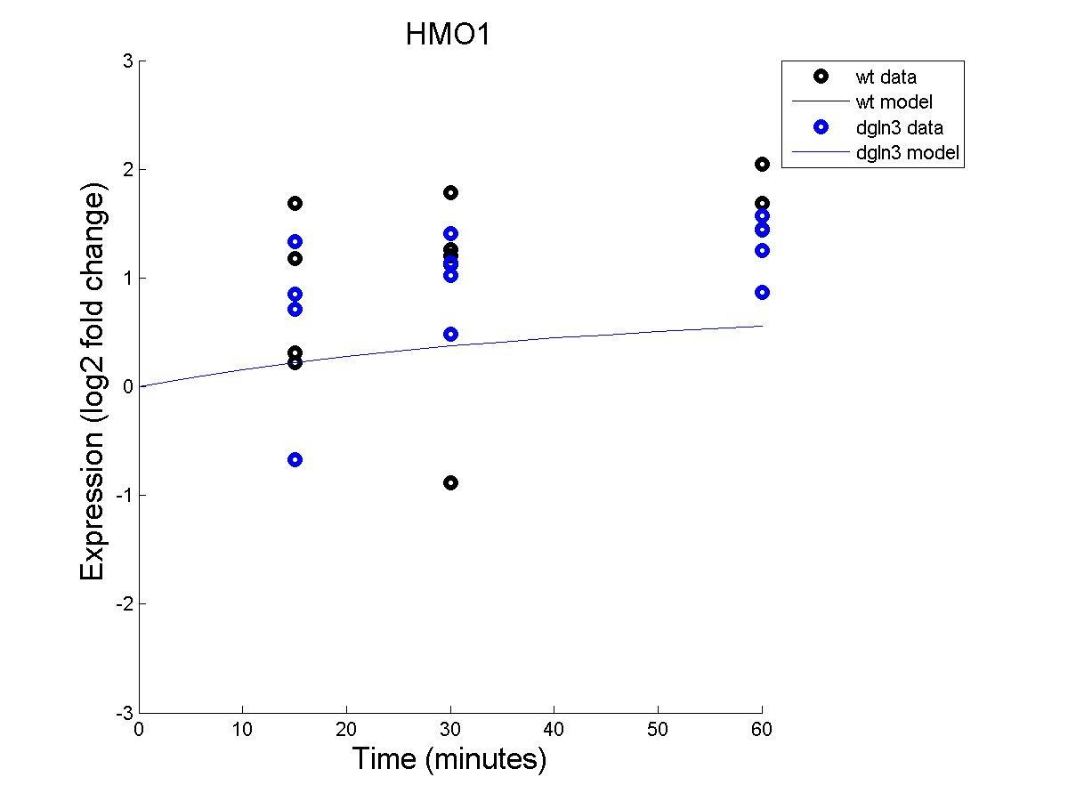
HMO1

Slide 31
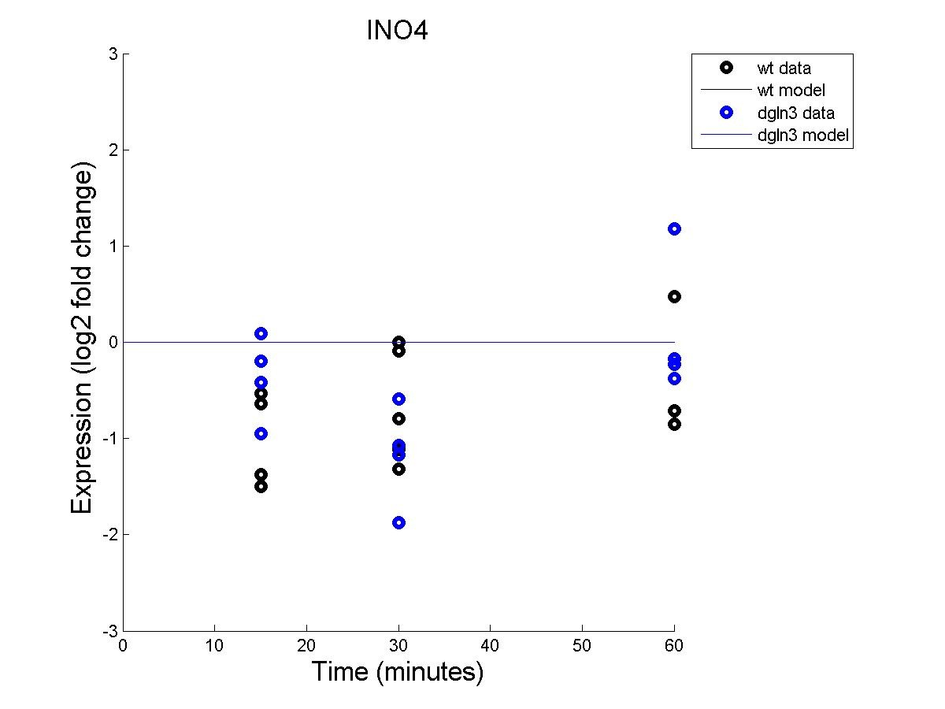
INO4

Slide 32
MCM1

Slide 33
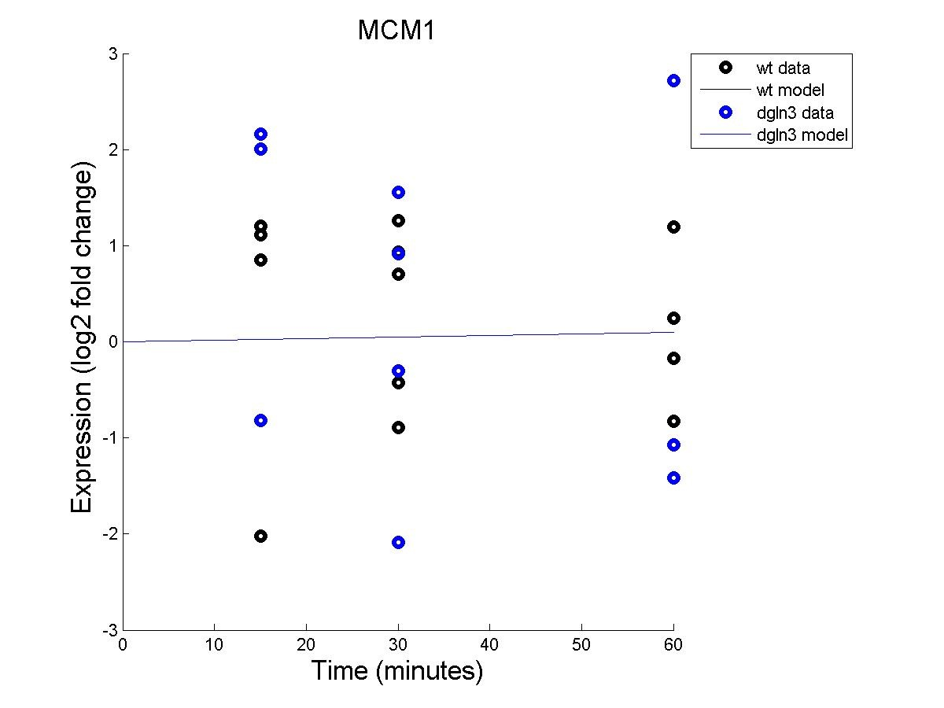
MCM1

Slide 34
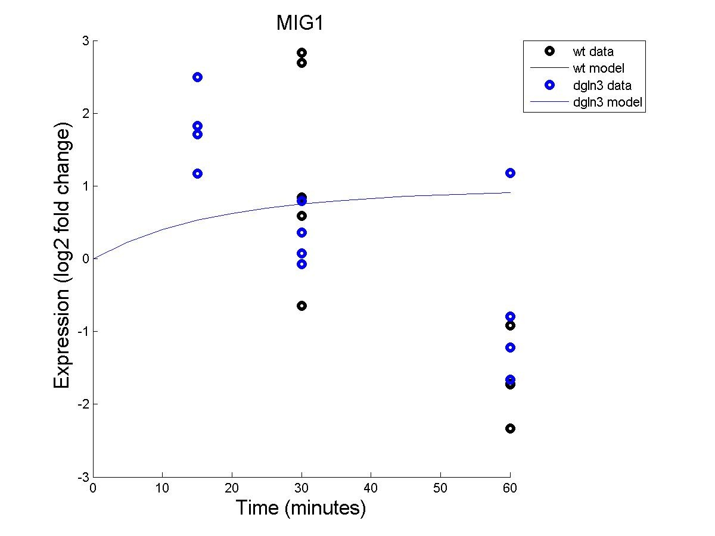
MIG1

Slide 35
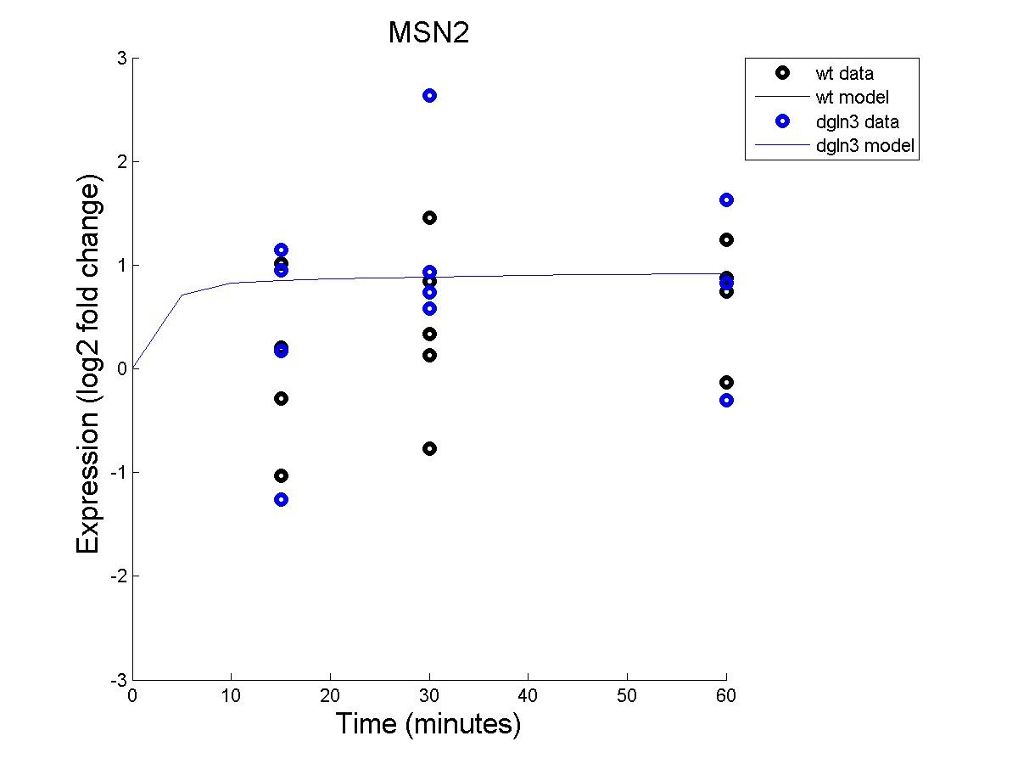
MSN2

Slide 36
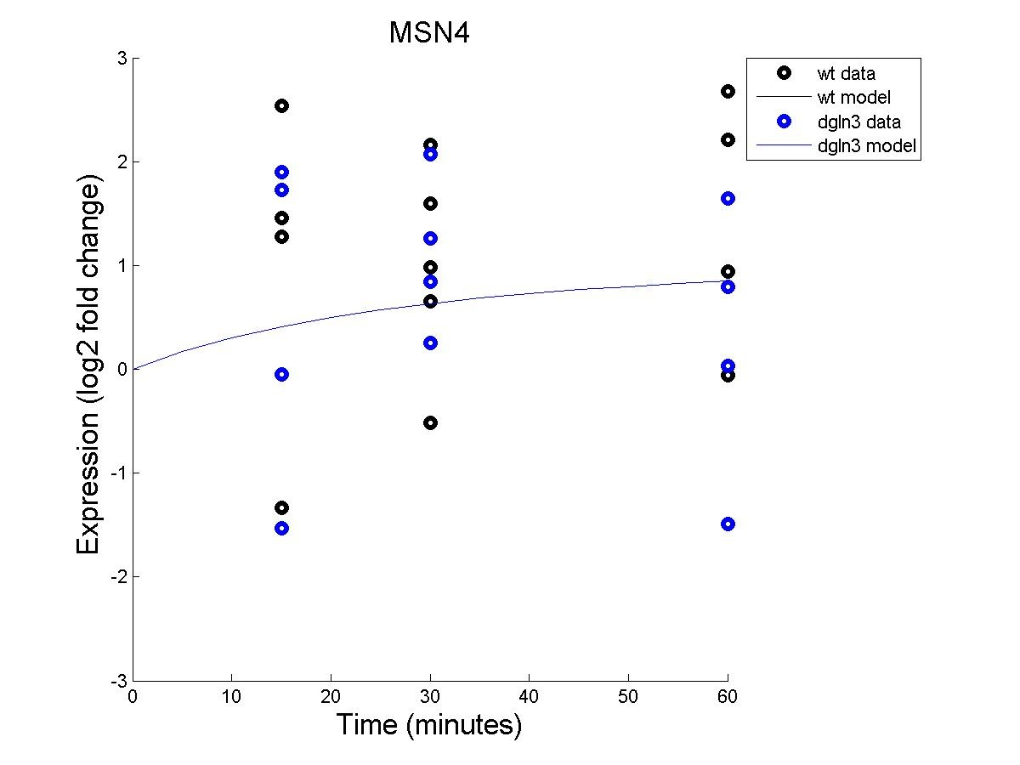
MSN4

Slide 37
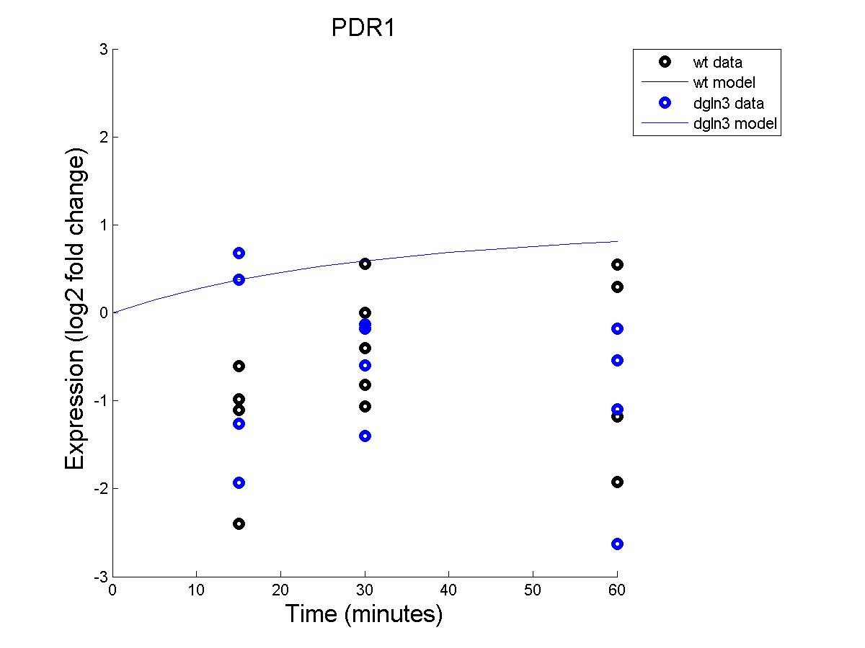
PDR1

Slide 38
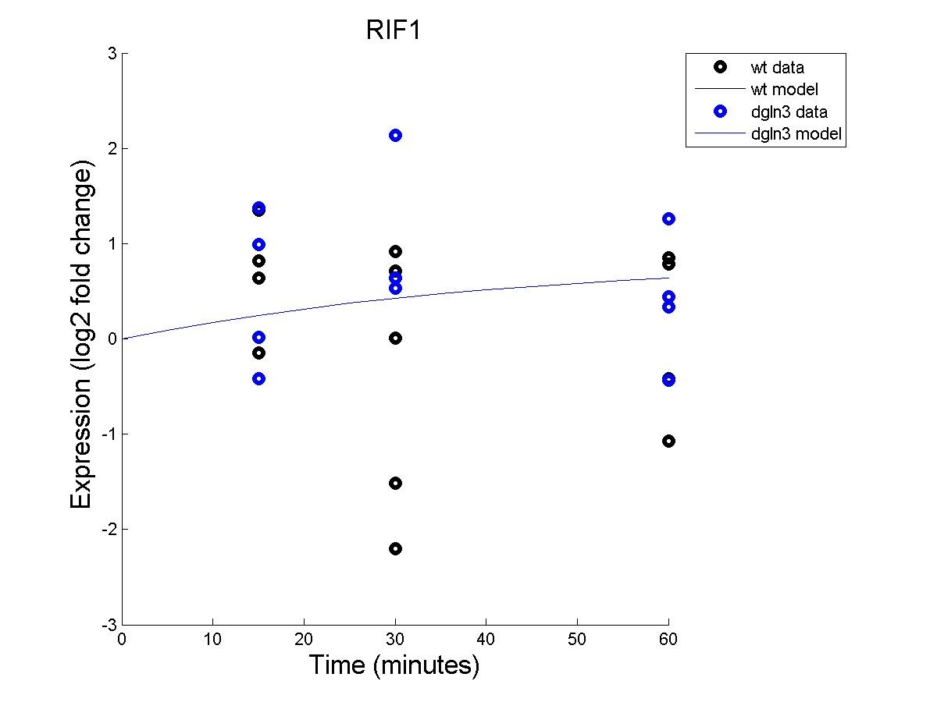
RIF1

Slide 39
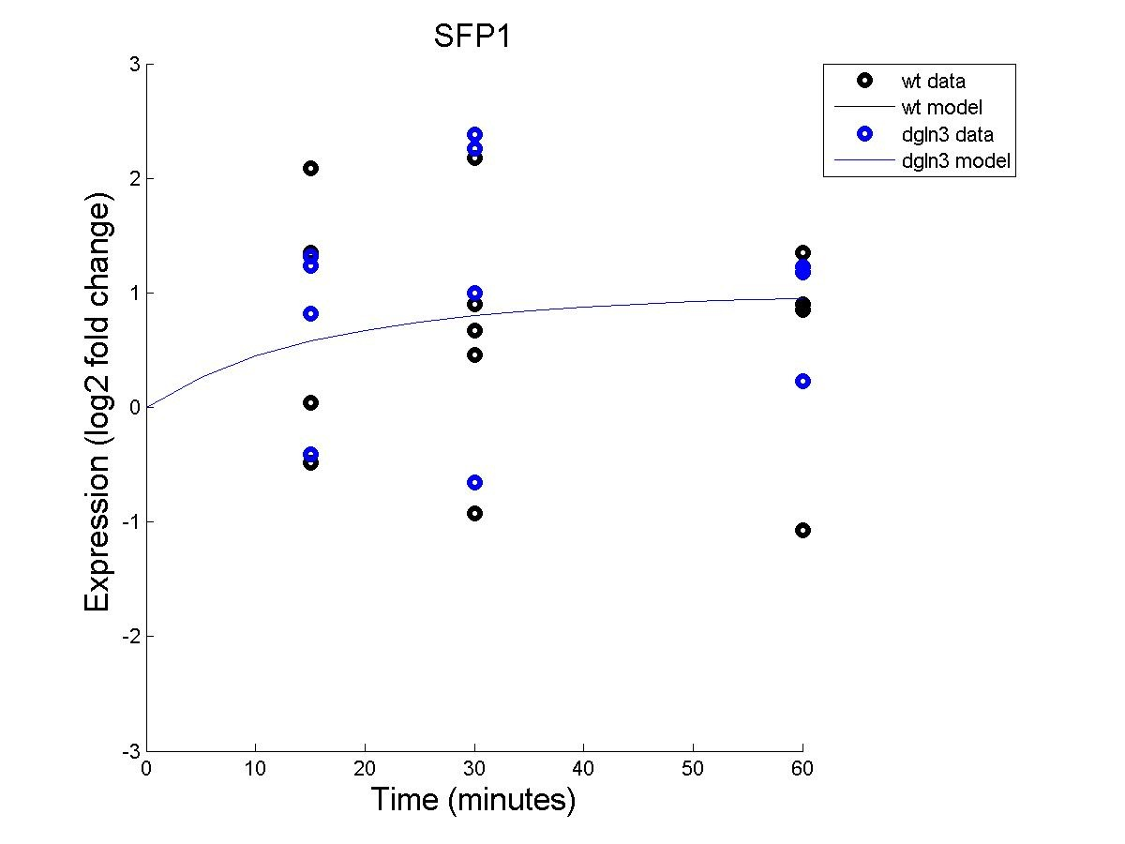
SFP1

Slide 40
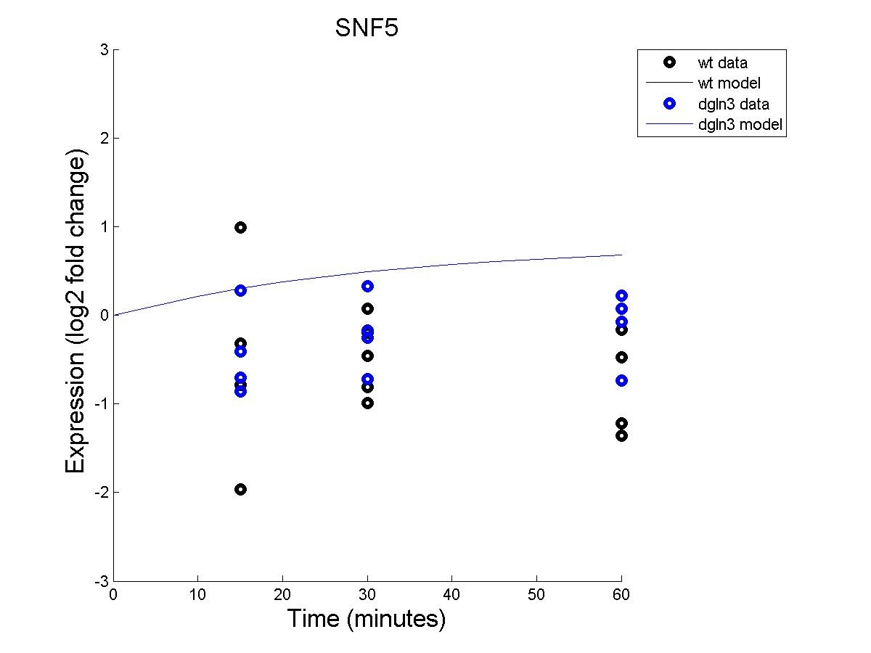
SNF5

Slide 41
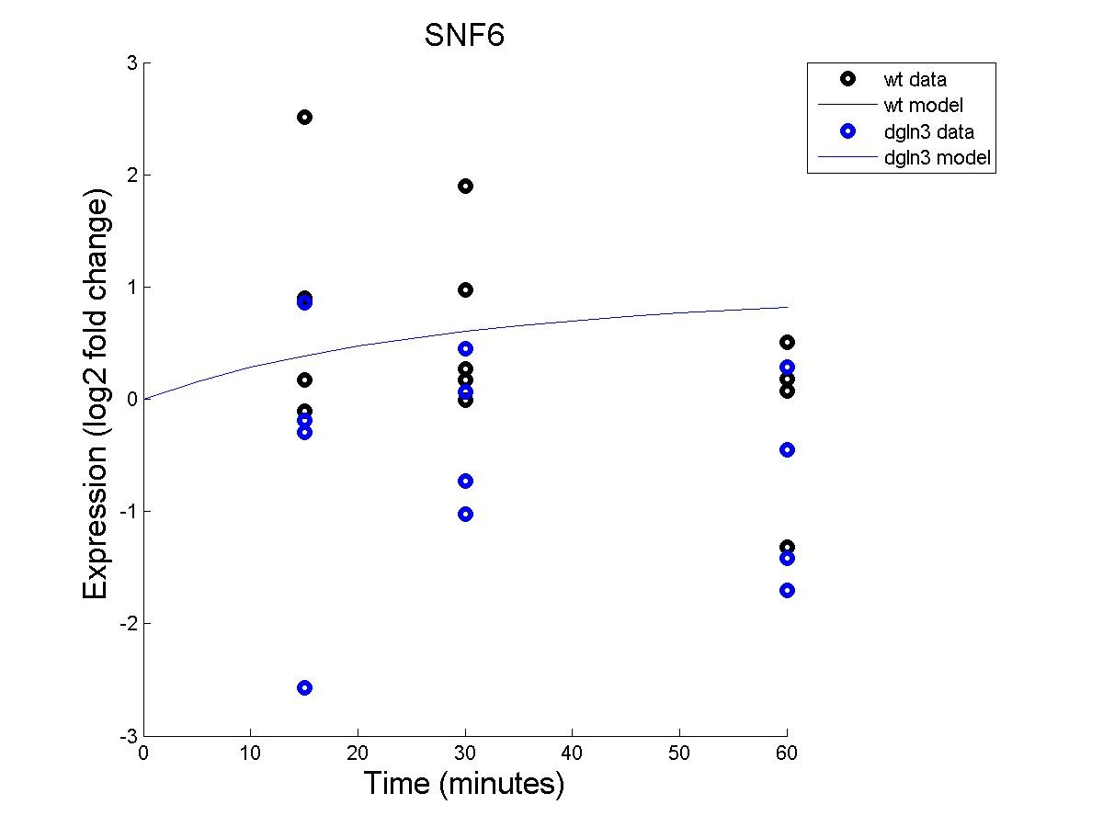
SNF6

Slide 42
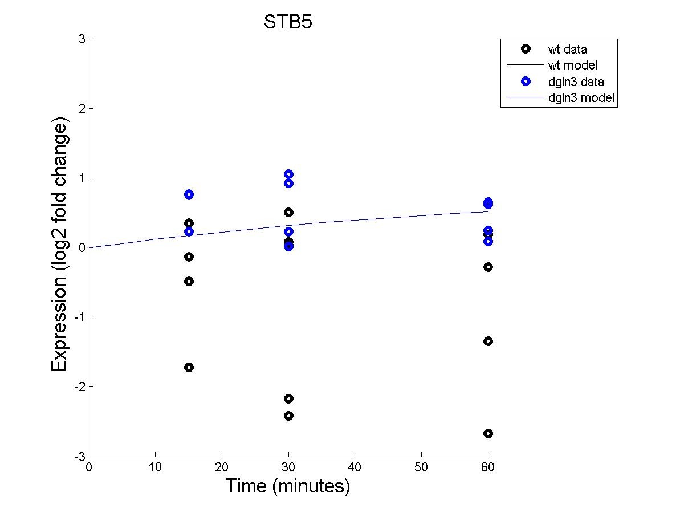
STB5

Slide 43
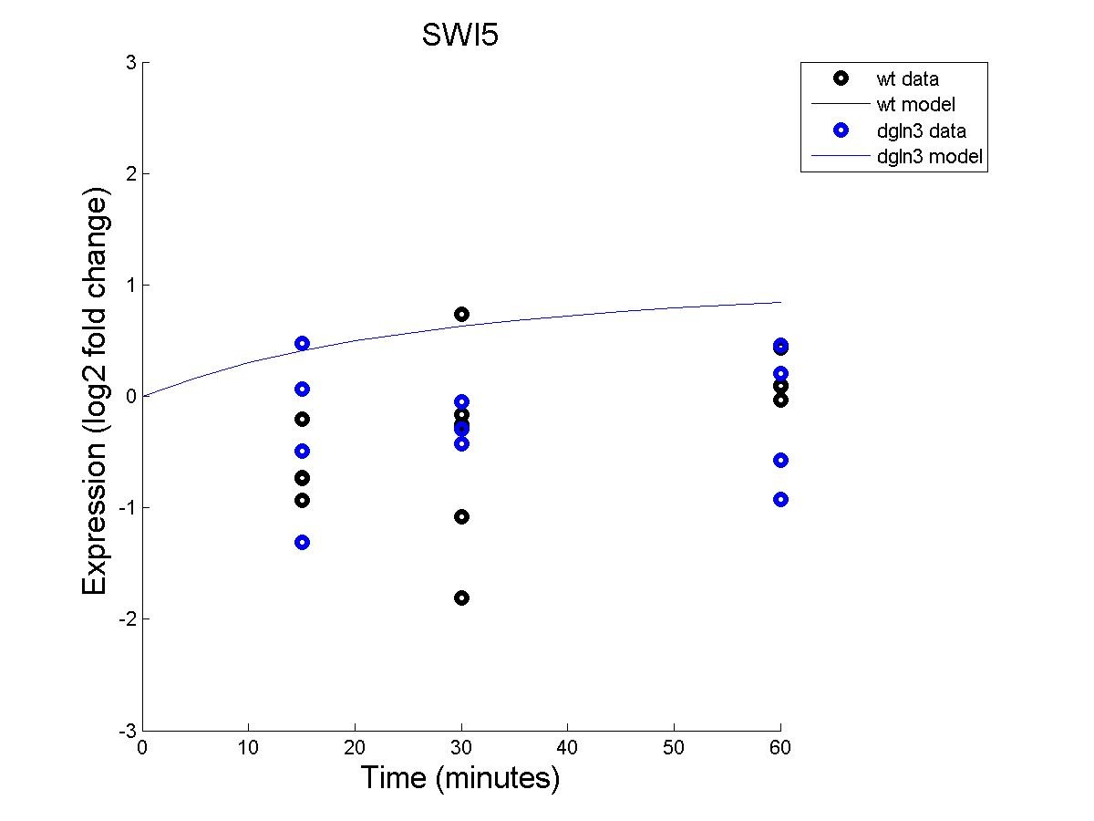
SWI5

Slide 44
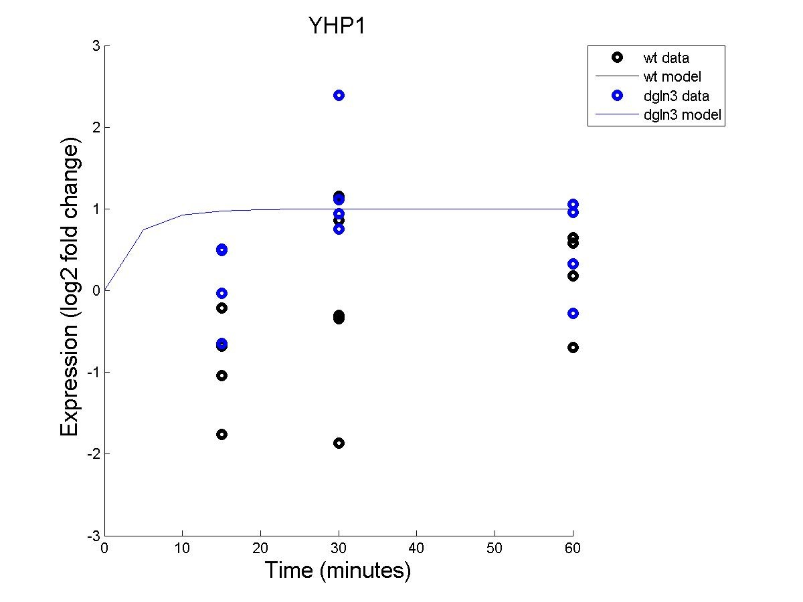
YHP1

Slide 45
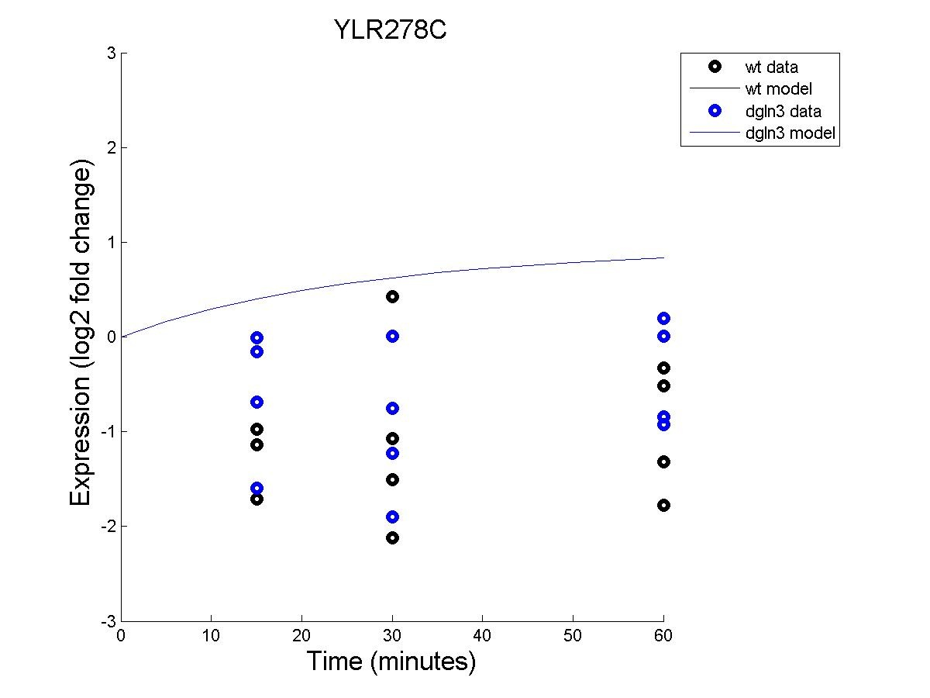
YLR278C

Slide 46
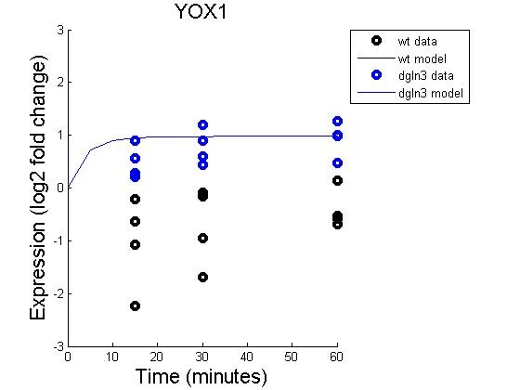
YOX1

Slide 47
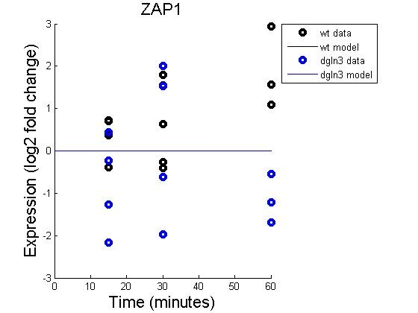
ZAP1

Slide 48
Modified Parameter Mappings for b=1

Slide 49
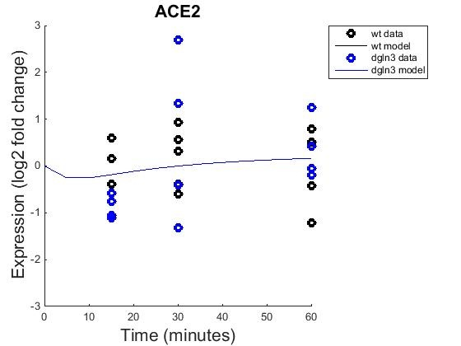
ACE2

Slide 50
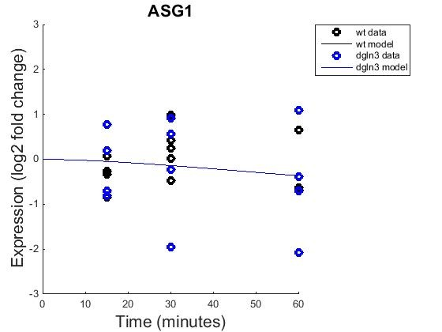
ASG1

Slide 51
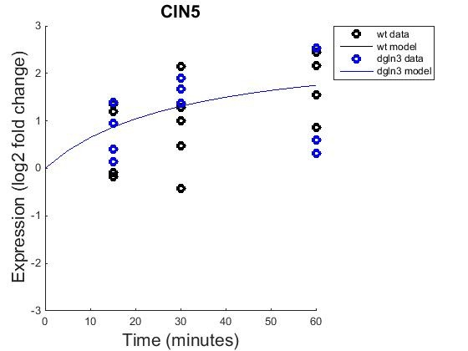
CIN5

Slide 52
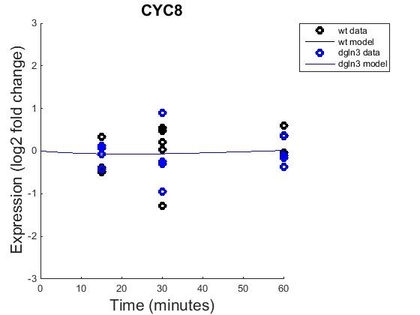
CYC8

Slide 53
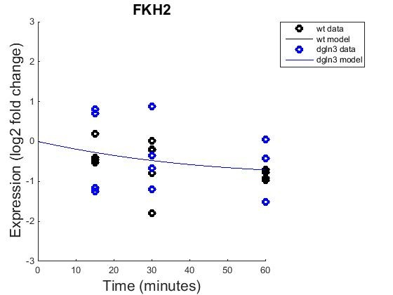
FKH2

Slide 54
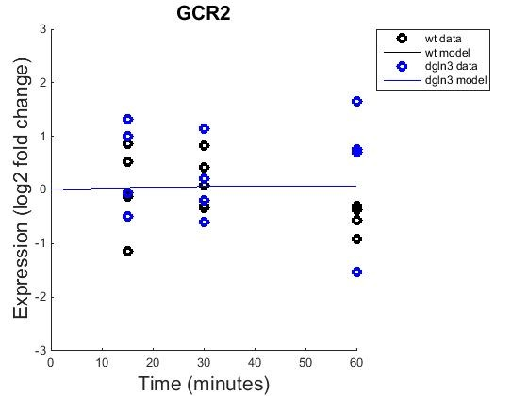
GCR2

Slide 55

GLN3

Slide 56

HMO1

Slide 57

INO4

Slide 58

MCM1

Slide 59

MIG1

Slide 60

MSN2

Slide 61

MSN4

Slide 62

PDR1

Slide 63

RIF1

Slide 64

SFP1

Slide 65

SNF5

Slide 66

SNF6

Slide 67

STB5

Slide 68

SWI5

Slide 69

YHP1

Slide 70

YLR278C

Slide 71

YOX1

Slide 72

ZAP1

Slide 73

GRN b=0

Slide 74

GRN b=1

