Slide 1
Comparison of the P-value significance between Wild Type and ΔGLN3
ANOVA | WT | ΔGLN3
p < 0.05 | 38.42% | 30.11%
p < 0.01 | 24.67% | 16.29%
p < 0.001 | 13.90% | 6.53%
p < 0.0001 | 7.43% | 2.04%
B-H p < 0.05 | 26.76% | 2.04%
Bonferroni p < 0.05 | 3.68% | 0.42%

Slide 2
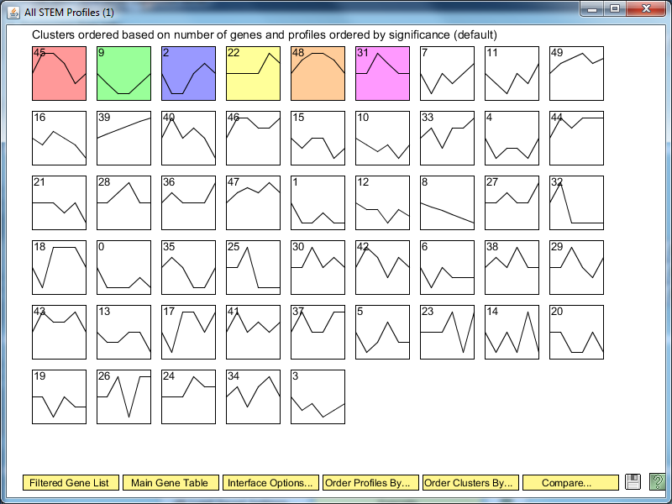
ΔGLN3 STEM Significance Profiles

Slide 3
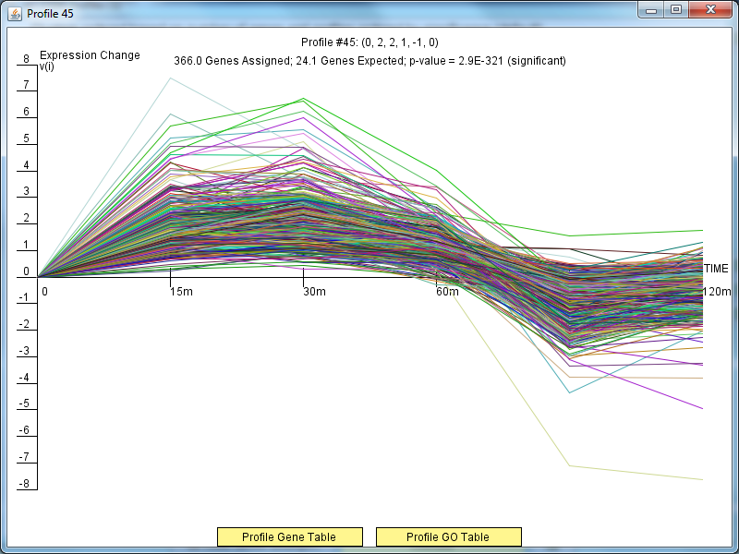
ΔGLN3 Profile 45

Slide 4
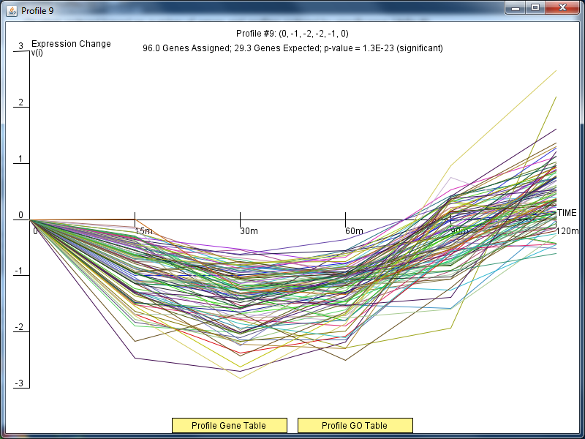
ΔGLN3 Profile 9

Slide 5
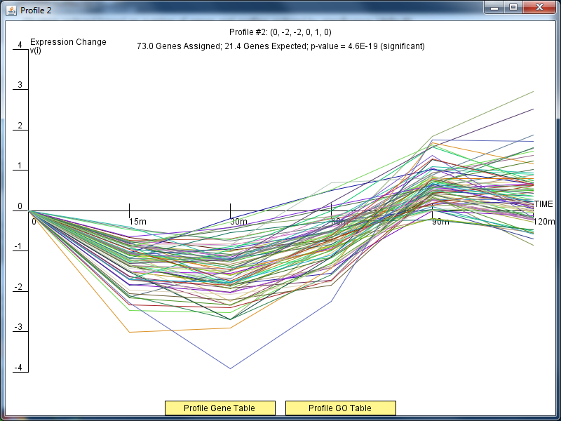
ΔGLN3Profile 2

Slide 6
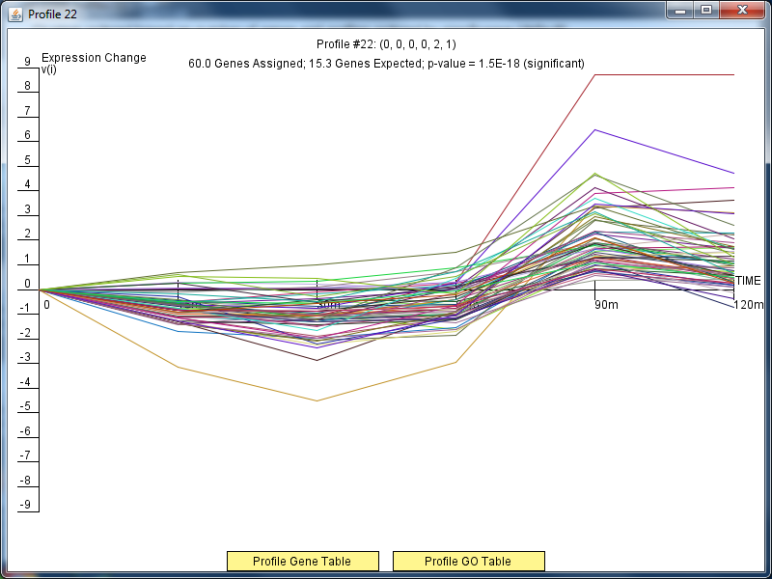
ΔGLN3Profile 22

Slide 7
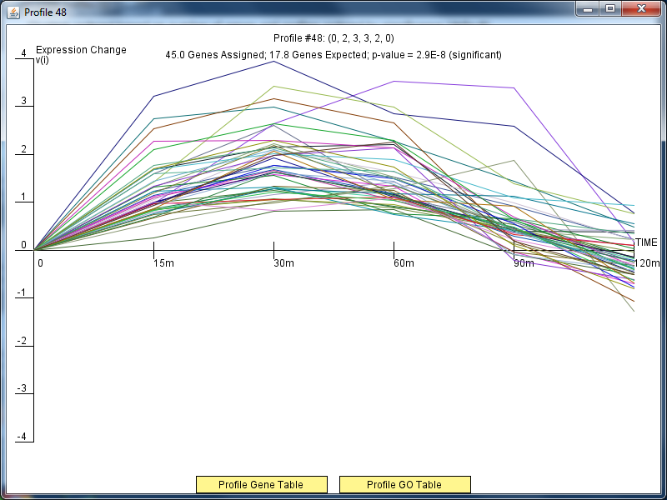
ΔGLN3Profile 48

Slide 8
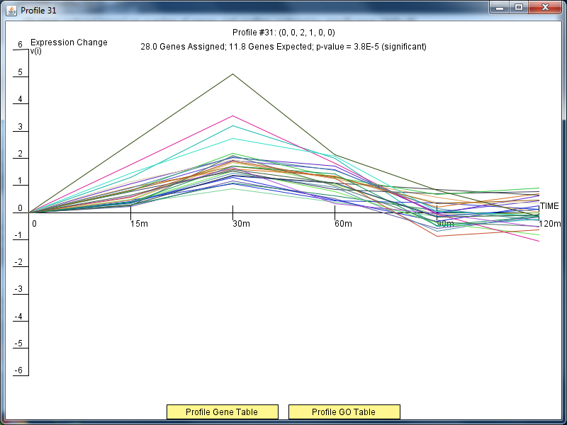
ΔGLN3Profile 31

Slide 9
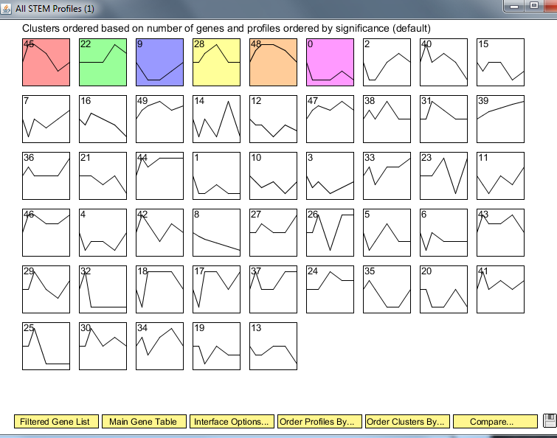
Wild Type Clusters

Slide 10
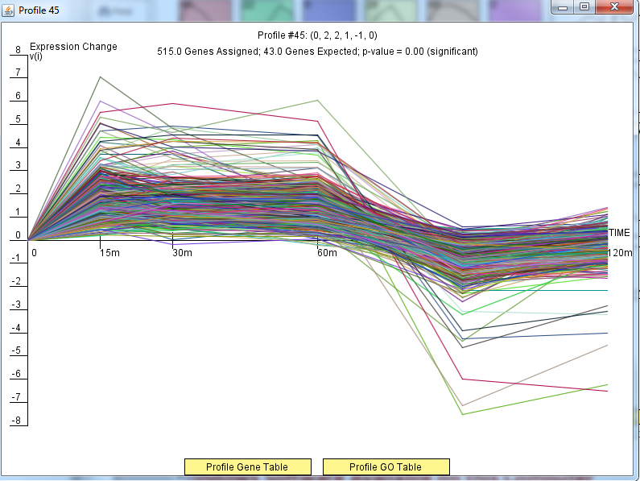
Wild Type Profile 45

Slide 11
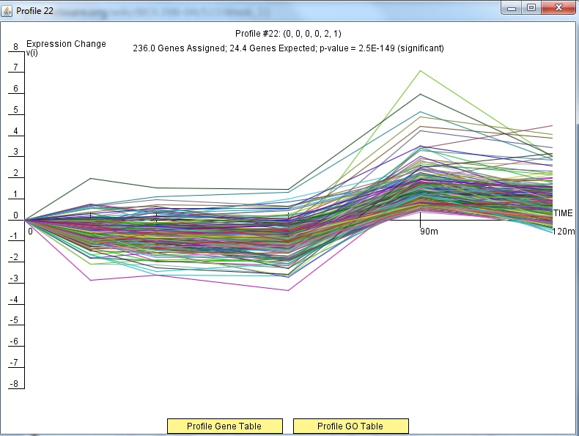
Wild Type Profile 22

Slide 12
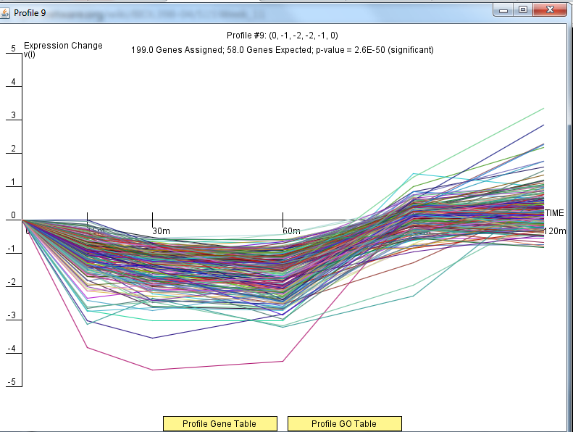
Wild Type Profile 9

Slide 13
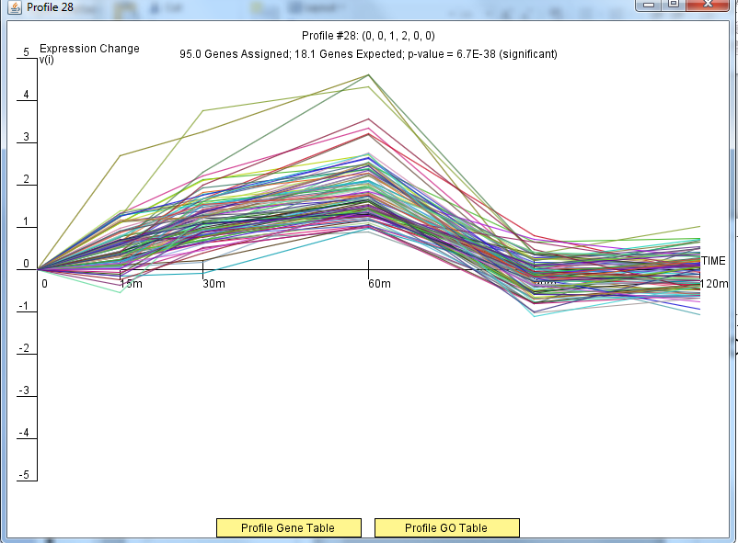
Wild Type Profile 28

Slide 14
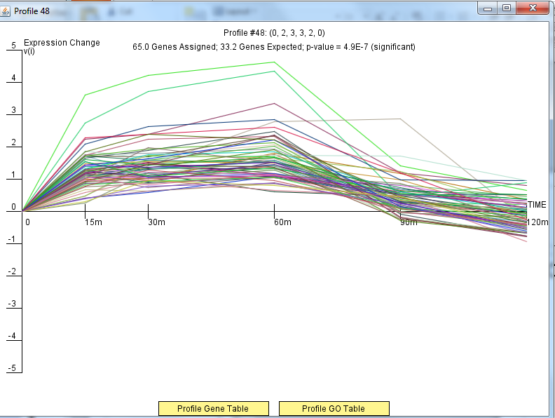
Wild Type Profile 48

Slide 15
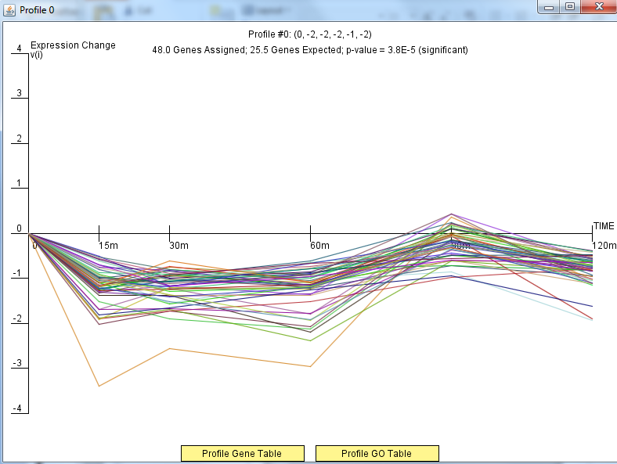
Wild Type Profile 0

Slide 16
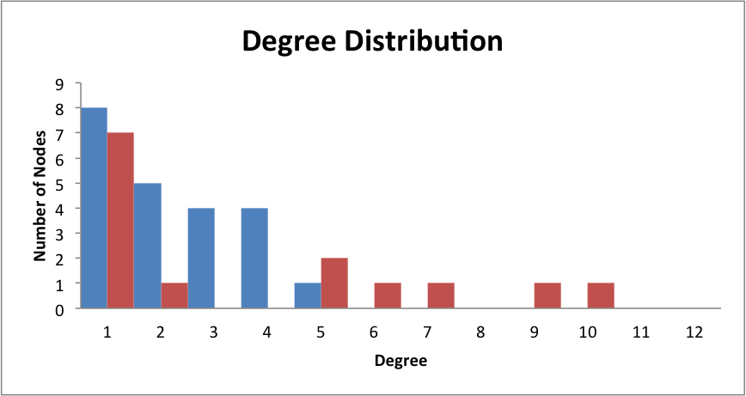
Only DNA Binding Degree Distribution

Slide 17
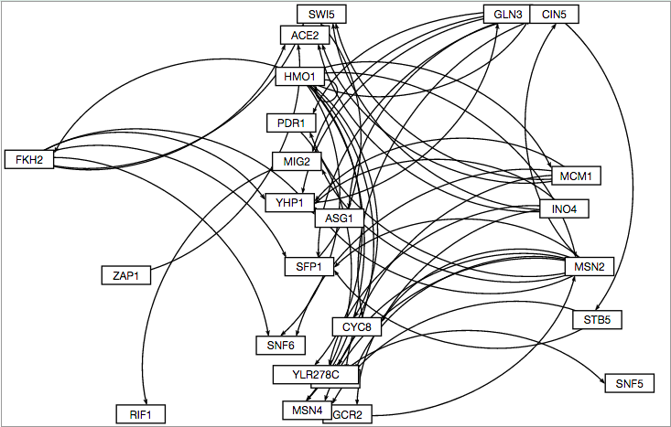
GRNSight Only DNA Binding Degree Distribution

Slide 18
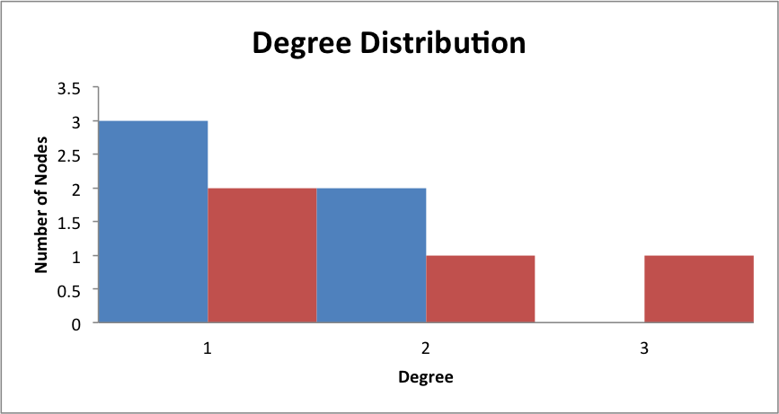
Binding AND Expression Distribution

Slide 19
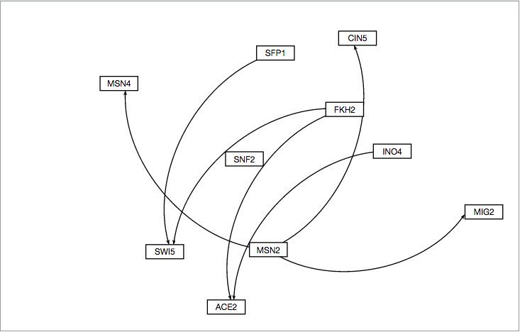
GRNSight Binding AND Expression

Slide 20
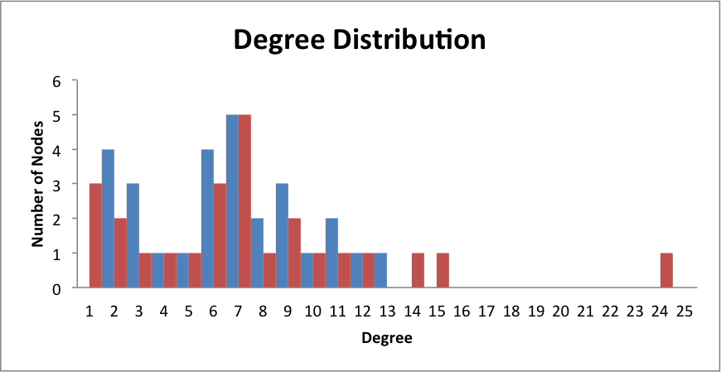
Binding PLUS Expression Distribution

Slide 21
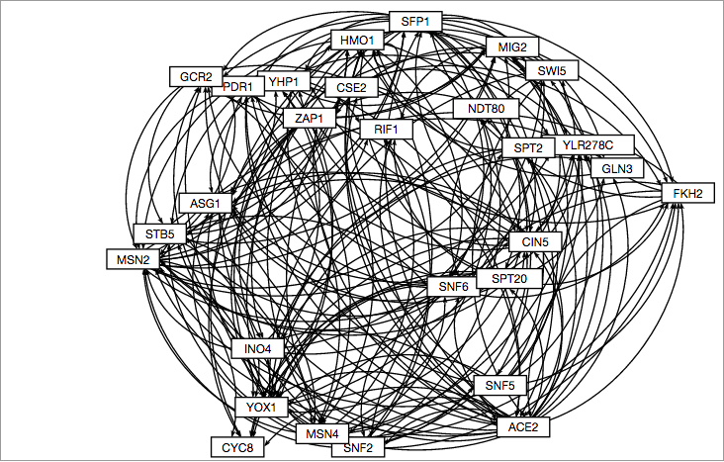
GRNSight Binding PLUS Expression

