Slide 1
Comparison of the P-value significance between Wild Type and ΔGLN3
ANOVA | WT | ΔGLN3
p < 0.05 | 38.42% | 30.11%
p < 0.01 | 24.67% | 16.29%
p < 0.001 | 13.90% | 6.53%
p < 0.0001 | 7.43% | 2.04%
B-H p < 0.05 | 26.76% | 2.04%
Bonferroni p < 0.05 | 3.68% | 0.42%

Slide 2
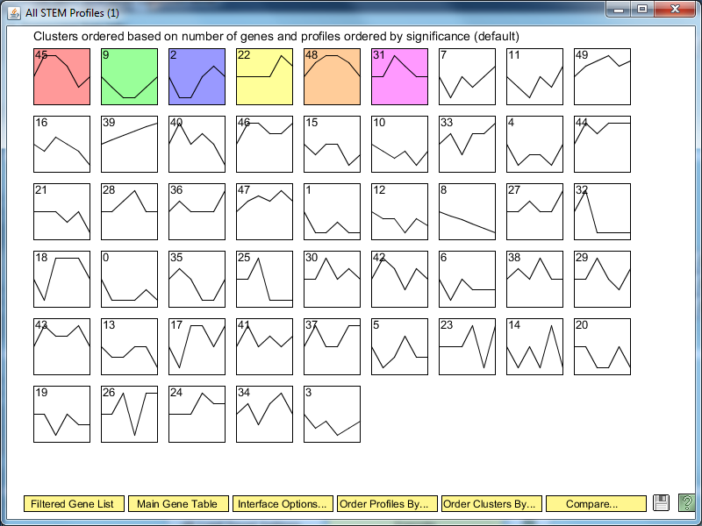
ΔGLN3 STEM Significance Profiles

Slide 3
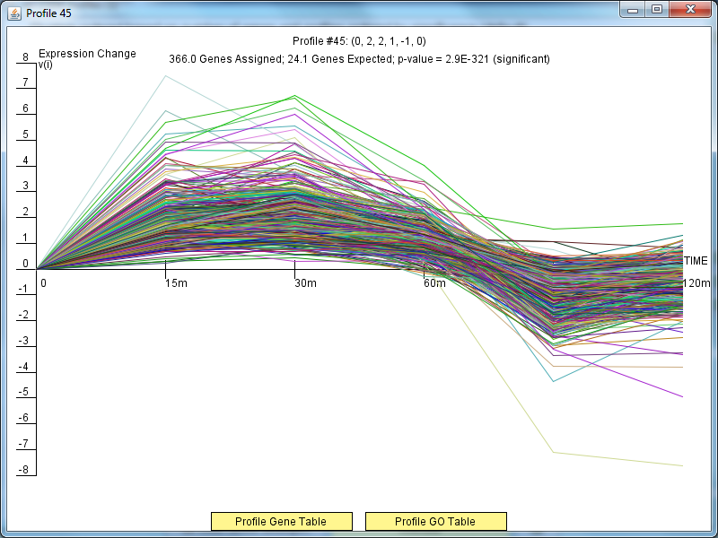
ΔGLN3 Profile 45

Slide 4
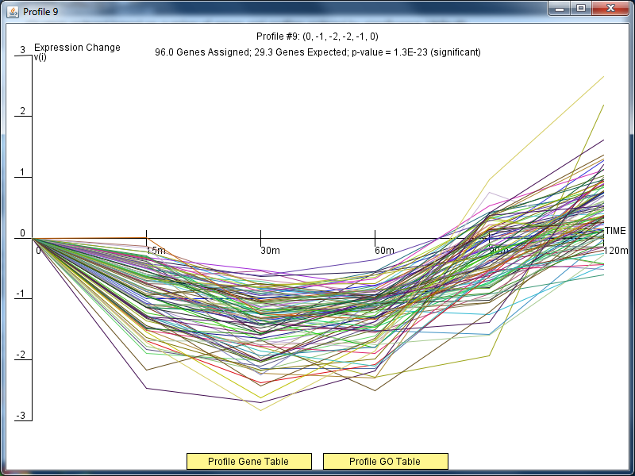
ΔGLN3 Profile 9

Slide 5
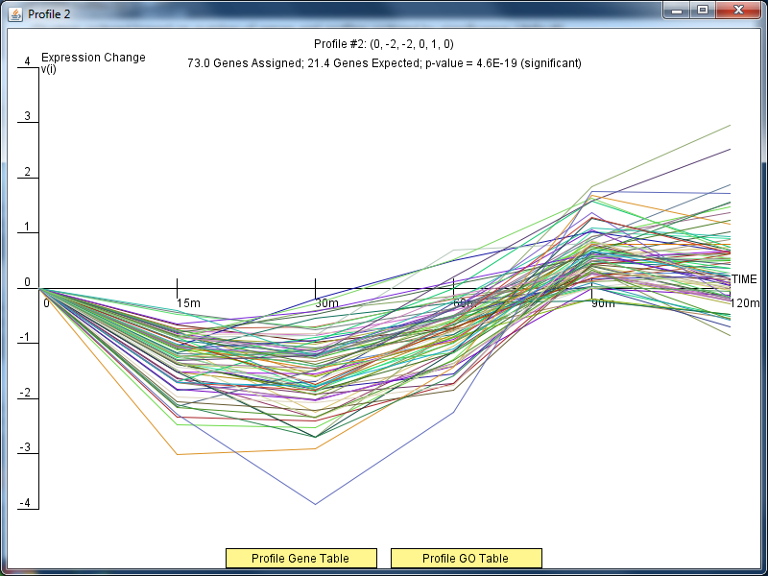
ΔGLN3Profile 2

Slide 6
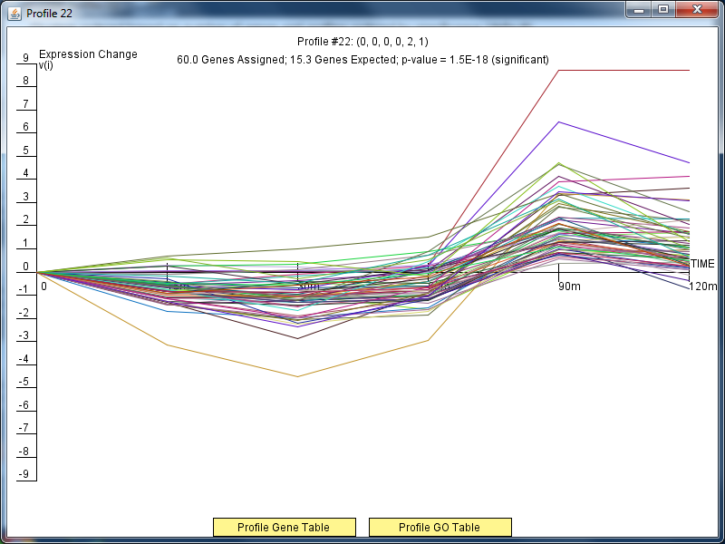
ΔGLN3Profile 22

Slide 7
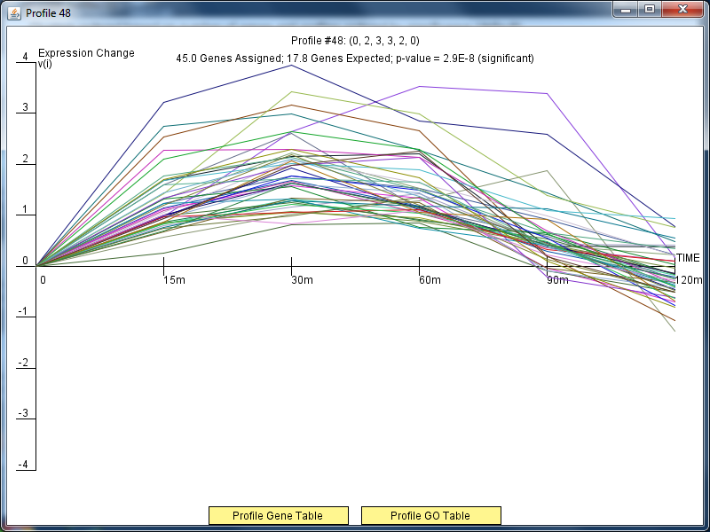
ΔGLN3Profile 48

Slide 8
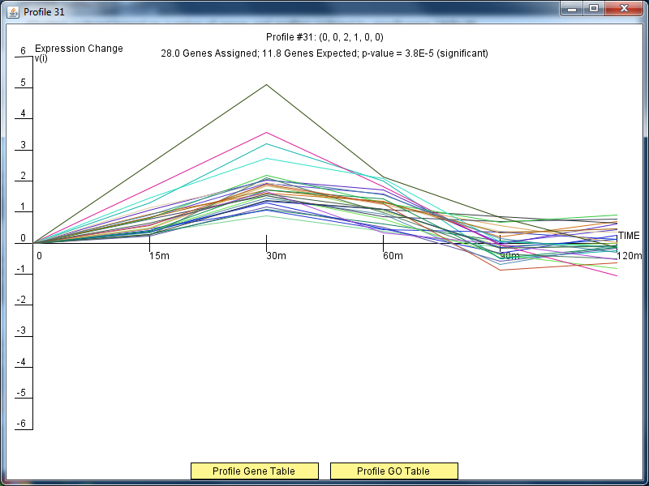
ΔGLN3Profile 31

Slide 9
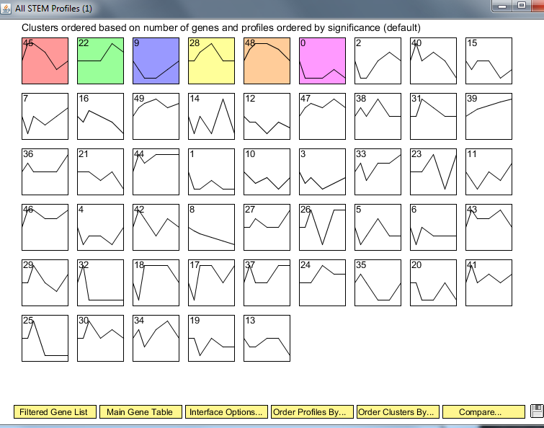
Wild Type Clusters

Slide 10
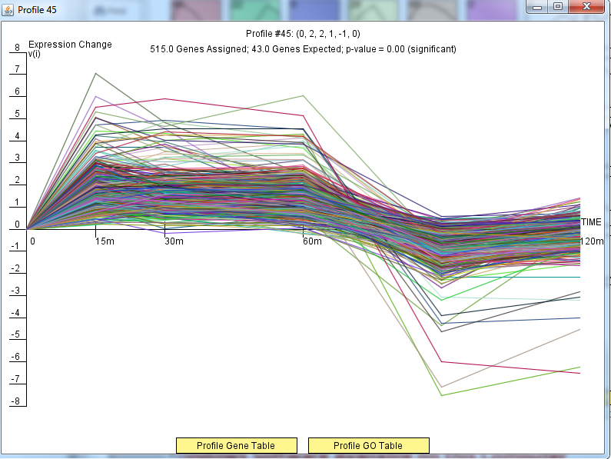
Wild Type Profile 45

Slide 11
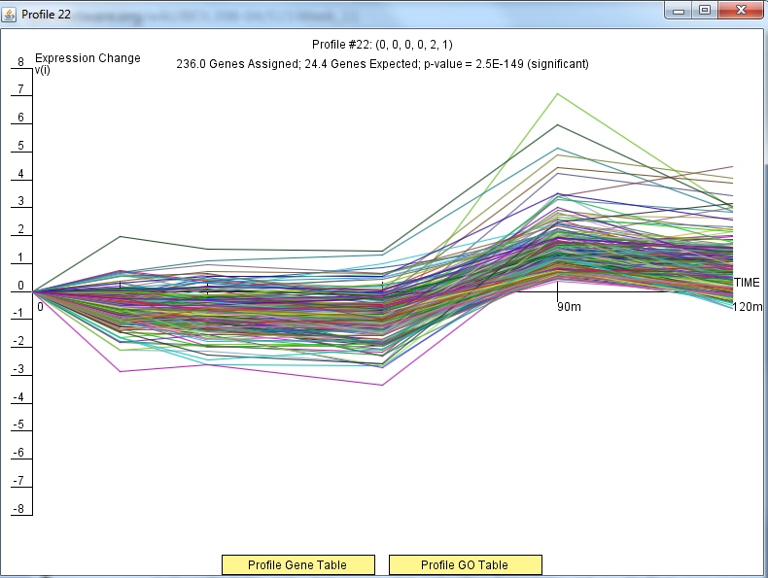
Wild Type Profile 22

Slide 12
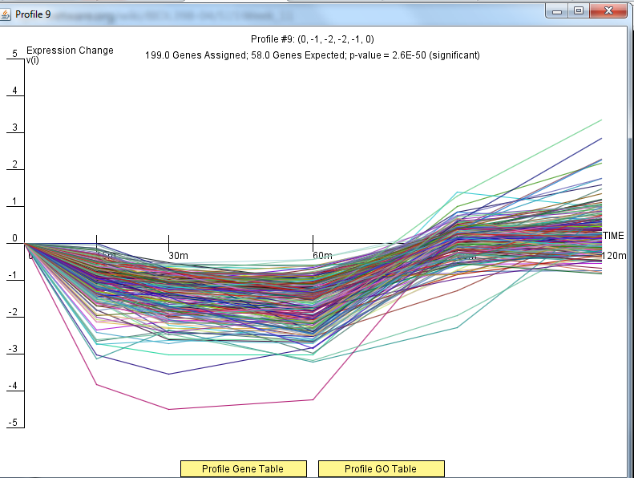
Wild Type Profile 9

Slide 13
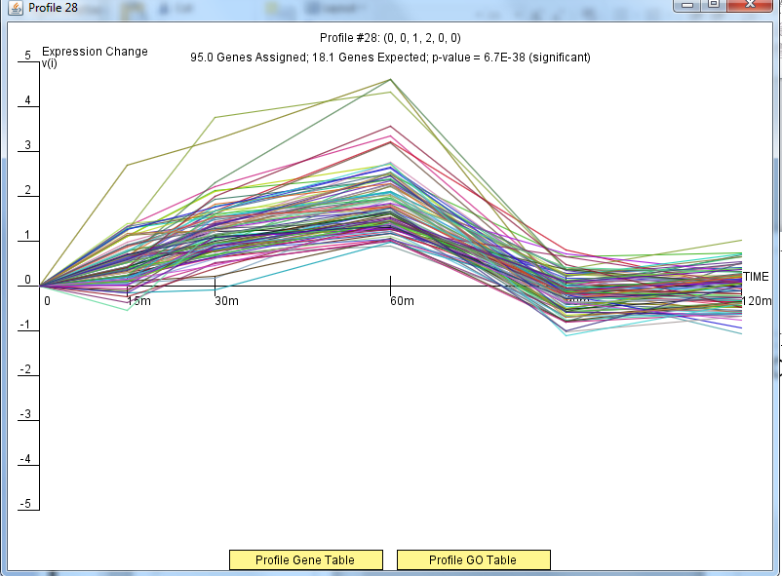
Wild Type Profile 28

Slide 14
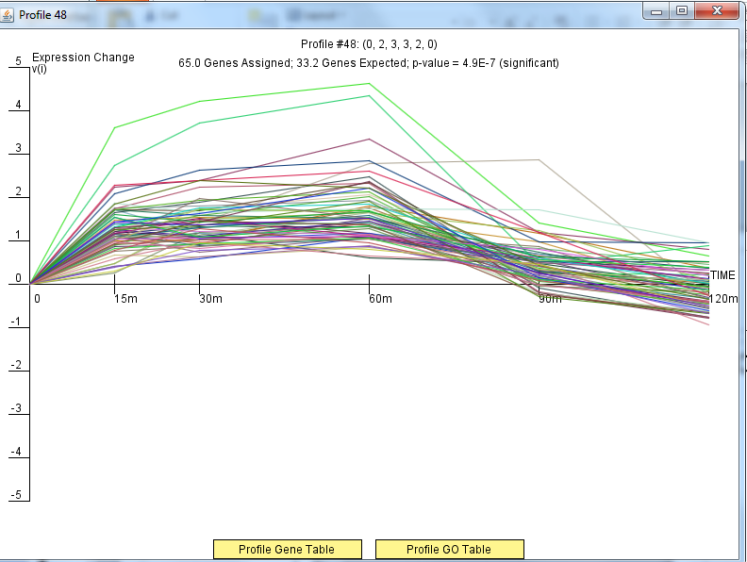
Wild Type Profile 48

Slide 15
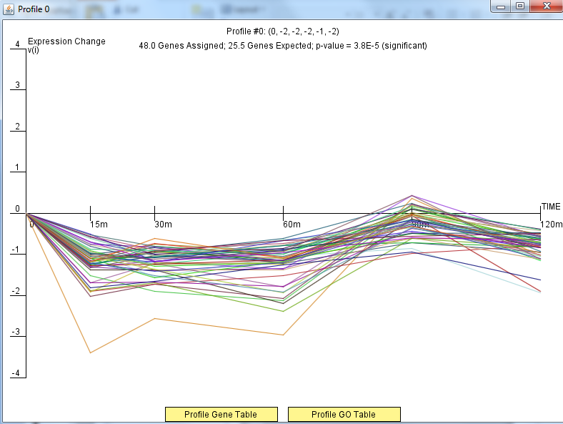
Wild Type Profile 0

Slide 16
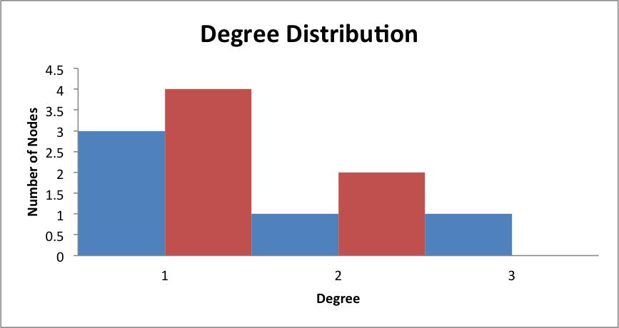
ΔGLN3: Binding AND Expression

Slide 17
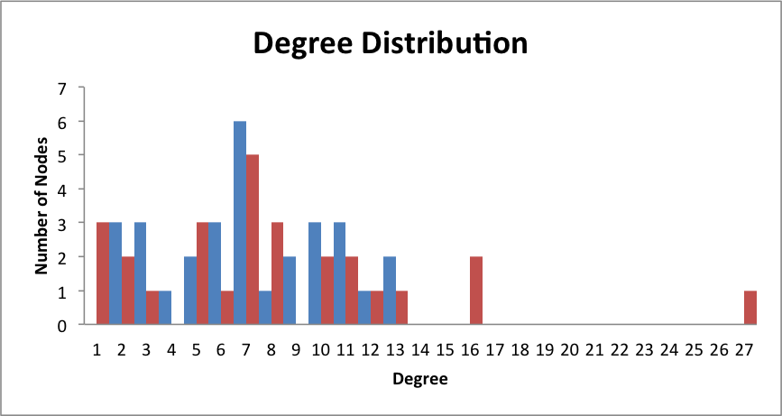
ΔGLN3: Binding PLUS Expression

Slide 18
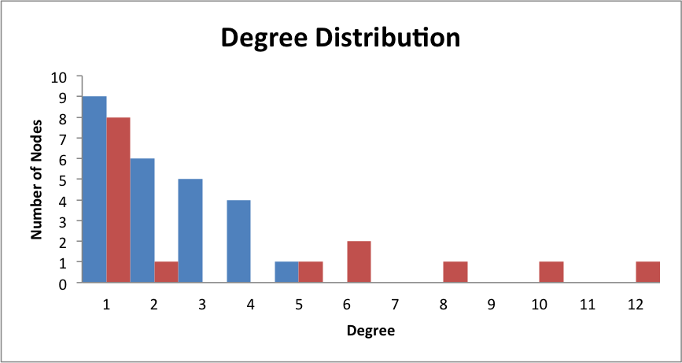
ΔGLN3: Only DNA Binding

Slide 19
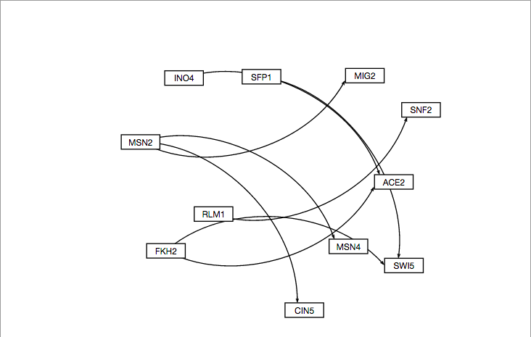
ΔGLN3: GRNsight Binding AND Expression

Slide 20
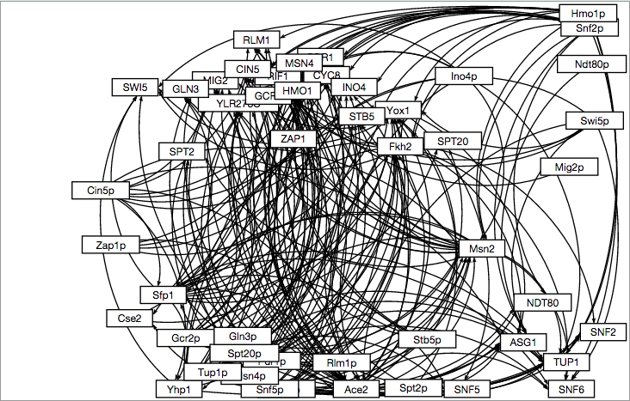
ΔGLN3: GRNsight Binding PLUS Expression

Slide 21
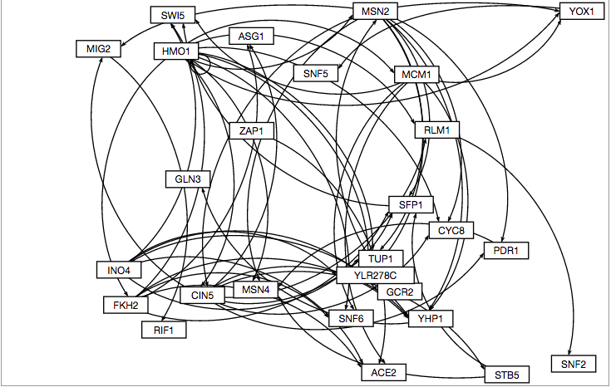
ΔGLN3: GRNsight Only DNA Binding

Slide 22
Wild Type: Binding PLUS Expression

Slide 23
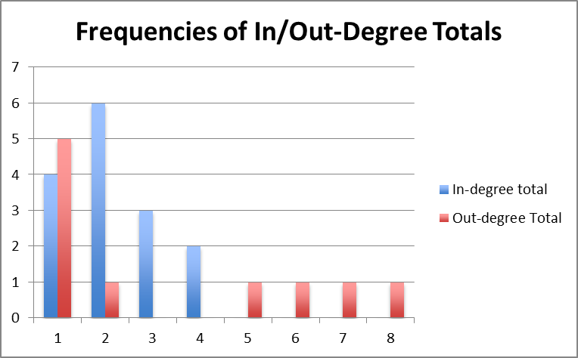
Wild Type: DNA Binding Only

Slide 24
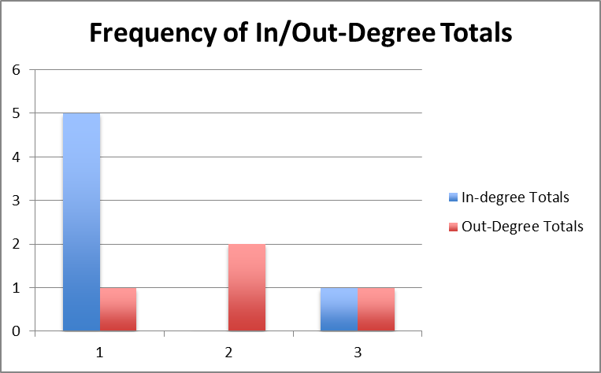
Wild Type: DNA Binding PLUS Expression

Slide 25
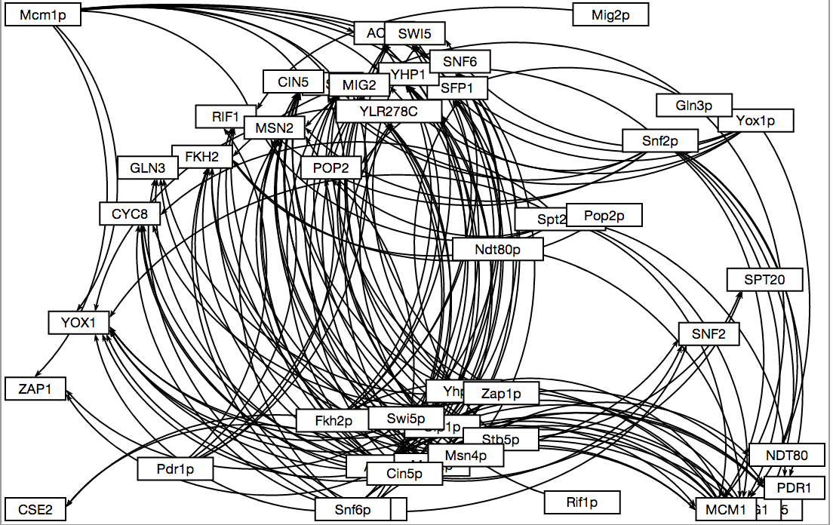
Wild Type: GRNSight Binding PLUS Expression

Slide 26
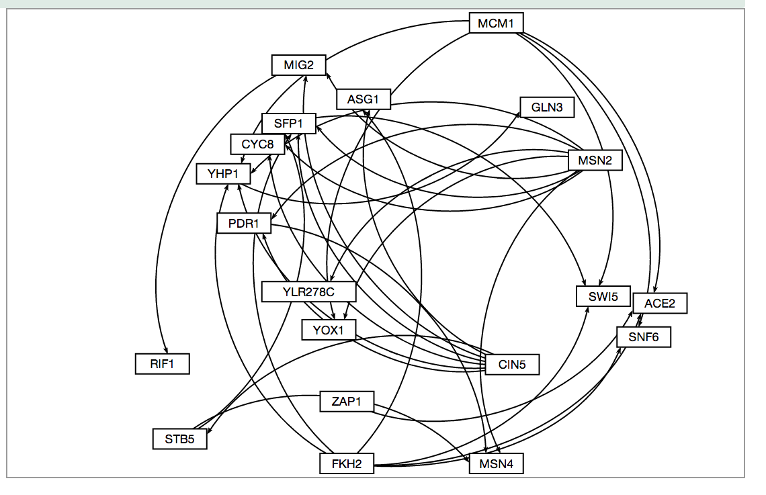
Wild Type: DNA Binding Only

Slide 27
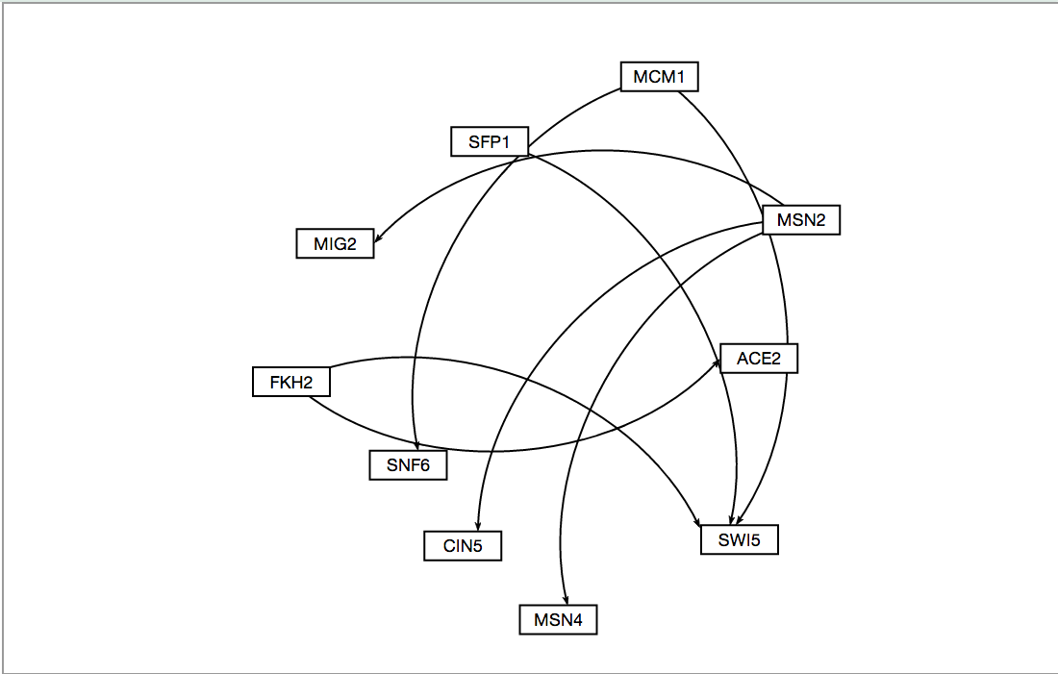
Wild Type: DNA Binding AND Expression

