Slide 1
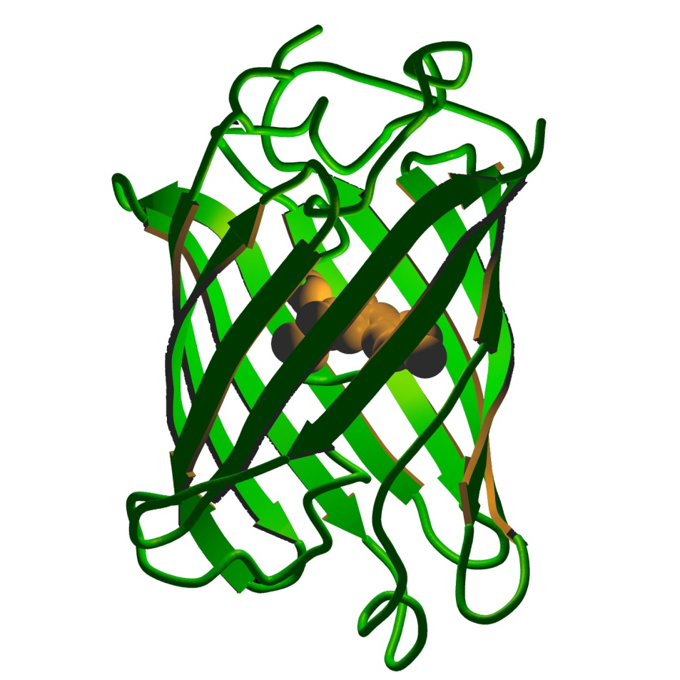
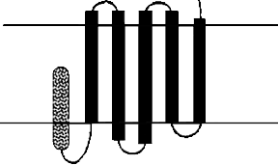
hisGFPmek and PDZ domain
His6 tag
(purification)
G H H H H H H G
Mek2 tag
(PDZ binding)
PDZ domain
E. coli
Q P G T P T R T A V
hisGFPmek
protein
LppOmpA
*not to scale, at all

Slide 2
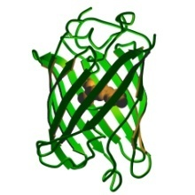
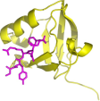
Initial cell binding assay
Ex 488, Em 507
(published for
EGFP clone)

Slide 3
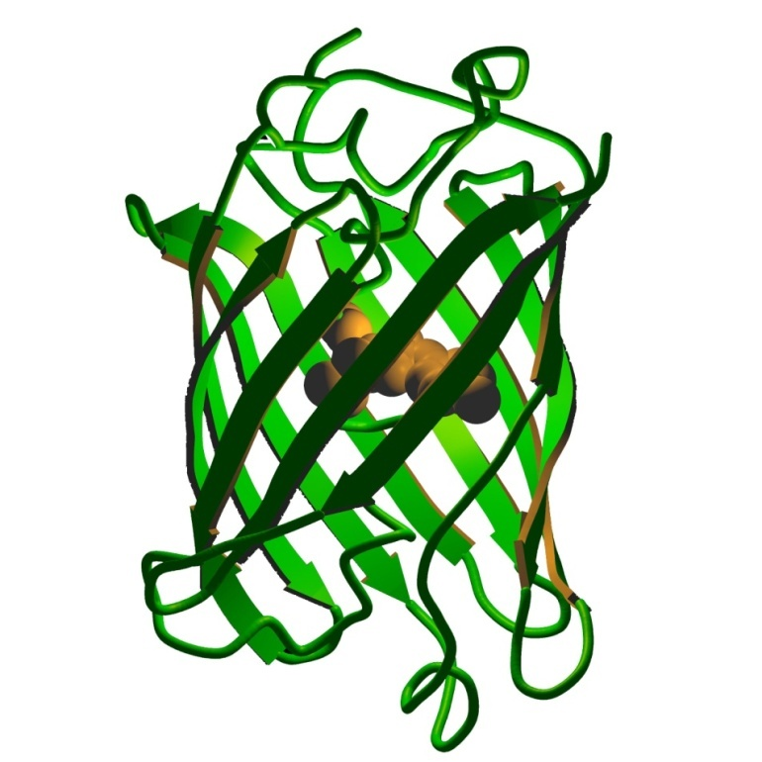
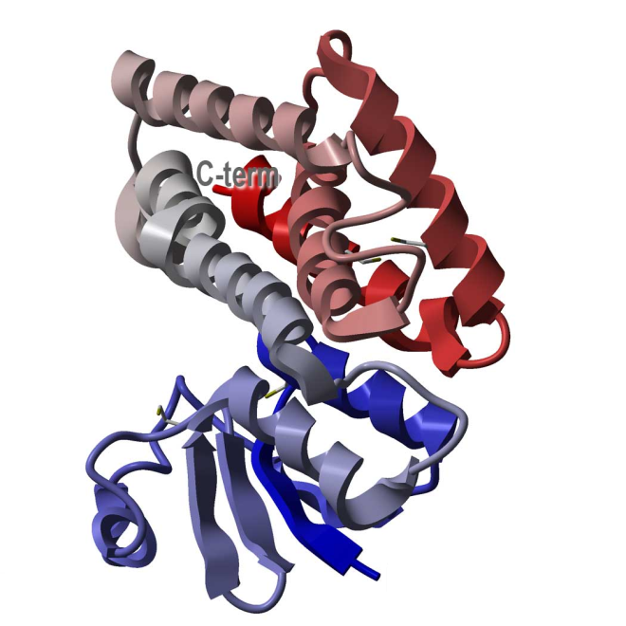


In vitro hisGFPmek binding assay with GST-PDZ fusion protein
Q P G T P T R T A V
hisGFPmek
--GSH
Glutathione bead
PDZ
GST
(glutathione S-transferase)

Slide 4
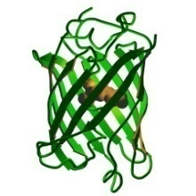




In vitro hisGFPmek assay
Ex 485, Em 538
(quorum-sensing
group protocol)

Slide 5
In vitro hisGFPmek assay
Ex 488, Em 507
(published for
EGFP clone)

Slide 6
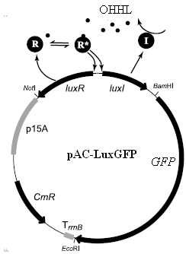

Rebuilding the Voigt construct
Voigt et al., 2006

Slide 7
Alternative PCR/digest assembly
Amplification by PCR, digestion/ligation of PCR’d fragments,
Pros
  Faster, more processive protocol
  No overnight liquid cultures or transformations (until the end)
  No gel isolation, just PCR purification
  No colony PCR
  PCR is better amplifier than bacteria
  Can reconstitute unavailable subparts
Cons
  Can’t save intermediate constructs (except by cloning PCR products into Topo vector)
  Requires careful primer design because of identical or homologous BioBrick parts

Slide 8














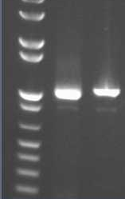


Alternative PCR/digest assembly
E
X
BB_F
S
P
VR
BBa_T9002
BBa_J23039
E
X
S
P
E
X
S
P
VR
BBa_T9002
E
X
S
P
VR

Slide 9

BB_R as well as BB_F
E
X
S
P
VR
BB_R
E
X
S
P

Slide 10
Plans
Explore AIDA construct
  AIDA-streptavidin
  AIDA-PDZ
Make a new hisGFPmek?
  Longer Mek tag, or longer linker
Finish the Voigt construct by PCR/digest
  Forever abandon traditional BioBricks protocol?

Slide 12
Alternative PCR/digest assembly
E
X
S
P
VR
BBa_T9002
E
X
S
P
VR

