Slide 1


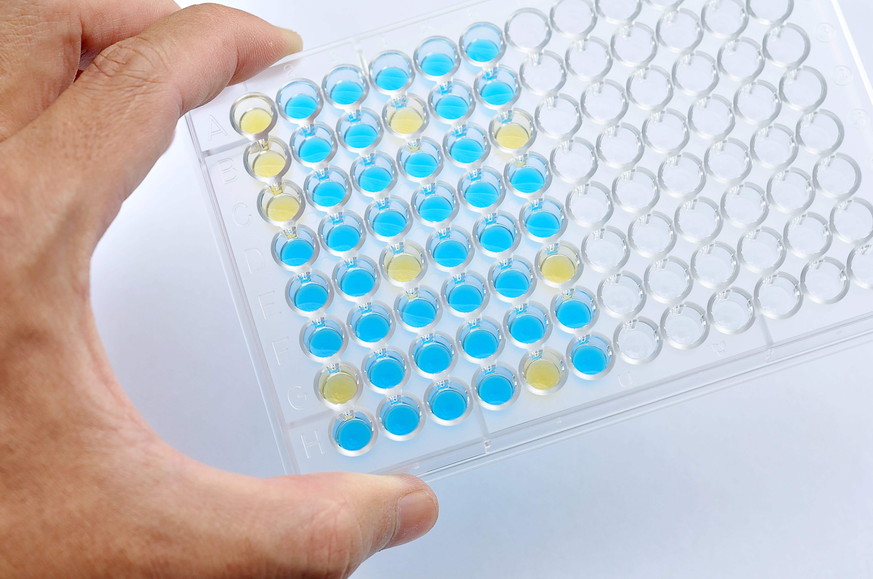
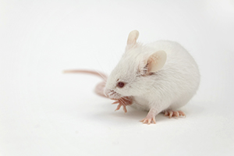

Genome Editing: CRISPR
Steve Lu

Slide 2
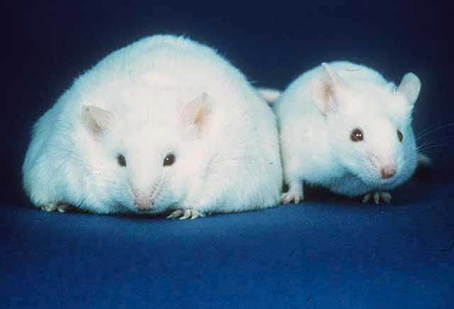
How to study a function of an unknown gene
Generate a gene “knockout” mouse
Mutant organism/Cell
Genetic analysis
Gene knockout
Unknown Cloned Gene
Express in cultured cells
Protein
Biochemical studies
Leptin knockout
Wild type
“Satiety Hormone”
Humans and mice share many genes. By observing the characteristics of knockout mice, researchers can better understand how a gene may contribute to human disease. Also serve as a disease model for treatment experiments.

Slide 3
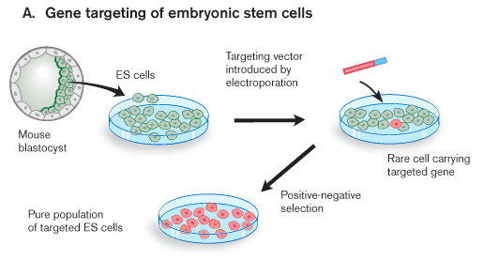
How to generate a knockout mouse – 30 years ago
Incorporated very rarely via a repair process called homologous recombination
Embryonic Stem Cells
6 months
Time-consuming and expensive
http://www.partners.org/researchcores/transgenic/transgenic_BWH.html

Slide 4
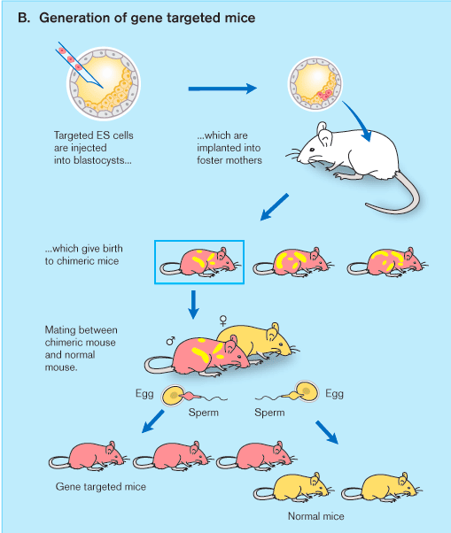
Chimeric: organism composed of cells from two different fertilized eggs
≤ 6 months
Unreliable and getting a mouse that has the mutation in its gonads takes several rounds.
Requires further breeding to generate mice with both copies of the gene knocked out
Chimeric mice
Heterozygous knockout mice
http://www.partners.org/researchcores/transgenic/transgenic_BWH.html

Slide 5
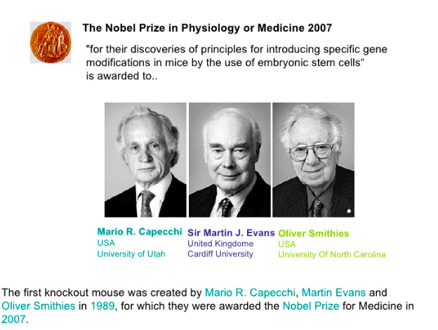

Slide 6
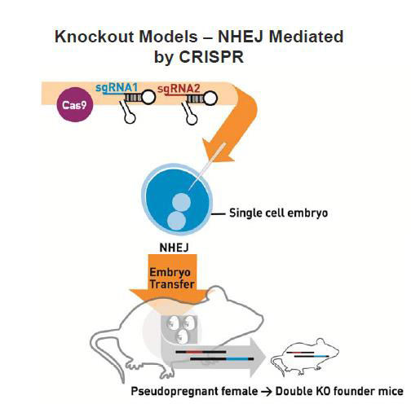
How to generate a knockout mouse – NOW
gRNA1
gRNA1
Cas9
As little as 1 month!
Skips the steps of ES cells
No need for multiple rounds of breeding
Highly efficient at cutting both copies of a gene
Error-prone repair
https://www.jax.org/news-and-insights/jax-blog/2016/february/three-crispr-approaches-for-mouse-genome-editing
Double knockout mouse

Slide 7
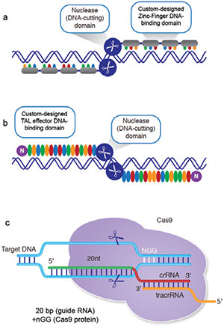
Genome Editing Tools
Nuclease (DNA-cutting) domain
Custom-designed Zinc-Finger DNA-binding domain
Zinc Fingers
A string of ~30 amino acid modules that interacts with nucleotide triplets (DNA)
Custom-designed TAL effector DNA-binding domain
Nuclease (DNA-cutting) domain
TALENs
Conserved 33-34 amino acid sequence with variable 12th and 13th residues that provide specificity
Cas9
CRISPR
RNA-based bacterial defense mechanism that recognizes target DNA sequences with guide RNA
Genome Editing Technologies: Defining a Path to Clinic
Notes:
Tal effectors are DNA-binding proteins that are secreted when a bacteria infects plants

Slide 8
Genome Editing Tools
Nuclease (DNA-cutting) domain
Custom-designed Zinc-Finger DNA-binding domain
Zinc Fingers
Protein/DNA recognition
Custom-designed TAL effector DNA-binding domain
Nuclease (DNA-cutting) domain
TALENs
$4000/gene
Protein/DNA recognition
Cas9
CRISPR
$20-40/gene
RNA/DNA recognition
Super efficient
Inexpensive and quick
Multiple gRNAs simultaneously
Notes:
Tal effectors are DNA-binding proteins that are secreted when a bacteria infects plants

Slide 9
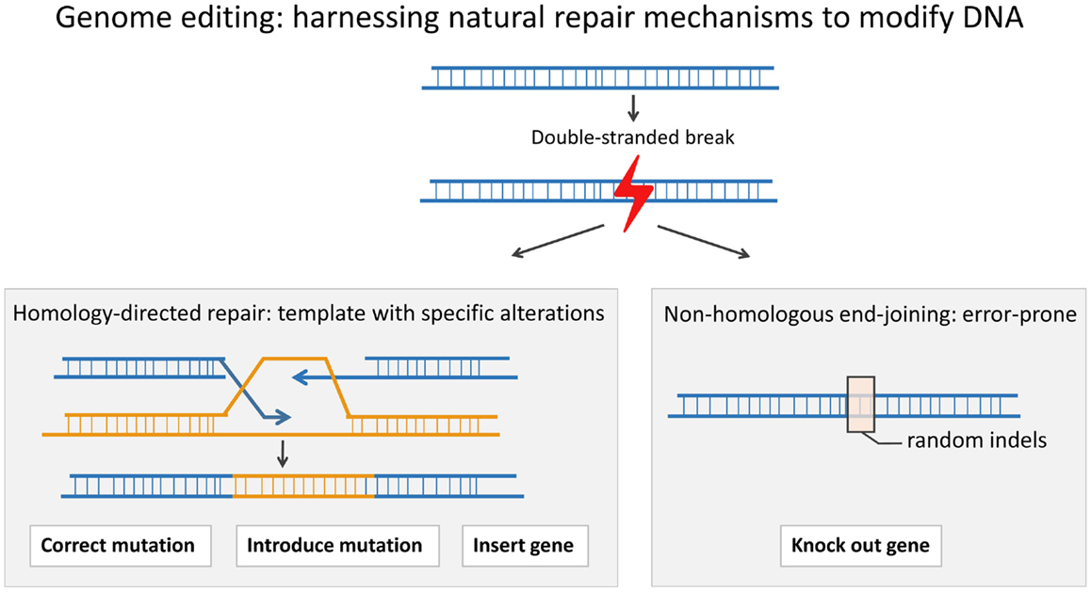
Zinc fingers, TALENs, CRISPR
Homology-directed repair
NHEJ (Error-prone)
random insertions & deletions
Limitations:
Off-target effects, Mosaicism, and Problem of multiple alleles
Novel genome-editing tools to model and correct primary immunodeficiencies

Slide 10
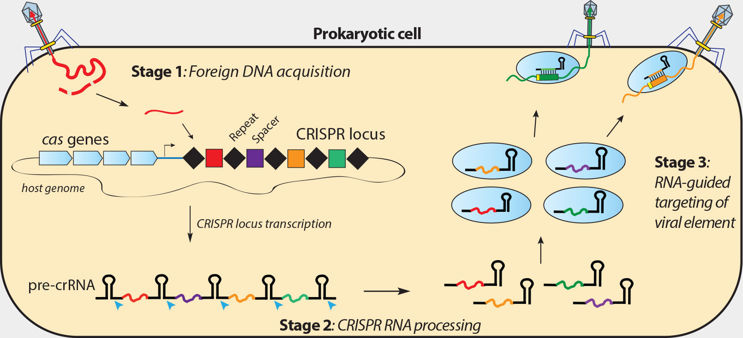
Quick CRISPR Review
Virus
Virus
Bacteria
CRISPR locus
Pre-crRNA
gRNA
How does the bacteria gRNA differentiate between its own DNA and viral DNA?
http://rna.berkeley.edu/crispr.html

Slide 11
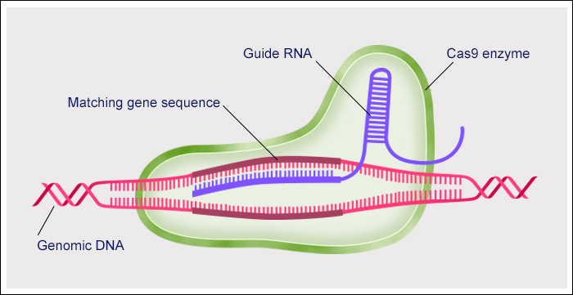

Protospacer Adjacent Motif (PAM) Sequence
20 nt - Protospacer
PAM
http://www.abc.net.au/news/2016-04-07/crispr-gene-editing-technology-explainer/7217782
Cas9 requires a specific PAM that varies depending on bacteria.
PAM is not present in bacteria genome but is in viral genome
Most common is NGG, recognized by Cas9 from S. pyogenes
Recognition of PAM helps destabilize helix & opens it up for gRNA

Slide 12
When designing gRNAs, gene must contain PAM
Using the frequency of ‘GG’ = 5.21% in the reference human genome, there would be an expected 161,284,793 NGG PAM sites in the human genome.
approx. one ‘GG’ dinucleotide every 42 bases
It is reasonable to expect that most genes will contain the NGG sequence of the S. pyogenes PAM.
https://www.idtdna.com/pages/docs/default-source/synthetic-biology/crispr_faq_043015.pdf?sfvrsn=2

Slide 13
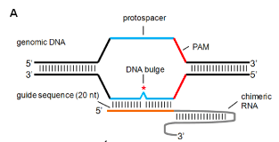
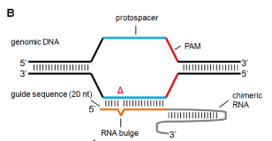
Off-target effects of CRISPR-Cas9
5’-NNNNNNNNNNNNNNNNNNNNNGG
20 nt
PAM
DNA Bulge
*
CRISPR/Cas9 allows for 1-3 nt mismatches between the target site and gRNA, therefore there can be off-target nuclease activity
Any off target effects can cause mutations in those genes as well due to Cas9 inducing double stranded breaks
*
RNA Bulge
https://mpnjournal.org/crisprcas9-off-target-activity/
Notes:
When generating a mouse, this is particularly undesirable

Slide 14
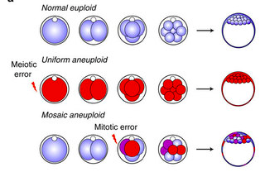



Mosaicism
Cas9 may not necessarily cut the DNA at the one cell stage of embryonic development. Therefore the mouse will only have a mutation is some of their cells.
No knock out
Cas9-induced break
Complete knockout
Mosaicism
Cas9-induced break
Mouse model of chromosome mosaicism reveals lineage-specific depletion of aneuploid cells and normal developmental potential

Slide 15
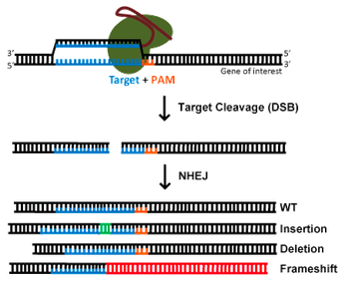
Multiple Alleles
REMEMBER: There are two copies of each gene.
Sequencing is required to verify the mutation because repair will result in different mutations in different mice. Mice may also be mosaics and additional breeding is required to isolate single mutations.
https://www.addgene.org/CRISPR/guide/

Slide 16

gRNA Design
GOAL
STEP BY STEP
Accurate gRNA target site
Minimize off-target potential
Optimal target location
Target gene analysis
Off-target analysis
Location analysis
gRNA delivery

Slide 17
1: Target Gene Analysis
Gene sequence
Gene structure
Exons: Protein coding sequence
Introns: Removed during RNA processing
5’ UTR
Exon 1
Intron 1
Exon 2
Intron 2
Exon 3
3’ UTR
Pre-mRNA
ALTERNATIVE SPLICING
Pancreas
Eye
mRNA
Protein Isoforms

Slide 18
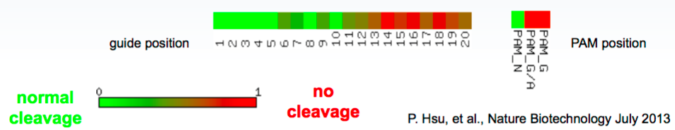
2: Off-target analysis
5’-ATCCTGACAACTATTCAACGNGG
“Distal”
“Seed”
PAM
Critical for specificity
Other PAM sequences that Cas9 can utilize
Higher sequence similarity → higher risk
Particularly similarity in the seed region
Effects of single mismatches on cleavage efficiency

Slide 19
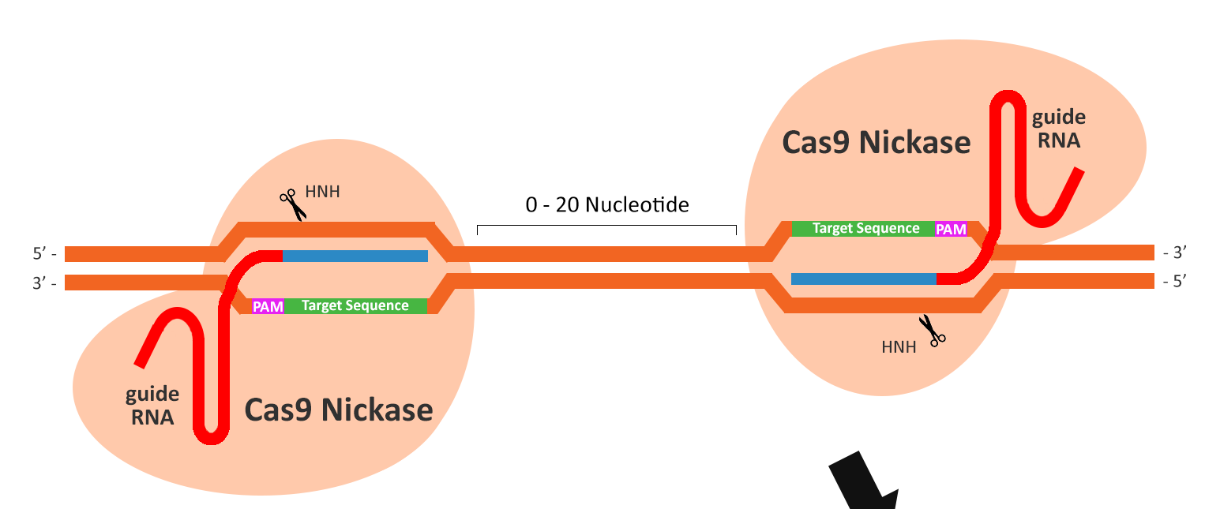
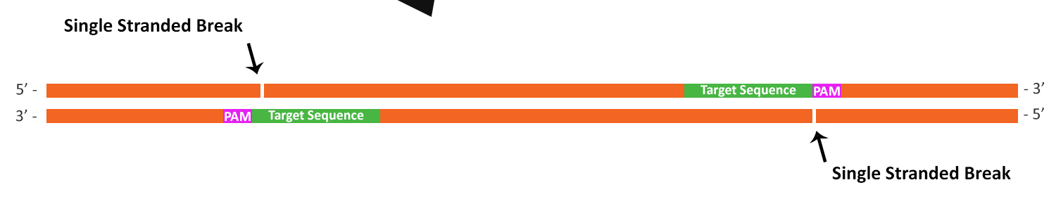
One solution: Paired Cas9 Nickases Strategy
Single stranded break
If two single stranded breaks are close enough, it will cause a double stranded break
Single stranded break
Cas9 Nickase only cleaves one strand: low mutation rate
Paired nickases can have high mutation rate and specificity (1500X increase)
Because requires two unique sites, reduces off target mutations
https://www.abmgood.com/marketing/knowledge_base/CRISPR_Cas9_gRNA_Design.php

Slide 20
3: Location analysis
Knocking out: Early exons and/or functional domains
5’ UTR
Exon 1
Intron 1
Exon 2
Intron 2
Exon 3
Intron 3
Exon 4
3’ UTR
Pre-mRNA
Remember: there must be a PAM to target
Brain
mRNA
DNA binding domain
Protein
Ligand binding domain
Should always use ≥ 2 gRNAs to ensure knockout
Notes:
However, can’t always target exon 1 if there isn’t an NGG sequence

Slide 21
4: gRNA Delivery
Based on time, cost, purpose, and cell/organism
Into a Cas9-expressing mouse or cell line
OR with Cas9-containing plasmid
gRNA in Plasmid
Virus
Lentivirus
Stable integration into genome, common
Adenovirus
Less toxic than lentivirus
Non-viral
Shorter time, less expensive, transient/stable
gRNA as RNA
with Cas9 mRNA
Transient, useful for embryos
with Cas9 protein
Transient

Slide 22
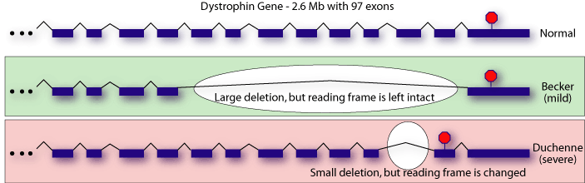
Short demo on gRNA design
http://chopchop.cbu.uib.no
Duchenne’s Muscular Dystrophy
X-linked recessive condition that affects boys due to mutation in Dystrophin (DMD). DMD provides important structural stability to muscle tissue. When mutated, results in muscle degeneration and premature death
Partially functional protein is produced
Protein is degraded

Slide 23
CRISPR in medicine

Slide 24


CRISPR Therapies in HIV
Equip T cells with Cas9 and gRNA targeting HIV genome
HIV
Cas9 and gRNA is integrated into genome
T helper Cell
Virus developed mutations at or near the sequences that were targeted by gRNA. Not all mutations are inactivating.
Notes:
Tal effectors are DNA-binding proteins that are secreted when a bacteria infects plants

Slide 25
CRISPR Therapies in HIV
Equip T cells with Cas9 and gRNA targeting CCR5 coreceptor
HIV
CCR5 – coreceptor for viral entry on T cells
Cas9 and gRNA is integrated into genome
T helper Cell
T cells with mutated CCR5 resisted infection of HIV. By isolating patient T cells, mutating CCR5 and then infusing the cells back into patients, there will be a pool of resistant of T cells that survive and persist.
Notes:
Tal effectors are DNA-binding proteins that are secreted when a bacteria infects plants

Slide 26
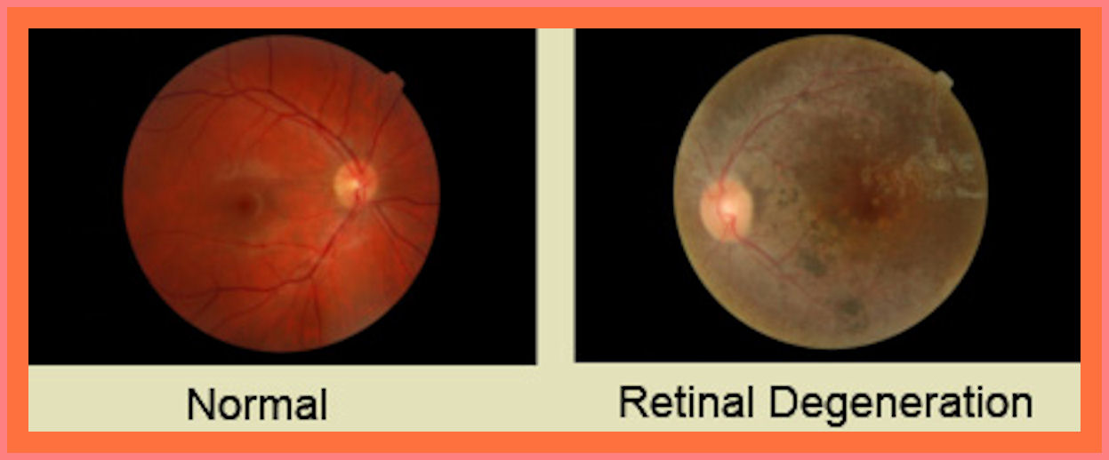
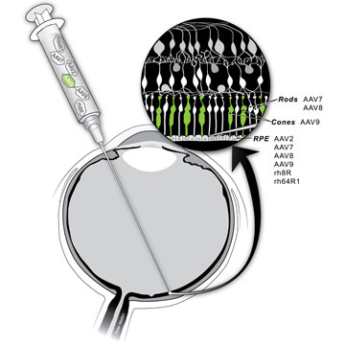
CRISPR Therapies in the Eye
Leber congenital amaurosis is due a variety of inherited mutations. 20% are due to mutations of CEP250
https://scientificearthconscientious6.wordpress.com/page/11/
3000 Americans have LCA
600 due to CEP250
Inject viruses encoded with Cas9/gRNA that will specifically mutate CEP250 at a certain location.
Previously, people have injected instructions for a functional copy of RPE65 which restored vision in some children with retinal dystrophies.
Revitalize photoreceptors
A rare disease will get approval easier. The eye is a relatively easy location to access. Editas hopes to begin trials in 2017.
Notes:
Tal effectors are DNA-binding proteins that are secreted when a bacteria infects plants

Slide 27
CRISPR in Personalized Cancer Immunotherapy
First proposed human test of CRISPR passes initial safety review
Patient T Cell
Tumor
Melanoma, Multiple myeloma, sarcoma
PD-1
PD-L1
NY-ESO-1
tumor antigen
Chimeric Antigen Receptor
T cell receptor
CAR T cells will efficiently recognize tumor antigen on tumor cells & release cytotoxic compounds. Because PD-1 is deleted, the T cell will not be turned off.
Notes:
Tal effectors are DNA-binding proteins that are secreted when a bacteria infects plants

Slide 28
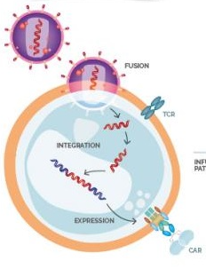


CRISPR in Personalized Cancer Immunotherapy
Multiple myeloma, melanoma, sarcoma
Infection of T cell
T cell isolation
Expansion and infusion back into patient
Healthy donor
http://labiotech.eu/leading-european-stem-cell-therapy-biotech-cardio3-us-patent-car-t/

Slide 29
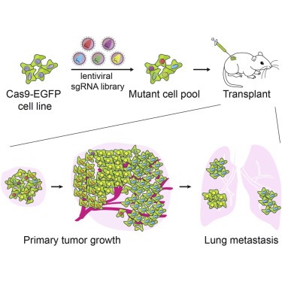
CRISPR Screen in Cancer Metastasis
In vivo screen for genes involved in lung metastasis
Each cancer cell will have one gRNA → one gene mutated
gRNA library against 20,000 genes
By injecting a smaller pool of targeted mutations, metastasis occurred much more rapidly
Will only identify
loss-of-function mutations
Genome-wide CRISPR Screen in a Mouse Model of Tumor Growth and Metastasis
Notes:
Tal effectors are DNA-binding proteins that are secreted when a bacteria infects plants

Slide 30

CRISPR in the Future
“By editing the DNA of these cells or the embryo itself, it could be possible to correct disease genes and pass those genetic fixes on to future generations. Such a technology could be used to rid families of scourges like cystic fibrosis. It might also be possible to install genes that offer lifelong protection against infection, Alzheimer’s, and, Yang told me, maybe the effects of aging”
MIT Technology Review, Engineering the Perfect Baby

