Slide 1
Tissue Engineering
Lecture 13, 4/2/15
Paper Review
Cell Motility Review

Slide 2
What is the motivation of this study?
•What’s the importance of cell motility?
–Immune system
–Embryogenesis
–Migration of tumor cells
•Cells use the actin cytoskeleton to migrate via “treadmilling”action by the cells
•Cells move directionally, so how do they control the rate and direction of motility

Slide 3
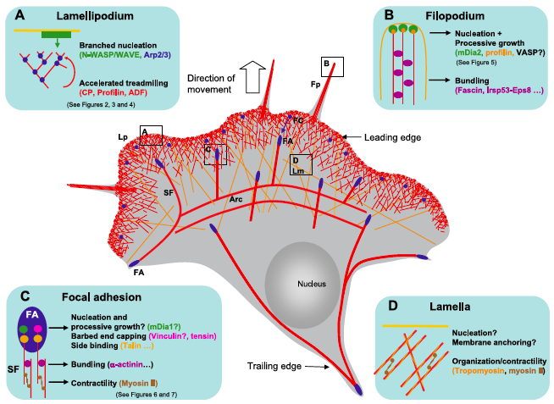
Figure 1: Jemima Lamothe
Notes:
Discussion Points: This is how cells move in 2D, what do you think about 3D? Any idea of different modes of how cells move in general?

Slide 4
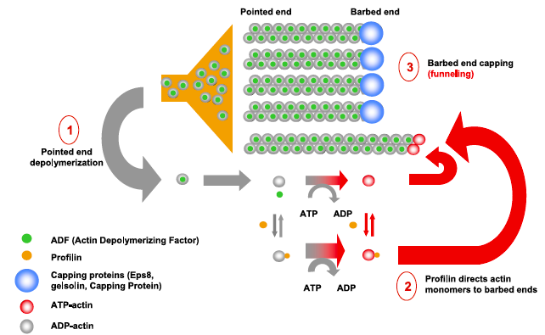
Figure 2: Sarah Johnson
Notes:
We see the Actin monomers move from one end to the other. How is shuttling facilitated and why would most of the barbed ends be capped?

Slide 5
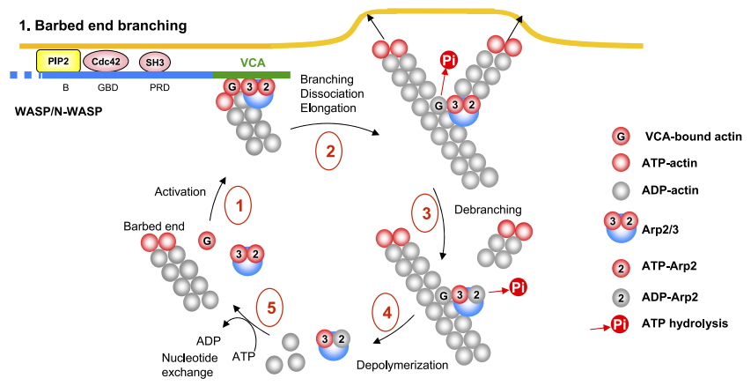

Figure 3: Cody Siroka

Slide 6
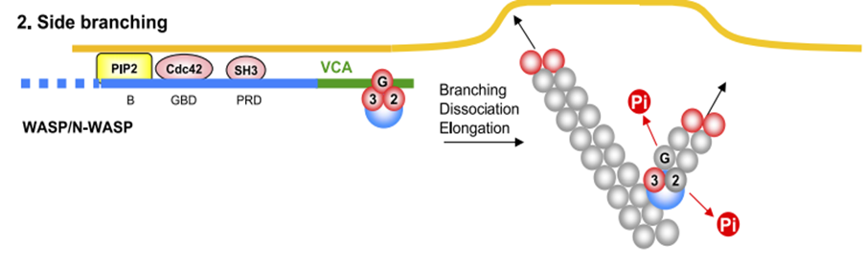

Figure 3: Cody Siroka
Notes:
What are the major differences in the models? Are they in any way compatible? How did the different authors arrive at different models?

Slide 7
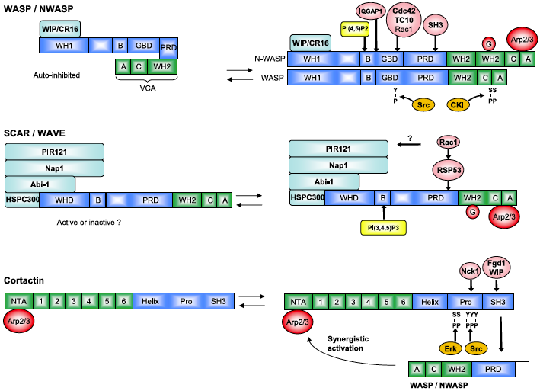
Figure 4: Brittany Shepler
Notes:
We see that there are a number of different proteins that are made available that interact with Arp 2/3. What’s the difference between each protein set and how is it important to actin assembly?

Slide 8
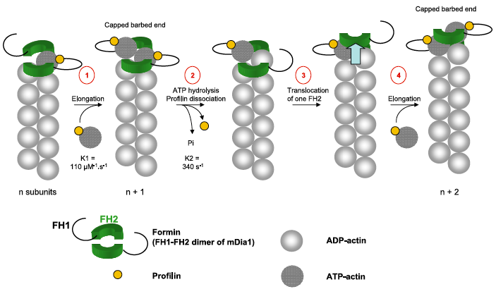
Figure 5: Eric Stowe

Slide 9
Figure 5: Eric Stowe
Video Link: https://youtu.be/VVgXDW_8O4U

Slide 10
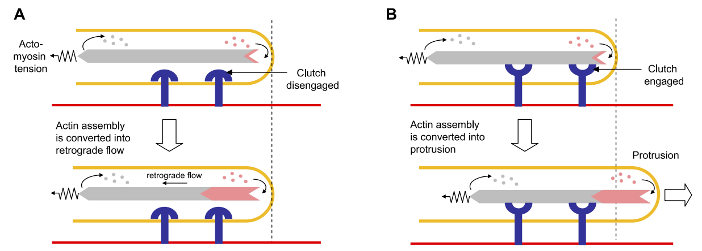
Figure 6: Than Nguyen
Newly polymerized actin
Actin network
Membrane
No protrusion occur
Retrograde flow >> Protrusion
Membrane protrusion takes place
Retrograde flow << Protrusion

Slide 11
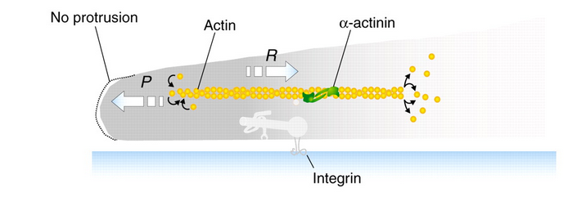
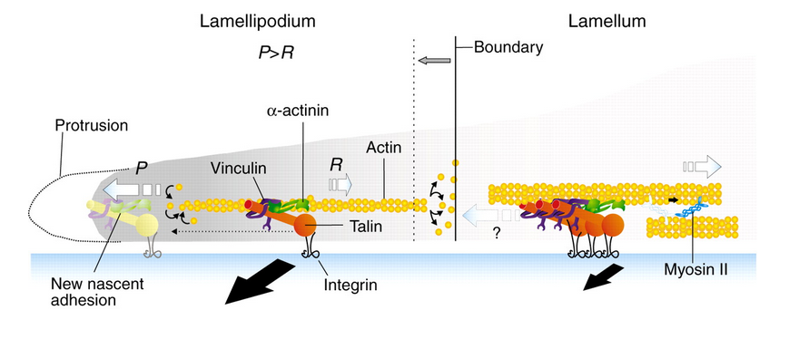
Actin network

Slide 12
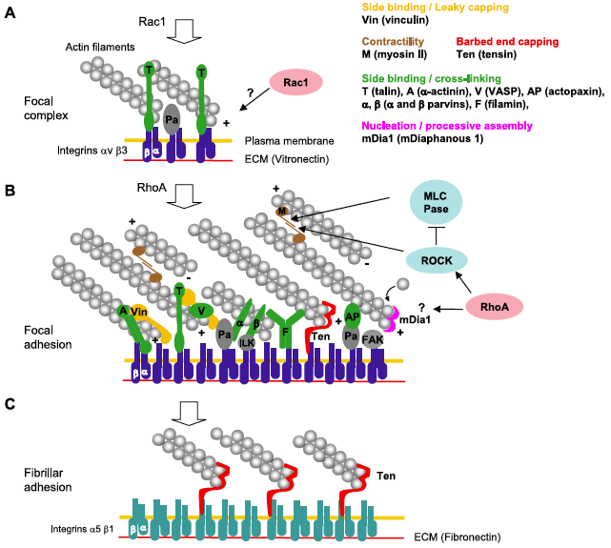
Figure 7a-c: Alpha Bamba

Slide 13
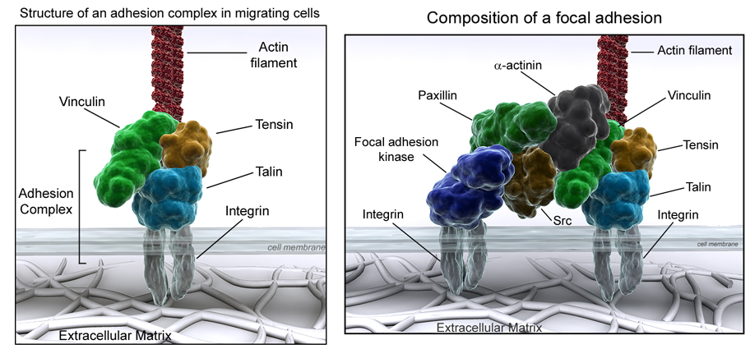
Figure 7a-c: Alpha Bamba

Slide 14
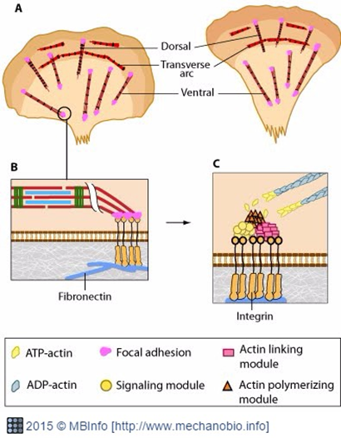
Figure 7a-c: Alpha Bamba

Slide 15
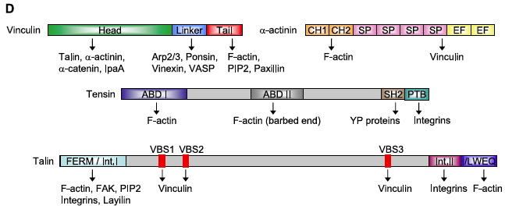
Figure 7d: Robert Gaspardi

Slide 16
Conclusions, Perspectives
•Understanding actin and the interactions it has in vitro are important to understanding cell motility
•This is only one perspective of these mechanisms
–How might this change in 3D?
–Were there theories not presented?
•What new technologies are needed to study the more intricate phenomena?
•The next “frontier” is understanding how mechanical forces affect focal adhesions and actin polymerization

