Slide 1
Mechanotransduction, Tensegrity and Durotaxis
ChemEng 575: Lecture 14
April 8th, 2014
Reading: 3 Papers online

Slide 2
In Lecture 8
We discussed ways to test and quantify the mechanical properties of materials
Left you with food for thought: is that important for tissue engineering design? (and your grant)?
Question for today: do cells care?
i.e. can cells sense and respond to mechanical forces?

Slide 3
Mechanotransduction
The ability of a cell to turn a mechanical cue from the ECM into an intracellular signal
RhoA, pSrc, pAkt
Or a phenotypic response
Migration, differentiation, shape, growth

Slide 4
Where might mechanotransduction be important in your body?
Class poll: where are cells exposed to mechanical forces?

Slide 5
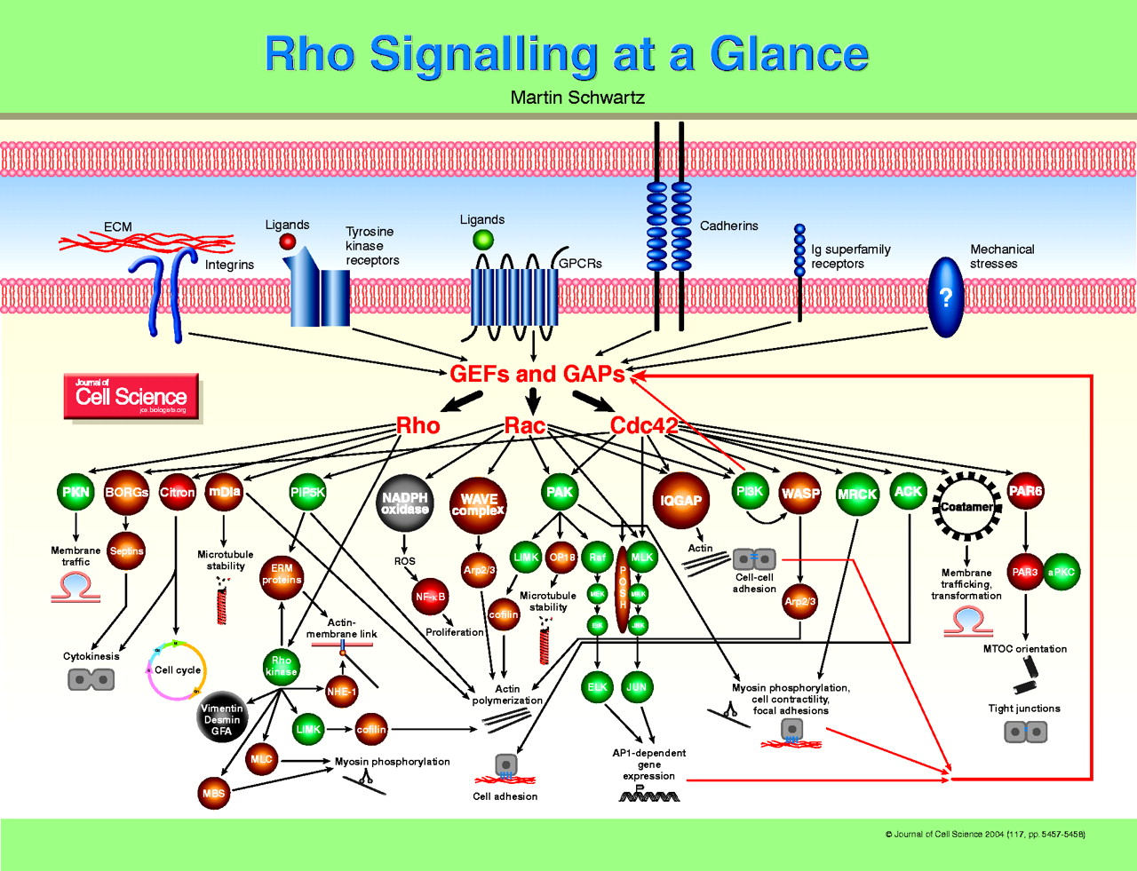
Mechanotransduction: Cell can translate Mechanical Information from the ECM to an intracellular biochemical signal
“Mechanotransduction”

Slide 6
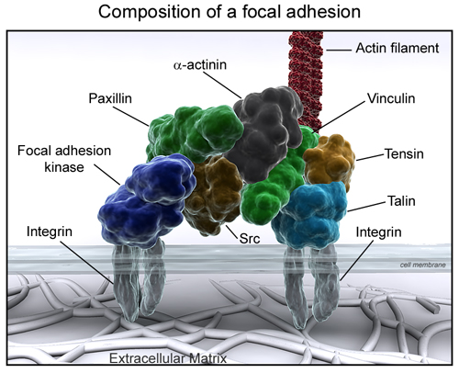
How does this happen?
Focal adhesions.
Remember, those connections between integrins and the actin cytoskeleton in a cell.
When, how do focal adhesions re-arrange in response to mechanical forces?
S
P
S
S=structural
P=signaler
P
S
S
S
P
S

Slide 7
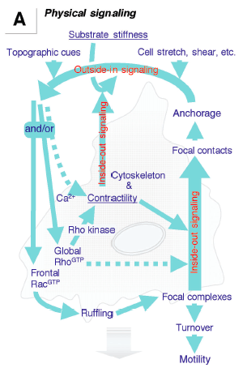
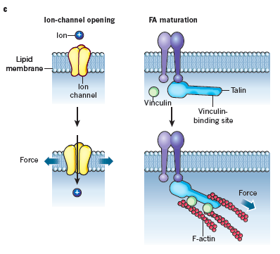
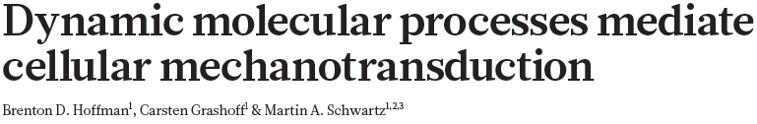

Two different ways this can happen
OUTSIDE-IN (ECM-initiated)
INSIDE-OUT (cell-initiated)

Slide 8
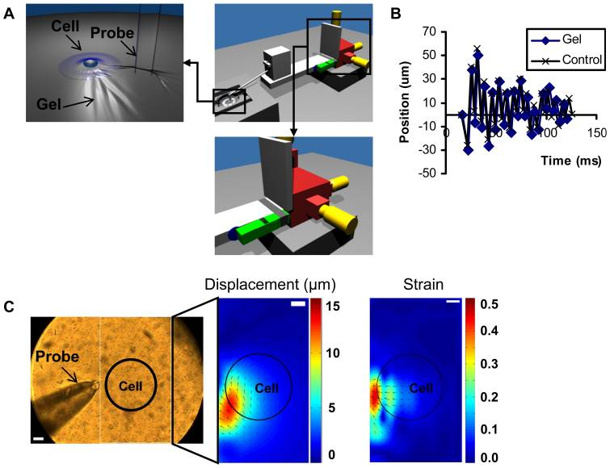
Vibrating Cells (outside in signaling) Cells will pull at the site of vibration
Go to
http://www.plosone.org/article/info%3Adoi%2F10.1371%2Fjournal.pone.0026181#s5
Nishitani, PLOS 1

Slide 9
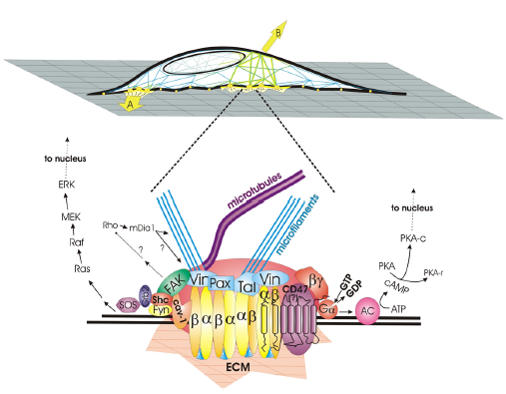
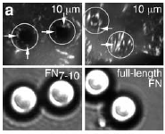


Pulling on cell attachment points (Outside-In) Focal adhesions are recruited to the site of stretch

Slide 10
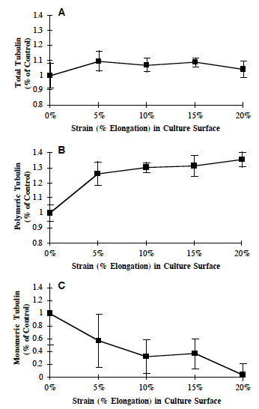
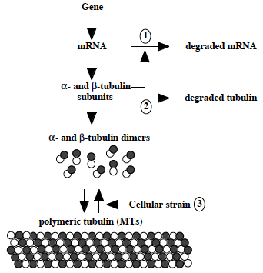
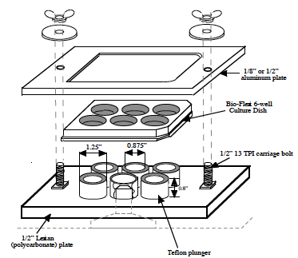
Stretching the underneath substrate (Outside-In) Microtubules assemble (polymerize) when cell is stretched
Putnam et al., JCS, 1998

Slide 11
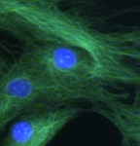
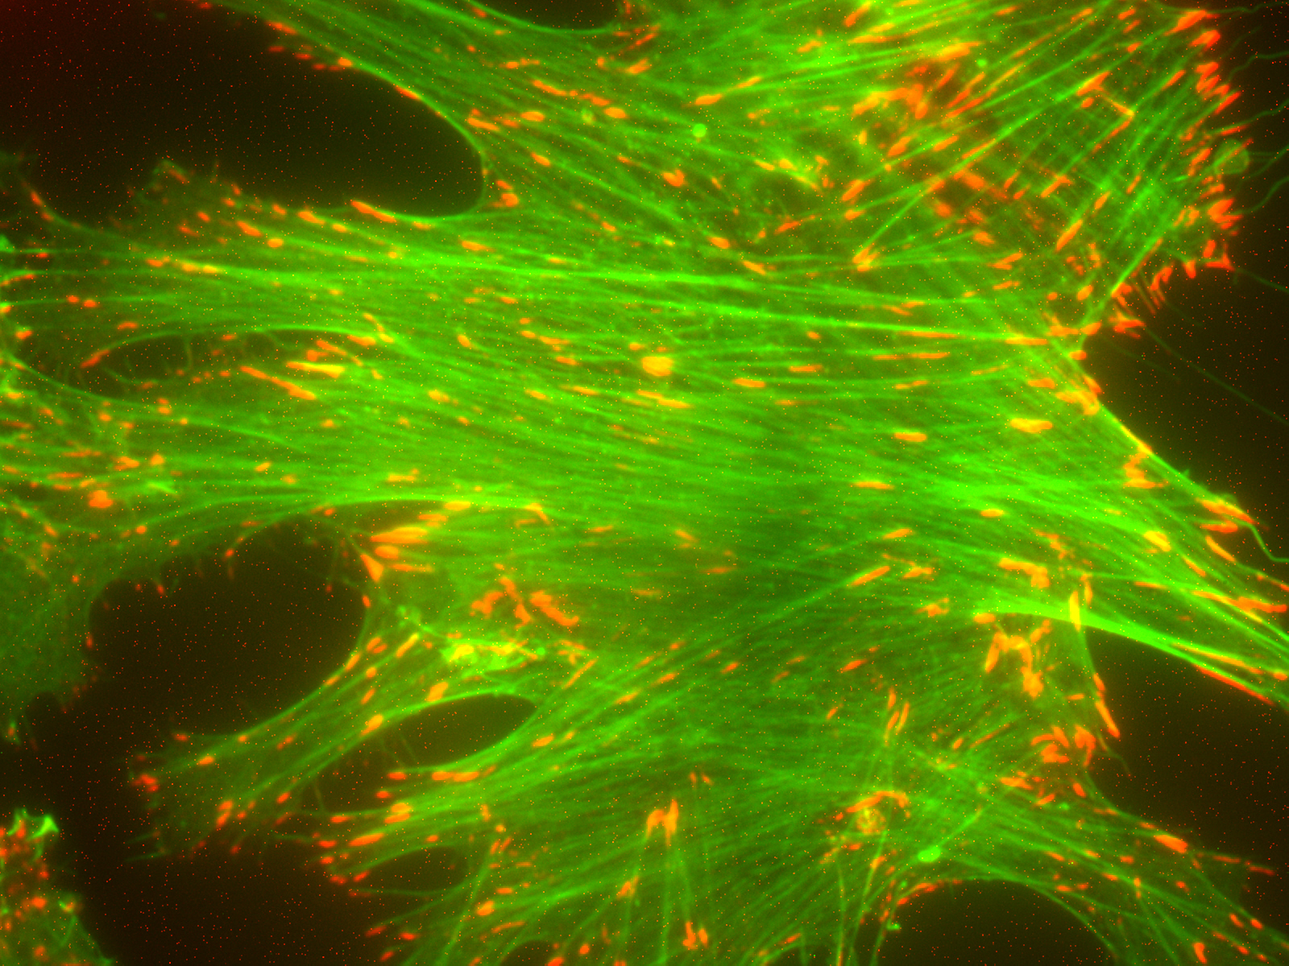
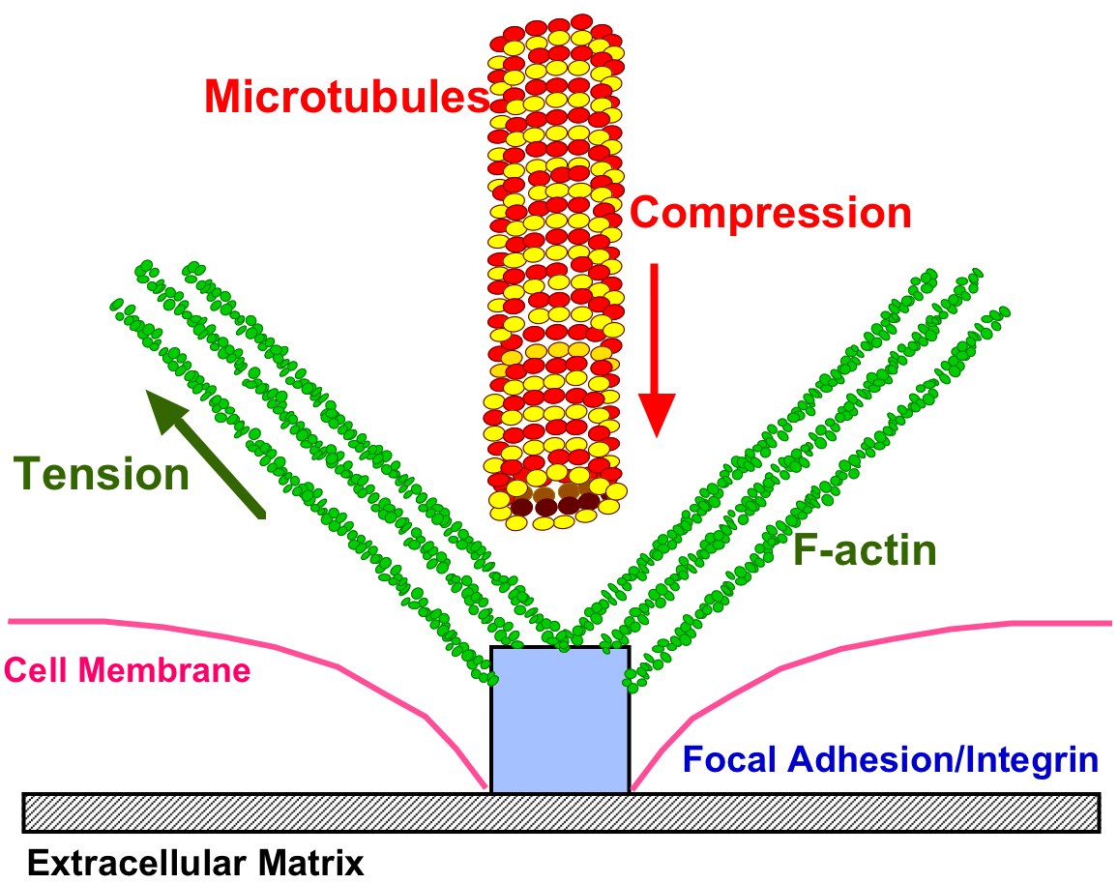
Proposed: Cell-ECM force balance through F-actin and microtubules
Courtesy of A. Putnam
In response to extracellular stretch or an intrinsic ECM stiffness, F-actin microfilaments adjust in tensional resistance, and the microtubule network adjusts in compressive resistance.
Notes:
Apart from the direct biochemical signaling that mechanical changes may impart, a second theory exists that cells exist in a biophysical, homeostatic force balance between themselves and the ECM.
One theory on how a mechanical signal from the ECM could be translated into a cellular process or initiate signaling is through a presumptive Cell-ECM force balance. In this theory, the cell is able to adjust to a mechanical force from the ECM by adjusting to load-bearing cytoskeletal elements, setting up a force balance between itself and either a static or dynamic ECM. The F-actin network consists of cables in constant tension, while the microtubules can buckle and resist compressive loading.

Slide 12
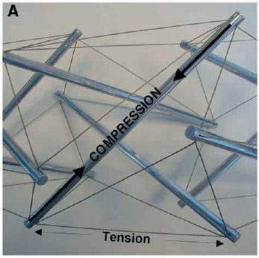
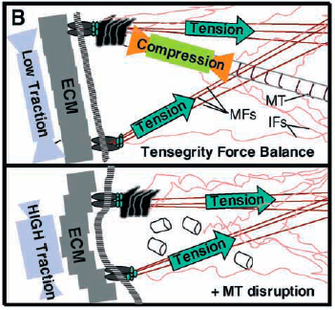
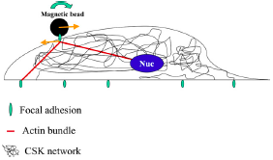
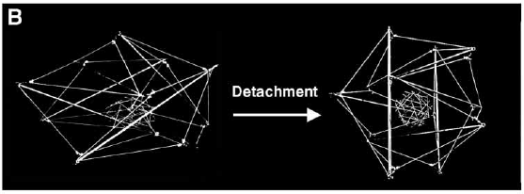

Tensegrity: a Physical Mechanism of Mechanotransduction
Cytoskeleton connects from focal adhesions to nucleus.
Forces at focal adhesions can propogate to changes in shape of nucleus → affects transcription regulators → gene expression/phenotype

Slide 13
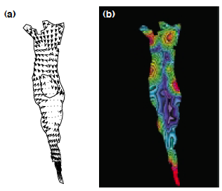
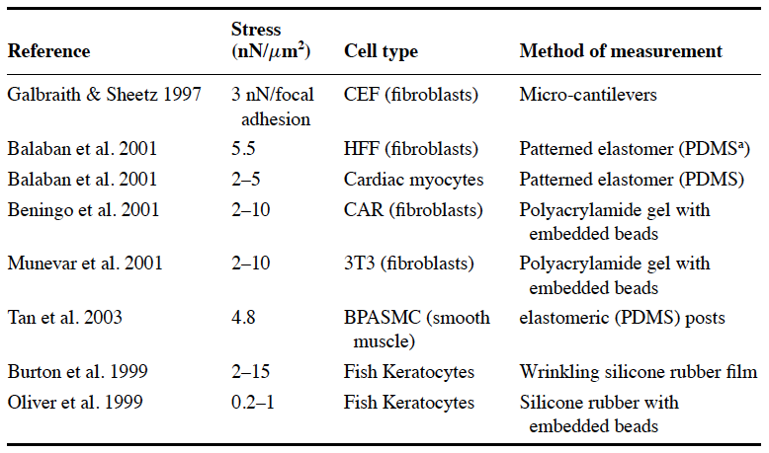



Traction Force Microscopy: Tool to Measure Cellular Forces Exerted on Substrate

Slide 14
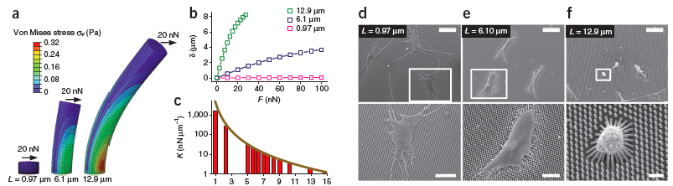
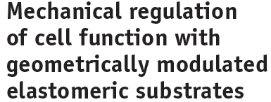

Elastomeric Posts

Slide 15
Phenotypic result
Either because of signaling changes at the site of focal adhesions…
Or through this force balance which eventually stretches the nuclear membrane…
Stiffness of the ECM can regulate:
Stem cell differentiation (bone v nerve v muscle)
Cell growth (many cell types)
Cell migration

Slide 16
Phenotypes: Durotaxis and Durokinesis

Slide 17
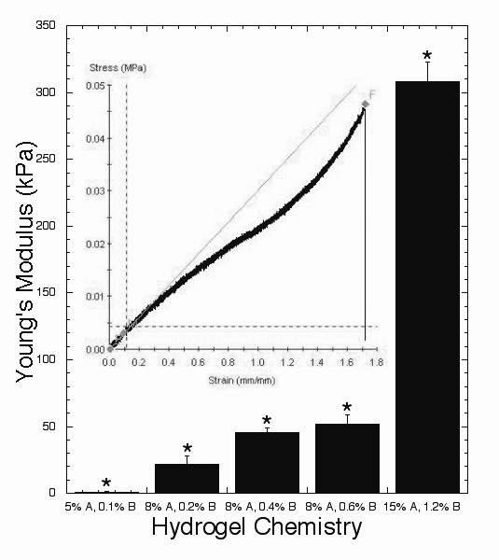
Polyacrylamide as a Biomaterial
Varying acrylamide and bis-acrylamide
Polyacrylamide disc
Heterobifunctional crosslinker sulfo-SANPAH
Fibronectin
Peyton, S.R. and Putnam, A.J. J. Cell. Phys. 2005 Jul;204(1):198-209.

Slide 18
1: Step Changes in Stiffness
3T3 Fibroblasts on PAA
Migrate from soft-to-stiff substrates
Biophys J. Lo et al. (2000) 79;144-152

Slide 19
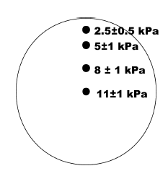
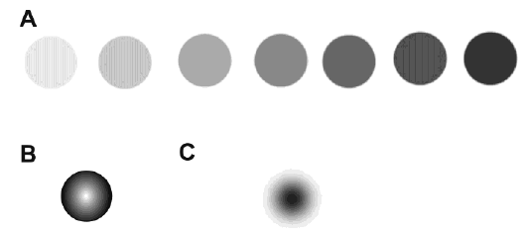
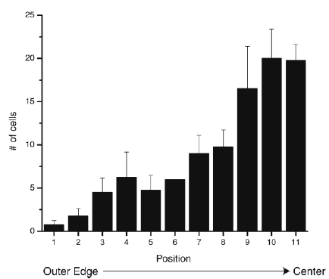
Durotaxis: gradients via photomask polymerization
Wong, J. Langmuir, 2003

Slide 20
Durokinesis: Biphasic Migration Dependence on Substrate Stiffness
Speed (um/hr)
Durokinesis: SMCs migrate fastest on an ‘optimally stiff’ substrate
Lecture 9: actin polymerization controlled by adhesive protein density as well (Haptokinesis).
Cells need stiffer substrate when less fibronectin is attached to surface to migrate at maximum capacity
Substrate stiffness
Peyton and Putnam, J. Cell. Phys. 2005

Slide 21
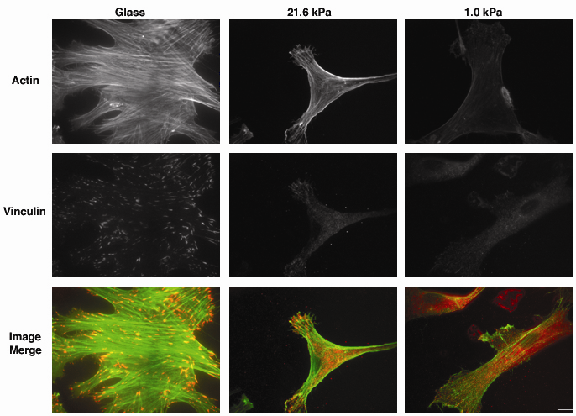
Cytoskeletal Assembly Regulated by Substrate Stiffness
Peyton and Putnam, J. Cell. Phys. 2005
Notes:
In concert with this change in motility, we also saw a clear difference in cytoskeletal assembly as a function of stiffness, indicating the role of the cytoskeleton and potentially RhoA in motivating these changes in cell motility.
As you can see here, the presence of very large, robust focal adhesions is present in cells cultured on the most rigid surface (polystyrene or glass). In contrast, relatively few punctate adhesive structures were observed in SMCs cultured on the softest 1.0 kPa substrate, as most of the vinculin staining in these cells was cytoplasmic. Likewise, the ability of SMCs to form a bundled actin stress fiber network was found to depend on ECM rigidity. As you can see here, there is a relative absence of stress fibers in SMCs on the softest 1.0 kPa substrate, in contrast to the well-defined discrete filaments observed in cells cultured on the stiffer substrates.

Slide 22
Biomaterials to Study Durotaxis/Durokinesis
Natural Biopolymers
Collagen, Fibrin, Matrigel
Contain cell-adhesive domains, 3D transferable
Natural chemistries
Soft 1Pa-10kPa
Lumped parameters
Synthetic Polymers
Polyacrylamide (PAA), Poly(ethylene glycol) (PEG), Polydimethylsiloxane (PDMS)
Independent tunability
Wide range of mechanical properties (100Pa – MPa)
Difficult chemistries
Not always 3D transferable
In Vivo Tissue Elastic Moduli Range
Brain: 100s of Pa
Liver: 10-100 kPa
Artery: ~40kPa
Skin: ~100 kPa
Bone: 100s of MPa to GPa

Slide 23
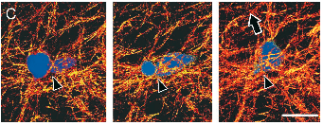
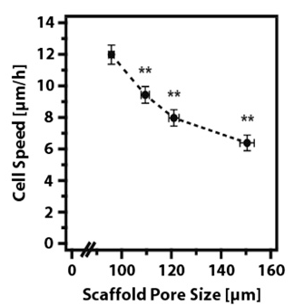
3D Collagen: Results Influenced by Polymerization Conditions
Native bovine dermal type I collagen
Motility requires MT1-MMP
(Nutragen)
JCB Wolf et. al. (2003)
Native bovine dermal type I collagen
Motility can be protease-independent
(Vitrogen, pepsin-extracted, non-covalent crosslinks)
MBC Kim et. al. (2008)
Freeze-dried Collagen-GAG
1D migration along fibers
Biophys J Harley et. al. (2008)

Slide 24
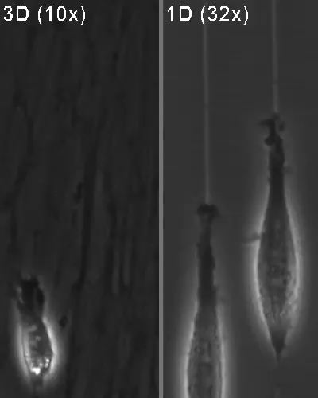
Cell-Secreted ECMs: 3D = 1D?
JCB Doyle et. al. (2009)

