Slide 1
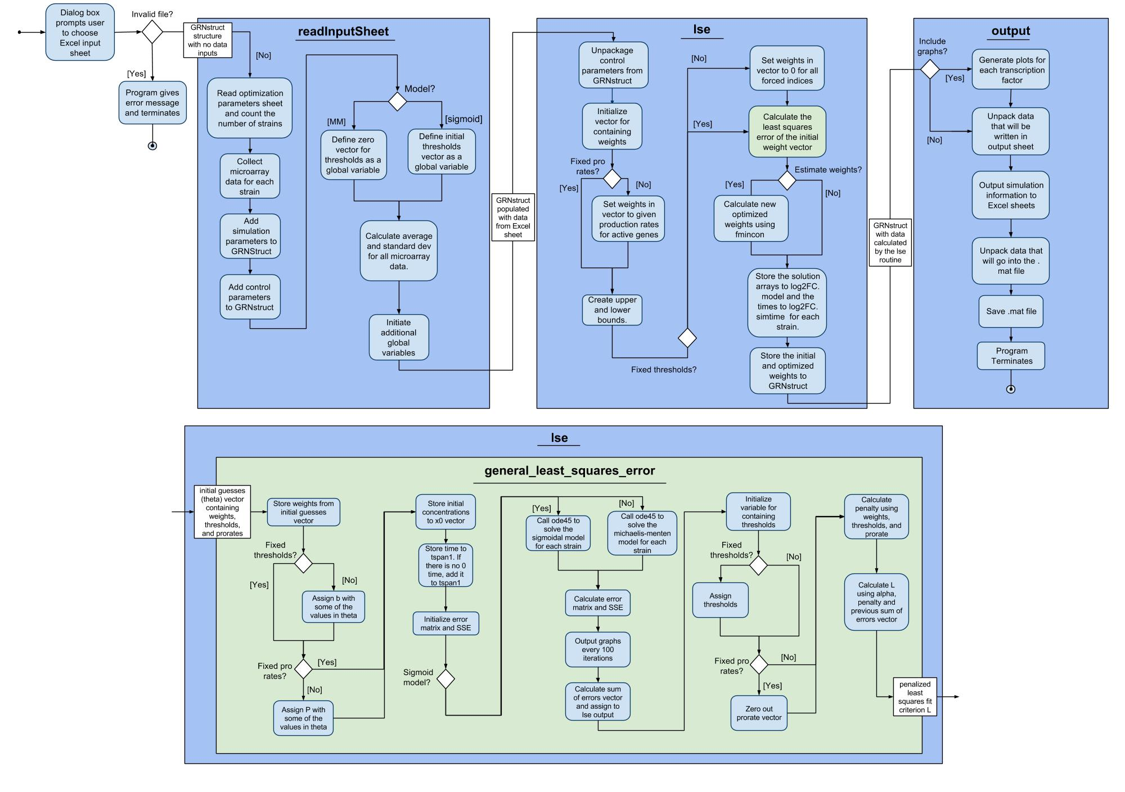
UML Activity Diagram Documents the Flow the of Program

Slide 2
We Added New Features, Fixed Bugs, and Documented the Changes to GRNmap
New Features:
Changed the names of the worksheets in the input and output workbooks
Computed standard deviations
Optimization diagnostics outputted for each run
Bugs fixed:
Correctly outputting estimated production rates and threshold parameters worksheets
Corrected computation for threshold for genes with no inputs
Documentation:
Updated the activity diagram to reflect changes in code
Updated the website and wiki
Testing Framework

Slide 3
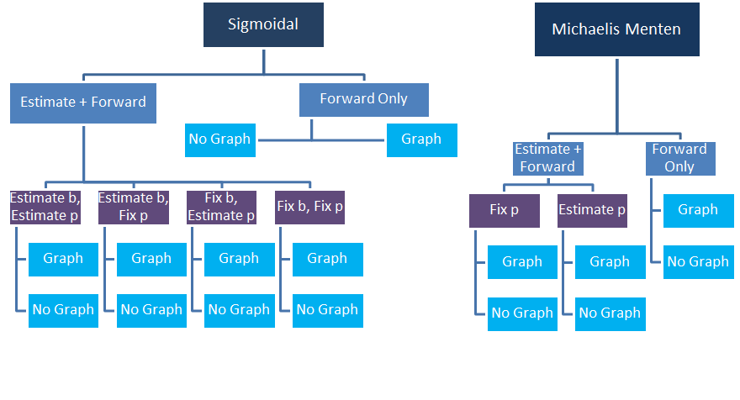
Input Sheets Were Designed to Test the Sixteen Ways GRNmap Can be Run

Slide 4
Manual Tests Were Performed to Verify Changes and Check for Bugs
Verify changes to the beta-branch of the code before pushing it to the master branch
Performed experiments to check the function of GRNmap
MATLAB executable
Standard deviation calculation
.xlsx vs. xls input files
Identical runs with same code version and same input workbook
Effect of “estimateParams” and “makeGraphs”
Currently working to automate these tests

