Slide 1

Over expression of Acetyl- CoA carboxylase (ACC) sub-unit accC in E.coli to enhance fatty acid (triacyl glycerol) accumulation for Bio-fuel production”
“Fuel it up”
Group 24
Sanju Timilsina
Parul Sirohi

Slide 2
CONTENT
Introduction
Overview
Experimental design
Results
Summary
Conclusion
References

Slide 3
GOAL
To overexpress Acetyl CoA carboxylase biotin carboxylase (accC) gene in E.coli to increases Tri acyl glycerol (TAG) production.

Slide 4
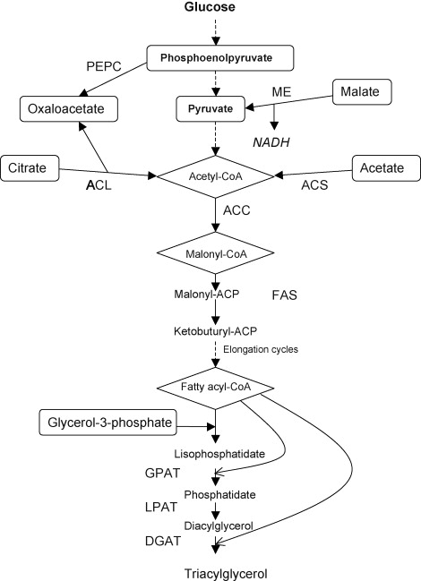
OVERVIEW
Target organism: E. coli 0157:H7
Assembly #: NC_011353.1 Length of gene: 1350bp
Introns: none ( prokaryotes)
Promoter part:
Initial choice BBa_J23100,
One that we used Bba_O1500
Plasmid Vector:
Initial choice pSB1A3, consecutive, Ampicillin
One that we used: PSB2K3 Kanamycin resistant site, with bio brick promoter part Bba_O1500.

Slide 5
EXPERIMENTAL DESIGN
E.coli culture and DNA isolation
PCR of accC gene
Electrophoresis
Restriction digestion
Ligation
Transformation
Recombinant selection
Inoculation of E.coli in biomass
Testing by TLC

Slide 6
RESULTS

Slide 7
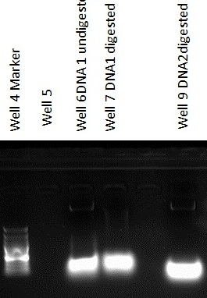
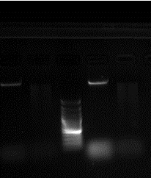
DNA isolation by using 1st protocol (chromosomal DNA isolation protocol) Source: Openwetware.com
Well 3 DNA 1 +EcoRI
Well 6 DNA 2 + EcoRI
100bp Marker
Well 2 DNA 1
Well 5 DNA2
3000bp
1500bp
1200bp
100bp
3000bp
1500bp
1200bp
100bp
Eco RI digested bands and undigested bands.
Well 5:DNA 2 has thicker band size than well 2:DNA 1
Bands smaller than expected
Digested and undigested DNA sample have same band so need run gel again

Slide 8
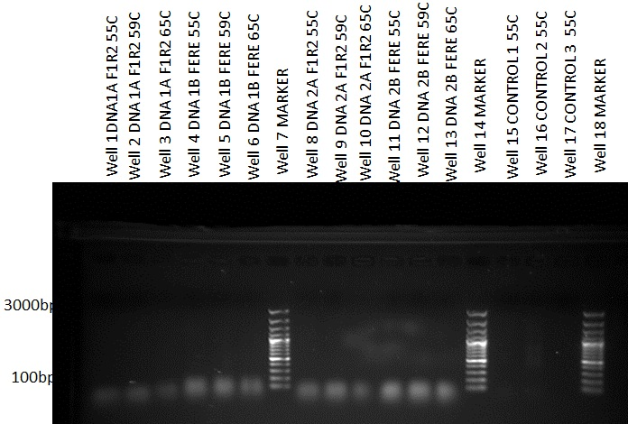
PCR Results
Amplified oligos
First PCR with extended and non- extended primers
No amplification of GOI, no positive control band
Temp.- 55°C, 59.1°C and 65°C

Slide 9
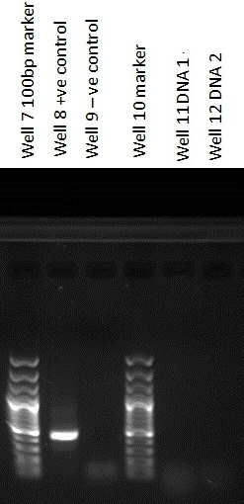
PCR FOR +VE CONTROL
Well 8 +ve control(plasmid DNA)
Temperature: 55C
well 11 and 12 EcoR1 digested DNA 1and 2
Changes: thawed plasmid, primers completely
3000bp
1000bp
100bp

Slide 10
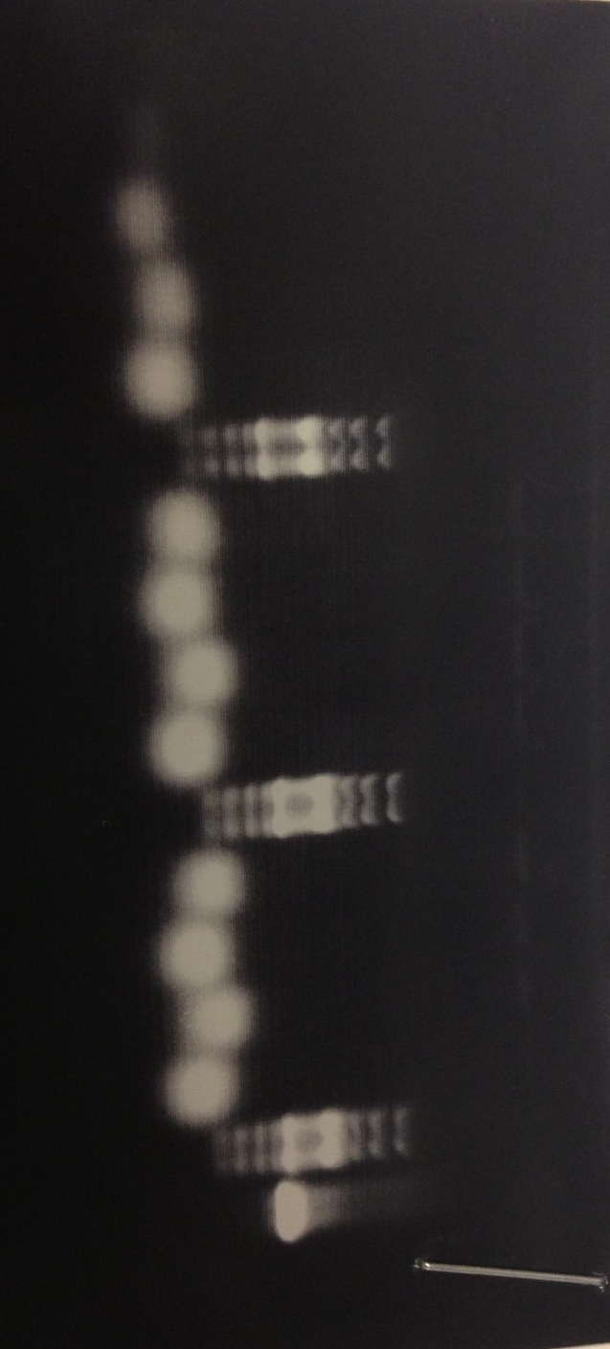
PCR Cont.……………..
No amplification with non-extended primers again but +ve control showed
Temp.- 44.8°C, 49.3°C, 55.2°C, 59.1°C, 63°C and 65°C
Out of DNA sample
3000bp
1500bp
1200bp
100bp
Positive control
Oligos

Slide 11
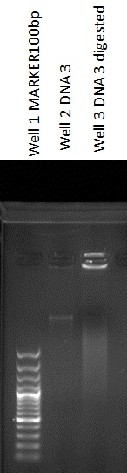
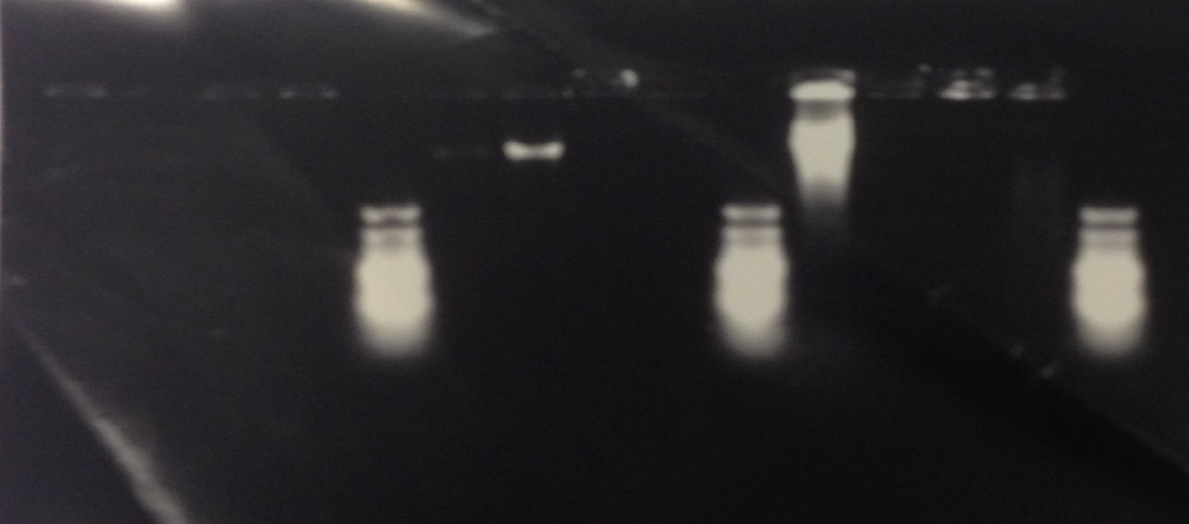
DNA isolation with different (genomic DNA Isolation) protocol Source: openwetware.com
Gel picture took after one day
Got DNA in 3 samples (D2,D5,D6)
D6 has good conc. Band
D2,D3 and D5 have same size band so we mixed them
Well 13 Digest D5
Well 8 Digest D1
Well 11 Digest D3
Well 14 Digest D6
Well 9 Digest D2
Well 12 Digest D4
Well 5 marker
Well 10 Marker
Well 15marker
Well 1 D1
Well 4 D4
Well 7 D6
Well2 D2
Well3 D3
Well6 D5
3000bp
1500bp
1200bp
100bp
3000bp
1500bp
100bp
Well 2 undigested D3
Well 3 digested D3

Slide 12
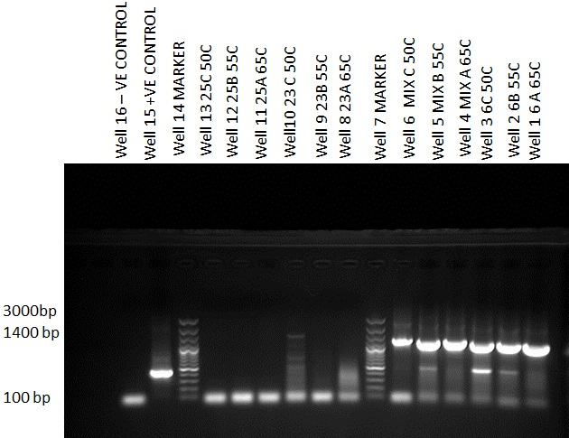
PCR for new DNA samples with non-extended primers
Well 1-6:Amplified DNA with non- extended primers
with band size approx. 1350bp
Well 8-13:DNA samples from other groups did not get amplified
Temperature:65°C,
55 °C and 50 °C.
6A, 6B and 6C have higher intensity bands of same size
11350
bp

Slide 13
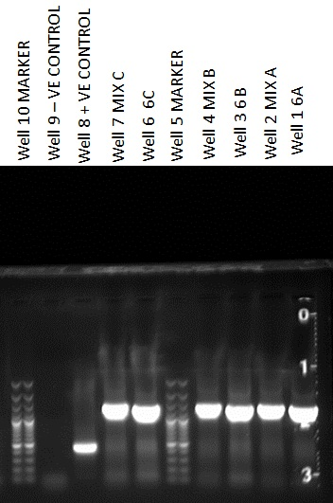
PCR with extended primers
Well 1-7: DNA samples with extended primers
Temperatures: 65 °C, 55.5 °C and 50 °C
Expected band size
3000bp
1500bp
1200bp
100bp
1350bp

Slide 14
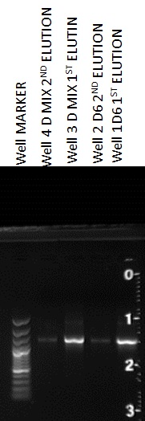
DNA extraction from agarose gel by using gel extraction kit
Well 1 and 2 : D6 1st and 2nd elution ( 35ul)
Sample loaded: 5ul + 1ul loading dye
3000bp
1500bp
1200bp 100bp
1350bp

Slide 15


Sticky end preparation for GOI
Mixed 1st and 2nd eluted DNA ( total volume 60ul)
Used 40ul for RE digestion
20ul stored at 80C
Well 10-11: 1st and 2nd eluted digested GOI with sticky ends X-P
XbaI- 5’….T CTAGA…3’
3’….AGATC T…5’
PstI- 5’…C TGCAG….3’
3’…GACGT C….5’
Sample loaded: 3ul
3000bp
1500bp
1200bp
100bp
1350bp

Slide 16
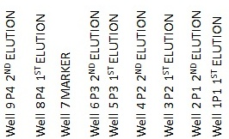
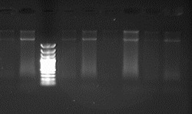
Plasmid (PSB2K3) Culture, Isolation
PSB2K3 with promoter part BBaI_01500 3000bp
Culture: LB+ Kanamycin
Samples: p1,p2,p3,p4 ( 1st and 2nd elution)
Isolation by using gene jet mini prep
1st elution 35ul and 2nd elution 35ul.
Mixed all 8 samples (240ul), and made more concentrated during purification process, by eluting it with 35ul elution buffer
3000bp
1500bp
1200bp
100bp

Slide 17
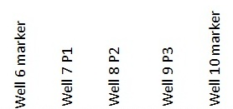
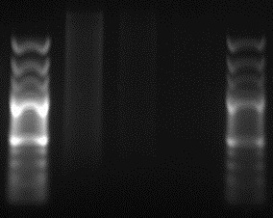
Plasmid Purification and sticky end preparation
Sticky end preparation by digesting with SpeI and PstI
SpeI- 5’….A CTAGT…3’
3’….TGATC A…5’
PstI- 5’…C TGCAG….3’
3’…GACGT C….5
Purification by using Gene jet purification kit
Total volume eluted- 35ul, 50 ul and 50ul (135ul)
’
Sample loaded- 5ul
Expected band size :3000bp
3000bp
1500bp
1200bp
100bp

Slide 18
☹ NO MORE TIME TO PROCEED☹

Slide 19
SUMMARY
E.coli culture and DNA isolation by using 1st protocol (Chromosomal DNA isolation) for E.coli
PCR and Electrophoresis
E.coli culture and DNA extraction by using different protocol
PCR amplification of accC gene/ electrophoresis
DNA extraction from gel by using gel extraction kit
Sticky end formation with PstI and XbaI
and purification
Plasmid PSB2K3 culture and isolation
Sticky end formation by with PstI and SpeI
Purification

Slide 20
CONCLUSIONS
Goal:
To overexpress accC gene in E.coli to produce tri-acyl glycerol
a precursor for biofuel production
Achievements:
Primer design was successful
accC gene amplified
Sticky end preparation with X and P in accC gene
Learned how to prepare sticky end in Plasmid vectors
All samples stored at 80 °C
Things to know:
Genomic DNA extraction protocol is better for DNA isolation
Thaw samples and reagents completely before starting work
Future approach:
To complete further steps in Spring semester
To do work: Vector preparation, Ligation, Transformation, Selectable culture, inoculation into biomass and verification test.

Slide 21
REFERENCES
Magnuson, K., Jackowski, S., Rock, C.O., and Cronan, J.E.(1993).Regulation of fatty acid biosynthesis in Escherichia coli. Microbial Rev.57(3):522
Noemie, M. D., Parisien, A., Wang, B., Lan, C., ( 2009). Enhancement of lipid production using biochemical, genetic and transcription factor engineering approaches. Journal of biotechnology, 141 (2009) 31-41
Siaut, M., Cuine, S., Cagnon, C., Fessler, B., Nguyen, M., Carrier, P., Bryly, A., Beisson, F., Triantaphylides, C., Beisson, L., and Peltier, G., (2011). Oil Accumulation in the model green algae Chlamydomonas reinhardetii: characterization, variability between common laboratory strains and relationship with starch reserves. BMC Biotechnol 2011: 117
http://partsregistry.org/Main_Page
http://www.ncbi.nlm.nih.gov/
http://scholar.google.com/
www.wikipedia.org/

Slide 22
THANK YOU
☺
Comments and questions……

