Slide 1
Polymerase Chain Reaction (PCR)
-Shaun Wootten

Slide 2
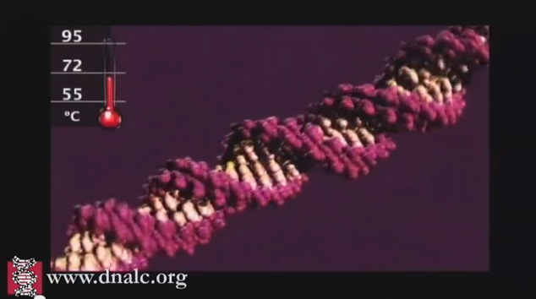
The Template DNA goes through a cycle of heating and cooling to form a new strand of DNA that only comprises of the cancerous DNA sequence that we desire.

Slide 3
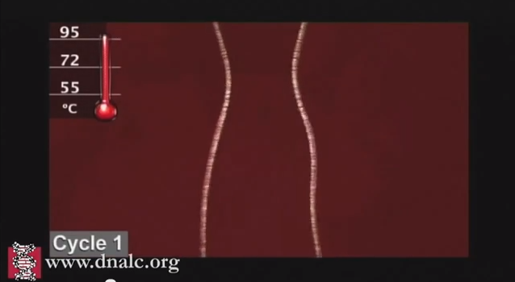
The DNA is then raised to near boiling, 95 degrees Celsius, to separate or denature into separate strands.

Slide 4
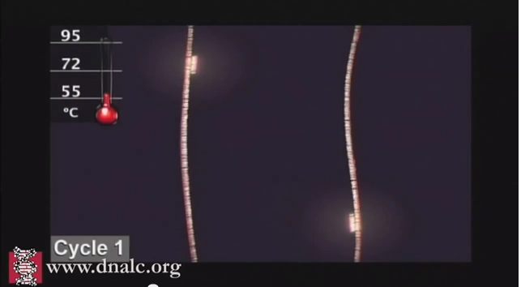
The DNA is then cooled down to 55 degrees Celsius for the forward and reverse primers to attach to both the sides of the desired DNA sequence.

Slide 5
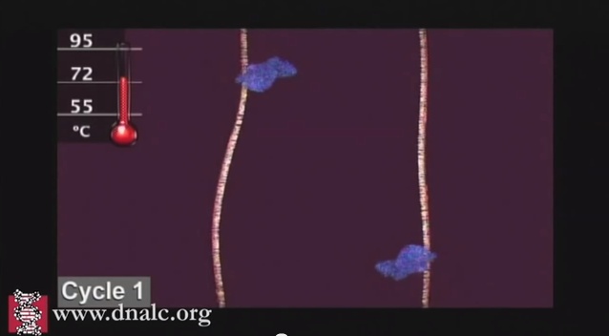
Then the DNA strands are heated to 72 degrees Celsius for the TAQ polymerase to add nucleotides so the DNA can further its duplication.

Slide 6
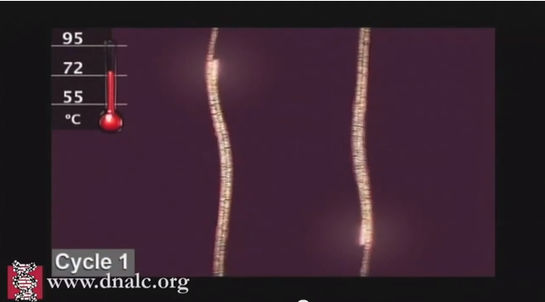
After the TAQ polymerase duplicates the sequence we now have a duplication of the Template DNA with only the desired cancerous sequence present.

Slide 7
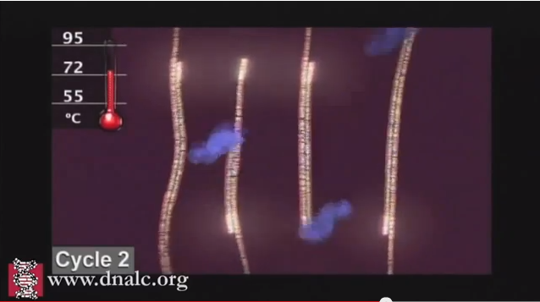
The process cycles through 35 times so that we have enough DNA cancerous strands for examination.

