Slide 1
Introduction to Tissue Engineering
ChemEng 575: Tissue Engineering
Lecture 1
January 21st, 2016

Slide 2
Who are you and why are you here
What’s your name
Major and year
Favorite class at UMass so far
Why did you want to take this class?

Slide 3
Group mini-project
Get into 6 groups of 4-5 – with neighbors
You have 15min to establish the critical design criteria for an engineered tissue.
What does this tissue/organ do?
What are the *minimum requirements* for someone to live/function w/ a replacement?
What would an ideal replacement contain?
Use anything you can as a resource to help you.

Slide 4
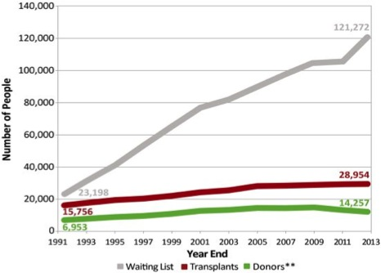
Tissue Engineering Seeks to Provide Replacement Tissues
Current lack of organ donors to meet rising demand of transplants
Each year, 40 to 90 million hospital days are attributed to the treatment of tissue and organ failure in the United States.
$400 billion per year is estimated as the total national health care cost for the 8 million or so procedures performed on patients suffering end-stage organ failure or tissue loss within the US.
Critical problems for tissue engineering
Vascularization
Cell Delivery
3. Mechanical mismatch

Slide 5
Tissue Engineering Strategy

Slide 6
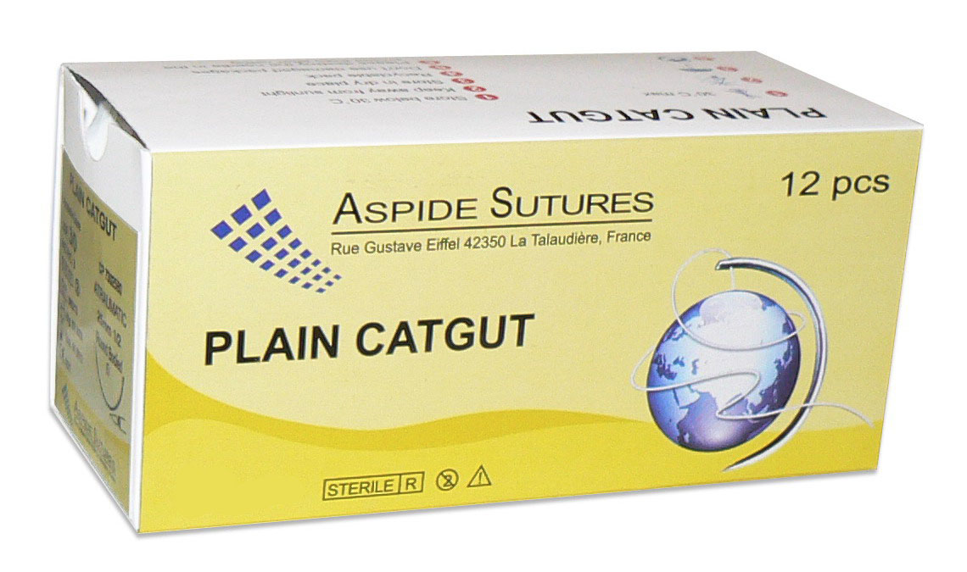
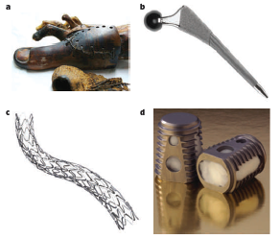
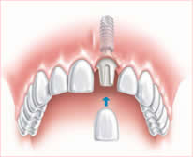
Tissue Engineered Solutions
Historically: Bio-inert materials to replace structural units of body
Resorbable sutures, 600 BC
Dental implants
Huebsch and Mooney, Nature, 2009
Later Reading during Biomaterials Lecture

Slide 7
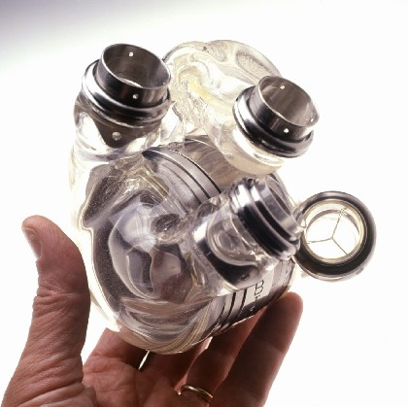
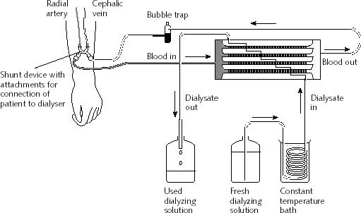
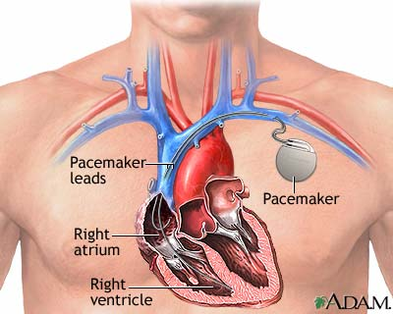
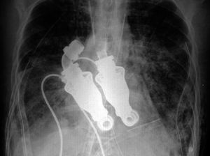
Machines to replace biological tissue function
AbioCore artificial heart
Ex vivo dialysis
“beatless” artificial heart
Texas Heart Institute

Slide 8
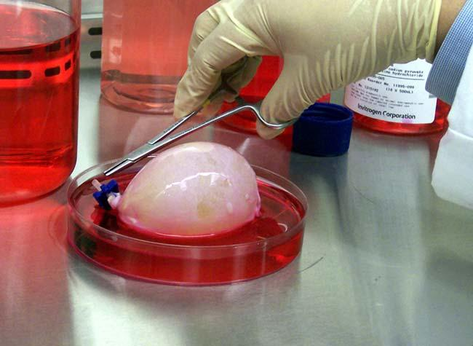
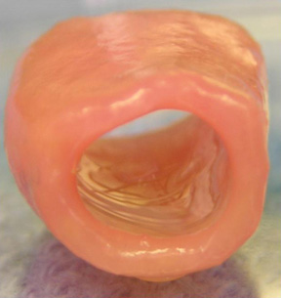
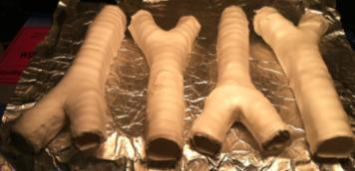
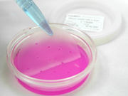
Engineered Biological Tissue
Trachea, Fauza, Children’s Hospital Boston
Nanofiber Solutions
Engineered bladder, Tony Atala
Skin grafts

Slide 9
SYLLABUS OVERVIEW
Instructor
Professor Shelly Peyton
Chemical Engineering Department
speyton@ecs.umass.edu
LSL N531
Telephone: 545-1133
Office hours: by appointment
Course Logistics
Lectures are scheduled on Tuesdays and Thursdays, 10-11:15a, Hasbrouck 107
Textbooks and Other Materials
There are no required textbooks for this class
Textbooks that might be helpful as references (and are available at the Library) are:
Tissue Engineering: by Saltzman, Oxford University Press (2004)
Molecular Biology of the Cell, by Alberts et al.
Biology for Engineers, by Johnson
Molecular Cell Biology by Lodish et al.
Principles of Polymer Chemistry by Flory
Course Website
http://openwetware.org/wiki/ChemEng_575

Slide 10
SYLLABUS, CONT.
Assignments
Readings: It is critical that you keep up with the reading assignments, as class lectures will give overviews of the reading with an additional focus on recent advances in the field of bioengineering. Readings come from current literature (research papers) and the online textbook.
In-Class Literature Review: During some classes, we will be reviewing journal articles as a group. Grading will be based on pre-class preparation, ability to lead discussion of the article, and participation.
Wiki Pages: Each class member will research one topical area of tissue engineering, create a wiki page on that topic for the student-created textbook, and do a short research presentation in class. http://openwetware.org/wiki/575_Wikis.
Research Project: There will be a group research project consisting of writing an NIH-style grant, and a research presentation.
Grading
This course will NOT BE CURVED. Numerical grades will be assigned for each homework assignment, examination, and project. Your final grade will be computed based on your performance in all aspects of the course with weights as follows :
Research Project 50%
Wiki Pages & Presentation 25%
In Class Literature Review 25%
Academic Honesty
Each student is responsible for all individual assignments. The University policy on academic honesty will be strictly enforced. The details of this policy as well as examples of violations are outlined in the “Undergraduate Rights and Responsibilities” document. Further information can be found at http://www.umass.edu/dean_students/codeofconduct/acadhonesty/

Slide 11
Overall Structure of Class
Lectures from Prof. Peyton and Sualyneth
Paper review
Wiki presentations (student lectures)
Group research presentations
No homeworks
No exams
This isn’t a typical engineering lecture-based class where I will tell you how the world works.
You will take ownership over what you get out of this class.

Slide 12
I am flexible, meet me halfway
Raise your hand if you plan to graduate this spring.
Raise your hand if you are applying to jobs and/or grad school.
I understand that you will have conflicts with class due to travel for #2.
I don’t take attendance.
But, email me that you are missing.
If you were signed up to give a wiki, we will re-schedule, email me to facilitate that.
If you were signed up to present a figure of a paper, YOU ARE RESPONSIBLE FOR FINDING A REPLACEMENT.
Find a classmate, switch with her/him, and email me the info.

Slide 13
I am passing around the wiki signup sheet
Choose a topic you’re excited about, or a date that works for you.
The dates are fixed. (first is 2/2)
Email me at any time this semester if you want another wiki for extra credit (1/3 letter grade, page only, no presentation.

Slide 14
Wiki Pages
Create a Wiki page giving a thorough description, with references, of your tissue engineering device, company, or leader in the field.
Post at http://openwetware.org/wiki/575_Wikis.
You will need to “sign up” at http://openwetware.org/wiki/OpenWetWare:How_to_join
There is a link to pages created in the previous years on the website as well, for inspiration. Yours will be better!
Some wiki pages that you can create are also on the current website. You need to create a new, improved wiki from this other page as starting material. Watch plagiarism!! There is a guideline online.
Wiki page + presentation = 25% of final grade (15% is the page, 10% is the presentation). Grading rubrics are also online.

Slide 15
Mini Research Presentation (from Wiki Pages Assignment)
Give a 10min presentation on a tissue engineered device, with another 5-10min for questions.
Discuss the following items
The human health problem or need that initiated the design of the device.
Potential market for the device (how many patients could it serve, what is the economic impact?)
The scientific literature leading up to the design (i.e. what role did initial scientists have in coming up with the idea.)
The partners involved (academic institution, VCs, industry)
Evolution of the device and its implementation
Role of animal studies and clinical trials
Reasons for its success or failure (both successful and unsuccessful examples desirable!)
Topics for presentation have already been assigned a date. You can sign up for any one you like, but the dates are fixed.
Check your plagiarism beforehand with TurnItIn: http://www.library.umass.edu/services/plagiarism-prevention/

Slide 16
In Class Literature Review
I am passing out the in class literature review sheet now.
Sign up for 2 figures. NOT on the same paper, but you can frontload (or backload).
Each figure presentation is 10% of your final grade. I drop the lower grade of the 2. (Total for all literature review is 25% of final grade)
Extra credit available: You can sign up for an extra figure, up to +3% each added to final grade (~1/3 letter grade). You have to wait until next week to sign up for extra figures – so that everyone gets their first choice of two first.

Slide 17
Preparing for Journal Review
Read the paper! (Everyone)
Come to class with questions! (everyone)
I will bring my laptop with a “slide per presenter” and help lead the discussion.
If you are presenting a figure, know the figure inside and out! (Be prepared for questions)
Walk the class through the figure and explain it thoroughly.
Do your best to relate the figure to previous figures, if that’s what the authors intended.
If you want any other material presented alongside your figure, email it to me and I will put it in the slides (supplemental, a method, etc.). (at least an hour before class please.

