Slide 1
Immunology, Vascularization, Cell and Drug Delivery
2/26/15
Lecture 9, ChE 575

Slide 2
Why do we need Blood Vessels???

Slide 3
Do a calculation for me
How far is your toe from the bottom of your lungs?
Assume the 2D diffusion coefficient of oxygen in tissue is 1.1x10⁻⁵cm²/s
Reminder: 2D brownian motion is r² = 4Dt
What is the time (t) it takes for an oxygen molecule to get to your toe cells if you have no blood vessels?
Is that fast enough?

Slide 4
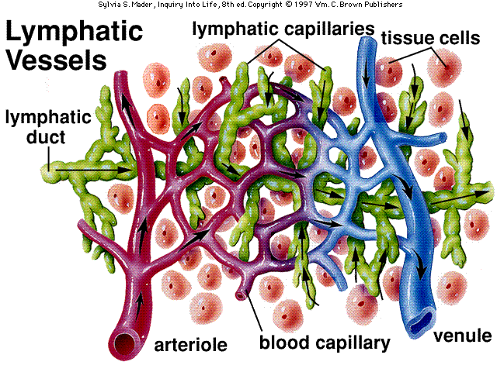
On average, each of your cells is 20μm away from the closest blood vessel (and lymph)

Slide 5
What are ways you can think of to get blood vessels into an engineered tissue?

Slide 6
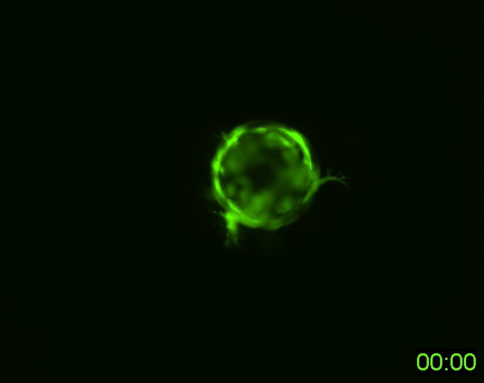
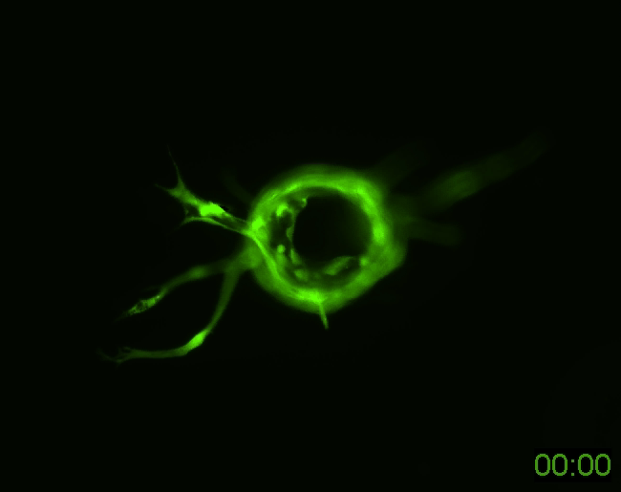
Examples of vascularizing tissues
Less porous
Very porous
GM6001 is a non-specific inhibitor of tissue proteases
Ghajar et al, Exp Cell Res 2010

Slide 7
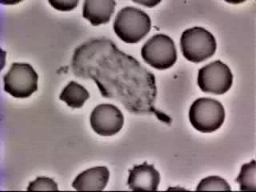
The other reason you need blood vessels: Immune response
Immediately following a break in the skin, phagocytes engulf bacteria within the wound.
This is an example of a nonspecific immune response which is innate against a pathogen.
Adaptive immunity mounts a response against a specific antigen, whereas innate immunity mounts a general response against any antigen.

Slide 8
Pathogens and Antigens
Pathogens are disease-causing micro-organisms, including viruses, bacteria, fungi, protozoa, and worms.
An antigen is anything that stimulates an immune response.
Nearly all pathogens are antigens, stimulating a strong immune response. Antigens are not always pathogens.
Particularly dangerous pathogens are non-antigenic. Can you think of any?
Pollens that cause hay fever are one of many examples of nonpathogenic antigens.
Biomaterial: pathogen or antigen or neither?
Bioengineering Challenge: Make drug delivery vehicles or materials “invisible” (non-antigenic/pathogenic)
Innate Immunity: First, quick (within hours, days) response to a new antigen.
Kill a few bacteria before they bloom, clot up and surround and implant.
Adaptive Immunity: complex, slow response to repeated infections. Requires B cells and T cells.
Vaccinations build up adaptive immune response.

Slide 9
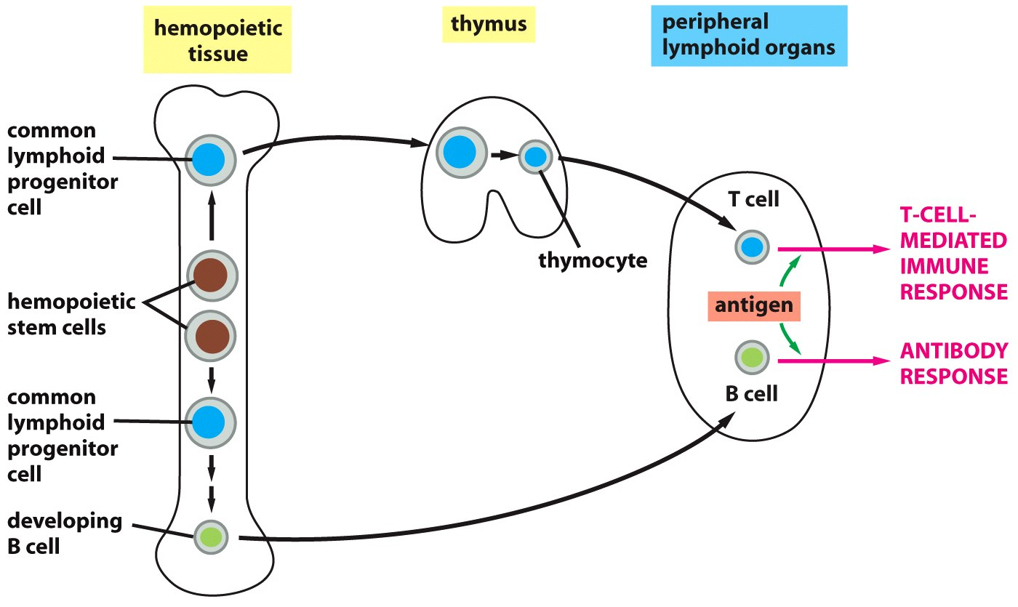
Immune cells develop, grow in the marrow, thymus, lymph, and spleen
What is leukemia?
Figure 25-6 Molecular Biology of the Cell (© Garland Science 2008)

Slide 10
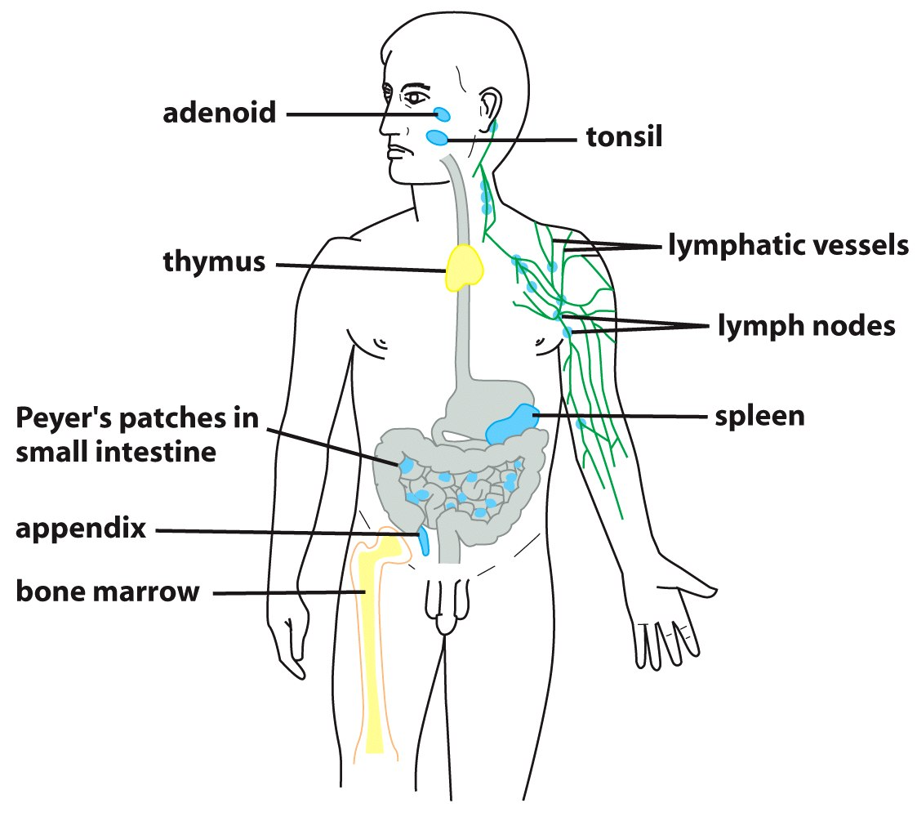
Lymph vessels collect debris, bring it to lymph organs, and then hook up with vasculature
Figure 25-3 Molecular Biology of the Cell (© Garland Science 2008)

Slide 11
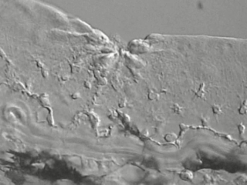
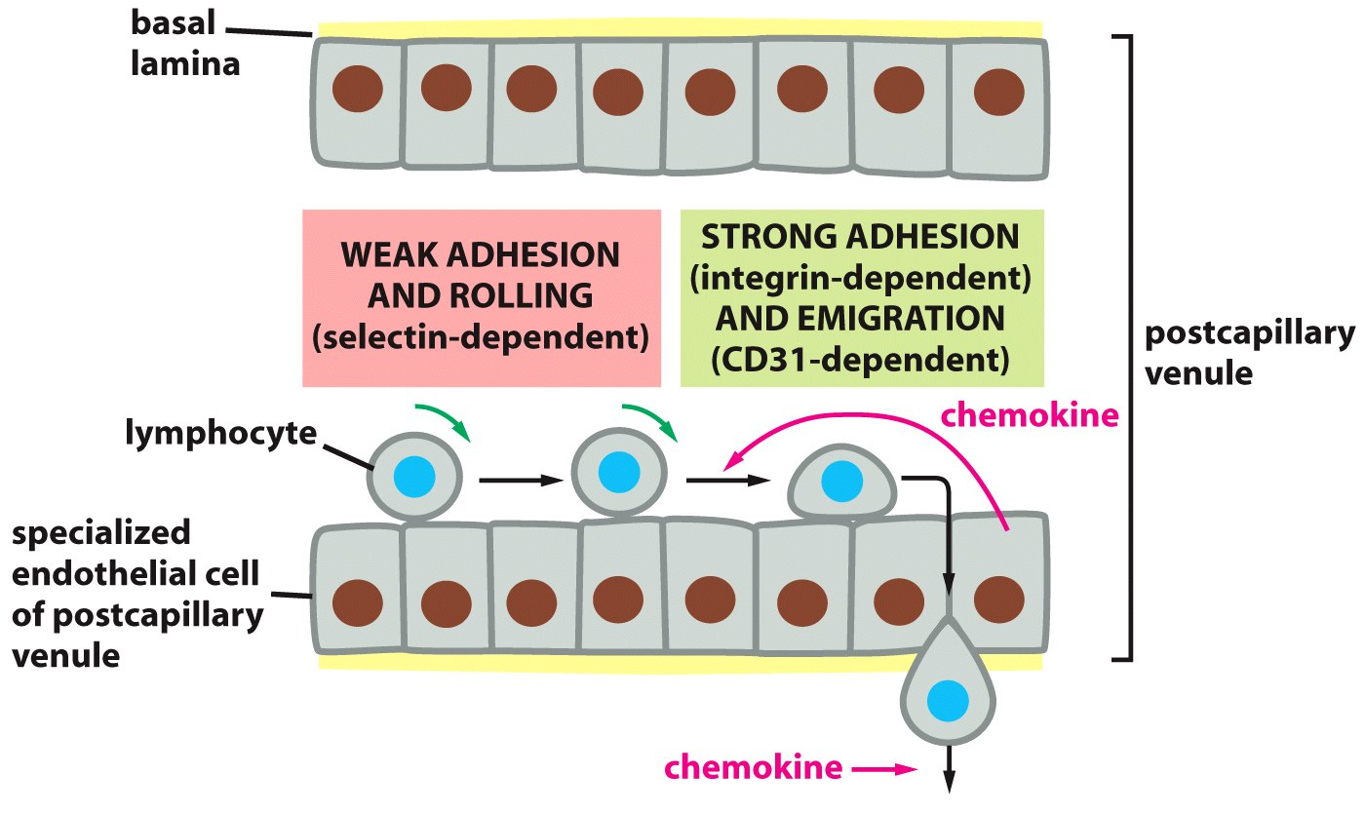
Immune cells get to tissues by squeezing out of blood vessels
Figure 25-15 Molecular Biology of the Cell (© Garland Science 2008)

Slide 12
The lack of an immune response is called Tolerance
Tolerance is the “opposite” of autoimmunity. Autoimmunity is an immune response to self, and tolerance is the lack of that response.
What is an autoimmune disease?
What is graft vs. host disease?

