Slide 1
Random Networks

Slide 2
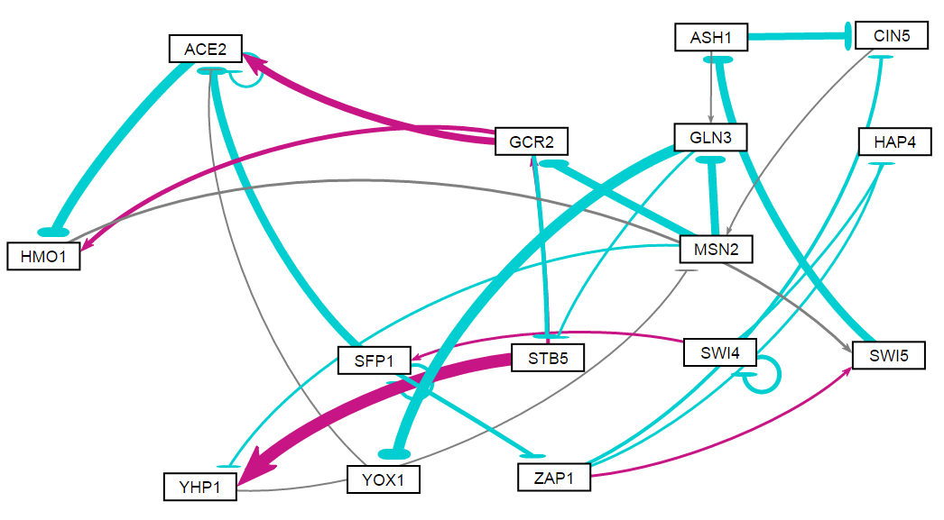
Random 1

Slide 3
id | indegree | outdegree | degree | weighted indegree | weighted outdegree | weighted degree | eccentricity | closnesscentrality | harmonicclosnesscentrality | betweenesscentrality | modularity_class | pageranks | strongcompnum | clustering | eigencentrality
ACE2 | 4 | 2 | 6 | -0.67148656 | -3.32327351 | -3.9947601 | 6 | 0.243902 | 0.326667 | 14 | 0 | 0.1352 | 0 | 0.25 | 1
ASH1 | 1 | 2 | 3 | -2.28517461 | -2.073799834 | -4.3589744 | 5 | 0.384615 | 0.495 | 40 | 1 | 0.089497 | 0 | 0 | 0.247175
CIN5 | 2 | 1 | 3 | -2.93791199 | 0.004928011 | -2.932984 | 5 | 0.357143 | 0.428333 | 27 | 1 | 0.054088 | 0 | 0 | 0.213441
GCR2 | 2 | 3 | 5 | -1.73065788 | 2.036084175 | 0.3054263 | 5 | 0.384615 | 0.536667 | 27.5 | 0 | 0.073736 | 0 | 0.083333 | 0.438201
GLN3 | 2 | 2 | 4 | -2.46743225 | -3.657041073 | -6.1244733 | 6 | 0.344828 | 0.478333 | 30.5 | 1 | 0.083125 | 0 | 0 | 0.335908
HAP4 | 2 | 0 | 2 | -0.49384029 | 0 | -0.4938403 | 0 | 0 | 0 | 0 | 1 | 0.020479 | 1 | 0 | 0.125413
HMO1 | 2 | 1 | 3 | -1.85471809 | 0.195487455 | -1.6592306 | 5 | 0.277778 | 0.351667 | 36 | 1 | 0.089526 | 0 | 0.166667 | 0.773239
MSN2 | 2 | 3 | 5 | -0.06064875 | -5.312926799 | -5.3735755 | 5 | 0.434783 | 0.578333 | 40 | 1 | 0.119906 | 0 | 0 | 0.367813
SFP1 | 2 | 3 | 5 | -0.38283867 | -4.0165295 | -4.3993682 | 5 | 0.342105 | 0.447436 | 12 | 1 | 0.02173 | 3 | 0.25 | 0.160598
STB5 | 2 | 2 | 4 | -1.55076993 | 4.762393892 | 3.211624 | 5 | 0.37037 | 0.486667 | 14 | 2 | 0.067433 | 0 | 0 | 0.424644
SWI4 | 1 | 3 | 4 | -1.17737782 | -1.127476215 | -2.304854 | 6 | 0.28 | 0.388095 | 0 | 1 | 0.015573 | 4 | 0.333333 | 0.040533
SWI5 | 2 | 1 | 3 | 0.443576545 | -2.285174608 | -1.8415981 | 5 | 0.322581 | 0.395 | 43 | 1 | 0.092131 | 0 | 0 | 0.478266
YHP1 | 2 | 1 | 3 | 3.727512091 | -0.065576762 | 3.6619353 | 6 | 0.3125 | 0.395 | 6 | 2 | 0.073736 | 0 | 0 | 0.438201
YOX1 | 1 | 1 | 2 | -3.28500199 | -0.156118959 | -3.441121 | 7 | 0.217391 | 0.310238 | 7 | 0 | 0.046523 | 0 | 0 | 0.186139
ZAP1 | 1 | 3 | 4 | -1.04708886 | -0.754835308 | -1.8019242 | 4 | 0.375 | 0.5 | 19 | 1 | 0.017317 | 2 | 0 | 0.120065

Slide 4
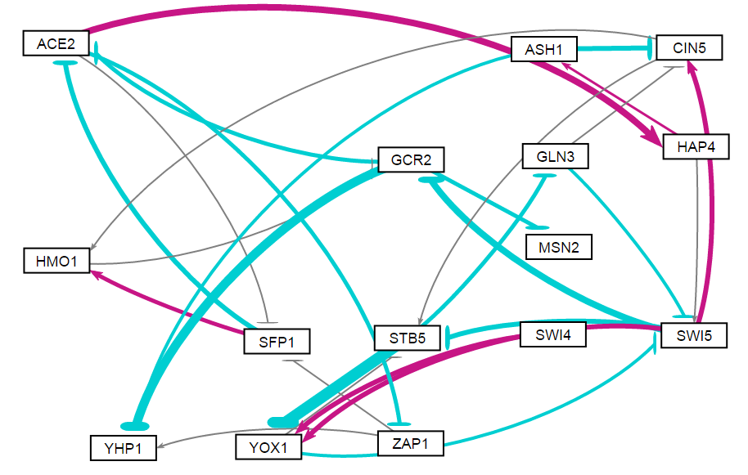
Random 2

Slide 5
id | indegree | outdegree | degree | weighted indegree | weighted outdegree | weighted degree | eccentricity | closnesscentrality | harmonicclosnesscentrality | betweenesscentrality | modularity_class | pageranks | strongcompnum | clustering | eigencentrality
ACE2 | 2 | 3 | 5 | -3.69091 | 1.523667 | -2.16724 | 4 | 0.419355 | 0.525641 | 63.5 | 1 | 0.066865 | 2 | 0.083333 | 0.440975
ASH1 | 1 | 2 | 3 | 0.71898 | -3.10934 | -2.39036 | 5 | 0.309524 | 0.411538 | 4.5 | 1 | 0.031933 | 2 | 0 | 0.111769
CIN5 | 3 | 2 | 5 | -0.16546 | 0.023999 | -0.14146 | 5 | 0.351351 | 0.444872 | 17.5 | 6 | 0.080549 | 2 | 0.15 | 0.608482
GCR2 | 2 | 3 | 5 | -3.10622 | -7.83066 | -10.9369 | 5 | 0.371429 | 0.496154 | 66.5 | 1 | 0.100546 | 2 | 0 | 0.562213
GLN3 | 1 | 2 | 3 | -1.77136 | -1.21123 | -2.98258 | 5 | 0.361111 | 0.457692 | 7.5 | 0 | 0.066308 | 2 | 0.5 | 0.468011
HAP4 | 1 | 2 | 3 | 3.280873 | 0.793239 | 4.074113 | 4 | 0.40625 | 0.487179 | 37 | 1 | 0.035722 | 2 | 0 | 0.219243
HMO1 | 2 | 1 | 3 | 1.850663 | -0.01456 | 1.836099 | 6 | 0.288889 | 0.366667 | 19.5 | 3 | 0.072621 | 2 | 0 | 0.462455
MSN2 | 1 | 0 | 1 | -1.37216 | 0 | -1.37216 | 0 | 0 | 0 | 0 | 2 | 0.04523 | 1 | 0 | 0.27081
SFP1 | 2 | 2 | 4 | -0.22638 | -0.2024 | -0.42879 | 5 | 0.351351 | 0.444872 | 14 | 3 | 0.050894 | 2 | 0.166667 | 0.331011
STB5 | 3 | 2 | 5 | -2.0691 | -8.2287 | -10.2978 | 6 | 0.288889 | 0.398718 | 15 | 4 | 0.116604 | 2 | 0.416667 | 1
SWI4 | 0 | 1 | 1 | 0 | 2.166253 | 2.166253 | 6 | 0.27451 | 0.340476 | 0 | 5 | 0.016761 | 3 | 0 | 0
SWI5 | 3 | 4 | 7 | -2.17274 | -0.543 | -2.71574 | 4 | 0.481481 | 0.596154 | 65 | 6 | 0.103664 | 2 | 0.166667 | 0.703253
YHP1 | 3 | 0 | 3 | -5.65952 | 0 | -5.65952 | 0 | 0 | 0 | 0 | 7 | 0.073986 | 0 | 0 | 0.445655
YOX1 | 3 | 2 | 5 | -2.04047 | -1.35495 | -3.39542 | 5 | 0.351351 | 0.444872 | 18.5 | 5 | 0.102595 | 2 | 0.166667 | 0.803507
ZAP1 | 1 | 2 | 3 | -1.55675 | 0.007134 | -1.54961 | 6 | 0.288889 | 0.398718 | 1.5 | 7 | 0.035722 | 2 | 0.333333 | 0.219243

Slide 6
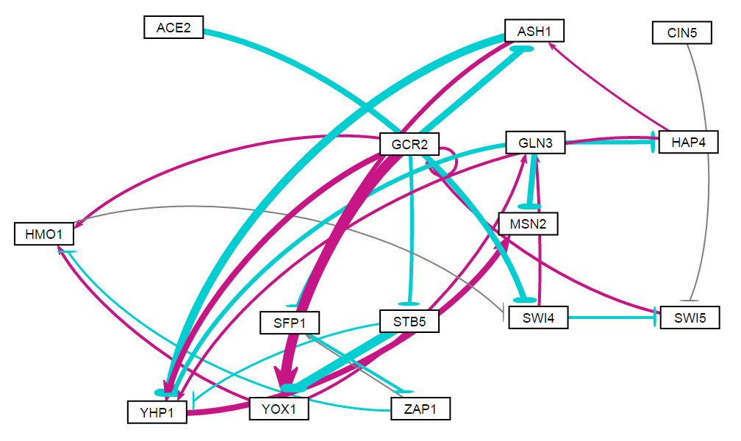
Random 3

Slide 7
id | indegree | outdegree | degree | weighted indegree | weighted outdegree | weighted degree | eccentricity | closnesscentrality | harmonicclosnesscentrality | betweenesscentrality | modularity_class | pageranks | strongcompnum | clustering | eigencentrality
ACE2 | 0 | 1 | 1 | 0 | -2.5119 | -2.5119 | 5 | 0.309524 | 0.367949 | 0 | 0 | 0.01729 | 3 | 0 | 0
ASH1 | 2 | 2 | 4 | -2.8402 | -2.06334 | -4.90353 | 7 | 0.285714 | 0.424405 | 17 | 3 | 0.046216 | 2 | 0.25 | 0.36897
CIN5 | 0 | 1 | 1 | 0 | -0.05264 | -0.05264 | 5 | 0.309524 | 0.361538 | 0 | 1 | 0.01729 | 4 | 0 | 0
GCR2 | 2 | 7 | 9 | 2.002912 | 3.96889 | 5.971802 | 3 | 0.6 | 0.722222 | 56.5 | 2 | 0.092338 | 2 | 0.214286 | 0.343231
GLN3 | 2 | 3 | 5 | 2.084409 | -6.38487 | -4.30046 | 9 | 0.218182 | 0.412831 | 27.5 | 6 | 0.086039 | 2 | 0.1 | 0.528114
HAP4 | 1 | 2 | 3 | -1.90475 | 1.466447 | -0.4383 | 8 | 0.244898 | 0.391171 | 13.5 | 2 | 0.041656 | 2 | 0.333333 | 0.294356
HMO1 | 3 | 1 | 4 | 1.319721 | -0.13433 | 1.185392 | 5 | 0.315789 | 0.377778 | 53 | 2 | 0.08175 | 2 | 0.083333 | 0.641156
MSN2 | 2 | 0 | 2 | 0.078709 | 0 | 0.078709 | 0 | 0 | 0 | 0 | 2 | 0.12865 | 0 | 0.5 | 0.850167
SFP1 | 2 | 1 | 3 | -1.0272 | -1.1192 | -2.1464 | 6 | 0.230769 | 0.302778 | 11 | 4 | 0.05614 | 2 | 0 | 0.325619
STB5 | 1 | 2 | 3 | -1.59559 | -4.74318 | -6.33876 | 7 | 0.3 | 0.431349 | 0 | 5 | 0.028505 | 2 | 0.333333 | 0.208734
SWI4 | 2 | 2 | 4 | -2.64623 | 0.106603 | -2.53962 | 4 | 0.413793 | 0.493056 | 66 | 6 | 0.101438 | 2 | 0 | 0.37213
SWI5 | 2 | 1 | 3 | -0.88594 | 0.993672 | 0.107733 | 4 | 0.413793 | 0.465278 | 56.5 | 2 | 0.075125 | 2 | 0 | 0.218135
YHP1 | 5 | 1 | 6 | -2.49857 | 2.922426 | 0.423859 | 1 | 1 | 1 | 6 | 2 | 0.102331 | 1 | 0.166667 | 1
YOX1 | 3 | 2 | 5 | 2.986827 | 1.994548 | 4.981375 | 6 | 0.333333 | 0.456944 | 39 | 2 | 0.060253 | 2 | 0.15 | 0.545409
ZAP1 | 1 | 2 | 3 | -1.1192 | -0.48822 | -1.60742 | 5 | 0.292683 | 0.397222 | 11 | 4 | 0.06498 | 2 | 0 | 0.19483

Slide 8
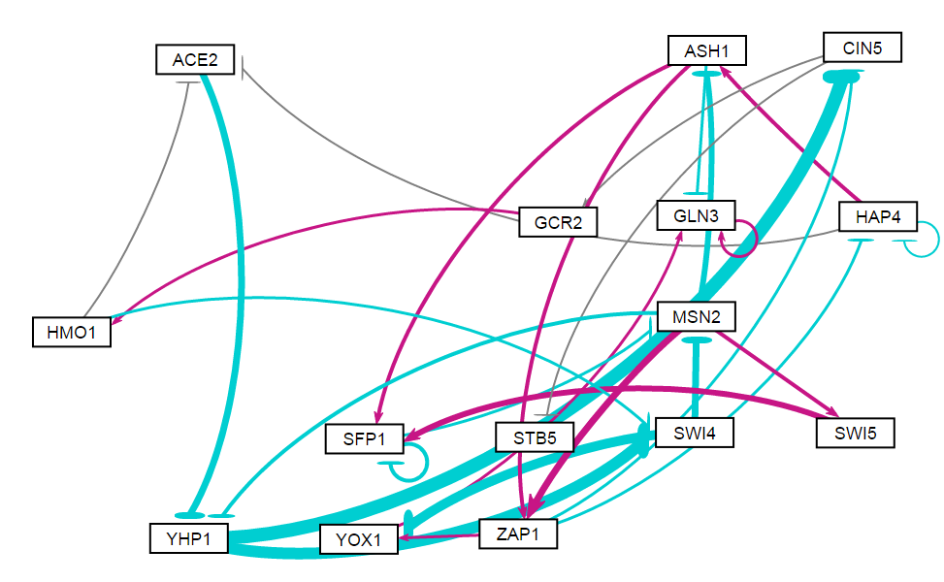
Random 4

Slide 9
id | indegree | outdegree | degree | weighted indegree | weighted outdegree | weighted degree | eccentricity | closnesscentrality | harmonicclosnesscentrality | betweenesscentrality | modularity_class | pageranks | strongcompnum | clustering | eigencentrality
ACE2 | 2 | 1 | 3 | -0.27687 | -2.24722 | -2.52409 | 5 | 0.297872 | 0.355952 | 13.5 | 0 | 0.03682 | 3 | 0 | 0.348374
ASH1 | 2 | 3 | 5 | -0.74146 | 0.941283 | 0.199823 | 4 | 0.411765 | 0.511905 | 17.5 | 2 | 0.034553 | 3 | 0.15 | 0.566579
CIN5 | 2 | 2 | 4 | -5.5222 | 0.02488 | -5.49732 | 6 | 0.259259 | 0.360714 | 31.5 | 0 | 0.046221 | 3 | 0 | 0.528327
GCR2 | 1 | 1 | 2 | 0.169878 | 0.428047 | 0.597925 | 5 | 0.285714 | 0.346429 | 22.5 | 0 | 0.031436 | 3 | 0 | 0.264983
GLN3 | 3 | 1 | 4 | 0.191316 | 0.346954 | 0.53827 | 0 | 0 | 0 | 0 | 1 | 0.392785 | 0 | 0.333333 | 1
HAP4 | 2 | 3 | 5 | -0.67391 | 0.36154 | -0.31237 | 5 | 0.358974 | 0.44881 | 11.5 | 2 | 0.030561 | 3 | 0.333333 | 0.556787
HMO1 | 1 | 2 | 3 | 0.428047 | -0.34845 | 0.079602 | 4 | 0.358974 | 0.440476 | 25.5 | 0 | 0.038515 | 3 | 0 | 0.134791
MSN2 | 2 | 4 | 6 | -2.66814 | 0.424619 | -2.24352 | 4 | 0.482759 | 0.589286 | 66 | 1 | 0.066353 | 3 | 0.133333 | 0.582883
SFP1 | 3 | 2 | 5 | 1.782031 | -1.39 | 0.392035 | 5 | 0.341463 | 0.40119 | 21 | 2 | 0.075851 | 3 | 0.416667 | 0.836881
STB5 | 1 | 0 | 1 | -0.145 | 0 | -0.145 | 0 | 0 | 0 | 0 | 3 | 0.031436 | 2 | 0 | 0.264983
SWI4 | 2 | 2 | 4 | -4.70823 | -5.6903 | -10.3985 | 5 | 0.368421 | 0.460714 | 40 | 0 | 0.05248 | 3 | 0.083333 | 0.319914
SWI5 | 1 | 1 | 2 | 0.747813 | 1.893985 | 2.641798 | 6 | 0.264151 | 0.322619 | 3.5 | 2 | 0.025891 | 3 | 0.5 | 0.293092
YHP1 | 2 | 2 | 4 | -3.19325 | -9.54807 | -12.7413 | 4 | 0.378378 | 0.458333 | 33.5 | 1 | 0.0572 | 3 | 0.083333 | 0.475659
YOX1 | 2 | 1 | 3 | -3.11409 | 0.356019 | -2.75808 | 1 | 1 | 1 | 7 | 1 | 0.044213 | 1 | 0 | 0.457364
ZAP1 | 2 | 3 | 5 | 2.936006 | -0.34135 | 2.594655 | 5 | 0.4 | 0.514286 | 34 | 1 | 0.035686 | 3 | 0.1 | 0.573185

Slide 10
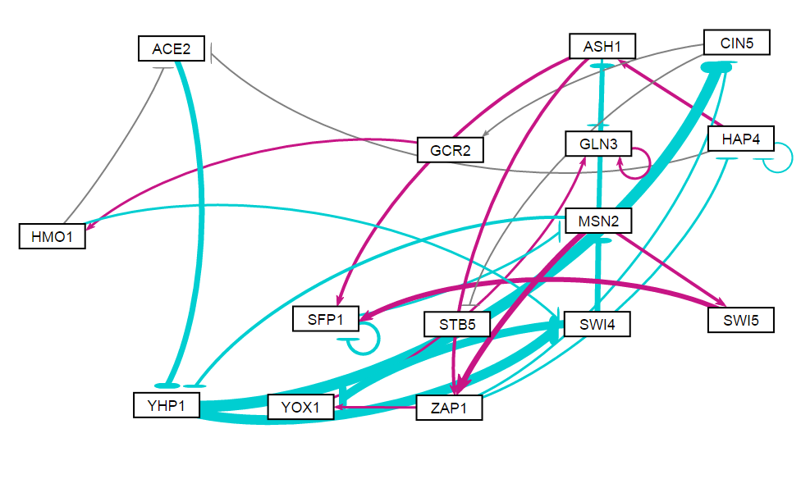
Random 5

Slide 11
id | indegree | outdegree | degree | weighted indegree | weighted outdegree | weighted degree | eccentricity | closnesscentrality | harmonicclosnesscentrality | betweenesscentrality | modularity_class | pageranks | strongcompnum | clustering | eigencentrality
ACE2 | 2 | 1 | 3 | -0.27687 | -2.24722 | -2.52409 | 5 | 0.297872 | 0.355952 | 13.5 | 0 | 0.03682 | 3 | 0 | 0.348374
ASH1 | 2 | 3 | 5 | -0.74146 | 0.941283 | 0.199823 | 4 | 0.411765 | 0.511905 | 17.5 | 3 | 0.034553 | 3 | 0.15 | 0.566579
CIN5 | 2 | 2 | 4 | -5.5222 | 0.02488 | -5.49732 | 6 | 0.259259 | 0.360714 | 31.5 | 0 | 0.046221 | 3 | 0 | 0.528327
GCR2 | 1 | 1 | 2 | 0.169878 | 0.428047 | 0.597925 | 5 | 0.285714 | 0.346429 | 22.5 | 0 | 0.031436 | 3 | 0 | 0.264983
GLN3 | 3 | 1 | 4 | 0.191316 | 0.346954 | 0.53827 | 0 | 0 | 0 | 0 | 1 | 0.392785 | 0 | 0.333333 | 1
HAP4 | 2 | 3 | 5 | -0.67391 | 0.36154 | -0.31237 | 5 | 0.358974 | 0.44881 | 11.5 | 3 | 0.030561 | 3 | 0.333333 | 0.556787
HMO1 | 1 | 2 | 3 | 0.428047 | -0.34845 | 0.079602 | 4 | 0.358974 | 0.440476 | 25.5 | 0 | 0.038515 | 3 | 0 | 0.134791
MSN2 | 2 | 4 | 6 | -2.66814 | 0.424619 | -2.24352 | 4 | 0.482759 | 0.589286 | 66 | 1 | 0.066353 | 3 | 0.133333 | 0.582883
SFP1 | 3 | 2 | 5 | 1.782031 | -1.39 | 0.392035 | 5 | 0.341463 | 0.40119 | 21 | 3 | 0.075851 | 3 | 0.416667 | 0.836881
STB5 | 1 | 0 | 1 | -0.145 | 0 | -0.145 | 0 | 0 | 0 | 0 | 2 | 0.031436 | 2 | 0 | 0.264983
SWI4 | 2 | 2 | 4 | -4.70823 | -5.6903 | -10.3985 | 5 | 0.368421 | 0.460714 | 40 | 0 | 0.05248 | 3 | 0.083333 | 0.319914
SWI5 | 1 | 1 | 2 | 0.747813 | 1.893985 | 2.641798 | 6 | 0.264151 | 0.322619 | 3.5 | 3 | 0.025891 | 3 | 0.5 | 0.293092
YHP1 | 2 | 2 | 4 | -3.19325 | -9.54807 | -12.7413 | 4 | 0.378378 | 0.458333 | 33.5 | 1 | 0.0572 | 3 | 0.083333 | 0.475659
YOX1 | 2 | 1 | 3 | -3.11409 | 0.356019 | -2.75808 | 1 | 1 | 1 | 7 | 1 | 0.044213 | 1 | 0 | 0.457364
ZAP1 | 2 | 3 | 5 | 2.936006 | -0.34135 | 2.594655 | 5 | 0.4 | 0.514286 | 34 | 1 | 0.035686 | 3 | 0.1 | 0.573185

Slide 12
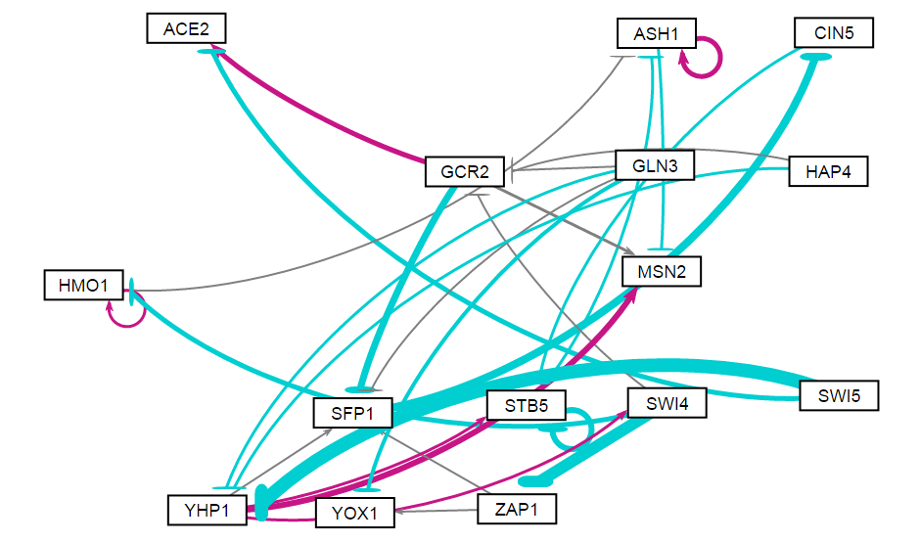
Random 6

Slide 13
id | indegree | outdegree | degree | weighted indegree | weighted outdegree | weighted degree | eccentricity | closnesscentrality | harmonicclosnesscentrality | betweenesscentrality | modularity_class | pageranks | strongcompnum | clustering | eigencentrality
ACE2 | 2 | 0 | 2 | 0.228821 | 0 | 0.228821 | 0 | 0 | 0 | 0 | 2 | 0.044543 | 0 | 0 | 0.080503
ASH1 | 3 | 2 | 5 | 1.026698 | 0.927798 | 1.954496 | 1 | 1 | 1 | 5 | 0 | 0.202631 | 2 | 0.25 | 1
CIN5 | 1 | 1 | 2 | -3.34808 | -0.31525 | -3.66333 | 3 | 0.5 | 0.611111 | 9 | 1 | 0.075684 | 4 | 0 | 0.172016
GCR2 | 3 | 3 | 6 | -0.52193 | -0.47461 | -0.99654 | 4 | 0.5 | 0.680556 | 8.5 | 2 | 0.045443 | 6 | 0.033333 | 0.063124
GLN3 | 0 | 4 | 4 | 0 | -1.99813 | -1.99813 | 3 | 0.521739 | 0.625 | 0 | 5 | 0.022218 | 12 | 0.166667 | 0
HAP4 | 0 | 2 | 2 | 0 | -0.75507 | -0.75507 | 4 | 0.428571 | 0.506944 | 0 | 3 | 0.022218 | 13 | 0 | 0
HMO1 | 2 | 2 | 4 | -0.89461 | 0.4209 | -0.47371 | 2 | 0.666667 | 0.75 | 1 | 0 | 0.054414 | 9 | 0.333333 | 0.196847
MSN2 | 3 | 0 | 3 | 1.528113 | 0 | 1.528113 | 0 | 0 | 0 | 0 | 5 | 0.130892 | 1 | 0 | 0.653262
SFP1 | 4 | 1 | 5 | -2.19561 | -3.34808 | -5.54369 | 4 | 0.4 | 0.520833 | 13 | 5 | 0.062861 | 5 | 0.1 | 0.172512
STB5 | 3 | 2 | 5 | -1.64387 | -2.53644 | -4.1803 | 2 | 0.666667 | 0.75 | 11 | 5 | 0.167574 | 3 | 0.25 | 0.491579
SWI4 | 1 | 3 | 4 | 0.476639 | -6.68668 | -6.21004 | 4 | 0.5 | 0.608333 | 14 | 5 | 0.03196 | 10 | 0 | 0.039919
SWI5 | 0 | 2 | 2 | 0 | -7.62053 | -7.62053 | 4 | 0.413793 | 0.493056 | 0 | 4 | 0.022218 | 14 | 0 | 0
YHP1 | 3 | 4 | 7 | -7.30562 | 3.305232 | -4.00039 | 3 | 0.55 | 0.651515 | 23 | 5 | 0.045828 | 11 | 0.02381 | 0.01621
YOX1 | 2 | 0 | 2 | -1.11987 | 0 | -1.11987 | 0 | 0 | 0 | 0 | 6 | 0.040238 | 7 | 0 | 0.057493
ZAP1 | 1 | 2 | 3 | -5.16368 | 0.147858 | -5.01582 | 5 | 0.375 | 0.547222 | 5.5 | 6 | 0.031277 | 8 | 0 | 0.052318

Slide 14
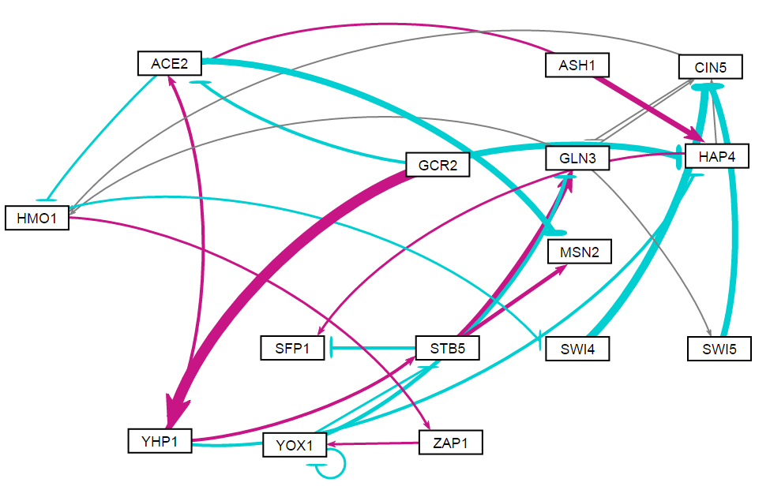
Random 7

Slide 15
id | indegree | outdegree | degree | weighted indegree | weighted outdegree | weighted degree | eccentricity | closnesscentrality | harmonicclosnesscentrality | betweenesscentrality | modularity_class | pageranks | strongcompnum | clustering | eigencentrality
ACE2 | 3 | 2 | 5 | 0.171748 | -2.80768 | -2.63593 | 5 | 0.333333 | 0.456667 | 15.5 | 0 | 0.030635 | 3 | 0.05 | 0.026528
ASH1 | 0 | 2 | 2 | 0 | 2.478744 | 2.478744 | 5 | 0.375 | 0.475 | 0 | 1 | 0.014785 | 5 | 0 | 0
CIN5 | 4 | 2 | 6 | -6.06264 | 0.096636 | -5.966 | 5 | 0.36 | 0.498148 | 29 | 0 | 0.173223 | 2 | 0.15 | 0.977912
GCR2 | 0 | 3 | 3 | 0 | 1.277563 | 1.277563 | 4 | 0.433333 | 0.538462 | 0 | 2 | 0.014785 | 7 | 0.333333 | 0
GLN3 | 3 | 3 | 6 | 0.926862 | 0.550867 | 1.477729 | 5 | 0.375 | 0.553704 | 23 | 2 | 0.133544 | 2 | 0.15 | 0.888201
HAP4 | 3 | 2 | 5 | -1.20182 | 0.340208 | -0.86161 | 6 | 0.333333 | 0.461667 | 8.5 | 0 | 0.030635 | 4 | 0.05 | 0.026528
HMO1 | 3 | 2 | 5 | -0.0148 | 0.015599 | 8.03E-04 | 4 | 0.375 | 0.490741 | 52 | 0 | 0.139266 | 2 | 0.15 | 1
MSN2 | 2 | 0 | 2 | -1.0448 | 0 | -1.0448 | 0 | 0 | 0 | 0 | 0 | 0.04221 | 0 | 0 | 0.194279
SFP1 | 2 | 0 | 2 | -0.48936 | 0 | -0.48936 | 0 | 0 | 0 | 0 | 0 | 0.04221 | 1 | 0 | 0.194279
STB5 | 2 | 3 | 5 | 0.257914 | 2.9969 | 3.254815 | 4 | 0.473684 | 0.601852 | 20 | 2 | 0.050865 | 2 | 0.05 | 0.258746
SWI4 | 1 | 1 | 2 | -0.31876 | -3.57987 | -3.89863 | 6 | 0.28125 | 0.383333 | 4 | 0 | 0.073949 | 2 | 0.5 | 0.517702
SWI5 | 1 | 1 | 2 | 0.12262 | -2.7082 | -2.58558 | 6 | 0.28125 | 0.383333 | 0 | 0 | 0.052598 | 2 | 1 | 0.450405
YHP1 | 1 | 3 | 4 | 5.094504 | 1.104565 | 6.199069 | 4 | 0.461538 | 0.5625 | 2 | 2 | 0.018975 | 6 | 0.166667 | 0.005195
YOX1 | 2 | 3 | 5 | 0.073681 | -2.27701 | -2.20333 | 3 | 0.5 | 0.574074 | 30 | 0 | 0.108372 | 2 | 0.333333 | 0.498188
ZAP1 | 1 | 1 | 2 | 0.334356 | 0.361181 | 0.695537 | 4 | 0.375 | 0.435185 | 33 | 0 | 0.073949 | 2 | 0 | 0.517702

Slide 16
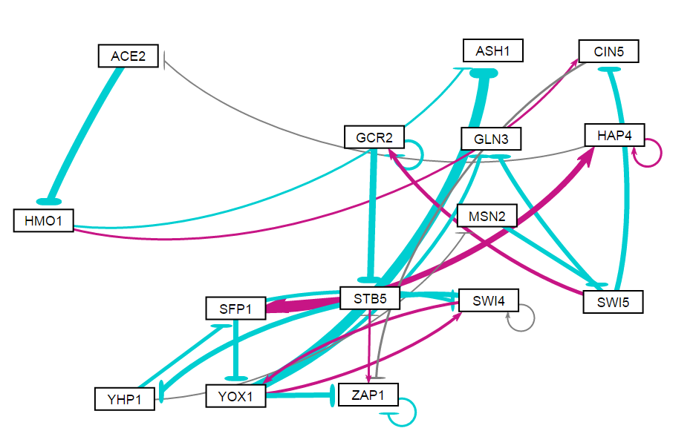
Random 8

Slide 17
id | indegree | outdegree | degree | weighted indegree | weighted outdegree | weighted degree | eccentricity | closnesscentrality | harmonicclosnesscentrality | betweenesscentrality | modularity_class | pageranks | strongcompnum | clustering | eigencentrality
ACE2 | 1 | 1 | 2 | -0.08287 | -3.31993 | -3.4028 | 10 | 0.184211 | 0.27894 | 27 | 0 | 0.043505 | 2 | 0 | 0.166014
ASH1 | 2 | 0 | 2 | -5.3168 | 0 | -5.3168 | 0 | 0 | 0 | 0 | 3 | 0.049596 | 1 | 0 | 0.277455
CIN5 | 2 | 1 | 3 | -1.9592 | -0.231 | -2.1902 | 8 | 0.215385 | 0.284609 | 35 | 3 | 0.048584 | 2 | 0 | 0.089459
GCR2 | 2 | 2 | 4 | 0.281466 | -4.14395 | -3.86249 | 6 | 0.269231 | 0.338095 | 19.5 | 1 | 0.046021 | 2 | 0.333333 | 0.125521
GLN3 | 2 | 0 | 2 | -2.78242 | 0 | -2.78242 | 0 | 0 | 0 | 0 | 2 | 0.038956 | 0 | 0 | 0.270544
HAP4 | 2 | 2 | 4 | 2.880725 | 0.254367 | 3.135092 | 11 | 0.166667 | 0.258648 | 25 | 5 | 0.066991 | 2 | 0.333333 | 0.348401
HMO1 | 1 | 2 | 3 | -3.31993 | 0.036156 | -3.28378 | 9 | 0.205882 | 0.325879 | 29 | 3 | 0.052011 | 2 | 0 | 0.083488
MSN2 | 1 | 1 | 2 | -0.07782 | -1.77028 | -1.8481 | 7 | 0.245614 | 0.332823 | 25 | 4 | 0.029976 | 2 | 0 | 0.146744
SFP1 | 2 | 3 | 5 | 2.262438 | -0.73132 | 1.531117 | 5 | 0.4 | 0.514286 | 99 | 5 | 0.082868 | 2 | 0.15 | 0.399528
STB5 | 2 | 2 | 4 | -3.20411 | 4.052939 | 0.848825 | 6 | 0.318182 | 0.421429 | 84 | 5 | 0.124453 | 2 | 0 | 0.539981
SWI4 | 3 | 3 | 6 | -0.19919 | -1.44498 | -1.64417 | 5 | 0.368421 | 0.460714 | 41 | 6 | 0.071149 | 2 | 0.5 | 0.741632
SWI5 | 1 | 3 | 4 | -1.77028 | -2.42405 | -4.19433 | 6 | 0.285714 | 0.429762 | 27 | 1 | 0.040491 | 2 | 0 | 0.06996
YHP1 | 1 | 2 | 3 | -2.29336 | -1.2381 | -3.53145 | 4 | 0.388889 | 0.464286 | 38 | 4 | 0.035188 | 2 | 0.166667 | 0.329975
YOX1 | 2 | 4 | 6 | -1.25704 | -7.64585 | -8.9029 | 6 | 0.325581 | 0.495238 | 24 | 6 | 0.058674 | 2 | 0.05 | 0.512362
ZAP1 | 4 | 2 | 6 | -2.49429 | -0.72667 | -3.22096 | 7 | 0.245614 | 0.312585 | 48.5 | 3 | 0.211538 | 2 | 0.333333 | 1

