Slide 1
Unit 3
Recombinant DNA Technology II and Forensics

Slide 2
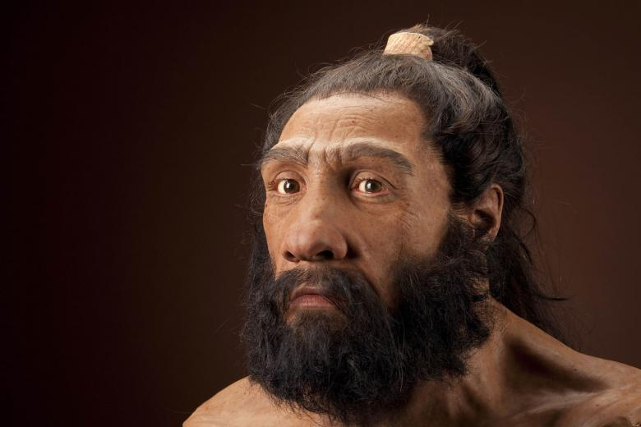
Lesson 1
Computer Webquest: Neanderthal Genome
Research the Smithsonian Genetics website.
http://humanorigins.si.edu/evidence/genetics/ancient-dna-and-neanderthals
Respond to questions
Whole class discussion about DNA sequences used and types of biotechnology procedures used in DNA identification.

Slide 3
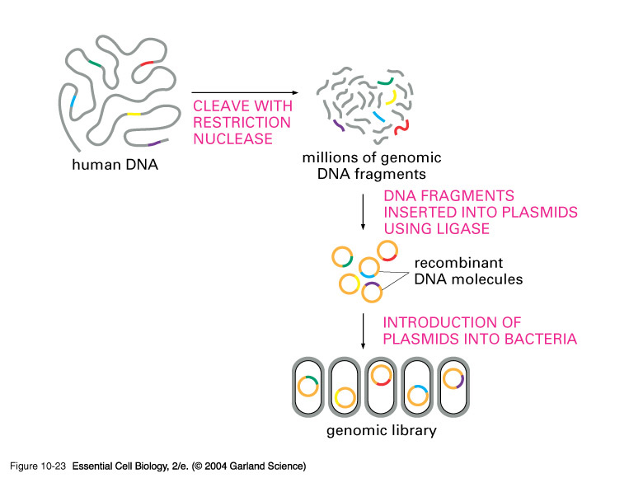
Lesson 2
Lecture: Identification of clones of interest
Lecture- genomic, cDNA, and expression libraries and how to use them.

Slide 4
DNA Library
http://www.pbslearningmedia.org/resource/biot09.sci.life.gen.dnalibraries/dna-libraries/?utm_source=teachersdomain_redirect%2Fresource%2Fbiot09.sci.life.gen.dnalibraries%2Futm_medium%3Dteachersdomain%2Fresource%2Fbiot09.sci.life.gen.dnalibraries%2Futm_campaign%3Dtd_redirects

Slide 5
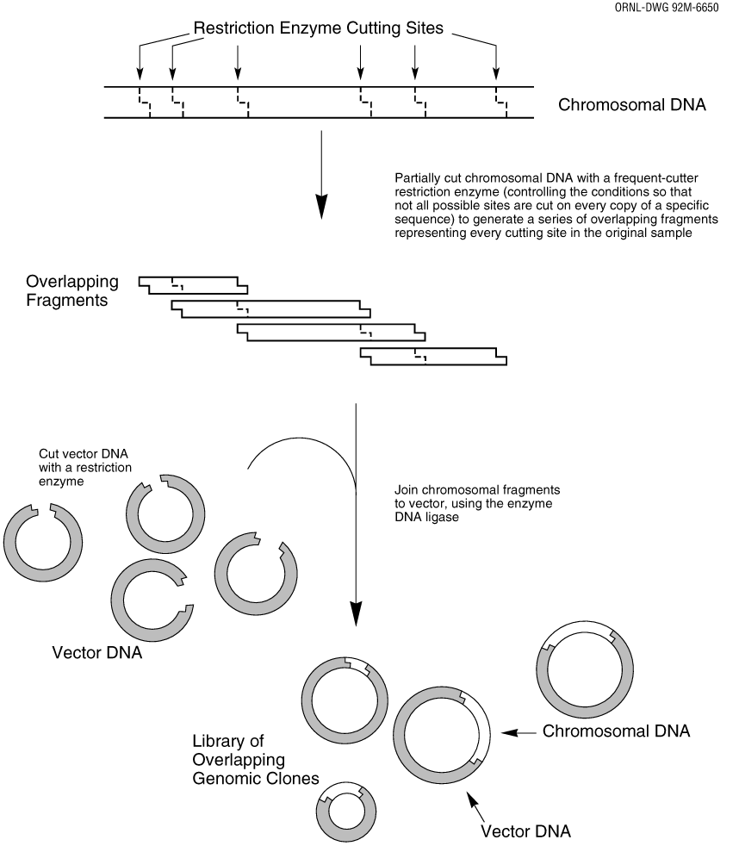
DNA Library
A DNA library is a collection of DNA fragments that have been cloned into vectors so that researchers can identify and isolate the DNA fragments that interest them for further study.
There are 2 types of DNA Libraries
Genomic Library
cDNA Library

Slide 6
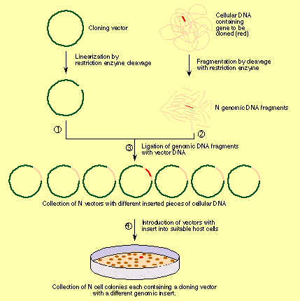
DNA Library
Genomic Library
Genomic library contains DNA fragments that represent the entire genome of an organism.
DNA is isolated from an organism.
DNA is cut with the same restriction enzyme so the vector is linearized and the ends are complimentary to those of the genomic DNA fragments.
Genomic fragments and vector are mixed with DNA ligase..
Vectors are usually plasmids but can be bacteriophages or cosmids.
Recombinant DNA is formed.

Slide 7
DNA Library
Genomic Library
Recombinant DNA is inserted into E.coli.
One plasmid( one DNA fragment) is inserted into one cell.
Can plate and grow bacterial cells; each colony has one different DNA fragment.
Several clones are needed to represent the entire genome.
Can then store organisms.
http://www.sumanasinc.com/webcontent/animations/content/dnalibrary.html

Slide 8
Review Genomic Library
Genomic Library
What does a genomic library contain?
After DNA is isolated from an organism, what occurs?
What enzyme is used to bind together the DNA of interest with the vector?
What types of vectors are used in DNA libraries?
What is recombinant DNA?
Although it is not mentioned on the PowerPoint, what procedure is used to insert the vector into E.coli?
What does each colony represent when the bacteria is grown?

Slide 9
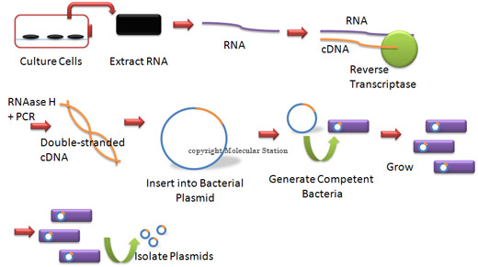
DNA Library
cDNA library
cDNA library is a library of actively expressed genes.
mRNA is isolated from a tissue of interest.
mRNA cannot be cut directly with restriction enzymes.
Reverse transcriptase is used to catalyze a complimentary DNA strand (cDNA).
mRNA is degraded by enzymes.

Slide 10
DNA Library
cDNA Library
DNA polymerase use to construct second DNA strand.
DNA linkers (restriction sites) are added to the DNA strands so they can bind to the vector.
DNA strand is mixed with a vector; most often a plasmid.
Plasmids are transferred to bacterial cells as with genomic libraries.
http://www.youtube.com/watch?v=SvjeCxVu2
Link not working: Type in Google youtube cDNA library

Slide 11
Review cDNA Library
cDNA Library
How is a cDNA library different from a genomic library?
What is the first step in this process?
To create a complimentary DNA strand to the mRNA, what enzyme is used?
What is the function of DNA polymerase in this procedure?
Why are DNA linkers added?

Slide 12
DNA Library
Genomic vs. cDNA
Genomic libraries are preferred if a biotechnologist’s interest are entire genomes.
Genomic libraries contain exons and introns.
__________________________________
cDNA libraries are preferred if the biotechnologist’s interest are expressed genes because bacteria cannot remove introns from DNA.
_____________________________________
Today, companies manufacture DNA libraries made from different tissues in a wide variety of organisms.

Slide 13
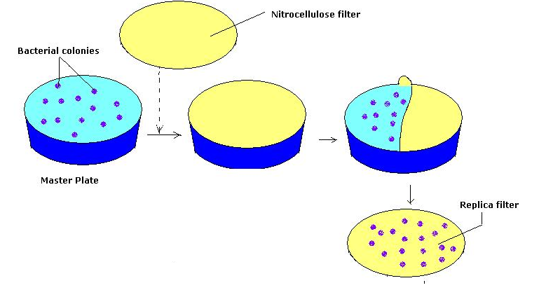
DNA Library
Screening Library
Colony hybridization is most common method of screening libraries.
Bacterial colonies are plated on a numbered agar plate. One number = one plasmid type.
A membrane is placed over the cells and some cells attach to the membrane.

Slide 14
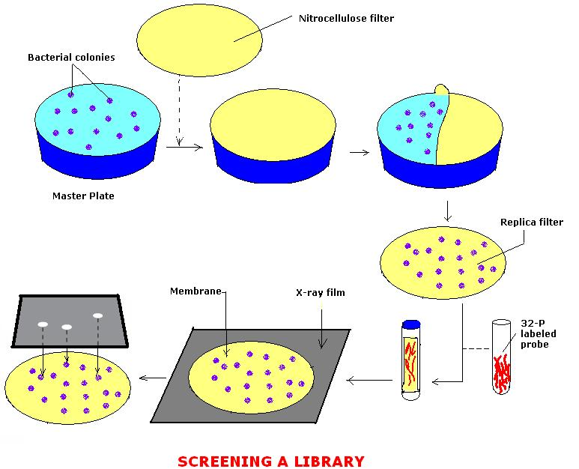
DNA Library
Screening Library
The membranes are treated to lyse bacterial cells and remove debris.
DNA is denatured into single strands and is still bound to membrane.
A probe, a complimentary single strand of DNA is introduced. It is tagged with a radioactive or flourescent dye.
The membrane is incubated and the probe and DNA of interest bond; called hybridization

Slide 15
DNA Library
Screening Library
Membrane is washed to remove unused excess probe.
Photographic film is used in an imaging technique called autoradiography.
Anywhere the probe is bound to the filter, silver grains appear on the film
The film is compared to the original numbered agar plate and those colonies can be isolated and grown on a larger scale for DNA study.

Slide 16
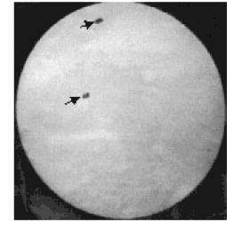
DNA Library
http://www.sinauer.com/cooper5e/animation0412.html
Screening Hybridization Technique

Slide 17
DNA Library
Probes
The type of probe used depends on what is already known about a gene of interest.
Sometimes, a gene cloned from another species such as a rat or mouse is used as a probe for eukaryotic cells.
The probe must be sufficiently complimentary to the DNA sequence of interest for hybridization to occur. So closely matching DNA can bind to the DNA of interest.
The specificity (called stringency) depends on the needs of the investigator.

Slide 18
Review Screening Library
Screening Libraries
What is the most common method of screening DNA libraries.
How are the bacteria plated?
Why are membranes used?
Explain the how the DNA on the membrane is identified? (Start with denaturing of DNA and end with the autoradiographic procedure

Slide 19
DNA Library
Expression Library
Expression libraries contain expression vectors.
Usually the ultimate aim of expression cloning is to produce large quantities of specific proteins.
A gene of interest is inserted in a plasmid next to a bacterial promoter region.
Proteins can then be made by the E.coli with the expression plasmid.
Many commercial products such as insulin and blood clotting factors are manufactured using bacteria from expression libraries.

Slide 20
Review Expression Library
Expression Libraries
What is an expression vector? (unit 2)
Who do you imagine would use an expression library?

Slide 21
Lesson 3 - What is Wolbachia?
Wolbacchia Webquest and Powerpoint Presentation
Research the websites provided in your handouts and respond to the questions.
Create a Powerpoint about Wolbacchia and related topics.
Present your Powerpoint to the class.

Slide 22
Lesson 4- What is the Wolbachia Project?
Movie: Introduction to the Wolbachia Project.
http://discover.mbl.edu/labs.htm
http://www.youtube.com/watch?v=RP9xSQo0_-Q
From here, we will be using this Power point and those found at the URL above.
We will be learning biotechnology procedures that are used in forensics in the context of completing the Wolbachia Project.
DNA Extraction – to recover the DNA
PCR – to amplify copies of DNA
Gel Electrophoresis – to identify DNA fragments
DNA Sequencing – to identify DNA sequence in genes of interest (or to identify unknown DNA)

Slide 23
Lesson 5 Wolbachia Project
Insect Identification Lab
You will conduct field work to collect insects from local fauna, appreciate the ubiquity of symbiotic microbes in animals, understand how to use a taxonomic key to identify insects to Order, sort insects into “morphospecies” – similar looking species-, and prepare lab notes and specimens for molecular studies.
http://discover.mbl.edu/labs.htm

Slide 24
Lesson 6 DNA Extraction
Powerpoint and discussion DNA extraction.
DNA Extraction Lab- Wolbachia Project
You will isolate total genomic DNA from morphospecies identified in the Insect Identification Lab. http://discover.mbl.edu/labs.htm

Slide 25
DNA Extraction- Wolbachia Project
The extraction of total genomic DNA involves three distinct steps:
1. Cell Lysis: Begin by blotting the ethanol away from their insect specimens and then macerating them in a cell lysis solution (Buffer ATL). This basically breaks open cell and nuclear membranes. The dilemma here is that it also exposes DNA to proteins in the insect tissue. Therefore, the enzyme Proteinase K must be added to denature the proteins and keep the DNA intact. Finally, add ethanol to precipitate the DNA.

Slide 26
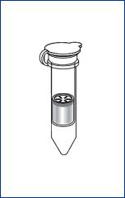
DNA Extraction-Wolbachia Project
2. Elimination of Cellular Debris: Once you have destroyed the hydrolytic enzymes and precipitated DNA, you will begin the DNA purification process. In essence you will place the cellular components, including DNA, into a spin column and wash the spin column of all components except DNA. Upon centrifugation the material will pass through the filter, which attracts DNA and allows debris to pass through. This will be followed by two wash steps with two buffers (AW1 and AW2).

Slide 27
DNA Extraction-Wolbachia Project
3. DNA Elution: You will complete the activity by removing the DNA from the filter. This is done by adding the elution buffer (AE). Spinning the tube with the DNA embedded in the filter will pull the elution buffer through the matrix, thus pulling the DNA into the collection tube.

Slide 28
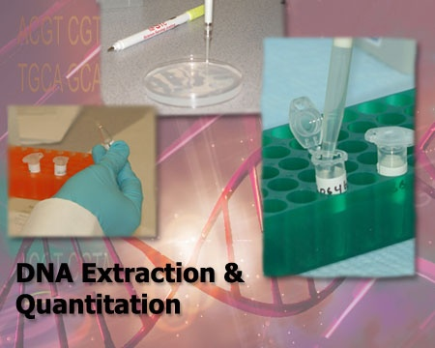
DNA Extraction
http://learn.genetics.utah.edu/content/labs/extraction/
Virtual Lab for DNA Extraction

Slide 29
Review DNA Extraction
What are the 3 major step for DNA extraction?
What is the function of ATL buffer?
What is the function of Proteinase K?
How is cellular debris eliminated?
What is the function of the elution buffer?

Slide 30
Lesson 7 PCR
Powerpoint and discussion PCR
PCR Lab – Wolbachia Project
In this activity, you will learn what Polymerase Chain Reaction (PCR) does, how it works, and why it is useful to research in the biological sciences.
You will use PCR to make many copies of Wolbachia DNA (if present) and arthropod DNA from the extracted DNA of the three morphospecies and controls.
The piece of DNA used for identifying Wolbachia is a region that codes for a small subunit of the ribosomal RNA (16S rRNA) that is unique to Wolbachia.
The piece of DNA used for identifying athropod DNA is a region that codes for the cytochrome oxidase I protein in animal mitochondria (CO1).
http://discover.mbl.edu/labs.htm

Slide 31
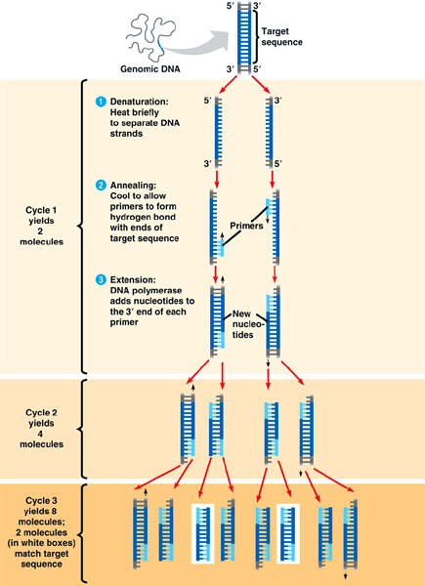
PCR
PCR background
Polymerase Chain Reaction (PCR) is a rapid technique to clone specific DNA fragments.
The technique revolutionized biotechnology with its many applications.
Among these applications are its use in forensics testing as well as a replacement for DNA libraries as it is much faster than building a screening a library.

Slide 32
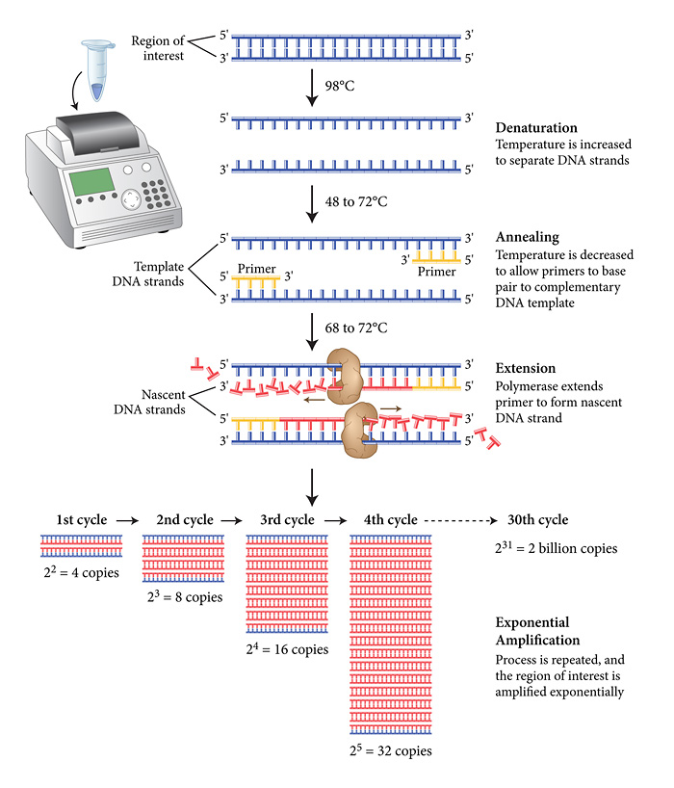

Slide 33
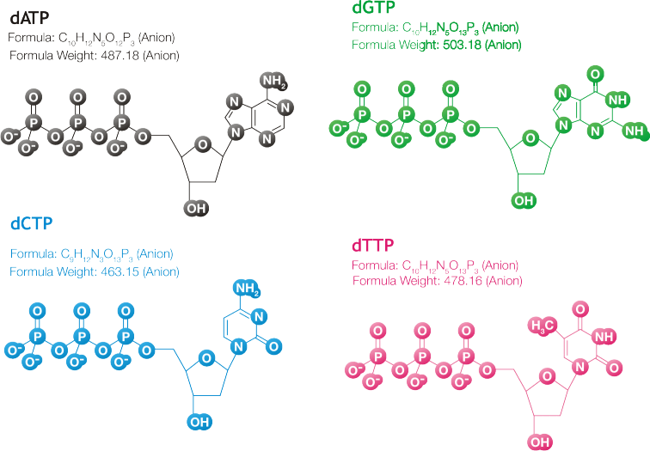
PCR
PCR Technique
Target DNA is put into a PCR test tube.
DNA is mixed with DNA polymerase, deoxyribonucleotides (dATP, dGTP, dCTP and dTTP) and buffer.
A pair of primers (short single stranded DNA nucleotides) is added. The primers are complimentary to nucleotides on the ends of the DNA.

Slide 34
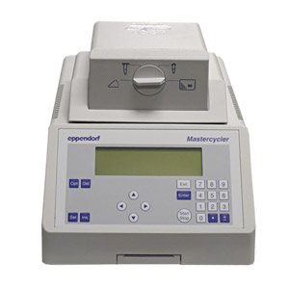
PCR
The test tube is placed in a thermocycler, a sophisticated heating block capable of changing temperatures over short time periods.
The thermocycler takes the sample through a series of reactions called the PCR cycle

Slide 35
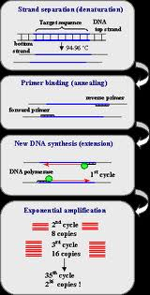
PCR
Each PCR cycle has 3 stages:
Denaturation- Sample is heated to 94-96 degrees C. This causes the DNA to separate into single strands.
Hybridization – Sample is cooled to 55-65 degrees C. This allows the primers to hydrogen bond to complimentary bases at opposite end of the target sequence.

Slide 36
PCR
Extension – Sample is heated to 70-75 degrees C. The DNA polymerase copies the target sequences by binding the nucleotides to the 3’ end of each primer.
At the end of one cycle, the amount of DNA has doubled.
Researchers usually run 20-30 cyles of PCR.
After 20 cycles, there are about 1 million copies of target DNA

Slide 37
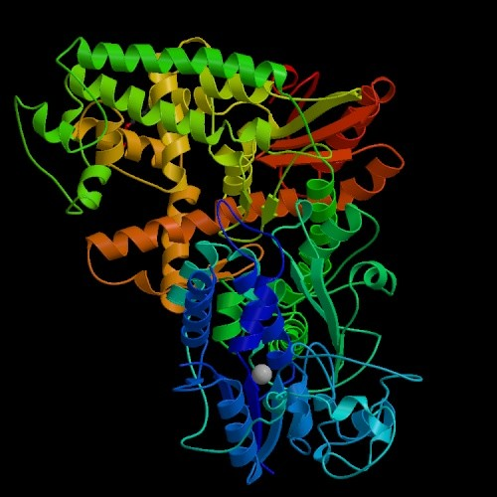
PCR
One of the keys to PCR is the type of DNA polymerase used.
Most DNA polymerase would denature in the heating and cooling process of PCR.
Taq DNA polymerase is used in PCR.
It is isolated from Thermus aquaticus, an Archaea species that thrives in the hot springs of Yellowstone National Park.
Taq is stable at high temperatures.

Slide 38
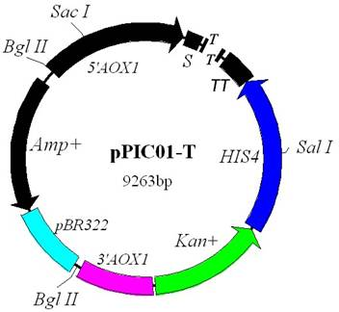
PCR
Cloning PCR products
If you wish to clone a gene made by PCR:
Thermostable polymerases like Taq add a single adenine nucleotide to the 3’ end of all PCR products (It’s a quirk).
PCR products can be ligated to T vectors which are plasmids that have a single stranded thymine nucleotide at each end.
Once ligated, the recombinant plasmid can be introduced into a bacteria.

Slide 39
PCR
http://highered.mcgraw-hill.com/sites/0072556781/student_view0/chapter14/animation_quiz_6.html
PCR animation

Slide 40
PCR Review
What is PCR?
At the start of PCR, what is mixed with the DNA?
Explain denaturation.
Explain hybridization (annealing).
Explain extension.
How many DNA copies can be made after 20 PCR cycles?

Slide 41
Lesson 8 Gel Electrophoresis
Review of Gel Electrophoresis
Gel Electrophoresis – Wolbachia Project
In this activity you will learn how DNA samples separate based upon different sizes and learn how to stain and visualize DNA samples. We will be using agarose gel electrophoresis to determine the presence and size of two different gene fragments (mitochondrial Cytochrome Oxidase I, and Wolbachia 16S rDNA) amplified by our PCR. http://discover.mbl.edu/labs.htm

Slide 42
Gel Electrophoresis
If you need a refresher on gel electrophoresis:
http://learn.genetics.utah.edu/content/labs/gel/

Slide 43
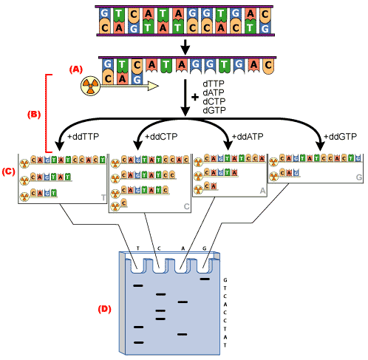
DNA Sequencing
Today, laboratories routinely sequence the order of nucleotides in DNA. DNA sequencing is done to:
Confirm the identity of genes isolated by hybridization or amplified by PCR.
Determine the DNA sequence of promoters and other regulatory sequences.
Reveal the fine structure of genes and other DNA.
Confirm the sequence of cDNA.
Deduce amino acid sequences.
Identify mutations.

Slide 44
Lesson 9- DNA Sequencing
Powerpoint and discussion of Sanger method.
Simulation of Sanger method activity.
Powerpoint and discussion of automated DNA sequencing.

Slide 45
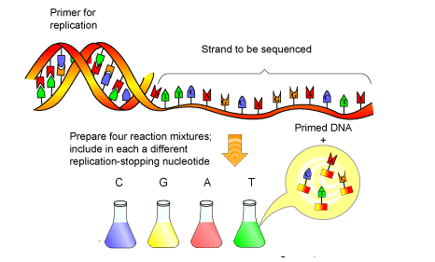
DNA Sequencing
Among the first sequencing technique used was the Sanger method.
Original Sanger method
Four separate reaction tubes are set up.
Each tube contained identical DNA of interest, a radioactively labeled primer to get DNA synthesis started, deoxyribonucleotide phosphate to be used in DNA synthesis (dNTP), and a small amount of dideoxyribonucleotide phosphate (ddNTP), and DNA polymerase.

Slide 46
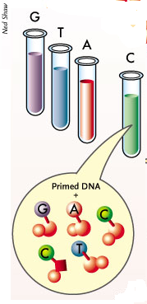
DNA Sequencing
All four test tubes have each of the four nucleotide bases (dNTP) but each one of the tubes will also have one radioactively labeled (ddNTP).
Example
"G" tube: all four dNTP's, ddGTP , DNA polymerase, and primer
"A" tube: all four dNTP's, ddATP , DNA polymerase aqnd primer
"T" tube: all four dNTP's, ddTTP, DNA polymerase and primer
"C" tube: all four dNTP's, ddCTP , DNA polymerase, and primer

Slide 47
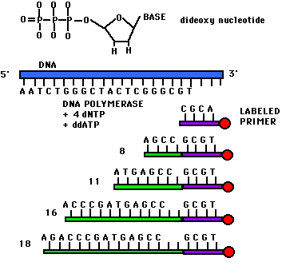
DNA Sequencing
Sanger Method
DNA strands are separated.
The radioactive primer binds to the 3’ end of the fragment.
DNA polymerase synthesizes a complimentary DNA sequence.
Every time a specific ddNTP is used in the complimentary strand, the DNA synthesis halts.
This creates fragments of different lengths.
EX: On the right are the contents of the “A” tube. It has ddATP in it.
The ddATP is used. Where the termination process ends with the ddATP is random in the tube. So you generate fragments of different lengths because every possible A site has incorporated ddATP

Slide 48
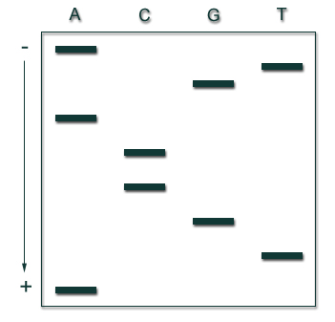
DNA Sequencing
Sanger Method
The same process that occurred in the A tube occurs in the C, G, and T tube.
The DNA from each tube is run in gel electrophoresis. The banding pattern allows you to sequence the DNA.
The sequence on the right is
ATGCCAGTA.
How do you figure this out?

Slide 49
DNA Sequencing
http://highered.mcgraw-hill.com/sites/0072556781/student_view0/chapter15/animation_quiz_1.html
http://www.dnalc.org/resources/animations/sangerseq.html
Sanger Method

Slide 50
Sanger Method Review
How many reaction tubes are used?
What is added to each reaction tube?
Using ddATP, explain the Sanger method.
Explain how gel electrophoresis enables the determination of DNA sequence.

Slide 51
DNA Sequencing
Computer Automated Sequencing.
The original Sanger Method could sequence only 200-400 nucleotides in a single reaction.
To run a sequence of 1,000 nucleotides, 2 reactions were required and the pieces of DNA had to be overlapped.
Sanger is a cumbersome method for large scale sequencing.
Automated sequencing today allow us to sequence 1 billion base pairs per reaction

Slide 52
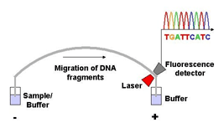
DNA Sequencing
Second generation- automated sequencing used a modified Sanger method with laser detection.
ddNTPs, dNTPs, primers, DNA polymerase, and the DNA of interest were mixed in a single reaction tube. However the ddNTPs and primer were labelled with a fluorescent dye.
Instead of gel electrophoresis, the reaction products were put into a single lane tube of gel called a capillary gel.
As DNA fragments move through the gel, they are scanned by a laser.
The laser emits a different wavelength for different ddNTPs.
Wavelength patterns are fed to a computer which processes the DNA sequence.
This process sequenced 500 base pairs/reaction.

Slide 53
DNA Sequencing
http://www.ilrn.com/ilrn/books/vbmb03c/sequencer_v2.html
Second Generation- Automated Sequencing

Slide 54
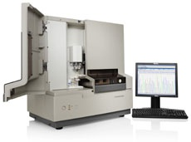
DNA Sequencing
Third generation – Automated Sequencing
There is a demand for DNA sequencers that fast and reliable.
Next Generation Sequencing (NGS) can sequence at least a billion base pairs/reaction.
With personalized medicine (genomics) as the wave of the future, the $1,000 genome has led to a race among companies to produce NGS methods.

Slide 55
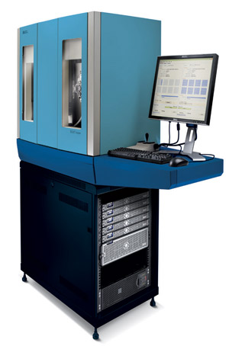
DNA Sequencing
There are a variety of techniques in use or being explored.
Pyrosequencing – Uses DNA on a bead to sequence complimentary DNA strands.
SOLID – Supported oligonucleotide ligation and detection which generates 6 billion base pairs/reaction.
http://www.youtube.com/watch?v=nlvyF8bFDwM&feature=related
Nanotechnology – to sequence DNA without fluorescent tags.

Slide 56
DNA Sequencing
How have second and third generation sequencers improved DNA sequencing?
Provide examples in your explanation.

Slide 57
Lesson 10 Bioinformatics
Power point and discussion Bioinformatics
BLAST activity (Bioinformatics) –Wolbachia Project
http://discover.mbl.edu/labs.htm

Slide 58
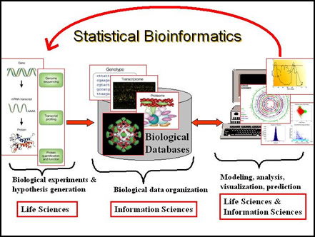
Bioinformatics
Bioinformatics – is a new discipline in science that incorporates biology, computer science, and information technology.
With the generation of large quantities of DNA sequence data, there is a need for computerized databases to organize, catalog, and store sequence data.
Bioinformatics provides the tools to help make sense of nucleic acid and protein sequences.

Slide 59
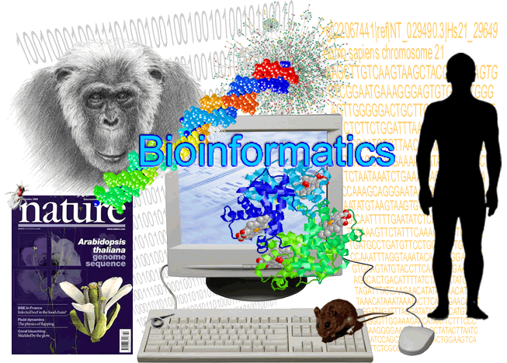
Bioinformatics
Goals of bioinformatics
Develop tools to allow for efficient access and management of databases.
Analyze and make sense of a large amount of DNA and proteins sequences; ex. Gene identification, predict protein structure and function, and conduct evolutionary analyses.
Develop new programs for the utilization and manipulation of data.

Slide 60
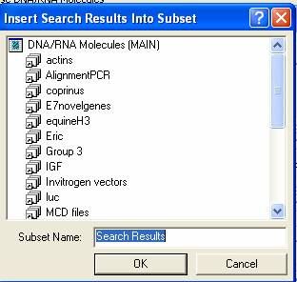
Bioinformatics
Gene Identification Search
If a scientist has cloned a gene with recombinant DNA technology, they enter the gene sequence into a database.
The new sequence is compared to all other sequences in the database.
The database creates an alignment of similar nucleotide sequences if a match is found.
This type of search is often one of the first steps taken when a scientist clones a gene.

Slide 61
Bioinformatics
Many different databases exist and can:
Retrieve DNA/protein sequences.
Search for similar DNA/protein sequences.
Sequence alignment for comparison.
Predict RNA structure.
Classify proteins
Analyze evolutionary relationships.
Find open reading frames, promoters, and special sequences.

Slide 62
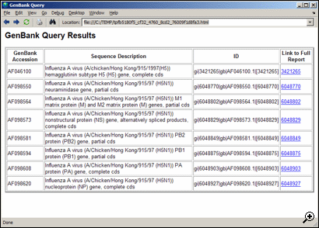
Bioinformatics
One of the most widely used DNA sequence databases if called GenBank.
GenBank contains the National Institutes of Health (NCBI) collection of DNA sequences.
GenBank shares data with Europe and Japan.
It has 100 billion bases of sequence data from over 100,000 species.

Slide 63
Bioinformatics
An example of an NCBI program is called Basic Alignment Search Tool. (BLAST).
BLAST can be used to search GenBank for sequence matches between cloned genes and to create new DNA sequence alignments.
We will visit the BLAST website:
http://www.ncbi.nlm.nih.gov/
To show the ways in which the NCBI online database classifies and organizes information on DNA sequences, evolutionary relationships, and scientific publications.
To identify an unknown nucleotide sequence from an insect endosymbiont by using the NCBI search tool BLAST

Slide 64
Bioinformatics Review
What is bioinformatics?
What are the goals of bioinformatics?
Describe a gene identification search.
What service does GenBank offer to biotechnologists?
What is BLAST?

Slide 65
Lesson 11- Human Genome Project
Powerpoint and discussion Human Genome Project.
Write one paragraph about the current status of the Human Genome Project
Group Discussion
Focus discussion question – “Who should have access to personal genetic information and how will it be used?”
Scenario: You are applying for a life insurance policy and have been denied because you have a disposition for a genetic disease.
1. Work in Groups of 4 and discuss options.
2. Visit this website: http://www.ornl.gov/sci/techresources/Human_Genome/elsi/elsi.shtml
3. Whole class discussion of focus question.

Slide 66
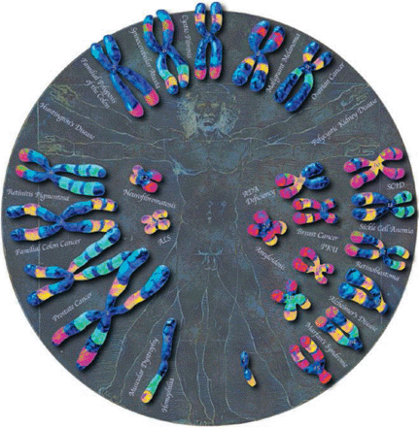
Human Genome Project
Initiated in 1990, the Human Genome Project was an international collaborative plan to:
Sequence the entire human genome
Analyze genetic variations among humans.
Map and sequence the genomes of model organisms ,including bacteria, yeast, roundworms, fruit flies, mice, and others.
Develop new laboratory technologies such as automated sequencers and computer databases.
Disseminate genome information among scientists and the general public.
Consider the ethical, legal, and social issues that accompany the HGP and genetic research.

Slide 67
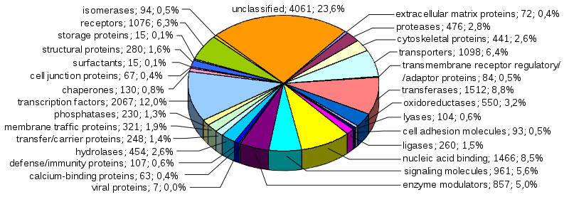
Human Genome Project
On April 14, 2003, the International Human Genome Sequencing Consortium announced they had a map of the human genome.

Slide 68
Human Genome Project
How did they sequence the human genome?
They used a method called whole genome “shotgun” sequencing for constructing sequences of whole chromosomes.
Using restriction enzymes, an entire chromosome is digested into pieces.
This produces thousands of overlapping fragments call contiguous sequences (contigs).
Each contig is sequenced and then computer programs are used to align fragments with overlapping sequences.
http://bcs.whfreeman.com/thelifewire/content/chp17/1702002.html

Slide 69
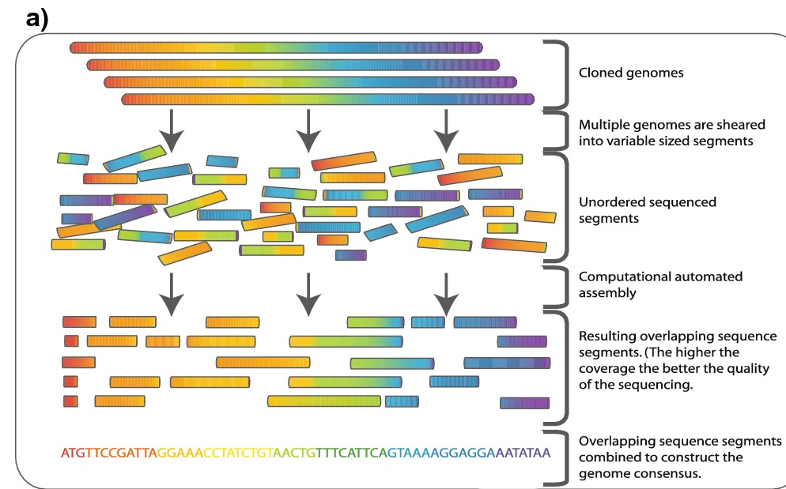
Human Genome Project
Shotgun Sequencing

Slide 70
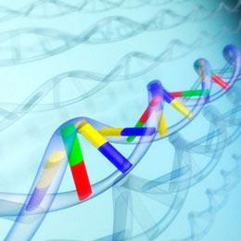
Human Genome Project
What did we learn from the Human Genome?
The human genome consist of about 3.1 billion base pairs.
The genome is 99.9% the same among all humans.
Single nucleotide polymorphisms (SNPs) account for the genomic diversity among humans.
Less that 2% of the total genome codes for protein.
Vast majority of genome is non-protein coding with 50% of it being repetitive DNA sequences

Slide 71
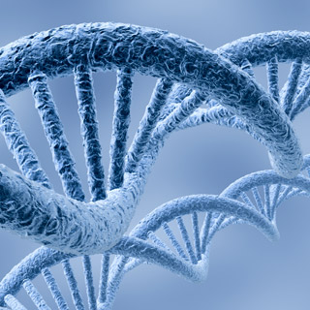
Human Genome Project
What did we learn from the Human Genome?
The genome has approximately 20,000 coding genes.
Many genes make more than one protein; 20,000 genes make 100,000 proteins.
Functions of one half of all human genes is unknown.
Chromosome 1 has the highest number of . The Y chromosome has the least.
Many of the genes in the human chromosome show a high degree of similarity to genes in other organisms.
Thousands of human diseases have been identified and mapped to their chromosomal locations.

Slide 72
Human Genome Project
Omics Revolution
The Human Genome Project and genomics ( study of genomes) are responsible for a new era of biological research – the “omics”.
Proteonomics – study of all proteins in a cell.
Metabolomics – study of proteins and enzymes involved in cell metabolism.
Glycomics- study of carbohydrates in a cell.
Transcriptomics – study of all genes expressed in a cell.
Pharmocogenomics – customized medicine based on a persons genetic profile for a particular disease

Slide 73
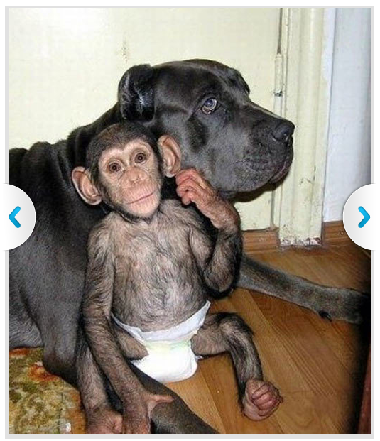
Human Genome Project
Comparative Genomics
Human Genome Project mapped genomes of model organisms; bacteria, yeast, round worms, fruit fly, plants, and mouse.
This has enabled researchers to study genes in model organisms and compare them to gene function in other species, including humans.
Comparative genomic analysis has shown we share 75% of our DNA with dogs; 30% with yeast; 80% with mice and 95% with chimps.
Two genomic projects underway:
Genome 10k Plan- sequencing of 10,000 vertebrates around the world.
Human Microbiome Project – sequencing of 100s of microbes.

Slide 74
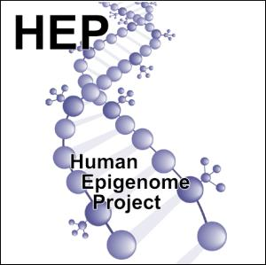
Human Genome Project
What is next?
Studies on the human genome are proceeding at a rapid pace.
Other areas of genome research to emerge:
Human Epigenome Project – is creating hundreds of maps of epigentic changes in different cell and tissue types and evaluating the potential role of epigenetics in complex diseases.
http://www.epigenome.org/

Slide 75
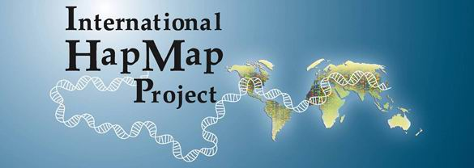

Human Genome Project
What is next?
International HapMap Project – Characterizes SNPS and their role in genome variation, in diseases, and in pharmocogenomic applications
http://hapmap.ncbi.nlm.nih.gov/abouthapmap.html
ENCODE, Encyclopedia of DNA Elements Project – Analyzing functional elements such as transcriptional start sites, promoters and enhancers.
https://www.genome.gov/10005107

Slide 76
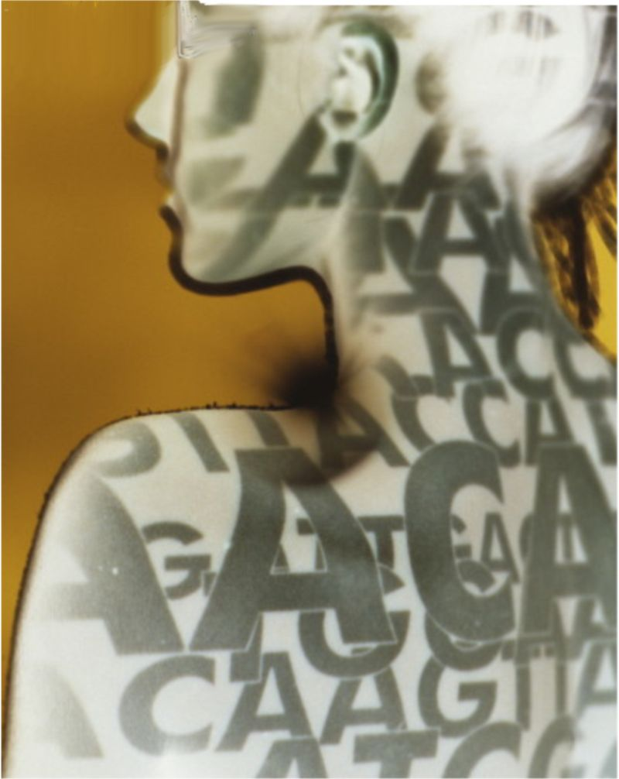
Human Genome Project
What is next?
Personalized Genome Projects
In 2006, the X prize Foundation announced the Archon X Prize for genomics, a project to award $10 million to the first group that could develop technology to sequence 100 human genomes in 10 days.
Other groups are working on sequencing a human genome for $1,000.
This is evidence that human genome readouts will eventually be affordable for individuals.

Slide 77

Human Genome Project
What is next?
Personal Genomics
James Watson’s genome has been sequenced. He has made his genome available to researchers except for his ApoE gene because it has mutations indicating a disposition for Alzheimer’s disease.
George Church and colleagues at Harvard have started the Personal Genome Project. They have recruited volunteers to provide DNA for individual genome sequencing with the understanding that the genomes will be made public. http://www.personalgenomes.org/

Slide 78
Human Genome Project
Cancer Genome Projects
The NIH has a cancer genome project called the Cancer Genome Atlas Project.
They have sequenced over 100 partial genomes for various cancers.
It is expected that key genes involved in tumor formation and metastasis will lead to improvements ins detection and treatment of cancer.
http://cancergenome.nih.gov/

Slide 79
Review Human Genome Project
What was the Human Genome Project designed to accomplish?
What was the role of Celera in the Human Genome Project?
Summarize what we have learned from the Human Genome Project.
Define the following:
Proteomics, Metabolomics, Glycomics, Transcriptomics, Metagenomics, Pharmacogenomics, Nutrigenomics
What is comparative genomics? Provide a scientific example of a comparative genomic analysis.
What is paleogenomics? Provide a scientific example of paleogenomics.
Name 3 projects that have grown out of the Human Genome Project and describe what they are accomplishing.
What is personalized genomics? Describe the Personal Genome Project.
What has the Cancer Genome Project accomplished?

