Slide 1
Tissue Engineering
Lecture 18
Paper Review
4-12-16

Slide 2
Introduction, Motivation
The kidney is very complex with more than 20 distinct cell types required for minimal function.
The kidney’s key functions are regulation of blood pH, electrolyte balance, excretion of urea, and water balance.
Previous studies (including by these authors) has shown they can differentiate kidney progenitors from human pluripotent stem cells (hPSCs).
They are going to put them together now to see if they can make rudimentary kidney organoids from stem cells.

Slide 3
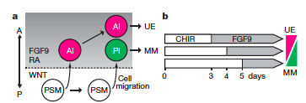
Figure 1a-b: Gladys Saruchera

Slide 4
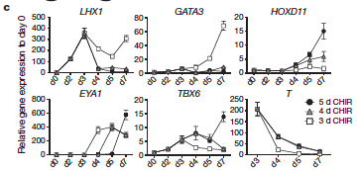
Figure 1c: Jack LaBelle

Slide 5
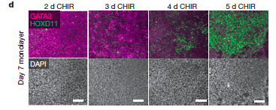
Figure 1d: Brandon Morgan

Slide 6
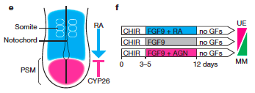
Figure 1e-f: Matt Long

Slide 7
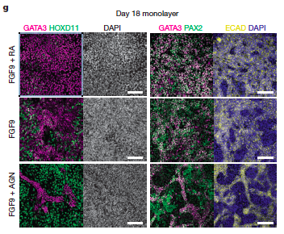
Figure 1g: Jon Velez

Slide 8
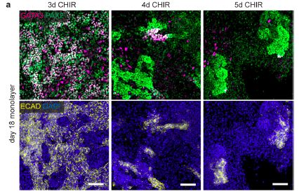
Extended data 1: Andrew Mason

Slide 9
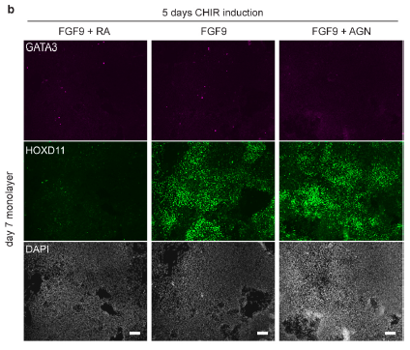
Extended data 1: Andrew Mason

Slide 10
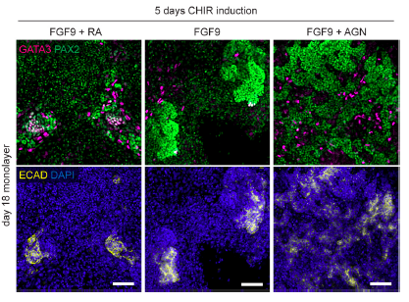
Extended data 1: Andrew Mason

Slide 11
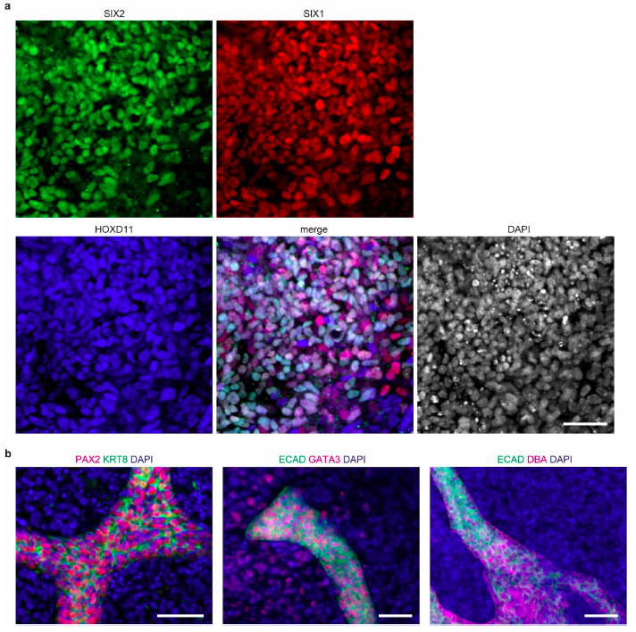
Extended Data 2: Steve Ayotte

Slide 12
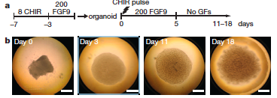
Figure 2a-b: Cory Thomas

Slide 13
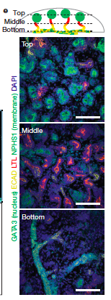
Figure 2e: Brian Cain

Slide 14
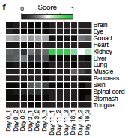
Figure 2f: Mark Pagkaliwangan

Slide 15
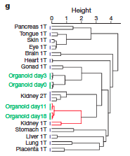
Figure 2g: Charit Tippareddy

Slide 16
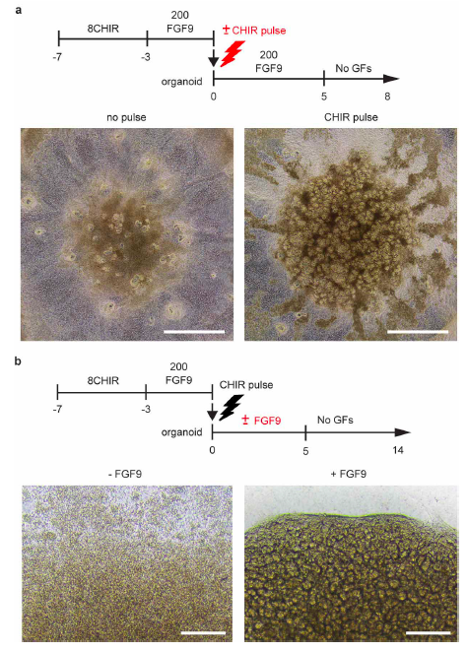
Extended data 3: Jake Kellett

Slide 17
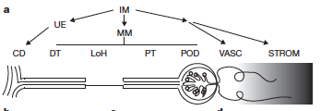
Figure 3a: Jason Ballenas

Slide 18
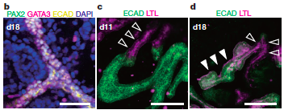
Figure 3b-d: Vinny Lue

Slide 19
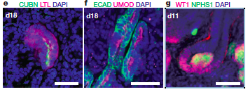
Figure 3e-g: Sydney Phillipo

Slide 20
Figure 3 h-j: Colton Kenny

Slide 21
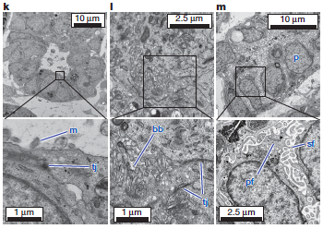
Figure 3k-m: Tom McCarthy

Slide 22
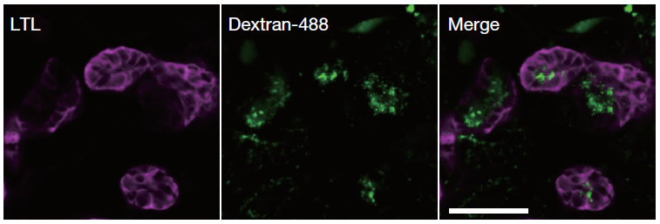
Figure 4a: Md Shafiul Hossain
The selective uptake of dextran-Alexa488 from the media by LTL+ tubules after 24 h of exposure (endocytosis)
Organoids at day 17 were cultured with $10 μg ml^{−1}$ of 10,000 MW dextran Alexa488-conjugated for 24 h
$Scale bar, 50 μm$
Biotinylated Lotus tetragonobolus lectin (stain); LTL+ : early proximal tubule
  Lectin are class of proteins that bind specifically to certain sugars
Dextrans are hydrophilic polysaccharides most commonly used in microscopy studies to monitor cell division, track the movement of live cells, and to report the hydrodynamic properties of the cytoplasmic matrix

Slide 23
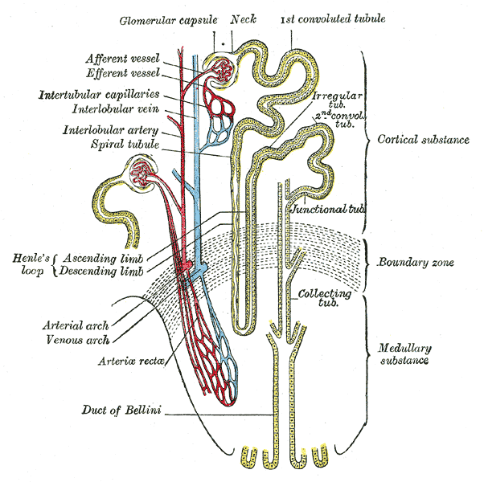
Figure 4a: Md Shafiul Hossain
Induced pluripotent cells (iPSCs) are somatic cells that have been transcriptionally reprogrammed to an embryonic stem cell (ESC) – like state
  Goals of generating replacement tissue and ‘disease in a dish’ laboratory models
Nephron is the basic structural and functional unit of the kidney
  Regulates concentration of water and soluble substances like salts by filtering the blood, reabsorbing what is needed and excreting the rest as urine
  Eliminates wastes from the body, regulates blood volume and pH
Cubilin is a 460-kDa protein functioning as an endocytic receptor for intrinsic factor vitamin B12 complex in the intestine
The proximal tubule is the portion of the duct system of the nephron of the kidney which leads from Bowman's capsule to the loop of Henle
  Regulates the pH of the filtrate by exchanging hydrogen ions in the interstitium for bicarbonate ions in the filtrate
Scheme of renal tubule and its vascular supply

Slide 24
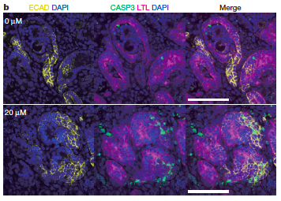
Figure 4b: Adlina Hasni

Slide 25
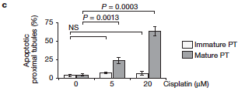
Figure 4c: Jeremy Keys

Slide 26
Conclusions, Perspectives

