Slide 1
Reprogramming Bacteria to Seek and Destroy an Herbicide
Joy Sinha, Samuel J. Reyes, Justin P. Gallivan
Nature Chemical Biology, Vol. 6, 2010
March 21, 2012
Presenters:
Nahum Seifeselassie
PJ Velez
Shlomiya Bar-Yam

Slide 2
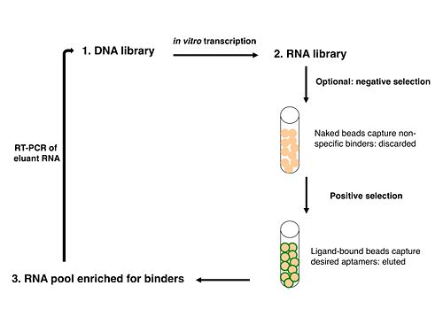
Background
Aptamer
Riboswitch
SELEX: In vitro selection method to sort through large libraries to isolate aptamers
Image from: <http://openwetware.org/wiki/20.109%28S10%29:Prepare_RNA_by_IVT_%28Day3%29>
Notes:
Aptamer: RNA sequences that bind tightly and specifically to ligands
Riboswitch: RNA sequence that regulates gene expression in ligand-dependent fashion without need for proteins

Slide 3
Goal and Motivation
Reprogram E. coli to respond to atrazine
Environmental:
Heavily used herbicide
Persistent organic pollutant
Widespread groundwater contamination
Chemical:
Attractive for RNA interaction due to H donors and acceptors
Biotechnological:
Catabolic pathway well characterized
Each of the enzymes can be expressed and purified in E. coli

Slide 4
Approach
In vitro and in vivo selection to identify riboswitch that responds to atrazine
Riboswitch to make E. coli move in presence of atrazine (pseudotaxis)
Add atrazine catabolism gene
Cells seek and destroy atrazine!

Slide 5
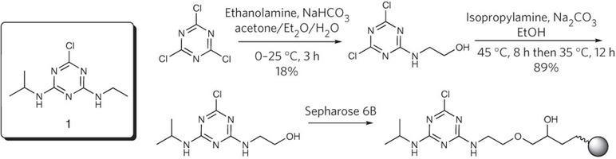
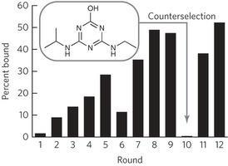
Aptamer Selection
Atrazine derivative synthesized and coupled to a solid support
Library of DNA sequences made
Nine rounds of SELEX using atrazine to elute bound RNA
One reverse round and two more rounds of SELEX
Notes:
Note on library: Each strand comprised of 40 random nucleotides flanked by T7 Promoter sequence and constant sequence at other end

Slide 6
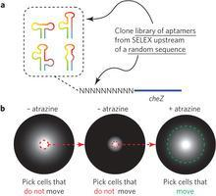
Aptamer Selection
Problem: High affinity not sole desirable aptamer characteristic
“riboswitch” properties
Extra screen for riboswitch activity
12 rounds of in vitro selection
Notes:
In terms of the screen, talk about the first screen, which involved no atrazine, then pick up cells that don’tt move. Once found, plate them on atrazine rich media and select those that do move. Also touch on the advantages of such a process: high throughput, cheap and user-friendly.

Slide 7
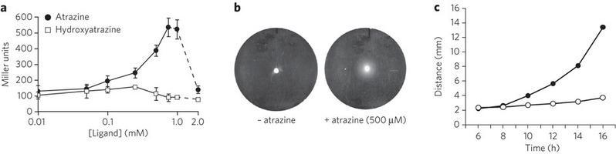
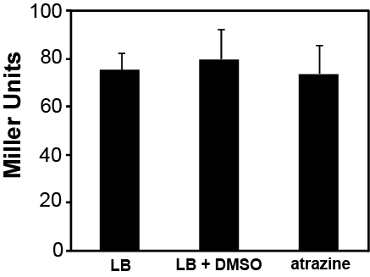
Motility Selection for Synthetic Riboswitches
Added riboswitch to ß-galactosidase reporter gene (lacZ) in order to quantify gene expression
Six of 96 clones showed fourfold increase of ß-galactosidase
Deletion of putative aptamer sequence deleted response to atrazine

Slide 8

Characterization: Translational or Transcriptional Regulation?
Created transcriptional fusion between to genes:
Site of Transcriptional Activation
Contains 3 Stop Codons
Site of Transcriptional Termination
If Transcriptionally Regulated:
If Translationally Regulated:
Atrazine would need to be present for transcription of the whole fusion gene to be transcribed
Expression of LacZ will be Atrazine Dependent
Transcription will occur independent of Atrazine
Translation of LacZ∆ will be atrazine activated
Translation of LacZ will be atrazine independent because it has its own RBS

Slide 9
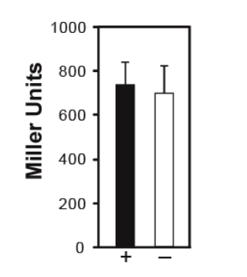
Characterization: Translational or Transcriptional Regulation?
Atrazine-dependent riboswitch acts at the translational level
Notes:
B-Gal production is not Atrazine dependent. Therefore the riboswitch acts at the translational level

Slide 10
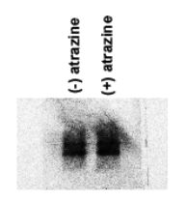
Characterization: Translational or Transcriptional Regulation?
Northern Blot Analysis:
Same amount of riboswitch-encoding RNA in presence or absence of Atrazine

Slide 11
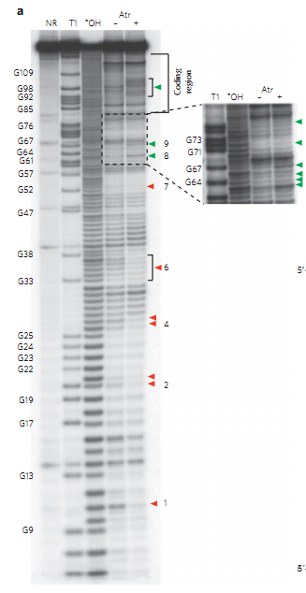
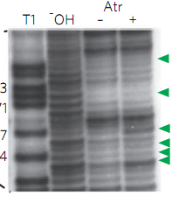
Characterization: Conformational Changes that Underlie Switching
In-line probing experiment:
N40 Region: Proposed site of Aptamer Complex
Notes:
In an in-line probing experiment, RNA is allowed to spontaneously hydrolize under mildly basic conditions. The rate of hydrolysis is dependent on the conformation of the RNA. In the presence of atrazine, several nucleotides show reduced cleavage, consistent with formation of additional secondary structure upon Atrazine binding the Aptamer site. All these sites are located within the N40 region that was randomized during SELEX experiment, which suggests that the region is the aptamer that binds atrazine. There was also increased cleavage in the area in between the aptamer and the start codon.

Slide 12
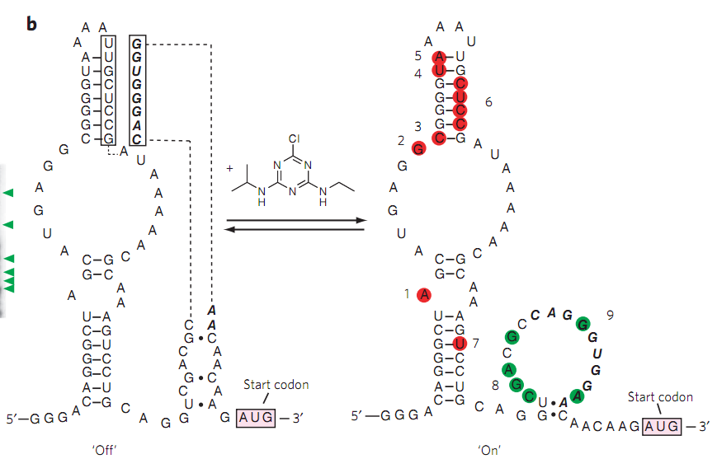
Model for Atrazine-Dependent Riboswitch
Pseudoknot
Ribosome Binding Site
Notes:
Ribosome binding site binding with a portion of the N10 region (motility selection region)

Slide 13
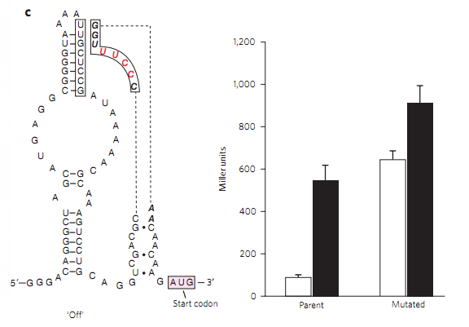
Verification of Atrazine-Dependent Riboswitch Model
Notes:
To test the model for riboswitch function, introduced four mutations that were expected to disrupt the pseudoknot, essentially opening up the RBS without Atrazine present.. Interesting to note is the increased B-Gal production in the mutated strand.

Slide 14
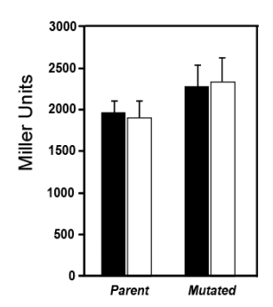
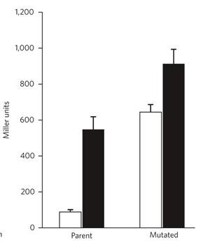
Ribosome Binding Site Strength
With Aptamer and Mutated Aptamer Sequence
Without Aptamer Sequence

Slide 15
Destroying Atrazine
Next: atrazine-catabolizing gene
Existing genes
Pseudomonas sp. ADP
AtzA

Slide 16
Destroying Atrazine
AtzA:
Atrazine Hydroxyatrazine
atrazine chlorohydrolase

Slide 17
Destroying Atrazine
activate
express
Atrazine Riboswitch Motility protein
AtzA, GFPuv constitutively expressed

Slide 18
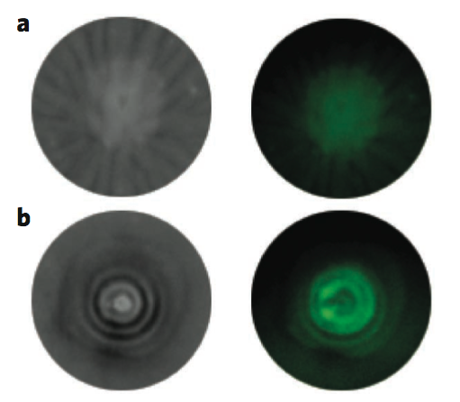
Destroying Atrazine
Figure 6

Slide 19
Outcomes
Riboswitch activated by atrazine
lessons about riboswitches
Dose-dependent motility
E. coli with riboswitch degrades atrazine

Slide 20
Outcomes
Riboswitch requires high concentrations in vivo
Delete atrazine efflux
Permeable chassis
Low vs. high background expression
Reverse switch behavior?

Slide 21
For Discussion
Forward engineering vs. finding in nature
Find vs. design aptamer-ligand pairs
Aptamer selection strategies
Applications of synthetic biology

