Slide 1
Analysis of Cold Shock in S. cerevisiae ∆hmo1 and Modeling Transcription Factors to Resemble Experimental Data
Anthony Wavrin & Matthew Jurek
Department of Biology
Loyola Marymount University
May 9th, 2013

Slide 2
Outline
Understanding cold shock response provides further insight to other cellular processes
Using DNA microarray data, significance of individual genes was determined
Clustering of DNA microarray data revealed 7 significant expression profiles
Profiles 9 and 45 have polarized expression patterns
3 additional transcription factors were independently incorporated into each transcription profile
Models fit experimental data well but, differ in regulatory properties
Manipulate the current model in a number of ways to compare results

Slide 3
Gene Regulation Changes Via Cold Shock Provide a Better Understanding of Cellular Processes
Cold Shock is a sudden, drastic drop in temperature occurring over a short period of time.
The response to cold shock in cells is regulated by changes in gene expression.
Understanding changes in gene expression provide a larger picture of cell function.
Hmo1 is involved in transcription and believed to be a key factor in cold shock response.

Slide 4
DNA Microarray Compare Expression Levels Between Two Transcriptomes
Two samples of cDNA with cy3 or cy5 are hybridized to a chip containing the yeast genome.
The yeast were exposed to cold shock for 60 minutes and then allowed to recover for 60 minutes.
Fluorescence of cy3 and cy5 on each gene spot is quantitated.

Slide 5
Raw Microarray Data Was Normalized for Comparison Purposes and Significance
Average log ratios were computed for each column within the sheet of raw data.
Based on the log ratios, standard deviation was derived to scale and center the data.
Average log fold changes were calculated for each replicate at each time point.

Slide 6
P-values
T statistics followed by P values were found to determine significance of individual genes.

Slide 7
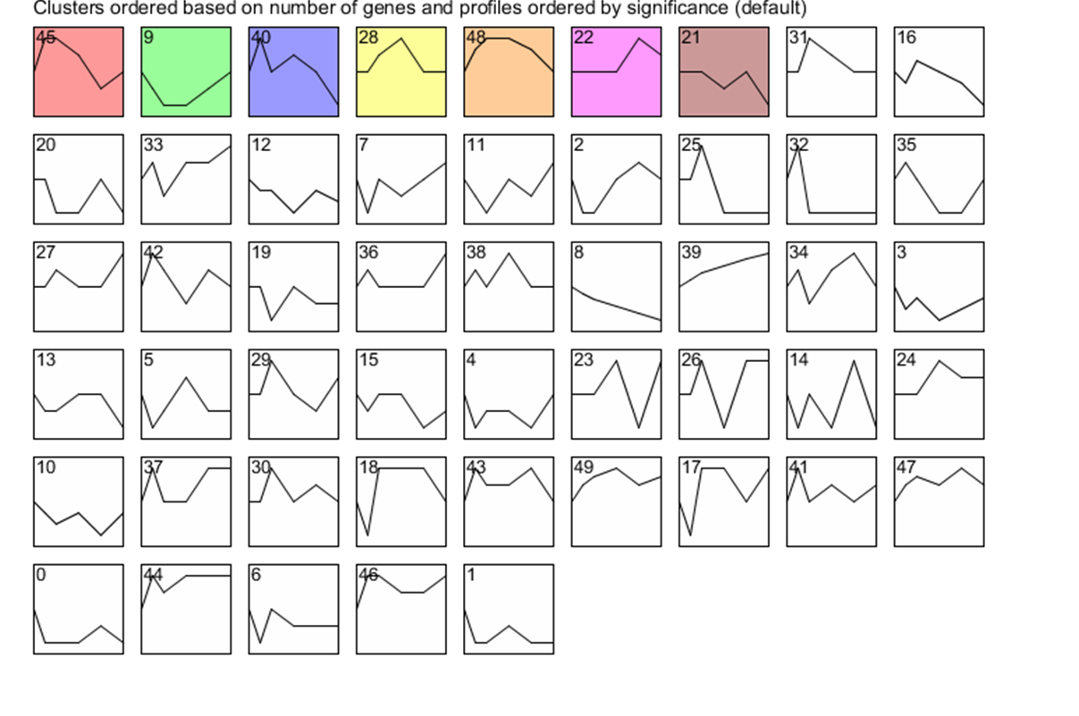
Clustering of Genes Based on Similar Expression Profiles

Slide 8
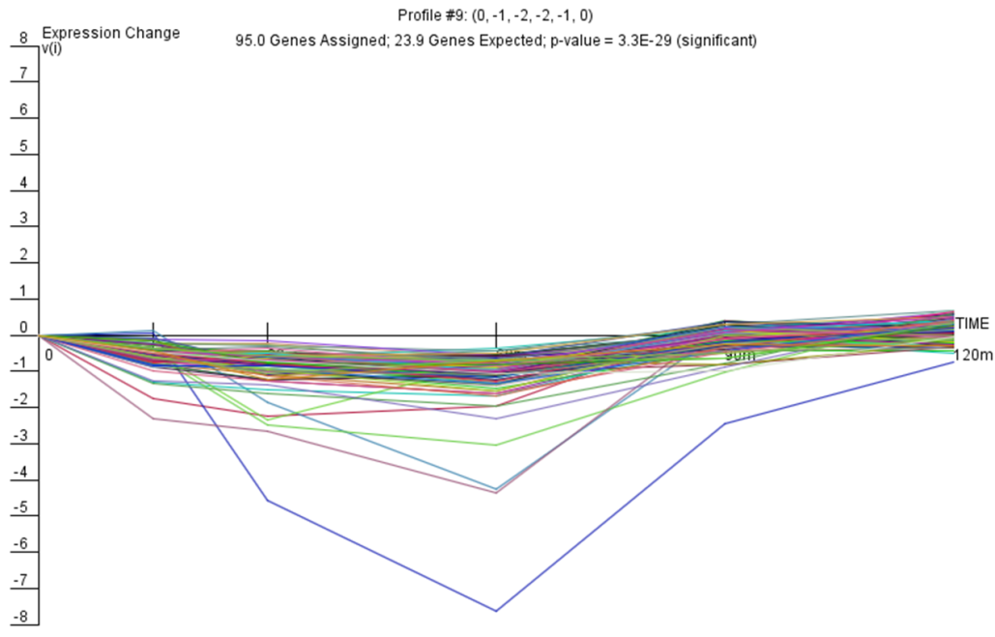
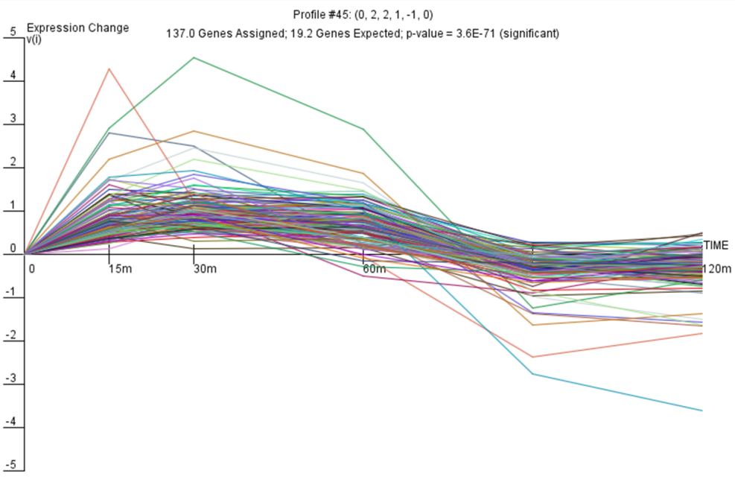
Further Analysis of Profile 9 and Profile 45 Based on STEM Expression Profiles

Slide 9
Inclusion of Additional Transcription Factors in Profile 9 and Profile 45 based on YEASTRACT
Profile 9
Profile 45
Transcription Factor | % of Genes T.F. Regulates in Cluster
Ste12 | 39.4
Rap1 | 30.9
Sok2 | 22.3
Fhl1 | 22.3
Skn7 | 22.3
Swi4 | 16.0
Mbp1 | 16.0
Msn2 | 16.0
Yap6 | 16.0
Hsf1 | 14.9
Transcription Factor | % of Genes T.F. Regulates in Cluster
Ste12 | 23.8
Rap1 | 21.4
Ino4 | 19.0
Rfx1 | 16.7
Yap6 | 14.3
Cin5 | 11.9
Abf1 | 9.5
Mcm1 | 9.5
Tec1 | 9.5
Cbf1 | 9.5

Slide 10


Transcriptional Networks Resulting From the Addition of Transcription Factors from Profile 9 and Profile 45
Profile 9
Profile 45

Slide 11
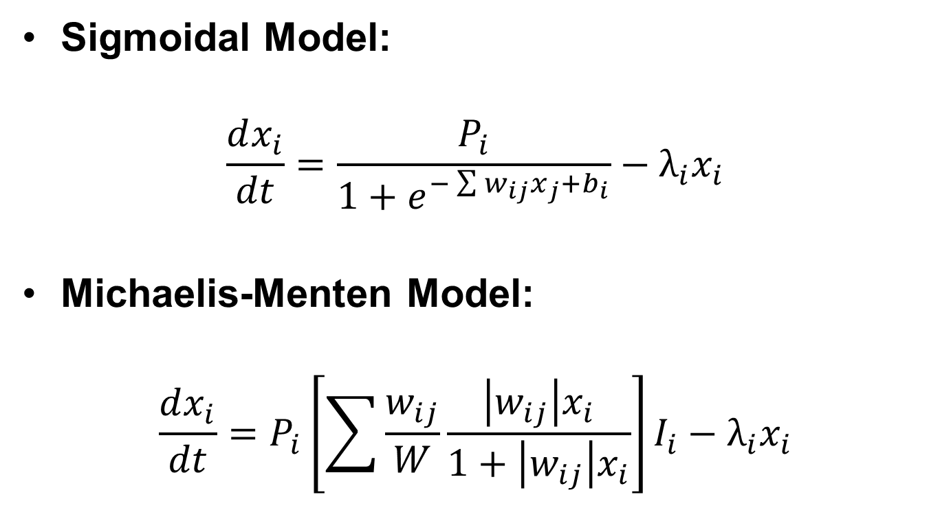
Utilizing Two Different Equations to Model Experimental Data
Sigmoidal Model:
$$\frac{dx_{i}}{dt}=\frac{P_{i}}{1+e^{−\sum{w_{ij}x_{j}+b_{i}}}}−λ_{i}x_{i}$$
Michaelis-Menten Model:
$$\frac{dx_{i}}{dt}=P_{i}\left[\sum{\frac{w_{ij}}{W}\frac{\left|w_{ij}\right|x_{i}}{1+\left|w_{ij}\right|x_{i}}}\right]I_{i}−λ_{i}x_{i}$$

Slide 12
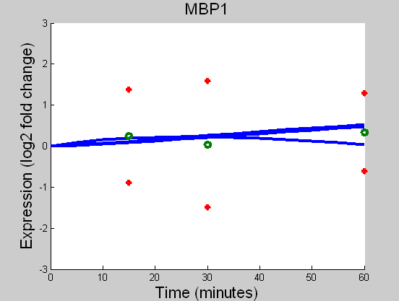
Regulation of MBP1 Varies Based on Model Used

Slide 13
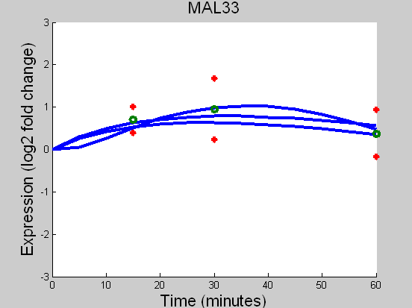
Regulation of MAL33 Varies Based on Model Used

Slide 14
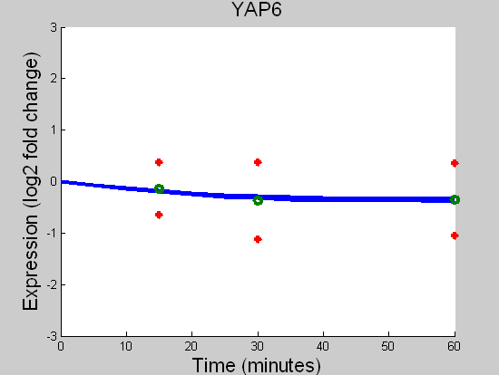
Regulation of YAP6, with 9 Transcription Factors Varies Based on Model Used but, Match to Data is Consistent

Slide 15
Regulatory Properties Differ While Models Appropriately Fit the Experimental Data
The two models, Sigmoidal and Michaelis-Menten, both yielded appropriate fits to the data.
Although profiles 9 and 45 were contradicting, they shared many of the same transcription factors.
MBP1 and MAL33 had the most variation in fit to data with large descrepencies in regulatory transcription factors.

Slide 16
Increasing the Complexity of the Model
Adding more transcription factors to the network.
Explore different techniques of modeling the experimental data.
Exploring batch culture versus chemostat.
Comparing the S. cerevisiae Δhmo1 to the wild type data.

Slide 17
Acknowledgements
A special thanks to Dr. Dahlquist for the biological background necessary to model this system and Dr. Fitzpatrick for his assistance in the logistics of modeling.

Slide 18
References
Gadal O, et al. (2002) Hmo1, an HMG-box protein, belongs to the yeast ribosomal DNA transcription system. EMBO J 21(20):5498-507

