Slide 1
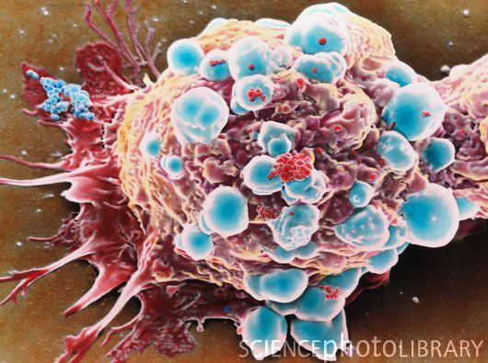
Functional genomics reveal that the serine synthesis pathway is essential in breast cancer
Introduction:
Tim Butler
Spellman Lab

Slide 2
Today’s Topics
Metabolism and Cancer
Functional Genomics
Breast Cancer

Slide 3
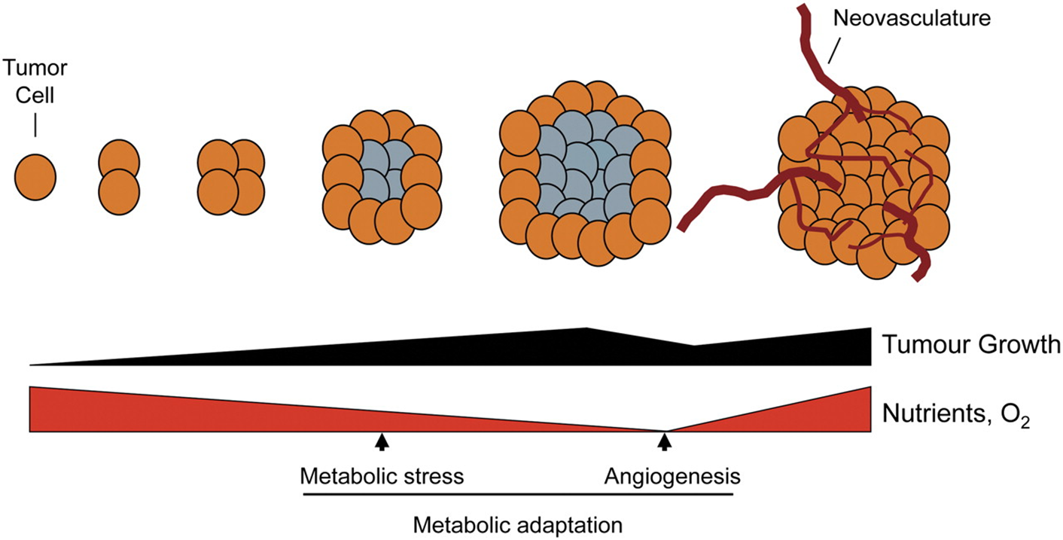
Metabolism and Cancer
Jones R G , Thompson C B Genes Dev. 2009;23:537-548

Slide 4
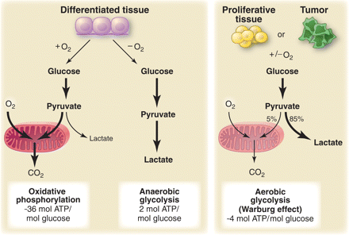
Warburg Effect
Under aerobic conditions tumor cells rely on glycolysis
~9x less ATP generated
Proliferating cells need more than just ATP
Lactate used to increase biomass
Warburg effect a phenotype of proliferating cells, including tumors
Vander Heiden, et. al., Science 2009;324.

Slide 5
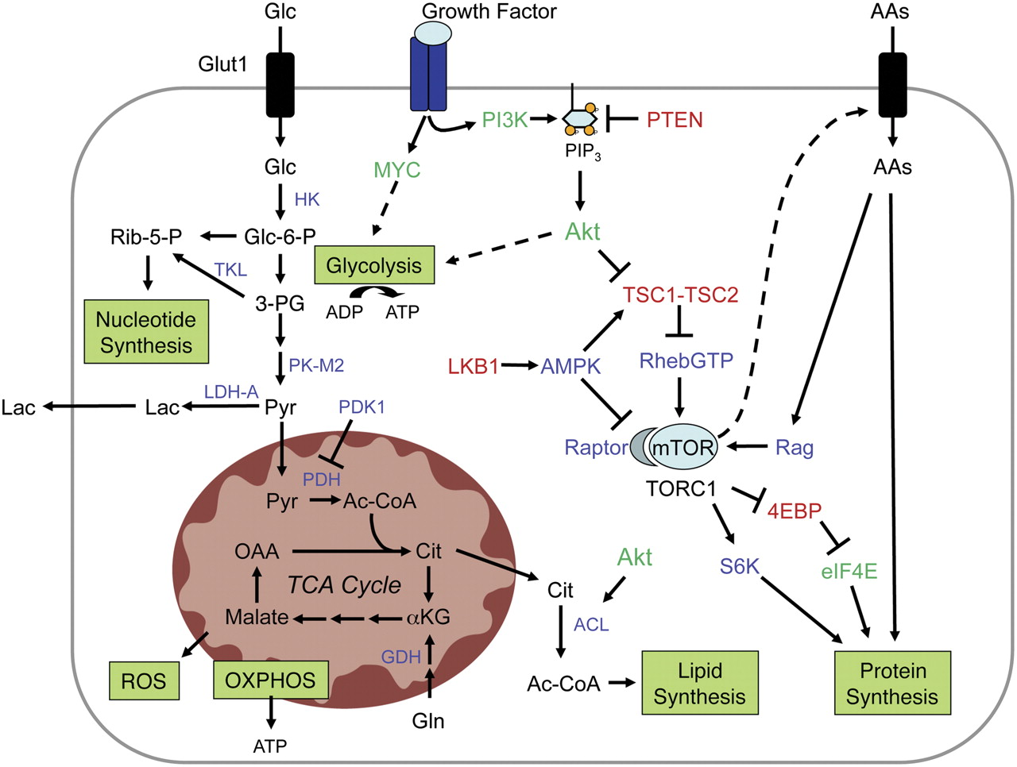
Tumor Genes and Metabolism
Jones R G , Thompson C B Genes Dev. 2009;23:537-548

Slide 6
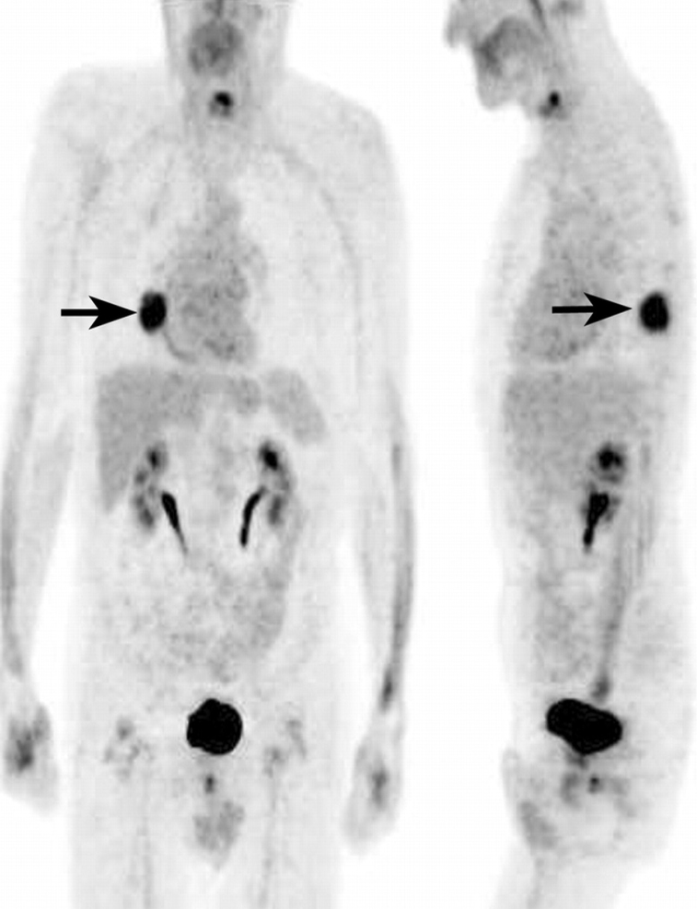
Understanding Cancer Metabolism
Metabolic pathways are utilized differently in cancer
Identifying metabolic genes that tumors are dependent on may lead to new therapeutic targets
Rohren et. al., Radiology 2004

Slide 7
Functional Genomics
Genomic studies of disease focus on identifying DNA alterations that are overrepresented
Functional genomics focuses on measuring the functional consequences of disrupting gene expression
RNAi is used to knockdown gene expression and screen for consequences
Gene Expression
Proliferation
Drug sensitivity

Slide 8
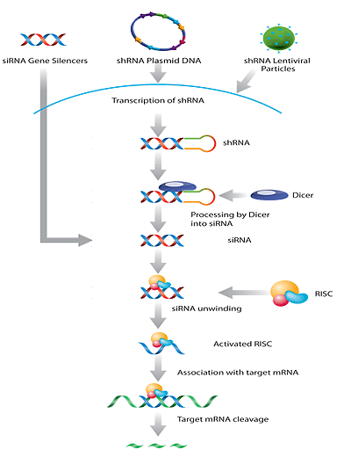
RNA interference (RNAi)
Uses RNA sequence complementary to a target gene to degrade transcripts
Knocks down protein level
Can be delivered via siRNA, shRNA plasmid, or shRNA lentivirus
"Gene Silencers." Santa Cruz Biotechnology, Inc. Web. 10 Feb. 2012. <http://www.scbt.com/gene_silencers.html>.

Slide 9
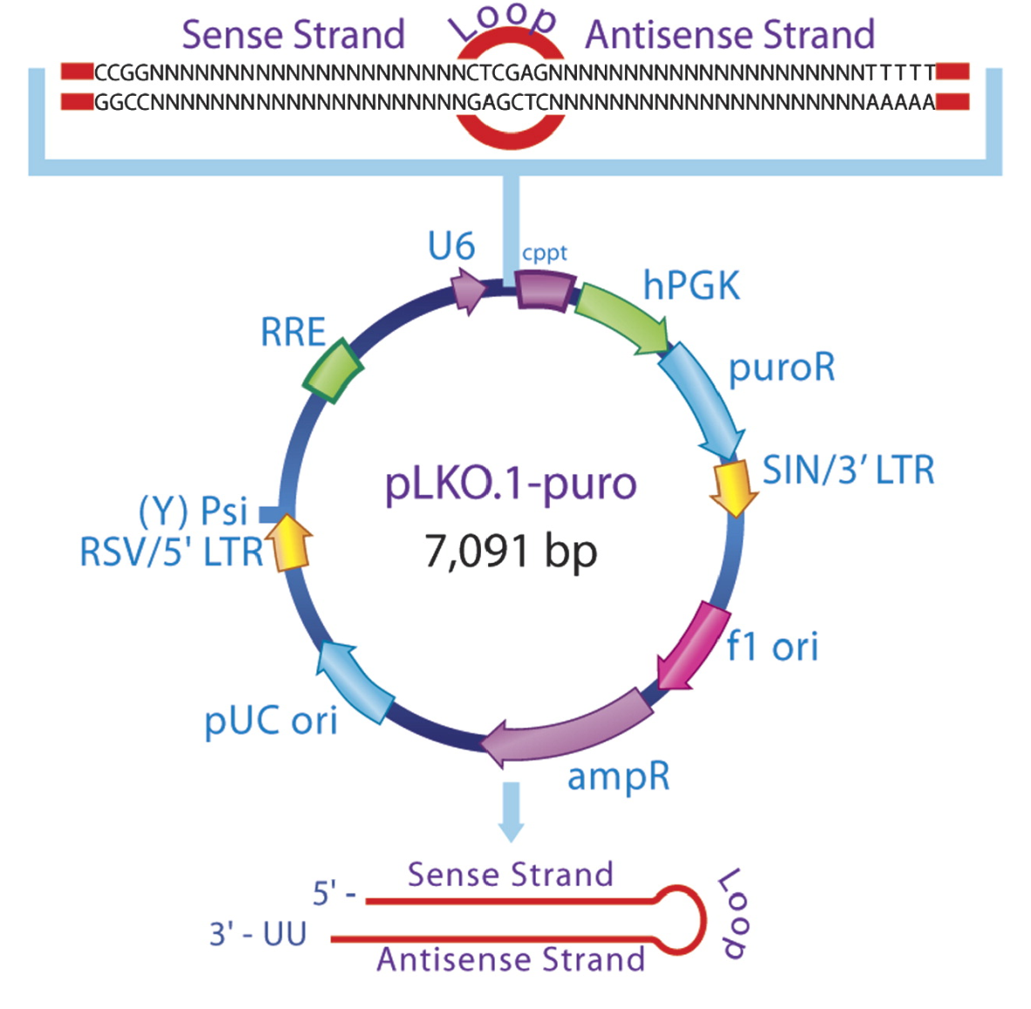
Lentiviral shRNA Delivery
Lentivirus will integrate its genome into target genome
Allows for constant expression at low levels, minimizing off target effects
Vector contains:
shRNA sequence
Antibiotic resistance
Promoters
Biosafety features
Lentiviral Machinery
Jason Moffat, et. al., Cell, Volume 124, Issue 6, 24 March 2006

Slide 10
Breast Cancer
Prognosis and treatment determined by molecular subtype
Estrogen Receptor (ER), Progesterone Receptor (PR), and HER2 primary markers
ER/PR Positive tumors dependent on androgens, treated with compounds that deplete androgens (tamoxifen)
HER2 Positive tumors respond to monoclonal antibody Herceptin
Cell lines have been created that represent all the major subtypes of breast cancer
Used as model systems to understand breast cancer biology, identify vulnerabilities, and test therapies

Slide 11
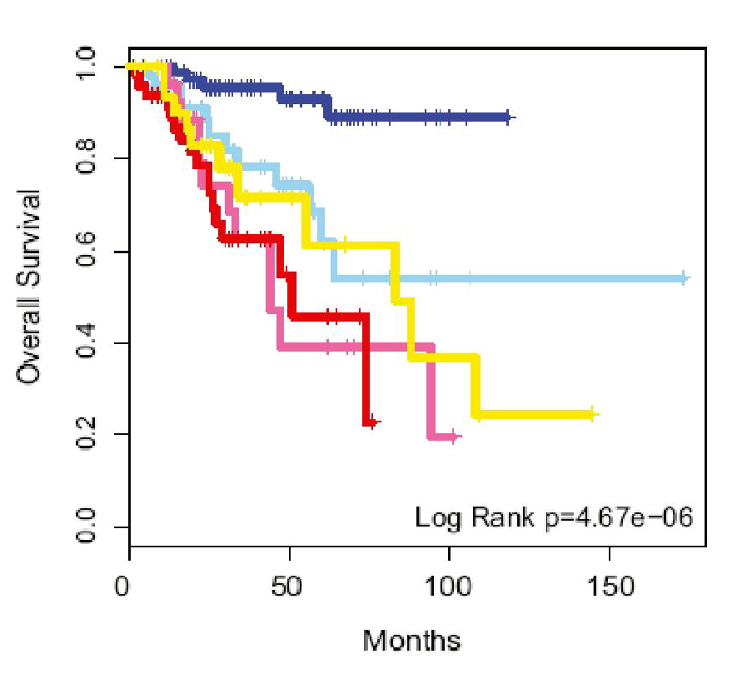
Breast Cancer Survival
Luminal A (ER+,PR+,HER2-)
Luminal B (ER+/-,PR+/-,HER2-/+)
Claudin-Low (ER-,PR-,HER2-)
Her2 Enriched (ER-,PR-,HER2+)
Basal-Like (ER-,PR-,HER2-)
Pilar Eroles et. Al., Cancer Treatment Reviews 16 December 2011.

Slide 12
Take Home Message
Tumors utilize metabolism differently than quiescent cells
A better understanding of tumor metabolism can identify vulnerabilities
RNAi is an effective method to conduct large scale screens to identify functionally important genes
Breast cancer cell lines are a valuable resource for investigating tumor biology

