Slide 1
Project 6: Strawberry
Nick Broadbent, Kelsey Lees
and Tami Reuter

Slide 2
Ideas
Clone scent into E. coli during Recombinant DNA Technique - Fall 2009
Scents exist in BioBrick library
  Banana
  Lemon
  Mint
Researched strawberries and raspberries
  Strawberries more researched

Slide 3
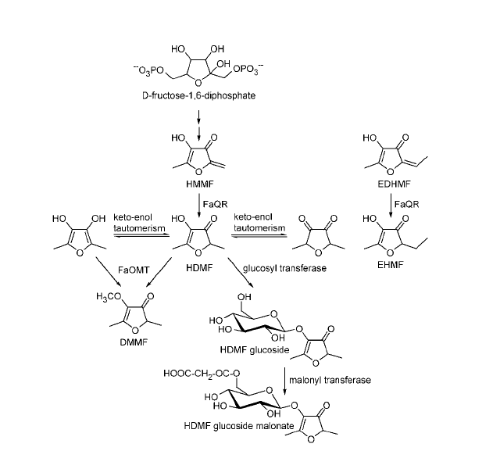
Strawberry Scent
Combination of terpenes
FaQR synthesizes 4-hydroxy-2,5-dimethyl-3(2H)-furanone (HDMF)
SAAT synthesizes fruity esters

Slide 4
Original Objectives
To construct a system containing the Fragaria x ananassa quinone oxireductase gene (FaQR) gene that is testable through a green fluorescent protein (GFP) marker
To create a system containing the Strawberry alcohol acyltransferase gene (SAAT) testable through scent or gas chromatography.

Slide 5
FaQR Device
FaQR fused with a tetracycline promotor and GFP
Device put into a plasmid then into E. coli
System tested through use of GFP
(R0040) TetR Repressable Promotor
FaQR Gene
(E0040) GFP

Slide 6
Parts Available
Part | Accession number
FaQR gene | DNA: AY048861 mRNA: AY048861
SAAT mRNA | AF193789
Tetracycline repressible promotor | Bba_R0040
Inducable pBad/araC promotor | Bba_I0500
Green fluorescent protein | Bba_E0040

Slide 7
Materials and Methods
Tissue Acquisition
  (1) Fragaria x ananassa var. Jewel
  (2) Fragaria x ananassa var. Jewel
  (3) Fragaria x ananassa var. Cabot
  (4) Fragaria x ananassa var. Mesabi
DNA Extraction
  Tissues ground with liquid nitrogen and mortar and pestle
  Protocol of Mercado et al. (2009)
Notes:
Tissue 1 was dried in silica gel
All others fresh tissue

Slide 8
Materials and Methods
Restriction Enzyme Digest
  One µg of DNA was digested with
    0.1 µl EcoR1 (10 unit/µl)
    2 µl (10 mg/ml) RNAase
    1 µl (10x) buffer
    1.9 µl H₂0
  37°C water bath for 15 minutes.
Further Purification
  QIAGEN AlQuick PCR Puficiation Kit
  final product eluted in 800 µl Buffer AE.
Notes:
Digest used to purify DNA
Kit used to further purify DNA

Slide 9
Materials and Methods
Agarose Gel
  1.0 g agarose boiled in 100 ml (1x) TBE buffer
  Once cooled, 2 µl EtBr were swirled to mix
  Mixture was poured into a gel tray and allowed to set
  The chamber was filled with TBE buffer
  Gels were run at 150 volts for 30 minutes.

Slide 10
Materials and Methods
Primer Design
  Primers were designed using Fragaria x ananassa FaQR DNA sequence, accession number AY158836 (Genbank 2009)
  Coding region: 3888 - 5680 nucleotides
    Contained four introns
  Forward primer, FaQR1
    5’ ATG GCT GCA GCT CCA AGC GAG TCC 3’)D
    Designed from the first 24 nucleotides of the coding region
    Internal binding sites thought to cause dimers found
  Modified forward primer, FaQR2
    5’ ATC GCC GCC GCT CCA AGC GAC TCC 3’
  Reverse primer, FaQR3
    5’ TGG GAT GGG ATA CAC AAC CAC CTT 3’
    Designed using the last 24 nucleotides of the coding region, omitting the stop codon, TCA.

Slide 11
Materials and Methods
PCR
  Both the FaQR1/FaQR3 and FaQR2/FaQR primer sets
  PCR reactions included:
    5 µl template DNA
    10 µl (2x) PCR mix
    0.8 µl (10 µM) FaQR1/FaQR2
    0.8 µl (10 µM) FaQR3
    3.4 µl H₂O.
  Positive control:
    10 µl (2x) PCR mix
    1 µl (unknown concentration) Bluescript plasmid DNA
    2 µl (2 µM) M13 forward primer
    2 µl (2 µM) M13 reverse primer
    5 µl H₂O.
  Negative control
    PCR cocktail without template

Slide 12
Materials and Methods
PCR Program “Strawberry”
Temperature (° C) | Time (minutes) | Step
95 | 4 | Initial Denaturation
94 | 1 | Denaturation
50 | 0.5 | Annealing
72 | 3 | Extension
72 | 10 | Final Extension
30 rounds of denaturation, annealing and extension

Slide 13
Materials and Methods
Gel Extraction
  QIAGEN QIAQuick Gel Extraction Kit
  assumed the agarose excisions weighted 100 mg and 100 µl as the volume.

Slide 14
Materials and Methods
Agar Plate Prep
  Made for transformations
  800 ml LB
    20 g LB/l
    12 g agar/l
    12 ml (60 mg/ml) ampicillin
  Poured into plates
  Work was done near a flame to decrease contamination and to remove bubbles from medium.

Slide 15
Materials and Methods
Ligation, Transformation, Overnight Cultures and Glycerol Stocks
  pGEM-T and pGEM-T Easy Vector Systems by Promega
  Background control, X
    calculate self ligation
  Transformation mixtures were placed in the 37°C shaker for 1 hour
  100 µl of the transformations plated
  Transformations were incubated for 37°C for 24 hours.
Overnight Cultures
  15 ml tubes to allow bacteria access to oxygen
  5 ml LB medium
  8 µl ampicillin (60 µg/µl → 100 µg/l final concentration).
Glycerol Stocks
  320 µl 50% glycerol
  680 µl of corresponding overnight culture
  -80°C freezer for long-term storage.
Notes:
15 ml tubes used to allow access to oxygen

Slide 16
Materials and Methods
Plasmid Isolation
  Isolated from the overnight cultures
  1.9 ml of overnight culture was put in 2 ml tubes, spun at 12000 x g for minutes and the supernatant removed
  Fermentas GeneJET plasmid isolation kit was used.

Slide 17
Materials and Methods
RNA Extraction
  QIAGEN RNeasy Plant Minikit
  Tissue from fresh strawberries
    Sunrise Growers via grocery store
  Approximately 100 mg of tissue were used.
RNA Formaldehyde Agarose Gel
  Extraction products were run on a formaldehyde agarose gel
  Following the protocol of Pitra (2008)

Slide 18
Materials and Methods
RT-PCR
  QIAGEN 1-step RT-PCR kit
  FaQR1/FaQR3 primer pair
  Reaction included:
    5 µl template RNA
    5 µl RT-PCR buffer
    1 µl dNTP mix
    1.5 µl (10 µM) FaQR1
    1.5 (10 µM) µl FaQR3
    1 µl RT-PCR enzyme mix
    10 µl H₂O.
Notes:
Reverse trascriptionase PCR

Slide 19
Materials and Methods: “StrawberryRTPCR” Program
Temperature (° C) | Time (minutes) | Step
50 | 30 | Reverse Transcription
95 | 15 | Initial Denaturation
94 | 1 | Denaturation
50 | 30 | Annealing
72 | 1 | Extension
72 | 10 | Final Extension
Denaturation, annealing and extension for 40 cycles

Slide 20
Results: DNA Extraction and Digestion
Undigested and restriction enzyme digested entire genomic DNA
Undig. 4
Undig. 3
Undig. 2
Undig. 1B
Undig. 1
Dig. 4
Dig. 3
Dig. 2
Dig. 1B
Dig. 1
3000bp
1000bp
Notes:
No difference between the intensity of the bands between the digested and undigested samples
Therefore, the DNA had to be further purified
Tissues 1 and 4 chosen due to bright bands -minikit
Tissues 2 and 3 restriction enzyme digested

Slide 21
Results: Further purification
QIAGEN DNeasy plant minikit
  Tissues 1B and 4 were chosen to further purify since their bands were further defined
Restriction Enzyme/Protease Digestion
  Tissues 2 and 3
  8 µl RNAase free H₂O, 10 µl DNA, 2 µl (10 mg/ml) RNAase and 2 µl (unknown concentration) protease
  Incubated at room temperature for 10 minutes
  Digested for 30 minutes in a 37°C water bath.

Slide 22
Results: Further purification
200 bp Marker
Undig. 3
Undig. 4
Undig. 1B
Dig. 2
Undig. 2
Dig. 1B
Dig. 3
Dig. 4
2000bp
1000bp
Notes:
1B and 4 showed differences between digested and undigested samples and could be used in PCR. The bands on 4 were much brighter than 1B, therefore the DNA 4 is more highly concentrated and less should be used in PCR.
Samples 2 and 3 were not clean and still contained large proteins, which may imply that the protease did not work

Slide 23
Results: Temperature Annealing Analysis
Completed with
  Both primer pairs
    FaQR1/FaQR3 and FaQR2/FaQR3
  Tissues 1B and 4
PCR program “Strawberry” with gradient annealing temperature
Column | H | G | F | E | D | C | B | A
Temp. (°C). | 50.0 | 50.8 | 52.3 | 54.4 | 57.3 | 59.6 | 61.1 | 62.0

Slide 24
Results: Temperature Annealing Analysis
Vial | Tissue | Primer Pair | Annealing Temperature (°C)
1 | 1B | FaQR1/FaQR3 | 50.0
2 | 1B | FaQR1/FaQR3 | 54.4
3 | 1B | FaQR1/FaQR3 | 59.6
4 | 4 | FaQR1/FaQR3 | 50.0
5 | 4 | FaQR1/FaQR3 | 54.4
6 | 4 | FaQR1/FaQR3 | 59.6
7 – pos. control | Bluescript plasmid | Fwd M13/Rvs M13 | 50.0
8 – neg. control | n/a | FaQR1/FaQR3 | 50.0
9 | 1B | FaQR2/FaQR3 | 50.0
10 | 1B | FaQR2/FaQR3 | 54.4
11 | 1B | FaQR2/FaQR3 | 59.6
12 | 4 | FaQR2/FaQR3 | 50.0
13 | 4 | FaQR2/FaQR3 | 54.4
14 | 4 | FaQR2/FaQR3 | 59.6
15 – neg.control | n/a | FaQR2/FaQR3 | 50.0

Slide 25
Results: Temperature Annealing Analysis
200 bp Marker
Neg. Control
200 bp Marker
Neg. Control
Pos. Control
14
13
12
11
10
9
6
5
4
3
2
1
2000bp
54.4⁰ C
54.4⁰ C
54.4⁰ C
1600-1800bp
50⁰ C
59⁰ C
50⁰ C
59⁰ C
50⁰ C
1000bp
54.4⁰ C
59⁰ C
50⁰ C
50⁰ C
59⁰ C
50⁰ C
50⁰ C
FaQR2/FaQR3
FaQR1/FaQR3

Slide 26
Results
Four – 20 µl PCR reactions were completed with tissue 4 and both primer sets
FaQR1/FaQR3 products to be column purified
FaQR2/FaQR3 products to be gel excised
  QIAGEN QIAQuick Gel Extraction Kit
Notes:
FaQR1/FaQR3 have double bands, but are too close for gel excision
The FaQR2/FaQR3 PCR products have three bands at ~500, ~1500 and ~2000 bp. The ~1500 and the ~2000 nucleotide bands will be excised for gel extraction

Slide 27
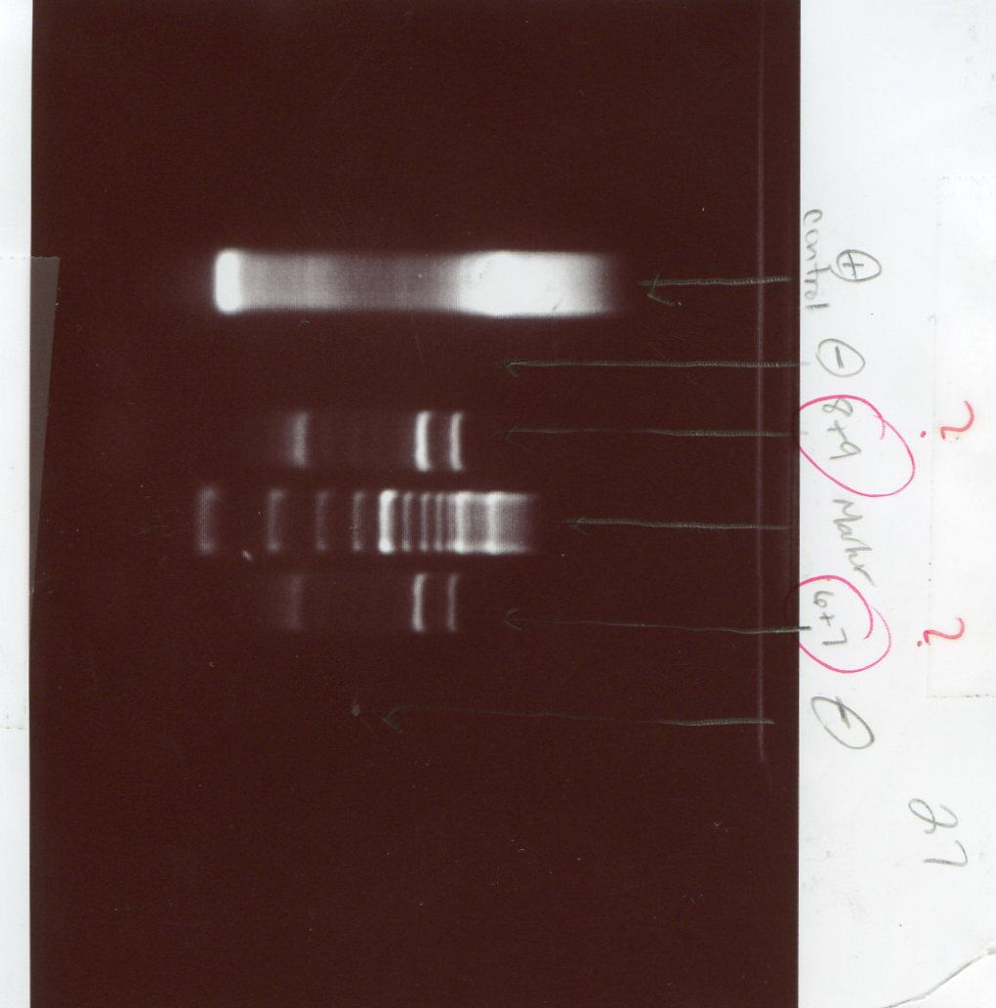
Results: PCR Results of FaQR2/FaQR3
200bp Marker
Pos. Control
Neg. Control
Neg. Control
4B
4A
Notes:
Top two bands became samples C and D

Slide 28
Results:
Column Purification of FaQR1/FAQR2 (A and B) gel extraction of FaQR2/FaQR3 (C and D).
200 bp Marker
Fast Ruler
Fast Ruler
D
C
B
A
1700-1800 bp
Notes:
Column purification successful
Gel extraction not, gel extraction redone with FaQR2/FaQR3 and tissue 4 - had to rePCR

Slide 29
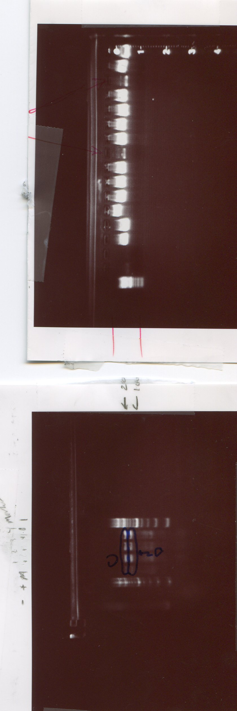
Results:
PCR of FaQR2/FaQR3 for 2nd Gel Extraction
200bp Marker
200bp Marker
Neg. Control
Pos. Control
1
2
3
4
2000bp
1000bp
Notes:
2nd gel extraction also not successful

Slide 30
Results: Ligation
FaQR1/FaQR3 primer pair
Three total ligations, A, B and X, were completed with a DNA concentration of 3 µl
Incubated at room temperature for 24 hours.
 | A | B | X
2x ligation buffer | 5 | 5 | 5
pGEM-T easy vector | 1 | 1 | 1
PCR product | 3 | 3 | 0
T4 DNA ligase | 1 | 1 | 1
De-ionized H₂0 | 0 | 0 | 3
Total | 10 | 10 | 10

Slide 31
Results: Transformation
 | A | B | X | Positive | Negative
Ligation (µl) | 2 | 2 | 2 | * | 0
Cells (µl) | 60 | 60 | 60 | 60 | 60
SOC (µl) | 950 | 950 | 950 | 950 | 950
Colonies | ~60 | ~60 | 3 | ~1600 | 0
* = 2 µl Bluescript Plasmid

Slide 32
Results:
Overnight Cultures, Glycerol Stocks, Plasmid Isolation
Six overnight cultures completed on A and B
3 overnight cultures completed on positive control
All vials were turbid
Glycerol stocks made for 1A-6A, 1B-6B
Plasmids were isolated from 1A-6A, 1B-6B using GeneJET Plasmid Isolation Kit

Slide 33
Results:
Gel Extraction and Plasmid Isolation
200bp Marker
2D
1D
2C
1C
6A
5A
2+
1+
6B
5B
4B
3B
2B
1B
4A
3A
2A
1A
Gel Extraction
Plasmid Isolation
Notes:
A3 and B1 did not contain DNA, the other isolations
The rest of the plasmid isolation products have DNA in high concentrations due to bright band The gel extraction product bands were either absent or very faint. The gel extraction was not successful.

Slide 34
Results:
Plasmid Isolation Digestion
Digested using EcoR1
  0.5 µl (10 u/10 µl) EcoR1
  5 µl plasmid isolation product
  1.9 µl (10X) buffer
  3.0 µl H₂0
Incubated at 37°C for 10 minutes.
Notes:
Cut our fragment from the vector.

Slide 35
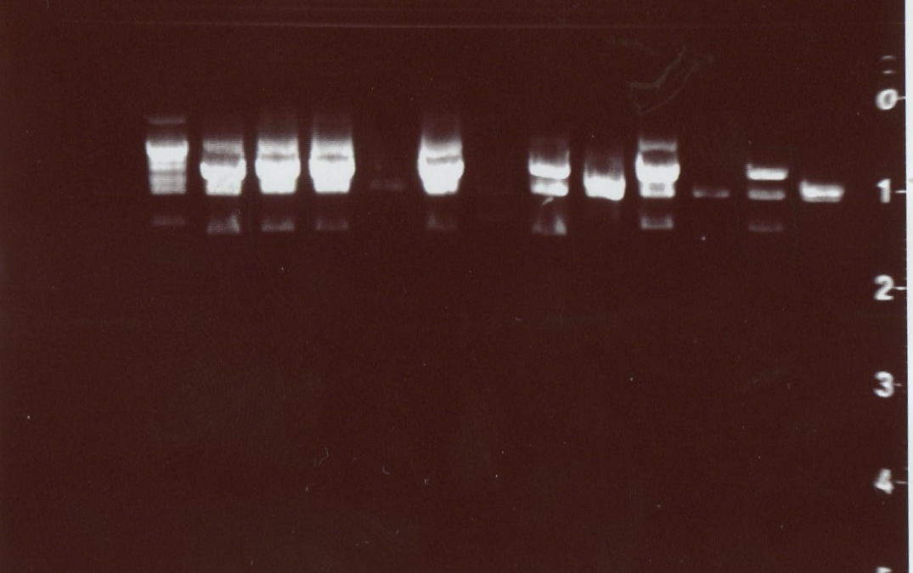
Results: Plasmid Isolation Digestion
200bp Marker
6B
5B
4B
3B
2B
1B
6A
5A
4A
3A
2A
1A
Notes:
Two bands were visible as expected, one for the FaQR fragment and one for the vector. 1A – 6A were hard to read since loading dye was accidently added. 3A and 2B were either very faint bands or lost. 1B, 3B-6B have very concentrated DNA. It is unclear which are bands of interest due to highly concentrated DNA. 2A and 5B plasmid isolation digestions were sent to Iowa State DNA Synthesis and Sequencing facility to be sequenced to check for the desired FaQR fragment.

Slide 36
Results
Nucleotide BLAST
top hits were all Fragaria x ananassa
  E values ranging from 0.0 to 8x10⁻¹³¹
Aligned with the AY158836, the Fragaria x ananassa FaQR DNA fragment
  95% identification from nucleotides 4708-5661
  Discrepancy is most likely due to strawberry variety variation
    Variety Mesabi was used in these experiments, but the variety of AY158836 is unknown
Due to the BLAST results, it was concluded that strawberry FaQR was isolated with introns in E. coli.

Slide 37
Results: RNA Extraction
RNA was extracted from fresh tissue using the QIAGEN RNeasy Plant Minikit
Four extractions were completed
  (1) 100 mg of sepals
  (2) 100 mg of sepals
  (3) 120 mg of fruit
  (4) 105 mg of fruit

Slide 38
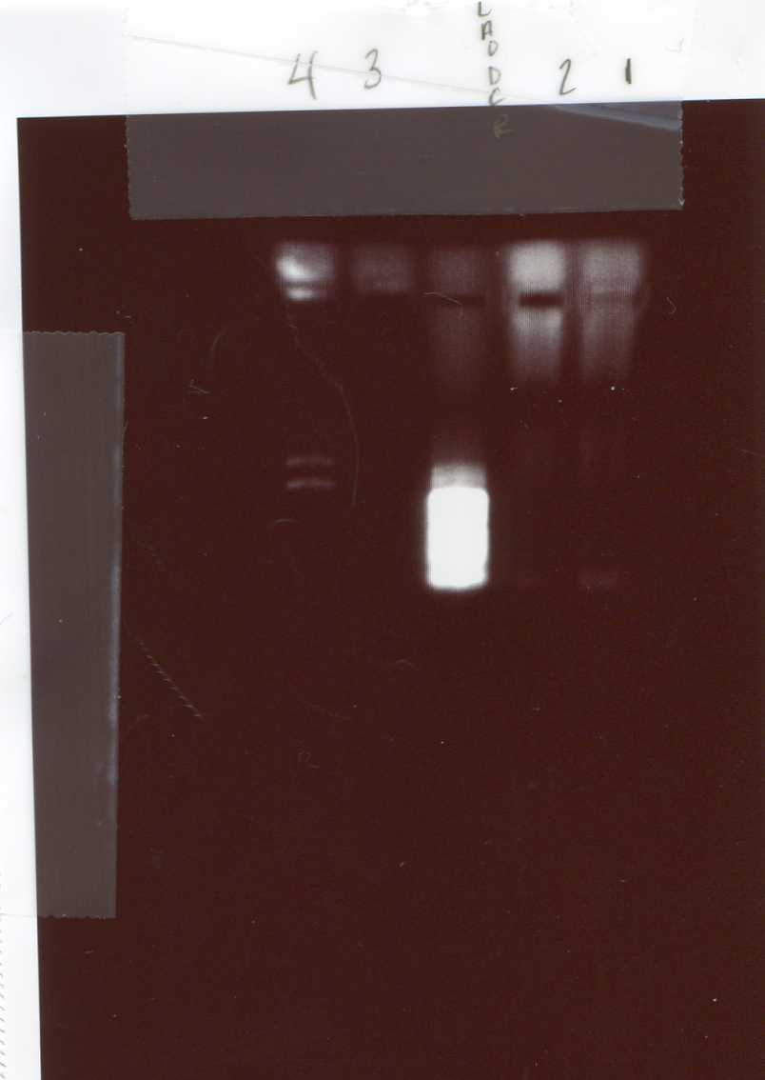
Results: RNA Extraction
200bp Ladder
4
3
2
1
Notes:
Sample 4 had strong ribosomal bands, indicating good preparation. 1 and 2 had RNA, but did not have strong ribosomal bands. 3 had little to no RNA.

Slide 39
Results: RT-PCR
QIAGEN 1-Step RT-PCR kit
Two reactions were completed with each RNA extraction 2 and 4
  15 μl template DNA
  5 μl template DNA
Notes:
amplify FaQR without introns

Slide 40
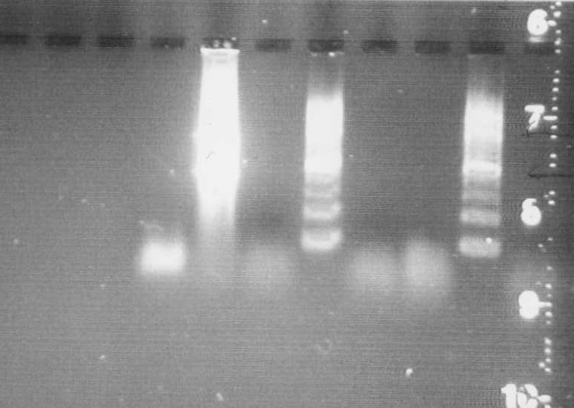
Results: RT-PCR
Neg. Control
Pos. Control
200bp Marker
200bp Marker
4B
2B
4A
2A
2000bp
1000bp
200bp
Notes:
The RT-PCR was not successful (Figure 12). The bands are all less than 200 bp, indicating small, unused oligos. The positive control had two bands and a streak. The negative control had a band from small oligos, indicating contamination and/or an unsuccessful preparation.

Slide 41
Discussion
Future SAAT Protocol
SAAT amplified using mRNA
  Protocol of Mercado et al (2008)
Made into DNA with reverse transcriptase, run on a gel, bands cut out and purified
Two promotors
  Tetracycline
  Arabinose
Put into plasmid, then E. coli
Bacteria grown in gradient mediums containing specific promotor inducer and Acyl-CoA

Slide 42
Discussion
Future SAAT Protocol
Tested using scent
  25 individuals will smell plates
Tested using gas chromatography

Slide 43
Discussion
Time Constraints
RNA, more specifically RT-PCR to cut out introns, may not be the most successful method in this instance.
RNA was acquired using the RNeasy Mini Kit, RT-PCR was not successful, most likely due to an insufficient amount of RNA extracted from the tissue
Due to time constraints and the sensitivity of RNA, the method was not tried with other variables, such as modifying the annealing temperature and concentration of DNA
Additionally, time was not allotted to attempt to cutting out introns using other methods, such as template jump PCR, blunt end PCR or overlapping primer PCR.
Notes:
These may all be viable options to make FaQR BioBrick compatible.

Slide 44
Discussion
Next Steps
The next steps would have been
  1) cut out introns within the gene
  2) add BioBrick compatible ends
  3) finally to submit the FaQR fragment to the BioBrick catalogue.

Slide 45
Discussion
Useful applications for FaQR
Mask smell of E. coli
Food industry
  Bread yeast
  Yogurt
Gene as attachment marker to check the accuracy of other cloning projects
  it is unknown if the FaQR gene would serve as a good attachment marker

Slide 46
Appendix I: Respective Specimens Examined
Fragaria x ananassa (Weston) Duchesne ex Rozier var. Cabot
United States: Iowa: Black Hawk County: Waterloo, Heartland Farms, 5111 Osage Rd 42°28’59.27”N 92°10’47.41”W, 280 m elevation, Reuter 1.
Fragaria x ananassa (Weston) Duchesne ex Rozier var. Jewel
United States: Iowa: Black Hawk County: Waterloo, Heartland Farms, 5111 Osage Rd, 42°28’59.27”N 92°10’47.41”W, 280 m elevation, Reuter 2. Des Moines County: Burlington, Gerst Family Farms, 3.2 mi west of US Hwy 99 on 125th St, growing amist Poaceae, 40°51’54.40”N 91°05’21.00”W, 162 m elevation, Lees and Stuart 53.
Fragaria x ananassa (Weston) Duchesne ex Rozier var. Mesabi
United States: Iowa: Black Hawk County: Waterloo, Heartland Farms, 5111 Osage Rd, 42°28’59.27”N 92°10’47.41”W, 280 m elevation, Reuter 3.
Fragaria x ananassa (Weston) Duchesne ex Rozier var. s.n.
United States: California: Sunrise Growers’ growing regions, unknown locality, purchased from grocery store, Reuter 4.

Slide 47
Materials and Services
The DNA Facility of the Iowa State University Office of Biotechnology
1190 Molecular Biology Building, Ames, IA 50011
Available online: http://www.dna.iastate.edu/
DNA Sequencing
Fermentas Life Sciences
830 Harrington Court, Burlington, Ontario L7N 3N4
Available online: http://fermentas.com/en/home
GeneJET Plasmid Isolation Kit
Restriction Enzymes
Fisher Scientific
Available online: http://www.fishersci.com/wps/portal/HOME
Buffers
Chemicals
Oligos
Integrated DNA Technologies
Available online: http://idtdna.com/Home/Home.aspx
Primers
Promega Corporation
2800 Woods Hollow Road, Madison, WI 53711
Available online: http://www.promega.com/Default.asp
pGEM-T and pGEM-T Easy Vector System
QIAGEN Sample and Assay Technologies Inc.
27220 Turnberry Lane, Valencia, CA 91355.
Available online: http://www1.qiagen.com/
1-Step RT-PCR Kit
AlQuick Gel Extraction Kit
AlQuick PCR Purifiction Kit
DNeasy Plant Minikit

Slide 48
References
Aharoni, A., A.P. Giri, F.W.A. Verstappen, C.M. Bertea, R. Sevenier, Z. Sun, M.A. Jongsma, W. Schwab, and H.J. Bouwmeester. 2004. Gain and Loss of Fruit Flavor Compounds Produced by Wild and Cultivated Strawberry Species. The Plant Cell 16: 3110-3131.
Aharoni, A., L.C.P. Keizer, H.J. Bouwmeester, Z. Sun, M. Alvarez-Huerta, H.A.Verhoeven, J. Blaas, A.M.M.L. van Houwelingen, R.C.H. De Vos, H. van der Voet, R.C. Jansen, M. Guis, J. Mol, R.W. Davis, M. Schena, A.J. van Tunen, and A.P. O’Connell. 2000a. Identifiation of the SAAT Gene involved in Strawberry Flavor Biogensis. The Plant Cell 12: 647-661.
Beekwilder, J., M. Alvarez-Huerta, E. Neef, F.W.A. Verstappen, H.J. Bouwmeester, and A. Aharoni. 2004. Functional Characterization of Enzymes Forming Volatile Esters from Strawberry and Banana. Plant Physiology 135: 1865-1878.
BLAST. 2009. Basic Local Alignment Search Tool. Available from http://blast.ncbi.nlm.nih.gov/Blast.cgi. Accessed 10 November 2009.
The Biobricks Foundation. 2009. Available from http://bbf.openwebware.org/ Accessed 1 September 2009.
Genbank. 2009. National Center for Biotechnology Information. Available from www.ncbi.nlm.nih.gov. Accessed 15 September 2009.
Kiefer, E., W. Heller and D. Ernst. 2008. A Simple and Efficient Protocol for Isolation of Functional RNA from Plant Tissues Rich in Secondary Metabolites. Plant Molecular Biology Reporter 18(1): 33-39.
Klein, D., B. Fink, B. Arold, W. Eisenreich, and W. Schwab. 2007. Functional Characterization of Enone Reductases from Strawberry and Tomato Fruit. Journal of Agricultural and Food Chemistry 55: 6705-6711.
Mercado, J.A., I. El Mansouri, S. Jiménez-Bermúdez, F. Pliego-Alfaro, and M.A. Aquesada. 1999. A Convenient Protocol for Extraction and Purification of DNA from Fragaria. In Vitro Cell Developmental Biology 35: 152-153.
Pitra, N. 2008. SOP-011: Formaldehyde Agarose Gel Electrophoresis for RNA. University of Northern Iowa Graduate Program.
Raab, R., J.A. Lopez-Raez, R. Klein, J.L. Caballero, E. Moyano, W. Schwab, and J. Munoz-Blanco. FaQR, Required for the Biosynthesis of the Strawberry Flavor Compound 4-Hydroxy-2,5-Dimethyl-3(2H)-Furanone, Encodes an Enone Oxidoreductase. The Plant Cell 18:1023-1037.
Ulrich, D., D. Kmoes, K. Olbritcht, E. Hoberg. 2006. Diversity of Aroma Patterns in Wild and Cultivated Fragaria accessions. Genetic Resource Crop Evolution 54: 1185-1196.

