Slide 1
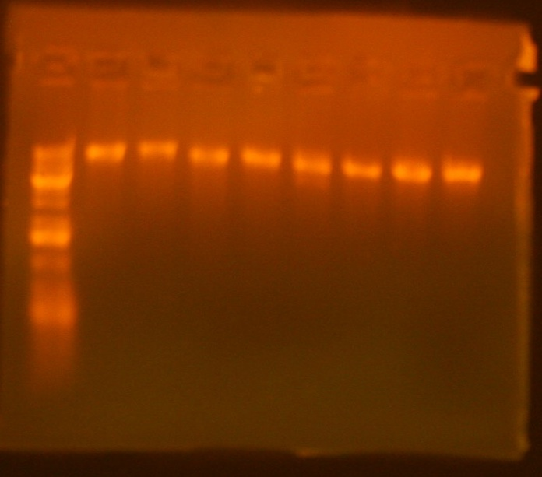
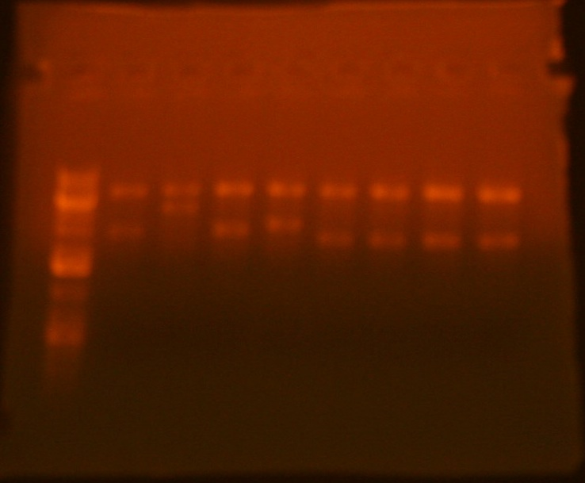
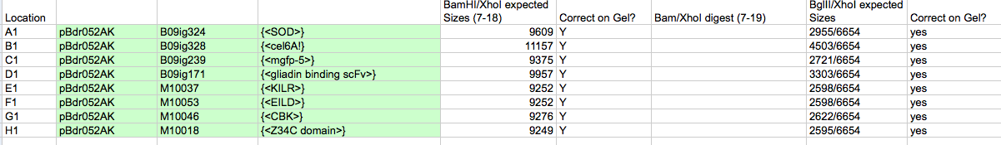
BamHI/XhoI Saturday 7-18
A1-H1
BglII/XhoI Sunday 7-19

Slide 2
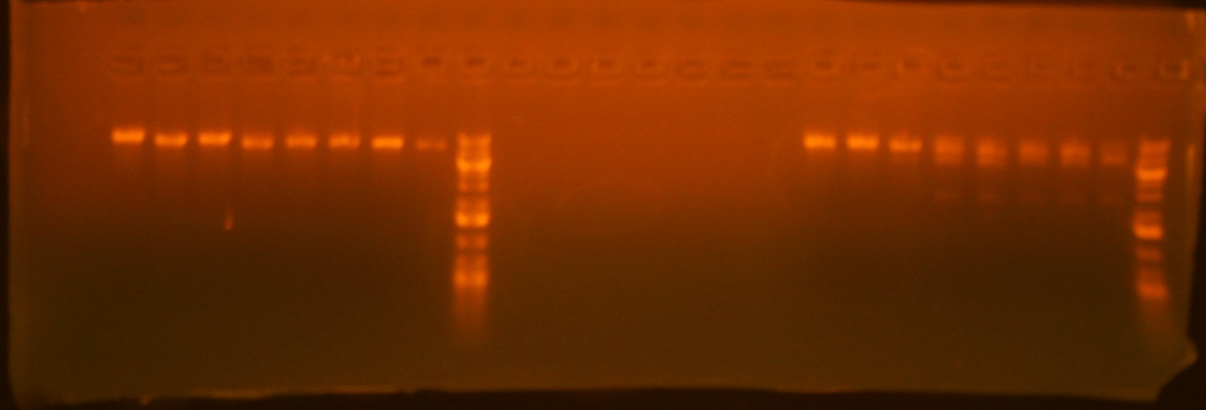
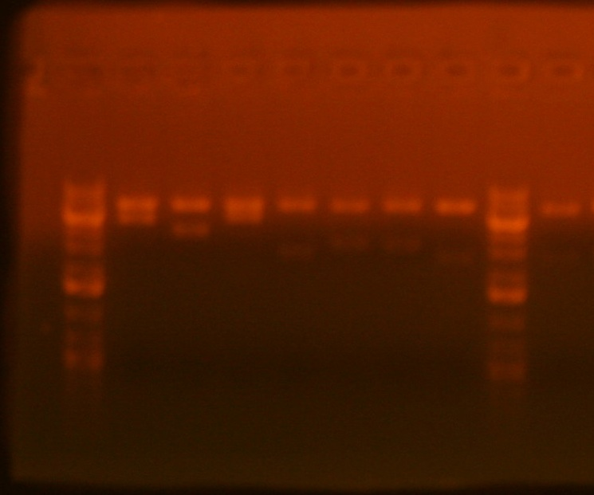
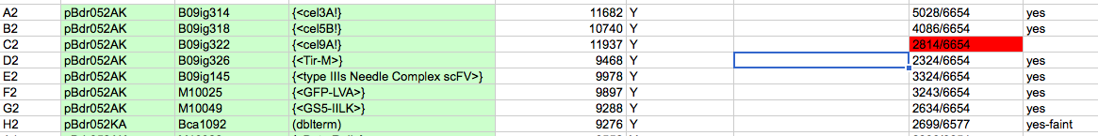
A2-H2
BamHI/XhoI Saturday 7-18
BglII/XhoI Sunday 7-19

Slide 3
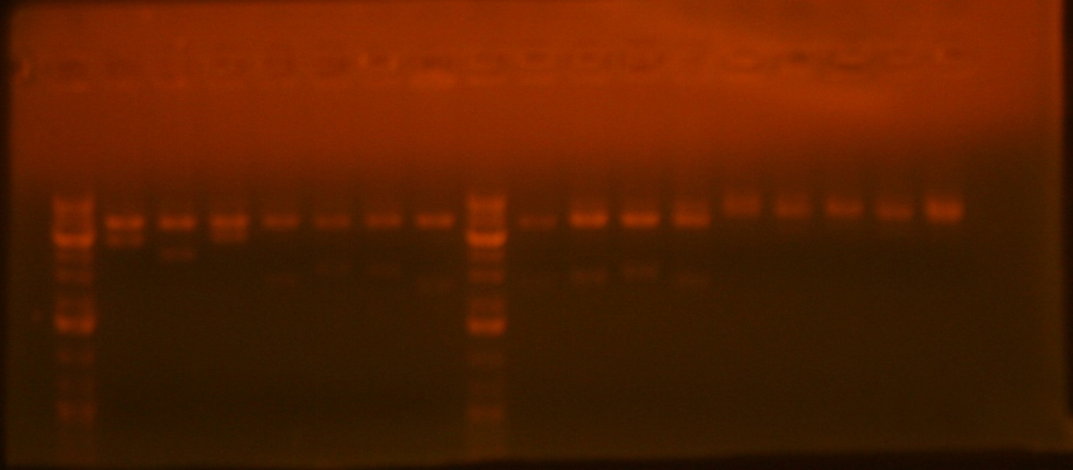
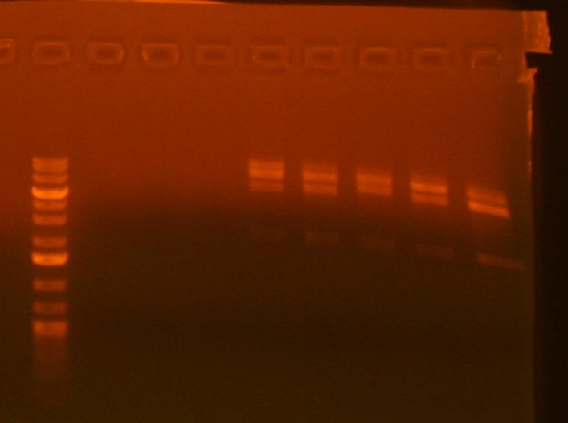
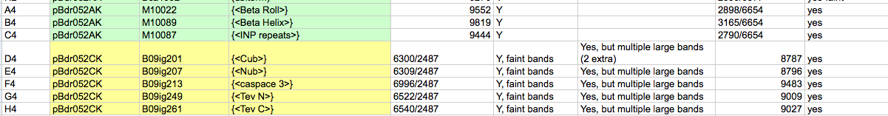
BamHI/XhoI Saturday 7-18
A4-H4
BglII/XhoI Sunday 7-19
BamHI/XhoI Sunday 7-19

Slide 4
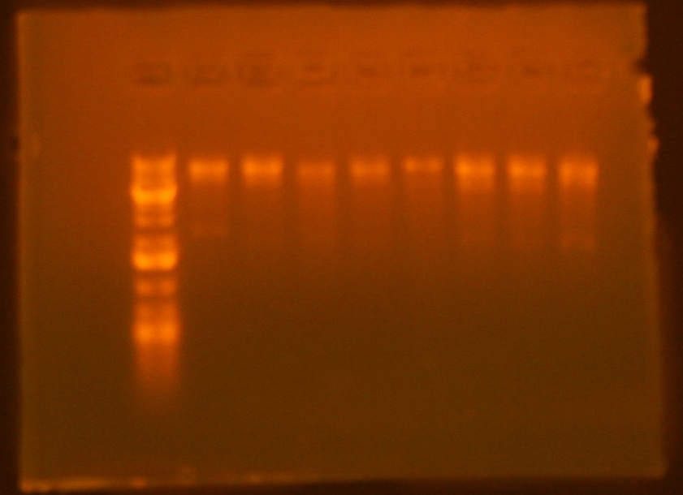
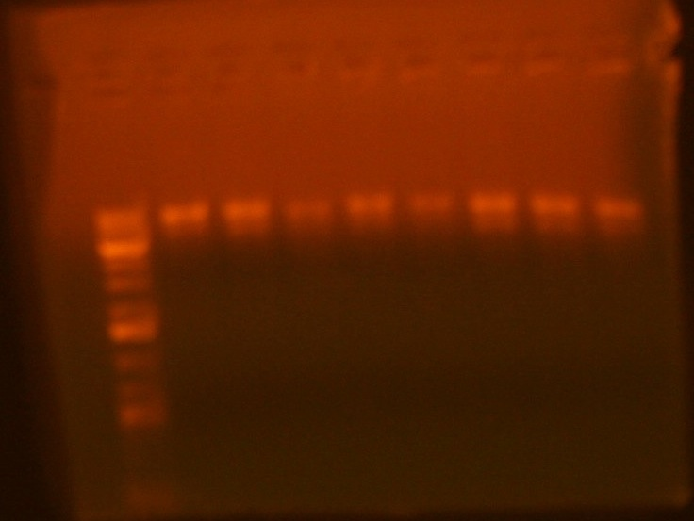
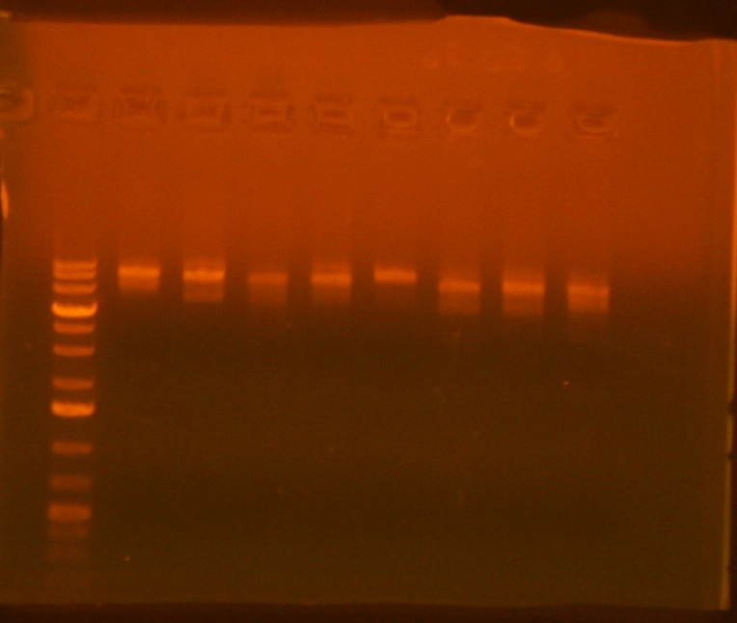
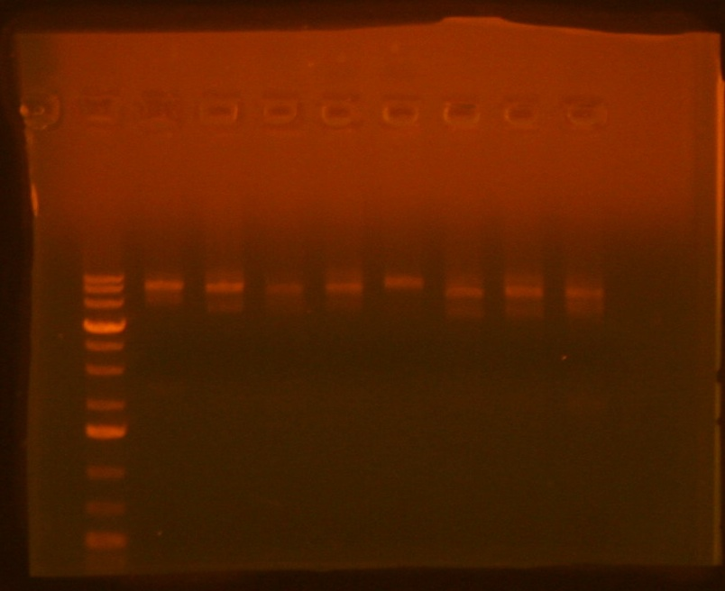
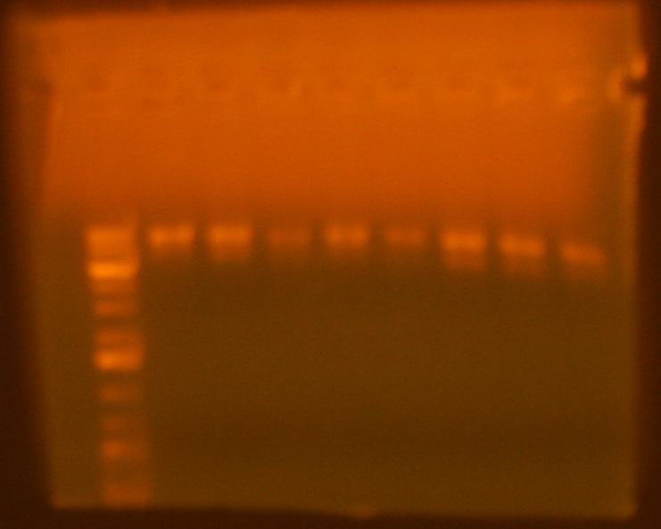
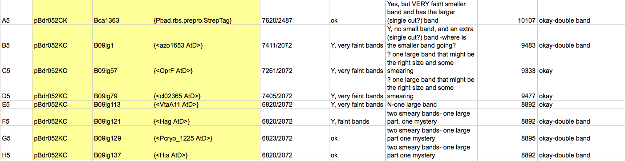
BamHI/XhoI Saturday 7-18
A5-H5
BglII/XhoI Sunday 7-19
BamHI/XhoI Sunday 7-19
BamHI/XhoI Sunday Run longer
BglII/XhoI Sunday Run Longer

Slide 5
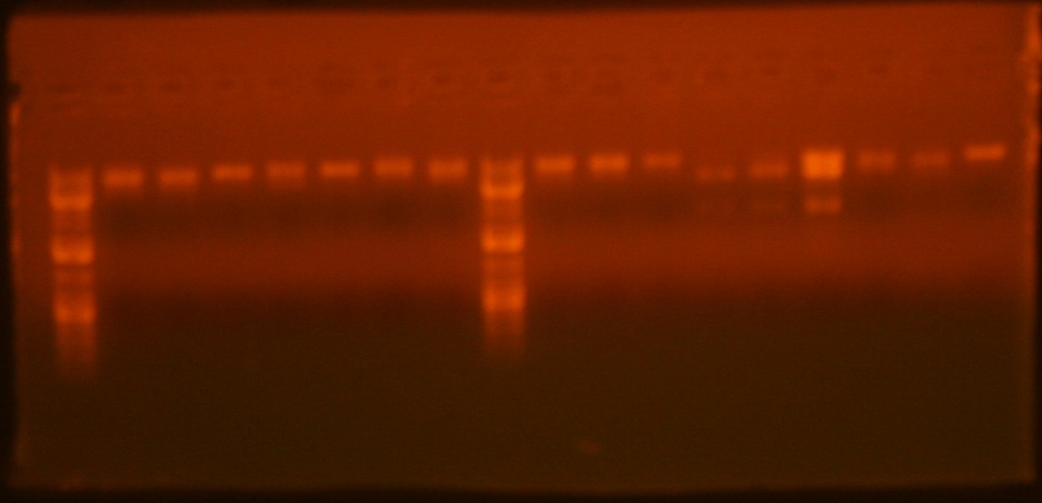
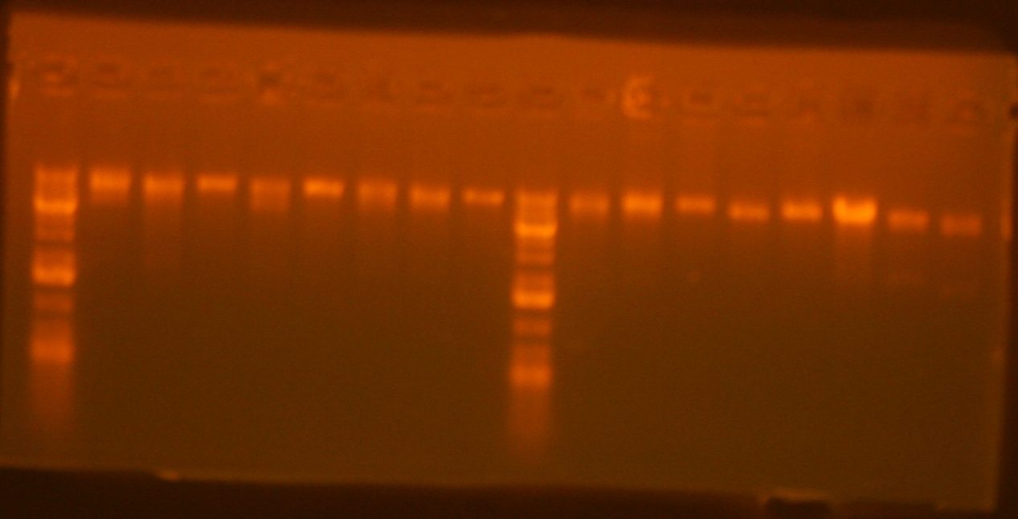
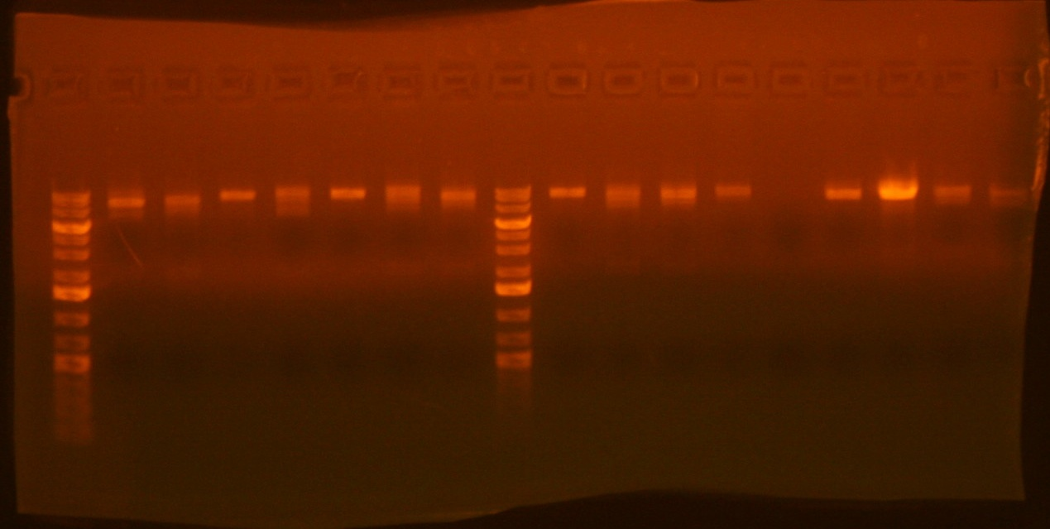
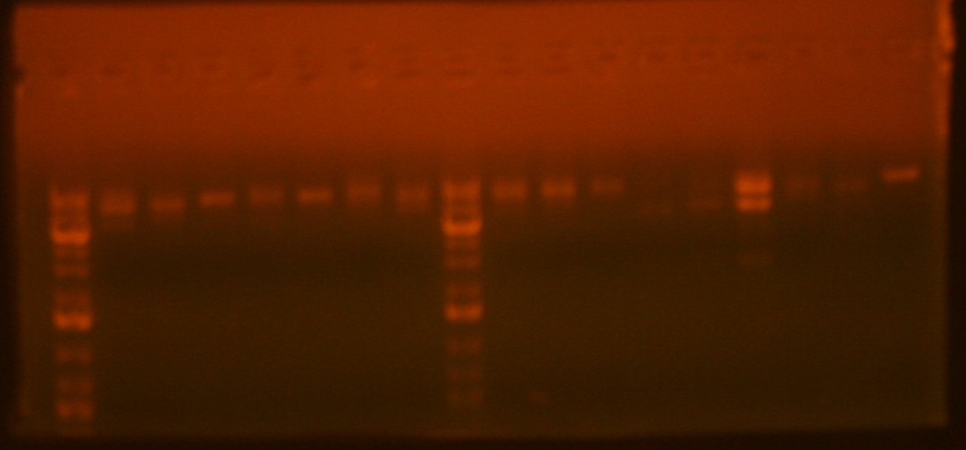
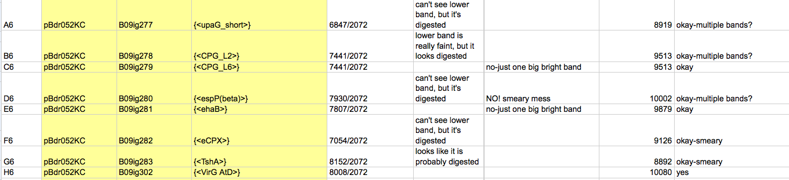
A6-H6
BamHI/XhoI Saturday 7-18
BglII/XhoI Sunday 7-19
BamHI/XhoI Sunday 7-19
BglII/XhoI Sunday Run Longer

Slide 6
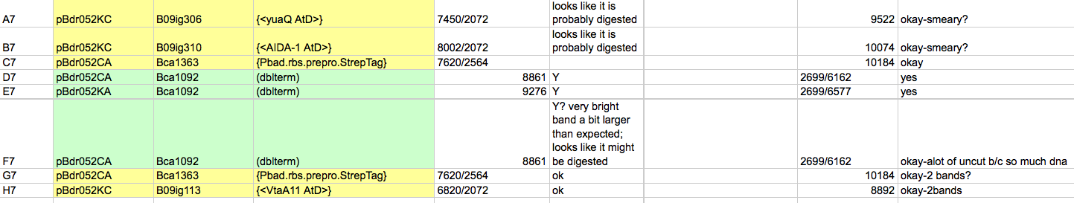
BglII/XhoI Saturday 7-18
A7-H7
BglII/XhoI Sunday 7-19
BamHI/XhoI Sunday 7-19
BglII/XhoI Sunday 7-19

