Slide 1
A proposal for: High affinity RNA aptamers as antagonists for AT₂ receptors to decrease bradykinin production
Tina Stutzman
Nick Swenson
20.109
May 12, 2010

Slide 2
Hypertension is related to renal and cardiac failure
Hypertension (high blood pressure)
Untreated leads to:
Treated by:
Angiotensin Converting Enzyme (ACE) Inhibitors
Angiotensin II Type I (AT₁) receptor (ARB) blocker
Kidney Disease
Cardiac Disease
Stroke
Side effects include coughing (12%) and angioedema (inflammation)

Slide 3
Renin-Angiotensin System (RAS) involved in regulation of blood pressure
Angiotenisinogen
Angiotensin I
Angiotensin II
Renin
ACE
Angiotensin Converting Enzyme (ACE) Inhibitors
Angiotensin II Type 2 Receptor (AT₂)
Liver
Increased Blood Pressure
Angiotensin II Type I Receptor (AT₁)
Angiotensin II Type I (AT₁) receptor (ARB) blocker

Slide 4
ARB drugs inhibit AT₁ receptors and decrease blood pressure
Angiotensin II
Angiotensin II type I (AT₁) receptor blocking (ARB) drugs prevent AngII from activating vascular smooth muscle cells to constrict
Current ARB drugs include losartan and valsartan
Mimic the structure of angiotensin II to bind to active site of receptor
Angiotensin II bound to AT₂ increases with bound ARB
Angiotensin II Type I (AT₁) Receptor
ARB
Angiotensin II Type 2 Receptor (AT₂)
Nitric Oxide
Increased Blood Pressure
Bradykinin

Slide 5
ARB drugs inhibit AT₁ receptors and decrease blood pressure
Angiotensin II
Angiotensin II type I (AT₁) receptor blocking (ARB) drugs prevent AngII from activating vascular smooth muscle cells to constrict
Current ARB drugs include losartan and valsartan
Mimic the structure of angiotensin II to bind to active site of receptor
Angiotensin II bound to AT₂ increases with bound ARB
Angiotensin II Type I (AT₁) Receptor
ARB
Angiotensin II Type 2 Receptor (AT₂)
Nitric Oxide
Bradykinin
Decreased Blood Pressure
Bradykinin
Cough, Angioedema

Slide 6
Aptamer bound to AT₂ may decrease the production of bradykinin
Angiotensin II
RNA aptamer selected for the AT₂ receptor will inhibit bradykinin activation function with decreased affect on NO production
Frequency of cough and angioedema could decrease with little affect on the blood pressure regulation
Angiotensin II Type 2 Receptor (AT₂)
Nitric Oxide
Bradykinin
Decreased Blood Pressure
Cough, Angioedema

Slide 7
High affinity RNA aptamers as an antagonist for AT₂ receptors
Problem: ARB hypertensive drugs are associated with a dry cough and angioedema due to increased bradykinin production
Goal: Select an aptamer that decreases bradykinin production in combination with ARB drugs
Applications: Selected aptamer can be used as tool to elucidate AT₂ function and structure

Slide 8
Experimental plan for aptamer selection and effect on AT₂ receptor activity
Isolating and immobilize AT₂
receptor
Use SELEX to select aptamers that bind AT₂ receptor
Assay effect on bradykinin production with ELISA and NO production with
Greiss reagent and spectrophotometry
Evaluate Kd with dot-blot analysis

Slide 9
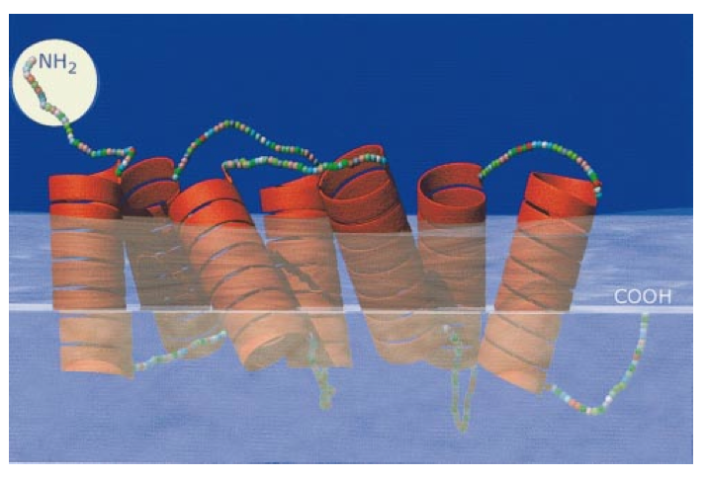
AT₂ Receptor Immobilization
Tag intracellular domain with an antibody binding site
Express AT₂ Receptors
Solubilize AT₂ in a micelle
AT2 receptor structure
Immobilize on glass beads
R. Carey et al, Hypertension 35, 155-163 (2000)

Slide 10

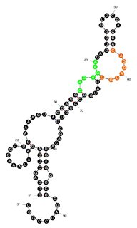
SELEX selection and evaluation of binding aptamers
Clone into vector
RT-PCR
to cDNA
Sequence
Isolate unique aptamers
Negative selection on bead, strepavidin, BSA-biotin, antibody
Use 11 rounds of SELEX to select binding RNA aptamers
Expected Results: Aptamers A1, A2, A3
Mfold analysis for structure
Variable region = 40 nucleotides

Slide 11
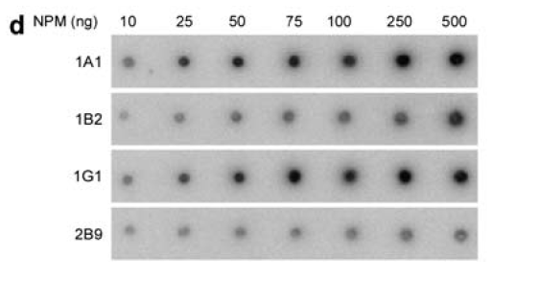
Dot-blot analysis to determine aptamer binding AT₂ receptor K_{d}
AT₂ (ng)
10 25 50 75 100 250 500
A1
A2
A3
Expected Results: Aptamers A1 and A2 show stronger binding to AT₂ than aptamer A3
Y. Jian et al. Oncogene 28, 4201–4211 (2009)

Slide 12
Bradykinin production assay
Sandwich ELISA to evaluate bradykinin levels in vascular smooth muscle cells in vitro incubated with known Angiotensin II concentrations
Control
No ARB
ARB
ARB + A1
ARB + A2
Measure Bradykinin
Baseline Bradykinin levels
Increased Bradykinin levels
Baseline Bradykinin levels
Baseline Bradykinin levels
Expected:

Slide 13
NO production assay
Spectrophotometry evaluation at 550 nm of NO with Greiss reagent in vascular smooth muscle cells in vitro incubated with known Angiotensin II concentrations
Control
No ARB
ARB
ARB + A1
ARB + A2
Measure Bradykinin
Expected:
Baseline NO₂⁻ levels
Increased NO₂⁻ levels
Baseline NO₂⁻ levels
Increased NO₂⁻ levels

Slide 14
Expected bradykinin ELISA results
Expected NO
A1 aptamer blocks NO production and bradykinin
A2 aptamer blocks bradykinin production but not NO
High affinity aptamers A1 and A2 reduce bradykinin production in the presence of ARB
2000
2000
1500
NO⁻₂ (µM)
Bradykinin (pg)
1500
1000
1000
Control
No ARB
ARB
ARB
+ A1
ARB
+ A2
Control
No ARB
ARB
ARB
+ A1
ARB
+ A2

Slide 15
Necessary Resources
Procedure | SELEX | Dot Blot Analysis | NO Detection | Sandwich ELISA
Reagents | RNA Library with variable region of 40 NTs, detergent, BSA-biotin | Nitrocellulose membrane | Sodium Nitrite Standards, Greiss Reagent | 1˚ antibody for bradykinin, 2˚ antibody
Equipment | Thermocycler | X-ray reader | Plate Reader | Absorbance Reader

Slide 16
Societal Impact
RNA Aptamer can be used as a scientific tool to:
Learn about the AT₂ receptor structure
Learn about the AT₂ receptor function
Build a small molecule drug for clinical use
Possible decrease in frequency of coughing and angioedema with hypertensive drugs

