Slide 1
Antibiotics Bio 1220 16 February 2010 Ethan Richman Ben Kwak
Ampicillin, Tetracyclin, and Chloramphenicol

Slide 2
Introduction: what are antibiotics?
Bacteria Antibiotics Death/Growth inhibition.

Slide 3
General Overview
Antibiotics either have lethal or bactericidal effect or prevent the growth of bacteria(bacteriostatic).
Many antibiotics are naturally synthesized by competing bacteria and by a wide range of microorganisms.
Antibiotics are also produced synthetically or semisynthetically – that is, the compounds are modified versions of what naturally occurs.

Slide 4
Uses
Antibiotics have become fundamental in treatment of infection. Various types of antibiotics may be administered orally or intravenously (for more severe infections).
Relevant to our interests, antibiotics are very useful in insuring that a culture contains only cells with a desired plasmid.
Natural competition: bacteria compete for resources amongst many colonizing populations, and naturally secrete a variety of antibiotics aimed at giving the producer an upper hand in the competition.

Slide 5
Antibiotic Actions
Some antibiotics target the bacterial cell wall or cell membrane.
Most, however, target essential bacterial functions or growth processes.¹
The activity of antibiotics may depend upon concentration.²
Typical antimicrobial activity increases with progressively higher antibiotic concentrations²
Some antibiotics are time dependent – a certain concentration must be maintained for some amount of time.²
Notes:
1. Finberg RW, Moellering RC, Tally FP, et al. (November 2004). "The importance of bactericidal drugs: future directions in infectious disease". Clin. Infect. Dis. 39 (9): 1314–20.
2. Slama TG, Amin A, Brunton SA, et al. (July 2005). "A clinician's guide to the appropriate and accurate use of antibiotics: the Council for Appropriate and Rational Antibiotic Therapy (CARAT) criteria". Am. J. Med. 118 Suppl 7A: 1S–6S.

Slide 6
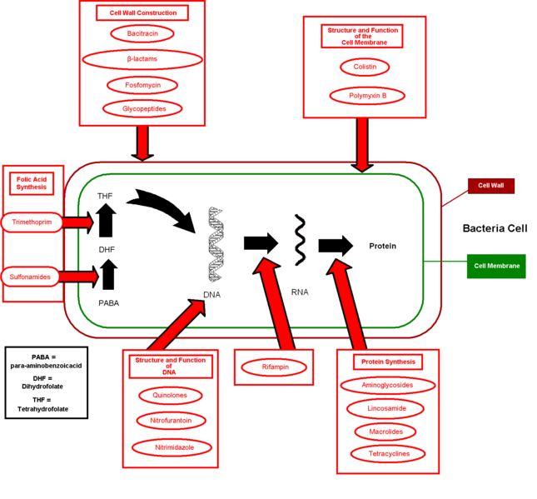
Notes:
Courtesy of wikipedia.

Slide 7
More general info
Antibiotics (aminoglycosides, macrolides and tetracyclines) that target protein synthesis are usually bacteriostatic¹.
Antibiotics that target cell wall, cell membrane, or essential enzymes are usually bactericidal¹.
Notes:
1. Finberg RW, Moellering RC, Tally FP, et al. (November 2004). "The importance of bactericidal drugs: future directions in infectious disease". Clin. Infect. Dis. 39 (9): 1314–20.

Slide 8
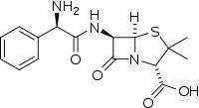
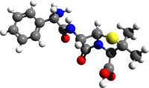
Ampicillin
Ampicillin is a beta-lactam antibiotic and is effective against both Gram-positive and Gram-negative organisms.
Member of the aminopenicillin family.
Relatively non-toxic.
Differs from penicillin by the presence of an amino group.
Ampicillin is bacteriostatic

Slide 9
Ampicillin - Mechanisms
Competitive inhibitor of transpeptidase (needed for the construction of cell walls).
Ampicillin’s ability to penetrate the Gram-negative cell wall is aided by the additional amino group.
By inhibiting the final stage in cell wall synthesis in binary fission, ampicillin leads to bacterial cell to lysis and prevents proliferation.

Slide 10
Ampicillin – Synth bio use
Ampicillin is typically used to select for and confirm transformation.
General protocol:
1.Gene coding for Ampicillin resistance is coupled with the desired gene that is to be inserted into the bacteria.
2. Cells are grown in a medium containing Ampicillin (~100mg/L)
3. Only the genes that have taken up the desired gene will have Ampicillin resistance (AmpR), and thus the surviving population in the culture will be only the bacteria that have taken up the desired gene.

Slide 11
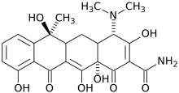
Tetracycline
Broad-spectrum (gram – and gram + effective), toxic to prokaryotic and eukaryotic cells
Protein synthesis inhibitor (bacteriostatic)
Produced by Streptomyces genus of Actinobacteria
Notes:
Image courtesy of wikipedia

Slide 12
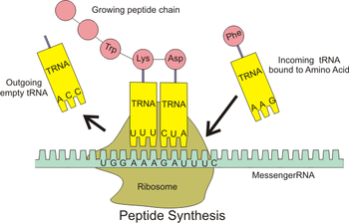
Tetracycline - Mechanisms
Tetracyclines bind the 30S ribosomal subunit and prevent the docking of amino-acylated tRNA³.
Notes:
3. Zakeri, B. & Wright, G. D. Chemical biology of tetracycline antibiotics. Biochem. Cell Biol. 86, 124-136 (2008).
Image courtesy of wikipedia

Slide 13
Tetracycline – Synth bio uses
Used to select for cells that have Tetracycline resistance (tetR gene) in a manner similar to the that of Ampicillin.
Cell culture concentration of ~10mg/L.
Tetracycline controlled transcriptional activation: “method of inducible expression where transcription is reversibly turned on or off in the presence of tetracycline” or a derivative.
Tet-Off: tTA (tetracycline transactivator protein) binds DNA at ‘tet’O operator -> activates a promoter and thus transcription. Tetracycline and derivatives can bind tTA and prevent it from binding at ‘tet’O, preventing transcription.
Tet-On: Opposite – in order to bind ‘tet’O, doxycycline (tetracycline derivative) must be present.

Slide 14
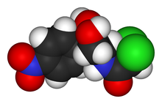
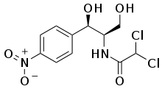
Chloramphenicol
Bacteriostatic (inhibits bacterial growth) antimicrobial
Broad-spectrum antibiotic
Highly lipid soluble
Protein synthesis inhibitor
Notes:
Images courtesy of Wikipedia.

Slide 15
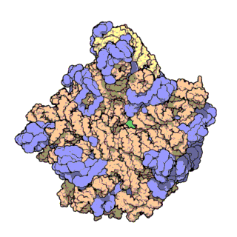
Chloramphenicol - Mechanisms
Binds to the 50S subunit of the ribosome, thereby inhibiting bacterial protein synthesis⁴.
Notes:
4. http://www.merck.com/mmpe/sec14/ch170/ch170d.html
Image courtesy of wikipedia

