Slide 1
Comparison of the P-value significance between Wild Type and dGLN3
ANOVA | WT | dGLN3
p < 0.05 | 38.42% | 30.11%
p < 0.01 | 24.67% | 16.29%
p < 0.001 | 13.90% | 6.53%
p < 0.0001 | 7.43% | 2.04%
B-H p < 0.05 | 26.76% | 2.04%
Bonferroni p < 0.05 | 3.68% | 0.42%

Slide 2
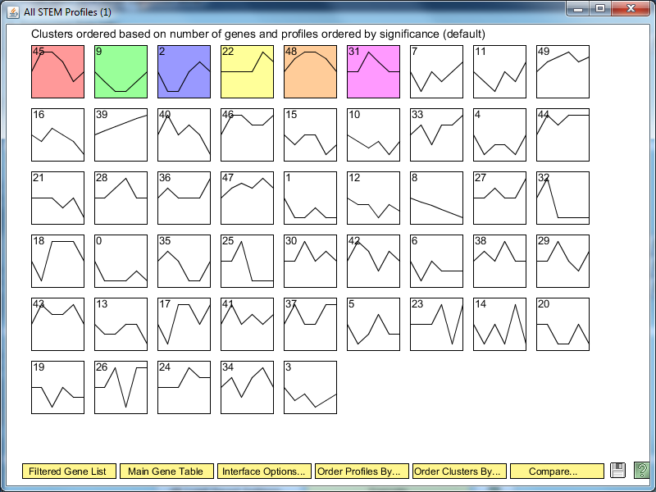
dGLN3 STEM Significance Profiles

Slide 3
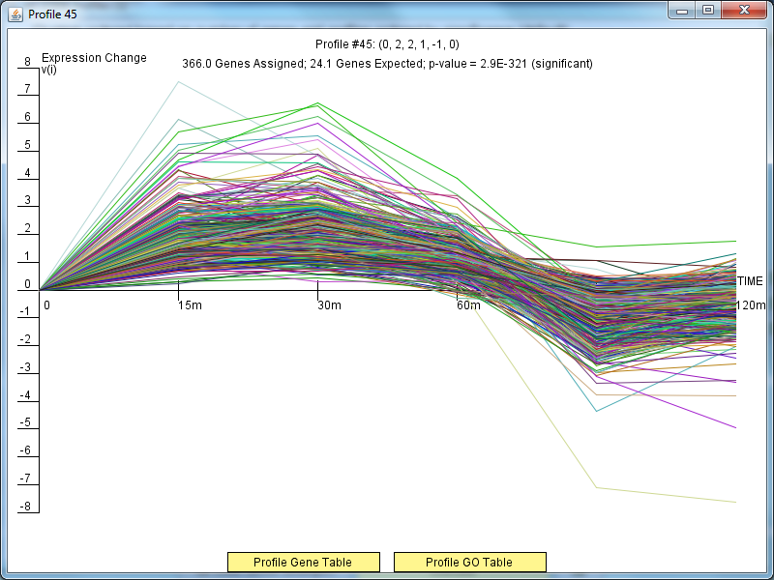
dGLN3 Profile 45

Slide 4
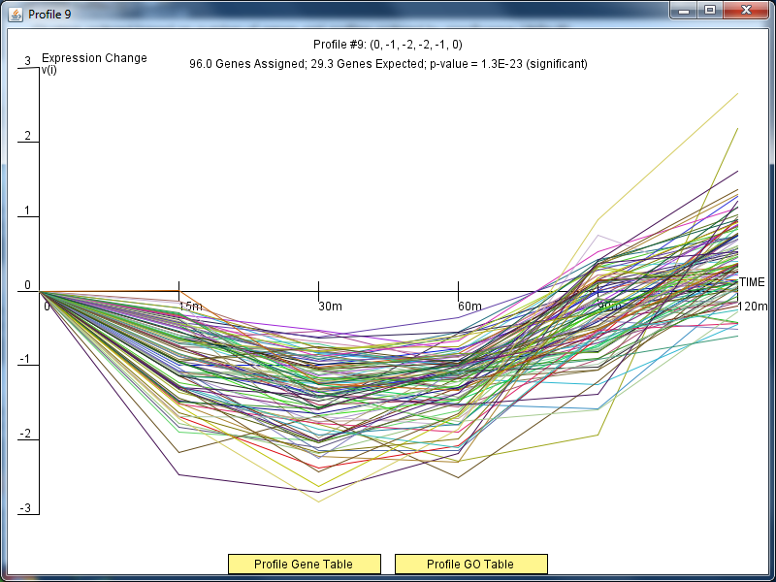
dGLN3 Profile 9

Slide 5
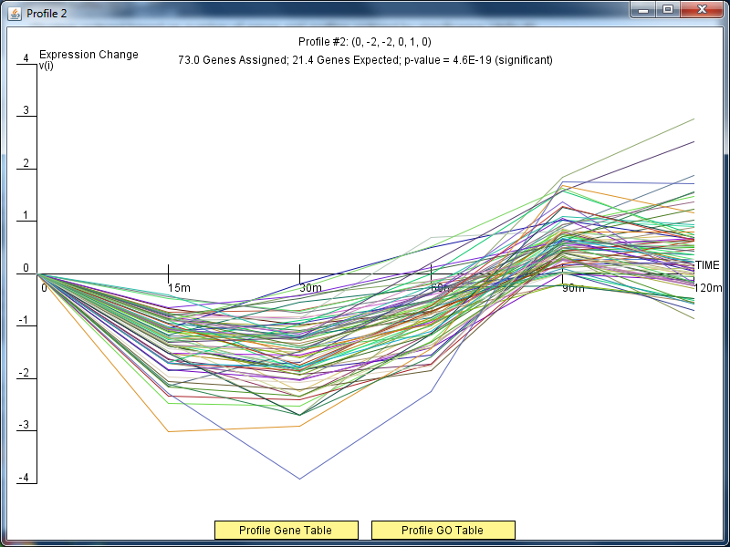
dGLN3 Profile 2

Slide 6
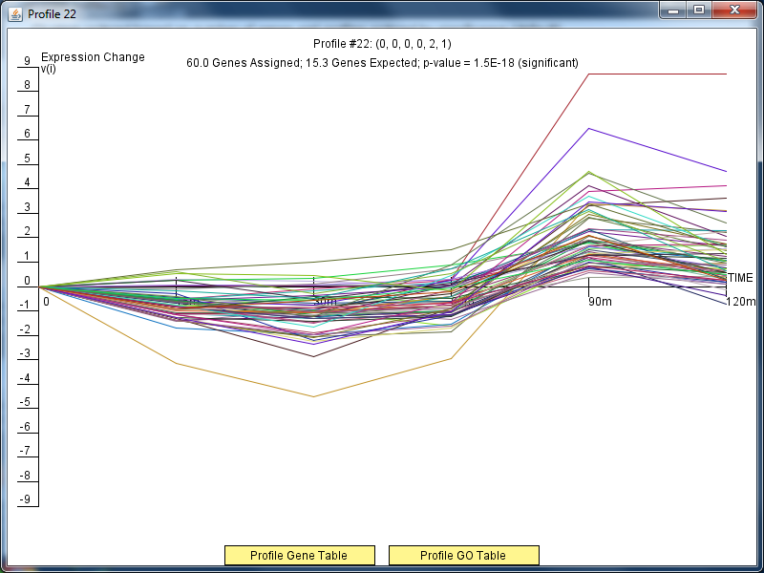
dGLN3 Profile 22

Slide 7
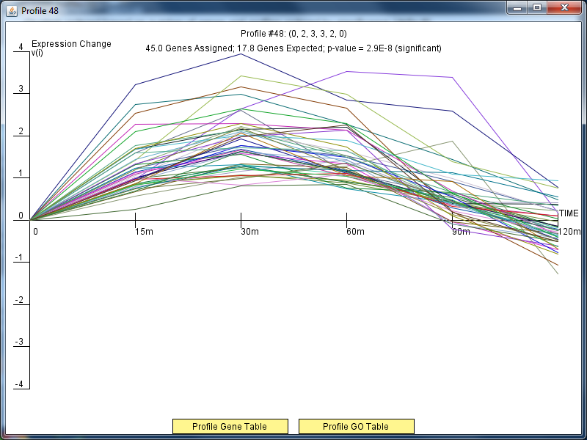
dGLN3 Profile 48

Slide 8
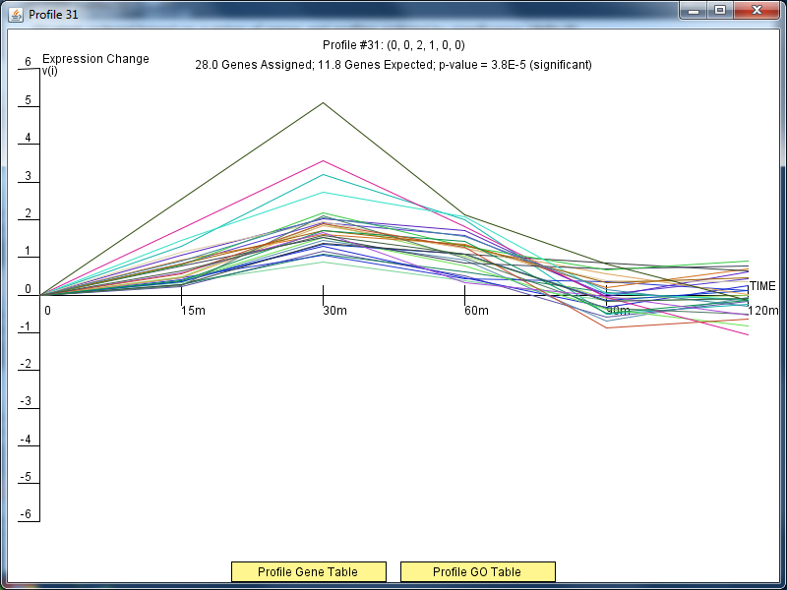
dGLN3 Profile 31

Slide 9
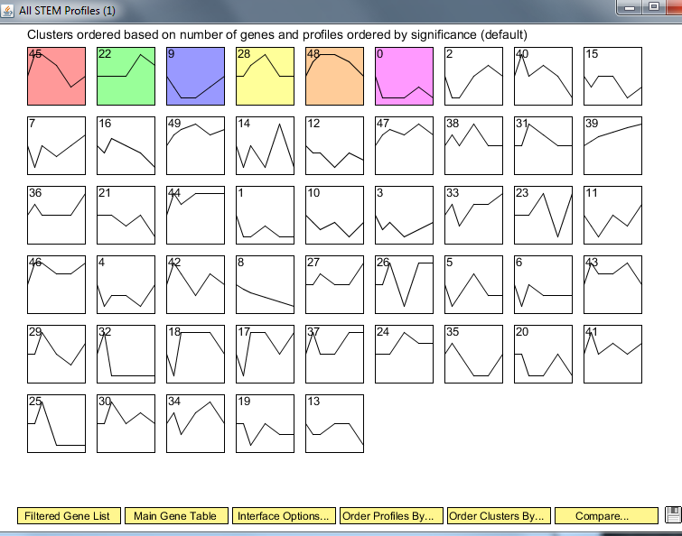
Wild Type Clusters

Slide 10
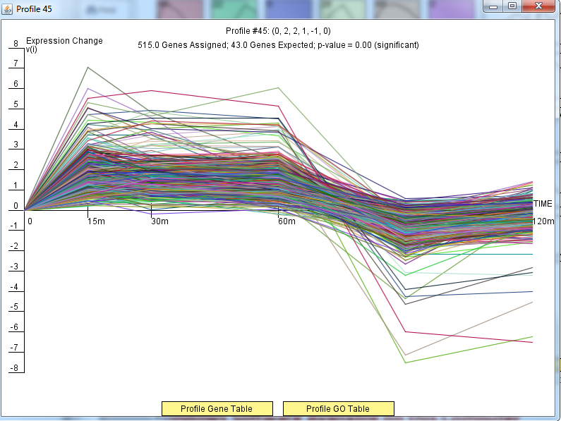
Wild Type Profile 45

Slide 11
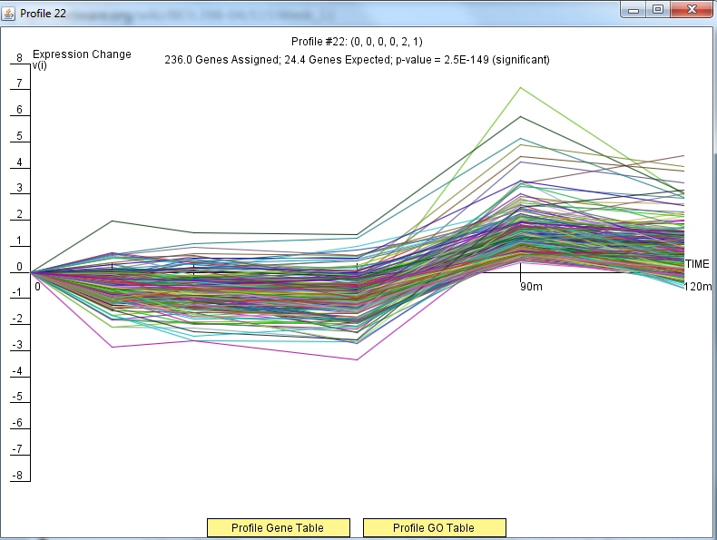
Wild Type Profile 22

Slide 12
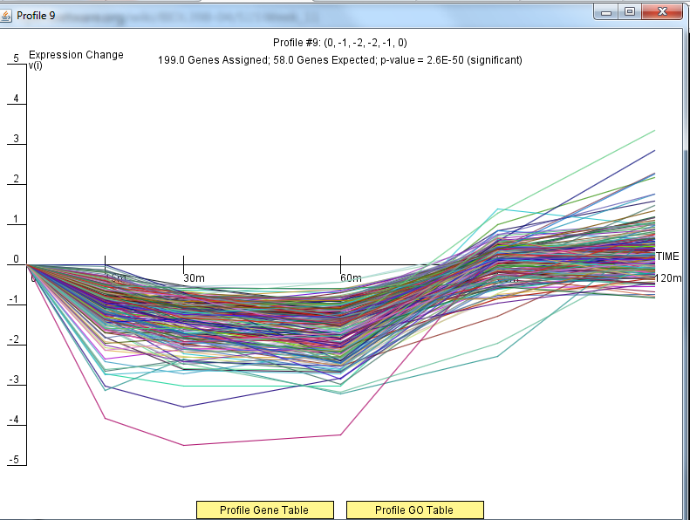
Wild Type Profile 9

Slide 13
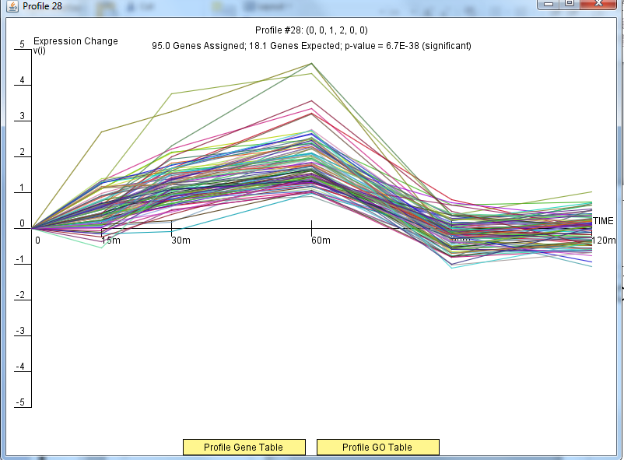
Wild Type Profile 28

Slide 14
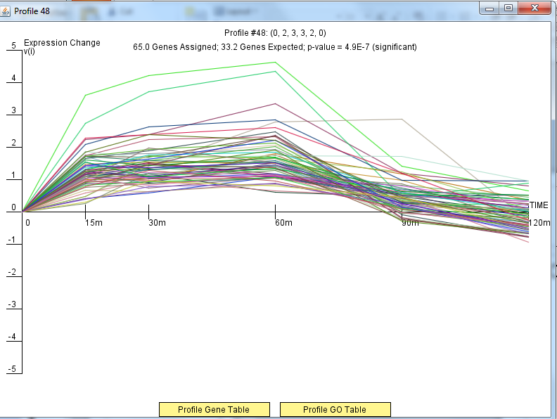
Wild Type Profile 48

Slide 15
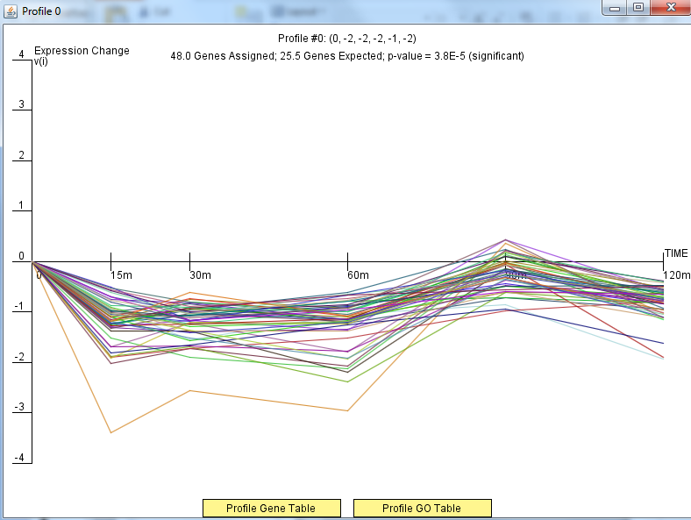
Wild Type Profile 0

